Slide 1
PPE and Burn Rate Calculator
Donna Ortelle, R.N., M.S.N.
DPH
July 29, 2020

Slide 2
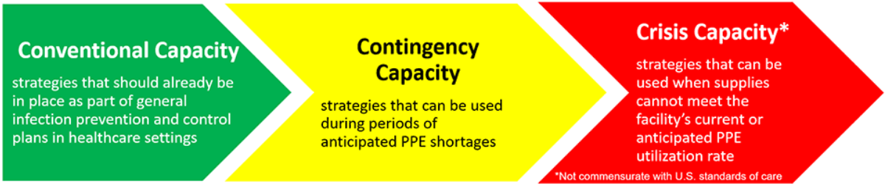
Optimizing Supply of PPE and Other Equipment during Shortages
https://www.cdc.gov/coronavirus/2019-ncov/hcp/ppe-strategy/index.html

Slide 3
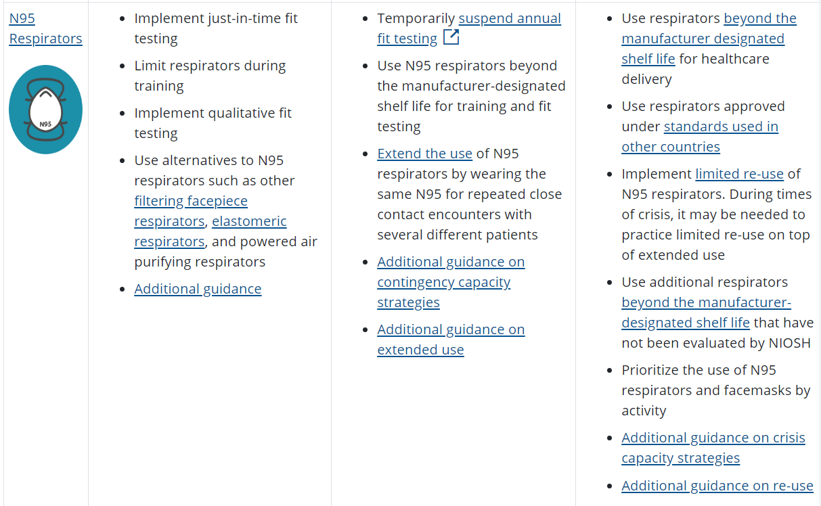
N95 Respirators

Slide 4
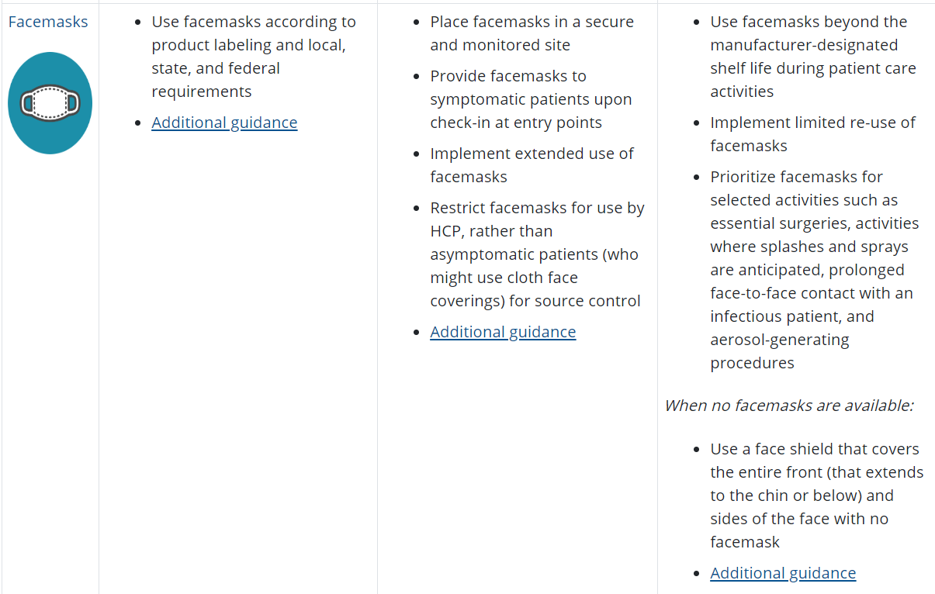
Facemasks

Slide 5
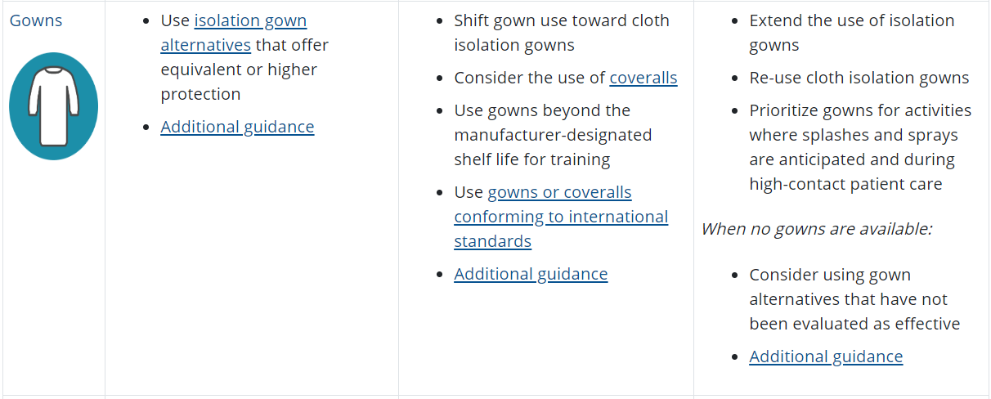
Gowns

Slide 6
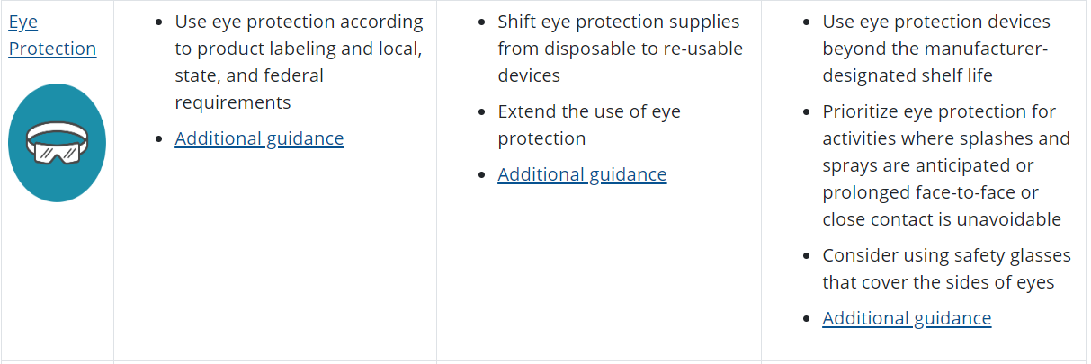
Eye Protection

Slide 7
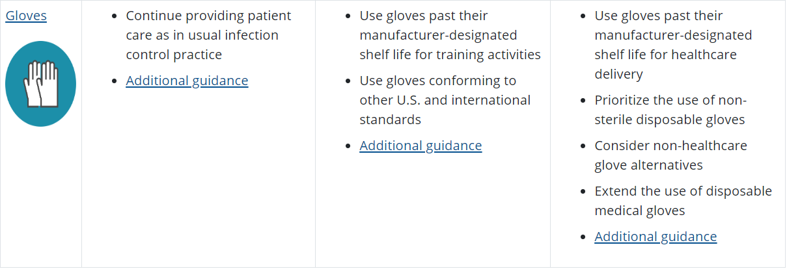
Gloves

Slide 8
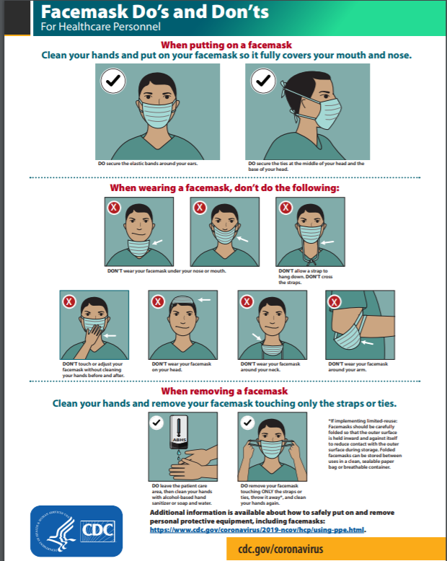
* Facilities implementing reuse or extended use of PPE will need to adjust their donning and doffing procedures to accommodate those practices.

Slide 9
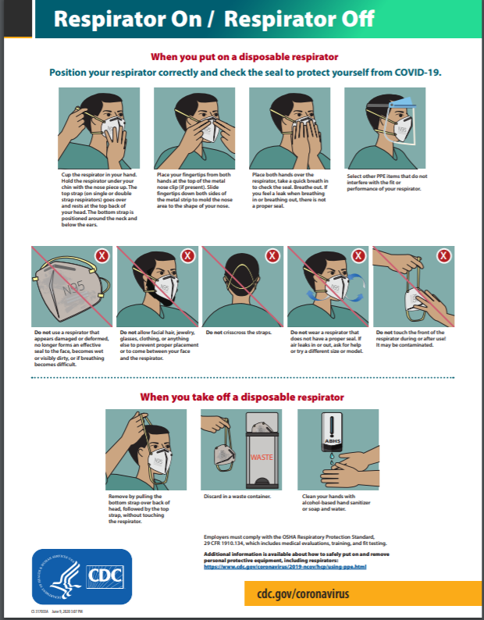
* Facilities implementing reuse or extended use of PPE will need to adjust their donning and doffing procedures to accommodate those practices.

Slide 10
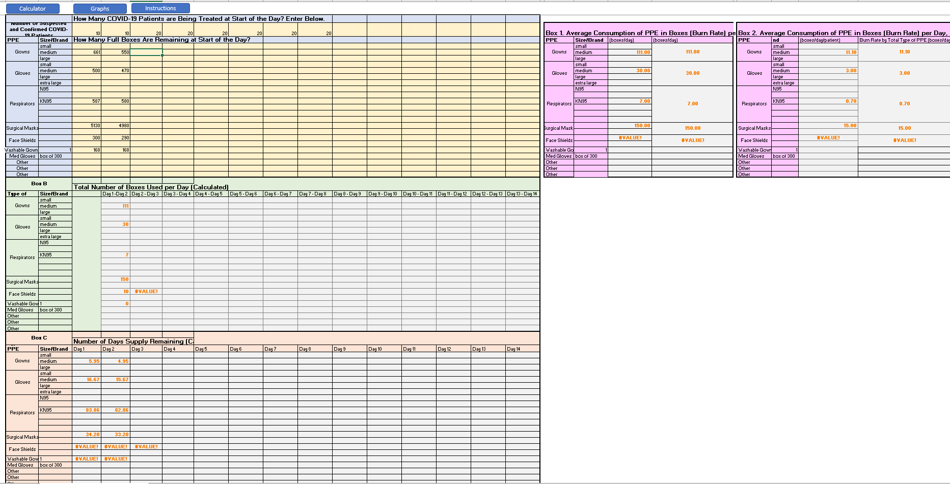
Personal Protective Equipment (PPE) Burn Rate Calculator

Slide 11
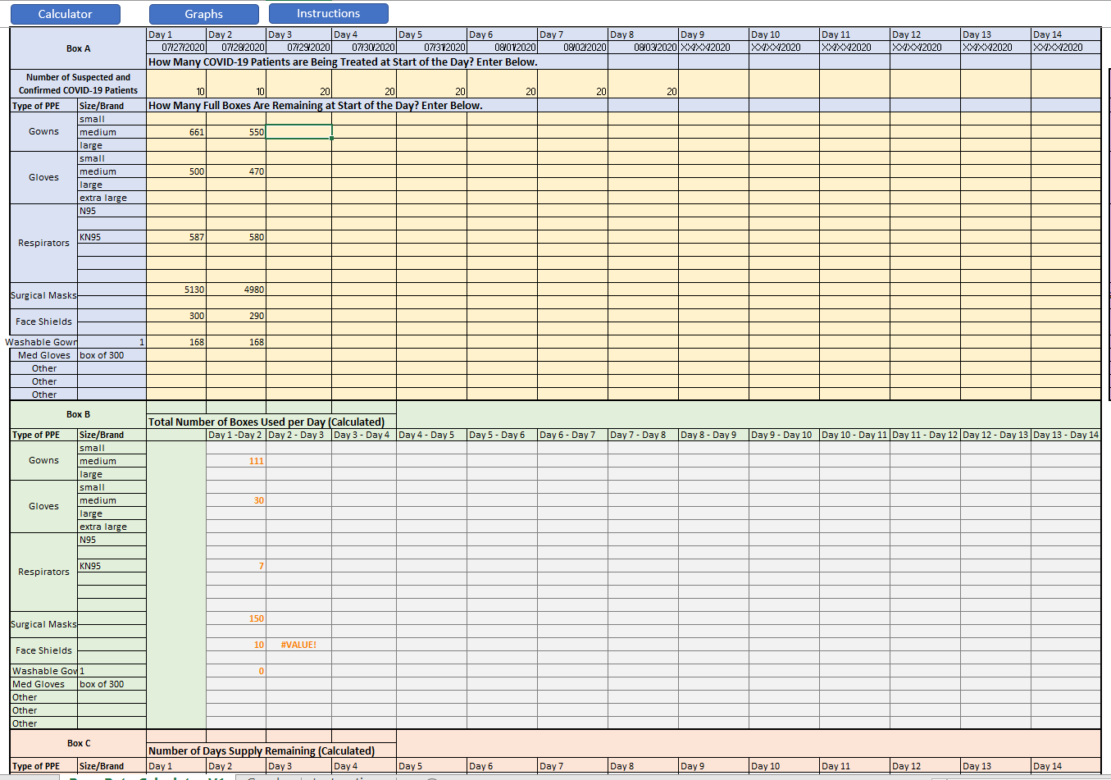

Slide 12
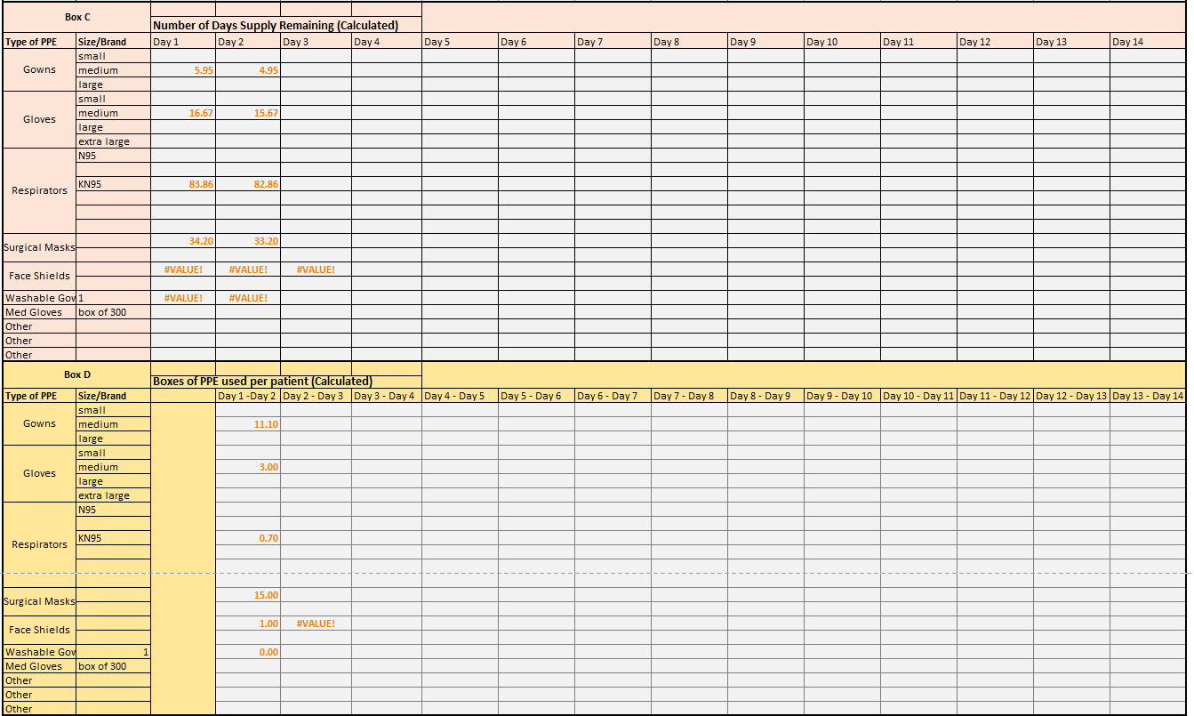

Slide 13
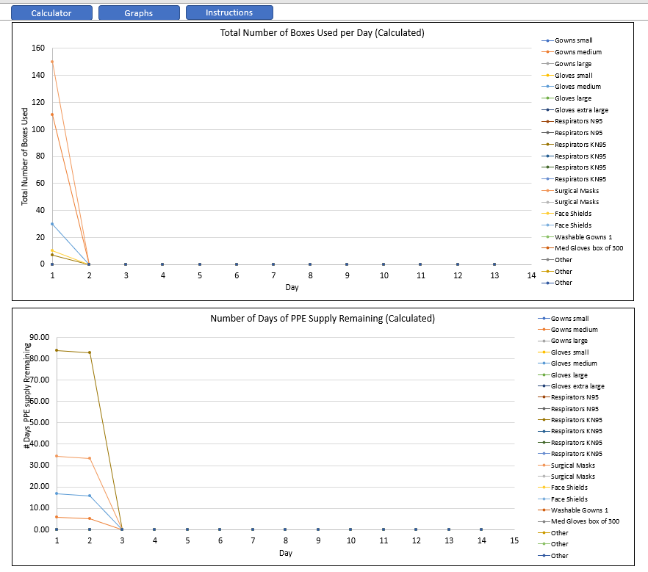
Graphs

