Slide 1
Formula Monitoring
Medical Documentation
Nutrition Assessment
May 11, 2021
Speaker: Luz Hago

Slide 2
Indicators – Medical Documentation | 2017/2018 | 2020/2021
MD completed correctly | 61 | 62.3
Prescription UpToDate | 93.5 | 100
Reason for Issuance | 95.7 | 93.3
Length of Issuance | 96.8 | 95.8
Date of Request written | 96.3 | 95.8
ICD10 code Matches Formula Rx | 79.9 | 82.5
WIC Food not allowed specified | 12.5 | 25%

Slide 3
Indicators – Medical Documentation | 2017/2018 | 2020/2021
PCP Signature | 87.5 | 95
1 Month Issuance | 40 | 30
New RX in 24 hours | 21.4 | 12.5

Slide 4
Indicators – Nutrition Assessment | 2017/2018 | 2020/2021
Formula Tolerance assessed | 94.4 | 93.4
Growth assessment | 51.4 | 72.1
Growth chart updated | 94.2 | 93.3
Nutrition Education counseling provided | 89.8 | 98.4
Risk Screen Updated | 56.9 | 64.8
Appropriate Food package Issued | 91.7 | 83.6

Slide 5
Indicators – Nutrition Assessment | 2017/2018 | 2020/2021
Month Issued Appropriately | 100 | ?
MD consultation Follow up as needed | 19.7 | 25.8

Slide 6
Medical Documentation – Specific Findings
Often the Authorized Person's name, WIC ID no. are left blank.
Formula amount and frequency not included in RX.
Length of use not checked.
HCP printed name left blank and facility stamp does not include physician name.
HCP credentials not included.
When Medical Documentation (MD)form not completed appropriately, a new RX not received within 24 hours.

Slide 7
Nutrition Assessment – Specific Findings
Often SOAP note not entered.
Contract formula for mild tolerance is not being considered prior to specialized formula Rx; HCP is not contacted to discuss infant condition.
C1 -was on specialized formula for milk allergy- however, regular whole cow's milk issued?
Vitamin D supplementation not needed if infant formula.

Slide 8
Nutrition Assessment – Specific Findings
For a C1 food not allowed not included in MD nor in nutrition assessment & progress note needed for a real food allergy.
Assessment of growth generally not included in progress note.
Local agency should consider follow up sooner than 3 months to assess formula or medical food tolerance.
Risk assignment not updated for new medical conditions Eg. GER, Food Allergies, Specialized formula.
RTF formula did not meet federal criteria for issuance.

Slide 9
Nutrition Assessment – Specific Findings
Evaluation of Ht. and Wt. and growth not included in progress note.
Progress note did not include assessment of amount and frequency of formula and tailoring accordingly.
HCP not contacted when MD needs clarification or to discuss formula chosen in relation to ICD10 code
Wrong formula issued: RTF Similac Sensitive Vs RTF Similac Advance
HCP wrote incomplete formula name: Enfamil NeuroPro
Issuance: Enfamil NeuroPro Enfacare

Slide 10
CT Medical Documentation (MD) can only be signed by:
  Medical Doctor (M.D.) (D.O.)
  Advanced Practice Registered Nurse (APRN)
  Physician’s Assistant (PA)
Notes:
Essentially someone who is authorized by CT Law to sign the medical documentation form. Therefore, this does NOT include RD’s.
Note: While an RD can sign a certification form, cannot sign WIC prescription form.
Medical documentation means a determination by a licensed health care professional authorized to write medical prescriptions under State law.
D.O. doctor is an osteopathic physician who practices medicine whose medical school training included a focus on the muscular and skeletal system to treat problems throughout the body. It regard the body as an integral whole, rather than treating for specific symptoms only.
DOs are licensed in all 50 States to practice medicine and surgery and to prescribe medications.
MD is a medical doctor, an allopathic physician that treat disease symptoms.
The education for both degrees is similar and both required to complete accredited medical residencies.
D.O. requires additional classes between 300 and 500 hours on the skeletal system and interactions of the body with diseases.

Slide 11
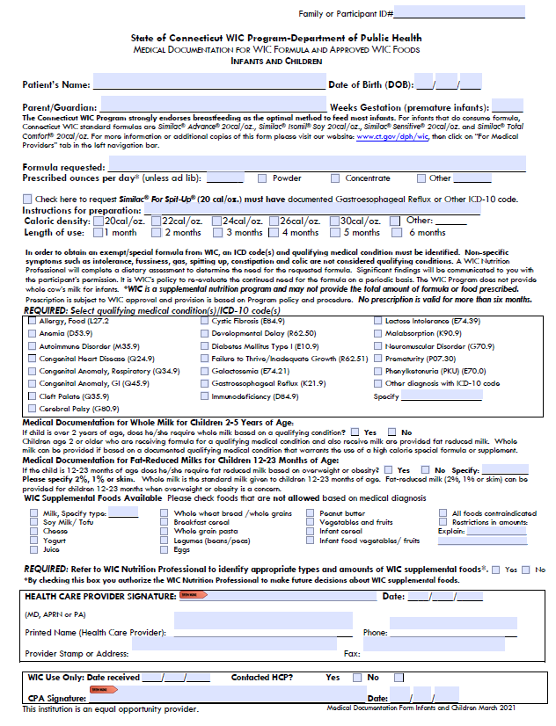
CPA – Make sure all sections of the MD are filled.
Participant ID#
Weeks Gestation (prematurity)
Parent/Guardian name
Caloric Density/ Instructions for Preparation
Length of Use
ICD-10 Code
HCP: Signature, Date, Printed Name, Address/Stamp, Phone/Fax
Food NOT Allowed
CPA Signature & Date
Notes:
The date the HCP signed the form is important, because that is the date in which the Length of Use start counting.

Slide 12
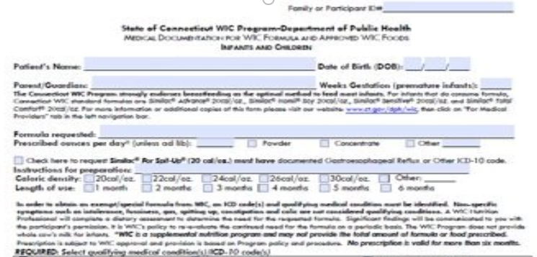
Medical Documentation: Local WIC Nutritionist's Role
Refer to the various formula references in the State Plan, local agency formula files and State memos/emails
Contacts State WIC Office for technical assistance if needed

Slide 13
Medical Documentation: Local WIC Nutritionist's Role
Screens WIC medical documentation form
Contacts Health Care Provider for clarification
Ensure the product is WIC approved
Check for age appropriateness, medical rationale

Slide 14
Medical Documentation Screening: Length of Use (LOU)
Issuance must not exceed expiration date
New order immediately invalidates previous order
Need new form with recertification
Maximum LOI is 6 months
Notes:
The ‘length of use’ start to count the date the Health Care Provided signed the form, and not the date in which the local agency received the medical documentation form.

Slide 15
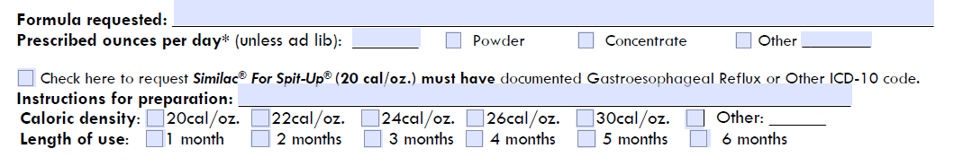
Formula Requested Section
Ounces/day, instructions for preparation
Disclaimer re: amount of formula is supplemental, coordinate with Medicaid/insurance company if formula needed is more than MMA WIC can provide
Notes:
Sometimes the HCP wants a caloric density different than the standard dilution – for which needs to write the Instruction for preparation. MMA (Maximum Monthly Allowance)

Slide 16
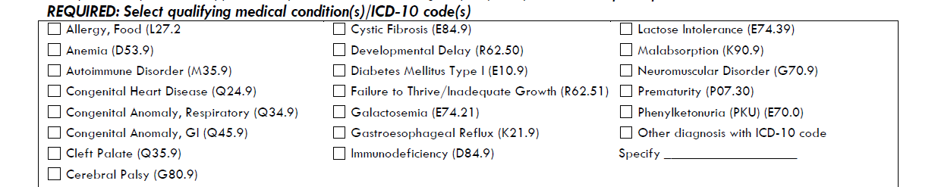
Medical Conditions –ICD-10 Codes
Most common nutrition-related diagnoses are listed.
Has “Other diagnosis with ICD-10 code” option to be considered on a case-by-case basis.
*CAUTION: Symptoms are disallowed.
For example, formula intolerance is not an acceptable medical condition/ICD-10 code.
Notes:
Rationale for formula should be based on indications for usage a related ICD-10 code (not enough to have just a code-the whole picture needs to make sense)
Disallows – exclude, disqualifies, omits, disregards, leave out : fussiness, flatulence, etc.
Important to remember-not all ICD10-codes are medical dx’s
Not all medical dx’s have ICD-10 codes

Slide 17
What do you do if the ICD-10 Code or Medical Diagnosis is missing on the form?
If only diagnosis provided: Refer to list (or website) for code. In some cases, diagnosis alone may be sufficient. Follow up with HCP.
If only code provided: Need to contact HCP
If both code and diagnosis are provided, but don’t match the ICD-10 code reference list, if close enough go with: Follow-up with HCP
If both code and diagnosis provided and match, but the rationale is in question: Contact HCP
Notes:
Website address: http://icd9cm.chrisendres.com/
Bottom line use a common sense approach, contact HCP for clarifications, contact State WIC office if needed
i. e. PediaSure – Failure to Thrive – But BMI %tile is above 95%tile.

Slide 18
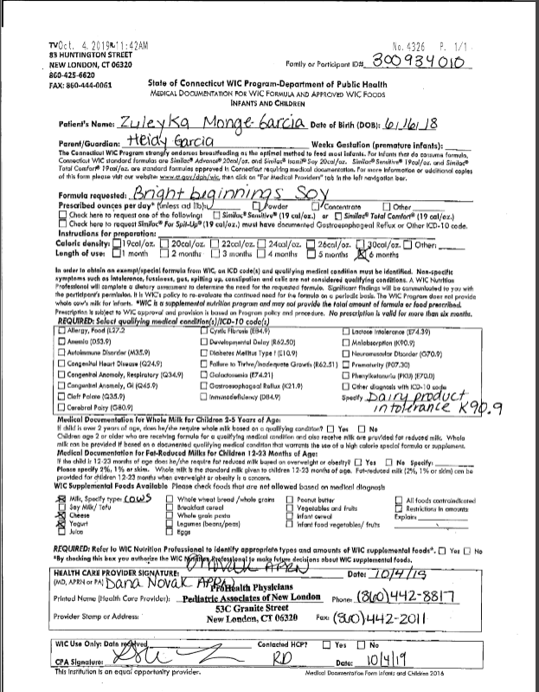
Ask yourself…
Would you approve this?
What would you question?
How would you go about addressing this?

Slide 19
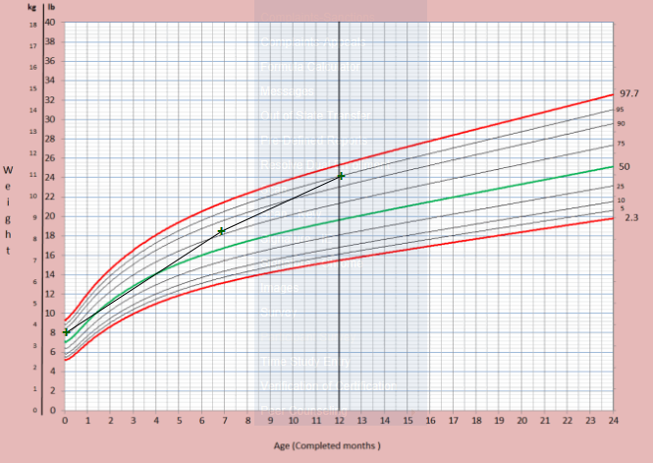

Slide 20
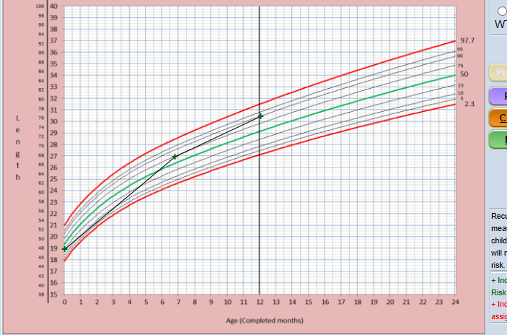

Slide 21
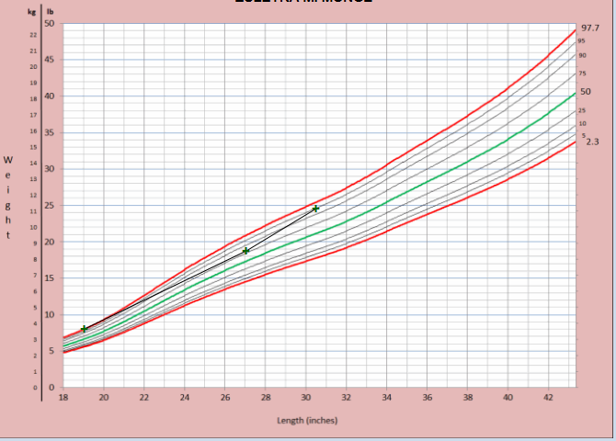

Slide 22
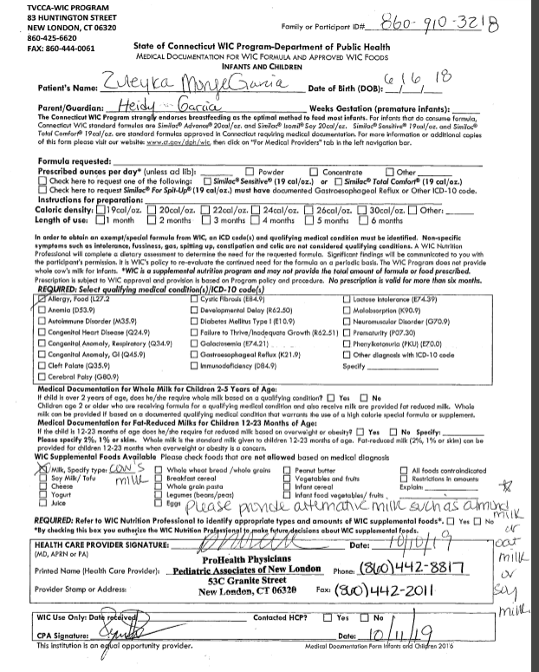

Slide 23
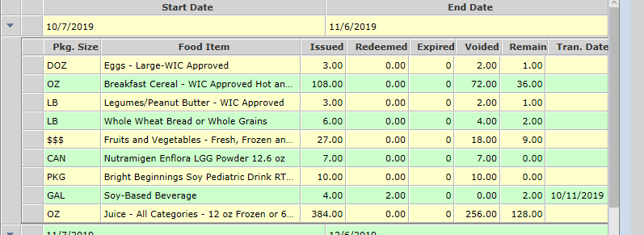


Slide 24
HCP Medical Documentation:
Verbal Orders
Verbal orders (VO) are ok in an emergency
Document orders received and by whom
VO must be followed by written documentation within 24 business hours
( 1 business day)
*Refer to WIC Policy 400-11 Use of Medical Documentation Form

Slide 25
HCP Medical Documentation:
Verbal Orders
Similac Alimentum, Powder V.O. Dave Smith, MD received by Jane Doe, WIC Nutritionist 5/4/2018.
Notes:
Document on the Medical Documentation form that the order is a verbal order (V.O.), date it, and sign your name. Also specify the name/credentials of the Health Care Provider who gave the verbal order.
Once all necessary information is obtained, a local agency CPA must sign and date the form, and scan into CT-WIC.

Slide 26
Round Table Questions
How do you proceed when reasons for prescribed RTF formulas do not meet federal regulations criteria for issuance?
When does a risk assignment need to be updated?
When does your nutrition staff contact the Health Care Provider?
What will be next specialized formula/medical food when the child reaches 1 y/o if was in Puramino, Neocate Infant during infancy?

Slide 27
The end.

