Slide 1

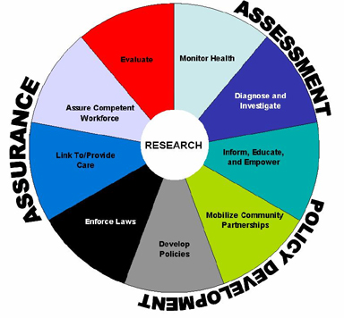

Creating Demand for Public Health
Public health is…
what we do as a society to ensure the conditions in which people can be healthy
federal, state and local partners with unique but interconnected responsibilities, one dependent upon the other , working together to assure the conditions in which people can be healthy
Lead Public Health is…
a way to create demand for public health through education, outreach and dialogue
an opportunity to create a vision for an equitable and robust public health system in Connecticut
www.ct.gov/dph/leadpublichealth
The 10 Essential Public Health Services

