Slide 1
Connecticut’s FNS-NERO
Management Evaluation Certification/Eligibility
Training for
Local Agency Staff
June 17, 2016

Slide 2

Notes:
Thanks to the local agencies that were part of the Certification MER conducted in September 2015

Slide 3
Overview
Employee Fraud and Abuse
WIC Participant Rights & Responsibilities
Physical Presence
Dual Participation
Income Eligibility & Documentation
Referrals
Participant Sanctions & Claims

Slide 4
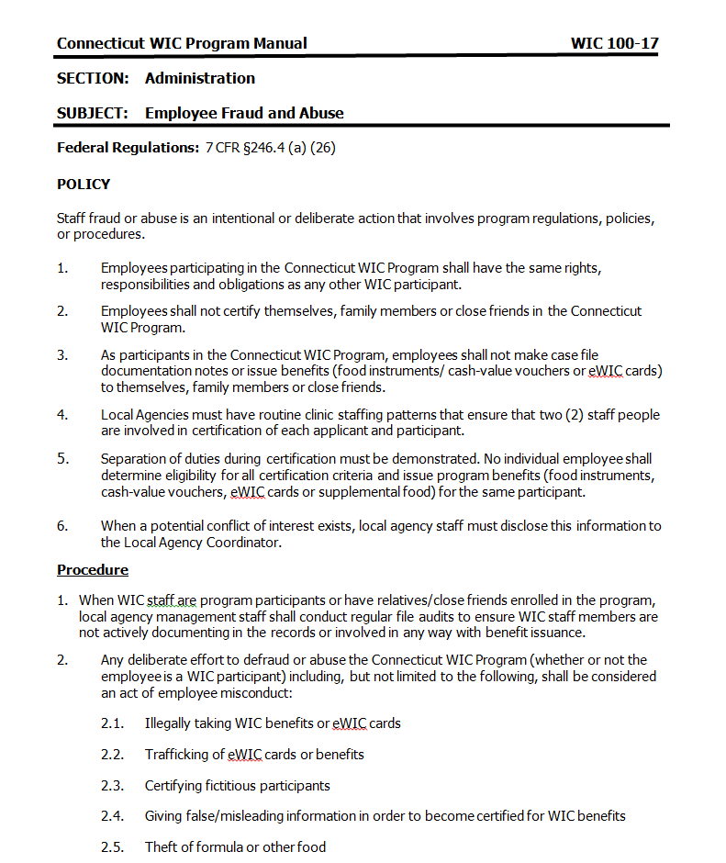
Employee Fraud
New Policy: 100-17 Employee Fraud and Abuse
Notes:
POLICY
Staff fraud or abuse is an intentional or deliberate action that involves program regulations, policies, or procedures. Employees participating in the Connecticut WIC Program shall have the same rights, responsibilities and obligations as any other WIC participant.
Employees shall not certify themselves, family members or close friends in the Connecticut WIC Program.
As participants in the Program, employees shall not make case file documentation notes or issue benefits (food instruments/ cash-value vouchers or eWIC cards) to themselves, family members or close friends.
Local Agencies must have routine clinic staffing patterns that ensure that two (2) staff people are involved in certification of each applicant and participant. Separation of duties during certification must be demonstrated. No individual employee shall determine eligibility for all certification criteria and issue program benefits (food instruments, cash-value vouchers, eWIC cards or supplemental food) for the same participant.
When a potential conflict of interest exists, local agency staff must disclose this information to the Local Agency Coordinator.
Procedure
When WIC staff are program participants or have relatives/close friends enrolled in the program, local agency management staff shall conduct regular file audits to ensure WIC staff members are not actively documenting in the records or involved in any way with benefit issuance.
Any deliberate effort to defraud or abuse the Program (whether or not the employee is a WIC participant) including, but not limited to the following, shall be considered an act of employee misconduct:
Illegally taking WIC benefits or eWIC cards
Trafficking of eWIC cards or benefits
Certifying fictitious participants
Giving false/misleading information in order to become certified for WIC benefits
Theft of formula or other food
Suspected intentional fraud or abuse shall be investigated by the Local Agency (Human Resource Department or Internal Auditor) with assistance from the State Agency, and may require investigation through the Connecticut Office of the Attorney General and/or the local police department.
Action to be taken as a result of an investigation of fraud or abuse (whether or not the employee is a WIC participant), beyond sanctions applicable to WIC participants (see Policy 104-04, WIC Participant Abuse of the WIC Program), shall depend on Local Agency personnel policy and procedures concerning employee misconduct.
The State Agency shall require that the Local Agency promptly remove any Local Agency employee suspected to be abusing the Connecticut WIC Program from WIC benefit issuing or processing responsibilities until the Local Agency investigation is completed.
All reports of abuse by staff should be investigated promptly; following the procedures stated above, and the Employee Fraud and Abuse Incident Report must be completed and forwarded to the State Program Operations Monitor.

Slide 5
WIC Participant Rights & Responsibilities
Staff must ensure that the WIC Participant Rights and Responsibilities form is signed by the participant or applicant after review and a copy is kept in the participant file.
In CT-WIC the signature is captured electronically (Income Information Tab) and stored in the participant electronic file. Processes are detailed in Policy 200-31.
Notes:
7 CFR 246.7 (i) (10)…Policy 200-31

Slide 6
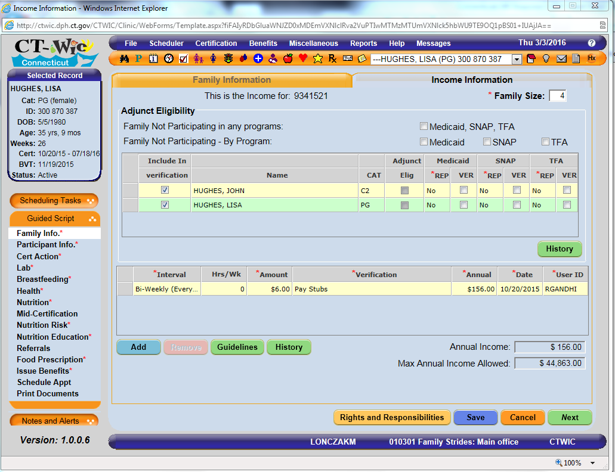
Notes:
Local agencies can choose to have any staff provide review this information with participants, but it MUST be done to be able to issue benefits.

Slide 7
Physical Presence Documentation
Physical Presence must be documented.
In CT-WIC – Physical Presence is captured in the Cert Action Screen.
Policy 200-02 Physical Presence Requirement

Slide 8
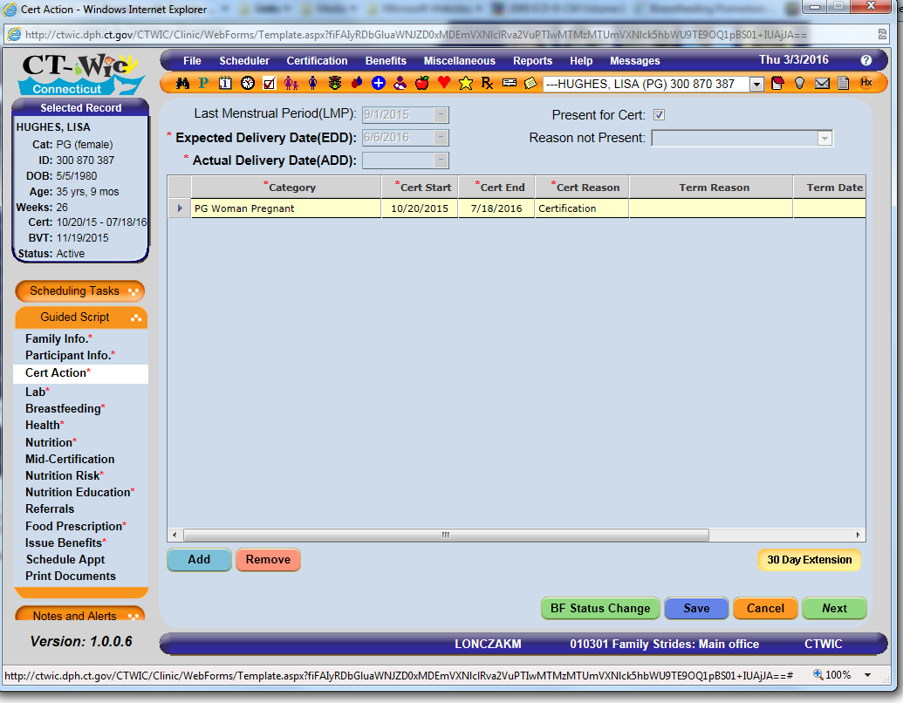
Notes:
In CT-WIC the certification cannot be completed without checking physical presence.

Slide 9
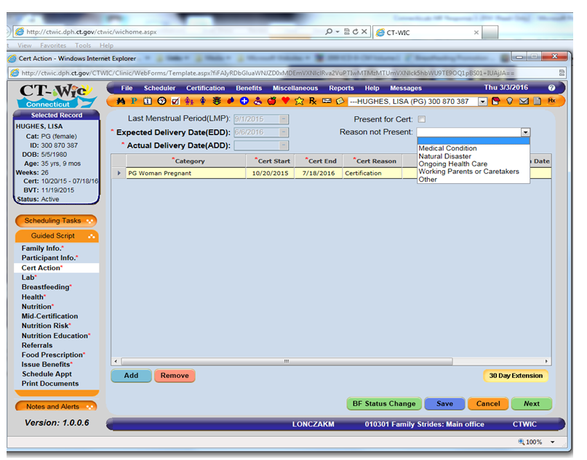
Notes:
7 CFR 246.7 (o)
We currently have the same 4 exemptions for physical presence loaded in the CT-WIC drop down menu. An exemption cannot be used in consecutive certification periods.
Note that “Other” is only allowed when an infant or child is not present for certification and ONLY up to maximum of 30 days.

Slide 10
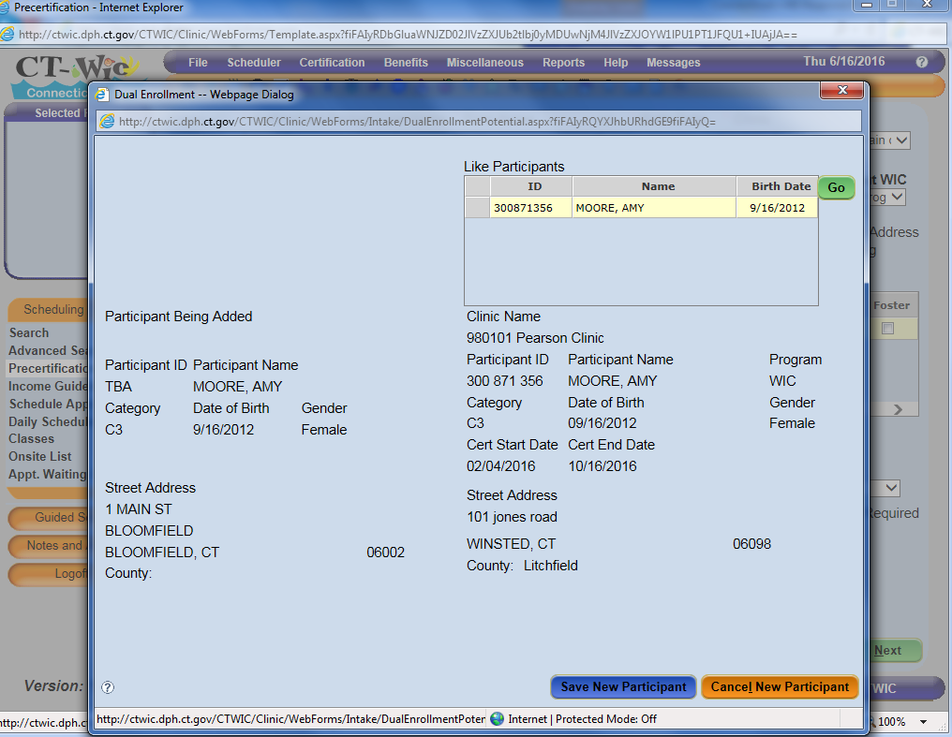
Dual Participation
Notes:
Whenever a dual participant is created – this screen comes up with when you attempt to save the screen. Staff must pay attention to this pop-up screen and click “Cancel New Participant” unless they are sure that they would like to save the information they just entered. If “Save New Participant” is selected, this will create a new record, which could be a dual participant.

Slide 11
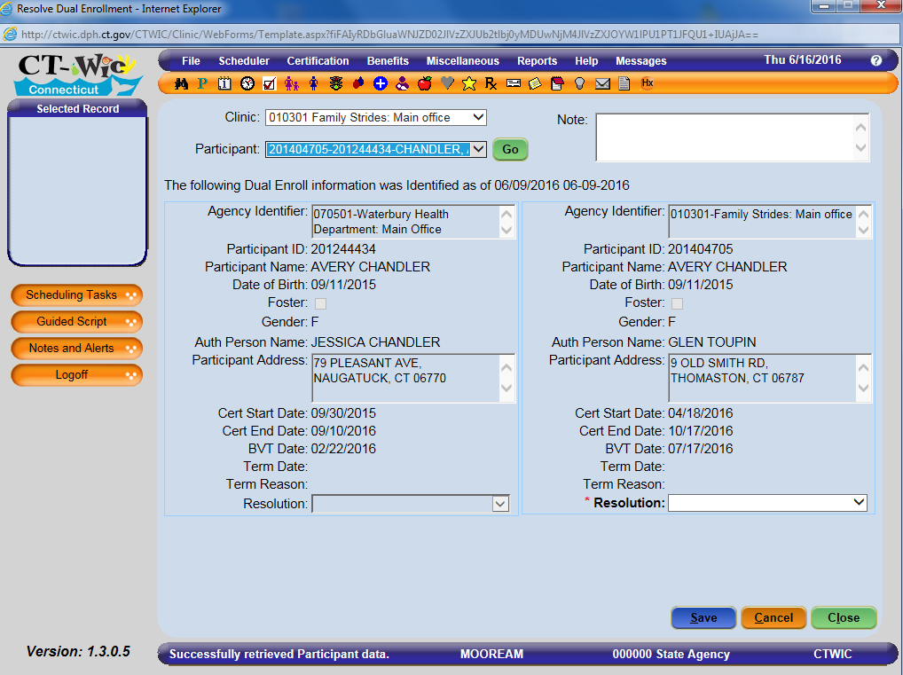
Dual Participation
Notes:
When the system identifies that there is a dual – need to go the Miscellaneous; Resolve Dual Enrollment and identify the reason for the Resolution. The options are: Resolve-Duplicate Record-Keep, Resolve-Duplicate Record-Block , Resolve-Other and Investigate

Slide 12
Dual Participation
The Coordinator or designee must resolve all potential dual participation during the BOD process.
An indicator/question has been added to the Program Operations evaluation tool to verify the local agency process for resolution of duals.
WIC policy 103-01 revised for CT-WIC
Notes:
7 CFR 246.7(l) (1) (i)
The State Agency will be monitoring the resolution of dual participants

Slide 13
Income
Special Situations
  Migrant Farmworkers
    Income eligibility expires 12 months from the date of the last income determination.
  Zero Income
    Prompt participant to describe how they obtain basics necessities (food, shelter, medical care and clothing).
  Foster Care
    Verbal declaration of foster stipend.
  Emancipated Minors
    Take responsibility of their own care. If not receiving HUSKY/SNAP/TFA document income supporting the economic unit.
Notes:
Migrant Farm workers: Income eligibility to be determined no more than once annually.
Zero Income: Participants claiming zero income shall be prompted to describe in detail their living situation and how they obtain basic necessities such as food, shelter, medical care and clothing in order to properly determine eligibility. Documentation could include bank statements, child support, etc and should represent the last 30 days. If the participant claims zero income, complete a self declaration form for up to 30 days. Determine if the participant may be eligible for state assistance and provide referrals as needed.
Foster Care: Must be considered a family size of one. While foster children participate with HUSKY A it is important to capture income to complete the certification process. A verbal declaration of the foster stipend is the only to be considered. In addition, income screening should occur at every re-certification even if they have not changed foster homes.
Emancipated Minors: In most cases emancipated minors are HUSKY eligible. If they claim zero income follow the procedure for zero income.

Slide 14
Income
  Students
    Loans (private or financial aid) that must be paid back should not be counted as income.
    Loans with unlimited access (trust, savings, personal loan form family) are considered as income.
  Participants Residing in Institutions/Homeless Facilities
    “Family Unit” does not include other residents of the shelter and income should be considered separate than other residents.
  Applicants or Family Members on Strike
    Since annual income may exceed eligibility guidelines, current income may be assessed to determine eligibility.
  Multiple Economic Units at One Address
    Determine if there is more than one economic unit at the address. Income eligibility should be determine based on its own source of income and not any in-kind benefits.
Notes:
Students: Any financial aid in the form of grants and scholarships are includes as income. This includes loans in which the participant has constant or unlimited access (trust, savings, personal loan form family) are considered as income because they do not have to be paid back. Loans that must be paid back (whether private or student financial aid) should not be counted as income.
Participants Residing in Institutions/Homeless Facilities:
Applicants for Family Members on Strike: Consider a strike, lockout or furlough as a temporary decrease in income. Both annual and current income may be used to assess income of applicants or family members on strike/furlough. Since annual income may exceed eligibility guidelines, current income may be assessed to determine eligibility. It’s important to remind the participant to report any changes in income as they occur. Additionally, consider referring the participant to other sources of aid or assistance.
Multiple Economic Units at One Address: Although the terms “household”, “family” and “economic unit” can be used interchangeably the later (economic unit) is preferred. Through appropriate questioning it is possible to determine if more than one economic unit is living under one roof. For example a pregnant woman who is sharing an apartment with her sister may be determined to be a separate economic unit if the staff can reasonably establish that she has a separate source of income and is paying her portion of the household, living and personal expenses.

Slide 15
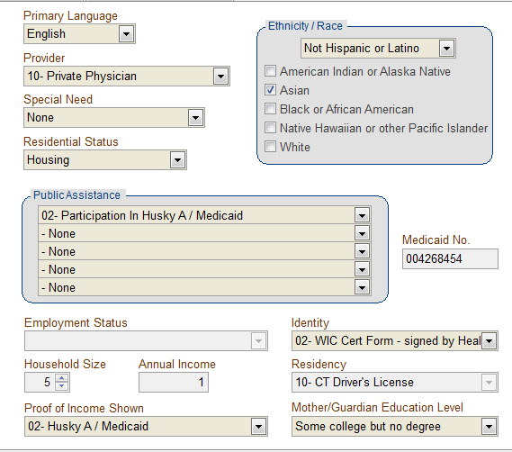
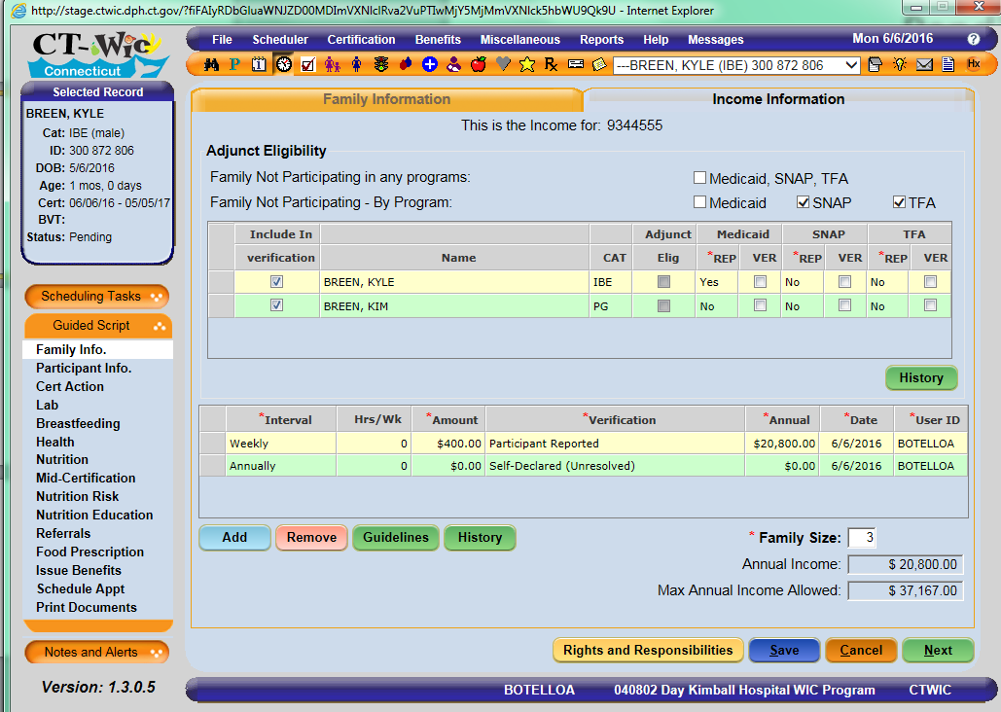
Income Documentation
SWIS
CT-WIC
SWIS eligibility:
Proof of Income Shown
CT-WIC eligibility:
Adjunct Eligibility grid
Notes:
Income documentation in CT-WIC is slightly different than how you verified income eligibility in SWIS. One difference is where state assistance is captured and where adjunct eligibility occurs. In the SWIS example staff correctly documented public assistance and documented proof of income shown as HUSKY A/Medicaid. As we know adjunct eligibility once confirmed ensures the participant’s income eligibility. In this SWIS example the annual income is documented as $1. However it is important to make every attempt to gather household income. Per the Zero Income discussion if a participant claims they have no income staff must respectfully prompt the participant to describe how they obtain basics necessities (food, shelter, medical care and clothing), income might include SNAP benefits, a partner’s income, bank statement, etc.

Slide 16
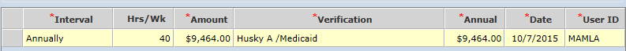
Income Documentation
Quick Review of Common Verification Selections
HUSKY A/Medicaid
  For conversion only. This should no longer be used for income verification.
Self Declared (unresolved)
  When adjunct eligibility cannot be confirmed and no other source of income is available. Up to 30 days.
Self Declared (resolved)
Participant Reported
  Verbal statement of income supporting family. To be used when found adjunctively eligible.

Slide 17
Income Documentation
Pending Husky
Proof of income unavailable
Notes:
So let’s talk through a common situation. Mom is in to certify her infant. She states the baby will have HUSKY A/Medicaid but has not received the card yet. As you can see mom had no sources of adjunct eligibility documented at the time of her pregnancy certification. You can document that mom reports pending Medicaid coverage for her baby but you will not verify it until she has provided staff with either the Medicaid card or number. Next you would fill out the income grid. Mom will need to sign a self declaration form to be eligible for 30 days until further documentation is provided. In this case you can request from mom what other sources of income supports her family or economic unit and document as participant reported.

Slide 18

Income Documentation
No more documentation of 9’s to fill the field. Staff should document YES as reported but not Verified since there is nothing to verify eligibility.

Slide 19
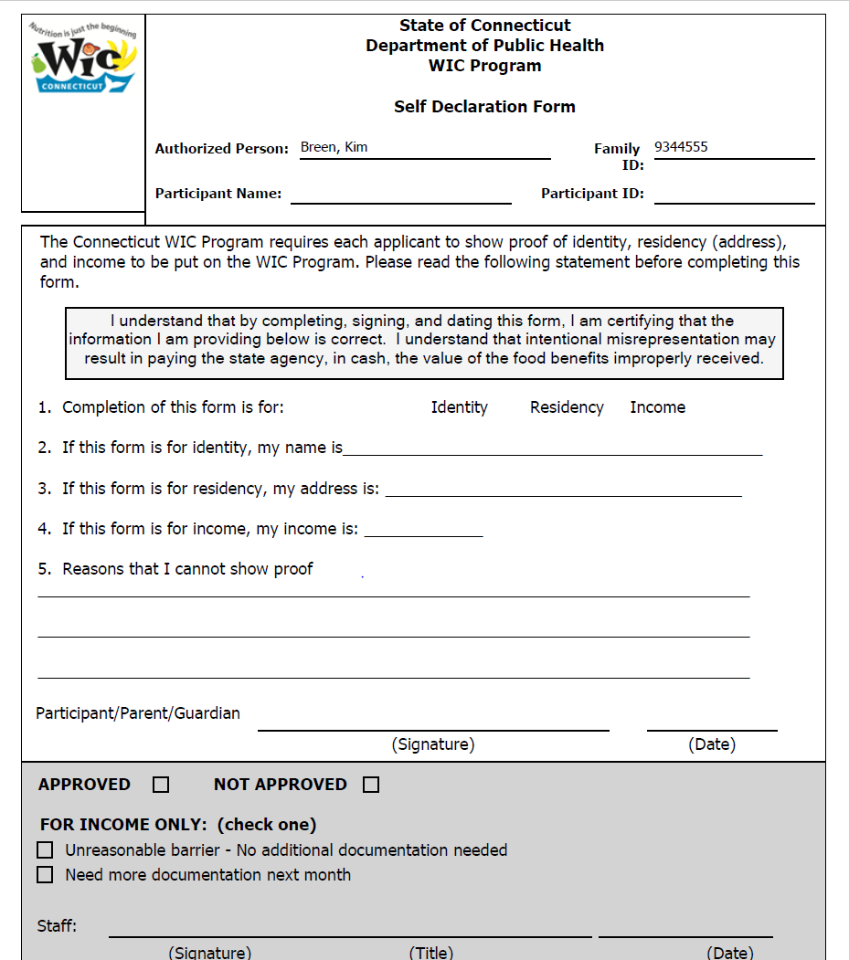
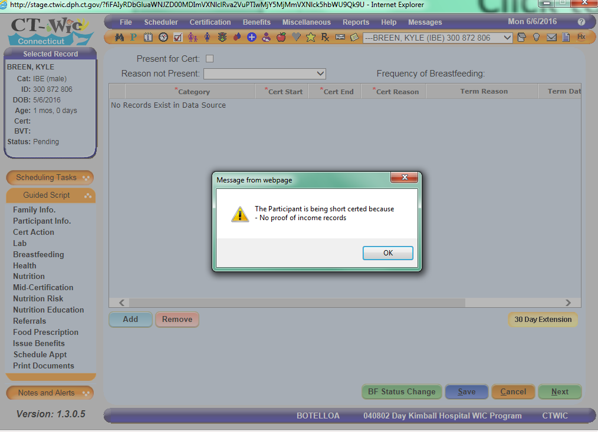
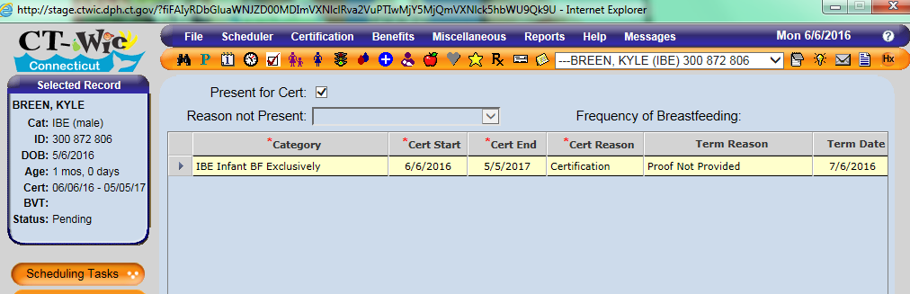
What Happens Next….
Self Declaration form upon saving income screen. Complete missing information, capture both participant and staff signatures and scan into images.
Notes:
Next you would have the participant complete the self declaration form. At this point you must inform mom of the infants eligibility for 30 days. This will create a short certification for 30 day eligibility. The system auto generates a term reason and future term date. At the next appointment she would need to bring in either the HUSKY A/Medicaid card or number or documentation of other form(s) of income for the household or economic unit for the last 30 daysWhen the mom returns in 30 days staff would need to complete the verification of the HUSKY A or Medicaid number. Also in the income grid change the self declared unresolved to resolved. Next the Nutritionist would remove the termination reason and term date in the cert action screen.

Slide 20
Referrals
Referrals must be provided and reviewed with the participant.
Referrals should be documented in CT-WIC Referrals screen.
WIC Policy 200-28: Coordination of Services-Referrals to other programs by WIC Staff
Notes:
Referral options currently in CT-WIC are: Referred, Declined and Enrolled. Would use Referred – if you provided the referral and they “accepted” or were ok with it. Declined is referral was offered but they said they were not interested in receiving the referral. Enrolled is you determined that they were already enrolled or you offered the referral and they told you that they were already enrolled. One agency requested clarification on how to document referral at the follow-up – do they change from referred to enrolled? So to decrease confusion we will request a change in CT-WIC with the following options: Participates, Referred, Declined and Enrolled. So Enrolled will be used at follow-up if it is determined that the person enrolled as a result of the referral. In order to maintain the hx -Referral options should not be changed.
A local agency expressed that – “Referrals are NOT mandatory in CT-WIC and they should be”. Our expectation is that referrals will be documented – if it is determined that they are not, we may have to reconsider making the Referral screen mandatory. The disadvantage of the Referral screen being mandatory is you will have complete that screen in order to complete the certification/issue benefits.

Slide 21
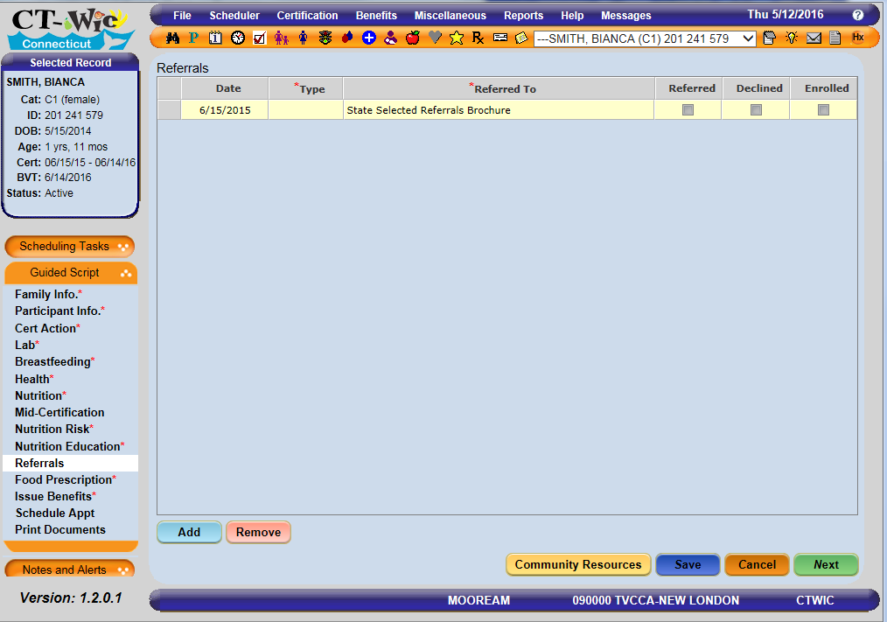

Slide 22
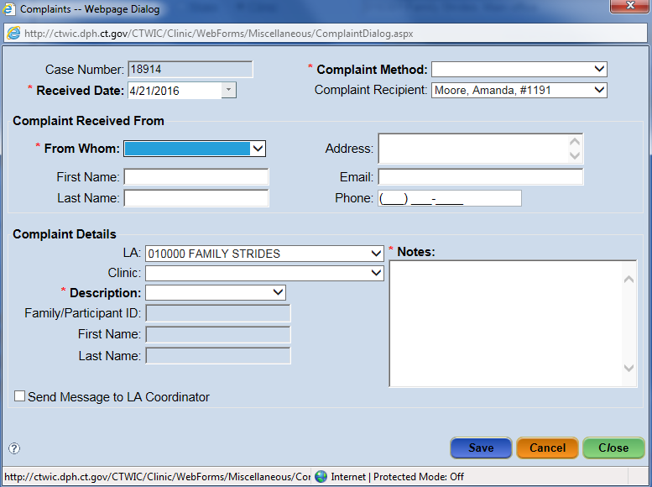
Participant Complaints, Sanction & Claims
Notes:
The Complaints-Add screen is where staff will enter information about a complaint against a WIC participant. There is the option to send a message to the Coordinator. If this is complaint that requires State Agency intervention, an email should be sent to the designated person(s) at the State Agency; person handling investigations and/or Program Operations monitor.

Slide 23
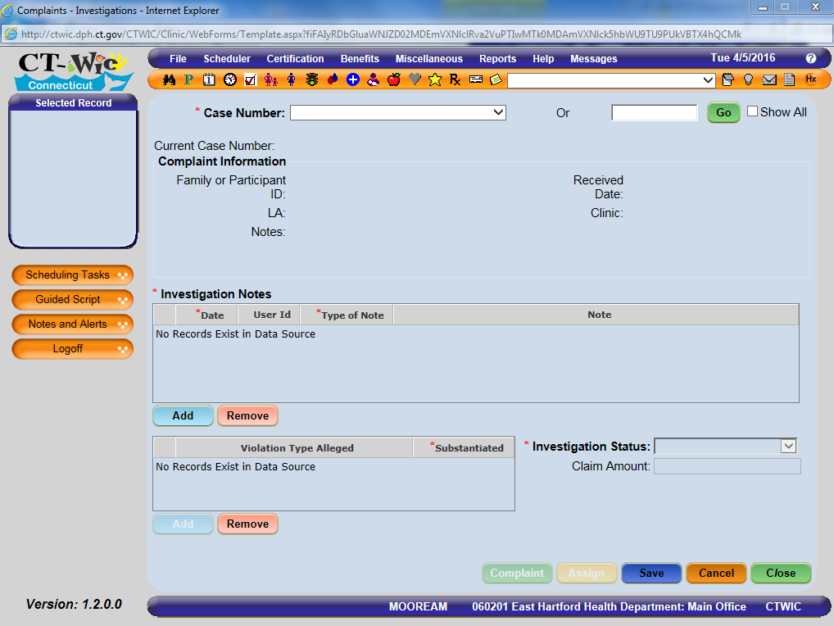
Participant Complaints, Sanction & Claims
Notes:
Complaints – Investigation screen allows the user to manage complaint information. Once the complaint information has been added, the information can be displayed on Complaints – Investigations. The user can add Investigation Notes, the alleged violation type and investigation status to this screen.

