Slide 1
DPH Long-Term Care Criminal History and Patient Abuse Background Search Program: Use of the ABCMS: 5 Steps
DPH.ABCMS@ct.gov
Connecticut Department of Public Health

Slide 2
Overview of
Applicant Background Check Management System
(ABCMS)
Development

Slide 3
ABCMS Overview
Providers will manage their respective applicants in the ABCMS:
Log in to the ABCMS website.
Enter new applicants.
Conduct registry checks.
Manages applicants and employees in the ABCMS.
Access to state CHR (even if not disqualifying) and eligibility determinations.

Slide 4
ABABCMS Overview, continued
CT DPH has overall administrative authority of ABCMS:
Assists providers with user accounts.
Manages ABCMS permissions based on user type.
Retains personally identifiable data.
ABCMS hosted at CT Bureau of Enterprise Systems & Technology (BEST) behind firewalls.

Slide 5
ABCMS Overview, continued
CT Department of Emergency Services and Public Protection (DESPP) has administrative authority of the criminal history reporting:
Access to State and Federal Criminal History Reports (CHRs).
Verifies and records applicant identity in ABCMS at time of fingerprinting.
Transmits fingerprints to Federal Bureau of Investigation (FBI).
Forwards CHR results through the ABCMS.

Slide 6
User Role Examples
Provider Users
Human Resources
3rd Party Staffing Company
Other users/administrators as may be authorized
Notes:
Provider Users: may also include Finance (payment reconciliation) staff

Slide 7
ABCMS – 5 Steps
Step 1: Enter Personal and Demographic Information
Step 2: Enter Pre-Employment Information
Step 3: Research Registries
Step 4: Data Review
Step 5: Submit Application
Notes:
Five Steps to Add an Applicant

Slide 8
ENTERING THE APPLICATION INTO ABCMSHE ABCMS

Slide 9
ABCMS Application Forms
Applicant needs to complete:
Consent Form
Fingerprinting Information Form
Notes:
Before adding an applicant, need to print the blank Consent Form and Fingerprinting Information Form and give them to the applicant to be filled out.
Certain particulars need to be obtained. That’s why they’re required. This information is from the Fingerprinting Information Form.

Slide 10
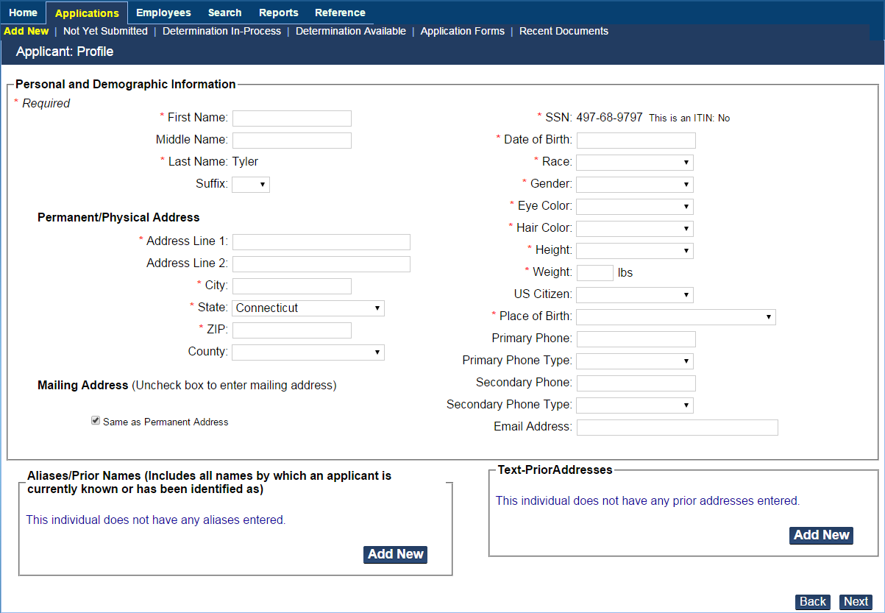
Step 1: Enter Personal and Demographic Information
1. Enter applicant information. *Necessary for accurate Criminal History Records (CHRs).
2. Profile is created and the Pre-Employment Information page is displayed.
* Add Aliases for Hyphenated names.
Notes:
To enter a new applicant into ABCMS:
If the applicant does not appear in the search results, click Add New Applicant. The Applicant: Profile screen appears.
In the Personal and Demographic Information section, enter the information for the applicant. Data entered on the previous page cannot be changed.
If the applicant’s Mailing Address is different than their Permanent Address, uncheck the box next to Mailing Address fill out the correct information.
Note: Fields marked with an asterisk are required fields.
4. If the applicant has a previous name (e.g., a maiden name), you must enter this information in the Alias/Prior Name section:
Click Add New in the Alias/Prior Name section. The Alias/Prior Name dialog appears.
Enter the applicant’s alias information, then click Save.
5. If the applicant has lived in a different state, you will need to enter a prior address to allow registries from the other state to be included.
Click Add New in the Prior Addresses section. The Prior Addresses dialog appears.
Enter the applicant’s previous address information, then click Save.
When you are finished adding the applicant’s information, click Next.

Slide 11
Step 2: Enter Pre-Employment Information
1. Enter the position information the applicant is applying for and click Next.
2. Research Registries page is displayed.
Notes:
The Enter Pre-Employment Information screen appears.
In the Position Applied For section
a. Select the name of the provider from the Provider drop down.
b. Select the category for the desired position from the Position Category drop down.
c. Select the name of the desired position from the Position drop down.
d. Select the Employee Type from the drop down.
Note: At this point in the process, you may save the application and continue at a later time by clicking Save & Close. To access a saved application, go to Applications > Not Yet Submitted.

Slide 12
REGISTRY CHECKS THROUGH
THE ABCMS

Slide 13
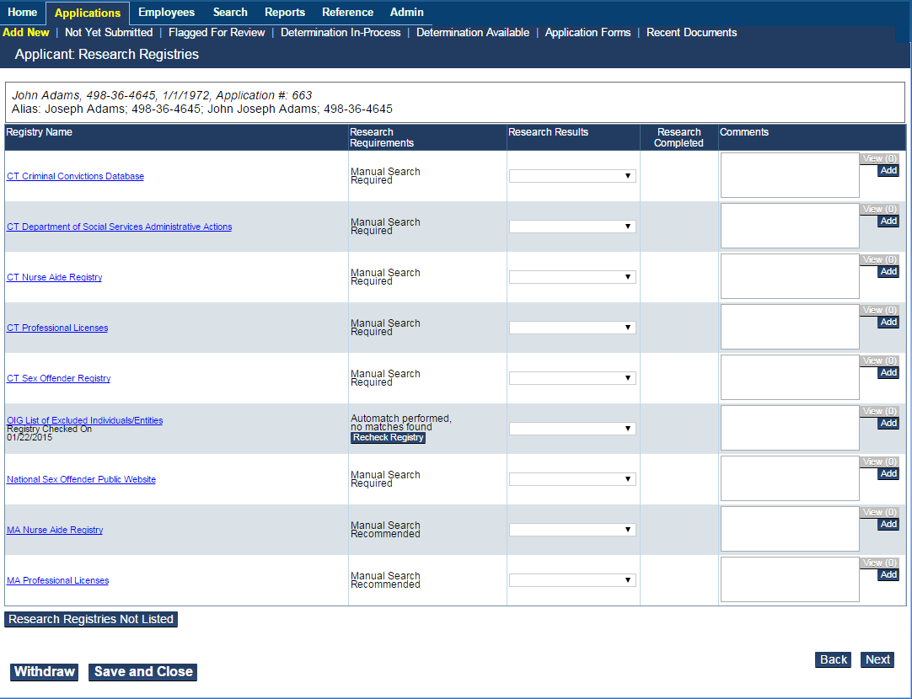
Step 3: Research Registries
1. Click the registry link to open the registry website.
2. “Cleared” = no disqualifying conviction
3. Enter Comments as needed.
4. Click Next.
* Hyphenated names need to be searched, by both names (e.g., “James-Smith” is searched as “James” and “Smith”).
Notes:
After an applicant’s personal information is received, you may log in to ABCMS and search for the applicant in applicable public registries. The applicant must be cleared in all required registries prior to fingerprinting and permanent employment. Check registries by clicking the registry link to open the registry website in a new window
Click a link in the Registry Name column to go to the registry site and perform a manual search.
If you have completed the search by clicking the link, the updated results appear in the Research Requirements column.
For the OIG Registry ONLY:
an Auto-Match button appears in the Research Requirements column with a link to view any matches.
the Auto-Match button appears in the Research Requirements column with a zero, if the registry has been searched and a match is not found.
Enter Comments (Entering Comments is optional, except when Flagging a Registry for Review). Registries set to Flagged for Review REQUIRE Comments.
For each registry, select a research registry result of Cleared or Flagged for Review.
• If the applicant is cleared on all required registries, you may continue with the process.
• If the applicant is Flagged for Review on a required registry, you cannot continue with the hiring process. Click Next to receive a Application Flag for Review Confirmation screen.
• If one or more of the registries is marked as Flagged for Review, then you must wait for DPH ABCMS Program Staff to review the registry check and determine whether the applicant should be marked as Cleared or Flagged for Review. You may view an application that has been flagged for review at any time by going to Application > Flagged for Review.
For registries marked as Flagged for Review, enter additional information into the Comments field for each corresponding registry [REQUIRED].
Note: At this point in the process, you may withdraw an application by clicking Withdraw. Applications may be withdrawn for any reason, regardless of the registry results.

Slide 14
Step 4: Data Review
Review for confirmation before Submit.
Notes:
If there are any corrections to be made, use the Back button to go to the

Slide 15
Step 5: Submit Application
Confirmation message is displayed.
Form will be pre-populated by the ABCMS with applicant demographic data.
Notes:
Confirmation that the Application Is Successfully Submitted: (Ready for Fingerprinting.)
Submit the application, then print the Fingerprinting Authorization Form. Locations on back of the form.

Slide 16
Post-Registry Checks, Applicant is Eligible for Fingerprinting
At this stage, Fingerprinting Authorization Form may be printed and given to the Applicant.
Applicant takes Fingerprinting Authorization Form to State Police Barracks to closest State Police Barracks for Livescan processing.
Notes:
Provider Users: may also include Finance (payment reconciliation) staff

Slide 17
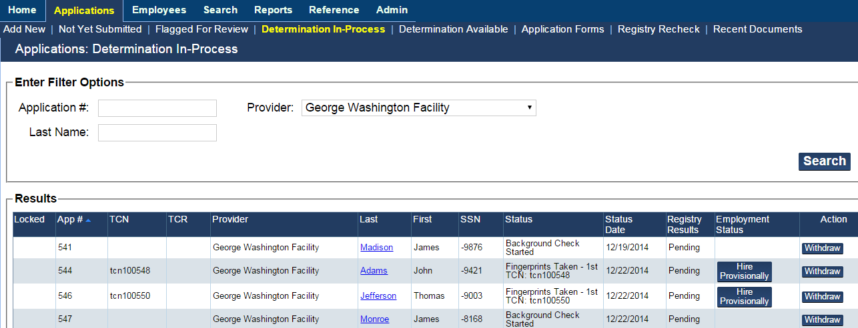
Tracking: Determination In-Process
1. All applications submitted and waiting CHRs and final determination are listed.
2. To track the applicant in the fingerprinting process, review Status.
3. In Enter Filter Options, enter your search criteria, then click Search. The updated search results appear.
Notes:
1. A list of all applications submitted and waiting CHRs and final determination is available for Provider.
2. Review the Status column to track where the applicant is in the fingerprinting process.
3. If hiring the applicant for a provisional period, click Hire Provisionally.
Re: #3: Applicants can only be hired provisionally after applicant’s fingerprints are taken.

Slide 18
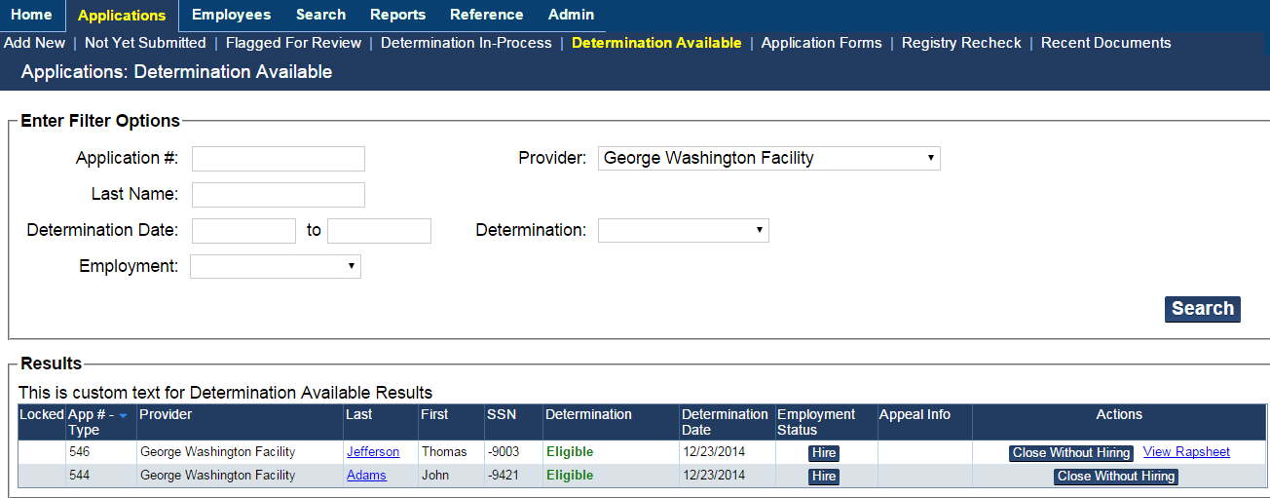
Determination Available – Application Decision Options
Notes:
Go to Applications > Determination Available. The Applicants: Determinations Available screen appears. This screen presents a list of all applications that have been submitted by you, and for which a fitness determination has been made. (The Hire button will only display for applicants with an Eligible fitness determination.)
Viewing an Available Determination:
After a criminal history determination has been made, you will receive an email notification. To view the results of the determination:
Go to Applications > Determination Available. The Applications: Determination Available screen appears with all of the applications that are currently in this status.

Slide 19
Applicant Status: No-hit Result
Determination is Eligible/ Clear to Work

Slide 20
Applicant Status: State Criminal History Result (CHR), but Not Disqualifying
“View Rapsheet”: You May Review State CHRs
Notes:
State records can be shared for your view, for a specific period of time.
Arrests will be shared too, although only a conviction disqualifies someone.
Under federal law, federal rap sheets can’t be shared outside of DPH.

Slide 21
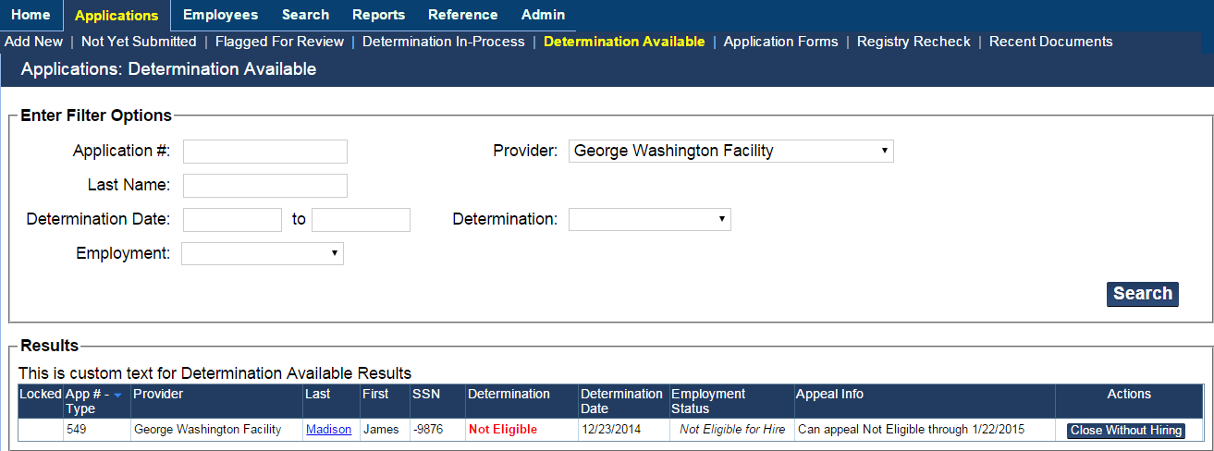
Applicant Status: Disqualifying Conviction Identified –
“Not Eligible”
Notes:
This is a disqualification based on federal offense; Rap Sheet is not available for viewing.
Trying to avoid delay. Very rapid.
-time fingerprinted to a no-hit result.
Majority cleared within 24 hours

Slide 22
Thank You DPH.ABCMS@ct.gov (860) 509-8366

