Slide 1


Employer User Guide
Notes:
Notes for Trainer
Topic Name: Employer Registration
In-Session Activities / Explanations:
Time: 4 hours 45 minutes
Instructor Notes:
There are no pre-requisites to be considered prior to taking this virtual Instructor Led Training (vILT). The total duration for this vILT is 4 hours 15 minutes.
Welcome the audience in a warm and cordial manner. Ensure that everyone is set up with the required resources, such as:
Electronic copy of the handout, having the common login credentials for all the learners and the data to be entered while doing the exercises in the training environment of ReEmployCT.<to be determined>
Present the vILT presentation using Microsoft Teams.
Introduce the topic and encourage learners to actively participate in the session.

Slide 2
Employer User Guide
Table of Content
Create an Account
Employer Registration
File Tax and Wage Report
Adjust Tax and Wage Report
Upload Tax and Wage Report File
Make Online Payment
Cancel Scheduled Payment
Acquisition Notification
Request to Close
Maintain Address
My User Profile
Email SignUp
Audits
940 Certification Request
Employer Inquiry
Notes:
Notes for Trainer
Topic Name: Employer Registration
Sub Topic Name: Employer Registration – Scenario
In-Session Activities / Explanations:
Time: 5 mins
Instructor Notes:
Read the scenario and explain to the learners that if a new employer to the state of Connecticut (CT) starts or acquires a business with Connecticut workers, that employer is required to register the business to pay unemployment insurance taxes.
The registration process helps to determine if the employer meets certain criteria as defined by CT laws.

Slide 3

Employer User Guide
Create an Account
Text 03

Slide 4
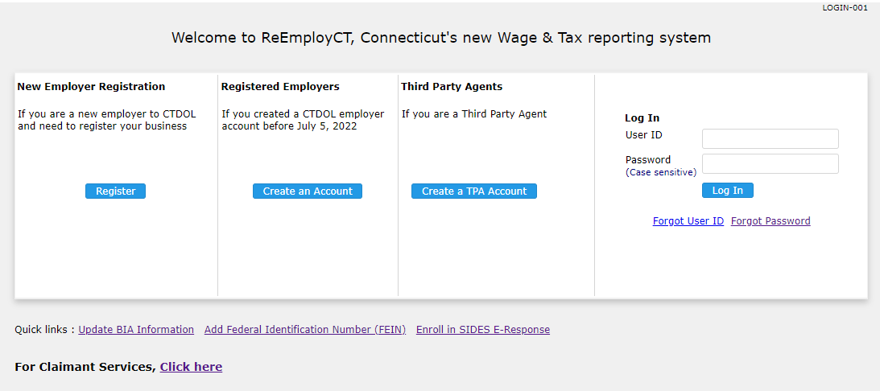
Create an Account
Create an Account
Employers who are already registered with CTDOL must follow the following step to create credentials to access their account online.
Click Create an Account.
Notes:
Notes for Trainer
Topic Name: Employer Registration
Sub Topic Name: Employer Registration – Scenario
In-Session Activities / Explanations:
Time: 5 mins
Instructor Notes:
Read the scenario and explain to the learners that if a new employer to the state of Connecticut (CT) starts or acquires a business with Connecticut workers, that employer is required to register the business to pay unemployment insurance taxes.
The registration process helps to determine if the employer meets certain criteria as defined by CT laws.

Slide 5
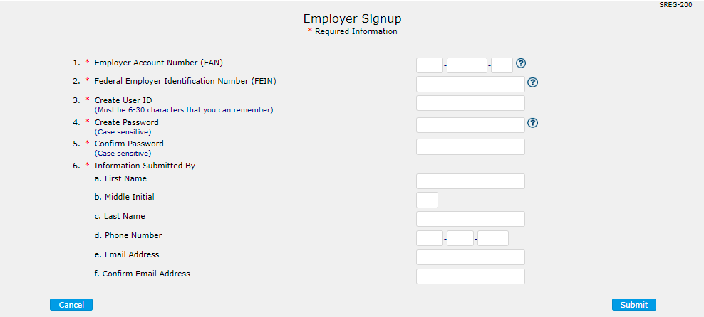
Create an Account
Create an Account
Employer Signup screen is displayed. Create User ID and Password. Enter additional company information. Click Submit.
Note: Passwords must be 8 to 15 characters. The password must contain at least one uppercase letter, one lowercase letter, one number and two symbols (i.e., !@#$*._).
Notes:
Notes for Trainer
Topic Name: Employer Registration
Sub Topic Name: Employer Registration – Scenario
In-Session Activities / Explanations:
Time: 5 mins
Instructor Notes:
Read the scenario and explain to the learners that if a new employer to the state of Connecticut (CT) starts or acquires a business with Connecticut workers, that employer is required to register the business to pay unemployment insurance taxes.
The registration process helps to determine if the employer meets certain criteria as defined by CT laws.

Slide 6
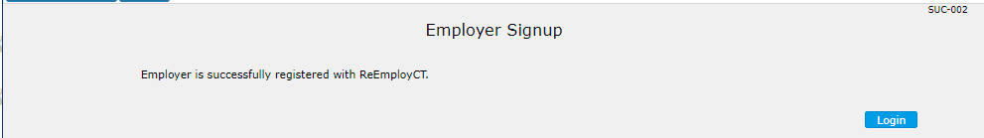
Create an Account
Create an Account
Employer Signup screen is displayed. Account has been created.
Notes:
Notes for Trainer
Topic Name: Employer Registration
Sub Topic Name: Employer Registration – Scenario
In-Session Activities / Explanations:
Time: 5 mins
Instructor Notes:
Read the scenario and explain to the learners that if a new employer to the state of Connecticut (CT) starts or acquires a business with Connecticut workers, that employer is required to register the business to pay unemployment insurance taxes.
The registration process helps to determine if the employer meets certain criteria as defined by CT laws.

Slide 7
Employer User Guide
2. Employer Registration-
For Employers who are not currently registered
Text 03

Slide 8
Employer User Guide
Employer Registration
For new employers, click Register.
Notes:
Notes for Trainer
Topic Name: Employer Registration
Sub Topic Name: Employer Registration – Scenario
In-Session Activities / Explanations:
Time: 5 mins
Instructor Notes:
Read the scenario and explain to the learners that if a new employer to the state of Connecticut (CT) starts or acquires a business with Connecticut workers, that employer is required to register the business to pay unemployment insurance taxes.
The registration process helps to determine if the employer meets certain criteria as defined by CT laws.

Slide 9
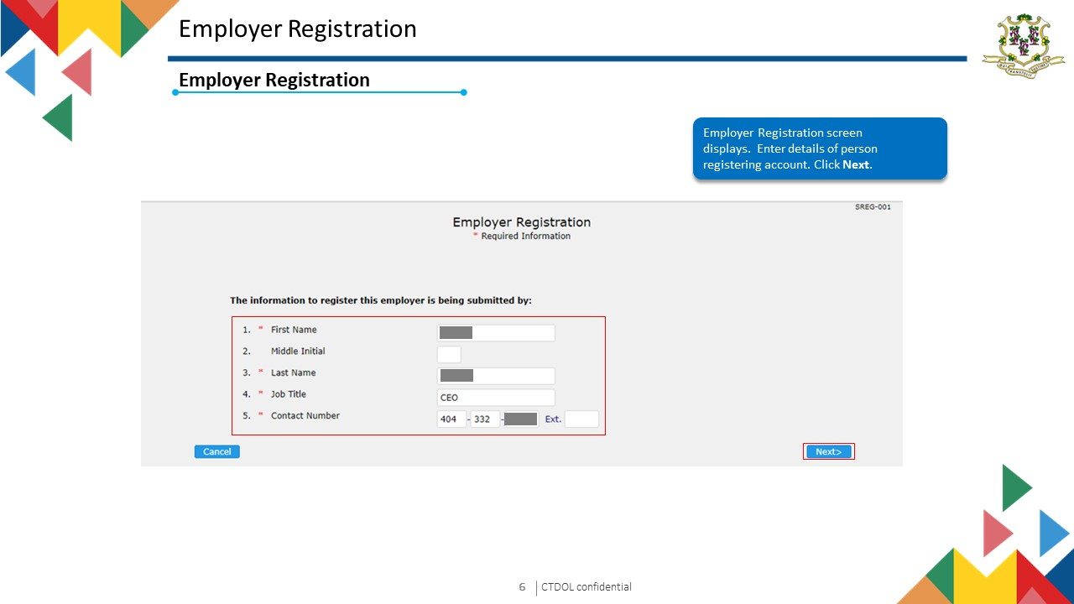
9
I
CTDOL confidential
Notes:
Notes for Trainer
Topic Name: Employer Registration
Sub Topic Name: Employer Registration – Scenario
In-Session Activities / Explanations:
Time: 5 mins
Instructor Notes:
Read the scenario and explain to the learners that if a new employer to the state of Connecticut (CT) starts or acquires a business with Connecticut workers, that employer is required to register the business to pay unemployment insurance taxes.
The registration process helps to determine if the employer meets certain criteria as defined by CT laws.

Slide 10
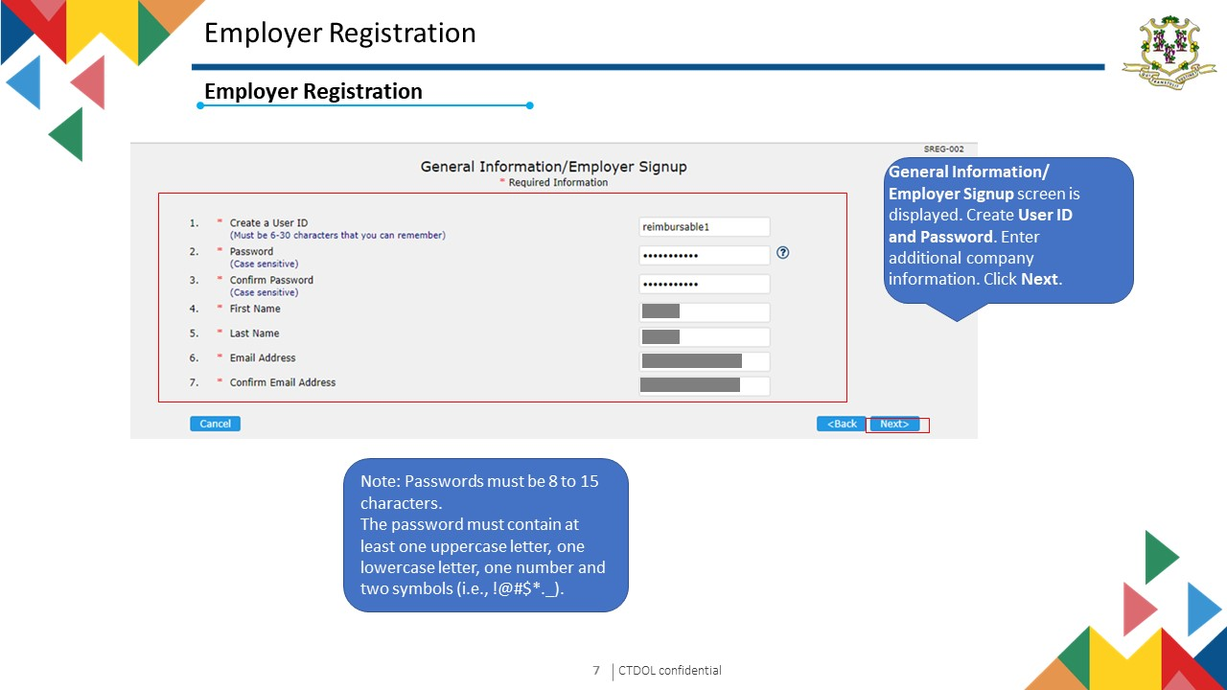
I
CTDOL confidential
10
Notes:
Notes for Trainer
Topic Name: Employer Registration
Sub Topic Name: Employer Registration – Scenario
In-Session Activities / Explanations:
Time: 5 mins
Instructor Notes:
Read the scenario and explain to the learners that if a new employer to the state of Connecticut (CT) starts or acquires a business with Connecticut workers, that employer is required to register the business to pay unemployment insurance taxes.
The registration process helps to determine if the employer meets certain criteria as defined by CT laws.

Slide 11
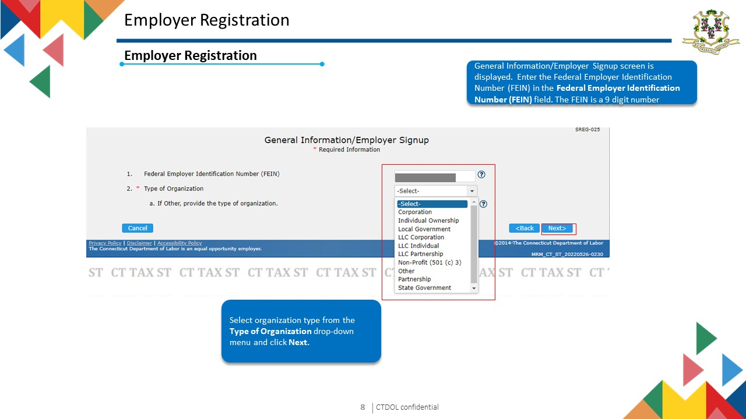
I
CTDOL confidential
11
Notes:
Notes for Trainer
Topic Name: Employer Registration
Sub Topic Name: Employer Registration – Scenario
In-Session Activities / Explanations:
Time: 5 mins
Instructor Notes:
Read the scenario and explain to the learners that if a new employer to the state of Connecticut (CT) starts or acquires a business with Connecticut workers, that employer is required to register the business to pay unemployment insurance taxes.
The registration process helps to determine if the employer meets certain criteria as defined by CT laws.

Slide 12
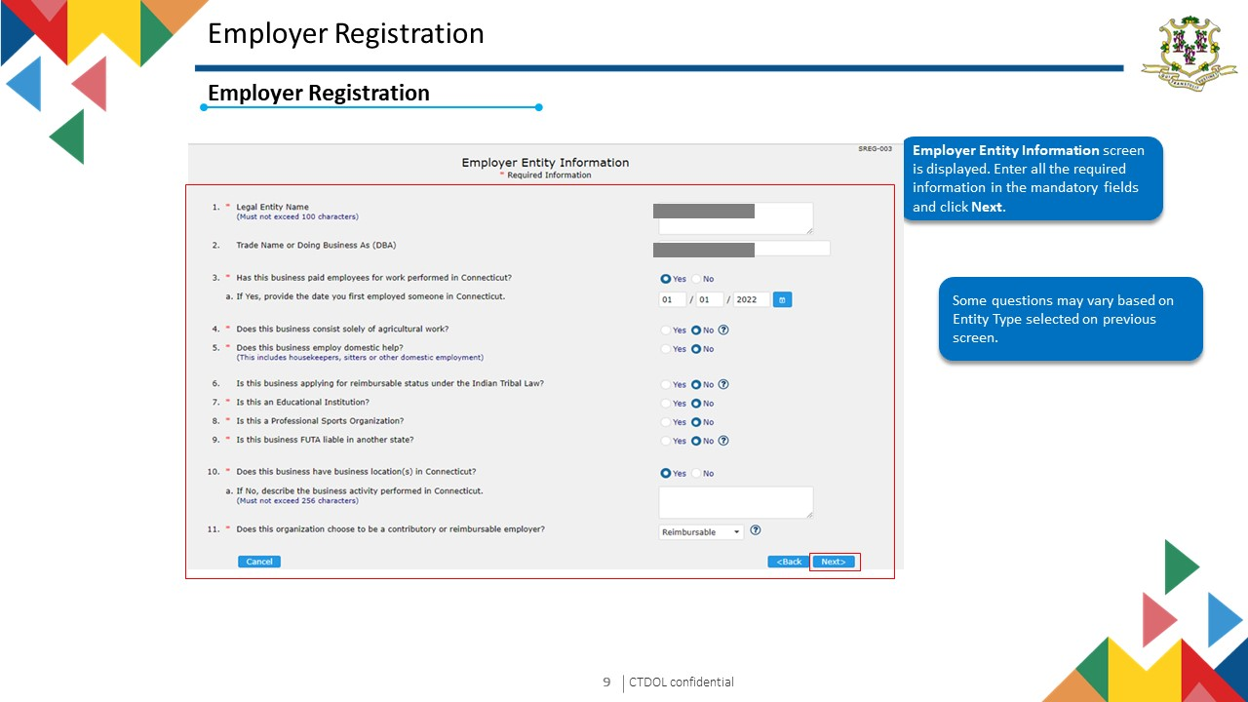
I
CTDOL confidential
12
Notes:
Notes for Trainer
Topic Name: Employer Registration
Sub Topic Name: Employer Registration – Scenario
In-Session Activities / Explanations:
Time: 5 mins
Instructor Notes:
Read the scenario and explain to the learners that if a new employer to the state of Connecticut (CT) starts or acquires a business with Connecticut workers, that employer is required to register the business to pay unemployment insurance taxes.
The registration process helps to determine if the employer meets certain criteria as defined by CT laws.

Slide 13
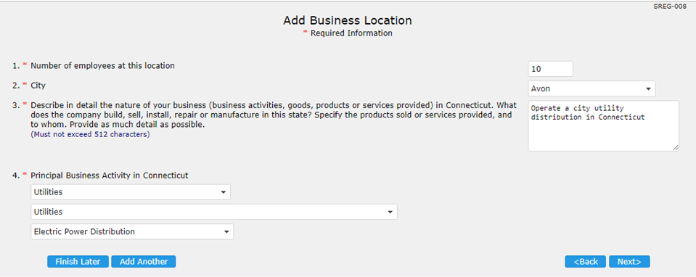
Employer Registration
Employer Registration
Add Business Location screen is displayed. Enter the required information in the mandatory fields. After entering all the required information, click Next.
Finish Later will save data and allow user to complete registration within 30 days of starting application.
I
CTDOL confidential
13
Notes:
Notes for Trainer
Topic Name: Employer Registration
Sub Topic Name: Employer Registration – Scenario
In-Session Activities / Explanations:
Time: 5 mins
Instructor Notes:
Read the scenario and explain to the learners that if a new employer to the state of Connecticut (CT) starts or acquires a business with Connecticut workers, that employer is required to register the business to pay unemployment insurance taxes.
The registration process helps to determine if the employer meets certain criteria as defined by CT laws.

Slide 14
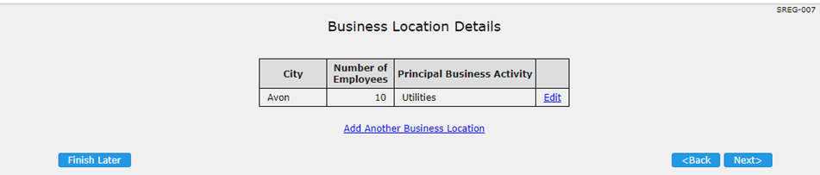
Employer Registration
Employer Registration
Business Location Details screen is displayed. To add another business location, click the Add Another Business Location link. The Add Business Location screen will be displayed.
Click Next.
Notes:
Notes for Trainer
Topic Name: Employer Registration
Sub Topic Name: Employer Registration – Scenario
In-Session Activities / Explanations:
Time: 5 mins
Instructor Notes:
Read the scenario and explain to the learners that if a new employer to the state of Connecticut (CT) starts or acquires a business with Connecticut workers, that employer is required to register the business to pay unemployment insurance taxes.
The registration process helps to determine if the employer meets certain criteria as defined by CT laws.

Slide 15
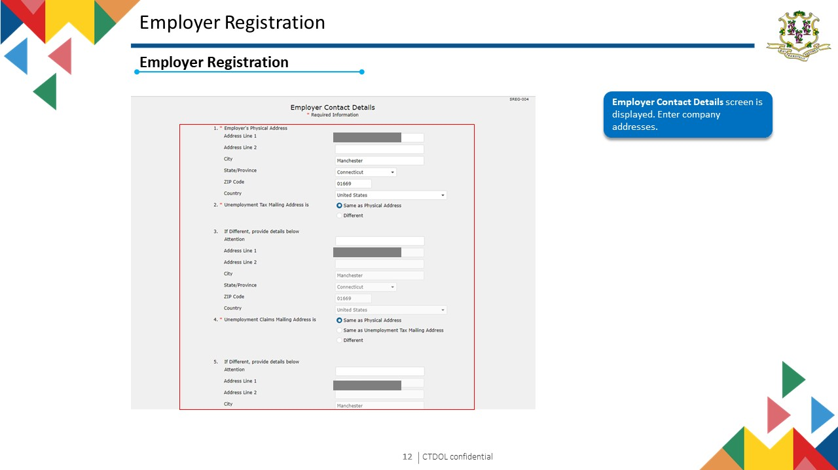
I
CTDOL confidential
15
Notes:
Notes for Trainer
Topic Name: Employer Registration
Sub Topic Name: Employer Registration – Scenario
In-Session Activities / Explanations:
Time: 5 mins
Instructor Notes:
Read the scenario and explain to the learners that if a new employer to the state of Connecticut (CT) starts or acquires a business with Connecticut workers, that employer is required to register the business to pay unemployment insurance taxes.
The registration process helps to determine if the employer meets certain criteria as defined by CT laws.

Slide 16
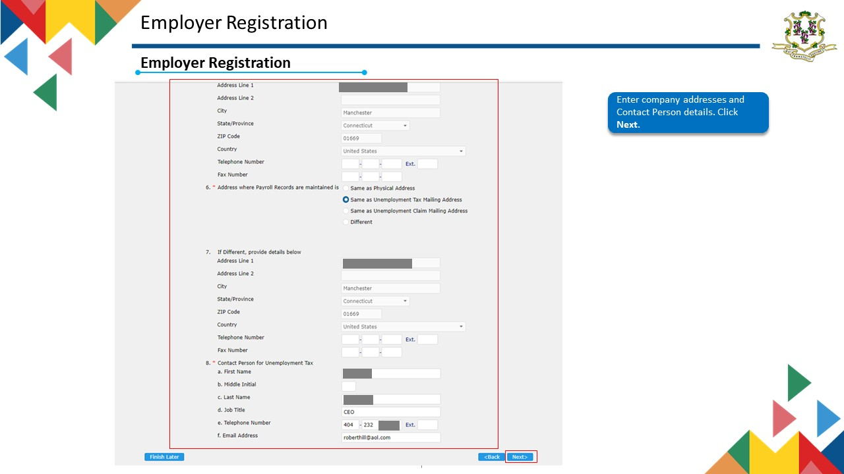
Notes:
Notes for Trainer
Topic Name: Employer Registration
Sub Topic Name: Employer Registration – Scenario
In-Session Activities / Explanations:
Time: 5 mins
Instructor Notes:
Read the scenario and explain to the learners that if a new employer to the state of Connecticut (CT) starts or acquires a business with Connecticut workers, that employer is required to register the business to pay unemployment insurance taxes.
The registration process helps to determine if the employer meets certain criteria as defined by CT laws.

Slide 17
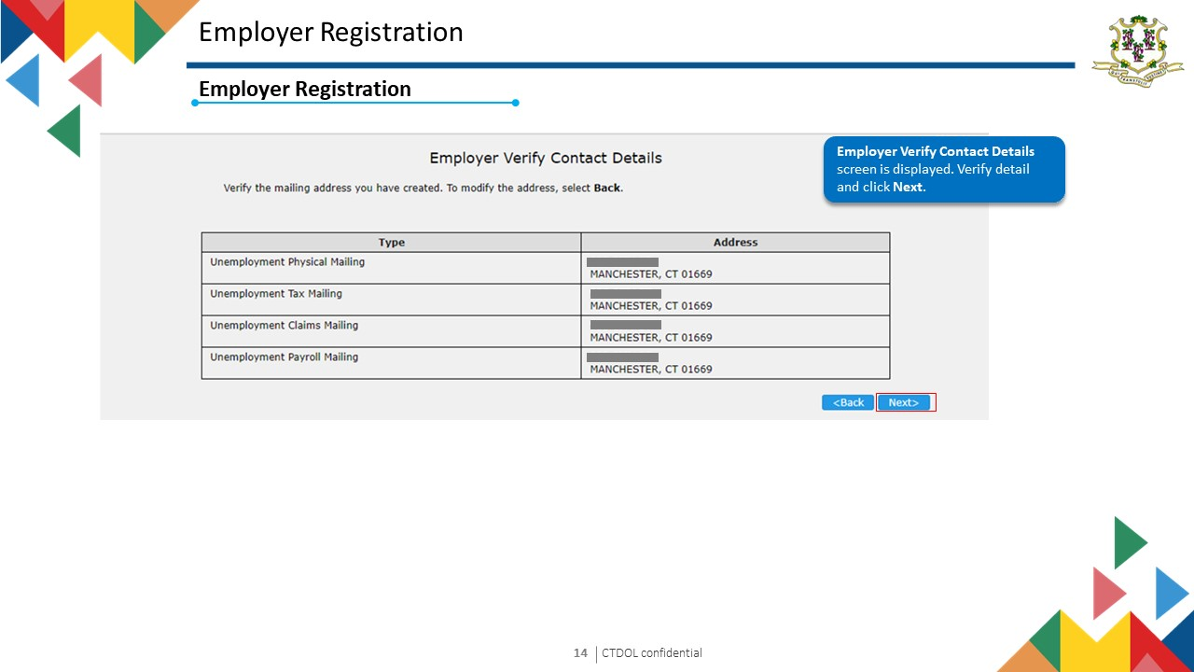
I
CTDOL confidential
17
Notes:
Notes for Trainer
Topic Name: Employer Registration
Sub Topic Name: Employer Registration – Scenario
In-Session Activities / Explanations:
Time: 5 mins
Instructor Notes:
Read the scenario and explain to the learners that if a new employer to the state of Connecticut (CT) starts or acquires a business with Connecticut workers, that employer is required to register the business to pay unemployment insurance taxes.
The registration process helps to determine if the employer meets certain criteria as defined by CT laws.

Slide 18
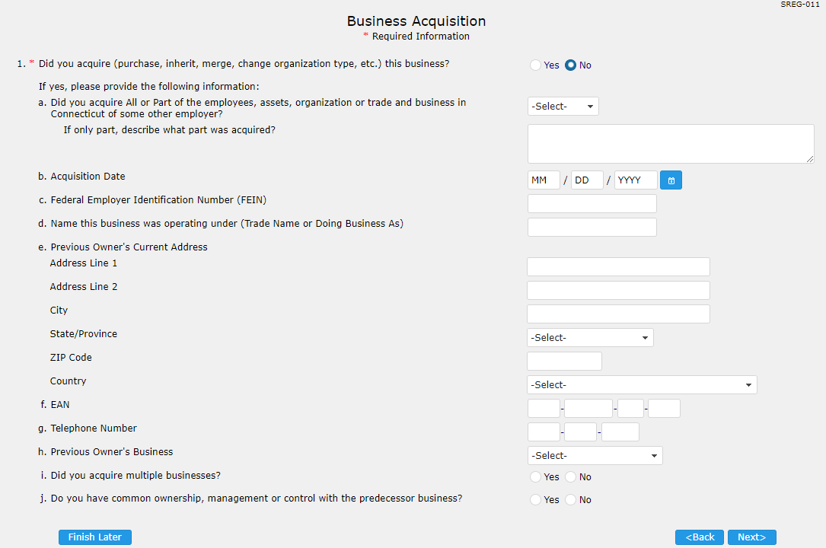
Employer Registration
Employer Registration
Business Acquisition screen is displayed. Select Yes/No response to the question Did you acquire (purchase, inherit, merge, change organization type, etc.) this business? and click the Next.
If yes is selected, responses are required for a-j.
Notes:
Notes for Trainer
Topic Name: Employer Registration
Sub Topic Name: Employer Registration – Scenario
In-Session Activities / Explanations:
Time: 5 mins
Instructor Notes:
Read the scenario and explain to the learners that if a new employer to the state of Connecticut (CT) starts or acquires a business with Connecticut workers, that employer is required to register the business to pay unemployment insurance taxes.
The registration process helps to determine if the employer meets certain criteria as defined by CT laws.

Slide 19
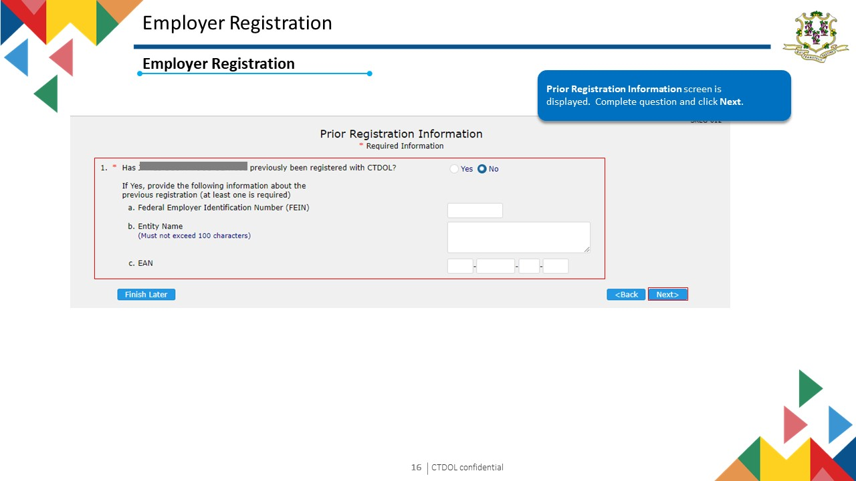
I
CTDOL confidential
19
Notes:
Notes for Trainer
Topic Name: Employer Registration
Sub Topic Name: Employer Registration – Scenario
In-Session Activities / Explanations:
Time: 5 mins
Instructor Notes:
Read the scenario and explain to the learners that if a new employer to the state of Connecticut (CT) starts or acquires a business with Connecticut workers, that employer is required to register the business to pay unemployment insurance taxes.
The registration process helps to determine if the employer meets certain criteria as defined by CT laws.

Slide 20
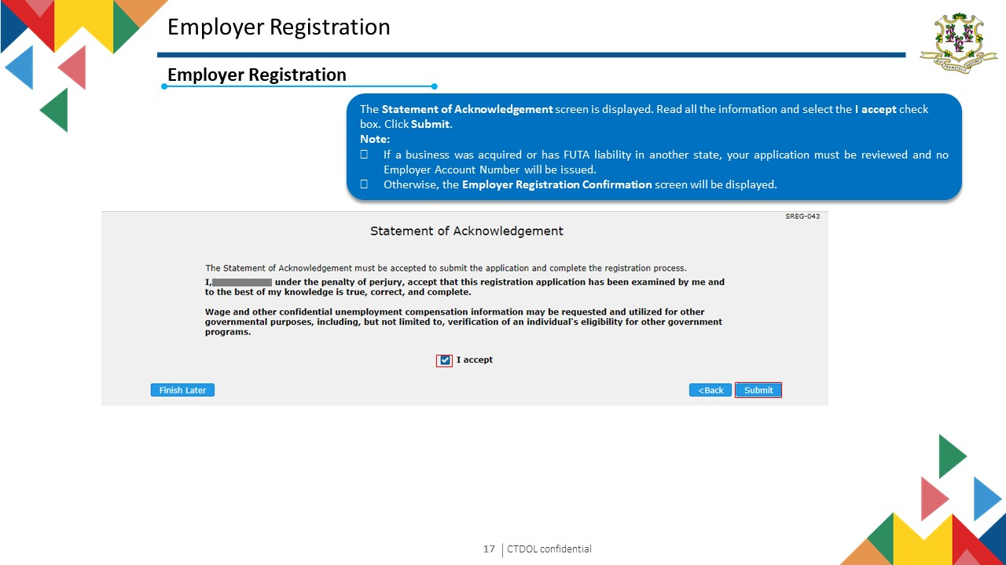
I
CTDOL confidential
20
Notes:
Notes for Trainer
Topic Name: Employer Registration
Sub Topic Name: Employer Registration – Scenario
In-Session Activities / Explanations:
Time: 5 mins
Instructor Notes:
Read the scenario and explain to the learners that if a new employer to the state of Connecticut (CT) starts or acquires a business with Connecticut workers, that employer is required to register the business to pay unemployment insurance taxes.
The registration process helps to determine if the employer meets certain criteria as defined by CT laws.

Slide 21
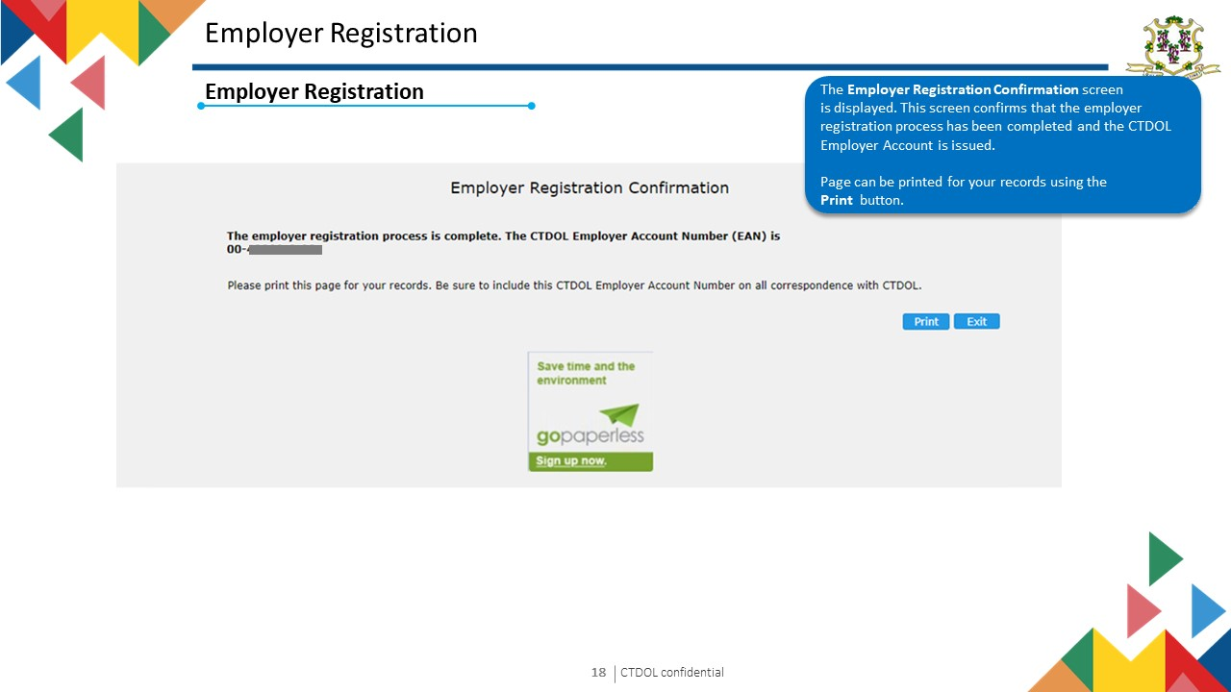
I
CTDOL confidential
21
Notes:
Notes for Trainer
Topic Name: Employer Registration
Sub Topic Name: Employer Registration – Scenario
In-Session Activities / Explanations:
Time: 5 mins
Instructor Notes:
Read the scenario and explain to the learners that if a new employer to the state of Connecticut (CT) starts or acquires a business with Connecticut workers, that employer is required to register the business to pay unemployment insurance taxes.
The registration process helps to determine if the employer meets certain criteria as defined by CT laws.

Slide 22
Employer User Guide
3. File Tax and Wage Report
Text 03

Slide 23
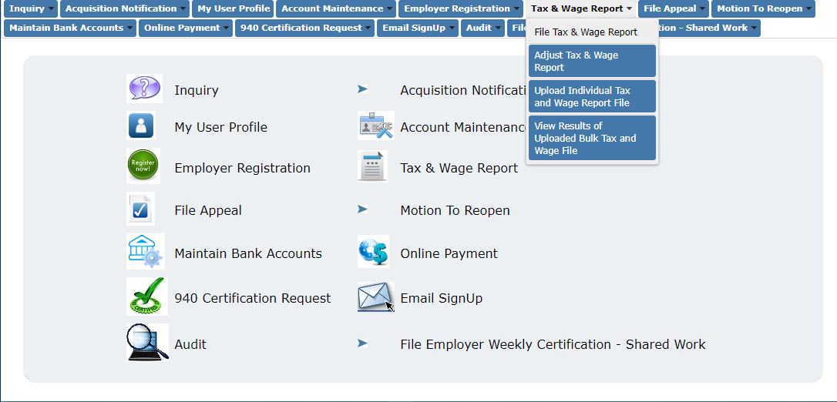
Tax Wage Reports
File Tax and Wage Report
Select Tax & Wage Report then File Tax & Wage Report.
I
CTDOL confidential
23
Notes:
Notes for Trainer
Topic Name: Tax Wage Reports
Subtopic: File Tax and Wage Report – Scenario
In-Session Activities / Explanations:
Time: 5 mins
Instructor Notes:
Read the scenario and explain the learners that the CSR will file a tax wage report on behalf of the employer for a specific quarter/year with the option to manually enter the wages using method A or method B, by uploading an electronic file.

Slide 24
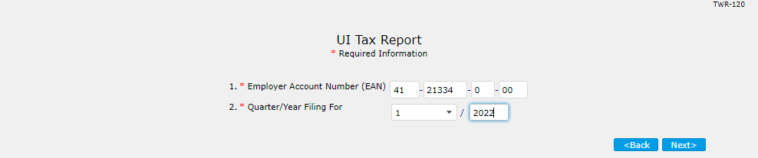
File Tax & Wage Report
The UI Tax Report screen displays. Select mandatory dropdown field from Quarter/Year Filing For and click the Next button.

Slide 25
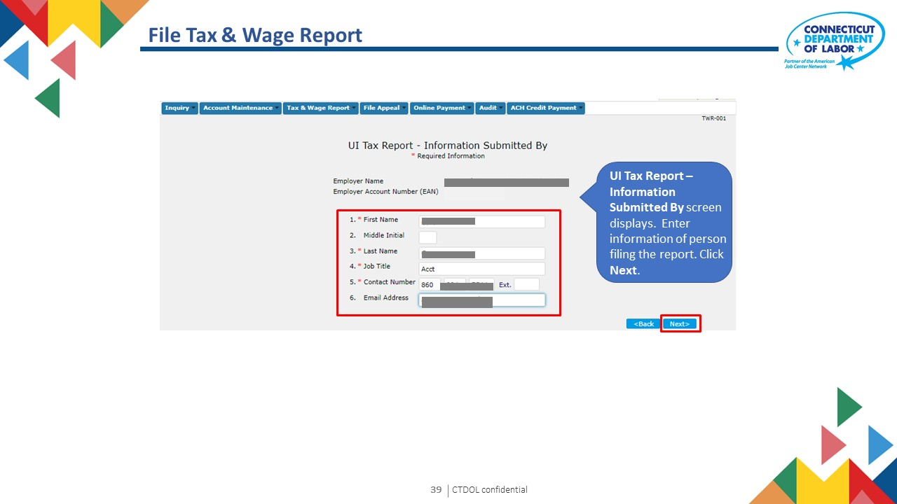
I
CTDOL confidential
25

Slide 26
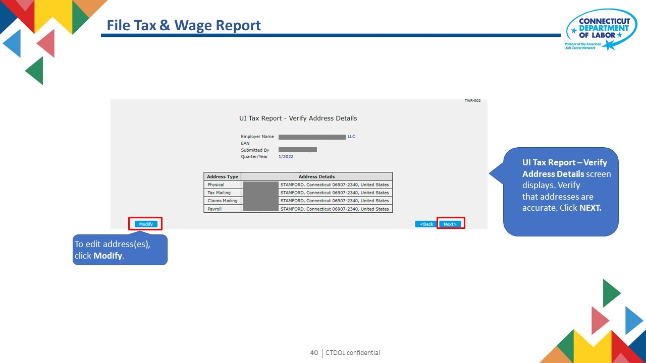
I
CTDOL confidential
26

Slide 27
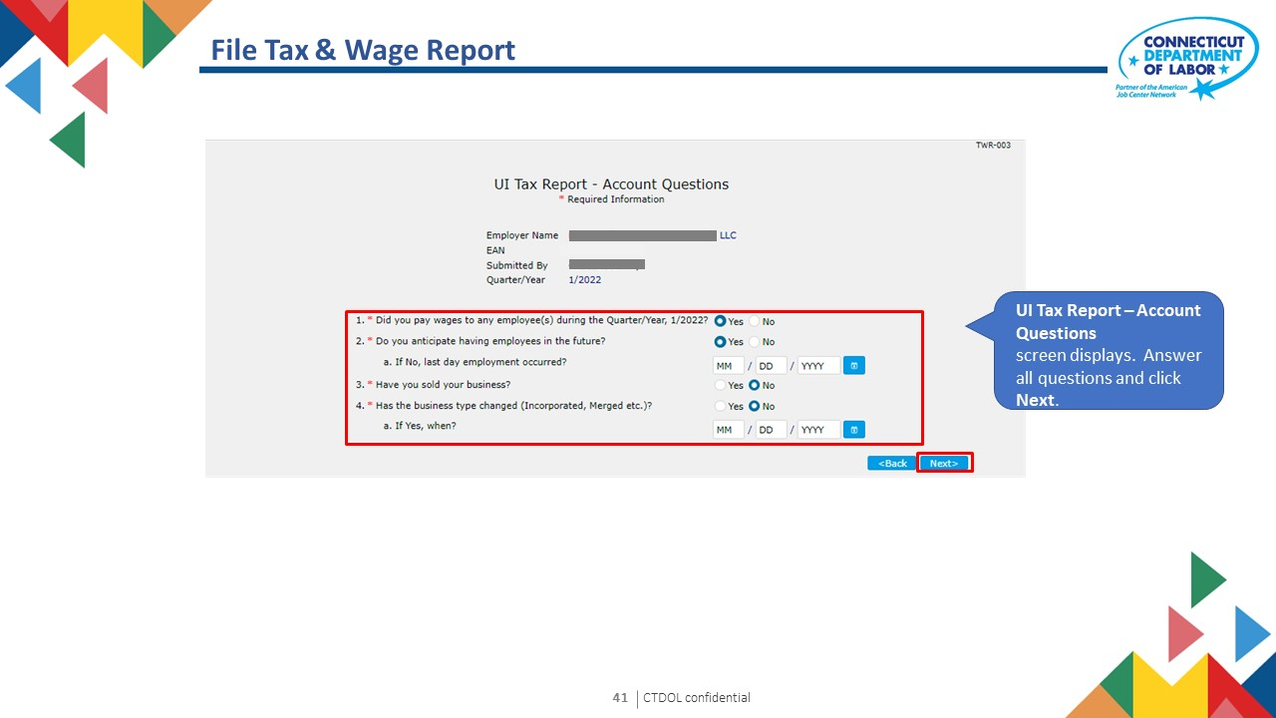
I
CTDOL confidential
27

Slide 28
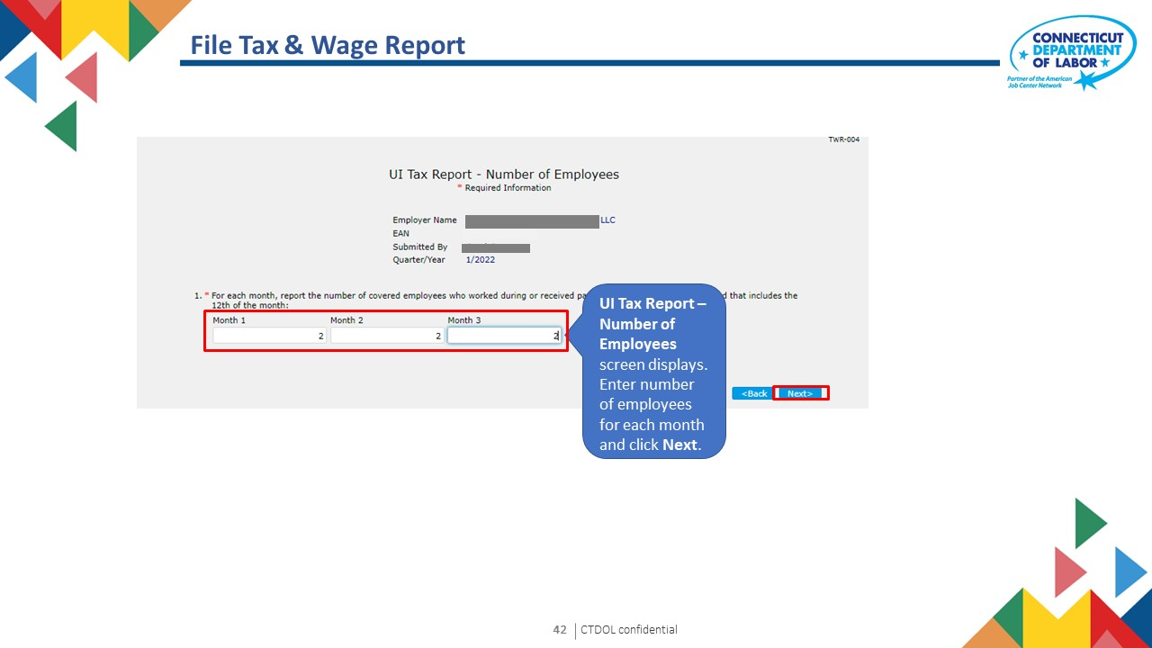
I
CTDOL confidential
28

Slide 29
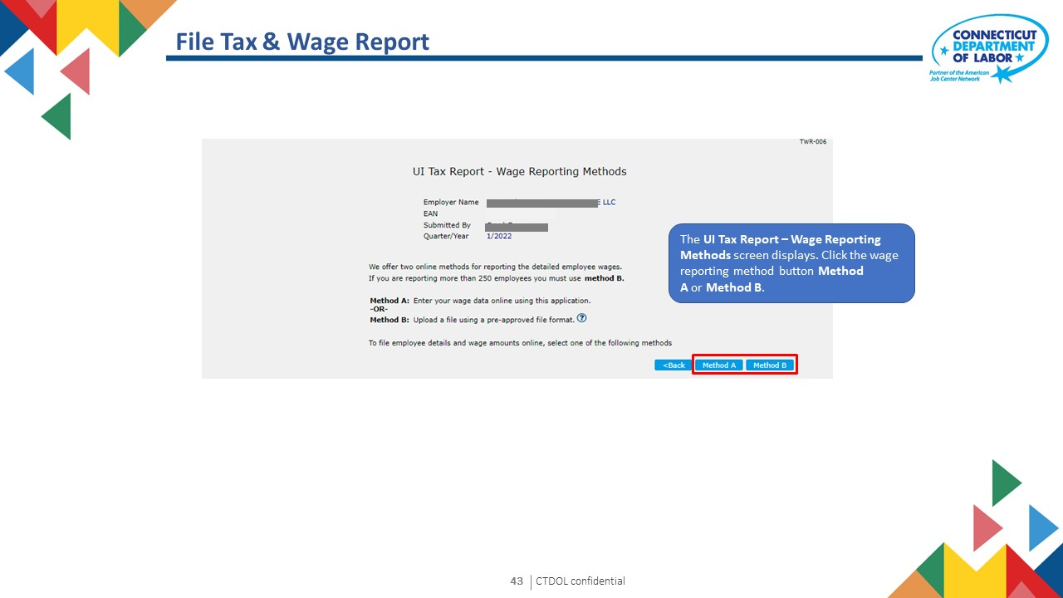
I
CTDOL confidential
29

Slide 30
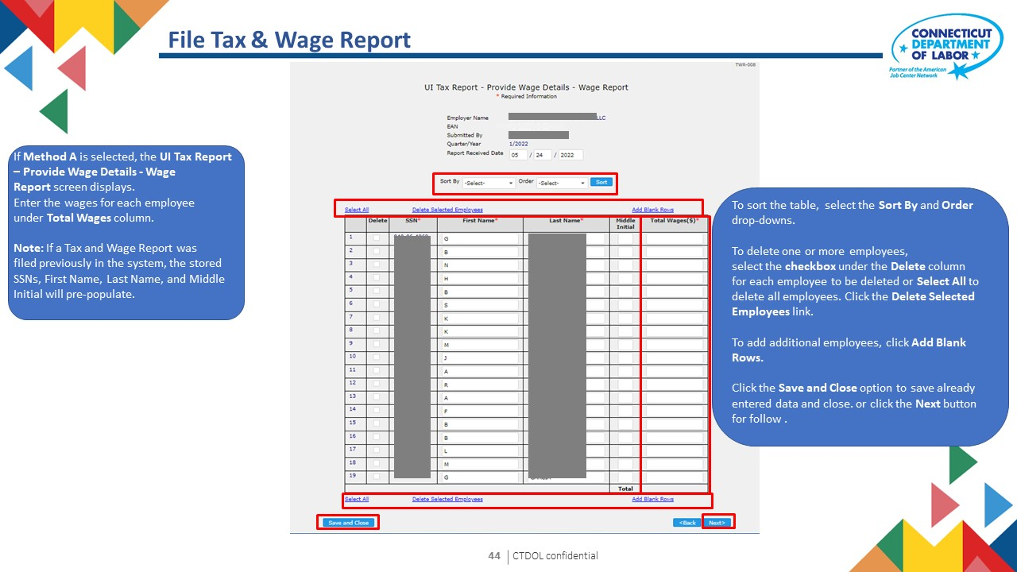
I
CTDOL confidential
30

Slide 31
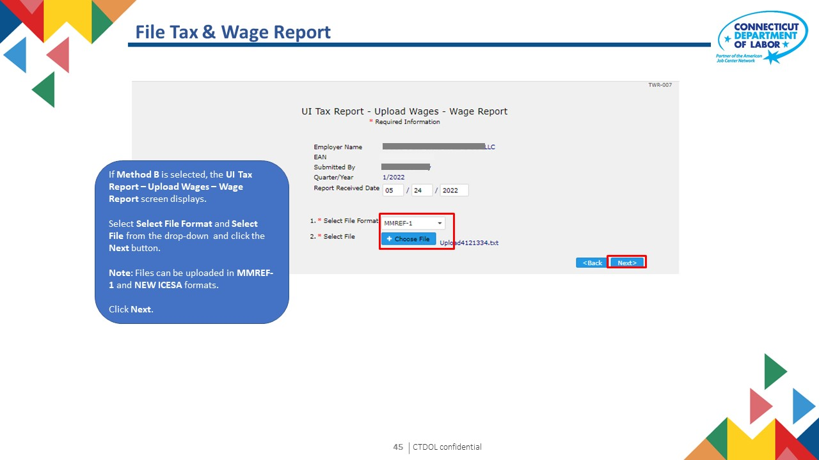
I
CTDOL confidential
31

Slide 32
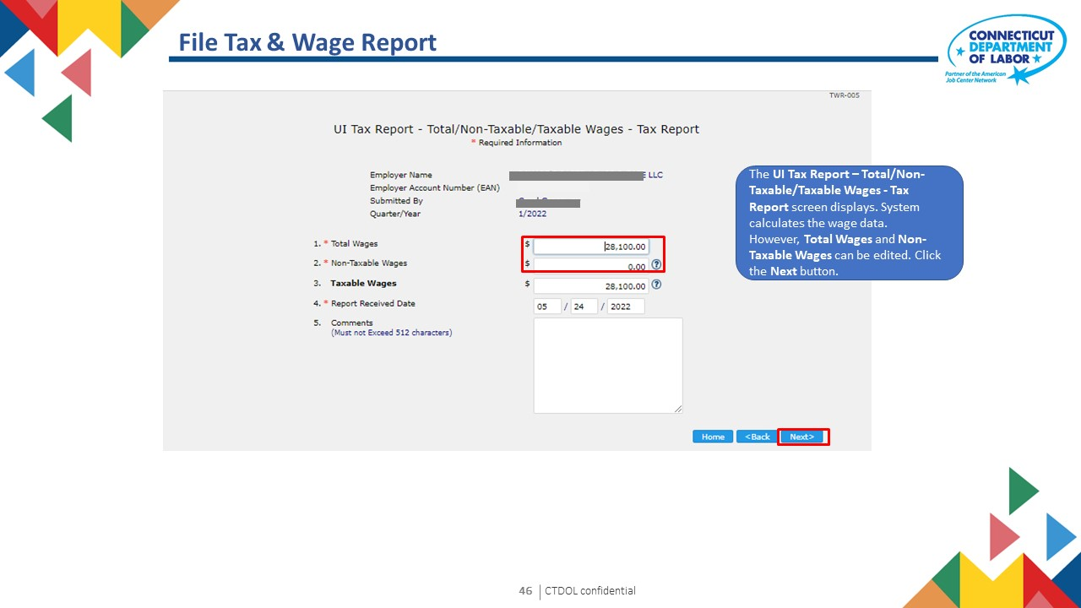
I
CTDOL confidential
32

Slide 33
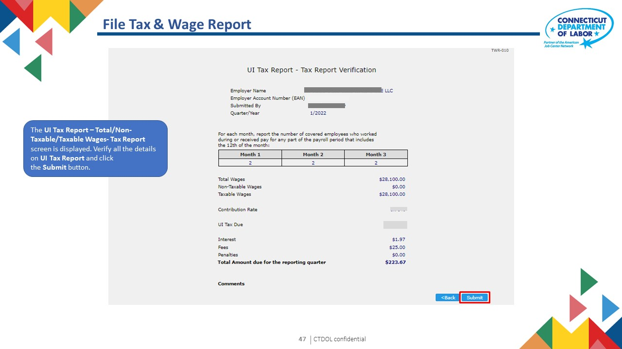
I
CTDOL confidential
33

Slide 34
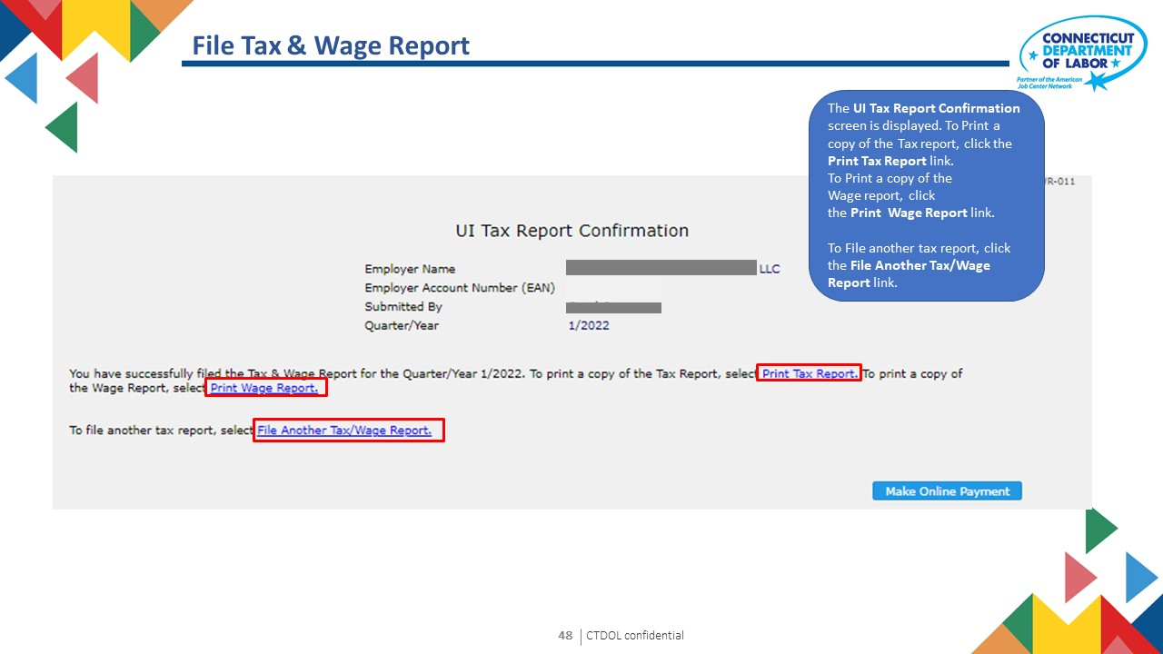
I
CTDOL confidential
34

Slide 35

Employer User Guide
v
4. Adjust Tax & Wage Report
I
CTDOL confidential
35
Notes:
Notes for Trainer
Topic Name: Tax wage Reports
Subtopic: File Tax and Wage Report
In-Session Activities / Explanations:
Time: 1 Hour 30 Minutes
Instructor Notes:
Demonstrate the system simulation of filing tax and wage reports to the learners.
Ask learners to perform these steps in the system, once the demonstration is complete.

Slide 36
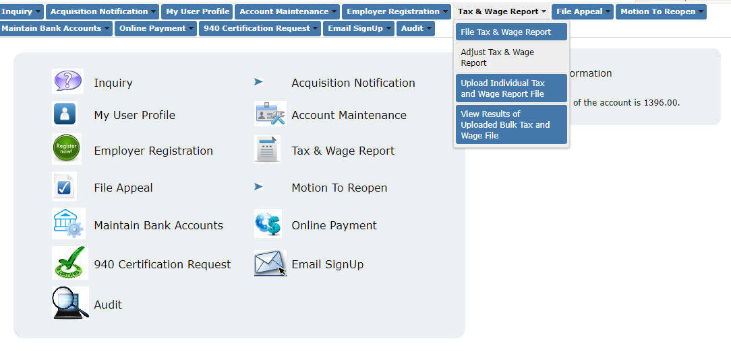
Tax Wage Reports
File Tax and Wage Report – Scenario
Select Tax and Wage Report
then Adjust Tax and Wage Report
I
CTDOL confidential
36
Notes:
Notes for Trainer
Topic Name: Tax Wage Reports
Subtopic: File Tax and Wage Report – Scenario
In-Session Activities / Explanations:
Time: 5 mins
Instructor Notes:
Read the scenario and explain the learners that the CSR will file a tax wage report on behalf of the employer for a specific quarter/year with the option to manually enter the wages using method A or method B, by uploading an electronic file.

Slide 37
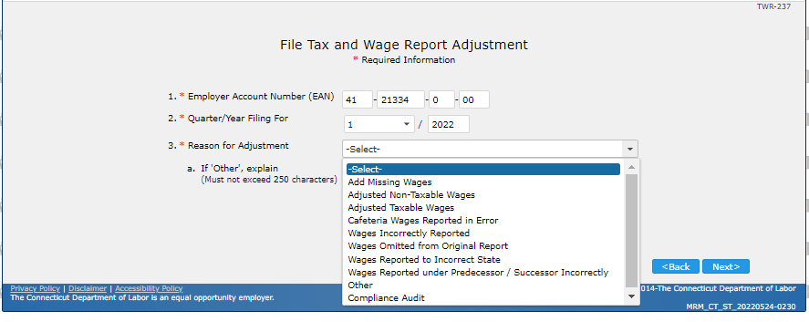
Adjust Tax & Wage Report
The File Tax and Wage Report Adjustment screen is displayed. Enter the information in the mandatory fields click the Next button.
I
CTDOL confidential
37

Slide 38
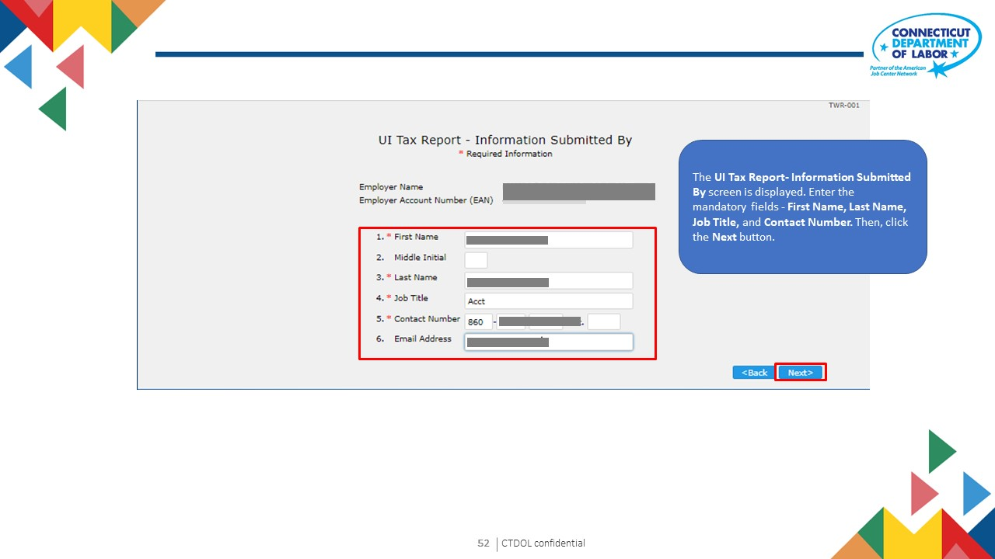
I
CTDOL confidential
38

Slide 39
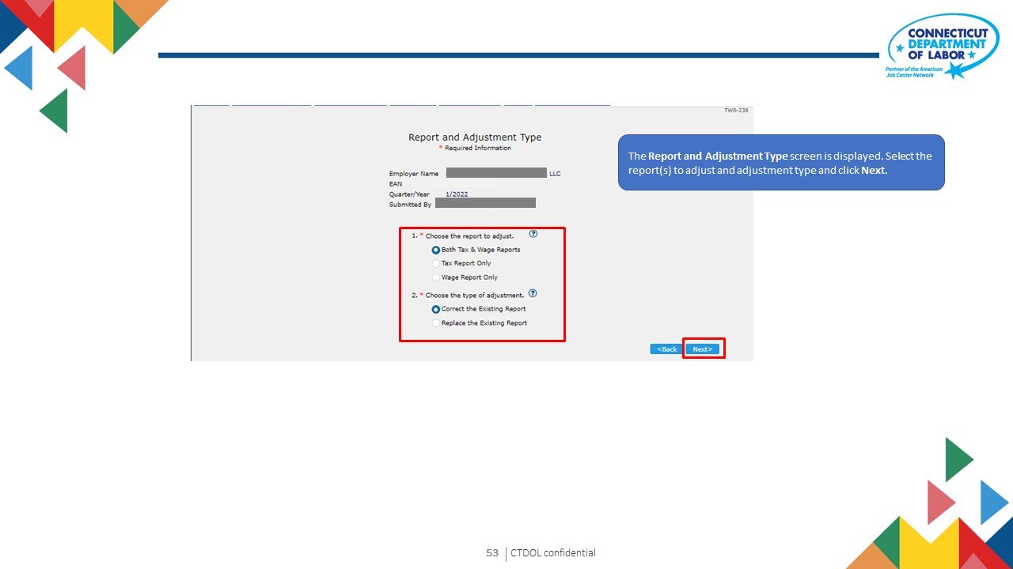
I
CTDOL confidential
39

Slide 40
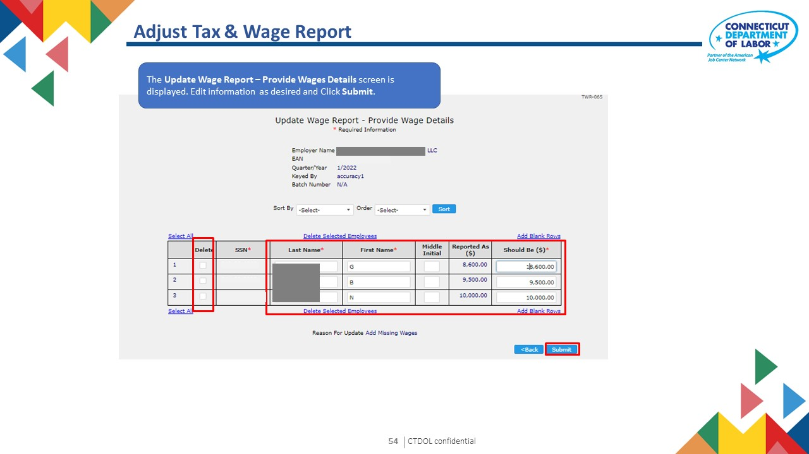
I
CTDOL confidential
40

Slide 41

Adjust Tax & Wage Report
The Wage Report Confirmation screen is displayed. This screen confirms that the wage report has been successfully corrected. Click Next.
I
CTDOL confidential
41

Slide 42
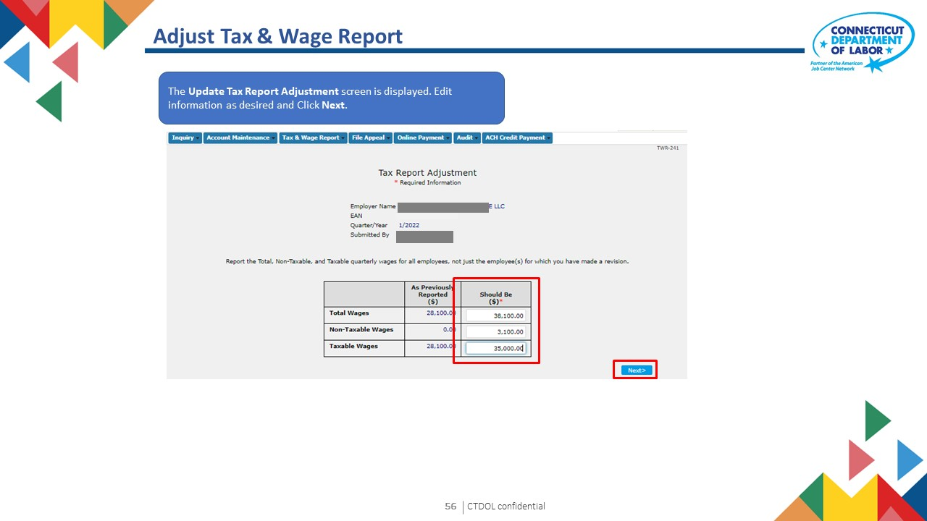
I
CTDOL confidential
42

Slide 43
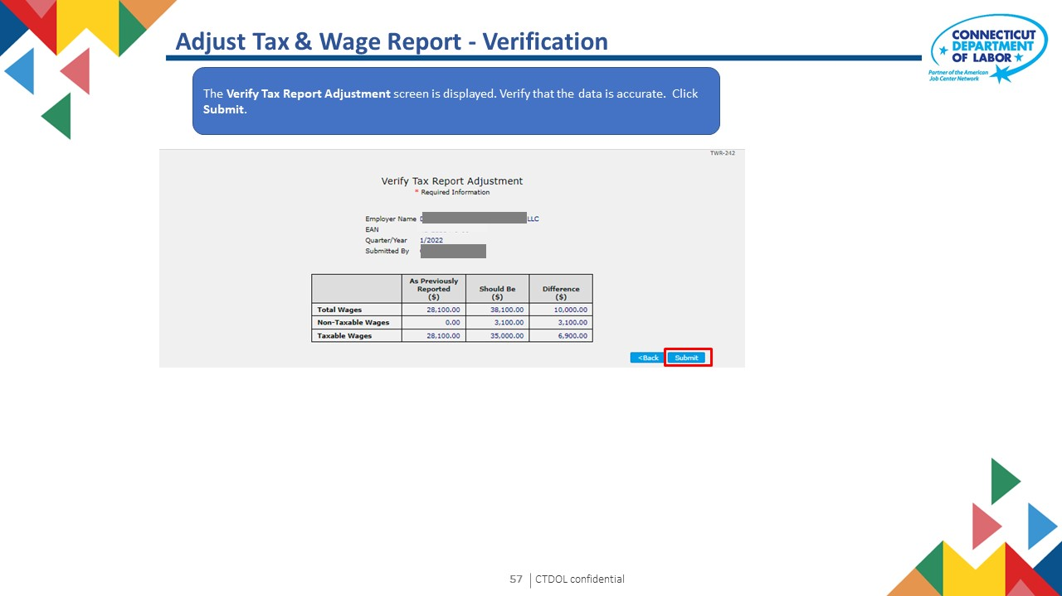
I
CTDOL confidential
43

Slide 44
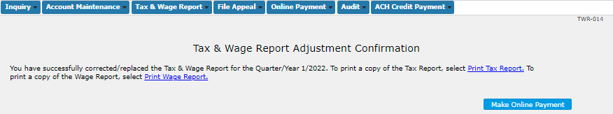
Adjust Tax & Wage Report - Confirmation
The Tax & Wage Report Adjustment Confirmation screen is displayed. This screen confirms that the Tax and Wage Report has been successfully corrected. Click Next.
To Print a copy of the Tax Report, click the Print Tax Report link.
To Print a copy of the Wage Report, click the Print Wage Report link.
To make an Online Payment, click Make Online Payment.
I
CTDOL confidential
44

Slide 45
Employer User Guide
5. Upload Tax and Wage Report File
Text 03

Slide 46
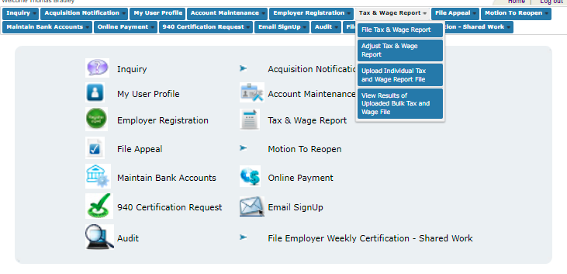
Upload Tax & Wage Report File
Select Tax & Wage Report then Upload Individual Tax and Wage Report File

Slide 47
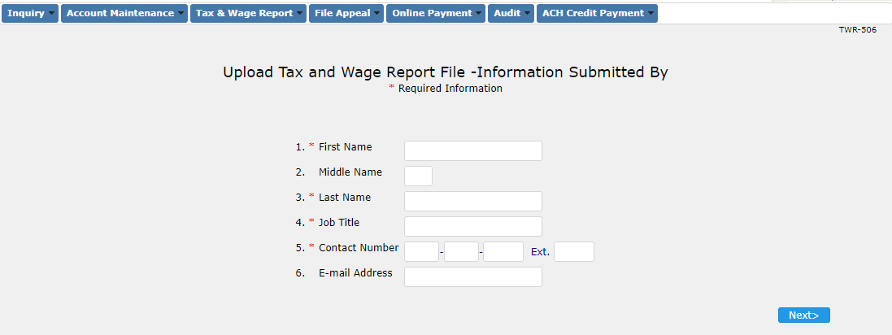
Upload Tax & Wage Report File
The user enters information of the person submitting the file and click Next.

Slide 48
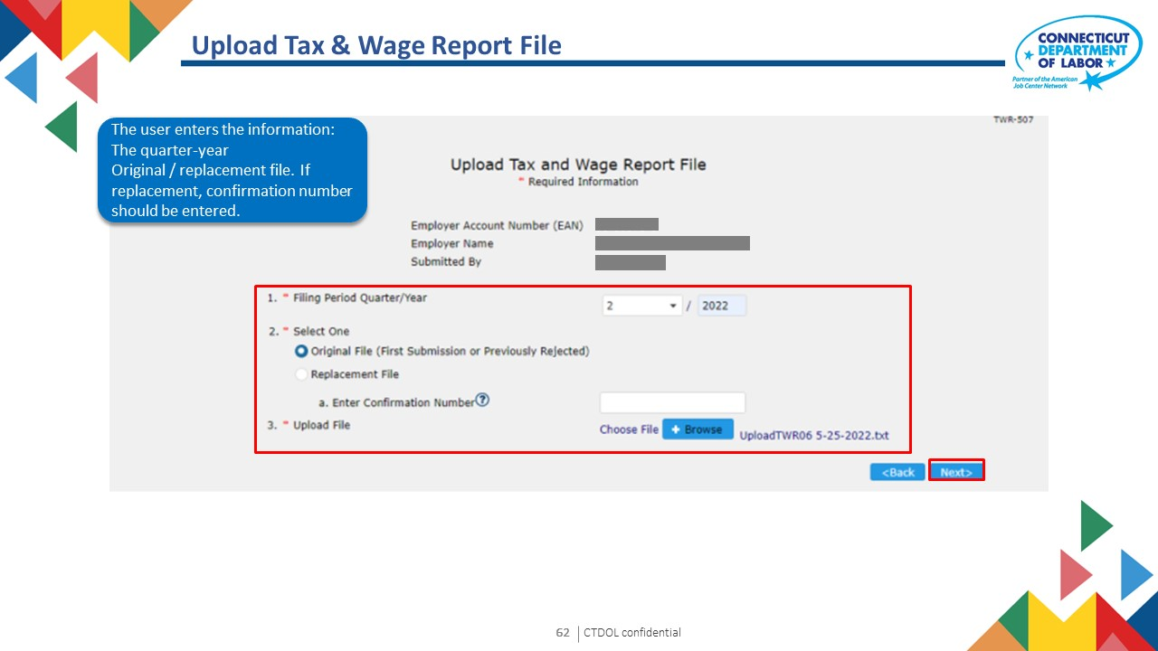
I
CTDOL confidential
48

Slide 49
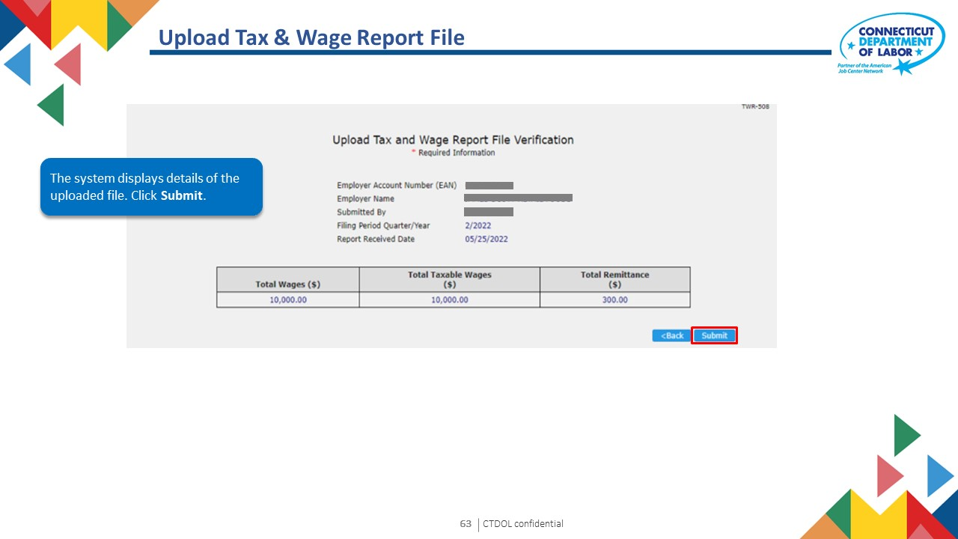
I
CTDOL confidential
49

Slide 50
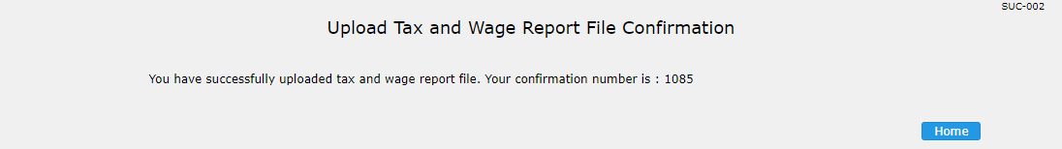
Upload Tax & Wage Report File
The file is submitted and a confirmation number is generated. The confirmation number can be used to make a online payment or resubmit the tax and wage report file.
I
CTDOL confidential
50

Slide 51
Employer User Guide
6. Make Online Payment
Text 03
I
CTDOL confidential
51

Slide 52
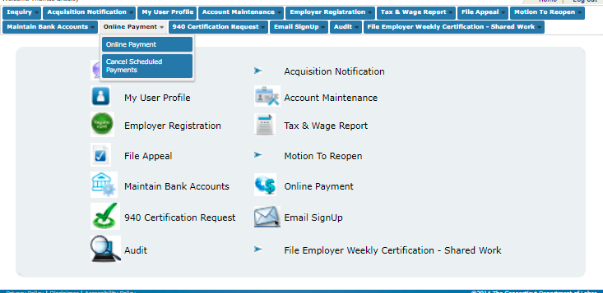
Make Online Payment
Click Online Payment

Slide 53
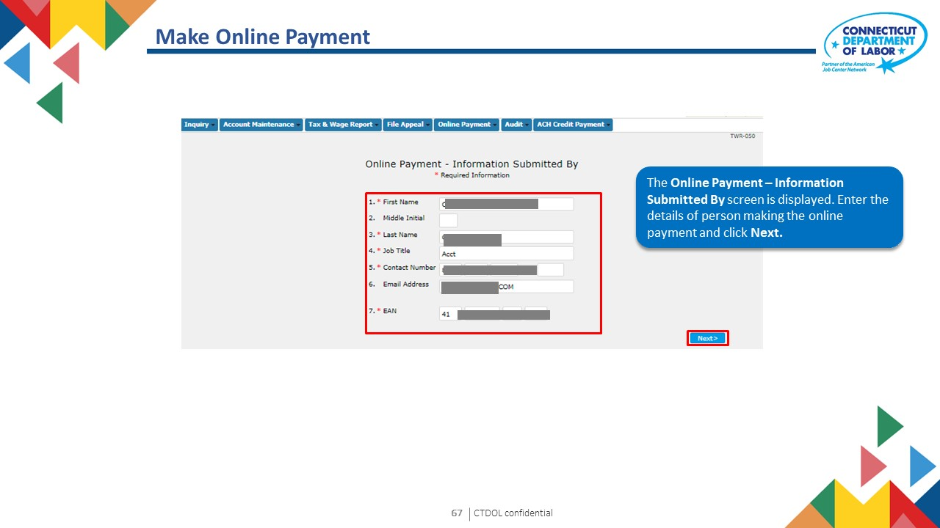
I
CTDOL confidential
53

Slide 54
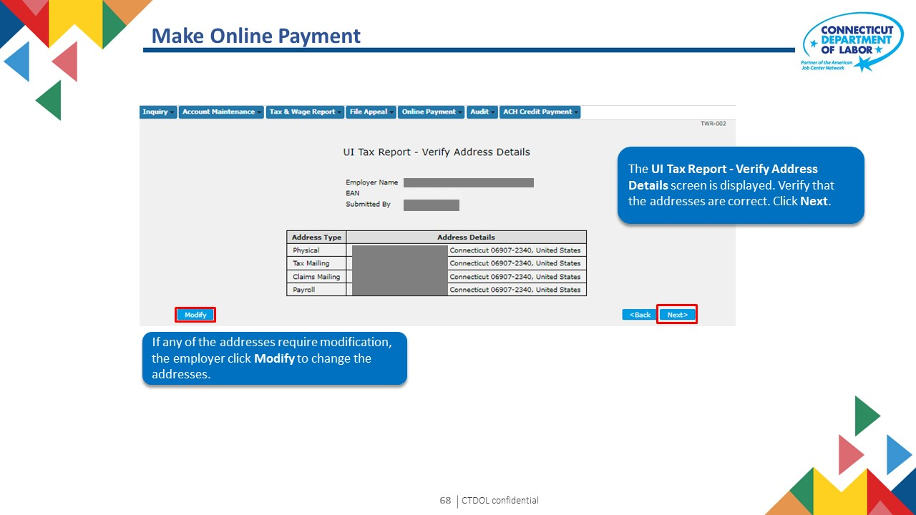
I
CTDOL confidential
54

Slide 55
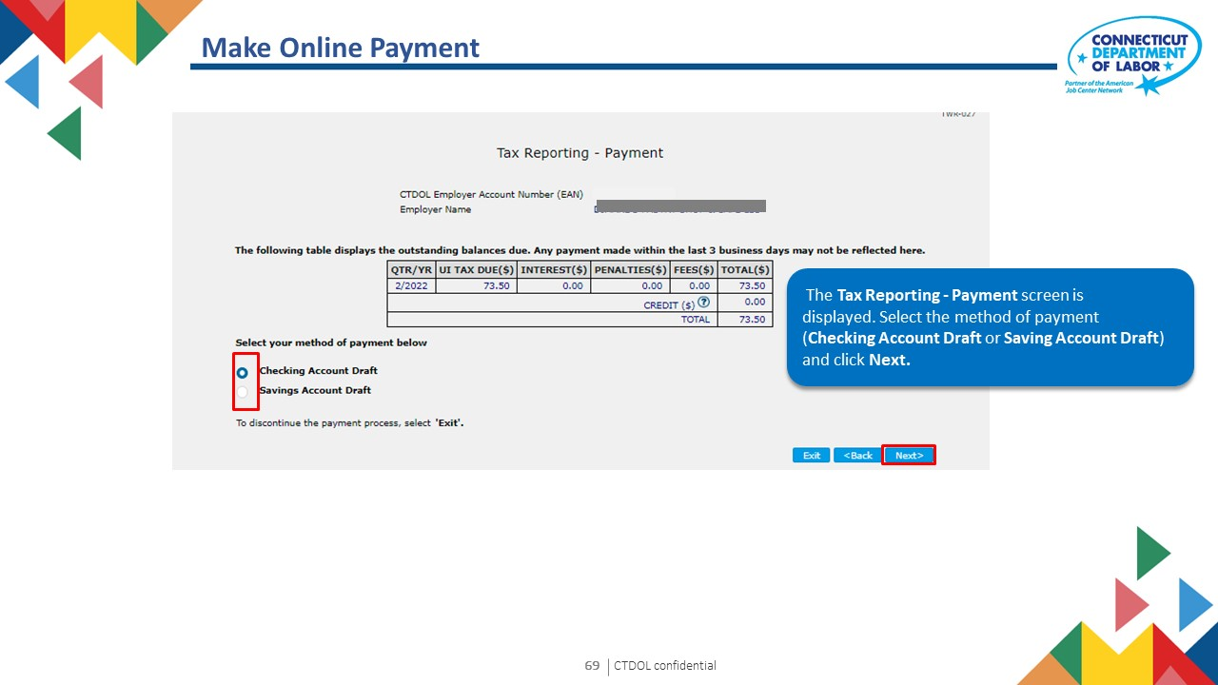
I
CTDOL confidential
55

Slide 56
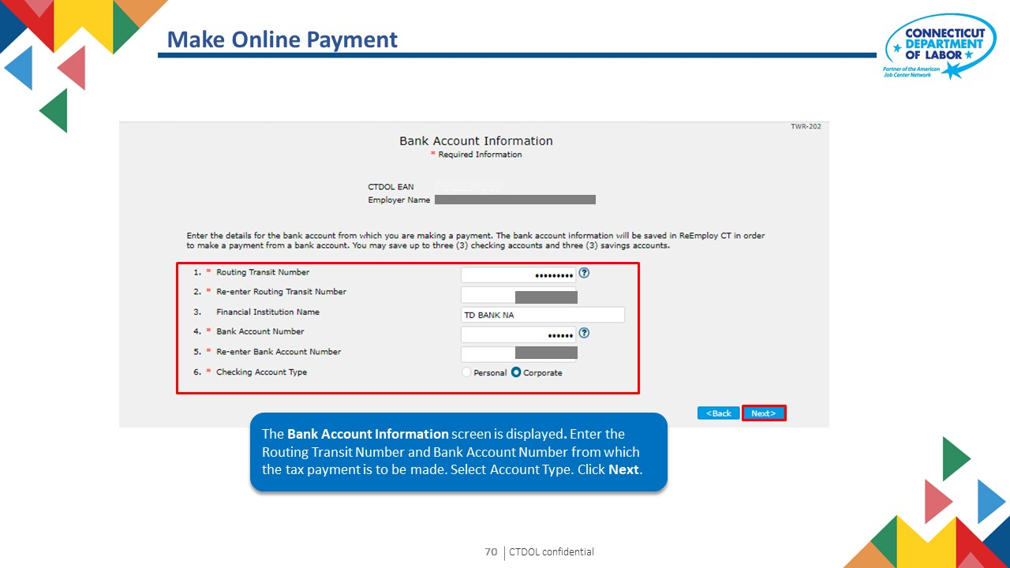
I
CTDOL confidential
56

Slide 57
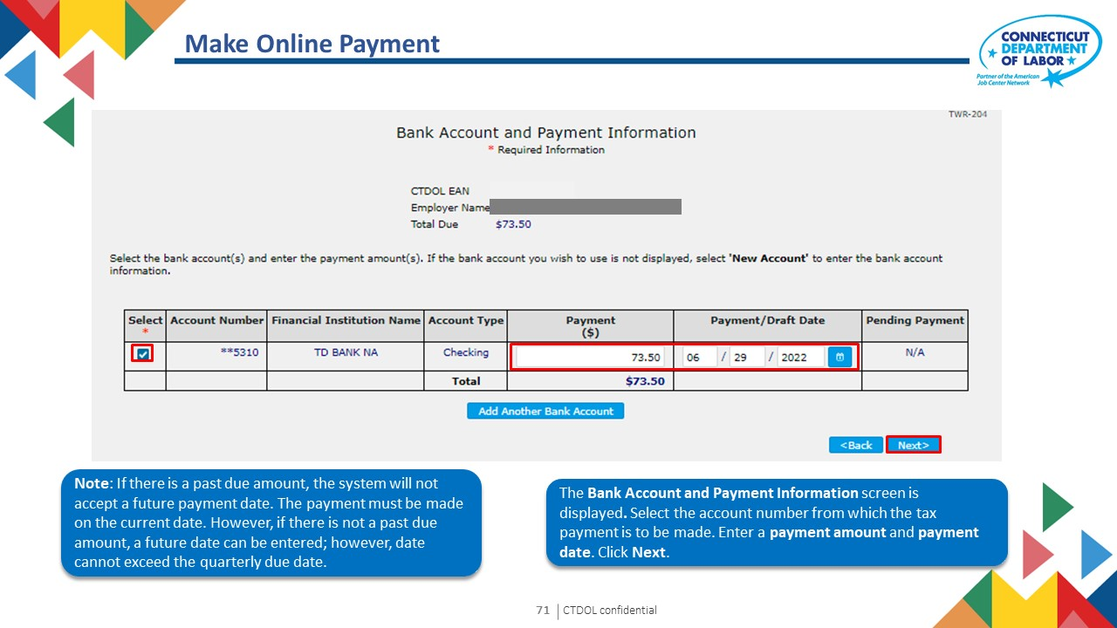
I
CTDOL confidential
57

Slide 58
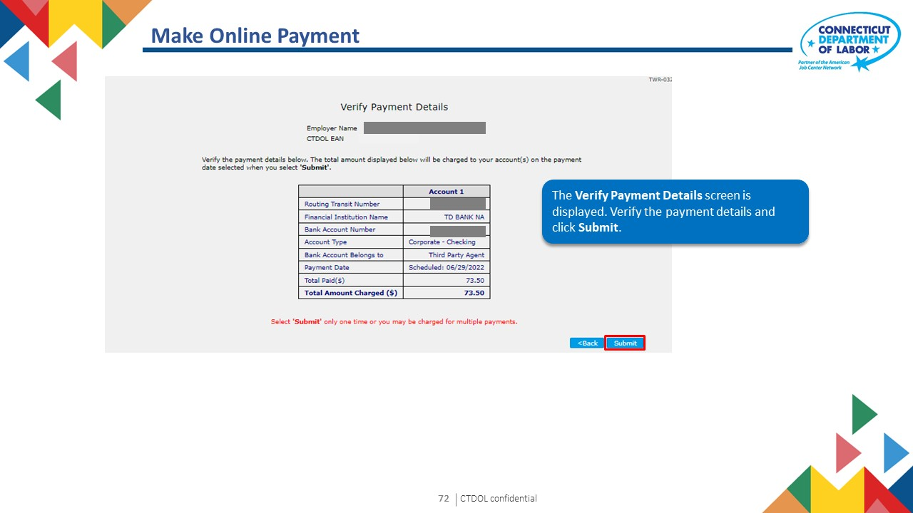
I
CTDOL confidential
58

Slide 59
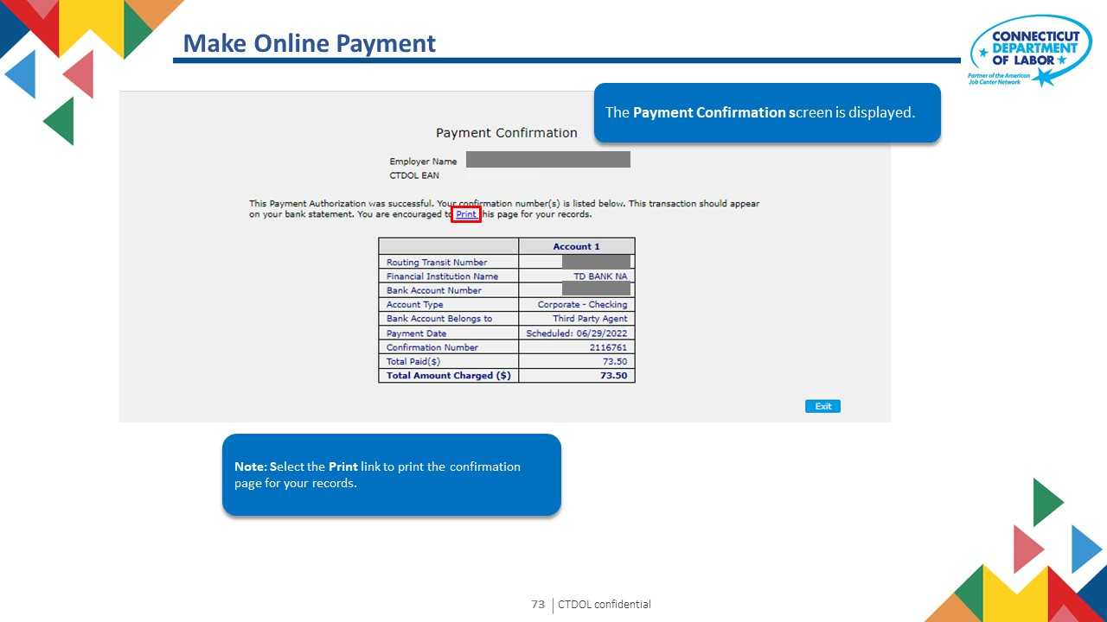
I
CTDOL confidential
59

Slide 60
Employer User Guide
v
7. Cancel Scheduled Payment
I
CTDOL confidential
60
Notes:
Notes for Trainer
Topic Name: Tax wage Reports
Subtopic: File Tax and Wage Report
In-Session Activities / Explanations:
Time: 1 Hour 30 Minutes
Instructor Notes:
Demonstrate the system simulation of filing tax and wage reports to the learners.
Ask learners to perform these steps in the system, once the demonstration is complete.

Slide 61
Cancel Scheduled Payment
Click Cancel Scheduled Payments
I
CTDOL confidential
61

Slide 62
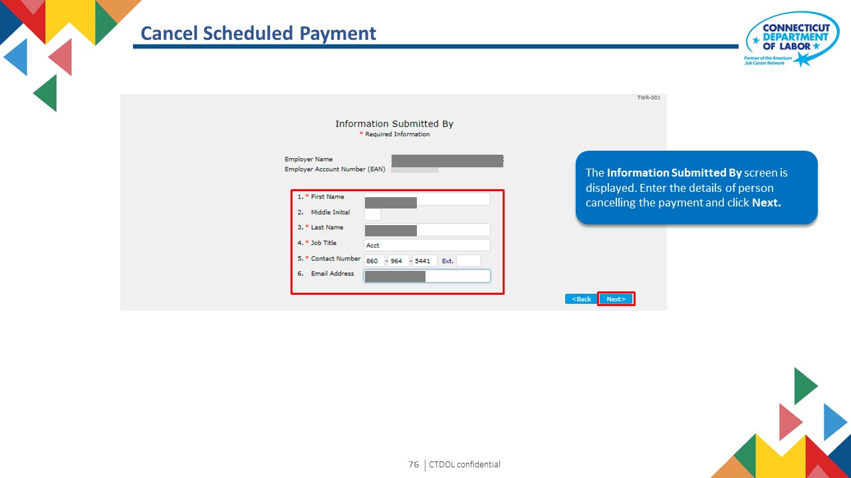
I
CTDOL confidential
62

Slide 63

I
CTDOL confidential
63

Slide 64

I
CTDOL confidential
64

Slide 65

I
CTDOL confidential
65

Slide 66
Employer User Guide
8. Acquisition Notification
Text 03
I
CTDOL confidential
66

Slide 67

Acquisition Notification
Click Acquisition Notification
I
CTDOL confidential
67

Slide 68

I
CTDOL confidential
68

Slide 69

I
CTDOL confidential
69

Slide 70

Acquisition Notification
Acquisition Notification Confirmation screen is displayed. Acquisition notification has been received successfully.
I
CTDOL confidential
70

Slide 71
Employer User Guide
9. Request to Close
Text 03
I
CTDOL confidential
71

Slide 72

Request to Close Account
From the home screen, select Account Maintenance tab then click the Request to Close Account option from the menu.
I
CTDOL confidential
72

Slide 73

I
CTDOL confidential
73

Slide 74

I
CTDOL confidential
74

Slide 75

I
CTDOL confidential
75

Slide 76

Request to Close Account
Enter the termination details. Click Next.
I
CTDOL confidential
76

Slide 77

I
CTDOL confidential
77

Slide 78

I
CTDOL confidential
I
78
CTDOL confidential
78

Slide 79

Request to Close Account - Confirmation
The Request to Close Account Confirmation screen is displayed.

Slide 80
Employer User Guide
10. Maintain Address
Text 03

Slide 81

Maintain Address
Select Account Maintenance then Maintain Address.

Slide 82

Maintain Address
The Maintain Address screen is displayed. Enter EAN and click Next.

Slide 83

I
CTDOL confidential
83

Slide 84

I
CTDOL confidential
84

Slide 85

Maintain Address - Confirmation
The Employer Contact Maintenance Confirmation screen is displayed.

Slide 86
Employer User Guide
11. My User Profile
Text 03

Slide 87

My User Profile
Select My User Profile to edit user information or add new user to account.

Slide 88

I
CTDOL confidential
88

Slide 89

I
CTDOL confidential
89

Slide 90

I
CTDOL confidential
90

Slide 91
Employer User Guide
v
12. Email SignUp
I
CTDOL confidential
91
Notes:
Notes for Trainer
Topic Name: Tax wage Reports
Subtopic: File Tax and Wage Report
In-Session Activities / Explanations:
Time: 1 Hour 30 Minutes
Instructor Notes:
Demonstrate the system simulation of filing tax and wage reports to the learners.
Ask learners to perform these steps in the system, once the demonstration is complete.

Slide 92

Email SignUp
Select Email SignUp then Email SignUp

Slide 93

I
CTDOL confidential
93

Slide 94

I
CTDOL confidential
94

Slide 95

Email SignUp
Email Registration Confirmation screen is displayed. Email notification information has been saved.

Slide 96
Employer User Guide
v
13. Audits
Notes:
Notes for Trainer
Topic Name: Tax wage Reports
Subtopic: File Tax and Wage Report
In-Session Activities / Explanations:
Time: 1 Hour 30 Minutes
Instructor Notes:
Demonstrate the system simulation of filing tax and wage reports to the learners.
Ask learners to perform these steps in the system, once the demonstration is complete.

Slide 97

To complete Audit Questionnaire, select Audit then Enter Audit Questionnaire.

Slide 98

I
CTDOL confidential
98

Slide 99

I
CTDOL confidential
99

Slide 100

Audits
Enter all questionnaire responses.

Slide 101

Audits
Enter all questionnaire responses.

Slide 102

Audits
Enter all questionnaire responses and click Next.

Slide 103

I
CTDOL confidential
103

Slide 104

Audits - Verification
After verifying all information, click Submit.

Slide 105

Audits
Enter Audit Questionnaire Confirmation screen is displayed. The questionnaire responses are saved successfully.

Slide 106
Employer User Guide
v
14. 940 Certification Request
Notes:
Notes for Trainer
Topic Name: Tax wage Reports
Subtopic: File Tax and Wage Report
In-Session Activities / Explanations:
Time: 1 Hour 30 Minutes
Instructor Notes:
Demonstrate the system simulation of filing tax and wage reports to the learners.
Ask learners to perform these steps in the system, once the demonstration is complete.

Slide 107

940 Certification Request
Select 940 Certification Request then 940 Certification Request

Slide 108

940 Certification Request
940 Certification Request screen is displayed. Enter year and click Next.

Slide 109

I
CTDOL confidential
109

Slide 110

I
CTDOL confidential
110

Slide 111

I
CTDOL confidential
111

Slide 112

940 Certification Request
940 Certification Confirmation screen is displayed. 940 Certification request has been received.
940 Certification form can be printed using the Print Certification link.

Slide 113
Employer User Guide
v
15. Employer Inquiry
Notes:
Notes for Trainer
Topic Name: Tax wage Reports
Subtopic: File Tax and Wage Report
In-Session Activities / Explanations:
Time: 1 Hour 30 Minutes
Instructor Notes:
Demonstrate the system simulation of filing tax and wage reports to the learners.
Ask learners to perform these steps in the system, once the demonstration is complete.

Slide 114

Employer Tax Reports Inquiry
Select Tax Inquiry then Employer Tax Reports.
Notes:
Notes for Trainer
Topic Name: Tax Wage Reports
Subtopic: File Tax and Wage Report – Scenario
In-Session Activities / Explanations:
Time: 5 mins
Instructor Notes:
Read the scenario and explain the learners that the CSR will file a tax wage report on behalf of the employer for a specific quarter/year with the option to manually enter the wages using method A or method B, by uploading an electronic file.

Slide 115

I
CTDOL confidential
115
Notes:
Notes for Trainer
Topic Name: Tax Wage Reports
Subtopic: File Tax and Wage Report – Scenario
In-Session Activities / Explanations:
Time: 5 mins
Instructor Notes:
Read the scenario and explain the learners that the CSR will file a tax wage report on behalf of the employer for a specific quarter/year with the option to manually enter the wages using method A or method B, by uploading an electronic file.

Slide 116

I
CTDOL confidential
116
Notes:
Notes for Trainer
Topic Name: Tax Wage Reports
Subtopic: File Tax and Wage Report – Scenario
In-Session Activities / Explanations:
Time: 5 mins
Instructor Notes:
Read the scenario and explain the learners that the CSR will file a tax wage report on behalf of the employer for a specific quarter/year with the option to manually enter the wages using method A or method B, by uploading an electronic file.

Slide 117

I
CTDOL confidential
117
Notes:
Notes for Trainer
Topic Name: Tax Wage Reports
Subtopic: File Tax and Wage Report – Scenario
In-Session Activities / Explanations:
Time: 5 mins
Instructor Notes:
Read the scenario and explain the learners that the CSR will file a tax wage report on behalf of the employer for a specific quarter/year with the option to manually enter the wages using method A or method B, by uploading an electronic file.

Slide 118

I
CTDOL confidential
118
Notes:
Notes for Trainer
Topic Name: Tax Wage Reports
Subtopic: File Tax and Wage Report – Scenario
In-Session Activities / Explanations:
Time: 5 mins
Instructor Notes:
Read the scenario and explain the learners that the CSR will file a tax wage report on behalf of the employer for a specific quarter/year with the option to manually enter the wages using method A or method B, by uploading an electronic file.

Slide 119

I
CTDOL confidential
119

Slide 120

I
CTDOL confidential
120

Slide 121

I
CTDOL confidential
121

Slide 122

I
CTDOL confidential
122

Slide 123

I
CTDOL confidential
123

Slide 124

I
CTDOL confidential
124

Slide 125

I
CTDOL confidential
125
Notes:
Notes for Trainer
Topic Name: Tax Wage Reports
Subtopic: File Tax and Wage Report – Scenario
In-Session Activities / Explanations:
Time: 5 mins
Instructor Notes:
Read the scenario and explain the learners that the CSR will file a tax wage report on behalf of the employer for a specific quarter/year with the option to manually enter the wages using method A or method B, by uploading an electronic file.

Slide 126

I
CTDOL confidential
126
Notes:
Notes for Trainer
Topic Name: Tax Wage Reports
Subtopic: File Tax and Wage Report – Scenario
In-Session Activities / Explanations:
Time: 5 mins
Instructor Notes:
Read the scenario and explain the learners that the CSR will file a tax wage report on behalf of the employer for a specific quarter/year with the option to manually enter the wages using method A or method B, by uploading an electronic file.

Slide 127

Employer Tax Payments Inquiry
Select Tax Inquiry then Employer Tax Payments.
I
CTDOL confidential
127
Notes:
Notes for Trainer
Topic Name: Tax Wage Reports
Subtopic: File Tax and Wage Report – Scenario
In-Session Activities / Explanations:
Time: 5 mins
Instructor Notes:
Read the scenario and explain the learners that the CSR will file a tax wage report on behalf of the employer for a specific quarter/year with the option to manually enter the wages using method A or method B, by uploading an electronic file.

Slide 128

I
CTDOL confidential
128
Notes:
Notes for Trainer
Topic Name: Tax Wage Reports
Subtopic: File Tax and Wage Report – Scenario
In-Session Activities / Explanations:
Time: 5 mins
Instructor Notes:
Read the scenario and explain the learners that the CSR will file a tax wage report on behalf of the employer for a specific quarter/year with the option to manually enter the wages using method A or method B, by uploading an electronic file.

Slide 129

I
CTDOL confidential
129
Notes:
Notes for Trainer
Topic Name: Tax Wage Reports
Subtopic: File Tax and Wage Report – Scenario
In-Session Activities / Explanations:
Time: 5 mins
Instructor Notes:
Read the scenario and explain the learners that the CSR will file a tax wage report on behalf of the employer for a specific quarter/year with the option to manually enter the wages using method A or method B, by uploading an electronic file.

Slide 130

Account Information Inquiry
Select Tax Inquiry then Account Information.
I
CTDOL confidential
130
Notes:
Notes for Trainer
Topic Name: Tax Wage Reports
Subtopic: File Tax and Wage Report – Scenario
In-Session Activities / Explanations:
Time: 5 mins
Instructor Notes:
Read the scenario and explain the learners that the CSR will file a tax wage report on behalf of the employer for a specific quarter/year with the option to manually enter the wages using method A or method B, by uploading an electronic file.

Slide 131

I
CTDOL confidential
131
Notes:
Notes for Trainer
Topic Name: Tax Wage Reports
Subtopic: File Tax and Wage Report – Scenario
In-Session Activities / Explanations:
Time: 5 mins
Instructor Notes:
Read the scenario and explain the learners that the CSR will file a tax wage report on behalf of the employer for a specific quarter/year with the option to manually enter the wages using method A or method B, by uploading an electronic file.

Slide 132

I
CTDOL confidential
132
Notes:
Notes for Trainer
Topic Name: Tax Wage Reports
Subtopic: File Tax and Wage Report – Scenario
In-Session Activities / Explanations:
Time: 5 mins
Instructor Notes:
Read the scenario and explain the learners that the CSR will file a tax wage report on behalf of the employer for a specific quarter/year with the option to manually enter the wages using method A or method B, by uploading an electronic file.

Slide 133

I
CTDOL confidential
133
Notes:
Notes for Trainer
Topic Name: Tax Wage Reports
Subtopic: File Tax and Wage Report – Scenario
In-Session Activities / Explanations:
Time: 5 mins
Instructor Notes:
Read the scenario and explain the learners that the CSR will file a tax wage report on behalf of the employer for a specific quarter/year with the option to manually enter the wages using method A or method B, by uploading an electronic file.

Slide 134

Respond to Correspondence
Select Correspondence then Respond to Correspondence.
Notes:
Notes for Trainer
Topic Name: Tax Wage Reports
Subtopic: File Tax and Wage Report – Scenario
In-Session Activities / Explanations:
Time: 5 mins
Instructor Notes:
Read the scenario and explain the learners that the CSR will file a tax wage report on behalf of the employer for a specific quarter/year with the option to manually enter the wages using method A or method B, by uploading an electronic file.

Slide 135

I
CTDOL confidential
135
Notes:
Notes for Trainer
Topic Name: Tax Wage Reports
Subtopic: File Tax and Wage Report – Scenario
In-Session Activities / Explanations:
Time: 5 mins
Instructor Notes:
Read the scenario and explain the learners that the CSR will file a tax wage report on behalf of the employer for a specific quarter/year with the option to manually enter the wages using method A or method B, by uploading an electronic file.

Slide 136

Respond to Correspondence
Select desired Correspondence Type and click Search.
Notes:
Notes for Trainer
Topic Name: Tax Wage Reports
Subtopic: File Tax and Wage Report – Scenario
In-Session Activities / Explanations:
Time: 5 mins
Instructor Notes:
Read the scenario and explain the learners that the CSR will file a tax wage report on behalf of the employer for a specific quarter/year with the option to manually enter the wages using method A or method B, by uploading an electronic file.

Slide 137

Respond to Correspondence
Correspondence list displays based on search criteria. Select from list displayed.
Notes:
Notes for Trainer
Topic Name: Tax Wage Reports
Subtopic: File Tax and Wage Report – Scenario
In-Session Activities / Explanations:
Time: 5 mins
Instructor Notes:
Read the scenario and explain the learners that the CSR will file a tax wage report on behalf of the employer for a specific quarter/year with the option to manually enter the wages using method A or method B, by uploading an electronic file.

Slide 138

View Correspondence
Select Correspondence then View Correspondence.
Notes:
Notes for Trainer
Topic Name: Tax Wage Reports
Subtopic: File Tax and Wage Report – Scenario
In-Session Activities / Explanations:
Time: 5 mins
Instructor Notes:
Read the scenario and explain the learners that the CSR will file a tax wage report on behalf of the employer for a specific quarter/year with the option to manually enter the wages using method A or method B, by uploading an electronic file.

Slide 139

I
CTDOL confidential
139
Notes:
Notes for Trainer
Topic Name: Tax Wage Reports
Subtopic: File Tax and Wage Report – Scenario
In-Session Activities / Explanations:
Time: 5 mins
Instructor Notes:
Read the scenario and explain the learners that the CSR will file a tax wage report on behalf of the employer for a specific quarter/year with the option to manually enter the wages using method A or method B, by uploading an electronic file.

Slide 140

View Correspondence
Employer Recent Correspondences screen is displayed. Select Tax from Correspondence Search Type and click Search.
Notes:
Notes for Trainer
Topic Name: Tax Wage Reports
Subtopic: File Tax and Wage Report – Scenario
In-Session Activities / Explanations:
Time: 5 mins
Instructor Notes:
Read the scenario and explain the learners that the CSR will file a tax wage report on behalf of the employer for a specific quarter/year with the option to manually enter the wages using method A or method B, by uploading an electronic file.

Slide 141

View Correspondence
Select desired Correspondence.
Notes:
Notes for Trainer
Topic Name: Tax Wage Reports
Subtopic: File Tax and Wage Report – Scenario
In-Session Activities / Explanations:
Time: 5 mins
Instructor Notes:
Read the scenario and explain the learners that the CSR will file a tax wage report on behalf of the employer for a specific quarter/year with the option to manually enter the wages using method A or method B, by uploading an electronic file.

Slide 142

I
CTDOL confidential
142
Notes:
Notes for Trainer
Topic Name: Tax Wage Reports
Subtopic: File Tax and Wage Report – Scenario
In-Session Activities / Explanations:
Time: 5 mins
Instructor Notes:
Read the scenario and explain the learners that the CSR will file a tax wage report on behalf of the employer for a specific quarter/year with the option to manually enter the wages using method A or method B, by uploading an electronic file.

Slide 143


THANK YOU!

