Slide 1

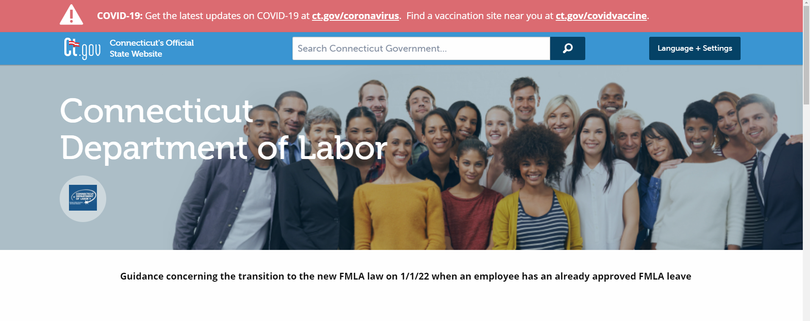
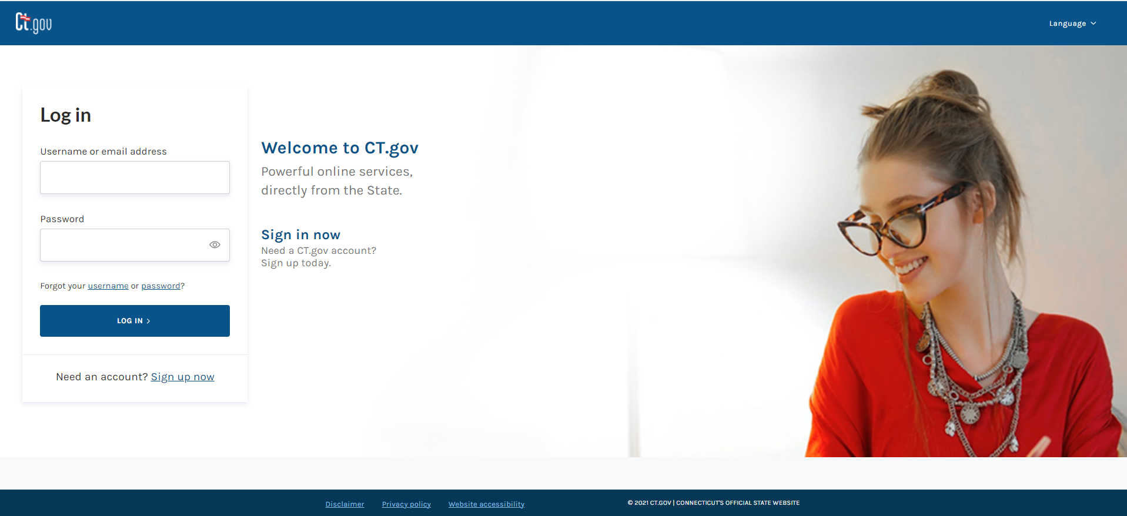
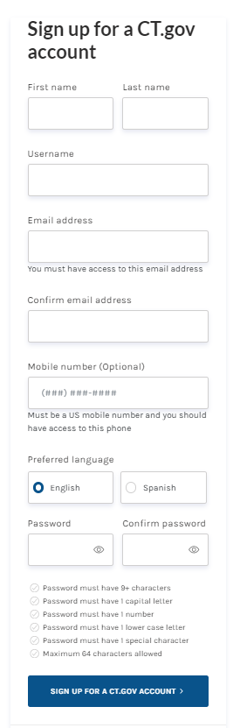
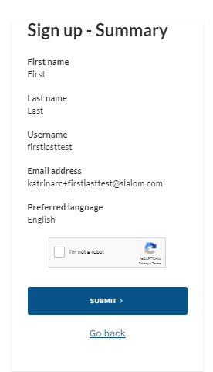
> Filing a Connecticut Paid Leave Appeal on behalf of Another
Disclaimer: All references within this document to the red box are solely for the use of this document and do not reference the website.
Scroll to the bottom of the CT DOL website and select the link that allows you to file an appeal
Before proceeding with filing an appeal with CT Paid Leave, you MUST have a state identity with CT.gov. If you do not, click “Sign up now”, highlighted here with a red box to set one up
If you already have one, proceed to sign in using the “Log In” button
At the CT.gov site, complete the form to create an account
Click “SIGN UP FOR A CT.GOV ACCOUNT” button, highlighted here with a red box
Review the information on the summary screen, and if any changes need to be made, click on the “Go back” link and adjust
If no changes need to be made, click in the CAPTCHA box to validate
Click “SUBMIT”, highlighted here with a red box
Continue

Slide 2
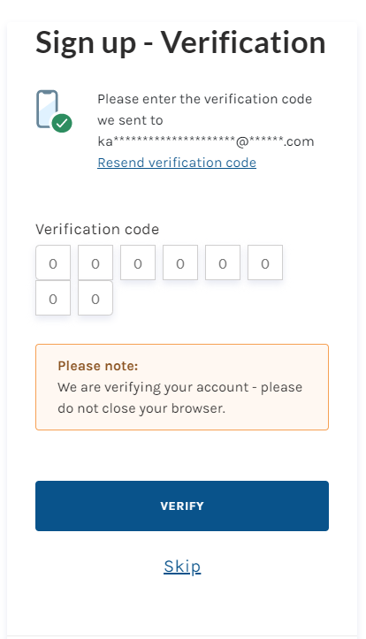
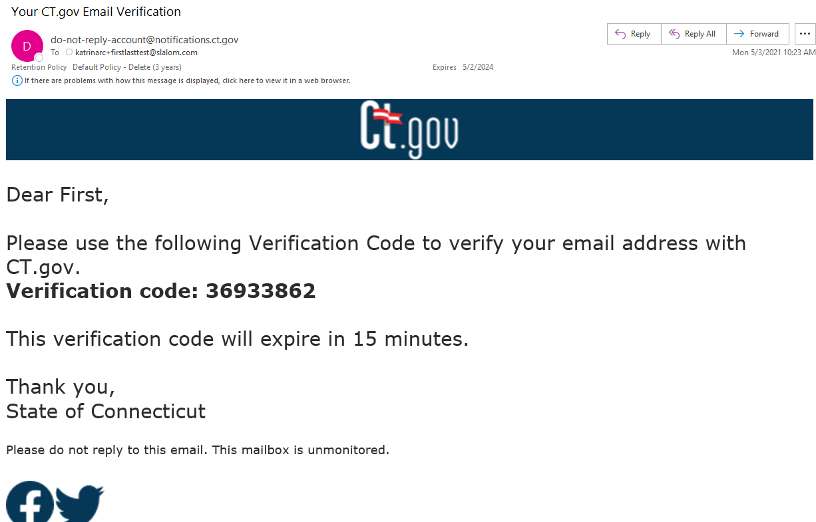
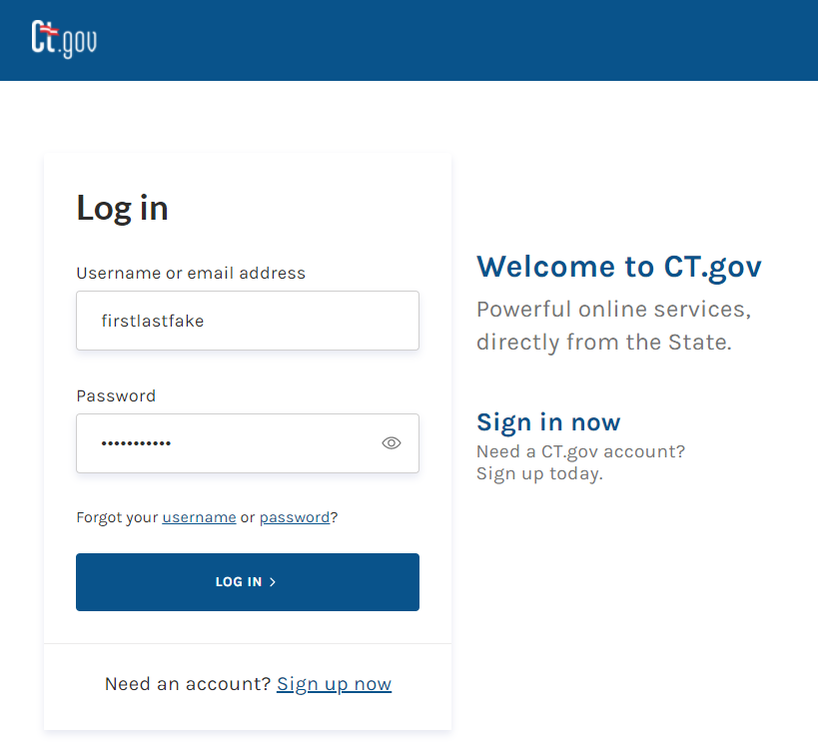
> Filing a Connecticut Paid Leave Appeal on behalf of Another
Disclaimer: All references within this document to the red box are solely for the use of this document and do not reference the website.
An eight-digit verification code will be sent to the email address used during the sign-up
You’ll need to toggle to the email account that you used to set up the CT.gov account with to acquire the code and then enter it here. The code is valid for 15 minutes
After you enter the code, click “VERIFY”, highlighted here with a red box
NOTE: You can use the “Skip” link to bypass the verification step as the system allows for 3 grace sign-in attempts before the system will force verification
Locate the email from do-not-reply-account@notification.ct.gov
Highlight the verification with your mouse or write down the code
Toggle back to the CT.gov verification screen and enter the code
Using the credentials, you just set up, enter your:
    Username OR email address, and
    Password
Click the “LOG IN” button, highlighted here with a red box
Continue

Slide 3
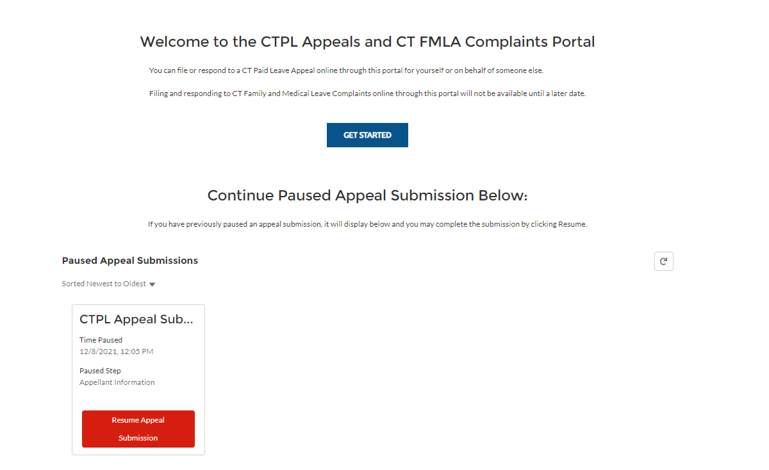
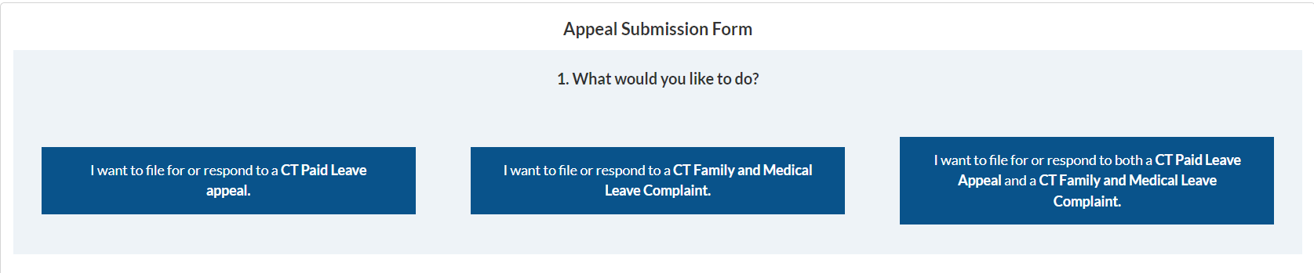
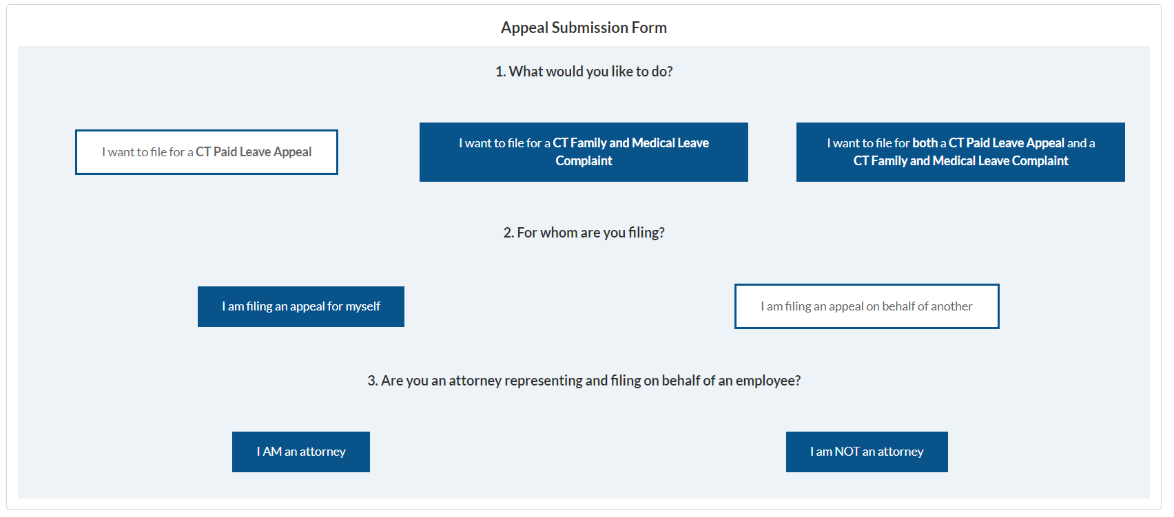


> Filing a Connecticut Paid Leave Appeal on behalf of Another
Disclaimer: All references within this document to the red box are solely for the use of this document and do not reference the website.
Click the button that states “Get started”, highlighted here with a red box
Note: If at any time you click “Save and Finish Later” while submitting an appeal, you can resume the paused appeal from this screen by clicking on the button that says, “Resume Appeal Submission”.
For the first question “What would you like to do?”, choose the scenario that best matches your reason:
  Scenario #1 - I want to file a CT Paid Leave Appeal.
  Scenario #2 - I want to file a CT Family and Medical Leave Complaint.
  Scenario #3 - I want to file both a CT Paid Leave Appeal and a CT Family and Medical Leave Complaint.
Scenario #1
Scenario #2
Scenario #3
I want to file for a CT Paid Leave Appeal.
I want to file a CT Family and Medical Leave Complaint.
I want to file both a CT Paid Leave Appeal and a CT Family and Medical Leave Complaint.
The process for Scenario #1 begins with the selection of “I want to file for or respond to a CT Paid Leave Appeal”.
As the answer to the next question “For whom are you filing?” select “I am filing an appeal on behalf of another”.
For Question #3: “Are you an attorney representing and filing on behalf of an employee?”
Select either:
“I AM an attorney” if applicable, or
“I am NOT an attorney” if applicable.
Click the “Next” button, highlighted here with a red box, to continue to the next screen, or click the “Back” button to return to the prior screen
If you are not ready to submit but do not want to lose your information, click the “Save and Finish Later” button before closing your browser window.
If you answered “I AM an attorney” move to page 5 of this job aid.
If you answered “I am NOT an attorney” move to page 6 of this job aid.
Scenario #1
Continue

Slide 4
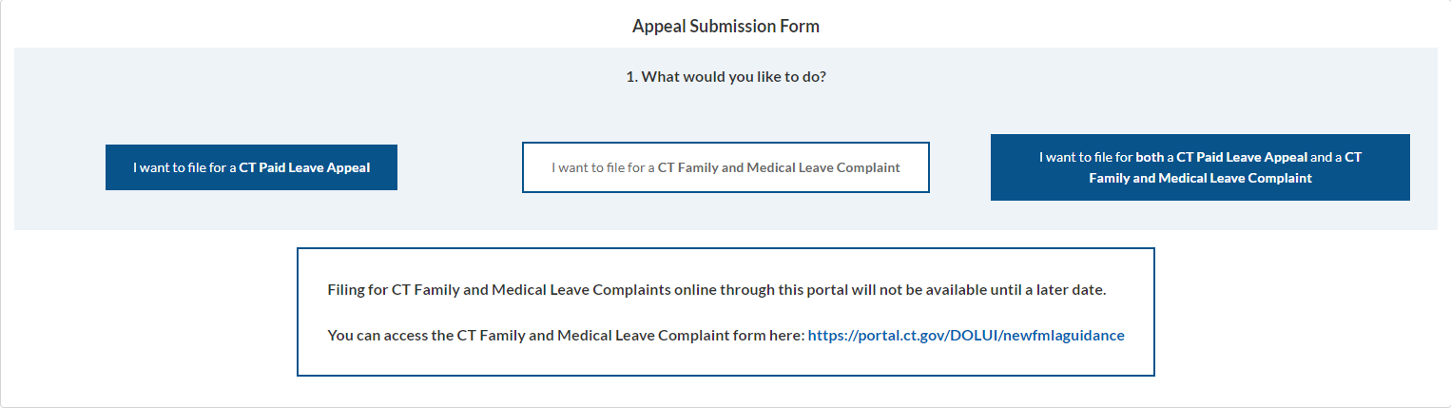
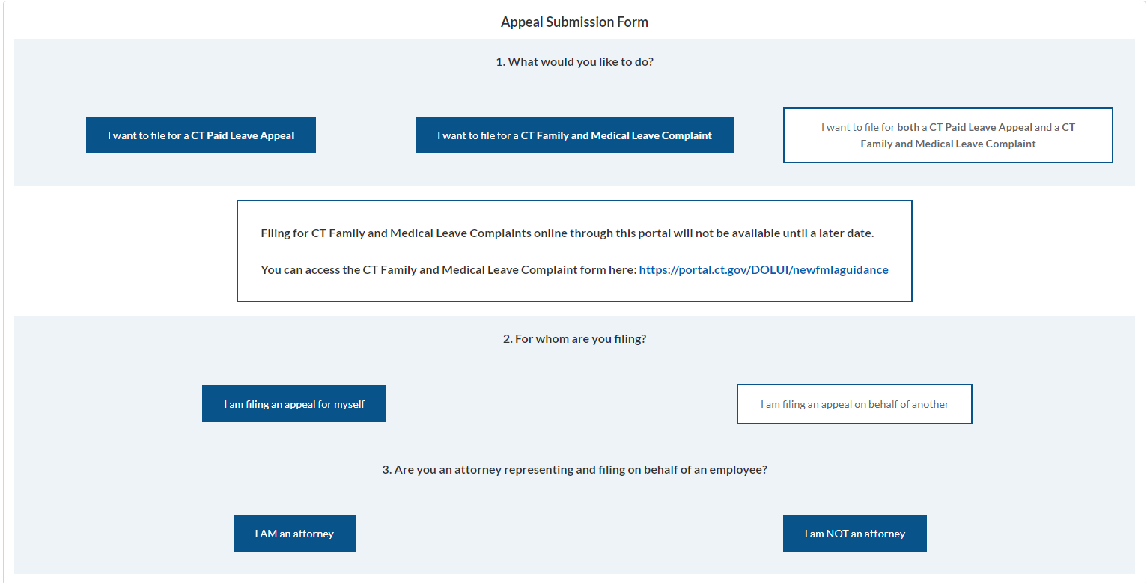
> Filing a Connecticut Paid Leave Appeal on behalf of Another
Disclaimer: All references within this document to the red box are solely for the use of this document and do not reference the website.
Scenario #2 - if “I want to file a CT Family and Medical Leave Complaint” is selected as the answer to question #1, the following message will display on the screen:
  Filing and responding to CT Family and Medical Leave Complaints online through this portal will not be available until a later date.
  You can access the CT Family and Medical Leave Complaint form here: https://portal.ct.gov/DOLUI/newfmlaguidance
Scenario #2
Scenario #3
Scenario #3 - If “I want to file for or respond to both a CT Paid Leave Appeal and a CT Family and Medical Leave Complaint” is selected as the answer to question #1,
You’ll once again receive the message called out in Scenario #2, as CT FMLA Complaints can not be filed online until a later date.
As the answer to the next question “For whom are you filing?” select “I am filing an appeal on behalf of another”.
For Question #3: “Are you an attorney representing and filing on behalf of an employee?” Select either:
“I AM an attorney” if applicable, or
“I am NOT an attorney” if applicable.
Click the “Next” button, highlighted here with a red box, to continue to the next screen, or click the “Back” button to return to the prior screen
If you are not ready to submit but do not want to lose your information, click the “Save and Finish Later” button before closing your browser window.
If you answered “I AM an attorney” move to page 5 of this job aid.
If you answered “I am NOT an attorney” move to page 6 of this job aid.
Scenario #3
Continue

Slide 5
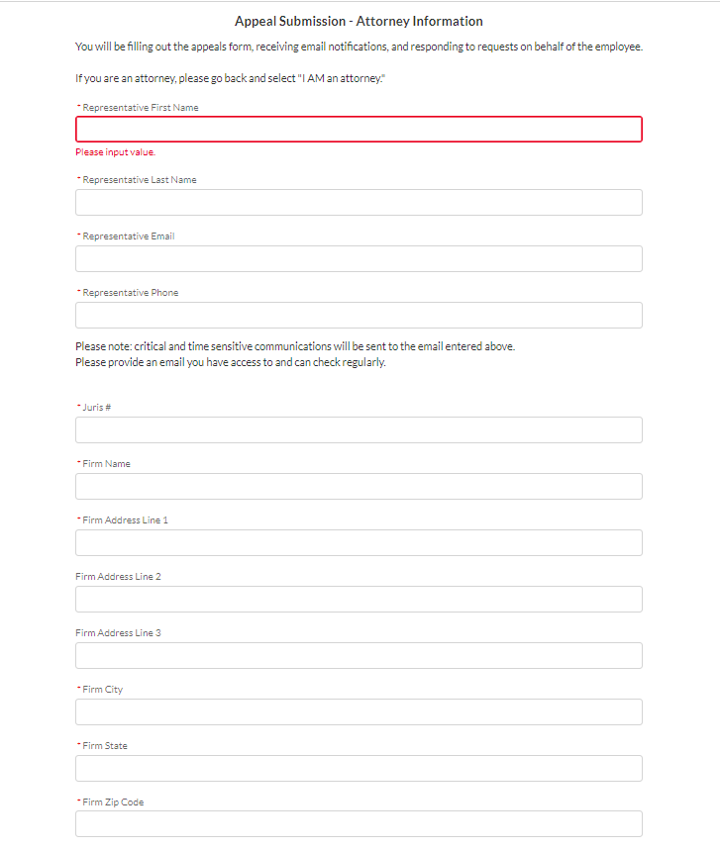

> Filing a Connecticut Paid Leave Appeal on behalf of Another
Disclaimer: All references within this document to the red box are solely for the use of this document and do not reference the website.
If you selected “I AM an attorney” from the prior screen, the Attorney Information Section will display, and you’ll need to complete the required fields.
Enter information into the following fields:
  Representative First Name (required)
  Representative Last Name (required)
  Representative Email (required)
  Representative Phone (required)
  Juris # (required)
  Firm Name (optional)
  Firm Address Line 1 (required)
  Firm Address Line 2 (optional)
  Firm Address Line 3 (optional)
  Firm City (required)
  Firm State (required)
  Firm Zip Code (required)
Click the “Next” button, highlighted here with a red box, to continue to the next screen, or click the “Back” button to return to the prior screen
**If you are not ready to submit but do not want to lose your information, click the “Save and Finish Later” button before closing your browser window.
Continue

Slide 6
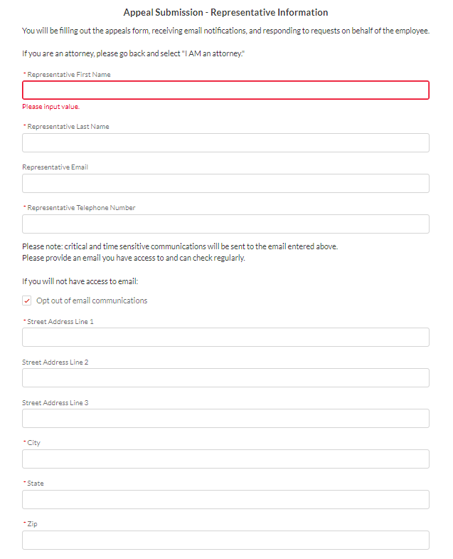
> Filing a Connecticut Paid Leave Appeal on behalf of Another
Disclaimer: All references within this document to the red box are solely for the use of this document and do not reference the website.
If you selected “I am NOT an attorney” from the prior screen, the Representative Information Section will display, and you’ll need to complete the required fields.
Enter information into the following fields:
  Representative First Name (required)
  Representative Last Name (required)
  Representative Email (required)
  Representative Telephone Phone (required)
  Street Address Line 1 (required)
  Street Address Line 2 (optional)
  Street Address Line 3 (optional)
  City (required)
  State (required)
  Zip Code (required)
Click the “Next” button, highlighted here with a red box, to continue to the next screen, or click the “Back” button to return to the prior screen
**If you are not ready to submit but do not want to lose your information, click the “Save and Finish Later” button before closing your browser window.
Continue

Slide 7
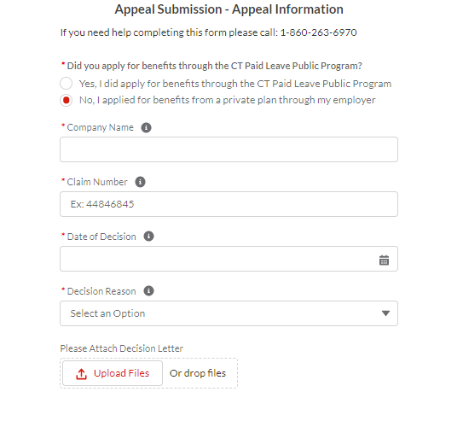
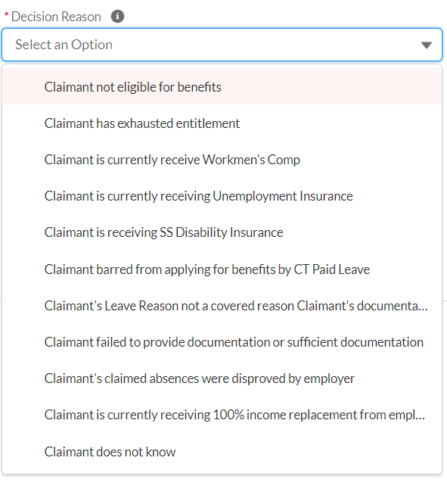
> Filing a Connecticut Paid Leave Appeal on behalf of Another
For Scenarios 1 & 3
Disclaimer: All references within this document to the red box are solely for the use of this document and do not reference the website.
Answer this information on behalf of the Appellant
To the question “Did you apply for benefits through the CT Paid Leave Public Program? select either:
“Yes, I did apply for benefits through the CT Paid Leave Public Program” or
“No, I applied for benefits from a private plan through my employer
Enter information into the following fields:
  Company Information - only displays if “No, I applied for benefits from a private plan through my employer” (required)
  Claim Number (required)
  Date of Decision (required)
  Decision Reason (required - select an option from the drop-down listing)
  Please Attach Decision Letter: (optional) click the “Upload Files” button, or drag and drop files to field labeled “or drop files” to upload a copy of the decision letter
  Click the “Next” button, highlighted here with a red box, to continue to the next screen, or click the “Back” button to return to the prior screen
**If you are not ready to submit but do not want to lose your information, click the “Save and Finish Later” button before closing your browser window.
See screen below for the drop-down listing options for Decision Reason
Claimant is currently receiving Workers’ Compensation
Continue

Slide 8
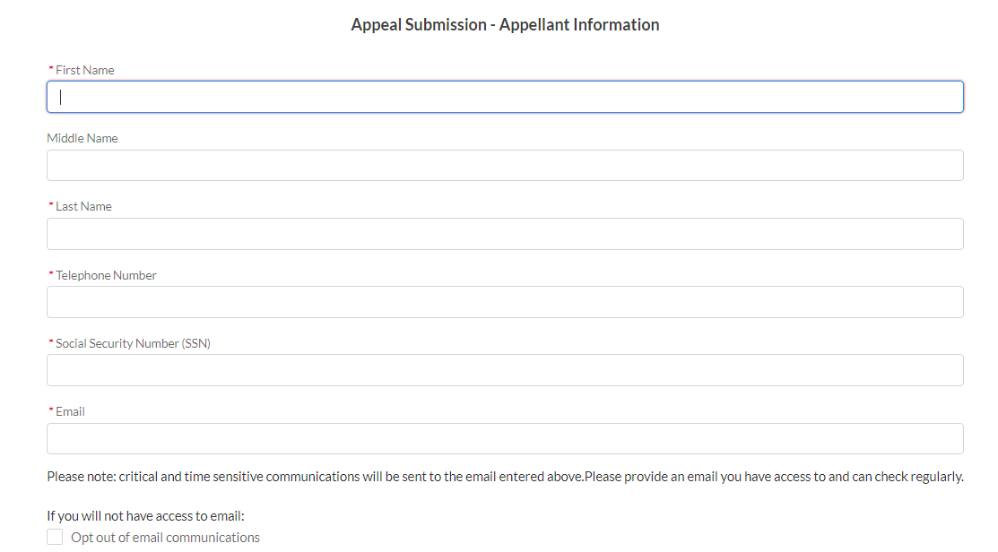
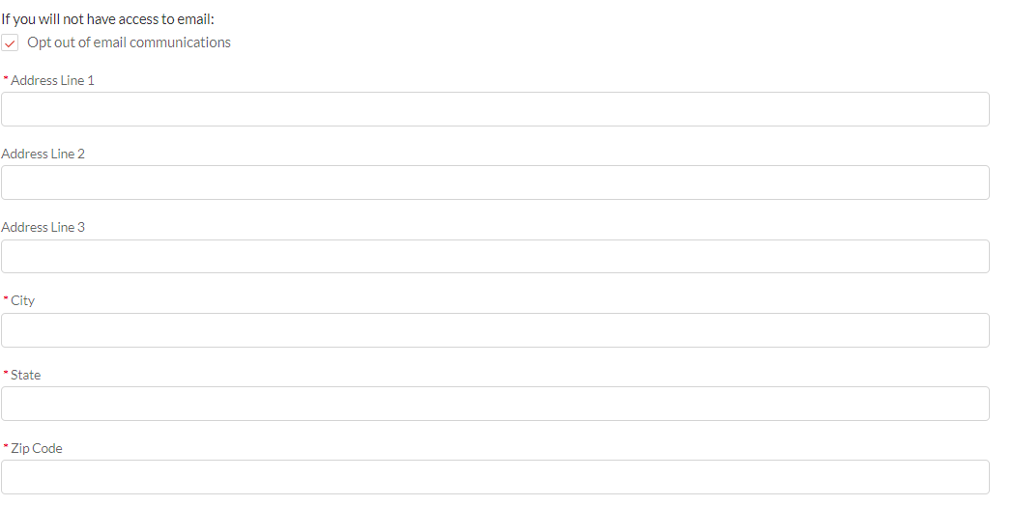
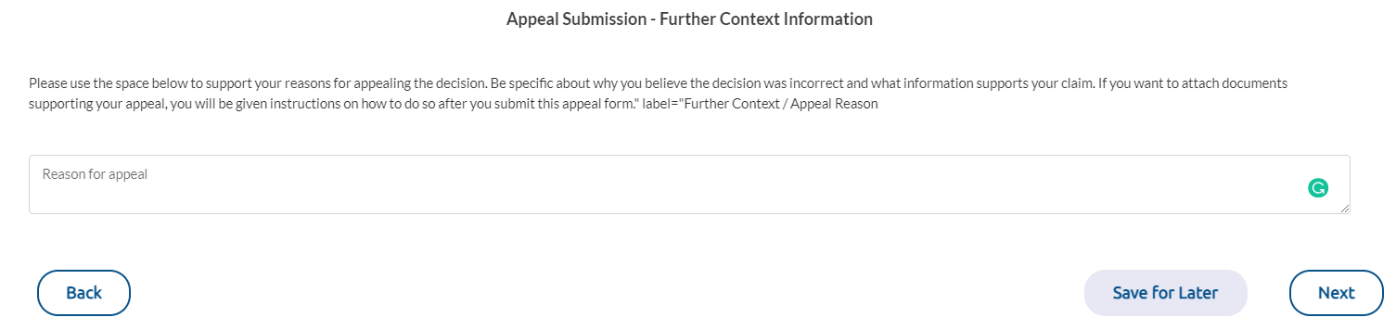

> Filing a Connecticut Paid Leave Appeal on behalf of Another
Appellant Information Section:
Enter information into the following fields:
  First Name (required)
  Middle Name (optional)
  Last Name (required)
  Telephone Number (required)
  Social Security Number (SSN) (required)
  Email (required)
  Communications will default to email. If you want to receive communications via paper mail, check the box next to “opt out of email communications”. Once the box is selected, address fields will appear
  Address Line 1 (required)
  Address Line 2 (optional)
  Address Line 3 (optional)
  City (required)
  State (required)
  Zip Code (required)
Click the “Next” button, highlighted here with a red box, to continue to the next screen, or click the “Back” button to return to the prior screen
**If you are not ready to submit but do not want to lose your information, click the “Save and Finish Later” button before closing your browser window.
To enter any additional information that will be added to the appeal, click in the box labeled “Reason for Appeal” and type the information to support your reasons for appealing the decision
Be specific about why you believe the decision was incorrect and what information supports your claim
If you want to attach documents supporting your appeal, you will be able to do so after you submit the form and will be given instructions on how to do so
Click the “Next” button, highlighted here with a red box, to continue to the next screen, or click the “Back” button to return to the prior screen
**If you are not ready to submit but do not want to lose your information, click the “Save and Finish Later” button before closing your browser window.
Continue

Slide 9

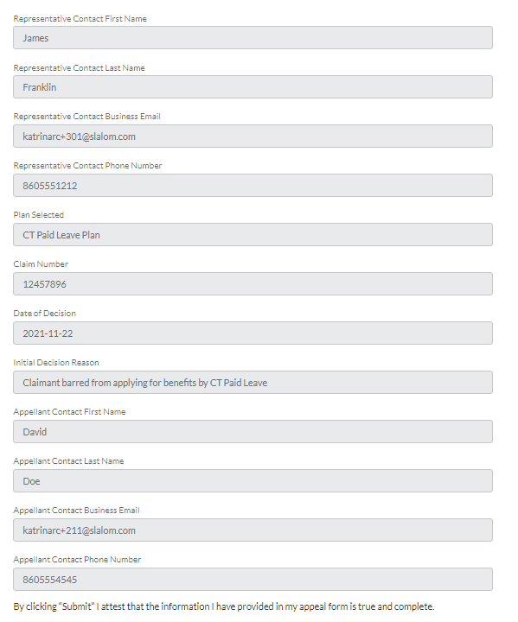
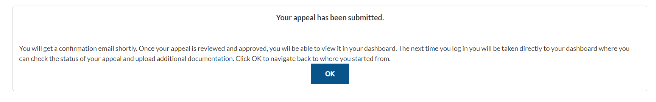

> Filing a Connecticut Paid Leave Appeal on behalf of Another
Disclaimer: All references within this document to the red box are solely for the use of this document and do not reference the website.
Before submitting the form, review and confirm all the information you entered is accurate and complete
If you need to edit any field, use the “Back” button until you reach the screen where the data is and make the change(s)
Click the “Next” buttons until you once again come to the review screen
Once you are ready to submit (and by doing so you attest that the information you provided in your appeal form is true and complete), click “Next” at the bottom of the review screen
**If you are not ready to submit but do not want to lose your information, click the “Save and Finish Later” button before closing your browser window.
A confirmation screen will appear confirming your submission
Click the “Ok” button, highlighted here with a red box
After clicking the “Ok” button, if you are not directly taken to screen on the next page, you can access the Appeal Account Dashboard by clicking on the logo in the top left-hand corner of the screen.
Continue

Slide 10
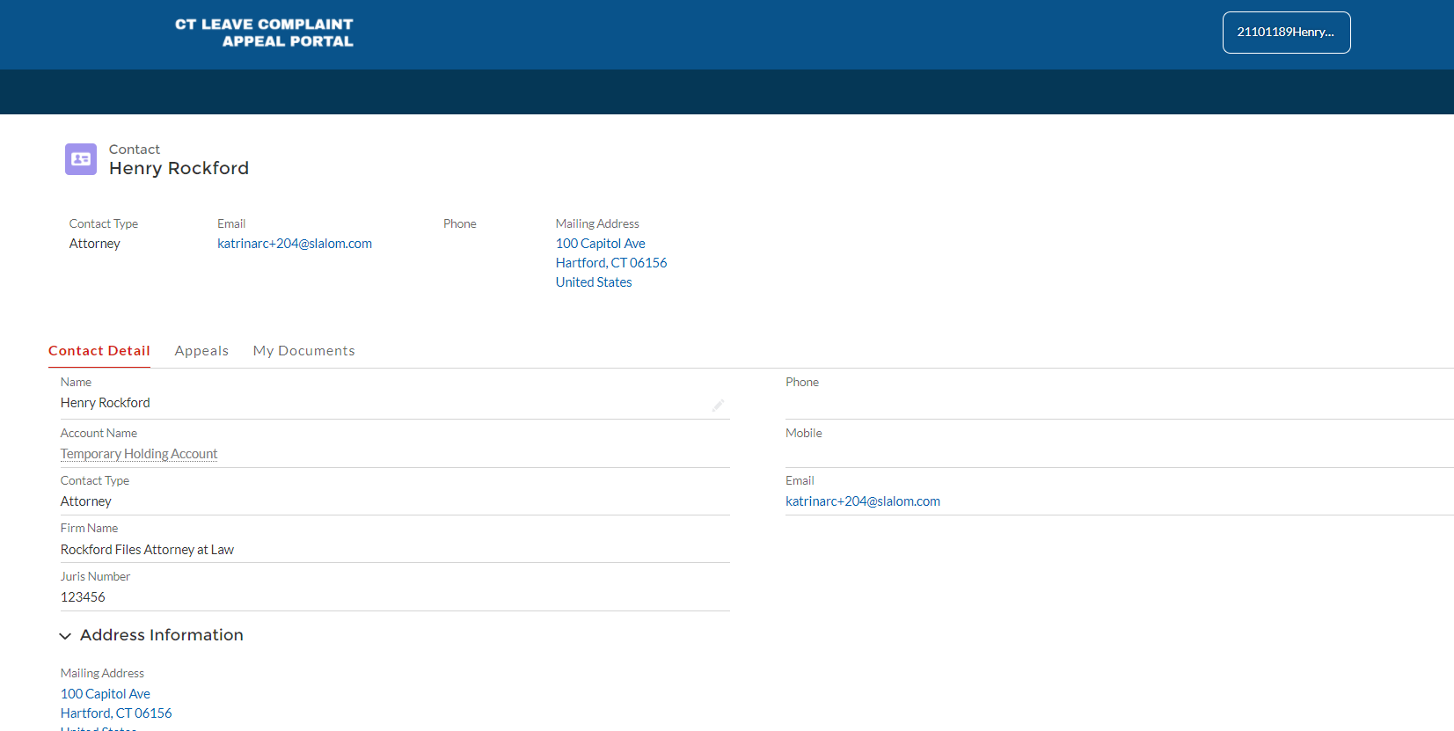
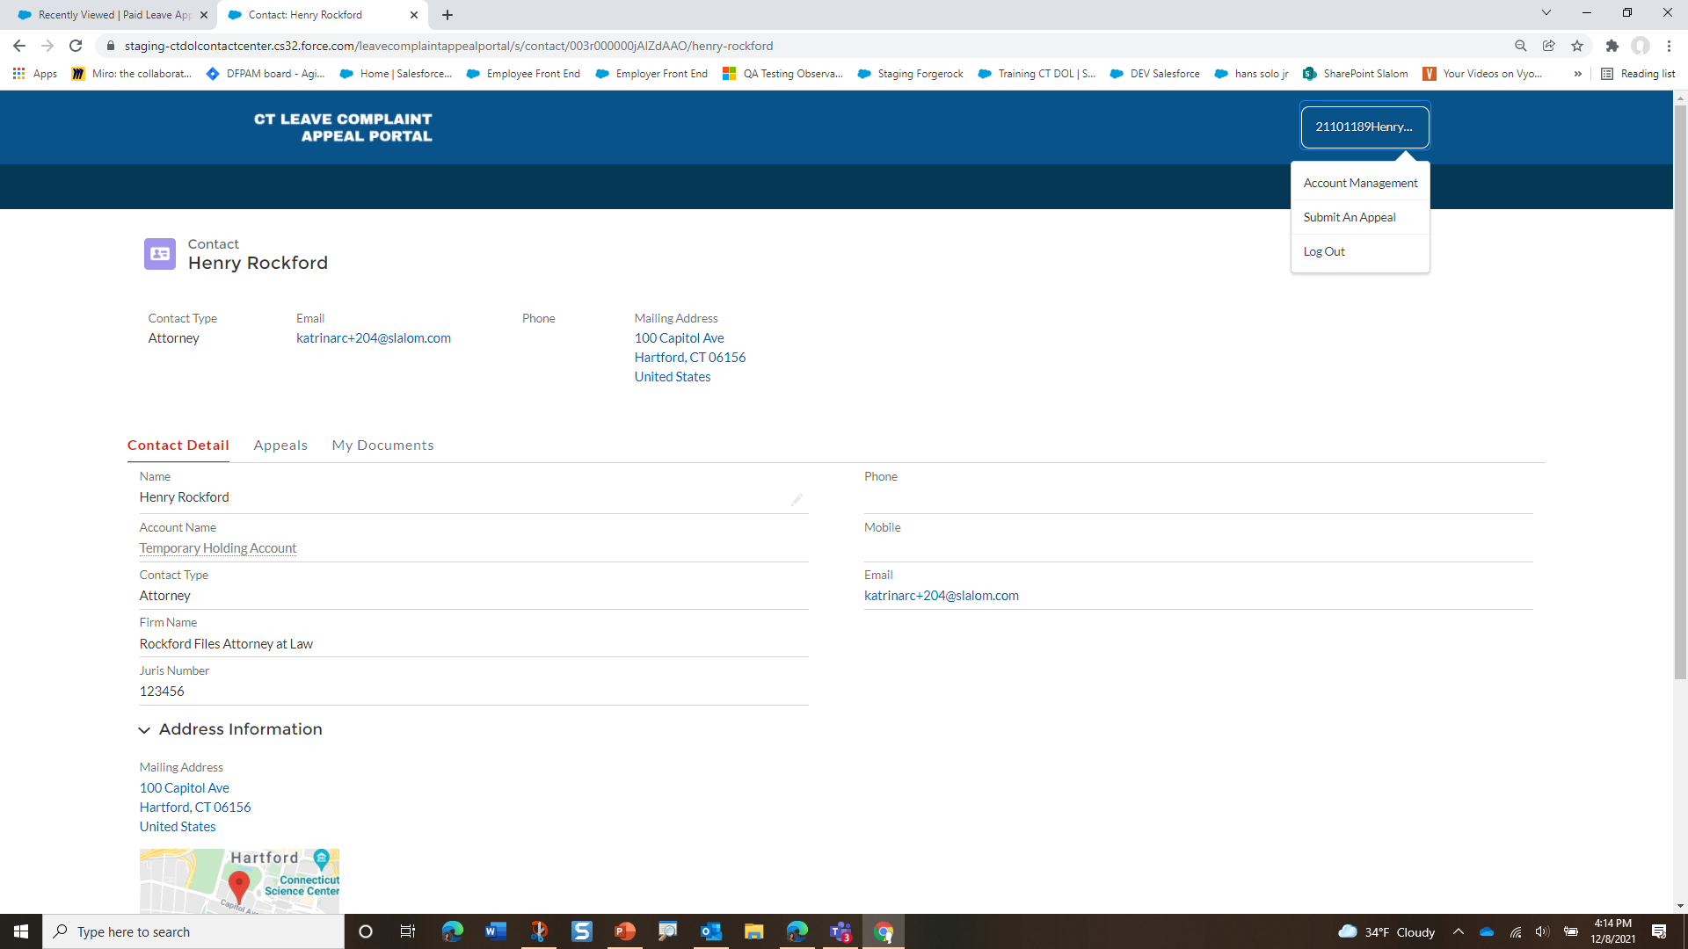

> Filing a Connecticut Paid Leave Appeal on behalf of Another
Disclaimer: All references within this document to the red box are solely for the use of this document and do not reference the website.
Click on the logo to access this dashboard
Click on the username to access the menu options
Account Management: allows user to update ct.gov information
Submit An Appeal: allows user to submit a new CTPL appeal
Log Out: allows user to log out of the CT Leave Complaint Appeal Portal
The main screen of the user’s Appeal Account dashboard defaults to the user’s contact record.
No information can be edited.
From here you can view:
  Contact detail information
  List of appeals filed
  All documents attached to the appeal that were uploaded by the contact. In this example, Henry Rockford is the contact.
Continue

Slide 11
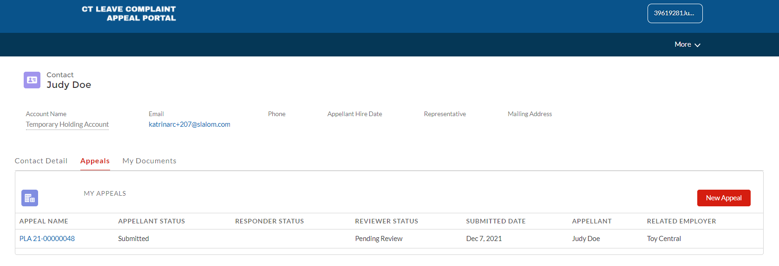
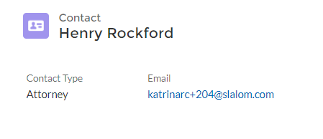
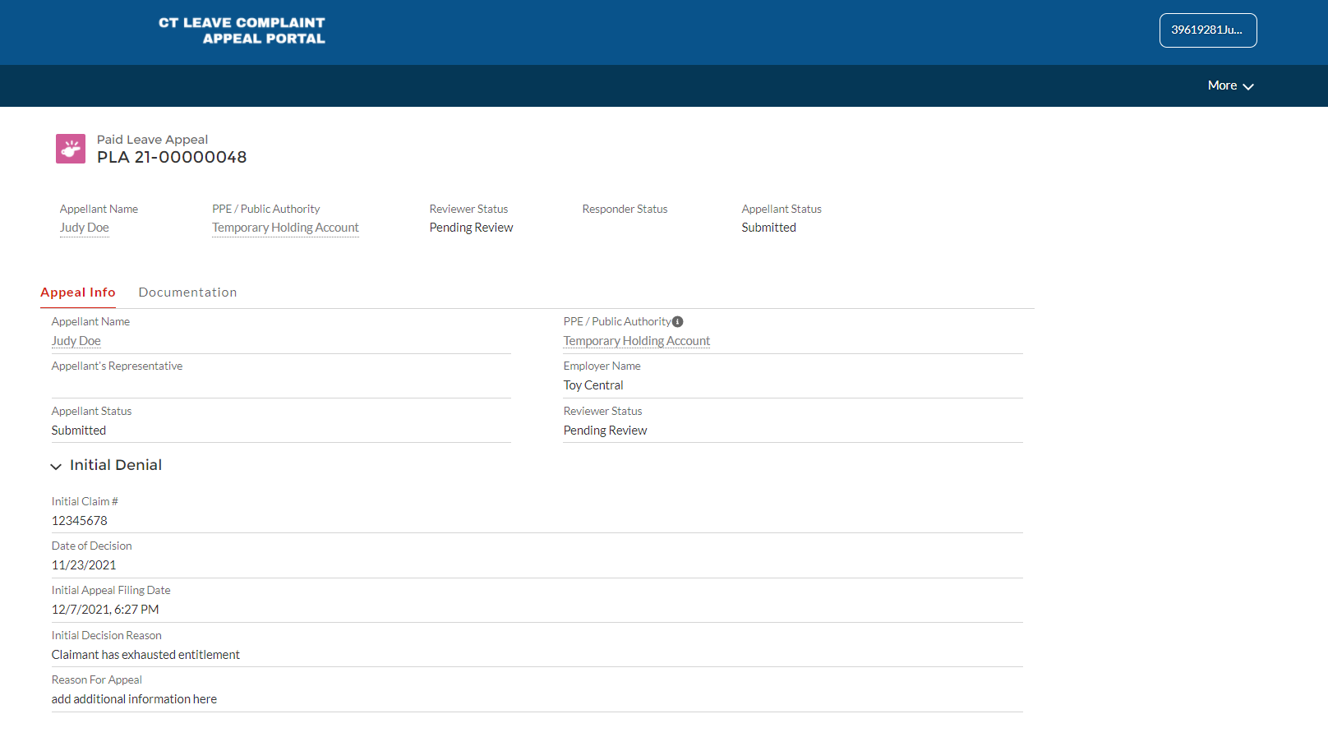
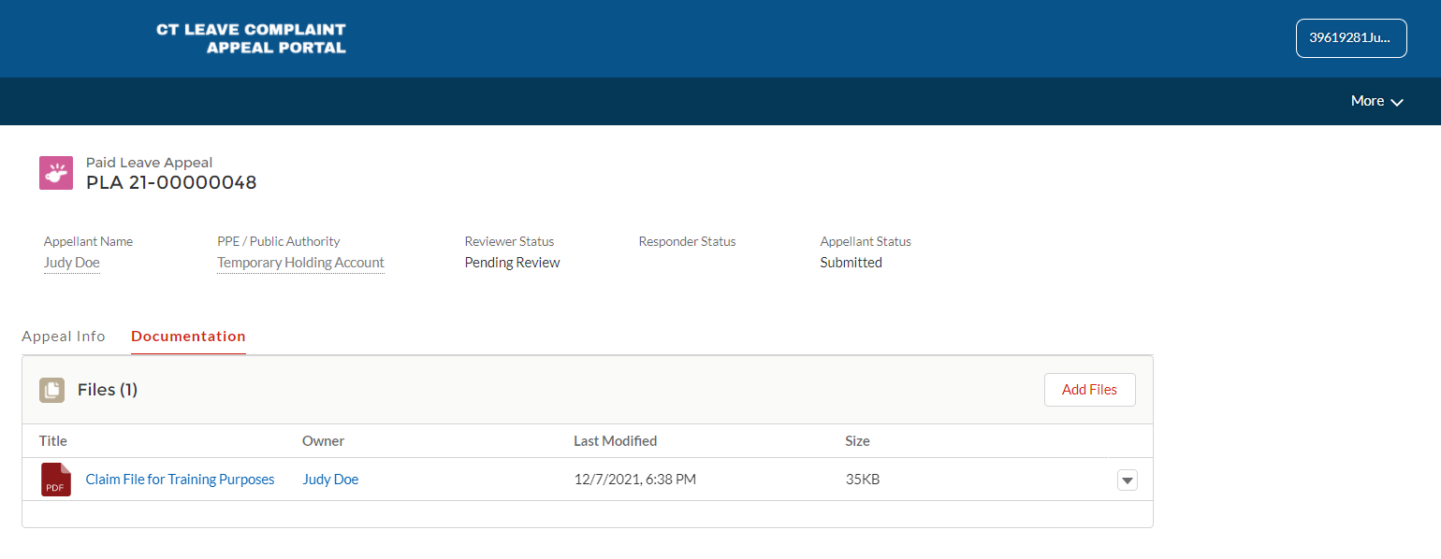
> Filing a Connecticut Paid Leave Appeal on behalf of Another
Disclaimer: All references within this document to the red box are solely for the use of this document and do not reference the website.
On the “Contact Detail” tab, appeals that were submitted and the status of each can be viewed.
From here, additional appeals can be filed by using the “New Appeal” button.
To upload documentation for a specific appeal, click on the appeal name.
Information added into the appeal form will display on the “Appeal Info” tab.
Please note, this information is not editable.
From the “Documentation” tab within the appeal record, you can upload documentation by clicking on “Add Files”.
To upload new versions of documents, click on “Add Files” and select “Upload New Version”.
Any files uploaded by interested parties, related to the appeal, and shared with the appeal record, will be viewable here.

