Slide 1

Technical Compliance

Slide 2

4.4 – 4.6
Project Review

Slide 3
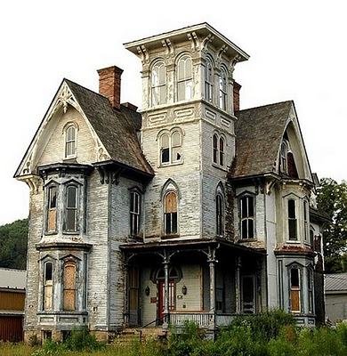

4.4
Site & Building Report
4.4.B
Approvals/Clearances
Existing conditions
Site – Building - Environmental
PROPOSED WORK
Expansions – Additions – Site Plan

Slide 4

construction
4.5
Drawing & Specifications Status
SCHEMATIC – DESIgn Development - final
ELECTRONIC DRAWINGS & SPECS
Disk – flash drive
Length of construction
# OF MONTHS

Slide 5
CURRENT STATE CODE
Pursuant to section 29-252 of the Connecticut General Statutes the following national model codes, as amended herein, are adopted and shall be known as the 2018 Connecticut State Building Code:
2015 International Building Code
2009 ICC/ANSI A117.1 Accessible and Usable Buildings and Facilities
2015 International Existing Building Code
2015 International Plumbing Code
2015 International Mechanical Code
2015 International Energy Conservation Code
2017 NFPA 70, National Electrical Code, of the National Fire Protection Association Inc.
2015 International Residential Code of the International Code Council, Inc.

Slide 6
Connecticut
Housing
Finance
Authority
2019 Multifamily Design, Construction and Sustainability Standards - CHFA
These Standards have been adopted by the Connecticut Department of Housing (DOH)

Slide 7
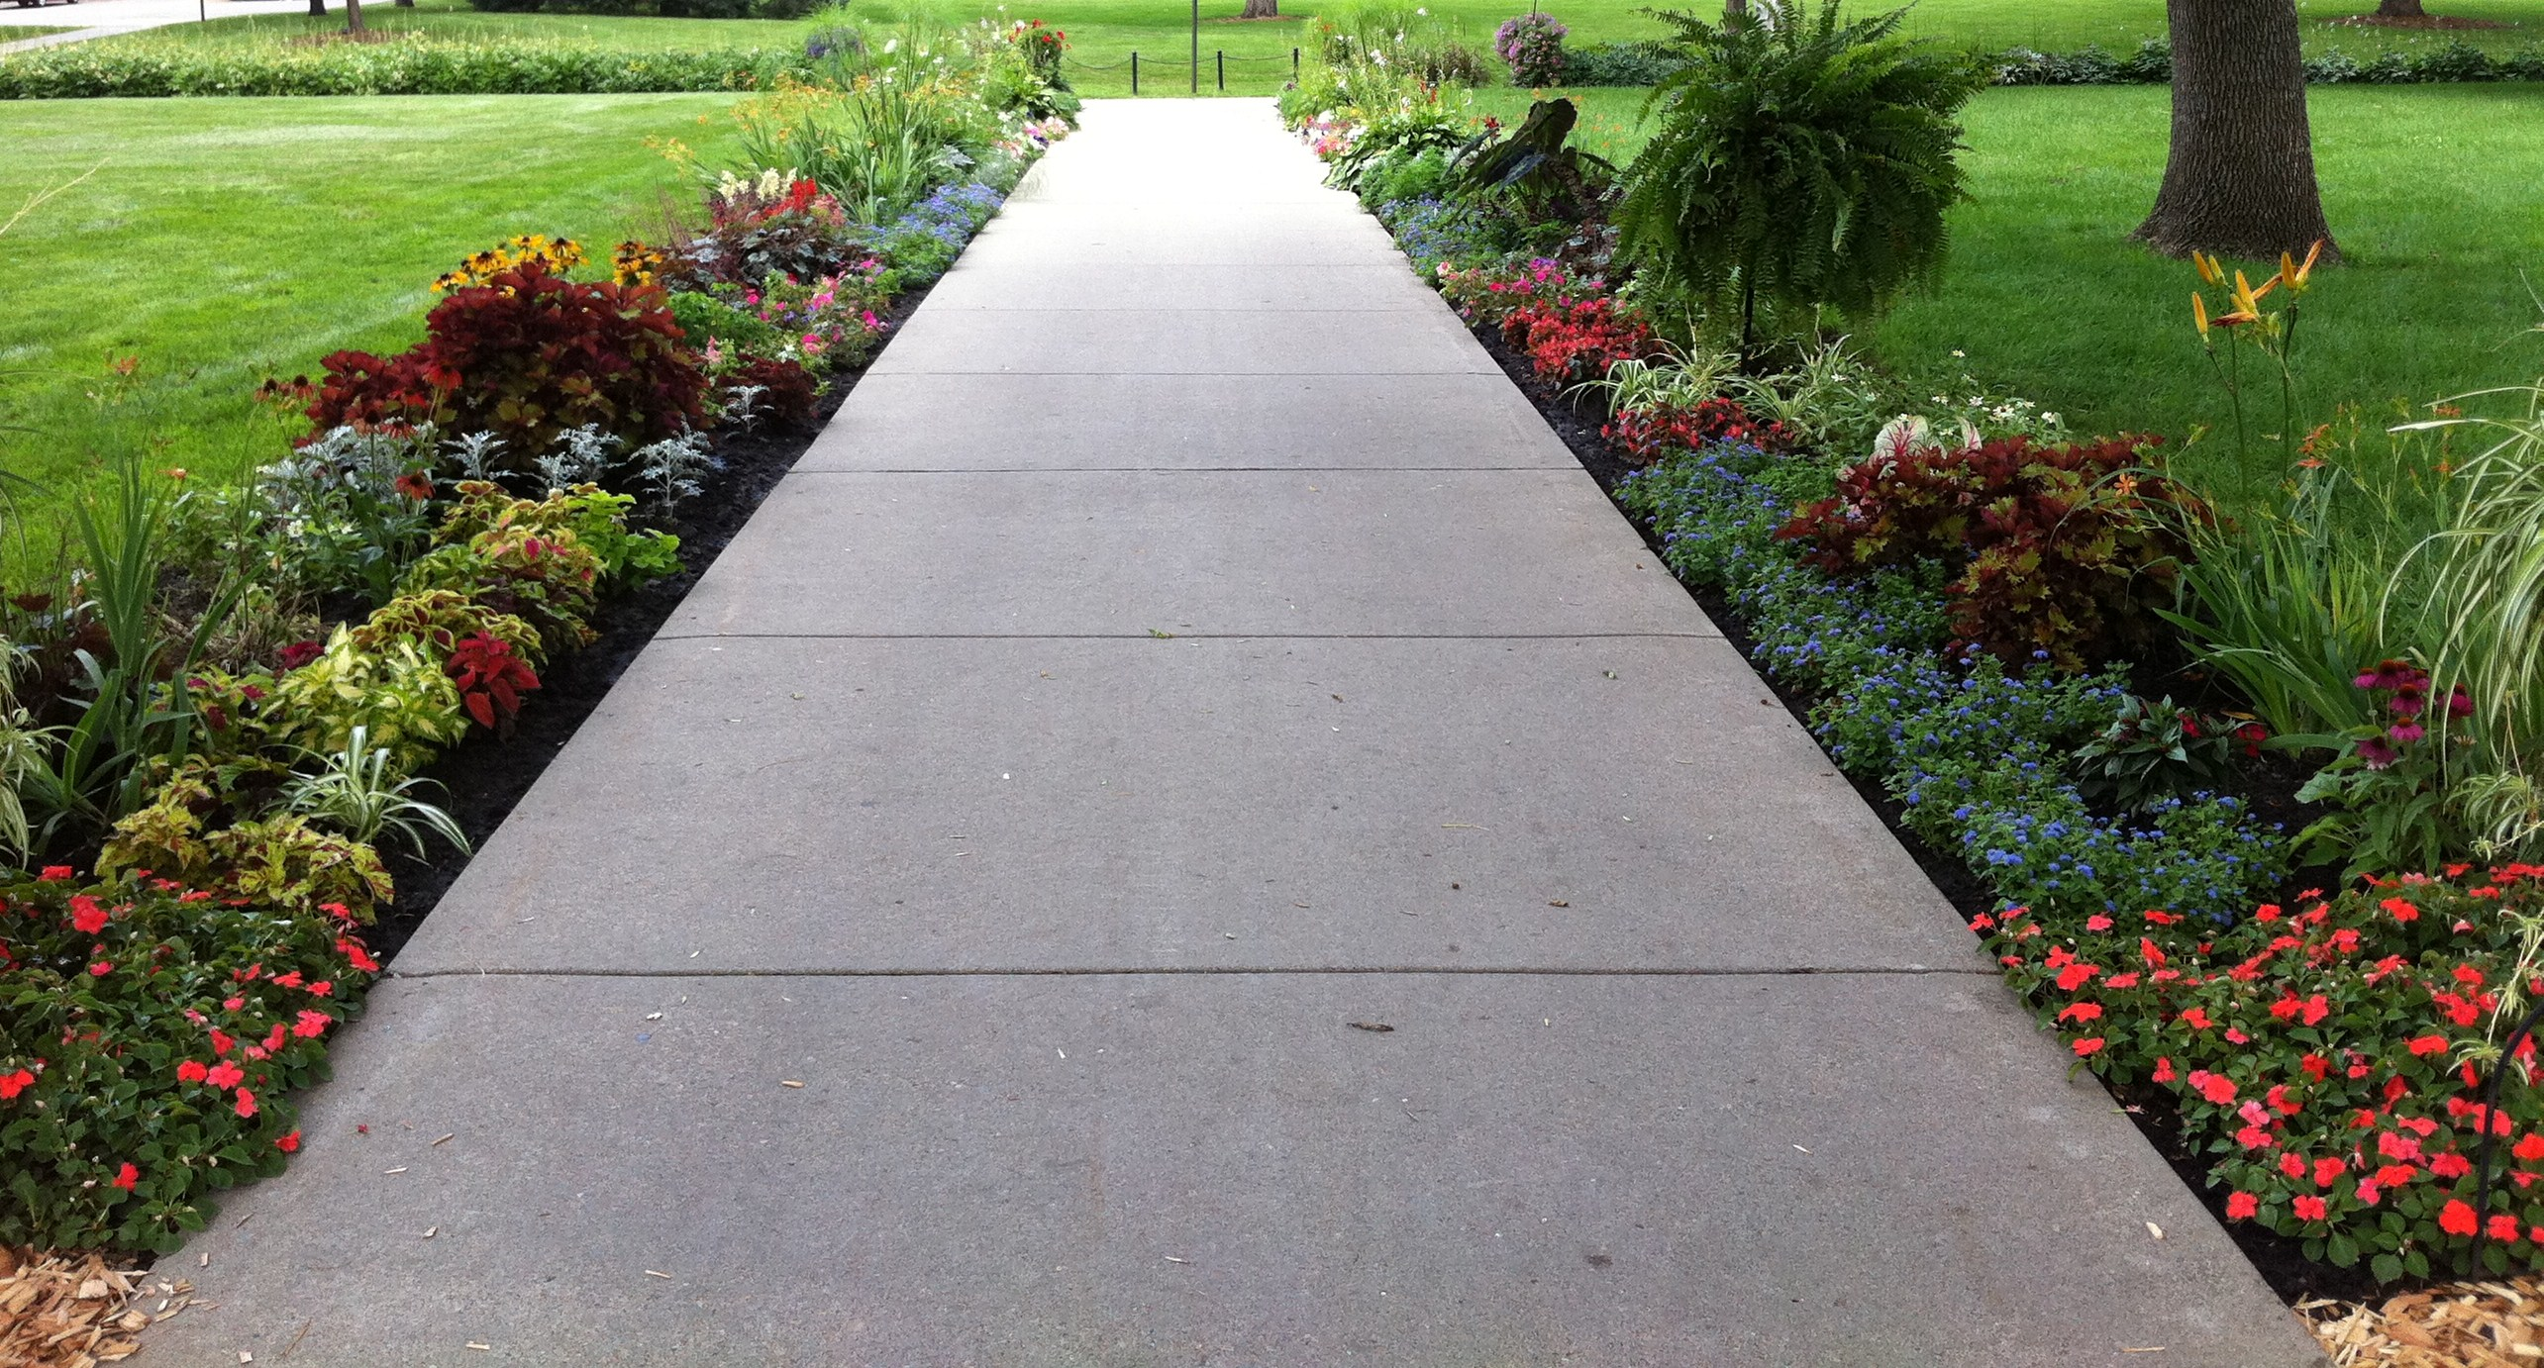
WALKWAYS
Design Standards Highlights
Walks shall be concrete.
Asphalt bituminous "walking trails" may be provided.
Page 20

Slide 8
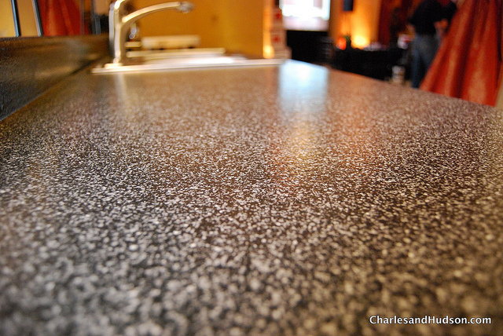
LAMINATES
Shelves Cabinets Countertops
Substrate material, exterior-type, hardwood-faced plywood, or other material approved by the manufacturer.
Use formaldehyde-free medium density fiber board, adhesives
Cut-out edges shall be sealed prior to the installation of sinks.
Back & side splashes - 4" (min.) bath vanity tops
6" (min.) at kitchen countertops.

Slide 9

ENERGY EFFICIENCY
Minor - Moderate - Substantial Rehab
All proposed energy performance-related fabrications, equipment, fixtures, controls and appliances must meet or exceed the prescriptive requirements of ENERGY STAR Certified Homes or ENERGY STAR Multifamily High Rise (MFHR) Programs (current versions), or as otherwise indicated in these Standards or other programmatic funding requirements

Slide 10

VINYL SIDING
Solid Color Virgin Vinyl
Expansion joint @ floor line (multistory)
.044” thick min
No vertical splice joints in walls less than 12ft
20 year warranty

Slide 11
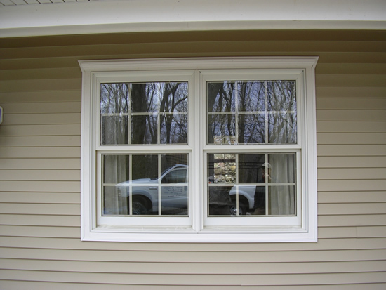
WINDOWS
Double-hung and single-hung windows are preferred
Sliding windows are not acceptable
Vinyl & aluminum-clad wood, vinyl & fiberglass sash are preferable
Provide argon gas-filled, low-E-coated, insulating glass
10yr min manufacturer’s warranty for window assemblies
All window, door & skylight areas, U-factors must comply with all energy code and ENERGY STAR requirements

Slide 12
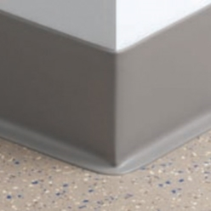
RESILIENT FLOORING
⅛" thick (min.) flooring/wall base trim for kitchens, bathrooms, laundry areas and storage rooms
AC-rated laminate flooring products
Bedrooms & Closets: AC2 Unit Hallways & Living Areas: AC3
Community Spaces: AC4 Common Lobbies & Corridors: AC5

Slide 13
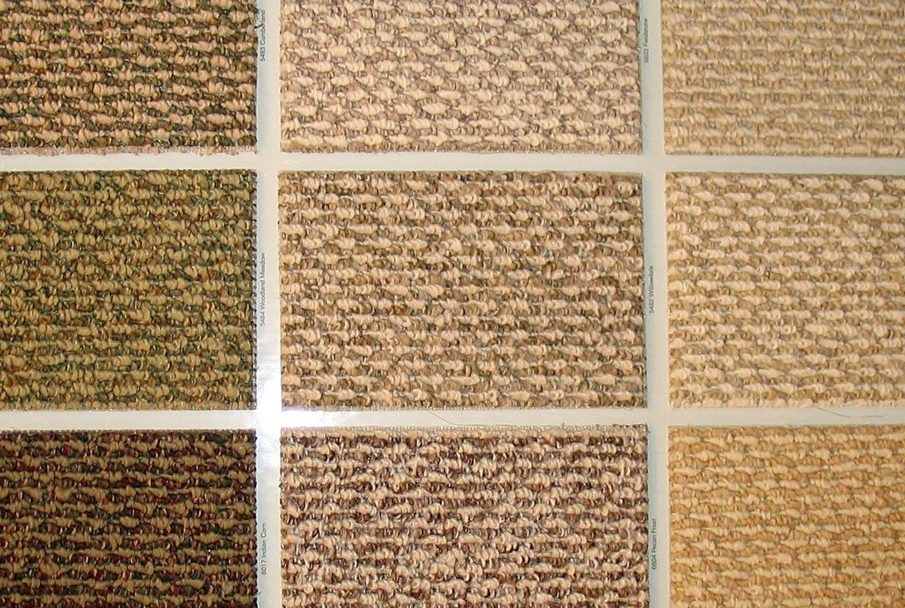
CARPET
Hard-surface flooring is preferable to wall-to-wall carpeting
Tufted level & textured level loop
100% Nylon
24 oz. or greater
HUD UM44d & Green Label Plus Certification Program
Synthetic fiber cushioning material

Slide 14
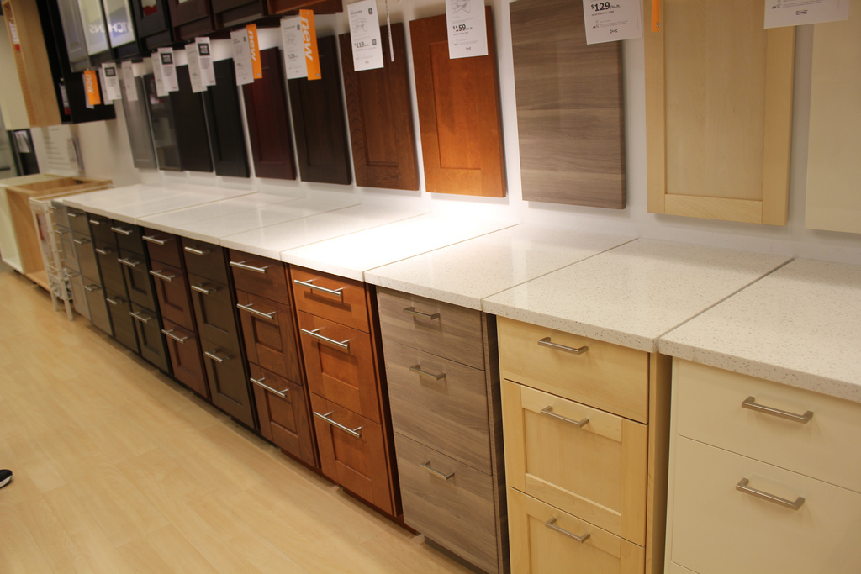
KITCHEN/BATH CABINETS
Certified by Kitchen Cabinet Manufacturers Association (KCMA)
as meeting HUD Severe Use standards
Ball-bearing type hardware for drawers
Base and wall cabinets shelves ¾” thick, min
42" wide vanities (min.), 30" removable sink base
& 12" fixed drawer base

Slide 15

4.5 PROCUREMENT
PROFESSIONAL SERVICES & GOODS
SMALL PURCHASE< $100K
Request quotes with detailed description of goods or services needed
Compare costs to ensure cost reasonableness
Document quotes, maintain in files
Award lowest responsive and responsible

Slide 16

4.5 PROCUREMENT
SEALED BIDS (Formal Advertising)
All Construction Contracts or Goods
> $100K
Publically solicited sealed bids
Firm-fixed-price lump sum or unit price contract
Public advertising for bids - Public opening
Award responsible lowest bidder
Document and file bids

Slide 17
4.5 PROCUREMENT
COMPETITIVE PROPOSALS
PROFESSIONAL SERVICES > $100K
Publish a written request for submissions
RFQ can be used for architecture and engineering services
Can request qualifications and cost information or just qualifications
RFP is required for non-architectural or engineering services
Review and select based on written evaluation criteria
Document and file submissions/costs

Slide 18

4.5 PROCUREMENT
NON-COMPETITIVE PROPOSALS
Award of Contract is infeasible for:
Small Purchase Procedures
Sealed Bids or Competitive Proposals
With 1 of the following:
Item only available from a single source
Public emergency or urgent situation
After solicitation competition is determined inadequate
Document and maintain in files

Slide 19

4.5 PROCUREMENT
CONFLICT OF INTEREST
EVERY GRANTEE SHOULD HAVE
Written code of standards to prevent conflicts of interest in procurement
TO APPLY TO ALL
Employees, officers, agents, members of immediate family, partners
No earned benefits, financial interest due to CDBG related procurement action
No solicitation, acceptance of gratuities, favors or other items of monetary value from contractors.
Minimum thresholds below which financial interest is not substantial or of nominal value should be established.

Slide 20

4.5 PROCUREMENT
EXCLUDED PARTIES
GRANTEES
Must not make any award (subgrant or contract) to any organizations
DEBARRED
SUSPENDED
EXCLUDED
INELIGIBLE
FOR PARTICIPATING IN FEDERAL ASSISTANCE PROGRAMS
Executive Order 1259 “Debarment and Suspension”

Slide 21

4.6.e Utility Incentives
Energy Efficiency
Rebate Letter
From the utility company!

Slide 22
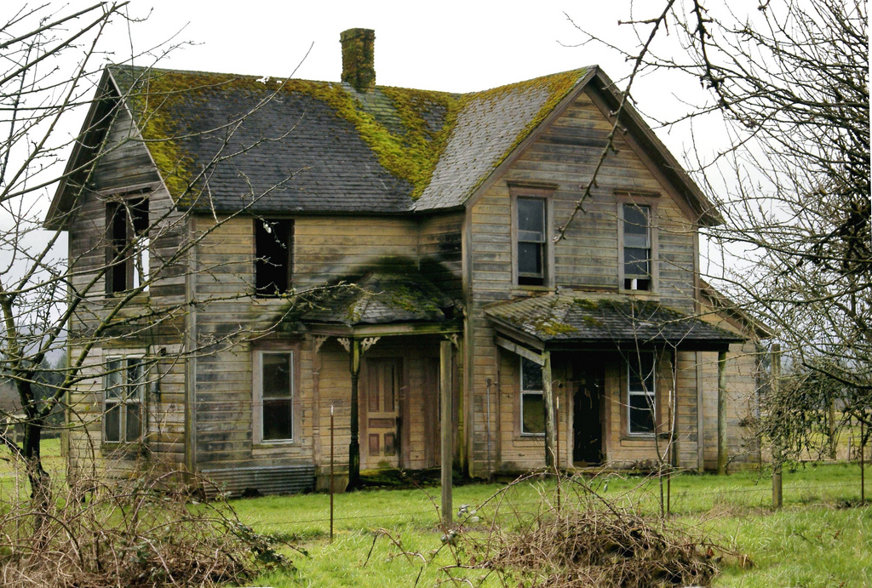
RESIDENTIAL REHAB
PROGRAMS

Slide 23
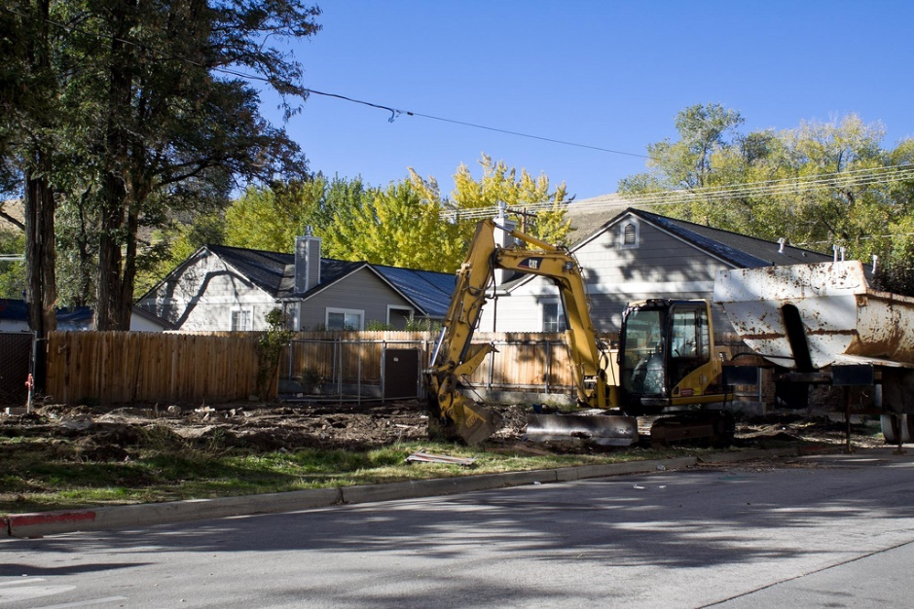
4.7G 75% RULE
WALK-AWAY POLICY
DEMOLITIONS
Reimbursement will not be given
WITHOUT
DOH prior knowledge and approval!

Slide 24
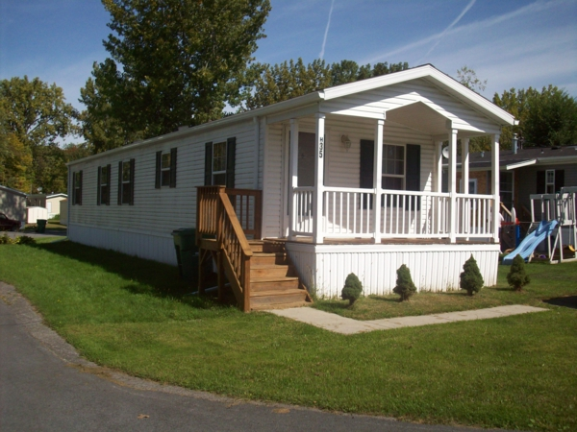
4.7G 75% RULE
WALK-AWAY POLICY
REPLACEMENTS
Reimbursement will not be given
WITHOUT
DOH prior knowledge and approval!

Slide 25
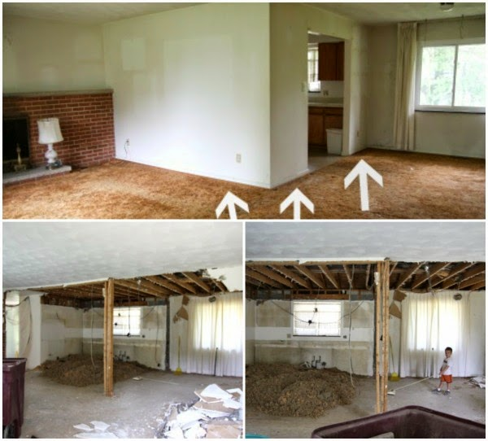
4.7G 75% RULE
WALK-AWAY POLICY
EXPANSIONS
Reimbursement will not be given
WITHOUT
DOH prior knowledge and approval!

Slide 26
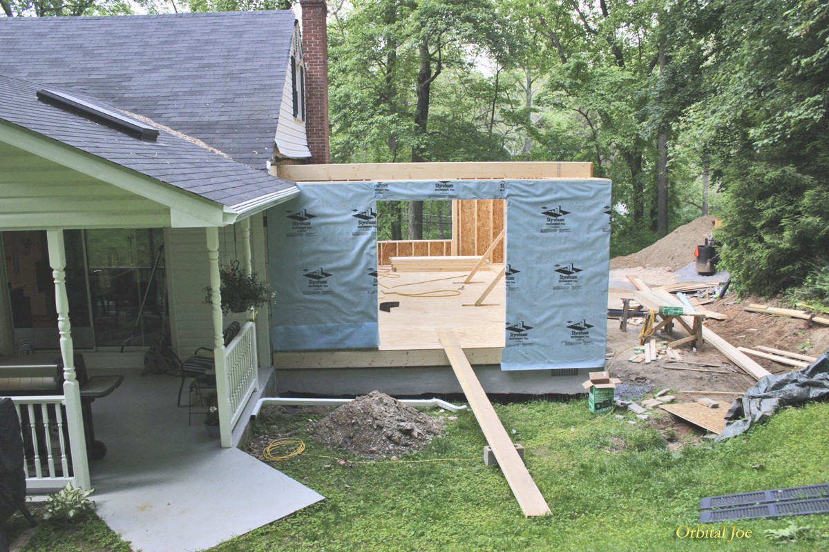
4.7G 75% RULE
WALK-AWAY POLICY
ADDITIONS
Reimbursement will not be given
WITHOUT
DOH prior knowledge and approval!

Slide 27
Technical Compliance
JaCinta “JC” Frazier 860-270-8129 jacinta.frazier@ct.gov

