Slide 1



Davis Bacon ACT (DBA)/ labor standards
Quick and dirty guide for cdbg-small cities projects

Slide 2
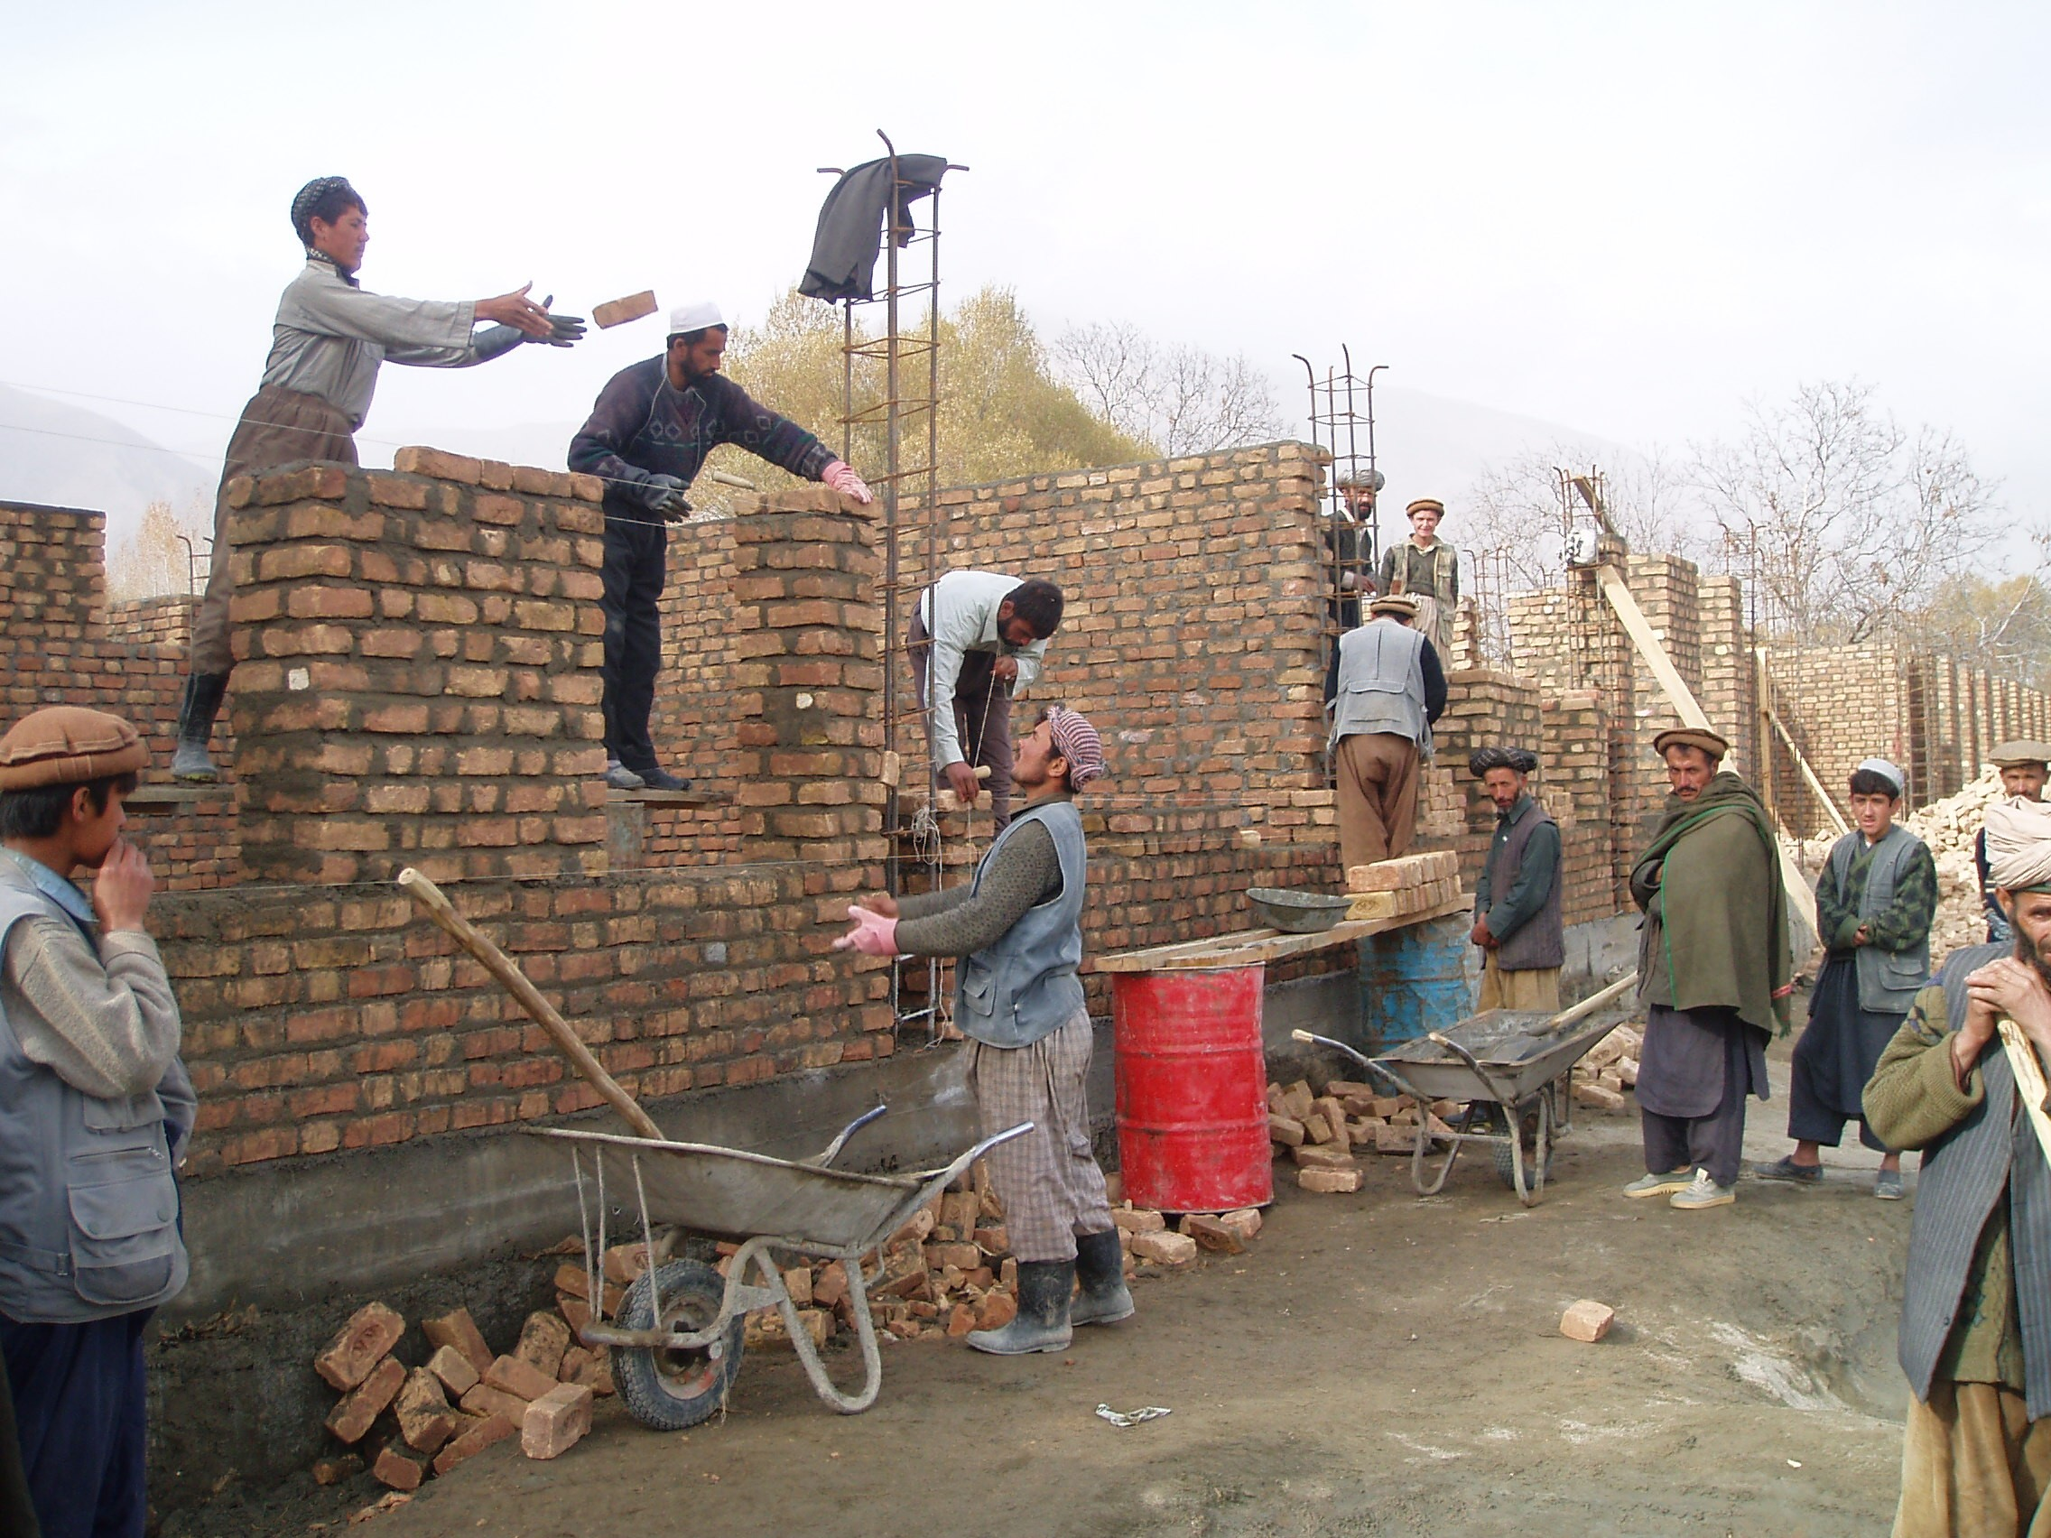

Davis-Bacon Act
(40 U.S.C. 276a.-5)
Enacted in 1931
Amended in 1935 and 1964

Slide 3

Sooo…..What’s all the to do about dba?

Slide 5
This is a big “XX” Deal!!!!

Slide 6
DBA-Why?
Protects communities and workers from non-local contractors underbidding local wage levels
Standards guarantee fair wages and compensation for workers
Helps provide a level playing field for bidders
Requires weekly payment of wages

Slide 7
The term “labor standards” means the requirements of:
The Davis-Bacon Act;
The Contract Work Hours and Safety Standards Act;
The Copeland Act;
Prevailing wage provisions of the Davis-Bacon and “related Acts”; and
Published Rules & Regulations, Title 29 CFR 1, 3, and 5.
Notes:
Set published rules and regulations can be found at 29 CFR 1,3,and 5

Slide 8
The Davis-Bacon and Related Acts, apply to:
contractors and subcontractors performing on federally funded or assisted contracts in excess of $2,000-
Properties with 8 or more housing units
Act is “site-based”
with some exceptions
Notes:
for the construction, alteration, or repair …(including painting and decorating) of public buildings or public works.

Slide 9
Davis-Bacon Act and Related Acts state that…..
“contractors and subcontractors must pay their laborers and mechanics employed under the contract for performance of construction, no less than the locally prevailing wages and fringe benefits for corresponding work on similar projects in the area”

Slide 10
The Contract Work Hours and Safety Standards Act (CWHSSA).
requires time and one-half pay for overtime (O/T) hours (over 40 in any work week) for laborers and mechanics, including guards and watchmen worked on the covered project. The CWHSSA applies to both direct Federal contracts and to indirect Federally-assisted contracts except where the assistance is solely in the nature of a loan guarantee or insurance.
The overtime provisions of the Fair Labor Standards Act may also apply to DBA-covered contracts.
Notes:
CWHSSA required OT for time over 40 hrs. for Laborers mechanics, including guards, watchmen etc

Slide 11
The Copeland Act (Anti-Kickback Act)
This Act makes it a Federal crime for anyone to require any laborer or mechanic (employed on a Federal or Federally-assisted project) to accept kickbacks (i.e., give up or pay back) any part of their wages.
The Copeland Act requires every employer (contractors and subcontractors) to submit weekly certified payroll reports (CPRs) and regulates permissible payroll deductions.

Slide 12

So in other words if you are utilizing federal funds in any capacity for your project i.e. CDBG funds….all trades working on the project site (public housing modernization, streets and sidewalks, public facilities etc.) are covered and therefore must be paid appropriately according to the wage rate determined and related provisions

Slide 13
Exceptions to dba
Construction contracts at or below $2,000. Note that arbitrarily separating a project into contracts below $2,000 in order to circumvent the requirements is not permitted.
01
Rehabilitation of residential structures containing less than eight units.
02
Notes:
1) So no separating of a project to bypass this requirement
2) Rehab of Res structures with < 8 units

Slide 14
More exceptions
3) Non-construction related activities that don’t apply to the whole project. These are activities such as real property acquisition, procurement of furnishings, architectural and engineering fees, and certain pieces of equipment that would not become permanently affixed to the real property
4) Separate and distinct projects. In some cases, an activity can occur in the same vicinity as another activity, but because it is a separate and distinct project, labor provisions may apply to one and not the other. Contact DOH for guidance
5) Contracts solely for demolition, when no construction is anticipated on the site

Slide 15

Always contact DOH if there is any situation where Davis-Bacon applicability is in question.

Slide 16
State prevailing wage
THE STATE OF CONNECTICUT HAS ITS OWN PREVAILING WAGE LAW CONNECTICUT GENERAL STATUTE (CGS) SECTION 31-53 AND 31-53A.
LAW APPLIES TO PUBLIC WORKS PROJECTS OF $100,000 AND MORE FOR CONSTRUCTION, REMODELING (REFINISHING, REFURBISHING, REHABILITATION), ALTERATION OF REPAIR OF PUBLIC WORKS PROJECT BY THE STATE AND ITS AGENTS~
THE NEW LAW 31-53A IMPOSES AND ADDITIONAL REQUIREMENT WHEREBY EVERY JULY 1, CONTRACTS THAT INCLUDE PUBLIC WORKS PROVISIONS ARE SUBJECT TO THE MOST LIKELY INCREASED WAGES published as of July 1 of that year.

Slide 17
State prevailing wage
THE STATE OF CONNECTICUT HAS ITS OWN PREVAILING WAGE LAW CONNECTICUT GENERAL STATUTE (CGS) SECTION 31-53 AND 31-53A.
• LAW APPLIES TO PUBLIC WORKS PROJECTS OF $100,000 AND MORE FOR CONSTRUCTION, REMODELING (REFINISHING, REFURBISHING, REHABILITATION), ALTERATION OF REPAIR OF PUBLIC WORKS PROJECT BY THE STATE AND ITS AGENTS~
THE NEW LAW 31-53A IMPOSES AND ADDITIONAL REQUIREMENT WHEREBY EVERY JULY 1, CONTRACTS THAT INCLUDE PUBLIC WORKS PROVISIONS ARE SUBJECT TO THE MOST LIKELY INCREASED WAGES AS OF JULY 1 OF THAT YEAR.

Slide 18
So you’re ready to prepare the bid package???
What to do……..

Slide 19
Follow these steps
Get
Get a record keeping document
Wage determination request Form
Know
Know…state, county and construction type and the specifics about the project
Complete
Complete the form with the required information-also include the WD#
Notes:
Link located on DOH website Grants management Manual

Slide 20
next
4) Go to the department of labor site-wage determination https://www.wdol.gov/dba.aspx

Slide 21
Selecting the correct Wage Determination
Selecting and incorporating the appropriate general wage determination for the project type:
    Building
    Residential
    Heavy
    Highway
  Guidance provided in AAM 130
  Note: Multiple wage determinations may apply where there are separate construction types and the different type of construction is at least 20 percent of the project cost or exceeds $1 million – guidance provided in AAM 131

Slide 22

Next……….
5) Prepare the bid documents

Slide 23
Wages change
Because the DOL continually monitors the economic conditions of the construction contracting profession, the wage rates are subject to change. It is essential that the Labor Standards Officer (LSO) verify that the most current rates are being utilized. The Davis-Bacon Wage Determination that is in effect on the day of bid opening is the wage decision that must be used for all construction related activities on the federally funded project. Therefore, the following actions must be taken:
Notes:
Because the DOL continually monitors the economic conditions of the construction contracting profession, the wage rates are subject to change. It is essential that the Labor Standards Officer verify that the most current rates are being utilized.

Slide 24
To do’s for the LSO
1) The Labor Standards Officer must obtain the wage decision in effect on the day of bid opening and provide it to the project Architect or Engineer to be forwarded to all prospective bidders
2) If it can be justified that there was not a ‘reasonable time’ available before bid opening to notify bidders of the modification, the previous wage decision may be assigned to the project with a written report of the justification submitted with the Wage Determination Lock-In Notice. DOH defines a ‘reasonable time' as a minimum of 72 hours prior to bid opening

Slide 25
Lock-in notice
The Labor Standards Officer (LSO) must complete the Wage Determination Lock-In Notice (LIN) and submit to DOH’s Labor Standards Specialist for reporting to the Department of Labor
DOH prepares the HUD 4710 report in April and October (semi-annually) so it is very important that the lock-in notices are communicated in a timely manner to our offices….No excuses. LSO must email LIN notice on or about the day of bid opening or note justification for using the original rate (if applicable).

Slide 26
Tidbit……
Wage Decisions are only effective for 90 calendar days after the bid opening. On the 91st day the previously issued determination expires. If the contract is not awarded within 90 calendar days of the bid opening, the wage decision that is in effect on the date that the construction contract is signed is the decision that will be utilized for the entire project. The Labor Standards Officer must notify the contractor and Engineer or Architect of the new wage decision that is applicable to the project and submit a new Wage Determination Lock-In Notice to DOH.

Slide 27

debarment
Occurs when a contractor is declared ineligible for future contracts due to:
  Violations of the DBA in disregard of its obligations to employees or subcontractors.
  Aggravated or willful violations under the labor standards provisions of related Acts.
  Period of ineligibility is 3 years for DBA and up to 3 years for DBRA.
  The debarment process is given at 29 CFR 5.12(b)

Slide 28
Debarment criteria
Debarment is considered when a contractor has:
  Submitted falsified certified payrolls;
  Required “kickbacks” of wages or back wages;
  Committed repeat violations;
  Committed serious violations;
  Misclassified covered workers in clear disregard of proper classification norms; and/or
  As a prime contractor, failed to ensure compliance by subcontractors.

Slide 29
Sam.gov
Before you enter into contract….make sure the contractor isn’t on this list
Go to www.sam.gov - https://www.sam.gov/SAM/pages/public/searchRecords/search.jsf
to determine if any of your bidders are on this list.
Click on the “search records” button
You do not need to enter username or password for this information
(off course save a print out of “no record found” in the project files)

Slide 30
Additional Grantee responsibilities
CHECK WEEKLY WAGES
01
CERTIFIED PAYROLLS
02
WORKER INTERVIEWS (MUST) EMPLOYEE INTERVIEW FORMS
03

Slide 31
resources
Wage Determinations – http://www.wdol.gov
Wage and Hour Division - http://www.dol.gov/whd/index.htm
Resource Book - http://www.dol.gov/whd/recovery/pwrb/toc.htm
Office of the Administrative Law Judges Law Library - http://www.oalj.dol.gov
Administrative Review Board - http://www.dol.gov/arb
CONNECTICUT DEPARTMENT OF LABOR . HTTP://WWW.CT.GOV/DOL
Doh labor resource advisor- mailto:Dominic.carew@ct.gov

Slide 32

I’ll
Leave you with these parting words…….

Slide 33
This is a big “XX” Deal!!!!

