Slide 1
Flood Management Certification
Maya Loewenberg, Permit Ombudsman
DECD Office of the Permit Ombudsman

Slide 2
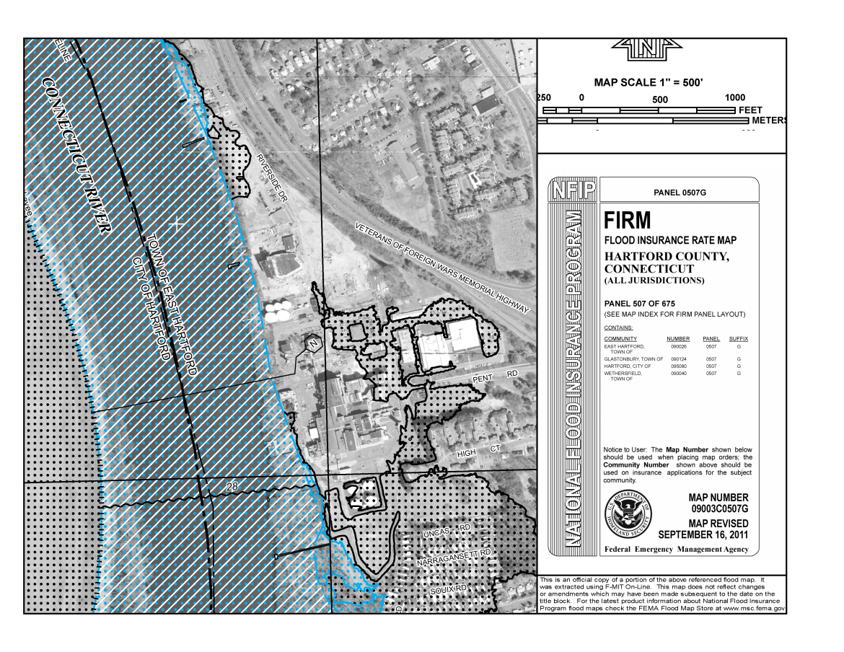
Is Your Project Within a FEMA Floodplain?
Go to FEMA Website:
http://msc.fema.gov/portal

Slide 3
Flood Management Certification (FMC)
Flood Management Certification (FMC) may be required if your project is funded by DOH and is within a FEMA Floodplain.
  FMC not required for: Planning Activities; Environmental Assessments or Abatement of Hazardous Building Materials.
  500-year floodplain
    If redevelopment plan includes a “Critical Activity” (Housing, Hospital, or School) FMC will be required.
  100-year floodplain
    Most redevelopment, demolition and remediation activity funded by DOH will require FMC.
  Statutory Reference: C.G.S. 25-68(b)-(h)

Slide 4

Flood Management Certification (FMC)
Three (3) options for Flood Management Certification:
  DOH General Certification for Minor Activities ;
  Individual Permit;
  Exemption (requires application to DEEP).
Applicant’s Professional Engineer completes FMC application.
Some projects can utilize the DOH Flood Management General Certification for Minor Activities.
DOH will work with the municipality to ensure that a building permit will not be issued unless the FMC for the redevelopment is approved by DEEP.

Slide 5
General Certification for Minor Activities
DOH has been granted a Flood Management General Certification for Minor Activities by DEEP.
The General Certification covers 15 types of minor activity including:
  Streetscape Projects;
  Demolition of an Existing Structure;
  Housing & Public Building & Historic Building Rehabilitation Projects (minor activities):
    Limited to the existing structure.
    Square footage of the building will not be increased.
    Work should be limited to 50% of the market value.

