Slide 1
How to Be an Informed Investor
State of Connecticut, Department of Banking
Securities & Business Investments Division
Notes:
Good evening….
Thank you for coming…

Slide 2
How to Be an Informed Investor
The mission of the Department of Banking is to protect users of financial services from unlawful or improper practices by requiring that regulated entities and individuals adhere to the law, assuring the safety and soundness of state chartered banks and credit unions, educating and communicating with the public and other stakeholders, and promoting cost-efficient and effective regulation.
Consumer Credit Division
Financial Institution Division
Securities and Business Investments Division
Notes:
Read Mission statement
Explain 3 divisions and what they regulate
Refer to pamphlet
Refer to title
Give my title and explain what I do at the Division

Slide 3
How to Be an Informed Investor
Make Your Money Work for You!
Set aside what you can for savings.
Pay yourself first before spending on extras
you don’t need.
Before investing in securities, have enough money
on hand for emergencies.
Notes:
It is important to set aside what you can for savings. A good goal would be to save anywhere from 6mos – 1 years’ worth of living expenses for you and your family. We never know what kind of emergencies can come our way, but it is better to be prepared. We should all do our best to prepare ourselves for emergencies like car repairs, home repairs and anything else that cannot be foreseen but is absolutely necessary.
The next thing that is important to do is to pay yourself before spending on extras we don’t need….we all need to save for retirement and make sure we account for inflation. Everything from gas for the cars to food seems to be getting more expensive.
The average life expectancy for a man in CT is 78 and for a women in CT is 82…we have an extra 4 years to figure out!!

Slide 4
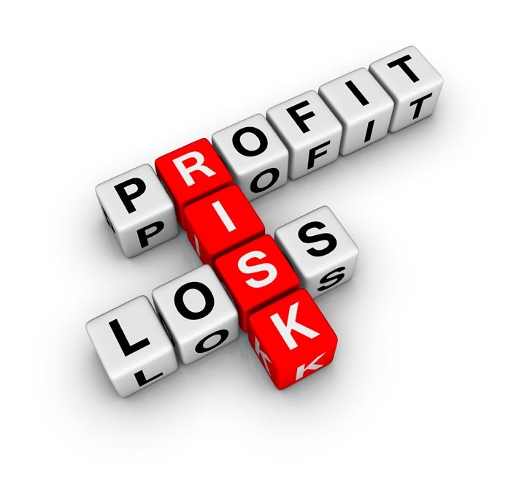
How to Be an Informed Investor
Before Investing……
Know Your Risk Tolerance!
Notes:
Definition of risk tolerance:
Its an individual’s realistic understanding of his or her ability and willingness to stomach large swings in the value of his or her investments…….. Let’s see what a financial professional has to say about risk tolerance.

Slide 5

How to Be an Informed Investor
Notes:
So how are we feeling about risk tolerance? Does everyone know where they stand as far as whether you are aggressive versus conservative…not only in investing, but in general as it concerns to your finances…
I have a risk tolerance quiz here- let’s take it….
View this clip

Slide 6

How to Be an Informed Investor
Can You Afford to Risk it All?
I Want To:
Keep My Money Safe (little risk allowed)
Receive a regular income stream
Let my money grow long term (more risk)
Speculate in the stock market and risk losing everything that was invested
Notes:
So what are some pros and cons of being conservative?
Aggressive?

Slide 7

How to Be an Informed Investor
Questions/Comments??

Slide 8
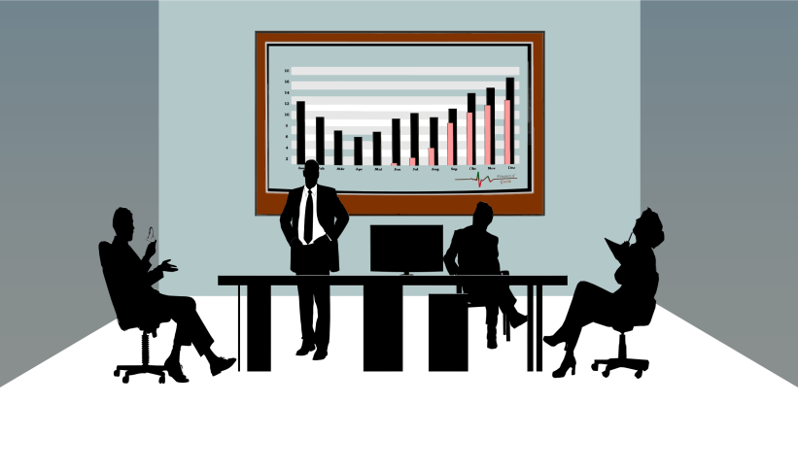
How to Be an Informed Investor
Choosing a Financial Professional
Individuals regulated by the Securities and Business Investments Division:
Financial Professionals (who offer/sell securities)
Notes:
There is a very broad spectrum in the types of individuals that are registered with my division…from lawyers and accountants to…I went to visit one investment adviser that owns and maintains a horse farm when hes not working with the financial markets and his clients…
All of these individuals are separated into two types…

Slide 9
How to Be an Informed Investor
Compensation – generally commissions based on what products are bought/sold
Is primarily focused on specific account(s) that are being managed, but does consider clients’ risk tolerances
Broker-dealer Agent
Investment Adviser Agent/ Financial Planner
Typically compensated by a % of assets under management or a flat fee
May also assist with budgeting and generally considers entire ‘financial picture’ of client
Notes:
Explain slide….
Any questions??

Slide 10

How to Be an Informed Investor
What is a Security?
  It is an investment of money.
  There is an expectation of profits from the investment.
  The investment of money is in a common enterprise
  (a business, company or project).
  Any profit comes from the efforts of a promoter or third party.
Notes:
Discuss employment background *2 mins* - and explain how when arrived at DOB didn’t know what criteria was used to determine whether an investment was a ‘security’. One explanation given to me was HOWEY test.
This Howey test came from a Supreme Court case that was decided on May 27, 1946…and in resolving that case the criteria for determining whether an investment was a security was established.
The four points in the criteria are……refer to slide.

Slide 11
How to Be an Informed Investor
Common Types of Securities
Mutual Funds
Stocks
Bonds
Notes:
Please refer the ‘5 Keys to Investing Success’ pamphlet…if you flip to the last page there is a glossary and it summarizes what each type of security is….go to pamphlet…
Now…there are also some other types of securities and investments that I am sure that you may have heard of…one investment that some people seem to be interested in lately is bit coin…
If you have never heard of bit coin before *refer to e-wallet page*
Now, what I thought was interesting about bitcoin is that it is not heavily regulated or, like I mentioned earlier, backed by a central bank…it’s a very volatile type of currency…
The risks associated with using bit coin are….
In all investments, there is a potential for unethical business practices , no matter how regulated the particular product is….the next clip we are going to look at will discuss how to be prepared and how to avoid scams and dishonest business practices

Slide 12

How to Be an Informed Investor
What do you know about SCAMS??
Notes:
I recently asked my 6 years old last night…about scams….and she says “Its when someone tries to trick you…so you have to be ready!’
And that is right…the best way to avoid being a victim of a scam is to be aware of potential red flags and have resources that you can rely on to check out the credentials of the individuals that approach you and try to get you to invest or get involved in financial products that you are not familiar with…
Refer to Investor Education resources sheet
View clip

Slide 13
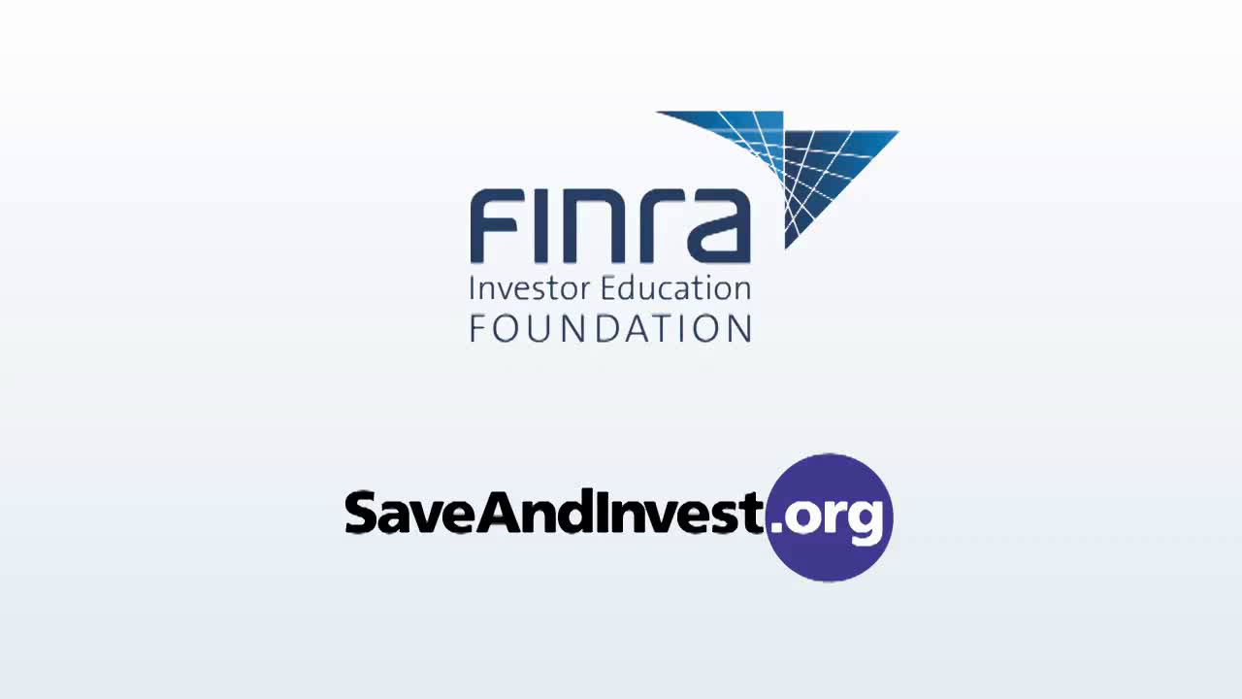
How to Be an Informed Investor
How to Avoid Being Scammed!!
Notes:
View this clip

Slide 14

How to Be an Informed Investor
Additional Red Flags
to Avoid…
“Low risk, high return”
“Guaranteed against loss”
Pay Now, Think Later (High Pressure Sales)
Telemarketer/ Spam E-mail/ Internet
Marketing Ploys – Free Investment Seminars; Questionable titles (Senior Specialist)
Notes:
Recently we have had some cases in the Division: Johnson and Nielsen case
If any financial professional is doing anything related to your financial affairs that you do not understand, always ask as many questions as you need to. And, if you still can’t understand what is going on…then that is the wrong financial profession for you!!
I hope you learned something this evening…or something that was said got the wheels turning in your mind and now you feel more equipped with the information provided to handle in financial matters that your dealing with, or maybe now you can steer a friend or family member in the right direction…

Slide 15
How to Be an Informed Investor
Questions/Comments??

Slide 16

CONTACT US
State of Connecticut Dept. of Banking
Securities Division
260 Constitution Plaza
Hartford, CT 06103-1800
http://www.ct.gov/dob
Agency Telephone Numbers:
(860) 240-8230 or
1-800-831-7225 toll-free

