Slide 1


Targeted Case Management
TCM

Slide 2

What We Will Cover in This Training
Definition of TCM
The Targeted Population
TCM providers
TCM levels of Care
TCM Service Codes
CLAMP
TCM Documentation
Record Retention
Fiscal Overview
RMTS

Slide 3
What is Targeted Case Management?
Targeted Case Management (TCM) is a set of services provided to a Target Population that helps our clients gain access to needed medical, clinical, social and educational services to improve the quality of their lives.
TCM services are reimbursable through Medicaid.

Slide 4
What is Targeted Case Management?
TCM in Connecticut is defined within the Medicaid State Plan Amendment (SPA) which has been approved by the Centers for Medicare and Medicaid (CMS). In Ct. The Department of Social Services is the agency responsible for oversight of Medicaid and the SPA.

Slide 5
What is Targeted Case Management?
The Medicaid State Plan Amendment (SPA) defines TCM services as: “services furnished to assist individuals eligible under the State Plan in gaining access to needed medical, social, educational, and other services.”
The Medicaid Provider Manual defines case management services as “the continuum of assessment, planning, linkage, support and advocacy activities systematically carried out by an individual case manager that are available to assist and enable an individual to gain access to needed medical, clinical, social, educational or other services.”

Slide 6
Who is the Target Population for TCM?
DSS defines the TCM target population based on ICD10 diagnosis codes.
In Connecticut, the TCM target population is defined as “individuals with serious chronic mental illness inclusive of individuals with substance use disorders and co-occurring mental illness.”

Slide 7

Who is the Target Population for TCM?
DSS maintains an updated approved codes list in Table 17 at https://www.ctdssmap.com/CTPortal/Portals/o/StaticContent/Publications/Fee Schedule Instructions.pdf

Slide 8
TCM Providers
Qualified Providers must have training, experience and expertise working with their target population.
Details on the requirements that staff members must have to provide TCM services are outlined in the Medicaid State Plan Amendment (SPA).
On a quarterly basis, TCM providers enroll staff in the Random Moment Time Study (RMTS).

Slide 9
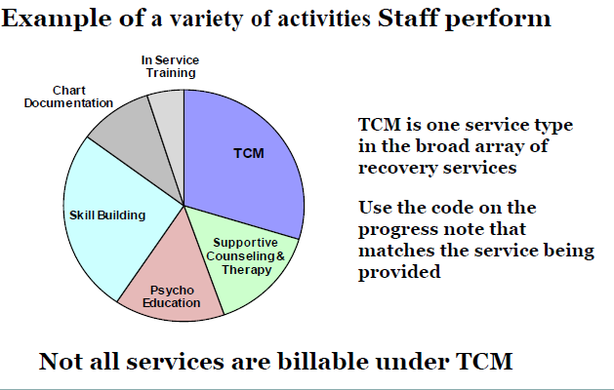
Recovery Services

Slide 10
TCM Levels of Care
DMHAS has identified the following levels of care (LOC) for which TCM is expected:
Assertive Community Treatment
Community Support Programs
MH Case Management
MH Intensive Residential
MH Residential Support
MH Supervised Apartments
MH Supportive Housing
MH Transitional Residential

Slide 11
TCM Service Codes
DDAP TCM Codes:
TCM01 – face to face with client
TCM02 – on the phone with client
TCM03 – with collateral
TCM04- Audio and Visual with the client (Effective November 1, 2020)
All TCM services can occur in the context of these 4 codes

Slide 12
What are TCM Services?
C L A M P
Coordination
Linking
Accessing, Assessing and Advocacy
Monitoring
Planning
When this set of services is included in the Treatment Plan, they should be documented and coded as TCM.

Slide 13
COORDINATING
Coordinating Services, Resources &Plans
Coordination of care that involves a person interacting with external resources.
Coordinating referral or supports
Coordinating schedules and appointments with outside agencies for or with the client.
Coordinating a plan of services, reviewing services and activities to ensure that the plan continues to meet the wants and needs of the client.

Slide 14

COORDINATING
Example: A client’s mother calls, asking what resources are available in the community to help educate her family on her son’s illness. You refer the mother to the National Alliance on Mental Illness (NAMI).

Slide 15

LINKING
Linking to Services & Resources
Linking a client to outside resources.
Linking the client with providers and other agencies to obtain services which addresses the client’s needs and helps them achieve the goals documented in their recovery plan.

Slide 16
LINKING
Example: Your client comes to your office and complains that he is isolated and lonely. You link him to Toivo, which is run by an external mental health agency, Advocacy Unlimited.

Slide 17

ACCESSING
Linking and Referring to Needed Services
Services that assist and enable the client to gain access and maintain needed medical, clinical, social, educational or other services.

Slide 18
ACCESSING
Example: Your client calls you and says his roommates are harassing him and threatening to kick him out of his apartment. You help the client access legal assistance through Connecticut Legal Rights Project (CLRP) to discuss his housing rights.

Slide 19

ASSESSING
Comprehensive assessments at admission.
Reassessments performed at least annually.
Assessments and reassessments completed for the purposes of developing a treatment plan or a treatment plan update.

Slide 20
ASSESSING
EXAMPLE: A new client is enrolled at your agency. You administer a complete biopsychosocial to assess the needs to be addressed on the treatment plan.

Slide 21

ADVOCACY
Helping a client obtain something they desire; eliminating a barrier.

Slide 22
ADVOCACY
Example: Your client loses their job at the grocery store due to tardiness. Since then you and the client have been working on strategies to help him wake up on time. You then reach out to the grocery store manager to advocate for the client to get his job back and assure the store manager that he has learned new skills to minimize the issue such as using multiple alarm clocks and working on better sleep habits.

Slide 23
MONITORING
Monitoring progress of a treatment plan objective, clearly identified in the intervention as a monitoring activity, not routine follow-up.
Activities are necessary to ensure the plan is implemented and adequately addresses the client’s needs.
Services in the recovery plan are adequate.

Slide 24

MONITORING
Changes in the needs or status of the individual are reflected in the service plan.
Adjustments in the plan and service arrangements with providers are made as necessary and as situations change with the client.

Slide 25
MONITORING
Monitoring can be provided:
Face to face or by telephone
In a case conference with the client present
Through collateral contact with family, friends, providers and others
Conducted as frequently as prescribed in the recovery plan.

Slide 26
Monitoring
Example: The nurse, as part of the treatment plan, is going to monitor the side effects of the client’s new medication on a monthly basis. The nurse will monitor through bloodwork and client self report. Each monthly monitoring activity is 1 TCM for as long as this activity is an intervention on the treatment plan.

Slide 27
CONFUSION ABOUT MONITORING
What it is & What it is not
Monitoring involves active observation of the service plan to make sure it is being properly implemented and meets the needs of the client.
Monitoring also involves consistent help in identifying problems, modifying plans, ensuring resources are available to achieve goals and/or the objective has been achieved, and monitoring the client’s participation in the plan.
Monitoring assures services are delivered as documented in the service plan, services in the plan are adequate for the client and that necessary adjustments are made in the service plan when changes are needed.

Slide 28
CONFUSION ABOUT MONITORING
What it is & What it is not
Confusion about the self administration of medication. Medication delivery is not a TCM activity. Nor is supervising/observing clients take their medication.
The client needs to have full access to their medications and make a choice to take or not take them. The monitoring occurs when in the service plan it is written that the staff will monitor that client has taken their medication in a specific time frame (example; weekly) and that the staff person monitors via looking in the pill box or counting pills in a pill bottle.

Slide 29

PLANNING
Planning with a client on any specific aspect of their goals and needs, or by participating in a treatment planning conference with a client, the client’s other providers and any natural supports.

Slide 30
PLANNING
Example: Your client meets with you to discuss the possible side effects of alcohol on his depression. You discuss possible interventions to include on the plan to reduce his alcohol intake over the next 6 months.

Slide 31
TCM DOCUMENTATION
In order to use a TCM code there must be the following items;
Initial and Ongoing Assessments- these determine the need for any medical, social, educational and other services.
Assessment activities include taking a client history, identifying needs, completing related documentation and gathering information from other sources.
Reassessments occur at least annually but may be done more frequently.
Includes a diagnosis. Have the client sign a release of information (ROI) for record reporting and DDaP.

Slide 32
TCM DOCUMENTATION
2. An Active Recovery Plan that identifies the plan for services.
Identifies areas of need
Has TCM goals and objectives
Has TCM interventions with anticipated duration, frequency, target dates and person(s) responsible.
Client signature or evidence of client participation-Use quotes- Document why the client refuses to sign or refuses to participate if that is the case.

Slide 33
TCM DOCUMENTATION
3. The Progress Note documents the services being delivered.
The activity provided must reference a Goal in the recovery plan.
The Intervention (What you did) and the client’s Response to the intervention must be documented.
The Plan for the next encounter must be documented.

Slide 34
Lets go back to the examples
A client’s mother calls, asking what resources are available in the community to help educate her family on her son’s illness. You refer the mother to the National Alliance on Mental Illness (NAMI).

Slide 35
TCM DOCUMENTATION
Writing the Note
Goal- “ I want to feel better and get rid of the stress in my life”
Mrs. Jones called this clinician(job title)upset that her husband and family are having difficulty with their son’s behavior and inconsistent use of his psychotropic medications. Mrs. Jones expressed that her husband and Jim(name of client) have been fighting a lot and everyone is feeling stressed and anxious. This clinician informed and suggested coordinating(TCM service) a referral to NAMI.(Intervention) Mrs. Jones was pleased to hear of a community resource that focuses on supporting the family of someone with mental illness. She commented that her husband might not be willing to go with her.(Response) I asked Mrs. Jones to call me after she attends her first meeting to discuss if she feels this a good option for her or to explore other possible resources.(Plan)
C.M. Zambetti, LPC, LADC(name of person providing the service and job title/credentials)2/25/20(Date)Start 11:16-End11:42 (Units) Total 26 minutes (Duration) collateral in staff office (Location)

Slide 36
Lets go back to the example
Your client comes to your office and complains that he is isolated and lonely. You link him to Toivo, which is run by an external mental health agency, Advocacy Unlimited.

Slide 37
TCM DOCUMENTATION
Writing the Note
Goal-” I want friends to hang out with and a girlfriend.”
Brian(Name of Client) came to this Case Manager’s (Job title) office. He appeared somewhat anxious and expressed that he has been feeling lonely and hasn’t seen his friends in a long time. This C.M. suggested linking(TCM service) him Toivo and informed that there are lots of opportunities to meet people, participate in groups, and make friends. (Intervention) Brian stated he was willing to give it a chance and said he might be interested in a meditation group also.(Response) Will meet Brian Thursday to explore and set up transportation for him to get to the location which is out of town.(Plan for the next session)
C. M. Zambetti, LPC, LADC (name of person providing the service and job title/credentials) 2/25/20 (Date) Start 2:08-End 2:44 (Units) Total 36 minutes(Duration) Face to Face in staff office.

Slide 38
Lets go back to the examples
  A client calls her Case Manager and says her roommates are harassing her and are threatening to kick her out of the apartment. The Case Manager helps the client access legal services through Connecticut Legal Rights Project (CLRP) to discuss her housing rights.

Slide 39
TCM DOCUMENTATION
Writing the Note
Goal- “ I want to stay in my apartment so I can get my kids back”
Cathy (name of client) called upset that she hasn’t been getting along with her roommates and they have been fighting about chores. They threatened that if she doesn’t keep the kitchen clean they are going to kick her out of the apartment. This Case Manager(job title)calmed her down and reassured her that she has rights as a tenant . This worker informed Cathy about CLRP and how they help people with housing issues like hers.(Intervention) Cathy seemed relieved when she heard that she had the right to stay in her home.(Response) Cathy will come in at 3pm today and help her access(TCM Service) CLRP regarding his housing issue.(Plan for next session)
C. M. Zambetti, LPC, LADC (Name of person providing the service and job title/credentials) 2/25/20 (Date) Start 10:02- End 10:21 (Units) Total 19 minutes (Duration) Phone in staff office (Location)

Slide 40
Lets go back to the examples
A new client is admitted into your program. The Clinician administers a complete biopsychosocial to assess the needs to be addressed on the Treatment Plan.

Slide 41
TCM DOCUMENTATION
Writing the Note
Goal “ I want to be healthier so I feel better and can get a job”
This clinician(Job title) administered a comprehensive assessment to assess(TCM Service) Linda’s (Client name) skills and areas of need to develop her treatment plan.(Intervention) Linda was cooperative, engaged and willing to answer the questions. She appeared interested in lowering her blood pressure and eating better since she was told recently by her PCP that she is obese and needs to lose weight.(Response) Meet next Wednesday to develop her treatment plan.(Plan for nest session)
C. M. Zambetti, LPC,LADC (Name of person providing the service and job title/credentials) 2/25/20 (Date) Start 11:00- 12:02(Units) Total 62 minutes (Duration) Face to Face staff office (Location)

Slide 42
Lets go back to the examples
  The client losses their job at the local grocery store due to tardiness, the client and the Employment Specialist have since been working on strategies to help the client wakeup on time. The Employment Specialist reaches out to the grocery store hiring manager to advocate for the client to get his job back, and ensures the client has learned new skills to minimize this issue such as using multiple alarm clocks, and working on better sleep habits.

Slide 43
TCM DOCUMENTATION
Writing the Note
Goal- “ I want to get a job so I have money to do fun things”
This Employment Specialist(job title) called Eric’s(name of client) former boss at Big Y where he used to work. This ES stated that Eric expressed that he really liked his job and would like to come back. When the Manager listed the issues he had with Eric that led to his termination this ES advocated(TCM service) for Eric to be given another opportunity. This ES explained that Eric has been working on going to bed and getting up on a regular schedule and using an alarm clock, and that Eric says he feels much less tired since he has made these changes to his sleep routine. (Intervention) The manager seemed pleased that Eric heard his concerns and commented that Eric was a good worker when he showed up.(Response) Eric and this ES to meet with the Manager next Monday to discuss the possibility of being rehired. (Plan for the next session)
C. M. Zambetti, LPC, LADC (name of person providing the service and job title/credentials) 2/25/20 (Date) Start 2:45-End 3:05 (Units) Total 20 minutes (Duration) Collateral in staff office.(Location)

Slide 44
Lets go back to the examples
  The nurse, as a part of treatment plan, is going to monitor the side effects of the client’s new medications on a monthly basis. The nurse will monitor through blood work and client self report. Each monthly monitoring activity is 1 TCM for as long as this activity is an intervention on the treatment plan.

Slide 45
TCM DOCUMENTATION
Writing the Note
Goal- “get off these meds that make me feel tired and depressed so I can be a good mother to my 2 boys”
This Nurse (Job Title) met with Belinda(name of client) to monitor (TCM service) her response after one month on her new medication clozapine. Reviewed with Belinda that her bloodwork came back normal and asked her how she was feeling since starting.(Intervention) Belinda expressed concern that she had gained some weight and felt bloated.(Response) This Nurse did confirm that there could be some weight gain and encouraged her to look at her diet and exercise more.(Intervention) Belinda was pleased her bloodwork was good and commented that she really did not like exercise.(Response) Meet next month to review lab results and to look at some ways to add some exercise to her daily routine. (Plan for the next session)
Susan Jones, LPN (name of person providing the service and job title/credentials) 2/25/20(Date) Start-3:30-End 3:55(Units) Total 25 minutes(Duration) face to face in office.

Slide 46
Lets go back to the examples
A client meets with you to discuss the possible side effects of alcohol on his depression. You discuss possible interventions to include on the plan to reduce his alcohol intake over the next 6 months.

Slide 47
TCM DOCUMENTATION
Writing the Note
Goal- “I want to stop taking medication because it makes me feel like crap”
This counselor(job title) met with Bob(Name of Client) following completion of his substance use assessment. This counselor explained that Bob’s use puts him in the risky category for future abuse and as a depressant may be having a negative impact on his depression.(Intervention). Bob expressed that he does not want to stop drinking but was willing to look at a plan at reducing his intake(Response).Bob and I came up with a plan (TCM service) to reduce his weekly consumption while still being able to enjoy more than 1, but less than 4 alcoholic beverages on the weekends.(Intervention) Will meet with Bob two Mondays from today and review Bob’s adherence to the plan and discuss any changes in his level of depression(Plan for the next session)
C.M. Zambetti, LPC, LADC (name of person providing the service and job title/credentials) 1/04/20(Date) Start9:02- End9:52 (Units)Total 50 minutes(Duration) face to face in client’s apartment(Location)

Slide 48
TCM DOCUMENTATION
Writing the Note
Progress Notes:
Tell a story- a good story has a beginning, middle and end.
Provide a narrative of the objectives and interventions that have been worked on.
Details the client’s progress in taking small steps to achieve life goals that are important to them.
Provides a summary of the work and progress that has been made for the next Recovery Plan update.

Slide 49
TCM DOCUMENTATION
Writing the Note
Services to clients who have no assessment, no treatment plan, or an expired treatment plan cannot be billed.
Services to clients in an inpatient setting, nursing home, or jail cannot be billed. Double billing is prohibited. Please ensure that the service location is input into DDaP.

Slide 50
TCM DOCUMENTATION
Writing the Note
TCM codes cannot be used for conducting collateral services within your organization.
TCM codes cannot be used for medical, educational, social or skill building services.

Slide 51
TCM Services
TCM Services actively involve care coordination where staff interacts with an external resource (provider, family, friends, community members) to your own agency.
TCM can also be any service that involves assessment, recovery planning or monitoring progress toward a Recovery Plan objective.

Slide 52
Examples of TCM Services
Coordinating dental or medical care.
Coordinating transportation.
Helping a client enroll to get his GED.
Monitoring client’s adherence to their budget.
Helping a client connect to a new church.
Monitoring a client’s adherence to medication.
Assisting a client to find new housing.

Slide 53
Non- TCM Services
All other types of services that involve teaching, explaining, counseling, transporting, psycho-education, coaching, researching, etc.
Many of the services provided in your programs are not TCM but skill building or case management.

Slide 54
Examples of Non-TCM services
Transportation
All skill building activities
Providing ADL’s
Medication delivery
Medication supervision/observation
Paying bills for a client
Helping a client move to a new apartment
Unsuccessful attempts at services- no shows, calling and leaving messages, cancellations
Texts and emails are not TCM services.

Slide 55
Use Language as a Signal
What you did determines the type of intervention …NOT the verb you use in the note to describe the intervention.
TCM: Coordinated care with…, attended a treatment planning meeting for.., assessed progress on..
Skill Building: Taught, prompted, coached, role played, demonstrated, cued, practiced
Case Management: Counseled, transported, supervised, assisted with, practiced

Slide 56
TCM Audits / Record Retention
Each provider agency is responsible for internal TCM audits and accurate reporting of services into DDAP or WITS.
Providers should conduct monthly reviews to verify required data is collected and submitted to DMHAS, and that data entered into the DMHAS data systems is complete and accurate. You can use the DDAP “TCM Missing Data” report to check the accuracy of your data
Providers should retain records for a minimum of 7 years from date of discharge.
External auditors (DSS, State Auditors, OIG) may audit TCM services and/or rates.

Slide 57
TCM Billing Overview
Maintaining TCM revenue is critical for DMHAS operated and contracted providers in mitigating potential service reductions.
The general fund allocates money to fund DMHAS services.
Providers enter TCM services (including service location) into DMHAS data systems (DDaP).
DMHAS Fiscal extracts TCM services from the data system and screens data for client Medicaid eligibility and covered diagnosis.

Slide 58
TCM Billing Overview(Cont.)
Medicaid payment for TCM is a statewide weekly rate.
DMHAS submits eligible services to Department of Administrative Services (DAS), the billing agent.
DAS submits claims to the CT DSS Medicaid claims processing vendor.

Slide 59
TCM Billing Overview(Cont.)
DSS bills the federal Centers for Medicare and Medicaid Services (CMS).
CMS reimburses CT for TCM services at 50% Federal Financial Participation (FFP).
TCM reimbursements are deposited to the state’s general fund.
The general fund is the source of funds allocated to fund DMHAS services.

Slide 60
TCM Billing Overview (Con’t.)
DMHAS currently has two data reports available to monitor TCM data and services: The “TCM Missing Data Report” and the “TCM Service Intensity Report.” Both are located in the EDW.
The “TCM Missing Data Report” identifies issues with the data submitted to DMHAS that is essential for billing purposes.

Slide 61
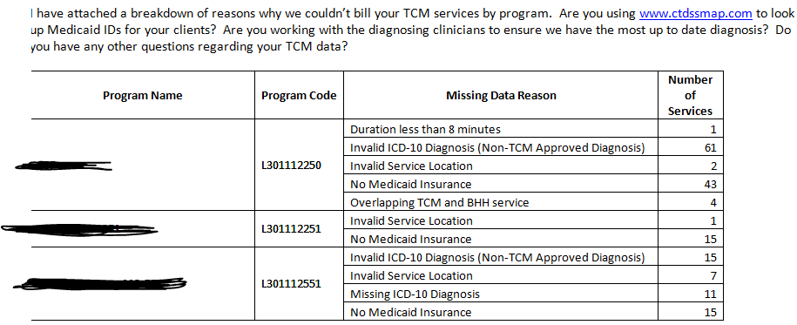
TCM Billing Overview (Con’t.)
TCM Missing Data Report

Slide 62
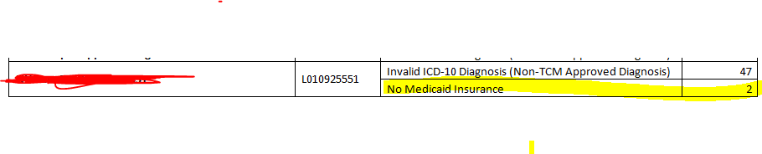
TCM Billing Overview (Con’t.)
TCM Missing Data Report
Agencies should routinely run the TCM Missing Data Report and identify and correct any fixable data errors identified.
You can use www.ctdssmap.com to look up Medicaid ID#’s

Slide 63
TCM Billing Overview (Con’t.)
Service Intensity TCM Report
The EDW contains a second report to monitor TCM activity- the “Service Intensity TCM” Report.
This report looks at data submitted to DMHAS about the amount of TCM services Provided.

Slide 64
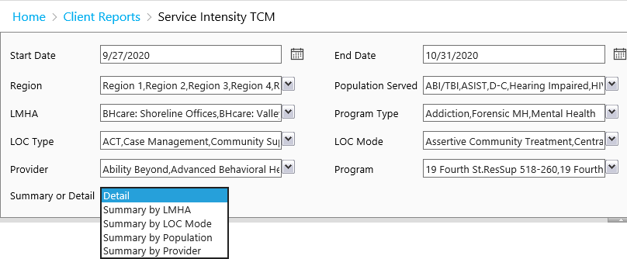
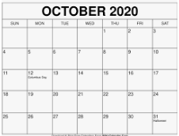
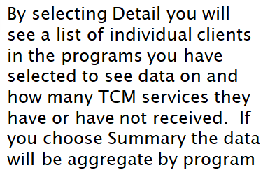
TCM Billing Overview (Con’t.)
Service Intensity TCM Report

Slide 65
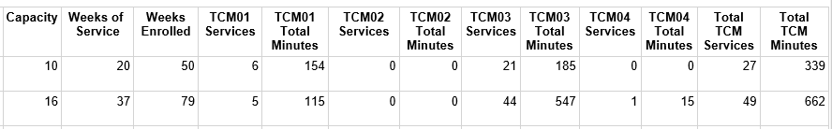
TCM Billing Overview (Con’t.)
Service Intensity TCM Report

Slide 66
CMS Required Rate Setting Process Random Moment Time Studies (RMTS)
CMS sets guidelines which require states to set adequate and efficient rates.
Provider staff time is spent performing a variety of tasks, so CMS requires that we randomly sample activities to determine the percentage of staff time spent on the delivery of TCM services.
UMASS is the vendor that administers the RMTS for DMHAS.

Slide 67
CMS Required Rate Setting Process Random Moment Time Studies (RMTS)
Each quarter, agencies provide DMHAS/UMASS with a roster of staff members to be included in the RMTS.
RMTS roster participants from State operated facilities should include all qualified staff that are reasonably expected to perform TCM services.
RMTS roster participants from Private Non-Profit agencies should include all staff from each TCM program.
The RMTS results are used to determine the TCM allowable direct costs for TCM rate setting purposes.

Slide 68
TCM TIPS
Document what you did then code it correctly. Don’t bend the language to make it a TCM service when it is not.
Don’t let your Recovery Plan expire.
Document the client’s participation in the development of the plan through the use of quotes and a signature, or document why the client did not participate.
Document a detailed plan for the next session.

Slide 69
SUMMARY
Maintaining TCM revenue is critical in mitigating potential service reductions.
DMHAS can only bill for TCM services that are properly coded and documented.
TCM services cannot be billed if the Recovery Plan is expired.
TCM focuses on “CLAMP” services

Slide 70
SUMMARY
TCM services cannot be billed for people in hospitals, jails or skilled nursing facilities.
Use the TCM Missing Data Report to determine why DMHAS did not bill a service.
Use the TCM Service Intensity Report to evaluate how many TCM’s each program is providing.

Slide 71
Contact Information
If you have additional questions please contact:
Carleen.Zambetti@ct.gov for TCM program questions
Lauren.Staiger@ct.gov for TCM billing questions
Vanessa.O’Neal-Campbell@ct.gov
for RMTS questions

Slide 72



