Slide 1
Silver Jackets Overview
CT Silver Jackets Team
19 JAN 2022

Slide 2
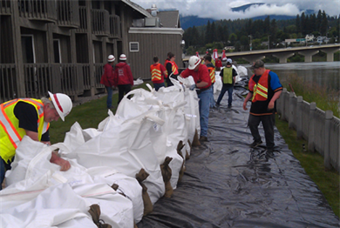
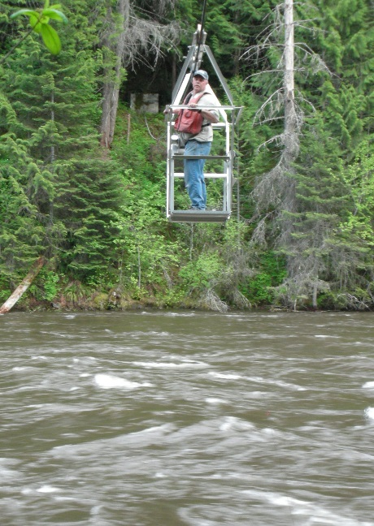
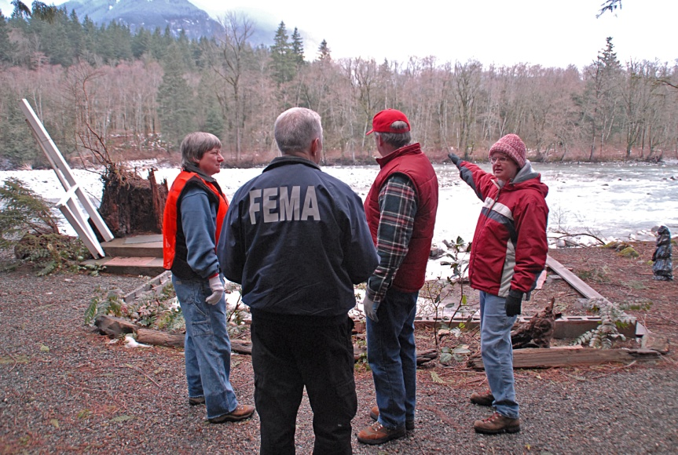
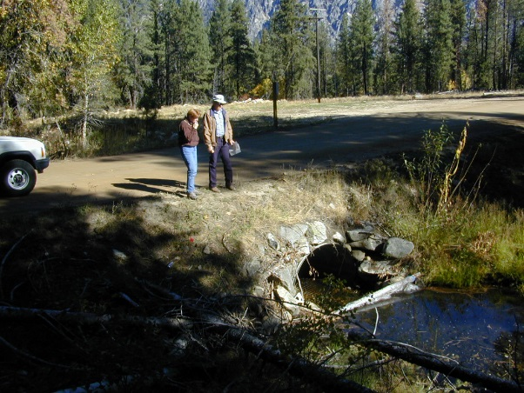
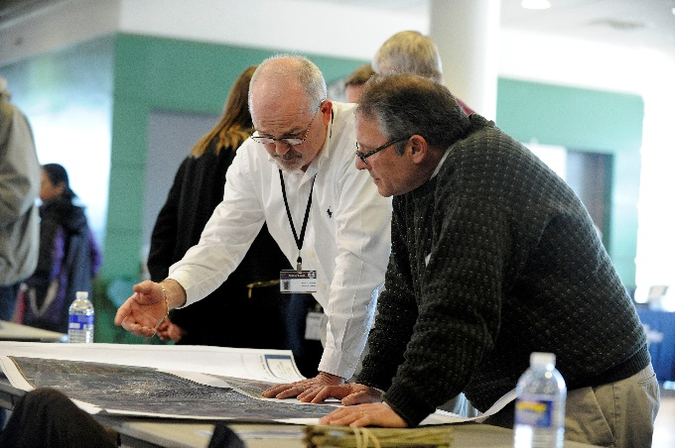
Silver Jackets . . .
State-led flood risk management teams.
USACE National Silver Jackets Program – component of National Flood Risk Management Program (NFRMP)
Notes:
An interagency team that coordinates and collaborates to manage and reduce flood risk
State-level implementation of USACE National Flood Risk Management Program.
Silver Jackets helps the Corps focus its expertise and resources on efforts that will help the state or local communities manage or mitigate their flood risk

Slide 3
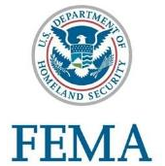
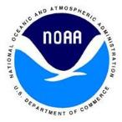
State SJ Team Participation
State
Typically - State Hazard Mitigation Officer and National Flood Insurance Program Coordinator
Others – Emergency Managers, Water Boards, Transportation Dept., Environmental Protection, Geographic Information System Analysts
Federal
Typically - FEMA, NOAA NWS, USGS, USACE
Sometimes - EPA, DOT, HUD, NRCS, NOAA OCM
Region Specific - BLM, USFS, USFWS, USBR, NPS
Others - Tribes, local governments, NGOs, universities, and/or private
Notes:
Team membership and focus will vary by state. At a minimum teams comprised of state NFIP coordinator and state hazard mitigation officer and usually FEMA. Participation by many other agencies as well, usually NOAA NWS USGS, NRCS, EPA, HUD, USBRS, USFS, universities and NGOs

Slide 4
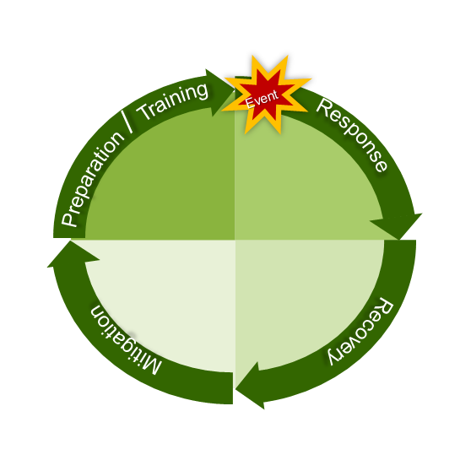
TEAM VISION & MISSION
Innovate and collaborate to facilitate and contribute to comprehensive and sustainable management of flood risk throughout the state of Connecticut.
Find ways to share and combine our agencies’ resources (funding, programs, and technical expertise).
Assist with identifying and communicating flood risk, and mitigating and managing flood risk, consistent with the State Hazard Mitigation Plan.
Team looks at whole risk management life-cycle

Slide 5
SILVER JACKETS PROJECTS IN NEW ENGLAND
Connecticut Ice Jam Outreach
Connecticut Flood Toolkit
Connecticut Flood Education Materials
Maine Coastal High Water Mark Projects in Portland, York, So. Portland, Scarborough and Belfast
Maine Dynamic Inundation Model, Portland, So. Portland, Damariscotta
Vermont HEC-RAS Model and EAP, Brattleborough
Vermont Ice Jam Assessments
Massachusetts High Water Mark Project, Boston
New Hampshire Flood Hazards Geodatabase
New Hampshire Flood Toolkit
Rhode Island Historical Structure Flood Hazard Vulnerability Assessment
Rhode Island Floodplain Managers' Handbook

Slide 6
Questions?
FOR MORE INFORMATION
USACE Silver Jackets Web Site
http://silverjackets.nfrmp.us/
USACE NEW ENGLAND DISTRICT
SILVER JACKETS COORDINATOR
Sheila Warren, Sheila.M.Warren@usace.army.mil

