Slide 1
RecycleCT & What’s IN, What’s OUT update
Sherill Baldwin
Sustainable Materials Management, CT DEEP
Sherill.Baldwin@ct.gov

Slide 2
RecycleCT Foundation Update
Lee Sawyer Community Waste Reduction & Recycling Grant
RFP Sought Proposals that will Increase Waste Prevention, Reuse, Recycling and Composting in Connecticut
33 proposals received requesting $393,405.90​
On October 12, 2021, the RecycleCT Board approved fifteen projects awarding $150,406.49.
Waste Reduction & Reuse: $66,588.10
Recycling & Waste Diversion: $83,775.30

Slide 3
RecycleCT Foundation Update
Lee Sawyer CWR&R: Waste Reduction & Reuse = $66,588.10
Center for EcoTechnology, Inc. - $14,250.00 - Statewide
Statewide building deconstruction education, outreach and technical assistance for municipalities and businesses engaged in demolition.
Center for Food Equity and Economic Development/The Council of Churches of Greater Bridgeport – $14,250.00 – Greater Bridgeport, Fairfield County
Funds to purchase a van and online software to increase amount and efficiency of recovery food for human consumption, including the development of new products linking with job skill training and employment.
Haven’s Harvest - $13,062.50 – Greater New Haven, New Haven County
Expand food recovery by increasing outreach to new business donors/partners and increase deliveries of recovered food to new sectors and communities. Includes increasing awareness of safety of consuming recovered food.
Hebron Green Committee – $10,112.75 – Town of Hebron, Tolland County
Create a swap shack at the town transfer station including signage, outreach, and educational materials and public space recycling bins
EcoWorks, Inc. - $7,125.00 – Greater New Haven, New Haven County
Artist led educational programs for creative reuse using used art supplies and coordination of swap events.
Town of Old Saybrook/Rotary Club - $6,500.94 – Town of Old Saybrook, Middlesex County
Create a swap shop at the town transfer station.
Canterbury Public Library - $1,330.00 – Town of Canterbury, Windham County
Create a tool lending library at town library, model for replication.

Slide 4
RecycleCT Foundation Update
Lee Sawyer CWR&R: Recycling & Waste Diversion = $83,775.30
Connecticut Coalition for Environmental Justice - $14,250.00 – City of Hartford, Hartford County
Pilot food scrap collection program designed to reach Black, Indigenous and People of Color testing 3 different and new food scrap collection approaches (curbside, “ice cream truck” and “bus stop”). Includes education, model for replication.
City of West Haven - $14,250.00 – City of West Haven, New Haven County
Expand municipal leaf compost operation to include food scraps, develop protocols for monitoring static aerated piles and testing finished compost in addition to collecting food scraps for the program.
Fairfield Sustainable Task Force/Waste and Food Subcommittee - $14,250.00 – Town of Fairfield, Fairfield County
Small pilot to start of collecting food scraps and processing on-site with food waste digester. Plans for expanding if successful, model for replication.
Housatonic Resources Recovery Authority - $14,250.00 – Town of Ridgefield, HRRA region, Fairfield and Litchfield Counties
Expand food scrap collection, composting-on site at town transfer station, educate residents on home composting, create options for residents seeking to divert food scraps. Uses diverse partnerships, model for replication.
CLiCK - $10,366.40 – Greater Willimantic, Windham County
Recover food scraps from commercial incubator kitchen, educate members and community about home composting.
LEARN Transition Academy - $8468.80 – East Lyme, New London County
Expansion of worm composting program to manage food scraps working with special education young adults which includes job/life skills.
Hampton Green Energy Committee - $4,750.00 – Town of Hampton, Windham County
Engage community to better understand food waste issues and home composting; includes mailer and kitchen containers to incentivize home composting.
Town of Easton/Energy and Environmental Task Force - $3,190.10 – Town of Easton, Fairfield County
Printing to provide recycling education.

Slide 5
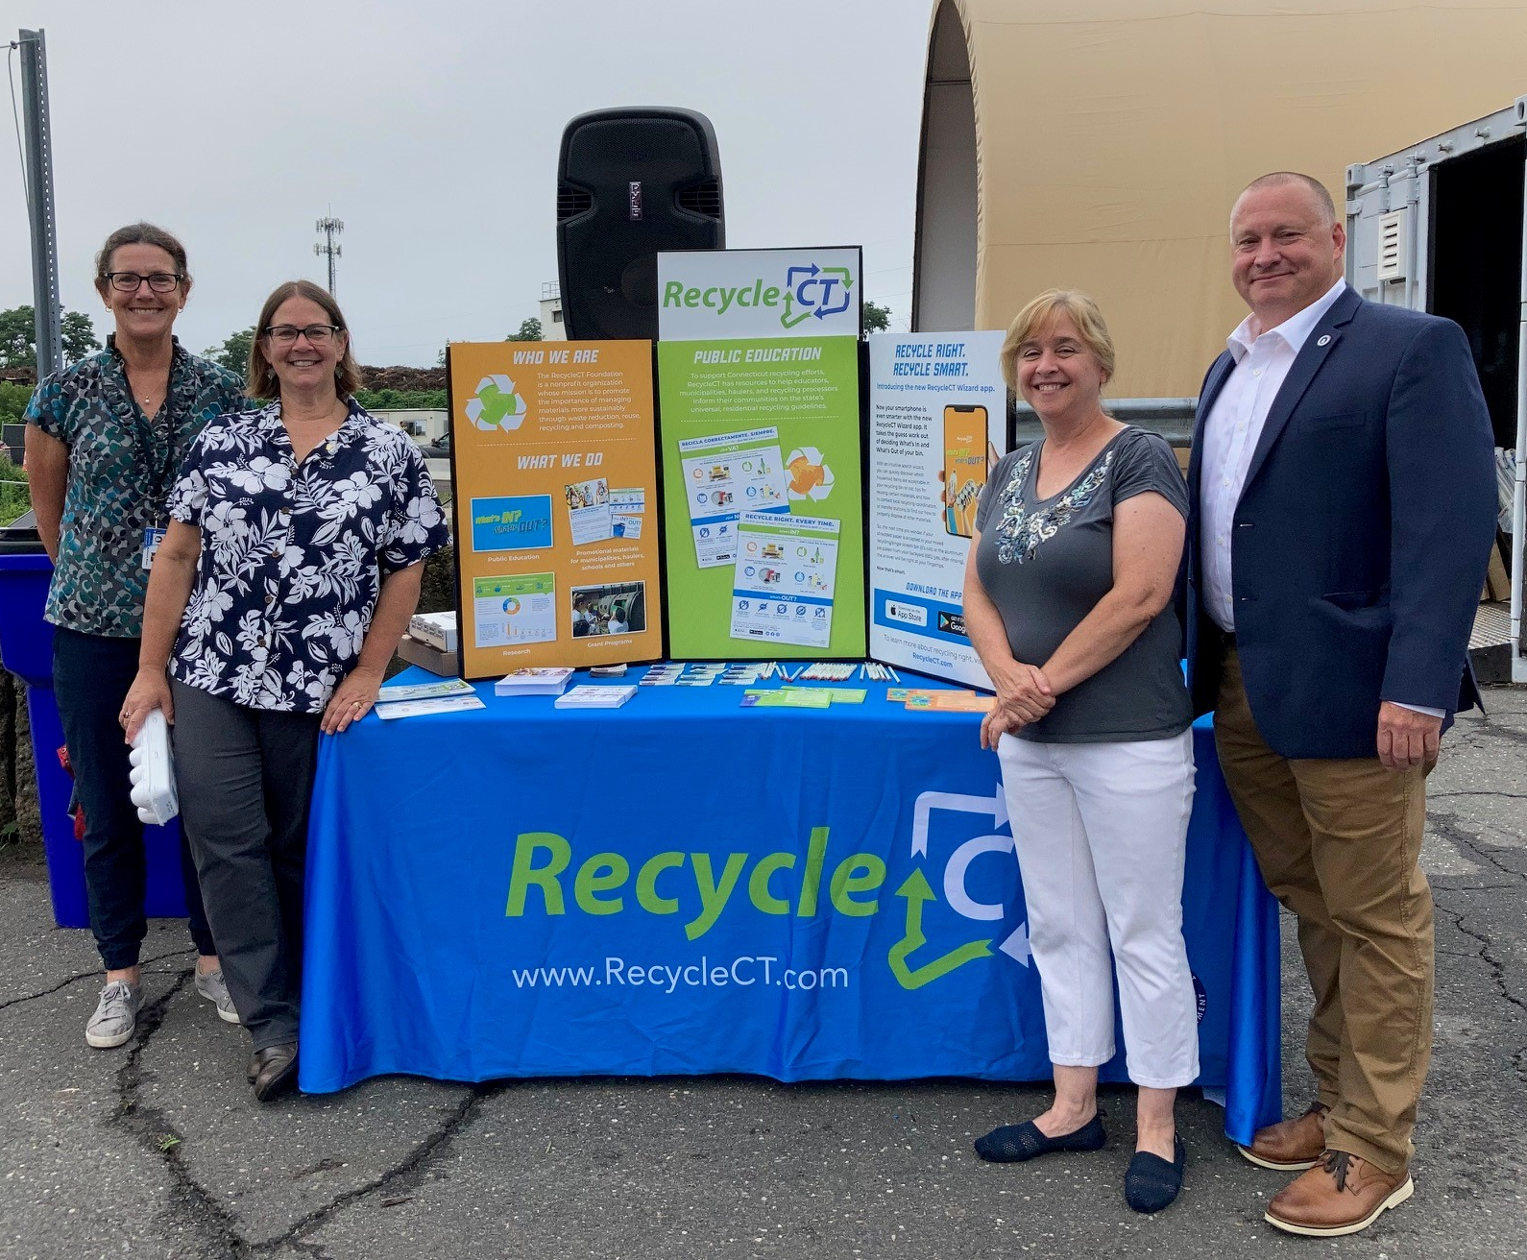
RecycleCT Foundation Update
RecycleCT Wizard APP
Apple or GooglePlay​
Same database as the RecycleCT Widget
For your municipal, business or nonprofit organization webpage​

Slide 6
RecycleCT Foundation Update
New materials to download and print​ https://www.recyclect.com/resources.html​
Flyer
Brochure
Post Card/Tip Card
Bill Insert
Bin Sticker
Magnet
Poster

Slide 7
RecycleCT Foundation Update
New materials to download and print​ https://www.recyclect.com/resources.html​
Flyer
Brochure
Post Card/Tip Card
Bill Insert
Bin Sticker
Magnet
Poster

Slide 8
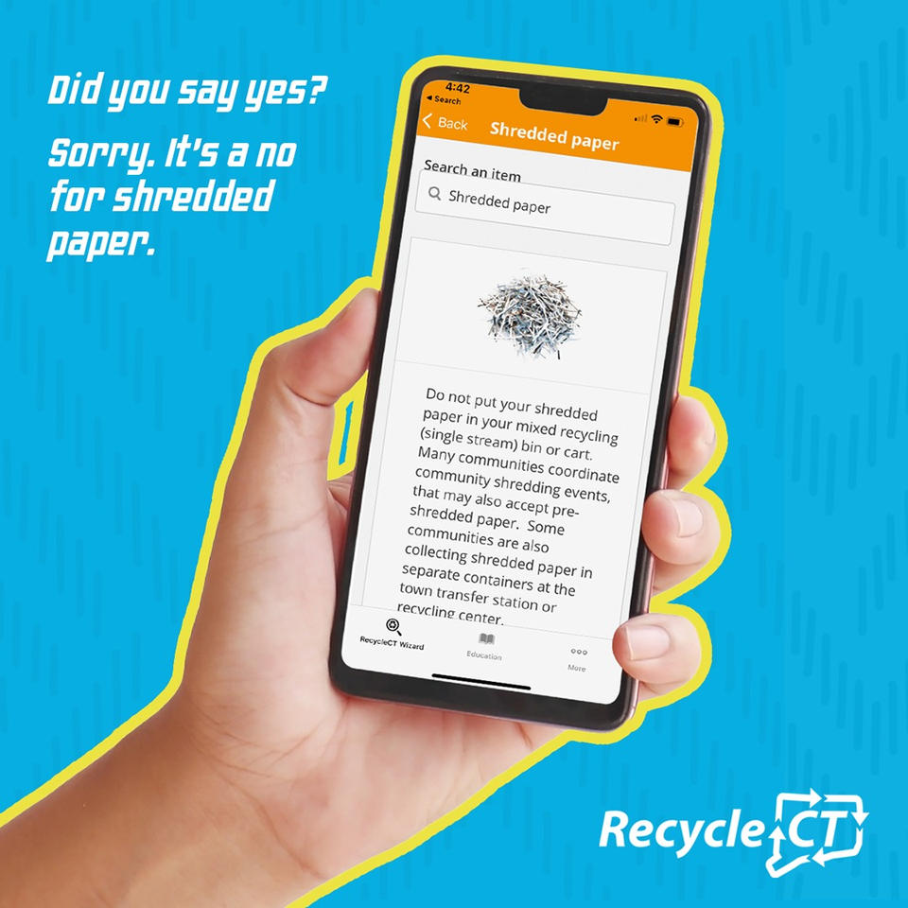
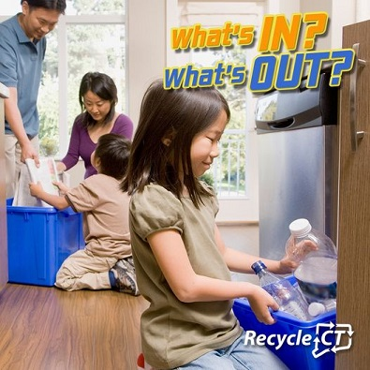
RecycleCT Foundation Update
​New social media materials​
https://www.recyclect.com/social.html​

Slide 9
What’s IN, What’s OUT Update
WIWO Review with MRFs – including new partners Win-Waste (formerly City Carting) and Willimantic/Casella​
List remains the same​
Materials/Products that continue to be challenges:​
Expanded polystyrene​
Masks and gloves​
Lithium batteries​
Gas cylinders​
New challenges​
Moisture​
Textiles​
Bulk collection of source separated items?​
Miniature liquor bottles

