Slide 1

CY20 Annual Report 10/26/21

Slide 2
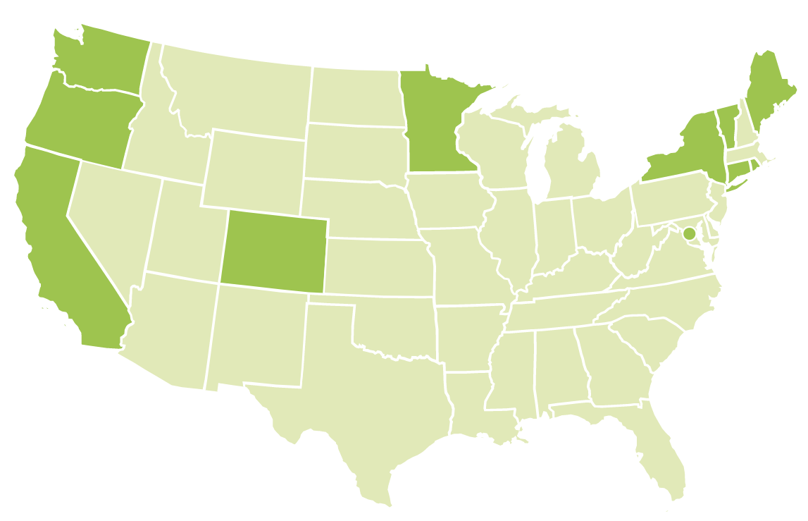
Started April 2021
May 2014
Starting May 2022
Oct 2015
Nov 2014
2010
June 2014
2013
2012
2015
2016
New and starting soon
Notes:
For updated maps, contact outreach with inquiries.
Folder of maps in box: paintcare-outreach-xxmultistate-maps

Slide 3
What’s new with PaintCare?
Switched to a CY report, effective 2020
Rebranded our logo and updated our website in 2021
LVP minimum amount for pickups has been reduced
to 100 gallons

Slide 4
Collection Infrastructure
Year-Round Sites
Paint Retailers | 104
Transfer Stations/Recycling Centers | 46
Reuse Stores | 1
Total
151
Supplemental Services
HHW Events & facilities | 46
Seasonal Transfer Stations | 2
Paint Retailer (partial) | 4
Total
52
LVPs – 31 and 1 RLVP

Slide 5
COVID Impacts
March to June 62% of retailers and 37% of transfer stations suspended paint drop-off
They were removed from the site locator for that time period
21 HHW events were canceled, the HHW facilities suspended their opening date
LVP services were also suspended for a few months
Communications also scaled back public outreach during that time period

Slide 6
Collection volume and Processing
405,200 gallons collected, 81% was latex and 19% oil-based
82% of the latex was made into recycled content paint, 18% was dry paint and landfilled
94% of the oil-based was used for energy recovery and 6% was incinerated
273 tons of containers were recycled

Slide 7
Revenue and Expenses
Revenue | $3,860,401
Expenses | $3,124,026
Change | $736,375
Recovery Rate | 6.5%
Cost Per Gallon | $7.71
Notes:
Create bullet slide like this with all in one column

Slide 8



Laura Honis
CT and RI Program Manager
(203) 747-4494
lhonis@paint.org
Notes:
If you start with all green opening slide, you must end with all green closing slide

