Slide 1
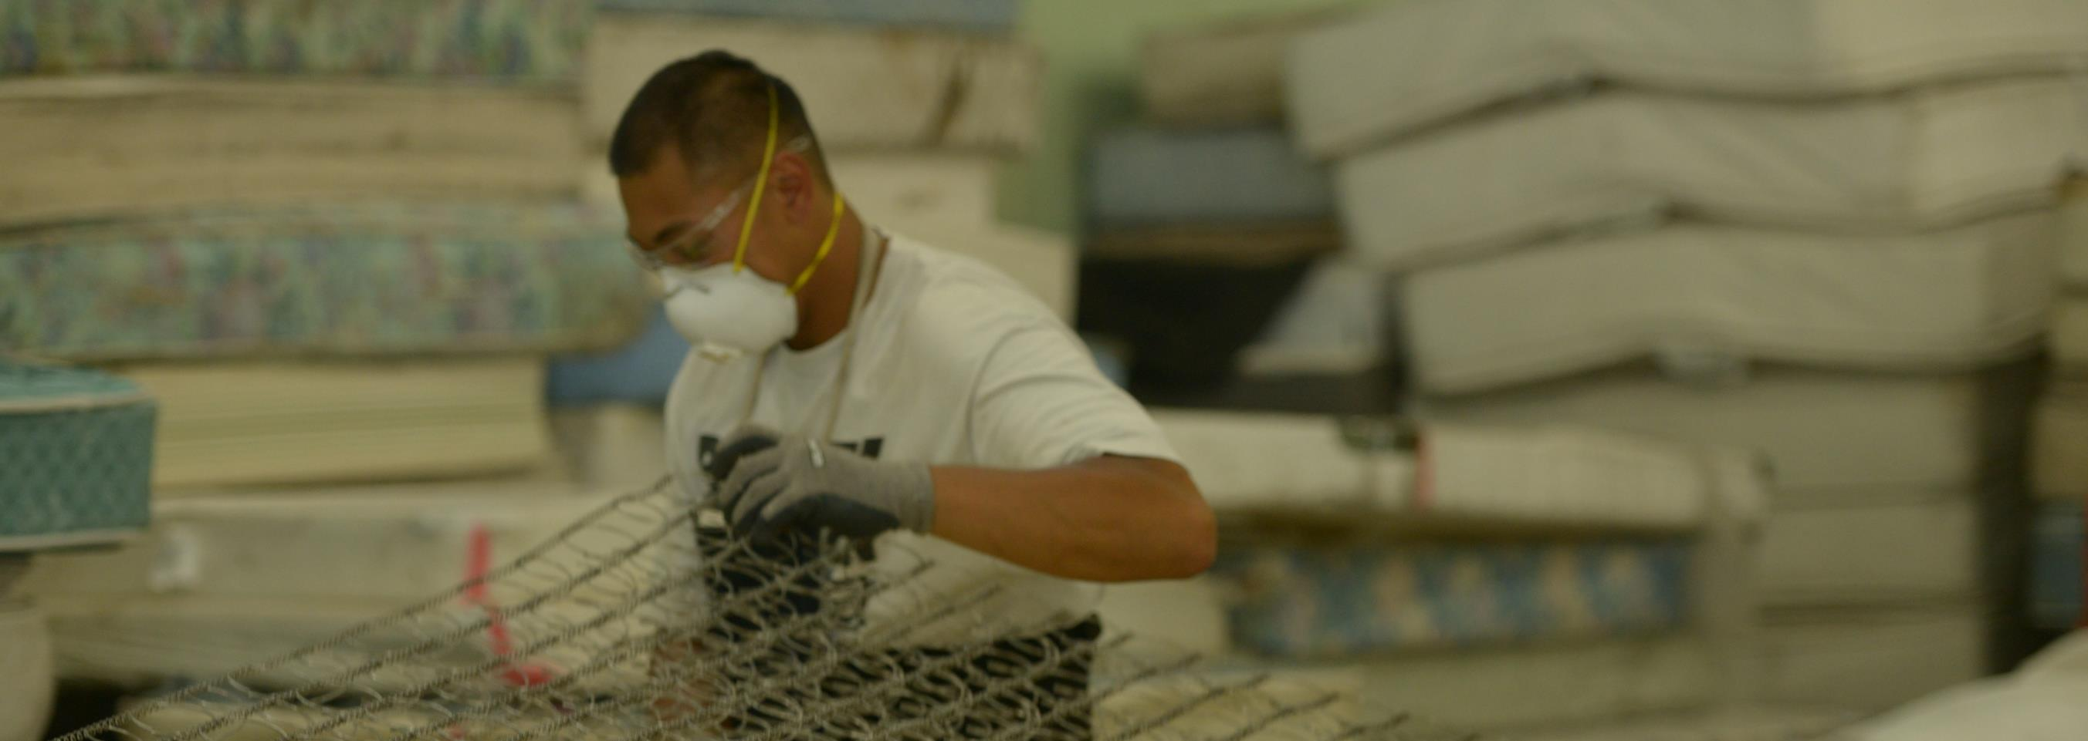



Connecticut’s Mattress Recycling Program

Slide 2
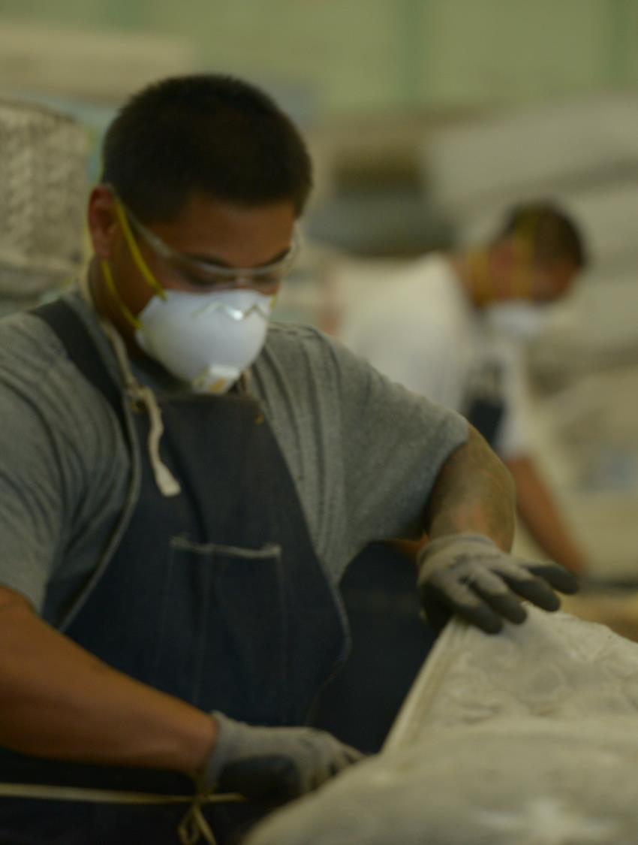

OVERVIEW
Industry-led nonprofit
Funded by visible recycling fee
Operating statewide recycling network
Providing education and outreach
Combating illegal dumping
Conducting research
CT DEEP oversight

Slide 3
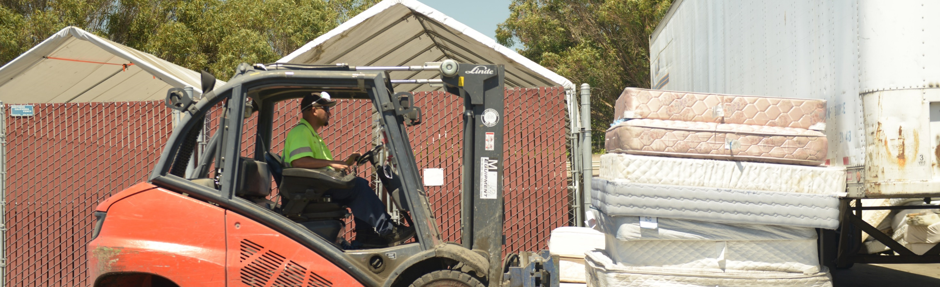

OBJECTIVES
Increase
Recycling
Curb Illegal Dumping
Operate Cost- Effectively
Recover and recycle units generated in the state
Working collaboratively to address this persistent problem
Being good stewards of the recycling fee

Slide 4

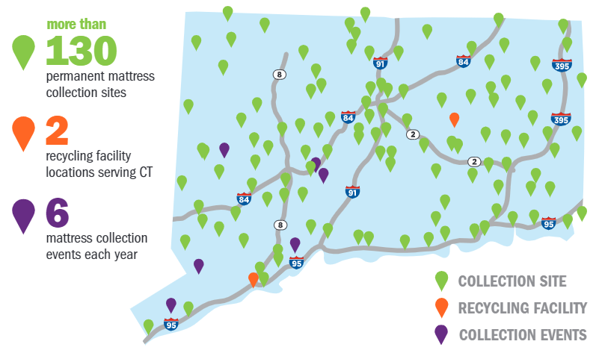

CONNECTICUT
Collected
213,543 units
97% of residents have
access to the program
QUICK FACTS
Launched: May 2015
Recycling Fee: $11.75
Recycling Facilities: 2
Participating Towns: 140
Permanent Sites: 140+
Notes:
Option 1

Slide 5

COMMERCIAL VOLUME PROGRAM
  Available to retailers, hotels, universities, military, hospitals and others
  No-cost transportation provided for 50+ units
  297 participants

Slide 6
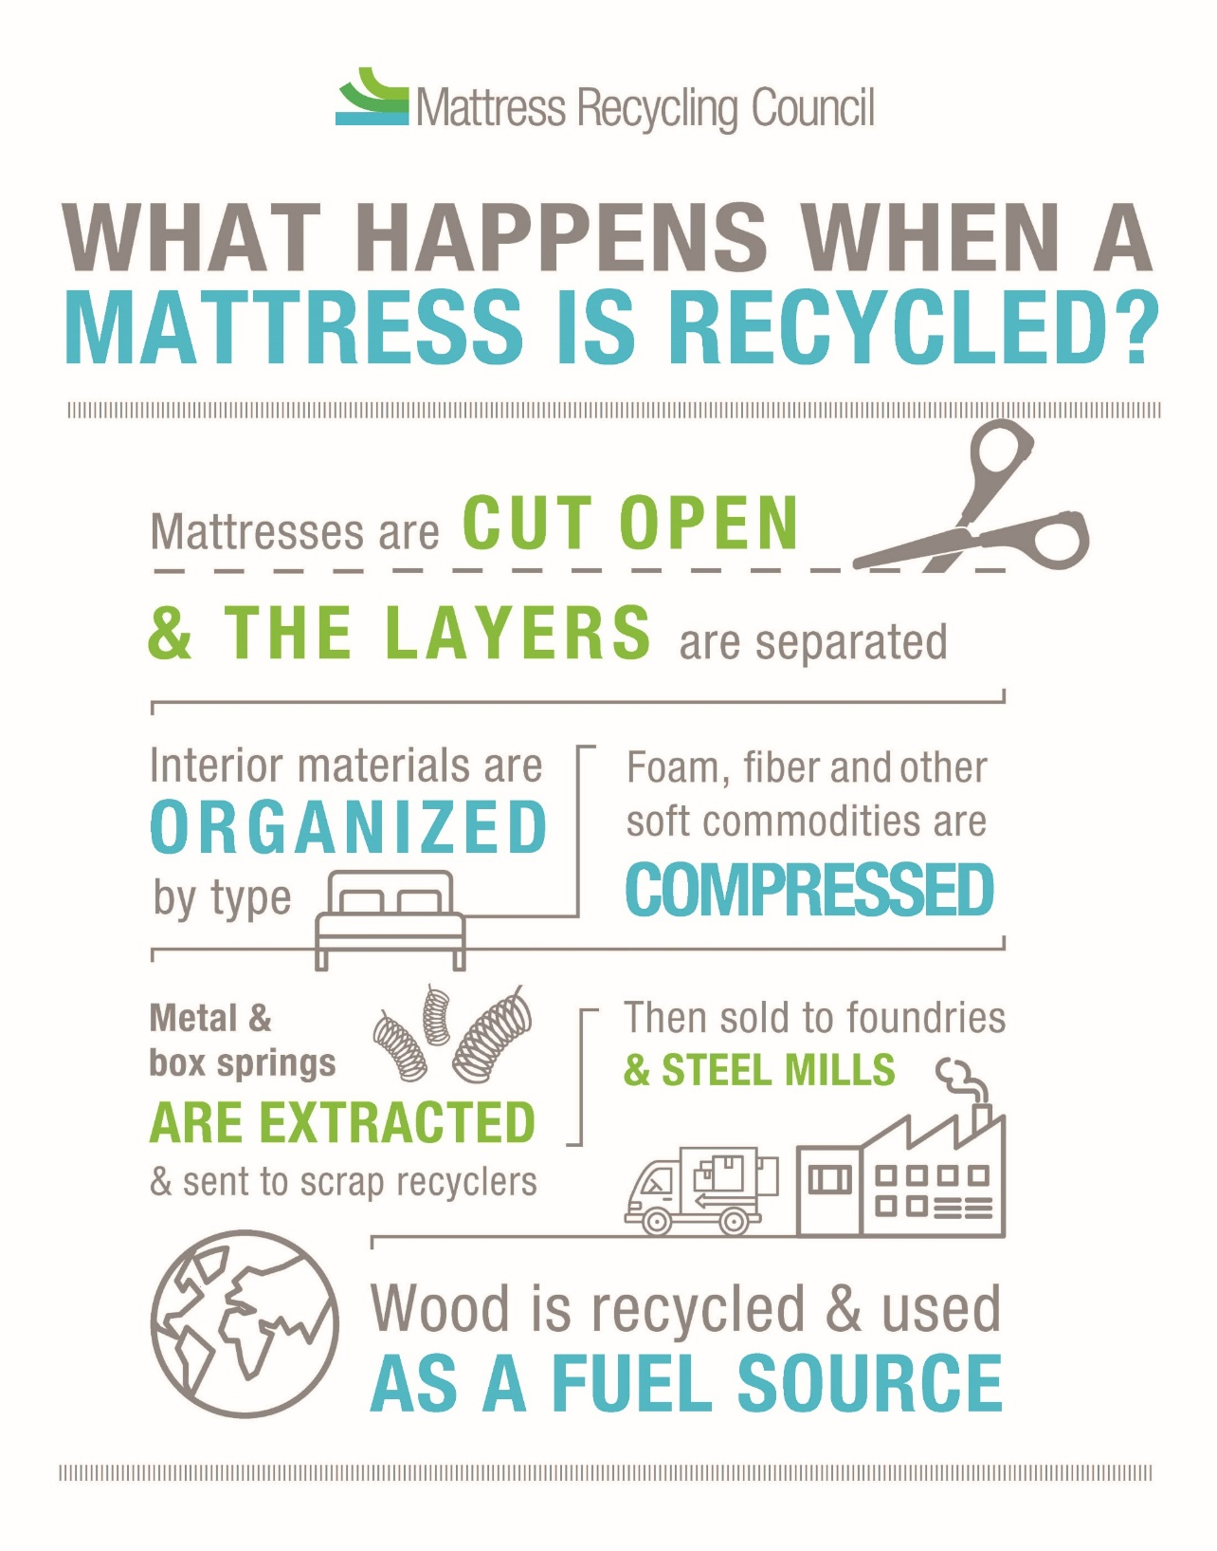
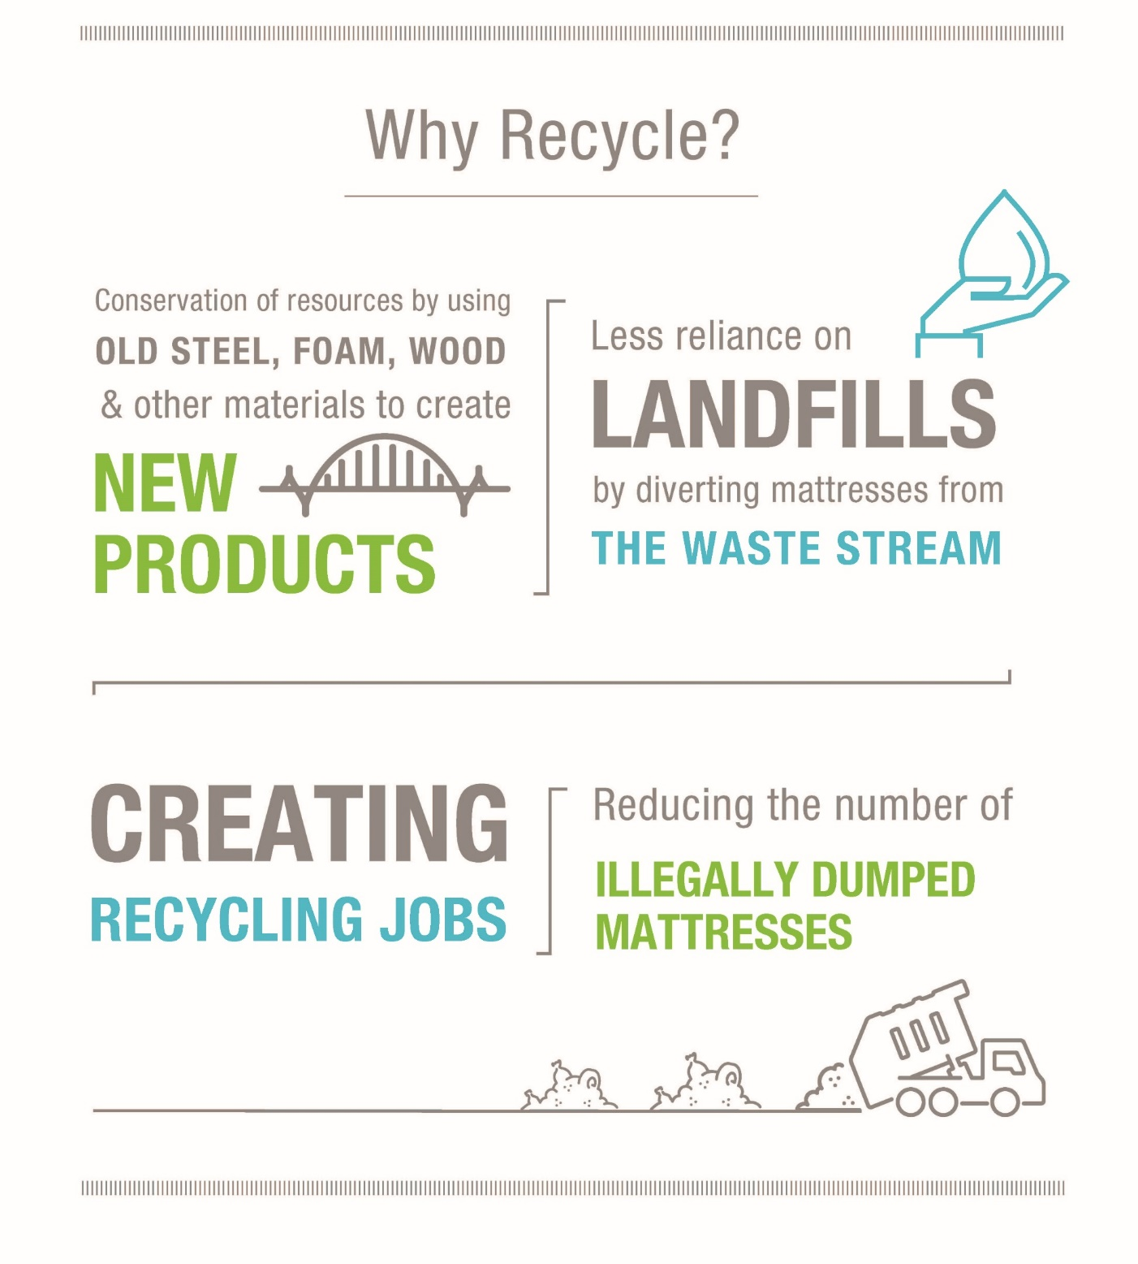

Slide 7

WHAT HAPPENS TO THE MATERIALS?

Slide 8

OUR IMPACT
OVER 75%
of a mattress
1,000,000
mattresses
36
MILLION pounds
Stacked on top of one another, that is enough mattresses to reach the International Space Station!
can be recycled. The steel, foam, fiber and wood can make hundreds of new products.
of material diverted
from the waste stream.

Slide 9
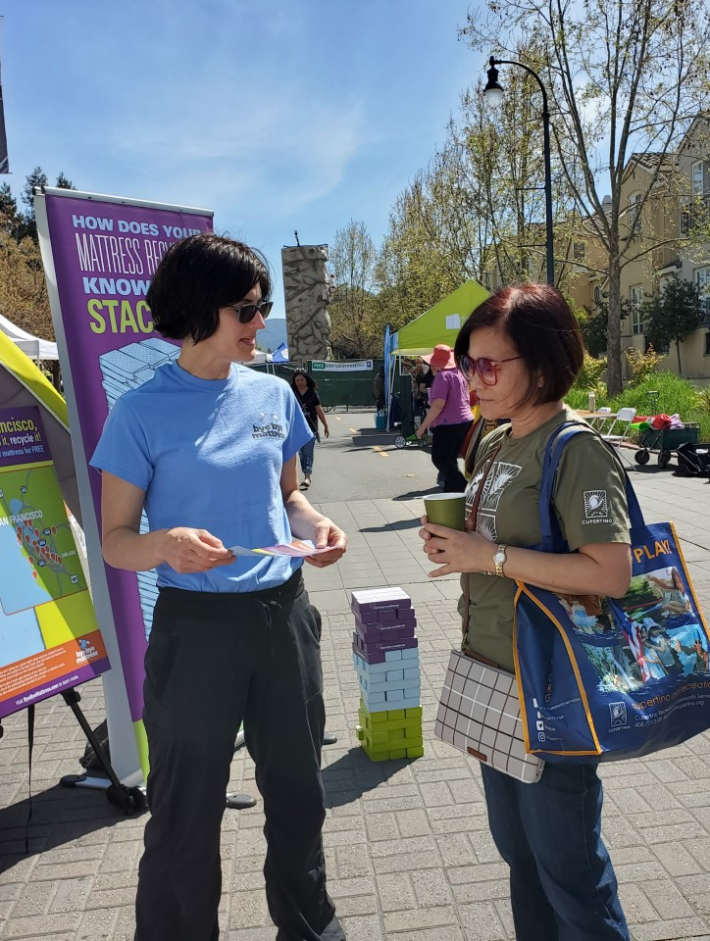

CONSUMER OUTREACH
  Point-of-sale materials
  Advertising campaigns
  Public service announcements
  Digital and social media
  Earned media
  Community events

Slide 10
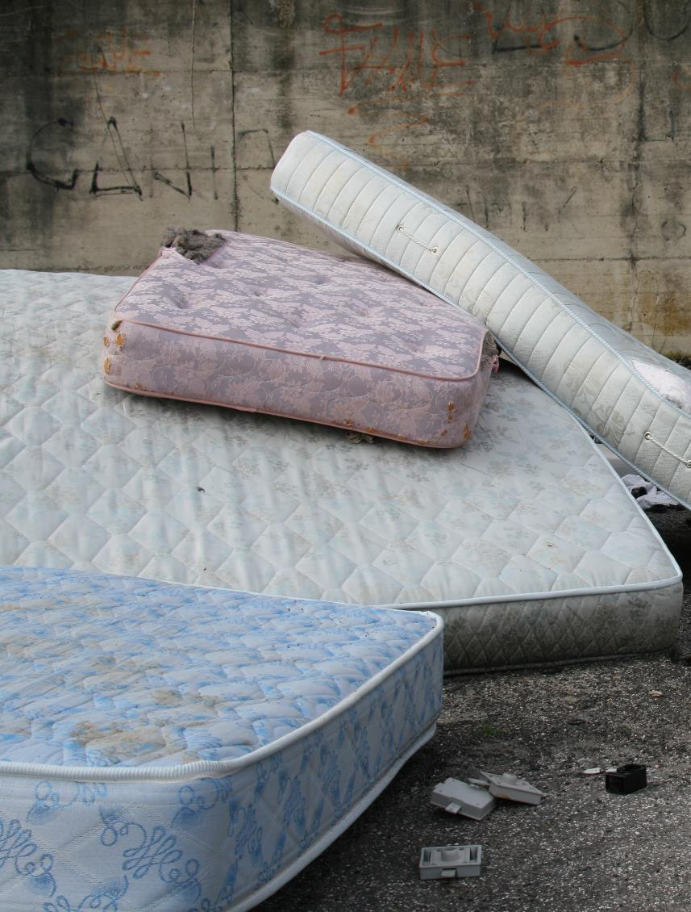
COMBATING ILLEGAL DUMPING
PSA campaign has reached over 3.5 million impressions across MRC’s program states
Working with local governments to educate residents
White Paper and Lesson Plan available

Slide 11

RESEARCH PRIORITIES
Increasing
Efficiency
Improving Recyclability
Expanding End Markets
Investing in studies to identify best practices
Awarding funding for infrastructure improvements
Searching for new uses for component material

Slide 12

LEGISLATIVE UPDATES
Additional state interest.
Maine pilot program under development
MRC interest in regional approach to mattress EPR
For more information:
Marie Clarke mclarke@sleepproducts.org
Grant Johnson gjohnson@sleepproducts.org

Slide 13
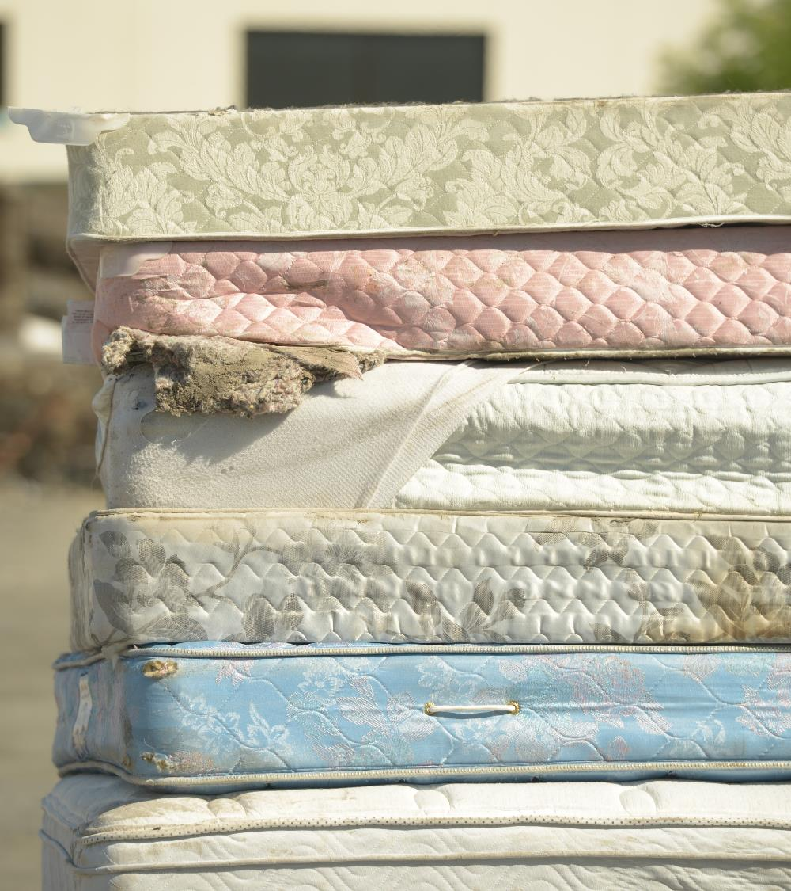

THANK YOU
dmcgowan@mattressrecyclingcouncil.org
860-830-3832
MattressRecyclingCouncil.org
Sign up to receive MRC Highlights and follow our announcements.

