Slide 2
Bottle Bill Updates
&
Facility Operator Certification Process
SWAC - October 26, 2021
Chris Nelson, CT DEEP

Slide 3
Special Session Public Act 21-2
  § 65. Establishes a beverage container recycling grant program:
    All moneys shall be used by DEEP to provide forgivable grants in urban centers and environmental justice (EJ) communities
  § 65. DEEP shall issue a grant application process not later than December 1, 2021
  § 308. (b)(15) $5M for a grant program to support solid waste reduction strategies, including a redemption center grant program
Notes:
SS PA 12-2 also created a grant program to help create new deposit container redemption centers to help provide more redemption options in underserved communities.

Slide 4
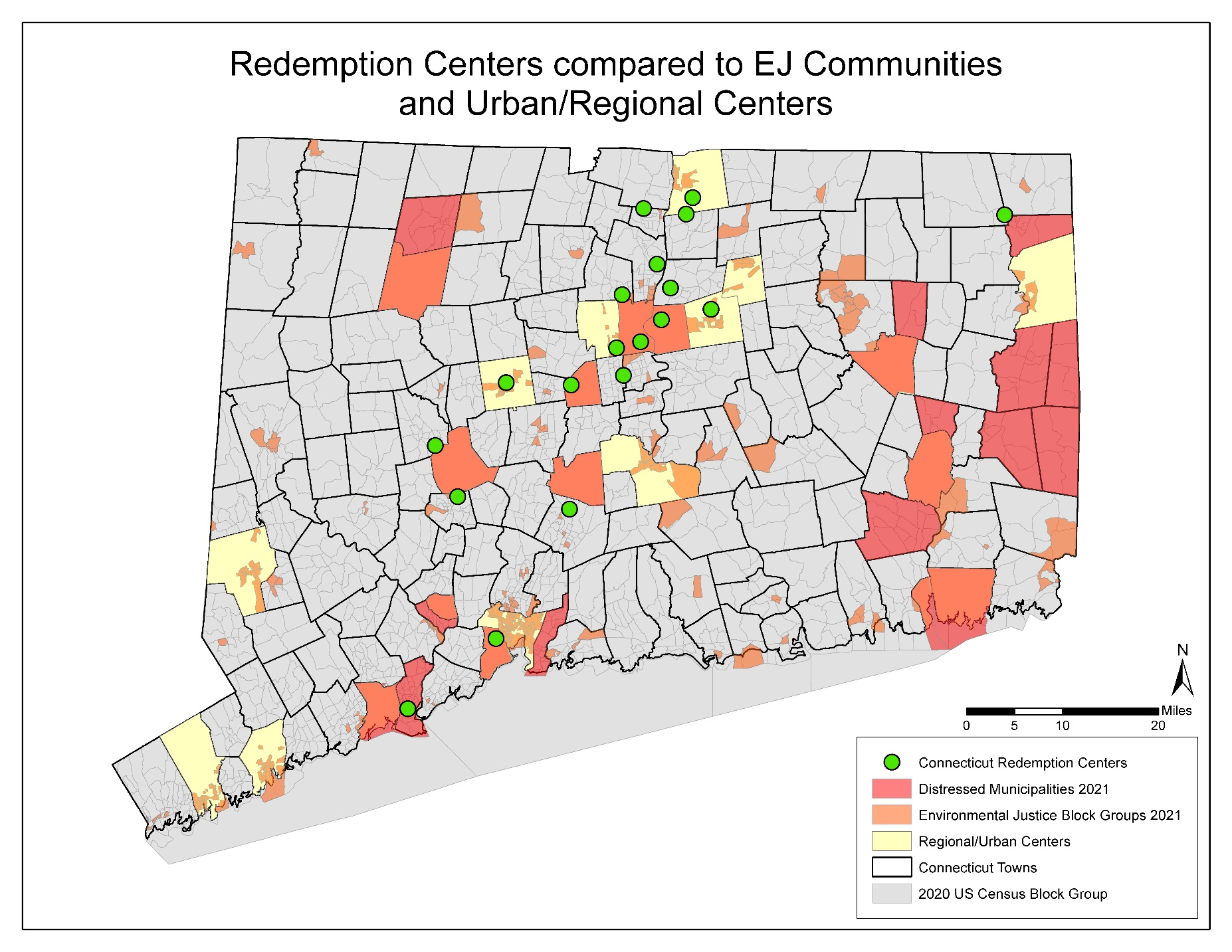
Special Session Public Act 21-2
Notes:
SS PA 12-2 created a grant program to help create new deposit container redemption centers to help provide more redemption options in underserved communities.

Slide 5
Public Act 21-58
  § 1. Addition of new beverage types (01/01/2023)
  § 2. Increase of deposit amount from 5 to 10 cents (01/01/2024)
  § 3. Increase of the handling fees (10/01/2021)
  § 7. Requirement for certain retailers to install reverse vending machines, or RVMs (10/01/2021)
  § 10. New 5-cent surcharge applied to sale of miniature bottles (<= 50 ml) containing spirits or liquor (10/01/2021)
Notes:
§1 - + hard seltzer, hard cider, plant water, juice, juice drink, tea, coffee, kombucha, plant infused drink, sports drink or energy drink
§3 - Beer, hard seltzer, hard cider, other malt beverage - 2.5¢,
All other covered beverages - 3.5¢ (effective 10/1/21)
§ 7 – impacted chain stores like Target, CVS, Walgreens must now install 2 RVMs per store
§ 10 – miniatures NOT part of bottle bill program. Monies collected by Wine & Spirits Wholesalers of CT to be paid directly to towns by WSWC.

Slide 6
Public Act 21-58
§ 8.
  Development the terms for a memorandum of agreement (MOA) that provides, by January 1, 2023, for the in-state processing of not less than eighty per cent of the wine and liquor beverage containers sold in this state into furnace-ready cullet or by-product that is melted or otherwise used in cement, glass or fiberglass products.
  DEEP “shall identify the requisite parties to such an agreement and engage such parties in ongoing discussions…”

Slide 7
Public Act 21-58
§ 9.
  Approval of the formation of a beverage container stewardship organization constituted by deposit initiators if such organization submits an application.
  Submittal of a plan, for the commissioner's review and approval, to operate a state-wide beverage container stewardship program. In developing any such plan, such organization shall obtain input from members of the independent redemption centers community, municipal resource recovery facilities, municipal leaders, wine and spirits distributors and reverse vending machine operators.

Slide 8
Next Steps
Grant program - DEEP plans to share a draft grant program scope soon for stakeholder feedback
§ 9. DEEP will develop and release for stakeholder feedback a draft list of criteria it will expect to see in any submitted state-wide beverage container stewardship program
§ 8. DEEP will convene a meeting of “requisite parties” (and other interested stakeholders) to begin the process of developing an MOA for wine & liquor containers

Slide 9
Bottle Bill Resources
  Bottle Bill Stakeholder Process webpage
  To stay informed and participate in the stakeholder process please fill out this form.
  Any bottle bill-related questions?

Slide 10
Facility Operator Training & Certification
  Previously, DEEP staff offered multiple in-person training sessions across the state over the course of a year.
  Now, transitioning to online training & testing

Slide 11
Getting Trained & Certified
  Folks interested in getting trained and certified should:
  Fill out a Certification Application Form (available on this webpage)
  Submit completed application form via email (to paula.guerrera@ct.gov) or via regular mail

Slide 12
Getting Trained & Certified (cont.)
  Look for posted training opportunities on the Certification and Training For Solid Waste Facility (SWF) Operators webpage
  Register to attend an online training session

Slide 13
Getting Trained & Certified (cont.)
  On day of training:
  Sign into the webinar
  Watch the various training modules
  To take the certification exam after the training:
  Applicants must have a webcam on while they are taking the online exam

Slide 14
Getting Trained & Certified (cont.)
  Post-exam, those who have received a passing score will get their certificate mailed to them.

Slide 15
Facility Operator Training & Certification
  Next steps:
  DEEP to continue evaluating online platforms for conducting training & testing
  DEEP to update & streamline training modules
  DEEP to finalize training modules for facilities beyond Transfer Stations & MRFs

