Slide 1
Sustainable Materials Management Update and Funding Opportunities
Christine Beling
U.S. Environmental Protection Agency New England
March 22, 2022
Solid Waste Advisory Committee (SWAC)
Notes:
Hello Everyone. Thank you for having me today. I especially want to thank Chris for inviting me. There is so much exciting news to share with you so let me get started.

Slide 2

Session Objectives
Provide an overview of Congressional and Policy Drivers Impacting EPA’s Sustainable Materials Management (SMM) Program
1
Provide an overview of EPA’s funding opportunities
2
Notes:
I plan to share with you recent legislation and its impacts to EPA’s Sustainable Materials Management program and what I know to date on potential grant programs. And then I want to hear from you on future engagement with us.

Slide 3
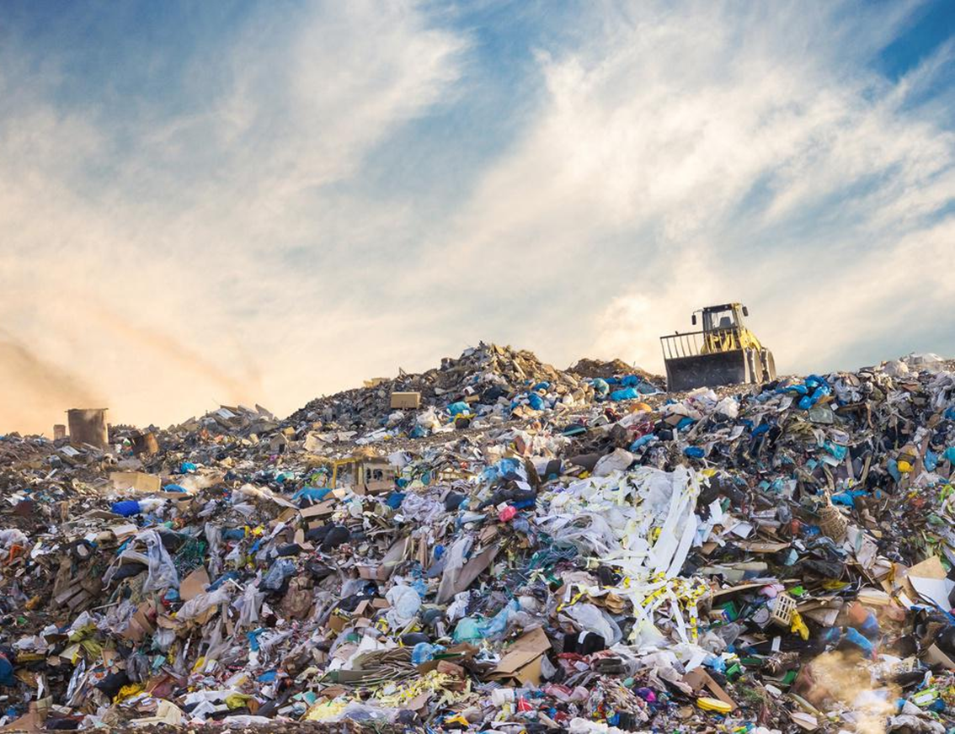
Recent Congressional and Policy Drivers Shaping EPA’s SMM Program
FY20 Appropriations directed EPA to produce a national recycling strategy
Save Our Seas 2.0 Act provides authority for grants, reports and a strategy on post-consumer materials management (“plastics strategy”)
Dec. 2020 Government Accountability Office (GAO) report includes actions for EPA to strengthen recycling and recommend future policies
FY21 Appropriations asked EPA to collect data on recycling and single-use plastics
17 pieces of proposed legislation related to recycling
Notes:
I wanted to take a moment to provide the background on what is driving our work in this time of transformational change.
New agency and congressional priorities provided an opportunity to look for new and better ways to move the needle on sustainable materials management.
In response to Congressional Fiscal Year 2020 Appropriations which directed EPA to produce a national recycling strategy 270 days from December 2019, we released the draft National Recycling Strategy
The Strategy identified many activities that stakeholders such as yourselves can undertake to increase diversion of materials. I’ll be talking a bit more about the Strategy in just a moment.
In December 2020, two things happened. The Save Our Seas 2.0 Act, provided authority for grants, reports and a strategy on post-consumer materials management, which we are calling our plastics strategy. And a Government Accountability Office Report included actions for EPA to strengthen recycling and recommend future policies.
Fiscal Year 2021 Appropriations asked EPA to collect data on recycling and single-use plastics.
What we saw was recycling was becoming a focus in legislation – specifically as part of 17 proposals.

Slide 4
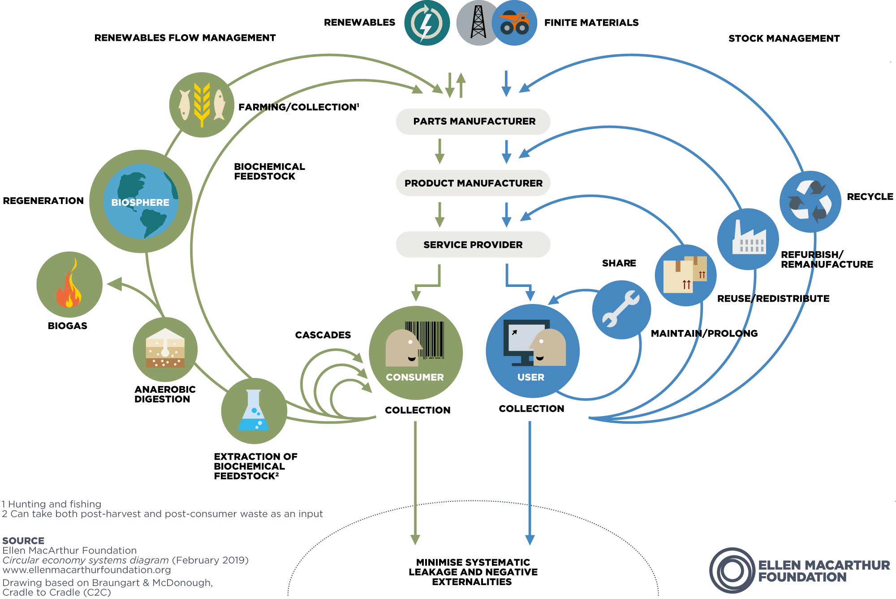
EPA’s Circular Economy Strategy Series
Part 1: National Recycling Strategy
Part 2: Plastics
Part 3: Food Waste
Part 4: Critical Minerals and Electronics
Part 5: Built Environment
Part 6: Textiles
We are establishing a 10-year vision and strategic direction for the SMM Program – one that embraces zero waste/circularity, sustainable materials management, addresses climate change, and environmental justice.
Notes:
A “circular economy,” as defined in the Save Our Seas 2.0 Act, refers to a systems-focused approach and involves industrial processes and economic activities that are
restorative or regenerative by design,
enable resources used in such processes and activities to maintain their highest values for as long as possible, and
aim for the elimination of waste through superior design of materials, products and systems
A circular economy reduces materials use, redesigns materials to be less resource intensive, and recaptures “waste” as a resource that can serve as feedstock to manufacture new materials and products.
Circularity is already embraced in the SMM approach that the United States has pursued since 2009.
Our National Strategy is Part One of at least a six-part series on building a circular economy.
The other 5 parts to our circular economy strategy will be released over the next few years based on the feedback we receive from our stakeholders

Slide 5
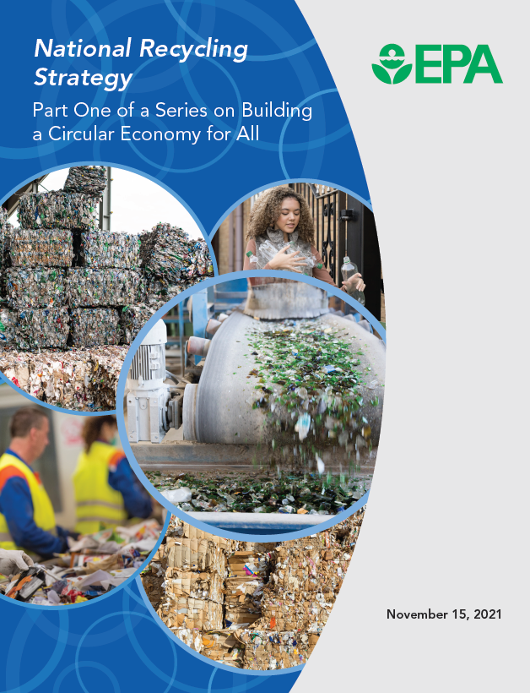
National Recycling Strategy
View the Strategy’s actions: https://www.epa.gov/recyclingstrategy
Successful Implementation of the National Recycling Strategy will take action from all stakeholders!
All stakeholders can sign up
to lead or “support Strategy actions
To identify new actions for consideration
Notes:
The Strategy actions are not just for EPA but for you and others that represent private and public entities.
Implementation of the strategy will offer an opportunity for EPA to work with all our stakeholders and drive change.
Rather than posting a Strategy and hoping the actions are implemented, EPA aims to encourage action by acknowledging those who are taking action and connecting entities who want to take action.
The entities who share their actions will be reflected on the online Implementation Plan, which is being modeled after the Water Reuse Action Plan.

Slide 6
National Recycling Strategy Objectives
Improve Markets for Recycled Commodities
Increase Collection and Improve Materials Management Infrastructure
Reduce Contamination in the Recycled Materials Stream
Enhance Policies and Programs to Support Circularity
Standardize Measurement and Increase Data Collection
6
Notes:
The Strategy includes 48 Actions which align with these 5 objectives
A. Improve Markets for Recycling Commodities
B. Increase Collection and Improve Materials Management Infrastructure
C. Reduce Contamination in the Recycled Materials Stream
D. Enhance Policies and Programs to Support Circularity
E. Standardize Measurement and Increase Data Collection
Keep these objectives in mind because they will be tied to the funding opportunity

Slide 7
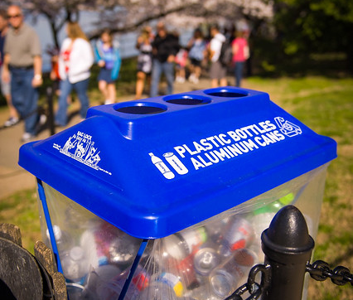
Challenges to the U.S. Recycling System
Inadequate recycling infrastructure and market demand for recyclables
Confusion on what is recyclable, leading to contamination
Environmental justice concerns, including around exporting recyclables
Notes:
The Strategy identifies several challenges to the U.S. Recycling System which I am sure many of you are familiar with.
Inadequate infrastructure and systems result in materials not being recycled, posing a challenge for communities and local governments who manage materials.
There is a lot of confusion on what is recyclable because it varies across local government jurisdictions and by hauler. Also, what is recyclable in your home may vary with what is recyclable in a multi-tenant building or office, even if the buildings are in the same jurisdiction.
There are environmental justice concerns in countries to whom the U.S. exports plastics, as some countries don’t have the infrastructure to process these recyclables effectively.
I am sure this is no surprise to most of us on today’s webinar.

Slide 8
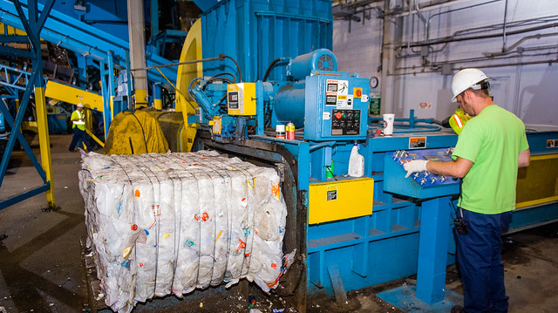
Unprecedented Congressional Support for Recycling and Materials Management
2021 Infrastructure Investment and Jobs Act /Bipartisan Infrastructure Law:
$350M for Grant funding for FY22-26:
$55M/year for Solid Waste Infrastructure for Recycling (SWIFR) grant program
$15M/year for education and outreach on prevention, recycling, including a toolkit to support programs
$25M for best practices for battery collection and voluntary labeling program
$10M for a battery collection program
$15M to create voluntary labeling guidelines for batteries
Notes:
Infrastructure Investment and Jobs Act - always spelled out when externally communicating. Otherwise we use and write out the Bipartisan Infrastructure Law.
At the same time as we released the final National Recycling Strategy, the Bipartisan Infrastructure Law or Infrastructure Investment and Jobs Act (IIJA) was signed. Also call the Bipartisan Infrastructure Law (BIL) and provids a historic investment of $350 million for solid waste and recycling grants and $25 million for battery recycling programs.
The 350 million is to be spent over a period of 5 years from fiscal years 2022 to 2026
$55Million a year will go towards Solid Waste Infrastructure for Recycling or SWIFR grants
and
$15Million a year will go to education and outreach
The $25Million related to batteries includes :
$10Million for a battery collection program and
$15Million to create voluntary labeling guidelines for batteries
I am encouraged that we have a boost to our funding and that we will be making it available to state and local governments, non-profit organizations and others. Especially those that are modernizing our domestic recycling system while ensuring that the needs of disadvantaged communities remain at the forefront of our minds.
BRAND NEW GRANT PROGRAM IS currently under development! Expecting more information on opportunities this summer.

Slide 9
Overview of funding
Solid Waste Infrastructure for Recycling (SWIFR)
Grants
$275,000,000 for grants under section 302(a) of the Save Our Seas 2.0 Act (55M/yr).
Implement the strategy developed under section 301(a) of the SOS 2.0 Act, support improvements to local post-consumer materials management, including municipal recycling programs; and assist local waste management authorities in making improvements to local waste management systems.
$75,000,000 ($15M/yr from FY22-26).
Award education and outreach grants focused on improving material recycling, recovery, management, and reduction. Directs EPA to develop a model recycling program toolkit for States, tribes, local governments for use in carrying out the grant program.
Calls for increased coordination at the federal level regarding the Comprehensive Procurement Guidelines (CPG) program and increases the frequency by which EPA must review the CPGs to every 5 years.
Directs EPA to assist educational community by promoting the introduction of recycling principles and best practices into public school curriculum.
Reduce, Reuse, Recycle Education and Outreach Grants & Other Activities
$10,000,000 for fiscal year 2022, available to be expended until September 30, 2026.
Develop best practices that may be implemented by State, Tribal, and local governments with respect to the collection of batteries, are technically and economically feasible for State, Tribal, and local governments; are environmentally sound and safe for waste management workers; and optimize the value and use of material derived from recycling of batteries.
Not later than 2 years after the date of enactment of this Act, the Administrator shall submit to Congress a best practices report.
Battery Collection Best Practices
Voluntary Battery Labeling Guidelines
$15,000,000 for fiscal year 2022, available to be expended until September 30, 2026.
Establish a program to promote battery recycling through the development of voluntary labeling guidelines for batteries and other forms of communication materials for battery producers and consumers about the reuse and recycling of critical materials from batteries. Strive to ensure that voluntary labeling guidelines and other forms of communication materials developed under the program are consistent with international battery labeling standards; and the Mercury-Containing and Rechargeable Battery Management Act
Notes:
Here is a little more detail on the funding and its use. I know it may be hard to see this small font but it can serve as a reference if you are downloading this presentation. Overall, the Bipartisan Infrastructure Law provides the funding and the Save our Seas Act 2.0 provides the authority for this investment.
The Save our Seas Act also allows us to award funding to not just states but to also local governments and other public entities. We can fund a range of projects from basic capacity building to innovative technologies.
The $275 million in SWIFR grants will support improvements to local post-consumer materials management, including municipal recycling programs; and assist local waste management authorities in making improvements to local waste management systems.
The $75 million will fund education and outreach grants focused on improving material recycling, recovery, management, and reduction. EPA is required to develop a model recycling program toolkit for States, tribes, and local governments.
Our Recycling Measurement Guide which will be released for public comment in the spring is going to be developed under this funding. brian.beneski@maine.gov; Vincent.Prescott@maine.gov
The legislation calls for increased coordination at the federal level regarding the Comprehensive Procurement Guidelines (CPG) program and increases the frequency by which EPA must review the CPGs to every 5 years.
The law directs EPA to assist educators by promoting the introduction of recycling principles and best practices into public school curriculum.
We are also directed to develop Battery Collection best practices that may be implemented by State, Tribal, and local governments for the collection of batteries and produce a best practices report within 2 years.
Lastly, $15 million will fund the development of voluntary labeling guidelines for batteries and other communication materials for battery producers and consumers regarding the reuse and recycling of battery components.
.

Slide 10
What are the Needs of Tribes, and Local and State Governments
Solid waste management infrastructure and education and outreach needs
Updates to waste characterization studies,
Data collection needs to more effectively run your programs.
Limitations in supporting an effective recycling program (staffing, equipment, end markets, recycled commodities, contamination, curbside vs. drop-off access, MRF processing capacity)
Assistance to underserved communities’ solid waste management programs
WHAT SAY YOU??????
Notes:
Municipalities and states have your own needs to improve your recycling systems What are your most critical obstacles and hurdles to your goals? From infrastructure to data collection needs. Please share your ideas with me as I noted the grant program is under development!

Slide 11
How do I Learn More?
Sign up to “stay connected”
New grant programs!
Solid waste Infrastructure for Recycling (SWIFR) grants
Reduce, Reuse and Recycle - Education and Outreach Grants
EPA reports (Recycling Measurement Guide)
Circular Economy strategies – Development and Implementation
Sign Up Here
epa.gov/recyclingstrategy/forms/stay-connected
Notes:
Please go ahead and sign up to “stay connected” to ensure you receive updates on our recycling infrastructure and education and outreach grants.

Slide 12
EPA Region New England ONLY Grants
Healthy Communities Grant Program
Sustainable Materials Management
Target Program Areas
Sustainable Management of Food
Sustainable Packaging
Built Environment
Request for Application issued
Proposals Due May 9, 2022
https://www3.epa.gov/region1/eco/uep/grants_2022hc.html
Notes:
So now one last thing specific to New England. We have had a Healthy Community Grant Program for close to 20 years where we utilize are SMM funds each year. EPA New England's main competitive grant program to work directly with communities to reduce environmental risks to protect and improve human health and the quality of life.
Again we have a larger budget than typical and we have expanded our target program area to include wasted food, sustainable packaging/plastics and built environment

Slide 13

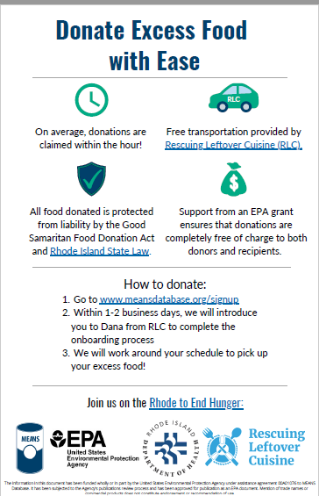
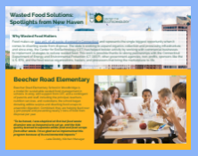
Healthy Community Grant Examples
https://www.epa.gov/sustainable-management-food/wasted-food-programs-and-resources-across-united-states#1

Slide 14
Christine Beling
U.S. Environmental Protection Agency New England
beling.christine@epa.gov
617-918-1792
Notes:
Thank you for your time today and please feel free to reach out with any questions especially regarding our Healthy Community Grant program since the RFA will be coming out shortly and we can have a more in depth discussion before that request is public. Any ideas for potential grant projects and really any questions at all.

