Slide 1

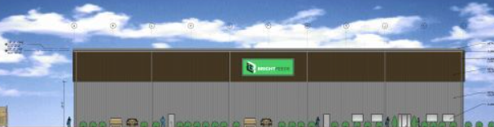
Bright Feeds Summary
www.
.com
Bright Feeds was founded to receive and process food waste and turn it into animal feed.
Bright Feeds received a 10-year authorization in February 2022 to process 450 tons/day, and plans to take in all different types of food waste meant for human consumption.
Bright Feeds’ facility is located at 76 Fuller Way in Berlin, CT and is scheduled to open by the end of Q2 2022.
Bright Feeds’ 25,000 square foot building includes ~10,000 square feet devoted to food waste drop-off and storage and ~15,000 square feet devoted to processing

Slide 2






Animal Feed offers strong environmental benefits
www.
.com
Animal Feed is near the top of the EPA food recovery hierarchy, preferred to other food waste recycling solutions
EPA’s Food Recovery Hierarchy
Most Preferable Option
Prevention
Waste Prevention
Redistribution to People
Reduction
Sent to Animal Feed
Anaerobic digestion
Composting
Waste
Incineration
Landfills
Least Preferable Option
Adapted from: https://www.effpa.eu/reducing-food-waste/

Slide 3
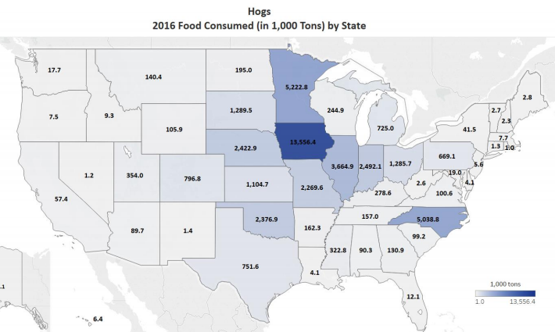
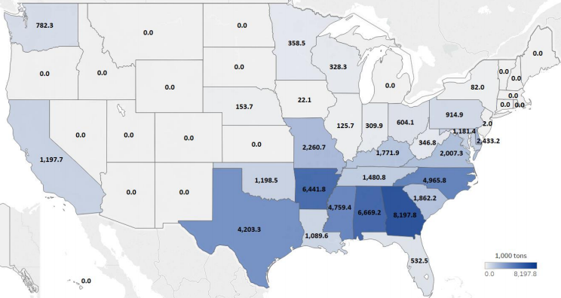
Demand for hog and chicken animal feed exceeds 100M+ tons per annum
www.
.com
Market for animal feed is large, with target animals consuming north of 100M tons per year⁽¹⁾
Economic Benefits Created By Feed Market
Hogs 2016 Food Consumed by State
High prices for processed feed translates to lower tipping fees for the MSW waste stream ($0-$50 per ton) compared to other recycling solutions
As growing demographics drive demand for food globally putting pressure on corn and soybean prices, demand for alternative sources of feed is expected to grow
(in 000s tons)
Broilers 2016 Food Consumed by State
2016 U.S. Animal Food Consumption Report: https://www.afia.org/pub/?id=49AB0CF7-F3ED-766D-F8F0-82EEB09179C8

Slide 4
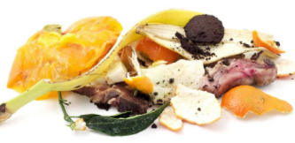
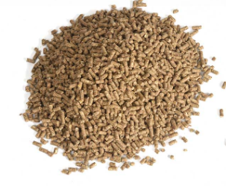
Bright Feeds facility
www.
.com
Receive or Pick Up
Food Waste
Bright Feeds Technology:
https://www.youtube.com/watch?v=skC4lJOhAd8
Distribute

Slide 5
Next steps
www.
.com
Bright Feeds will work directly with businesses and haulers to source food waste.
Our pricing for a given food waste streams depends on the nutrient value of the waste stream; after we take a small sample we will test for the nutrient value and provide pricing within a few days.
Bright Feeds will be able to handle food waste that arrives at its facility in all different formats including packaged food waste.
Please contact: Jfife@brightfeeds.com with any questions.

