Slide 1
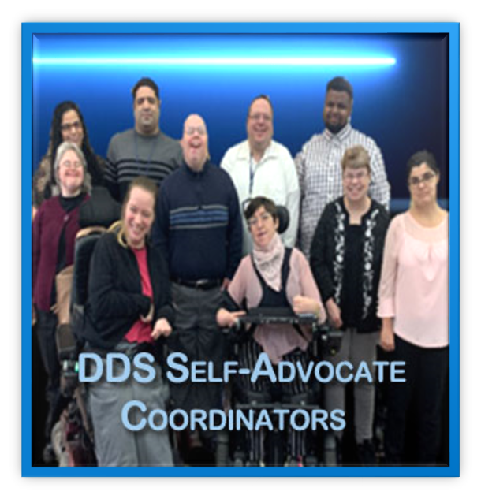
2022 End-of-Year ​ Report
Seeds of Change – Supporting people to blossom and thrive

Slide 2
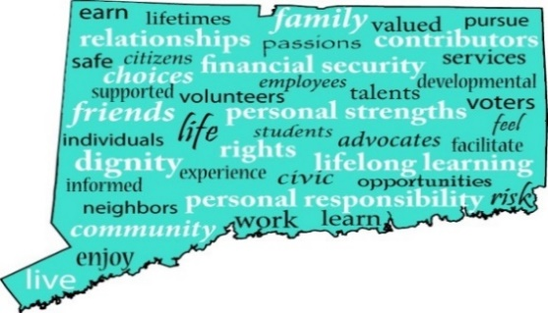
Self-Advocate Coordinators at Work!
Who are the SACs?
Legislature Supported
A Voice of the People
Making a Difference
What do they do?
Promote Self-Advocacy
Spread the Word!
Promote Individual Involvement
Lead by Example
Support Regional and State Activities
Notes:
Varian

Slide 3
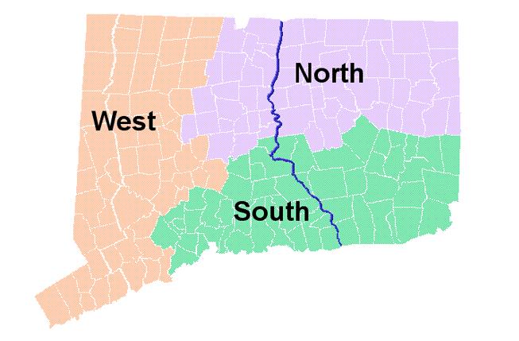
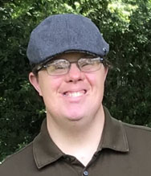
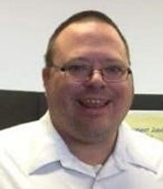
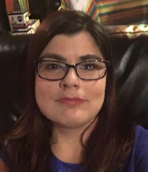
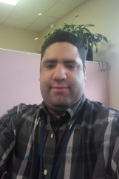
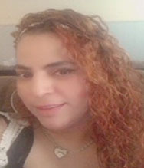
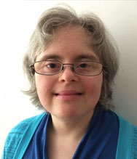
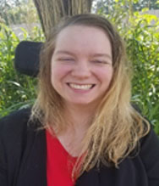
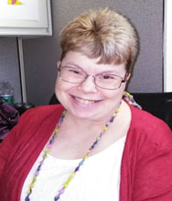
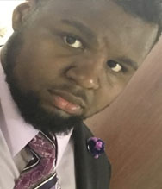
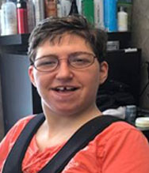
Yana Razumnaya
Varian
Salters
James Louchen
Kevin Arce
Natasha Cole
Josse
Torres
Kellie Hartigan
Jeremy Powell
Paige
Librandi
Carol Grabbe
Notes:
Kevin

Slide 4
South Region
Self-Advocate Coordinators
Carol Grabbe
Self Advocate Coordinator
35 Thorpe Ave, 3RD. Floor
Wallingford, CT 06492
carol.grabbe@ct.gov
Tel: (203) 294-5119 Fax: (203) 294-0220
Kellie Hartigan
Self Advocate Coordinator
401 W. Thames St. Suite 202
Norwich, CT 06360
kellie.hartigan@ct.gov
Tel: (860) 859-5512 Fax: (860) 859-5579
Paige Librandi
Self Advocate Coordinator
370 James Street New Haven, CT 06511
paige.librandi@ct.gov
Tel: (203) 974-4232 Fax: (203) 974-4201
Notes:
Carol

Slide 5
West Region
Self-Advocate Coordinators
James Louchen Natasha Cole
Self-Advocate Coordinator Self-Advocate
195 Alvord Park Road 55 West Main Street
Torrington, CT 06790 Waterbury, CT 06702
james.louchen@ct.gov natasha.cole@ct.gov
Tel: (860) 496-3067 Tel: (203) 805-7467
Fax: (860) 496-3001 Fax: (203) 805-7410
Jossie Torres
Self Advocate Coordinator Jeremy Powell
55 West Main Street 55 West Main Street
Waterbury, CT 06702 Waterbury, CT 06702
jossie.torres@ct.gov Jeremy.powell@ct.gov
Tel: (203) 805-7431 Tel: (203) 805-7464
Fax: (203) 805-7410 Fax:(203) 805-7410
Notes:
Jeremy

Slide 6
North Region
Self-Advocate Coordinators
Yana Razumnaya
Self Advocate Coordinator
155 Founders Plaza
East Hartford, CT 06108
yana.razumnaya@ct.gov
Tel: (860) 263-2554
Fax: (860) 263-2525
Kevin Arce
Self Advocate Coordinator 155 Founders Plaza
East Hartford, CT 06108
kevin.arce@ct.gov
Tel: (860) 263-2457
Fax: (860) 263-2525
Varian Salters
Self Advocate Coordinator
90 South Park Street
Willimantic, CT 06226
varian.salters@ct.gov
Tel: (860) 456-6345
Fax: (860) 456-6378
Notes:
Kevin

Slide 7
SACs Support the VOICES of All the Advocates of DDS!
Where it all began - 2004 - CT Legislature supported DDS in creating 10 state positions to represent the people supported by the department – 10 Self-Advocate Coordinators (SACs)
The SACs are State Employees
SACs lead the department in Making A Difference!
Notes:
Varian

Slide 8
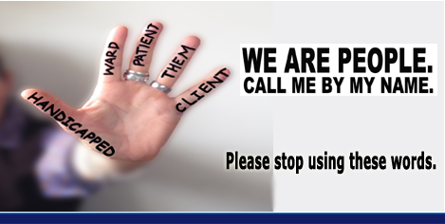
WE Are People. Call ME By MY Name!
Since February 2015, the
“We are People – Call Me by My Name” campaign has asked that everyone be called by their given name.
The DDS Self Advocate Coordinators (SACs) have promoted “People First Language”.
SACs hope to eliminate the words and terms: "client”, "patient”, "ward”, "them”, "handicapped” & the “R” word.
Notes:
Carol

Slide 9
Take the Pledge!
The SACs have written “The Disability Awareness Pledge” and challenge everyone to take the pledge to reaffirm a commitment to seeing the person and not the disability
1,309 pledges reported this year!
All new employees now take the pledge with Onboard Training
Over 5,481 people have taken the Pledge!
The SACs are challenging each one of us to be the change that makes a difference.
SACs are promoting all stakeholders to
Take the Pledge and keep it moving forward!
Together, we all can be the CHANGE!
Notes:
Jeremy

Slide 10
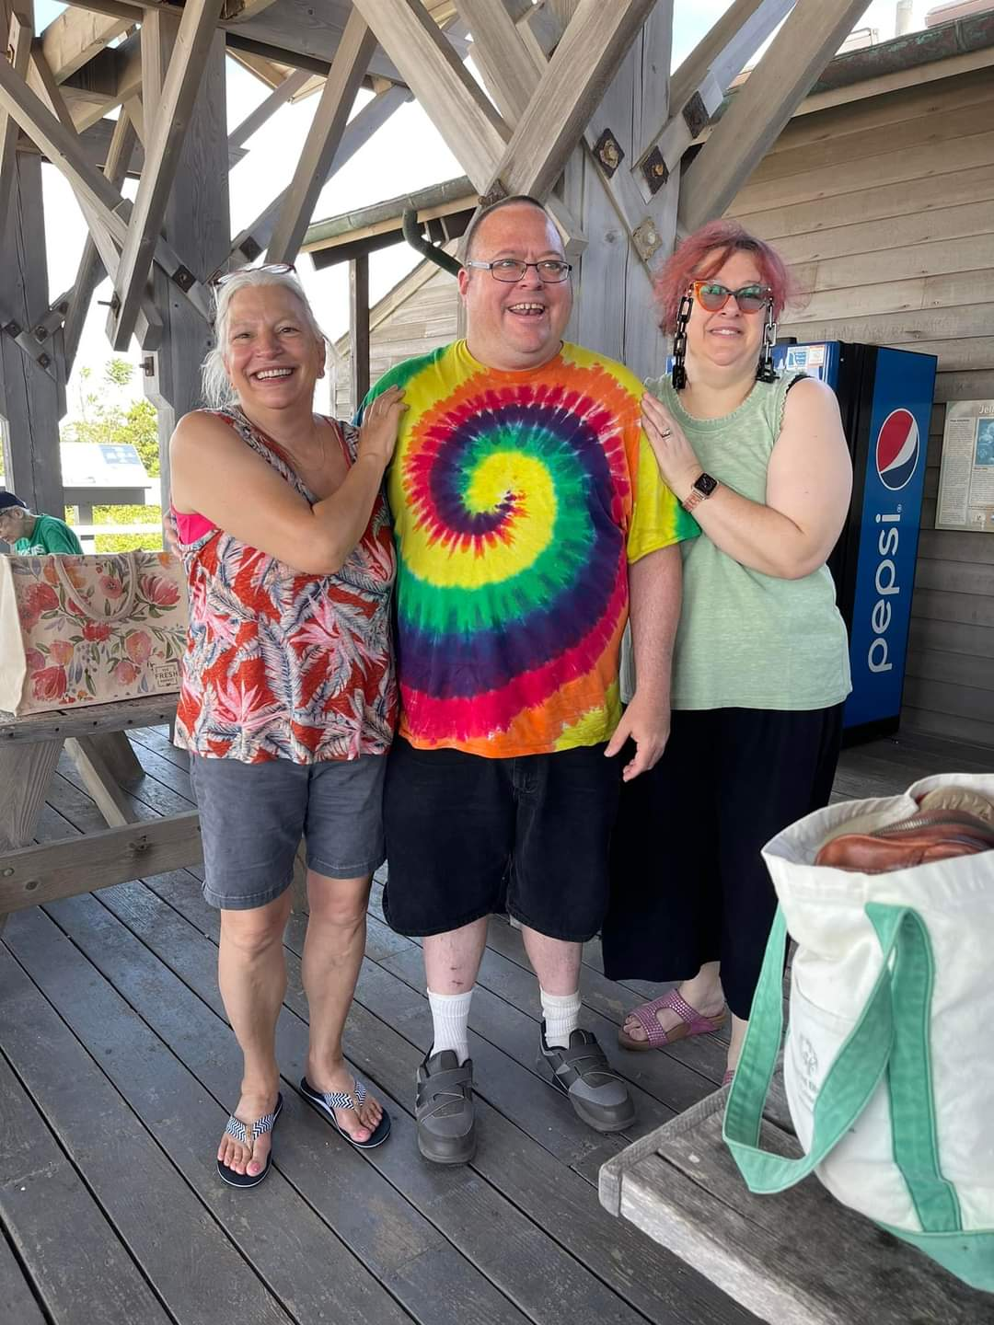
Self Determination/Self Direction 2022 Varian’s Focus Area
SACs assisted Corinne Jackson Rehabilitation Therapy Assistant II with 70 recreation events in 13 months in the Self Determination Division!

Slide 11
Self-Advocates Continue to Reach Out during the Challenge of COVID
Total Number of Participants in ​
2022 Advocacy Groups = 1,361
Notes:
Carol

Slide 12
Virtual Connections!
Technology continues to increase our outreach!!!
Virtual Flyers
Virtual Bulletin Boards
Virtual Self Advocacy Meetings
Virtual 1:1 Advocacy
Virtual Trainings
Notes:
Kellie

Slide 13
Self-Advocate Coordinators Continue to Lead the Way by Providing Education & Training
Regional Leadership Forums
Cross Disability Lifespan Alliance
Peer 2 Peer Support
DDS New Employee Training
Developing, Updating, and Supporting the DDS Advocates’ Corner website
Secondary Transition Symposium
Youth Leadership Forum
Ongoing presentations to DDS staff and all Stakeholders
DDS Council
Job Development Leadership Network
CT Family Support Network Collaboration and trainings
Ongoing trainings for Healthy Relationships
Write and Share Success Stories to post on the DDS Advocates’ Corner website
Notes:
Yana

Slide 14
Leadership
Statewide and Regional Conferences, Trainings, & Committee Work:
Hiring Interview Committees, Qualified Provider Interviews
Provider Qualification Review Board
Promote community living options
SACs are Ambassadors for Charting the LifeCourse
CT Coalition for Aging and Developmental Disabilities conference development committee
Family & Mentoring Leadership with CTFSN
Training area hospital on "How to Best Support Me" during hospital stay
Membership with Cross Disability Lifespan Alliance Committee
Membership with Sexual Abuse Prevention and Awareness Task Force
Membership with JDLN
Notes:
Yana

Slide 15
Continue to Promote Awareness of Abuse and Neglect
SACs Promote Knowledge of Human Rights, Self-Advocacy and Self-Determination to Help Prevent Abuse!
Sexual Abuse Prevention and Awareness Task Force –
Promotion of a month in April of spread the word #itsnotok and continuing throughout the year to remain active in promotion of awareness of abuse and neglect
Training and promotion of the Degrees of Mean
SACs together with staff have been training providers and individuals in promoting positive relationships to recognize abuse and neglect- the Degrees of Mean
It’s Not Ok
The Healthy Relationships Series helps to prevent sexual abuse
Peer 2 Peer Services
Can allow people to learn from someone else’s experiences which may prevent abuse
Notes:
Varian

Slide 16
Self Determination/Self Direction 2022 Varian’s Focus Area
SACs submitted 12 success stories to the “Advocates Corner” promoting Self Determination and Self Direction with advocates and families across the state
All EORs are using EVV Platform for Self-Hires.
We have about 2,574 people Self-Directing their services.
9 SACs did presentations on Self Determination.
8 SACs out of 10 use Self-Directed Services.

Slide 17
Self Determination/Self Direction 2022 Varian’s Focus Area
Our outreach contacts increased from 120,371 last year to 164,777.
We continue to learn new skills for navigating the virtual world.
Teaching each other & our advocates how to connect meaningfully even though we may not see each other in person.
We continued to create PowerPoints & presentations educating advocates across the State.
SACs created 12 Virtual Bulletin Boards, 17 CTFSN presentations and 31 advocacy presentations this year.
SACs hosted 133 Advocacy groups with 1,361participants this year.

Slide 18
Focus Areas: Self-Advocacy 2021-2022
This year Rights and Diversity Committees were started in each region, and the SACs are taking part of that, and creating presentations, and writing articles.
It’s a new area to explore how individuals can speak up and speak out loud!

Slide 19
Outreach Contacts
Outreach has increased to 13,731 contacts per month.
We are coming out of the Pandemic, so, as a result some SA group are starting back up, and the other groups that are virtual are either becoming a hybrid of virtual, and in person meetings, and some are returning just in person.
We continue our research groups and create and send out FAB Topic information on a monthly basis.

Slide 20
Kevin’s Focus Area: Self-Advocacy
709 people took the pledge this past Fiscal year, and this brings our total number to 4,958 people who have taken the pledge.

Slide 21
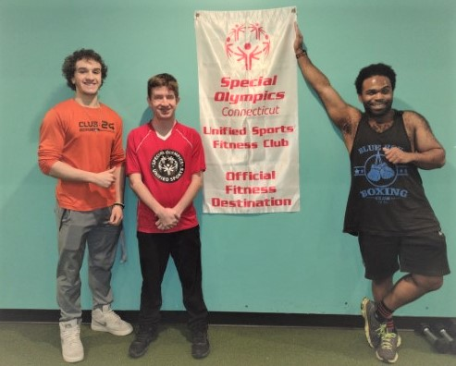
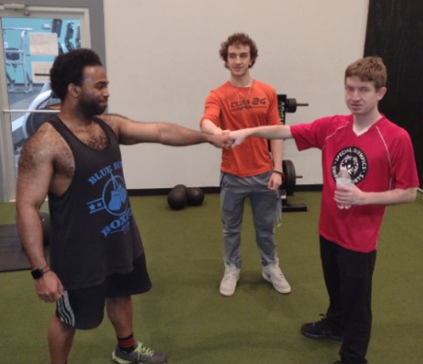
Healthy Living
The SACs have been promoting the FIT 5 which helps remind individuals to drink 5 glasses of water, do 5 workouts, and eat 5 fruits/vegetables a day, and provides screenings, such as Healthy Mind, Unified Sports, Fit Feet, and Healthy Smiles. The SACs are promoting a collaboration between DDS & SO with our Fit 5 groups and DDS Recreation.
Fit club has done one event at Club 24 this year with 5 individuals. Individuals have been encouraged to go to the gym solo. We have locked in our memberships through 2023. IFS workers have brought their people individually since COVID.
As James moves on into retirement, Natasha moves forward with Healthy Living

Slide 22
Special Olympics (SOCT)
SACs promoted the virtual Fall, Winter, and Summer Special Olympic games. The SACs typically have a booth but due to the Pandemic, they did not this year.
Some SACs participated in Special Olympics Summer Games 2022 in New Haven, CT.
James Louchen retired but before he left his role as a SAC he worked on continuing to share the importance of being active and fit through participating in SOCT.
Thank you James and all the best in your next steps in “Making Your Life Happen”

Slide 23
The Self-Advocate Coordinators share information that according to the ADA, 30 percent of Americans over the age of 65 and 50 percent over age 75 have a disability. This can range from having difficulty walking, to hearing loss, and problems with vision and thinking.
AGING
*Self-Advocate Coordinators attended the annual Aging Conference, “Aging My Way” on May 13, 2022, with 62 people in attendance. The conference was about independence, staying home and staying safe, retirement and how to approach your end of life.
*Life Course materials target families and individual perspectives. Self-Advocate Coordinators encourage individuals to use the Life Course materials, for example the integrated star. The star can assist people in frame working strategies such as advance care planning and health directives.
www.Prepareforyourcare.org
info@hospicefoundation.org
1-415-735-1106
Hospice Foundation America
wwww.hospicefoundation.org/end-of-life-support-and-resources
1800-854-3402
info@hospicefoundation.org

Slide 24
*The SACS continue to promote information on aging throughout the year. SACS promote fire safety and assistive technology. Below are some informative links the SACS provided on Aging.
https://www.newtownbee.com/07242021/connecticut-officials-launch-new-elder-justice-hotline/
https://www.wtnh.com/news/health/the-center-for-healthy-aging-begins-new-pilot-program/
https://www.apa.org/monitor/2020/10/adults-control-aging
https://aginginplace.org/senior-home-care/

Slide 25
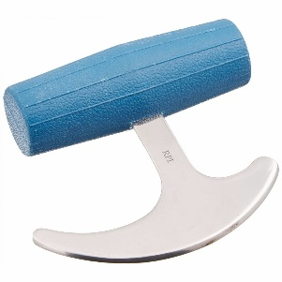
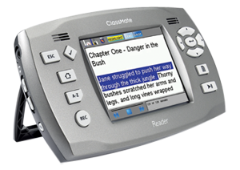
Assistive Technology
We promote visiting the lending library at UCP to utilize their assistive technology option to borrow equipment. This option enables people to live their lives independently.
SAC's create PowerPoints for Self-Advocacy groups that teach assistive technology tools.
For example, teaching individuals at Sharp Training Inc. how to use kitchen adaptive technology.
SAC’s continually offer virtual Self-Advocacy Groups, Fab Topic information, and virtual recreational opportunities all focusing on equity, diversity and inclusion.
April 2022 focused on Homelife. SACs reported on how independence is heightened with AT.
Stay Independent With These Assistive Technologies (verywellhealth.com)
NEAT Marketplace, Connecticut's largest private provider for people with disabilities, offers vans, wheelchairs, product demonstration, equipment restoration, expos, classes and computer use. Removing barriers for all individuals.

Slide 26
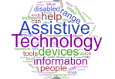
Assistive Technology
This year the SACs created a video (below) on specific assistive technology they use to celebrate AT Awareness Day including Pro Lo Quo To Go, power wheelchairs, iPad/iPhone, and Alexa devices.
Midstate ARC uses a statewide program designed in collaboration with Connecticut’s leading disability agencies for the purpose of training staff in the use and application of technology to reduce barriers and increase the independence of individuals.
Technology Center – MidState Arc
Click to listen
SACs promoted the ATECH Conference 2022 held in Mystic, CT:
Journey to Independence: Assistive Technology at its Best

Slide 27
Housing
Self-Advocate Coordinators support the Fair Housing Act. This act offers reasonable accommodations that promote change and service. These options enable people with disabilities an equal opportunity to obtain housing.
SACs promoted a variety of housing choices by presenting virtual Self-Advocacy Groups, creating and sharing Virtual Bulletin Boards and promoting the Advocates’ Corner.
Living Options:
Self- Direct Your Own Supports
CCHs
Shared living
Independent living
Clustered living
Living with your family
Section 8

Slide 28
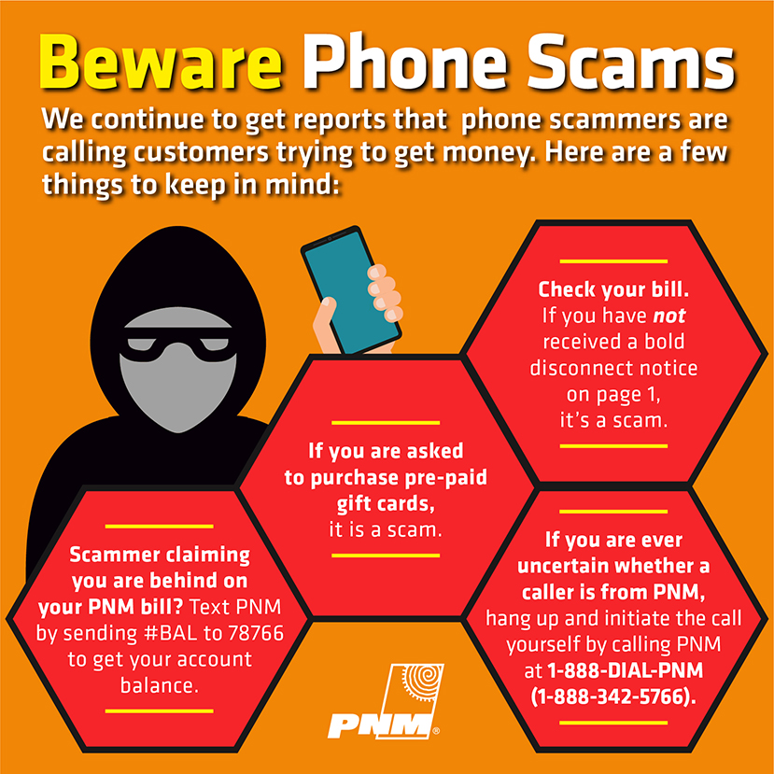
Internet Safety Tips
Having our individuals set a 6–8-word passcode for all their social media accounts.
Teaching our individuals not to give out their information to anyone on social media or in general, such as (credit card numbers, living addresses, credit and debit cards pins, phone number, etc.)
Helping them to understand to be careful of scam phone calls.
Encourage them to know what you put on social media can influence your life or job.
Employers can see your social media accounts.

Slide 29
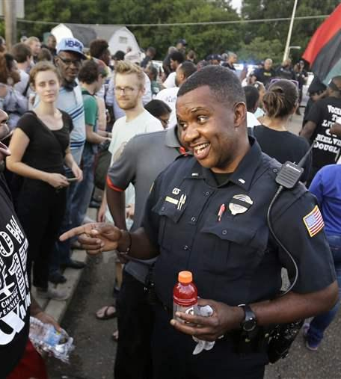
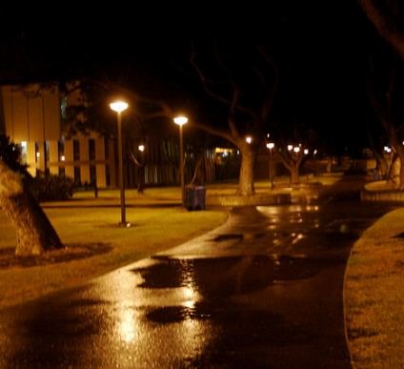
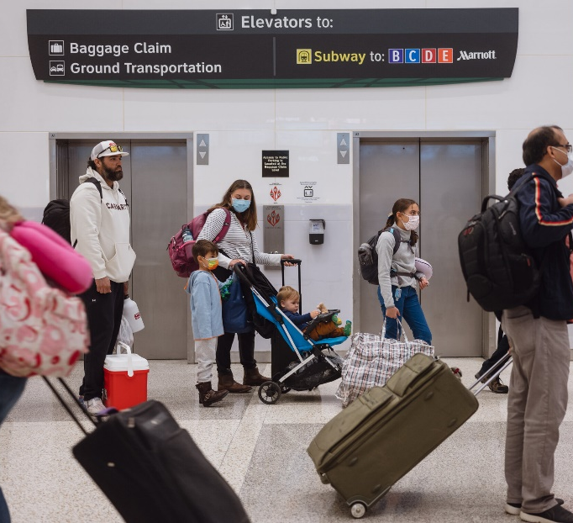
Public Safety
SACs promoted the importance of public safety by helping to understand not to travel alone at night.
Educating on how to be mindful when interacting with law enforcement.
Having open discussions about not being afraid to call 911.
Always stay alert to your surroundings. Look around even when listening to music. Always look behind you day in the daytime and at night.

Slide 30
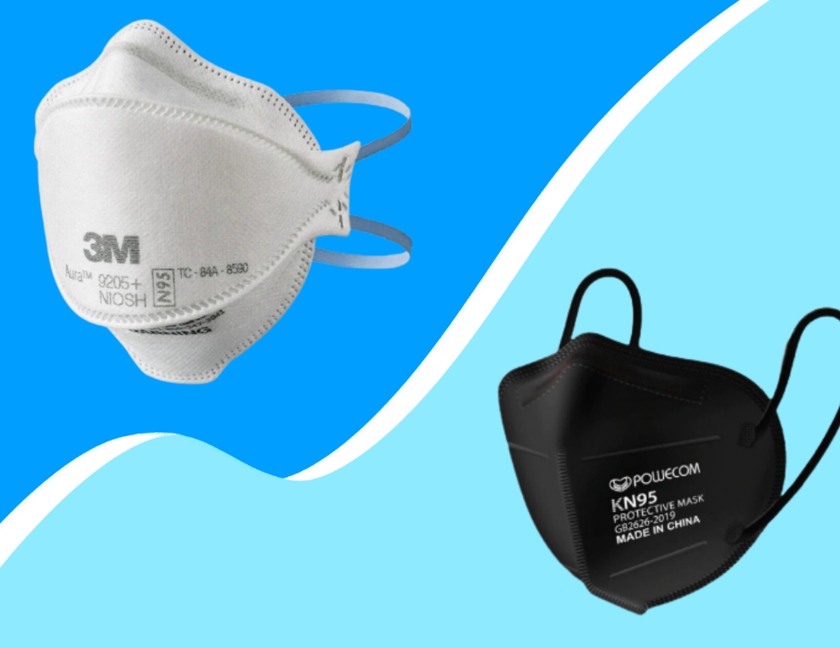
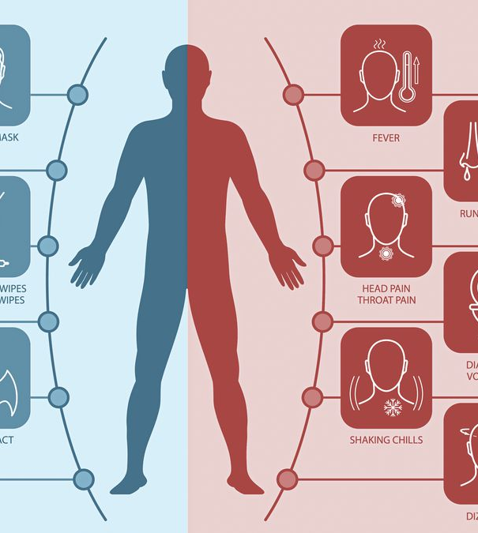
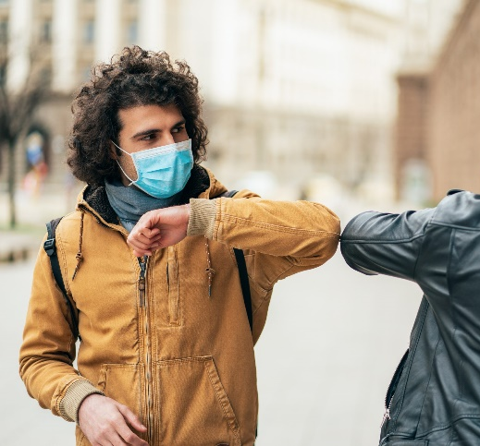
Covid-19 Safety
N-95 is the best mask to wear even if you are fully vaccinated.
Always wash your hands for 20 seconds. Don’t touch any part of your faces.
Make sure to use and carry hand sanitizers.
Wear gloves, if possible, still wash your hands.
Stay 6-10 feet away from each other.
Try to avoid going to large events or the beaches.
Take extra precaution while traveling to others states or countries.
You can elbow bump as a greeting instead of hand shaking and giving hugs.
Covid-19 has a variant called Omicron.

Slide 31
Transportation
As of April 18, 2022, CDC's January 29, 2021, Order requiring masks on public transportation conveyances and at transportation hubs is no longer in effect. Therefore, CDC will not enforce the Order.
Governor Ned Lamont announced that effective Tuesday, May 24, 2022, electric trains will begin running on Shore Line East (SLE). Electric trains are already running on the New Haven Line. These trains are more environmentally friendly, comfortable and reliable.
In April, Governor Lamont announced that CT is receiving $250 Million in federal funding for public transportation.
The first zero-emission electric CT Transit bus was revealed in Hamden in October and there are plans to bring as many as 700 electric buses onto Connecticut's roadways.
The Connecticut Department of Transportation (CTDOT) announced that all public transit buses will be fare-free across Connecticut until December 1, 2022.
Free services include all CTtransit local buses statewide, CTtransit Express and CTfastrak services. ADA Paratransit is also fare free statewide until December 1, 2022.

Slide 32
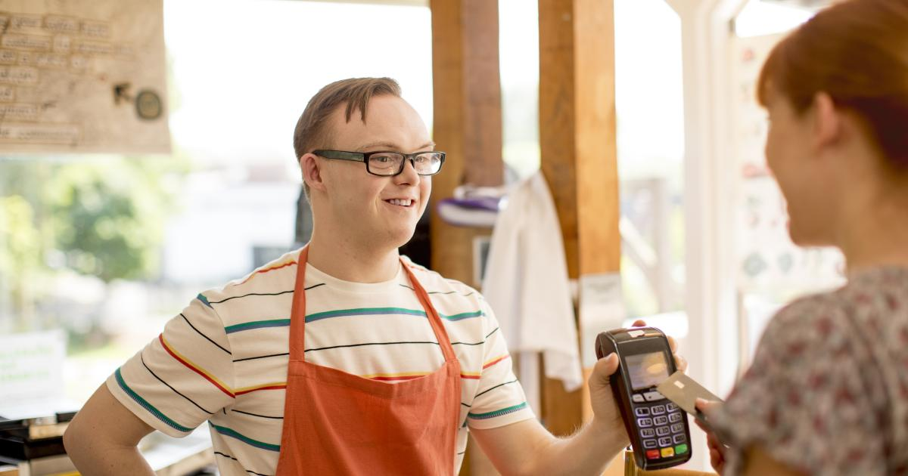
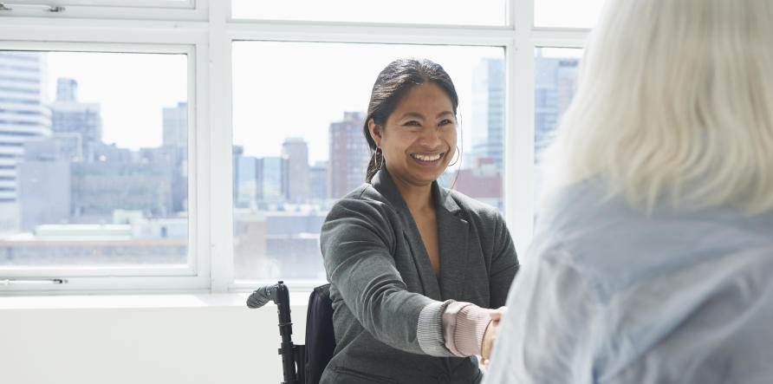
Employment Career vs. Just a Job
Real Work for Real Pay
Self-Advocate Coordinators on APSE Board – Association of People Supporting Employment First.
Self-Advocate Coordinators are members of JDLN -Job Development Leadership Networks
Promote employment in virtual and in-person Self-Advocacy groups.
Promote employment on Virtual Bulletin Boards on the Advocates’ Corner.
SELN- Leadership subcommittee and Strategic Planning.
Self-Advocate Coordinators support and attend Employment Resource Fairs
Virtual Employment Customize Conference
Reach for the stars!

Slide 33
Collaboration with Planned Parenthood of Southern New England and DDS Healthy Relationships Series
The SACs of DDS along with Planned Parenthood of Southern New England co teach individuals about safe and meaningful relationships
Click on this link for more information
Planned Parenthood of Southern New England, Inc.
The classes are held virtually and all year long such as (Winter, Fall, Summer and Spring)
The information that is taught in the classes is very simplified and easy to understand
Over 84 individuals have taken the course
At the end of the classes, you will receive a celebration of appreciate for coming to the classes
All individuals who attend all classes get a certificate

Slide 34
New Provider Orientation
The SACS did virtual and in person new Provider Orientation
Throughout the year of 2021-2022
194 Total people attend
We teach about what we as DDS employ’s believe in
We talk about how important it is to take the people first language pledge
And seeing us for our abilities and not out disabilities.

Slide 35
On Board Training
The Sacs did virtual On-Board Training for new employee for DDS throughout the year of 2021-2022
600 total people attended
We taught on the topic of Self-Direction/Self-Determination and Self-Advocacy
Also, we taught about human rights and being a mandate reporter
Talk about what we as Self-Advocate Coordinators do on a day to day basis

Slide 36
Youth Leadership Forum 2022 Virtual
There were a total of 30 students who were excited to attended the forum
We had 3 different teams
All the participants did a community service event
The young adults learned so much throughout the week . They learned how to advocate for themselves, use the life course materials and most important learned leadership skills
All individuals attending the forum left as stronger leaders as well as ambassadors of the Life Course materials.

Slide 37
SACS
Share the latest
on the Updated
Advocates’
Corner
Website
Advocates’ Corner
Notes:
Paige

Slide 38
Moving Forward!
Continue to Promote Living a Self-Determined Life
Promote advocates’ voices by expanding and developing Self- Advocacy Groups
Continue Virtual Connections
Continue to promote Healthy Relationships
Continue to promote various Living Options
Interview and Share Success Stories of Special Olympic Athletes
CT CoP -Promote and lead by example the Individual Plan (IP) and use of the CT Life Course Materials while expanding IP Buddy support
Degrees of Mean - Continue to promote and train providers/staff and self advocates
Continue to provide education and training to Individuals, Families, DDS Staff, Providers, and Sister Agencies on the Department’s Initiatives
Youth Leadership Forum – participate, train, roll model and support the youth of CT to become great Self-Advocates
Continue to promote REAL WORK for REAL PAY
Support DDS's Five-Year Plan such as Assistive Technology and Customize Employment
Fiscal Year
This Photo by Unknown Author is licensed under CC BY
Notes:
Jeremy - 1-6
Paige 7-12

