Slide 1
An Overview of Mental Health Issues concerning Individuals with
Developmental Disabilities and Positive Behavioral Supports
Peter Tolisano, Psy.D.
Director of Psychological Services
Connecticut Department of Developmental Services
Tracey M. Sondik, Psy.D.
Director of Behavioral Intervention Services
Connecticut Valley Hospital
Department of Mental Health and Addictions Services

Slide 2
Intellectual Disability and Autism Spectrum Disorder
Goals of Presentation
Identifying IQ Functioning along the Bell Curve
Learning about Focal Regions of the Brain
Appreciating the Full Scale IQ and the Specific Indexes
Better Understanding Adaptive Functioning
Learning about DDS Eligibility Determination
Understanding Autism Spectrum Disorder

Slide 3
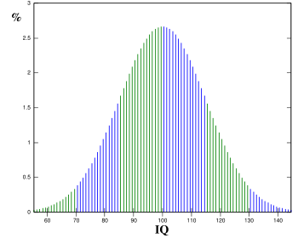
Understanding General Intellectual Functioning
1 Percentile Rank 100
Full Scale IQ is the total score that summarizes performance across multiple cognitive abilities. When unusual variability is observed in the subtests, it is most useful to examine the index scores.

Slide 4
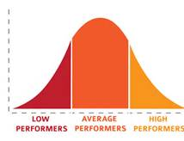
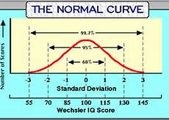
Understanding General Intellectual Functioning
Average FSIQ = 100
Standard Deviation = 15

Slide 5
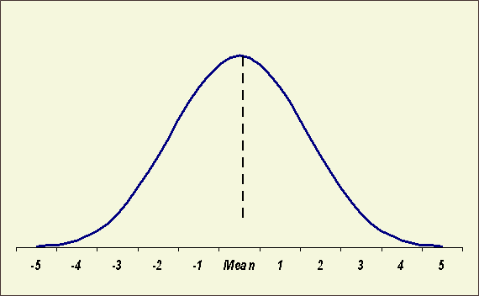
Understanding Intellectual Disability
Less intelligent
than average
More intelligent
than average
Degrees of Severity
Mild 85%
Moderate 10%
Severe 3%
Profound 2%
25
40
55
70
Intellectual Developmental Disorder: Intellectual and
adaptive deficits with onset during the developmental period
that occurs between birth to 18 years old.
I/DD is noted to have over 250 syndromal (25%) and non-syndromal causes (75%).

Slide 6
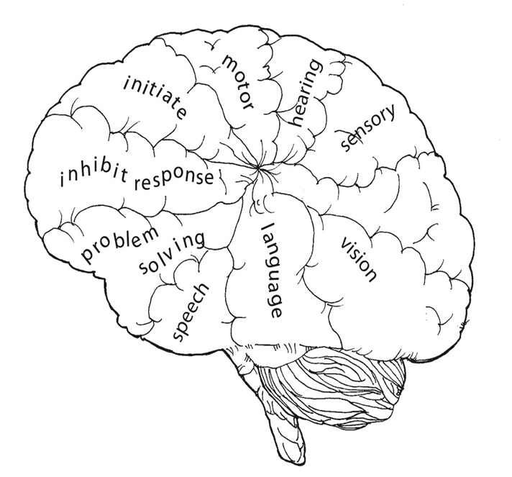
Brain Hemispheres
Hemispheric Functions
Contra-lateralization
Corpus Callosum

Slide 7
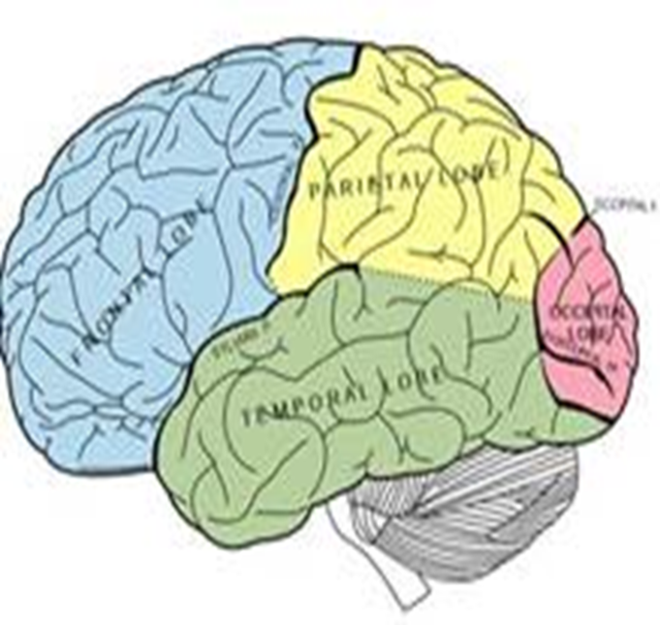
Brain regions
The brain has three parts:
Frontal lobes for higher-order thinking and executive functions: These include a sense of time and context, planning, inhibiting and initiating action, and empathic understanding.
Limbic system that governs emotions
Brainstem that controls physical functions and survival responses

Slide 8
Intellectual Functioning Indexes
Verbal Comprehension:
General knowledge and reasoning skills. Related to formal and informal education.
Language is central our ability to label, organize and manage our internal experiences and the external environment.
Difficulty putting feelings and needs into words makes individuals prone to frustration, aggression, and depression.
Perceptual Organization:
Visual-spatial skills.
Ability to create solutions, especially in novel situations.

Slide 9
Intellectual Functioning Indexes
Working Memory:
In-the-moment reasoning tied to attention, concentration, and short-term memory.
Important to learning, flexibility, planning, and self-monitoring.
Sensitive to anxiety and depression.
Related to trauma responses and anger management
Processing Speed:
Ability to work quickly and efficiently.
Sensitive to motivation and persistence.
PS may negatively effect overall cognitive functioning.
Intellectual impairment is often related to problems delaying gratification, controlling impulses, and tolerating frustration.
Best approach is building on strengths and minimizing weaknesses.

Slide 10
Adaptive FUNCTIONING
Based on performance of daily activities at a given age, rather than ability.
Refers to how effectively people cope with common life demands across multiple environments.
Domains of Practical, Conceptual, and Social skills.
Measures include the Vineland Scales and the BASC.
Self-care
Expressive and Receptive Communication
Social and Community Activities
Independent living skills (e.g. housekeeping)
Health and safety
Vocational abilities
Self-direction

Slide 11
DDS Eligibility Determination Process
Connecticut General Statute Section §17a-210b; Subsection 1-1g is the law that DDS is required to use in order to determine whether someone has an intellectual disability and to determine eligibility along three criteria.
A significant limitation in intellectual functioning and deficits in adaptive behavior (existing concurrently) that originated during the developmental period before eighteen years of age.

Slide 12
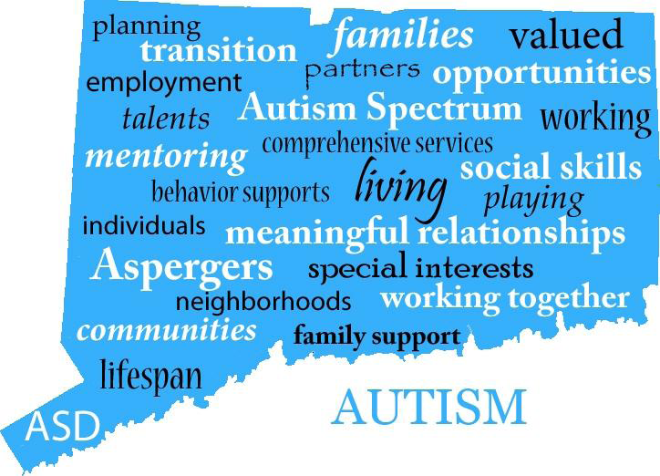
Autism Spectrum Disorder

Slide 13
The latest numbers in Epidemiology
Steady Increase in Prevalence:
2000 birth year of 1992- rate 1 in 150
2004 birth year of 1996-rate of 1 in 125
2008 birth year of 2000-rate of 1 in 88
2010 birth year of 2002-rate of 1 in 68
Probably genuine rates
Result from broadening of diagnostic criteria and increased treatments as a driving force (ABA, speech therapy)
Notes:
A little over a year ago the CDC released new data about the prevalence of ASD

Slide 14
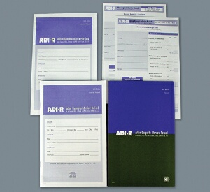
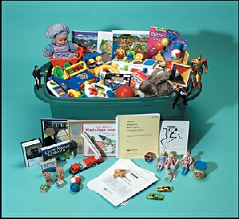
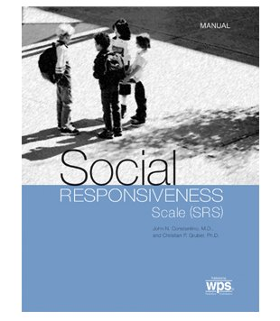

Why are numbers increasing:
Better tools?
New diagnostic measures
Autism Diagnostic Interview (1989, 1994)
Autism Diagnostic Observation Schedule (1989, 2000)
Screening tools/algorithms/instruments in wide use despite some reliability concerns.
MCHAT / AAP guidelines
SCQ
SRS
CARS
GARS

Slide 15
Core ASD Symptom Domains PLUS Associated Medical Features
Gastro-intestinal Dysfunction
Epilepsy-
EEG abnormalities
Aggression
AUTISM
SPECTRUM
DISORDER
Social Anxiety
ADHD
Impaired Social Communication/
Interactions
Restricted & Repetitive Behavior
Sleep Disturbance
Immune Dysfunction
Language Disorders
Intellectual Disabilities
OCD
Motor problems: Apraxia

Slide 16
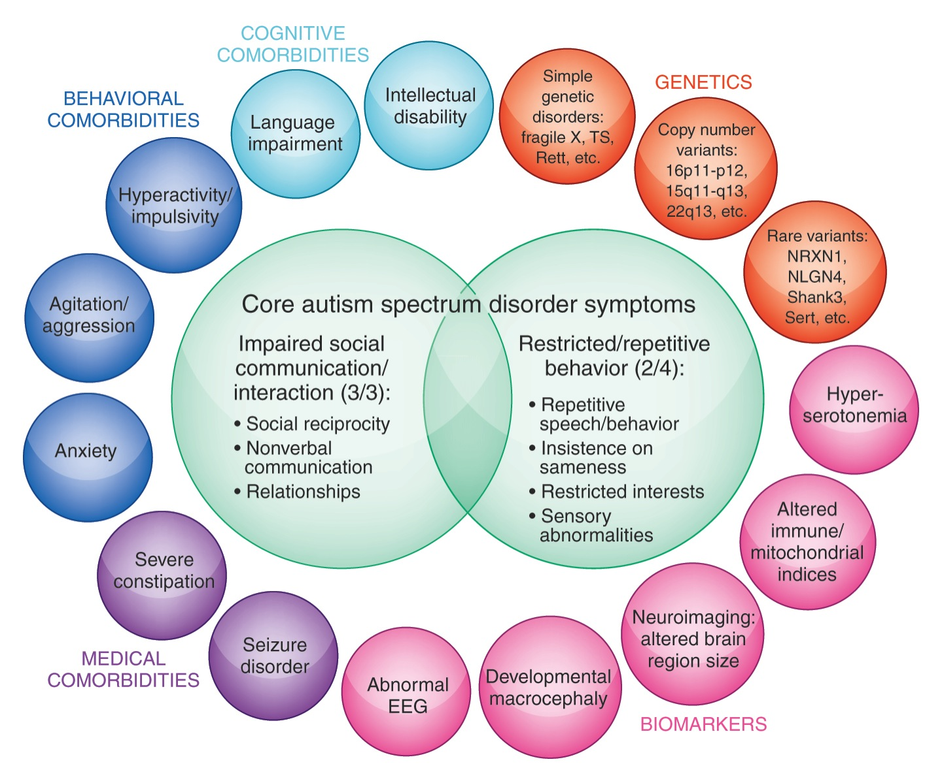
Autism Spectrum Disorders (ASD)

Slide 17
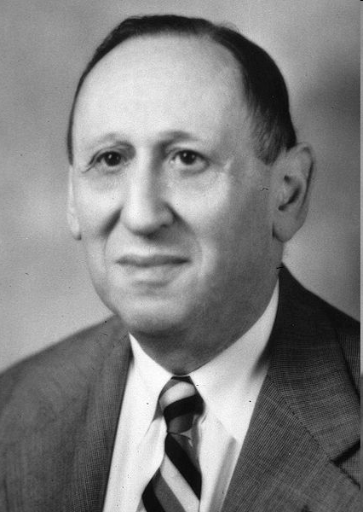
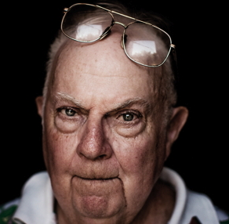
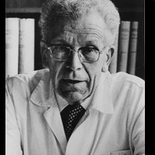
Defining: Autism Spectrum Disorder
1943 – Leo Kanner – Infantile autism
1944 – Hans Asperger
1960s – Separation from schizophrenia
1970s – Biology / genetic underpinnings
1980 – DSM-III – Pervasive Developmental Disorders
1987 – DSM-III-R - Autistic Disorder / PDD-NOS
1994 – DSM-IV – Asperger’s Disorder
2013- DSM-5- Autism Spectrum Disorder
Notes:
Autistic D/O of affective contect.
Kanner 11 children limited interest in and impaired interest in others from infancy onward
Simultaneously in German hans asperger describing a similar grouping of young boys in German.
Decades understood a childhood schizophrenia until the work of Rutter and Kolvin distinguished characteristics
Personality, though, mood, affect onset after 11; speech, delay, retualistic behavior, deficits in social relations and play.

Slide 18
DSM-5 and ADOS-2
Categories:
Autism
Autism Spectrum (PDD-NOS, Asperger’s, Childhood Disintegration Disorder)
Non-Spectrum (Rhett Syndrome, Fragile X)
Asperger’s
Autistic Disorder
Autism Spectrum Disorder
PDD-NOS
Notes:
Common Approaches to Functional Framework – ZW with WS comments – 20 min
18

Slide 19
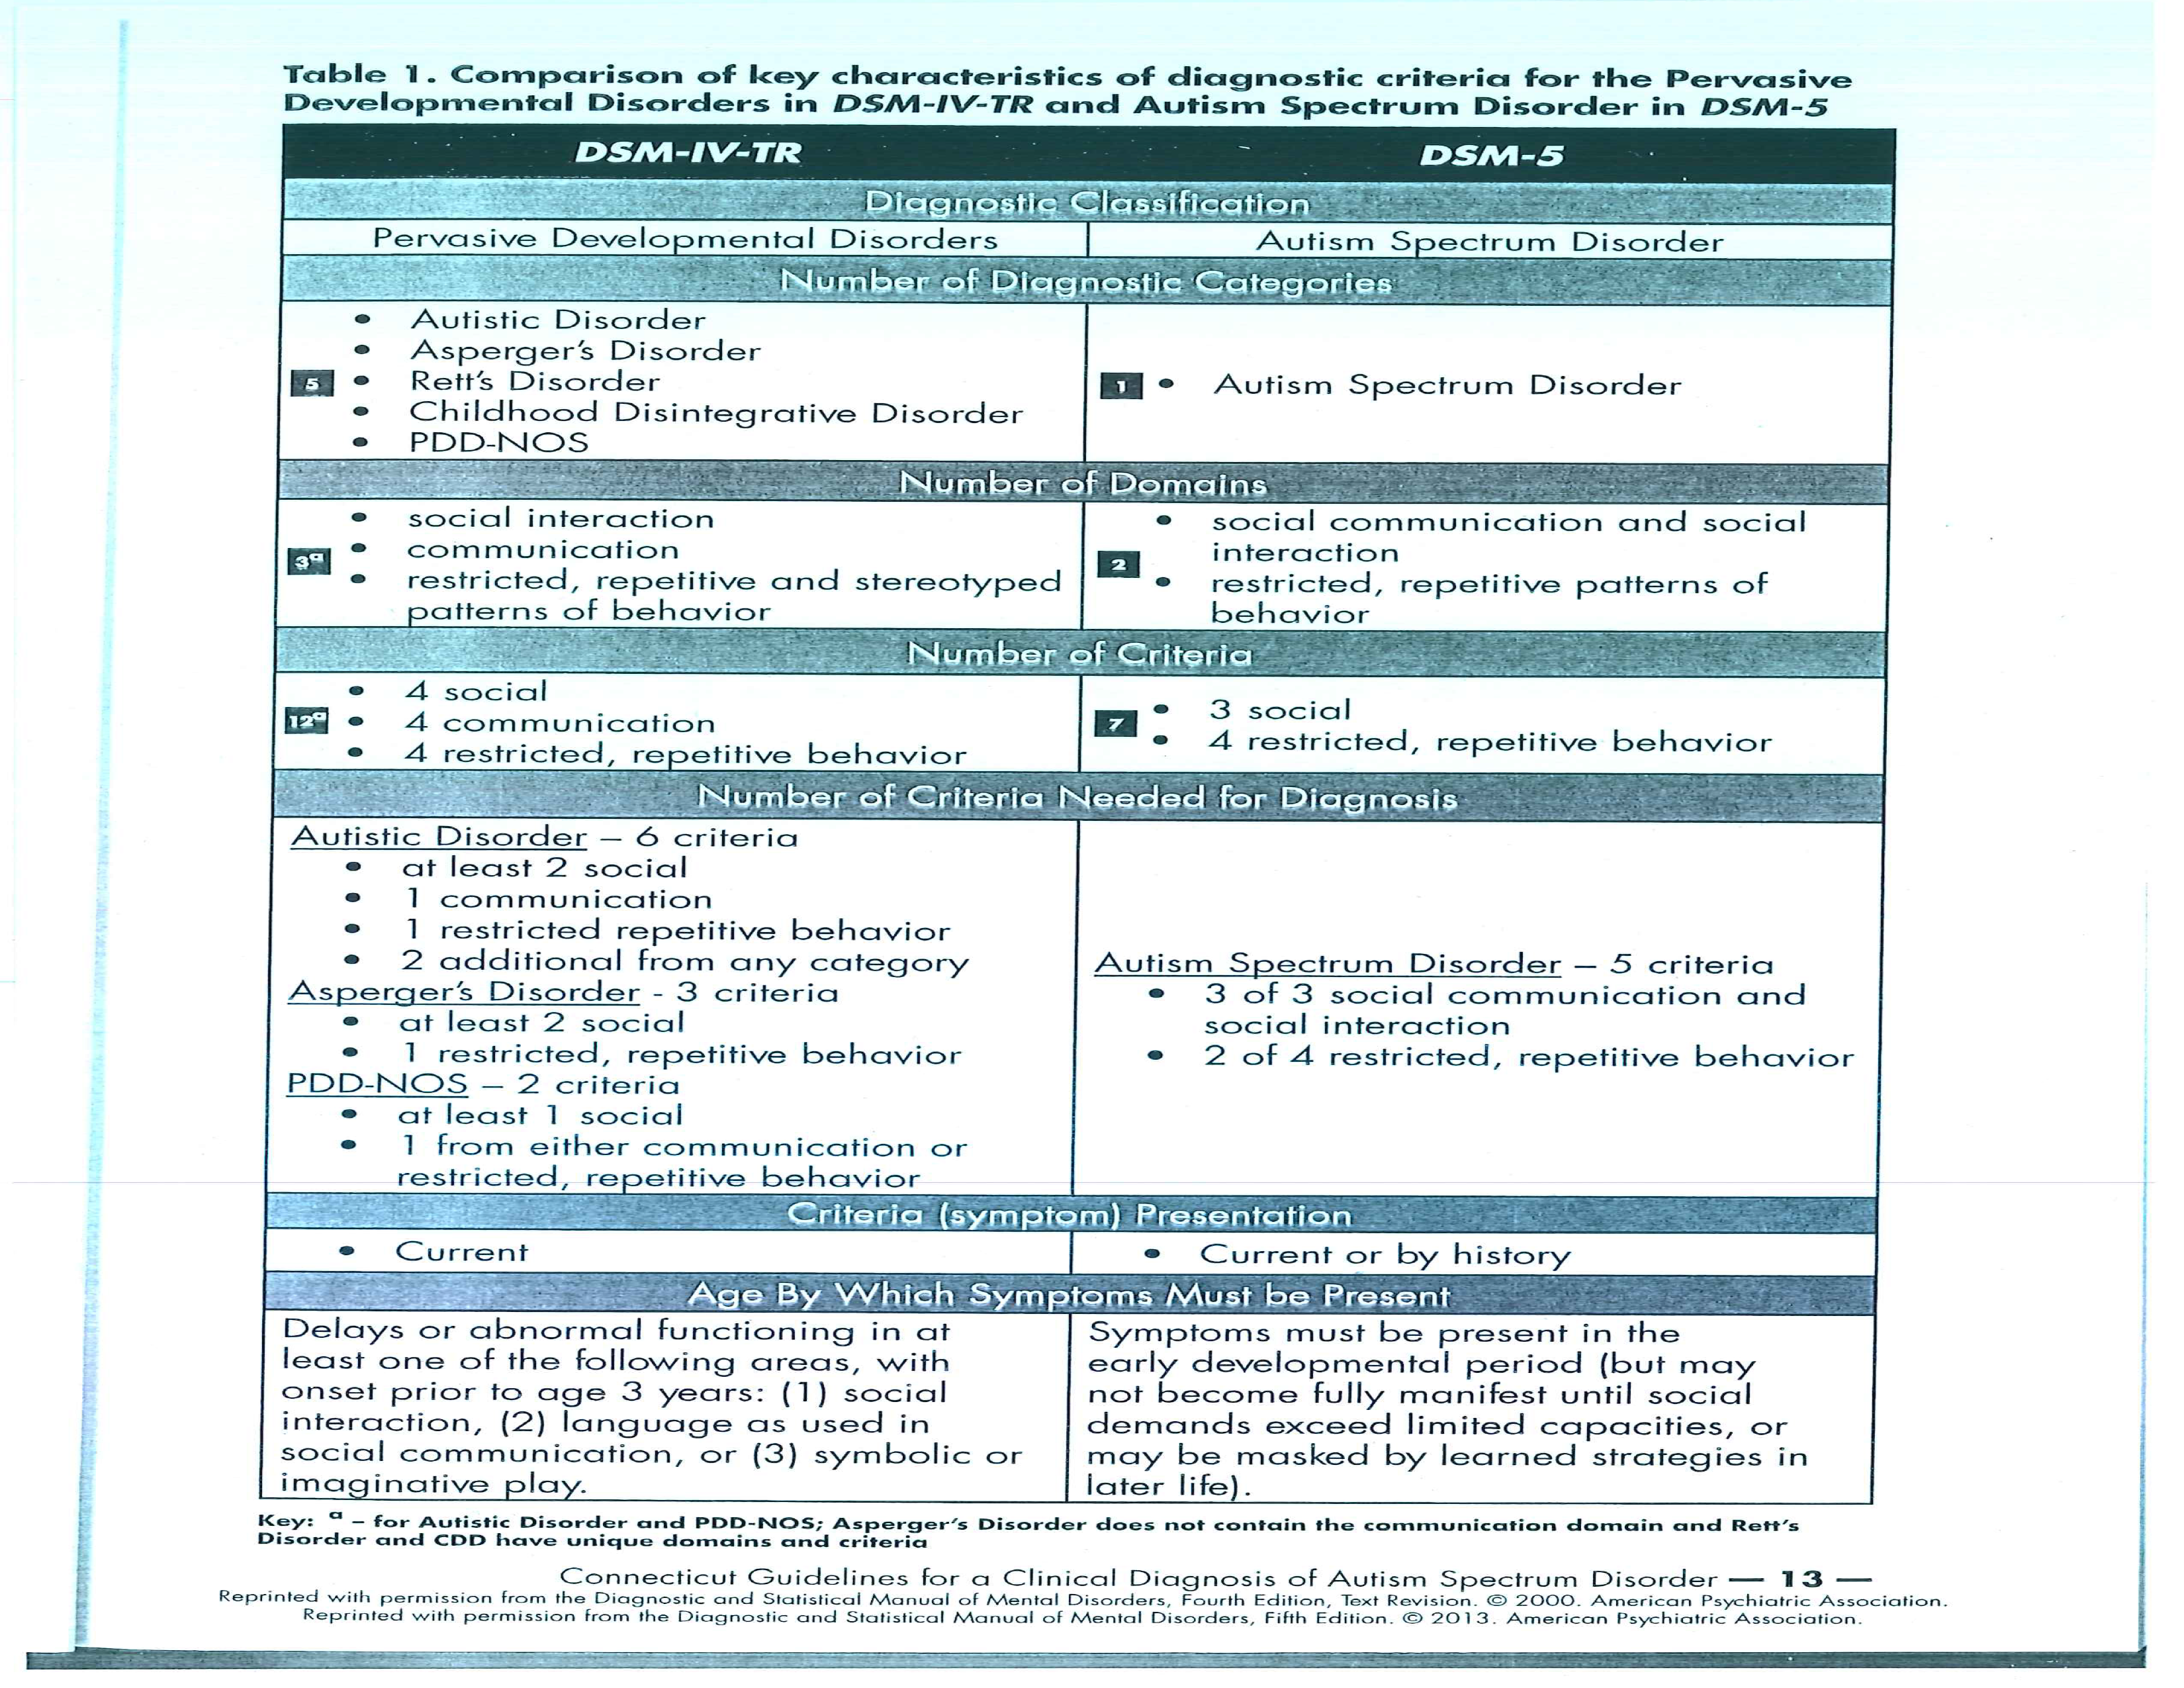

Slide 20
DSM-5
Deficits in social communication (all 3):
Deficits in nonverbal communication
Deficits in social and emotional reciprocity
Deficits in maintaining relationships
Restricted, repetitive patterns of behavior, interest, and activities (2 out of 4)
Stereotyped motor or verbal behavior
Unusual sensory behavior
Excessive adherence to routines and ritualized behavior
Restricted, fixated interests
Symptoms present in early childhood (manifest when social demands exceed capabilities)
Notes:
Common Approaches to Functional Framework – ZW with WS comments – 20 min
20

Slide 21
Autism Spectrum Diagnostics:
Goal is symptom identification (phenotypes) and an understanding of severity (specific abnormalities not general impressions).
ADOS creates a “Social World” with interactive questions.
Cautiously look for atypicalness (normal kids will perseverate or overtly gesture to communicate).
ASD can be reliably diagnosed at 2 years. If regressed type check medical first. For example, “prancing” might be other physical condition or smelling of hands could reflect a tic disorder.
Its found across all cultures and socioeconomic groups. About 5:1 male to female.
Often symptoms present in early developmental period but diagnosis comes later (becomes noticeable where social and communication skills are needed across different environments.
Delays are an absence of skill sets. Can be diagnostic overlap (e.g., expressive language affects socialization).

Slide 22
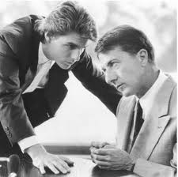
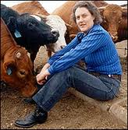

The nature of Autism Spectrum Disorder

Slide 23
ASD: Themes and Variations
‘Severely Affected’
Non-verbal
Intellectual Disability
Severe behaviors (e.g. self-injury)
Little to no social skills (‘in their own world’)
‘Less Noticeably Affected’
Average to above average IQ
Verbal
Lack of social understanding
Inability to see another’s perspective (ToM)
Insistent on sameness

Slide 24
Autism Spectrum Disorder
Theory of the Mind:
Those with an autism spectrum diagnosis often have significant difficulty understanding and appreciating that others may have thoughts, feelings, opinions, intentions, and plans that are different from their own.
It can result in the following:
Misreading body language. It is used to regulate social interactions (e.g., tone of voice, facial expressions, postures, and vocal volume).
Misinterpreting subtle social cues. “Distancing” in the form of indirect eye contact allows those with autism time and space to make meaning out of sensory information.
Problems with “give and take." Poor reciprocation in social relationships.
Difficulty understanding expectations. Problems predicting what they and others will say or do in social situations.
Painful awareness of social differences. Challenges "fitting in" socially may give rise to episodes of anxiety and depression.

Slide 25
Autism Spectrum Disorder
Cognitive Functioning:
Often rigidly cling to beliefs, convictions, or rules especially when distressed (c.f., with schizophrenia become disorganized).
Autism is frequently misassociated with intellectual disability.
On the contrary, strong language skills can easily be misinterpreted as advanced communication/social skills, which can lead others to mislabel their actions as purposeful and manipulative.
Early interventions are crucial!
Symptoms may not manifest until social demands exceed capacities or may be masked by learned “compensatory” strategies in adolescence and adulthood.

Slide 26
Autism Spectrum Disorder
Areas for Diagnostic Consideration:
Language and communication skills
Social relationships and responses to social situations
Responses to noises, touch, sights, and other senses
Behaviors while alone versus in groups
Ability to do a range of intellectual activities

Slide 27
ASD Treatment Considerations:
A lifelong condition. No biological tests exist. Multigenetic make-up with 10 to15% genetic markers identified.
Younger age makes it more difficult to differentiate ID from ASD. Before 70-80% were ID; now 30-80%. About of those with ASD 75% acquire language.
Diagnostics and treatment are challenging because there are both positive (abnormal) and negative (absence of normal) behaviors.
Heterogeneity and variability in behaviors in same child versus different children (e.g., ID, language deficits, ADHD, anxiety disorder).
Overarching treatment goals are modulation of behavior and building life skills especially socially.

Slide 28

Understanding Mental Health Issues
Goals of the Presentation
Acknowledge that co-occurring mental health conditions are frequent in intellectual disability with three to six times higher rates than the general population.
Develop a basic understanding of the common DSM-5 psychiatric disorders that might affect those with intellectual disability.
Identify the pharmacological interventions that are often used to treat these disorders.

Slide 29
Mental Illness and Intellectual Disability
Individuals with either condition have been stigmatized and marginalized.
Multiple supportive relationships needed to face unique challenges.
People with ID experience a full range of psychiatric disorders just like those with typical cognitive functioning, but there are higher prevalence rates.

Slide 30
Mental Illness and Intellectual Disability
Treatment should be based on the most specific psychiatric diagnosis possible. We need to properly assess in order to accurately intervene.
Identify the predisposing, perpetuating, and protective factors.
The best practice is to rely on the biopsychosocial model to determine the cause of mental health issues and the appropriate course of treatment (e.g., differential diagnosis between repetitive behaviors in OCD, Autism, and Tourette’s syndrome).
Behavioral problems may or may not be related to mental health issues.

Slide 31

Neurodevelopmental Disorders:
Childhood Onset

Slide 32
Autism Spectrum Disorder:
Persistent deficits in Social communication, Social interaction, and Repetitive behaviors
Attention-Deficit/Hyperactivity Disorder:
Inattentive versus Hyperactive/Impulsive Types
Evidence before age 12
Disruptive Disorders:
Intermittent Explosive Disorder
Oppositional Defiant Disorder:
Irritable, Argumentative, and Vindictive
Conduct Disorder:
Destructive, Deceitful, Rules violations, and Precursor to Antisocial Personality
*Difficulties related to impulsivity and hyperactivity are easily misinterpreted as aggression

Slide 33
Challenges posed by Intellectual Disability that Influence Psychiatric Diagnosis
Symptom presentation should always be evaluated
in the context of developmental delay
Intellectual Limitations: Problems with abstract thinking and difficulties with receptive/expressive language lead to challenges in describing past and present symptoms.
Mental Status Exam: Self-reported versus endorsed symptoms.
Psychosocial Masking: Concealing issues to present as “normal.”
Cognitive Disintegration: Decreased ability to tolerate stress leads to anxiety-induced psychiatric symptoms.
Baseline Exaggeration: Increased severity of mental health symptoms after onset of problem.

Slide 34
Diagnostic Overshadowing Bias
Clinicians tend to overlook mental health symptoms or attribute them to the presence of an intellectual disability.
Clinicians are more likely to recognize mental health issues in those with normal IQs than those with intellectual disabilities.
Mental health problems are difficult to recognize in people with intellectual disability. Symptoms of mental illness in people with ID may or may not differ from those without ID.
People who cannot communicate well pose a challenge to clinicians who overly rely on verbal communication for diagnosis. How we phrase questions and review information is extremely important.
Example: An individual with an intellectual disability reports talking with imaginary friends. Is it a psychotic disorder or a coping mechanism?

Slide 35
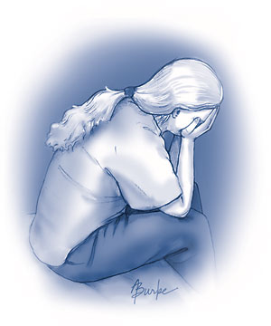

Slide 36
Mood Disorders
Depressive Disorders
Dysthymia/Persistent Depression
Major Depression
Premenstrual Dysphoric Disorder
Disruptive Mood Dysregulation Disorder
Bipolar Disorders
Formerly Manic-Depression
Cyclothymia
Type I vs. Type II Episodes
Manic syndrome is characterized by a loss of emotional (e.g., labile to irritable) and behavioral (e.g., impulsivity, novelty seeking) control.
Child vs. Adult Presentation in Mood Disorders
Episodic Mood Instability vs. Affective Shifts

Slide 37
Unlocking the Process
Acting
Feeling
Thinking
Problems with communication affect predisposition, assessment, and treatment. Always check with knowledgeable informants and review the behavioral data.

Slide 38
Signs and Symptoms of Mood Disturbance
Presentation
Crying
Changes in Appetite and Sleep
Irritability
Agitation and Aggression
Tiredness and Lethargy
Thinking
Negative beliefs about past, present, and future
Feeling Worthless or Unlovable
Perceptions of Helplessness and Hopelessness
Loss of Enjoyment
Suicidal Ideation
Distractibility
Psychomotor Slowing
Emotions
Sadness
Guilt
Despair
Signs and Symptoms of Mood Disturbance
Presentation
Crying
Changes in Appetite and Sleep
Irritability
Agitation and Aggression
Tiredness and Lethargy
Thinking
Negative beliefs about past, present, and future
Feeling Worthless or Unlovable
Perceptions of Helplessness and Hopelessness
Loss of Enjoyment
Suicidal Ideation
Distractibility
Psychomotor Slowing
Emotions
Sadness
Guilt
Despair
Signs and Symptoms of Mood Disturbance
Presentation
Crying
Changes in Appetite and Sleep
Irritability
Agitation and Aggression
Tiredness and Lethargy
Thinking
Negative beliefs about past, present, and future
Feeling Worthless or Unlovable
Perceptions of Helplessness and Hopelessness
Loss of Enjoyment
Suicidal Ideation
Distractibility
Psychomotor Slowing
Emotions
Sadness
Guilt
Despair

Slide 39
Anxiety Disorders
Separation Anxiety
Specific Phobias
Panic Attacks vs. Panic Disorder
Social Phobia
Generalized Anxiety Disorder
Agoraphobia

Slide 40
Other Anxiety-Related Disorders
Obsessive-Compulsive Spectrum
Obsessive and Compulsive “Loops”
Differential Diagnosis
Domains:
Hoarding
Contamination
Fear of Harm and Checking
Symmetry and Order
Posttraumatic Stress Disorder
Symptom Clusters
Re-Experiencing
Arousal
Avoidance

Slide 41
Trauma and Stress-Related Disorders
I. Secondary to Insufficient Care
Reactive Attachment Disorder:
Inhibited versus Disinhibited
II. Developmental Trauma Disorder
Repeated inconsistency, often involving abandonment, rejection, abuse, or neglect (“anything less than nurturing”) in early life causes negative effects on neurocognitive, emotional, and psychosocial development.
III. Posttraumatic Stress Disorder
Symptom Clusters: Intrusions, Avoidance, Arousal, and Negative Thinking and Mood
Eye Movement Desensitization and Reprocessing: To help resolve memories locked in the Limbic System

Slide 42
Signs and Symptoms of Anxiety Disorders
States vs. Traits
Presentation
Avoidance
Seeking reassurance
Sleeplessness
Restlessness
Tension
Thinking
Impaired Attention and Concentration
Catastrophic beliefs
Preoccupations
Emotions
Nervousness
Fear
Worry

Slide 43
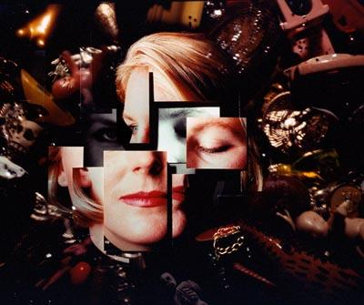

Slide 44
Schizophrenia Spectrum and
Psychotic Disorders
Psychosis
Hallucinations
Delusions
Schizophreniform Disorder: Prodromal Phase
Schizophrenia Subtypes
Schizoaffective Disorder

Slide 45
Features of Thought Disorders
Presentation
Negative Symptoms: “Taken Away”
Disheveled, Lethargic, Diminished emotional expression, Avolition
Abnormal Motor Behavior: Catatonic, Pacing, Regressed
Thinking
Poor insight into nature of the illness
Disorganized thinking, such as tangential, circumstantial, ideas of reference, and a flight of ideas.
Positive Symptoms: “Added On”
Hallucinations (e.g., auditory, visual, tactile, olfactory, gustatory)
Delusions (e.g., grandiose, paranoid, persecutory, religious)
Responses to Internal Stimuli
Emotions
Blunted or flat affect
Depressed to Excited
Irritable
Aggressive
Anhedonia

Slide 46
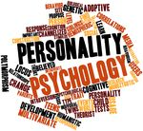
Personality Functioning
Behaviors across people and situations
Rooted in four components:
Temperament
Character
Cognitive Functioning
Morals and Values

Slide 47
Understanding Personality Dysfunction
Categorical vs. Dimensional Approach
Ego Syntonic vs. Ego Dystonic
Primary attachment figures throughout the formative years most definitely impact a person's characterological makeup and personality functioning across the life span.
For example, unpredictable and chaotic parenting during childhood influences a person’s insecurity and fears of abandonment in adulthood.

Slide 48
General DSM Characteristics of
Personality Disorder
Misperceptions
Reactivity
Interpersonal Issues
Impulsivity
*Diagnostic Criteria Overlap

Slide 49
Personality Disorders
DSM Phenomenology
Cluster A: Odd disorders
Paranoid: Irrational mistrust and suspicion
Schizoid: Detached from social relationships and restricted emotions
Schizotypal: Odd beliefs and discomfort interacting socially
Cluster B: Dramatic, emotional or erratic disorders
Histrionic: Attention-seeking behavior and excessive emotions
Narcissistic: Grandiose and Unempathic
Antisocial: Exploitative, disregard for rights of others, even psychopathy
Borderline:
Proper: Instability in relationships, identity, and emotions.
Level of Personality Organization: Identity diffusion, primitive defenses,
and variable reality testing.
Cluster C: Anxious or fearful disorders
Dependent: Excessive need for caring and reassurance
Avoidant: Socially inhibited and sensitive to negative evaluation
Obsessive-Compulsive: Rigid, controlling, and perfectionistic

Slide 50
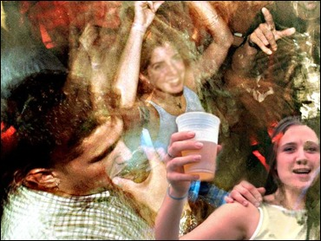

Slide 51
Substance-Related and
Addictive Disorders
Alcohol
Cannabis
Hallucinogens
Cocaine
Inhalants
Opioids
Stimulants
Sedatives
Caffeine and Tobacco
Gambling
Virtual Addictions: Internet and Video Games

Slide 52
Substance-Related and
Addictive Disorders
Formerly Abuse versus Dependence
General Criteria:
Impaired Control
Social Impairment
Risky Use
Pharmacological

Slide 53
Stage of Change Model
Precontemplation:
Characterized by denial, poor awareness, or rebellion.
Goal is to raise consciousness without confronting or create a discrepancy.
Contemplation:
Ambivalent feelings. Reflect both sides by weighing pros and cons.
Explore function of the behavior. Avoid dwelling on consequences.
Preparation:
Taking proactive steps about imminent change.
Verbal commitment to a concrete plan within 30 days.
Action:
Demonstrate a commitment to a plan in real life.
Maintenance:
Staying changed at least for 6 months.
Focus on relapse prevention skills.
General Considerations:
Change into and out of behaviors.
Vacillate between stages and phases of each.
Transition from Contemplation-to-Action tends to be most difficult.

Slide 54
Sleep-Wake Disorders
Insomnia
Hypersomnolence
Breathing-Related Disorders (Obstructive vs. Central vs. Complex Apnea)
Circadian Rhythm Disruption
Eating Disorders
Anorexia and Bulimia
Neurocognitive Disorders
Delirium vs. Dementia
Acquired vs. Traumatic Brain Injury

Slide 55
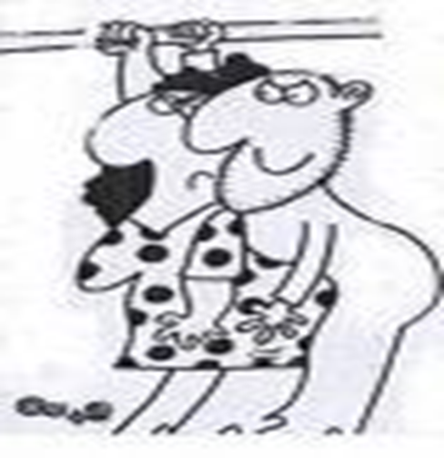
Sexual Disorders
Paraphilias
Pedophilia
Hebephilia
Fetishism
Frotteurism
Exhibitionism

Slide 56
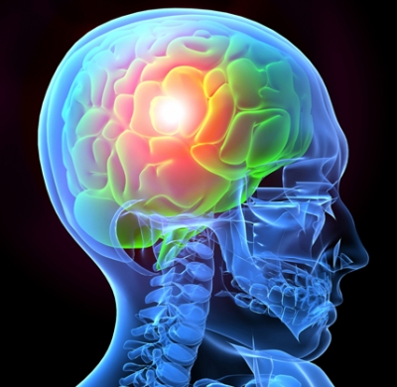
Neurocognitive Disorders
Delirium
Major and Mild Neurocognitive Disorder (NCD)
Primarily COGNITIVE disorders
Acquired (after childhood) and represent decline (i.e. not neurodevelopmental disorders such as intellectual disability).

Slide 57
Delirium Diagnostic Criteria
Key Features: Rapid and Abrupt onset of:
Impaired Attention
Lack of Awareness of environment
Developed over short period of time, fluctuating throughout day
Change in at least ONE Cognitive Domain:
Recent Memory
Orientation
Language (i.e. rambled speech, mumbling, difficult to understand)
Perceptual Disturbance
Direct result of a medical condition, substance intoxication/withdrawal, exposure to toxin, or multiple causes.
Associated Features
Change in sleep-wake cycle
Change in emotional states
Worsening of behavioral problems in the evening

Slide 58
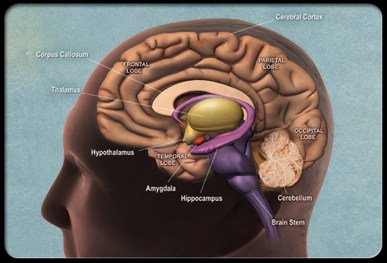
“Neurocognitive Disorders” (NCD) vs. “Dementia”
“Dementia” typically refers to degenerative disorders in older adults.
DSM-5 expands category to disorders of younger adults
E.g., NCD due to HIV, traumatic brain injury
DSM-5 broadens the diagnosis to include patients with impairment in a single domain.
Acknowledges wider range of impairment (major and mild) instead of just “dementia”.

Slide 59
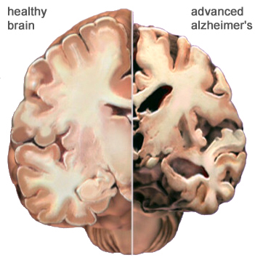
Major NCD
Significant Cognitive Decline from a previous level in one or more domains, based on:
Concern of the individual, a knowledgeable informant, or the clinician, AND
Substantial impairment in cognitive performance, “preferably documented by standardized neuropsychological testing or, in its absence, another quantified clinical assessment.”
Interfere with independence in everyday activities (“at a minimum, requiring assistance with complex IADLs”.
Not due to delirium
Not due to other mental disorder

Slide 60
Mild NCD
Modest decline in one or more cognitive domains based on:
Concern of the individual, a knowledgeable informant, or the clinician, AND
Modest impairment in cognitive performance, “preferably documented by standardized neuropsychological testing or, in its absence, another quantified clinical assessment.”
Deficits do NOT interfere with independence, but “greater effort, compensatory strategies, or accommodation may be required.”
Not due to delirium
Not due to other mental disorder

Slide 61
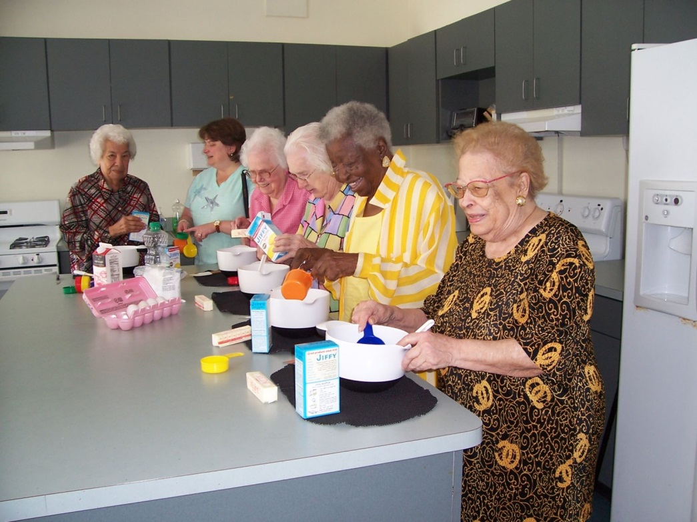
Major vs. Mild NCD
The major difference hinges on dependence in everyday activities.

Slide 62
Mild vs Major NCD: Cognitive Testing
“Neuropsychological testing…is part of the standard evaluation of NCDs and is particularly critical in the evaluation of mild NCD.”
Mild: typically 1–2 standard deviations (SDs) below appropriate norms (between the 3rd and 16th percentiles).
Major: typically 2 or more SDs below appropriate norms; 3rd percentile or below.

Slide 63
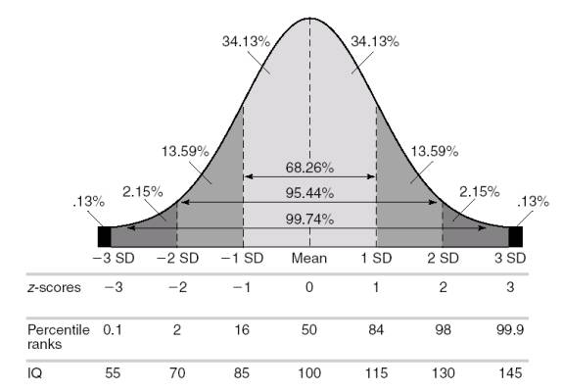
Test Scores
MILD
MAJOR
*Thank you to Allyson Rosen, PhD, ABPP, for this diagram.

Slide 64
Major and Mild Neurocognitive Disorder (NCD) etiologies
Alzheimer’s disease
Frontotemporal lobar degeneration
Lewy body disease
Vascular disease
Traumatic Brain Injury
Substance/medication use
HIV infection
Prion disease
Parkinson’s disease
Huntington’s disease
Another medical condition
Multiple etiologies
Unspecified

Slide 65
Diagnostic flowchart
Is disorder present?
If yes,
1. Is it Mild or Major?
2. What is etiology?
If Alzheimer’s disease, frontotemporal lobar degeneration, Lewy bodies, vascular disease, and/or Parkinson’s disease:
Is the etiology Probable or Possible?
Specify if behavioral disturbance
Specify if behavioral disturbance and severity

Slide 66
Types of Brain Injuries
Open head injuries occur when the skull and meninges is penetrated by an external object
Closed head injuries often occur as the result of blunt force to the skull

Slide 67

Types of Acquired Brain Injuries (non-traumatic type)
Stroke
Anoxic/hypoxic injury
Encephalitis
Meningitis
Toxicity

Slide 68
Behavioral and Emotional Changes following Traumatic Brain Injury
Anger | Depression | Thinking Difficulties | Relationship Difficulties | Psychiatric Symptoms
Irritability | Sad | Poor delay of gratification | Self-focused Behaviors | Paranoia
Low frustration | Loss of interest | Impulsive | Decreased sensitivity to others | Delusions
Yelling | Crying most of the time | Concrete | Poor self-awareness | Impaired Reality Testing
Threatening | Decreased appetite | Mood swings | Sexuality changes | Phobias
Physical Aggression | Impaired sleep | Perseveration | Aggression | Substance induced psychosis
Destruction of property | Isolation | Confabulation | Divorce | Hoarding
Self-injury | Suicidal thoughts | Memory impairment | Loss of relationships | OCD symptoms

Slide 69
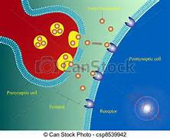
Psychotropic Medications
Understanding Neurotransmitters
GABA
Serotonin
Norepinephrine
Dopamine
Acetylcholine
Glutamate
Pharmacodynamics and Pharmacokinetics

Slide 70

Psychotropic Medications
Excite (Sympathetic or “Gas Pedal”): Norepinephrine, Dopamine, Glutamate
Inhibit (Parasympathetic or “Brake Pedal”): Serotonin, GABA
Attention Deficit Disorders: Psychostimulants (Adderall, Ritalin, Concerta)
Depressive Disorders: Antidepressants
Serotonin Selective Reuptake Inhibitors
(Prozac, Lexapro, Celexa, Paxil, Zoloft, Luvox)
Selective NE Reuptake Inhibitors-Dual Agents
(Effexor, Cymbalta, Remeron, Wellbutrin)
Tricyclics (Anafranil, Elavil, Tofranil, Pamelor)
Bipolar Disorder: Mood Stabilizers
(Lithium, Depakote, Tegretol, Lamictal, Topamax): Stabilize Nerve membranes; No Neurontin
Anxiety Disorders: Anxiolytics, Tranquilizers, and Sedatives
(Ativan, Xanax, Klonopin, Valium)
Psychotic Disorders: Antipsychotics
Neuroleptics versus Atypicals (First, Second, and Third Generation)
(Haldol, Thorazine vs. Risperdal, Seroquel, Zyprexa, Fanapt, Geodon, Clozaril vs. Abilify)

Slide 71

Psychotropic Medications
Neurocognitive Disorders: Acetylcholinesterase and
Glutamate Inhibitors (Aricept, Excelon, Namenda, Namzaric)
Substance Use Disorders: Antabuse, Methadone, Naltrexone, Buprenorphine, Soboxone, Chantix
Sleep Disorders: Sedatives, Hypnotics, and Antidepressants, not Benzodiazepines (Ambien, Lunesta, Sonata)
Impulse Control Disorders and Behavioral Dyscontrol: Antidepressants, Mood Stabilizers, Antipsychotics, Antiadrenergics, and Antihypertensives (Inderal, Tenex)
Sexual Disorders: Antidepressants and Depo-Provera
Star-D Study: SSRI 63 % effective; Enhancing/Boosting agents (Abilify, Lithium)
Future in Prescribing: Increased Specificity to Receptors

Slide 72
Psychotropic Medications
Personality Disorders: Psychotherapy for Cognitive and Defensive Restructuring , as well as Life Skills Building
Eating Disorders: Psychotherapy for Symptom Management
Problem Behaviors: Up to 30% of those who are receiving psychotropic medications, it is prescribed for challenging behaviors
Intellectual Disability: None
ID population has been subjected to polypharmacy, is particularly vulnerable to side effects, and may lack subjective complaints.
Please avoid “working backwards” by using the response to prescribed medications as the guide to arrive at a working diagnosis.

Slide 73
Method of Seeking Medication Consultation
Frank Anderson, MD
Identify the symptoms and behaviors to target
Saying anxiety or depression is too generic
Limiting to 3 or 4 symptoms helps reduce polypharmacy
Focus is symptoms (e.g., insomnia and low motivation), rather than feelings (e.g., loneliness and sadness)
Reducing intensity of symptoms (e.g., making affect manageable), might warrant consideration of PRN instead of a standing order
Differentiate psychology (e.g., psychosocial and emotional distress) from biology
Validate any concerns about medications (prescribing is polarizing)
Educate on which medications do what and Collaborate along the way
Monitor reactions and progress
Neurogenesis: Medications stimulate changes in the brain, especially neural integration
Cortisol (stress hormone) reduces tolerance to medications
Receptor Up or Down Regulation

Slide 74
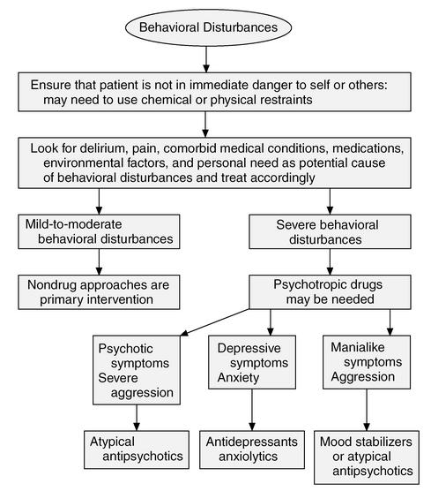

Slide 75
Treatment Paradigm
Level of Intellectual Disability | Possible Treatment Modalities
Mild | Interpersonal and Insight-Oriented Psychotherapy Cognitive-Behavioral Interventions Psychoeducation Positive Behavioral Supports Positive Self-Attribution
Moderate | Skills Building Positive Behavioral Supports
Severe-to-Profound | Positive Behavioral Supports with emphasis on environmental strategies

Slide 76
Psychotherapy in the Context
of Intellectual Disability
Misperceptions:
Present as chronologically younger
Misbelief about insufficient cognitive ability to benefit
Opportunity for self-exploration, growth, and change, rather than “punishment”
Adaptations:
Flexible length of sessions due to shorter attention span
Simplify interventions by breaking down into smaller chunks
Directive language about socially acceptable behavior
Adjust vocabulary and avoid abstract concepts (e.g., metaphors)
Add activities to deepen learning: Drawing, games, and role plays.
Involve caregivers to identify issues and monitor progress
Increase length of care because a slower pace ensures skills building
Structure and consistency!
Empirically validated therapies include motivational interviewing, cognitive-behavioral, dialectical behavioral, and supportive.

Slide 77
Positive Behavior Support Testimonials… “Before PBS we were fighting an uphill battle. The strategies we were using included consequences, such as time outs, strikes, etc., which only increased our son’s anxiety and behavior issues. Since implementing the PBS strategies, we see a dramatic decrease in his negative behaviors. Through using proactive, as opposed to reactive strategies, not only has his behavior improved, but his confidence as well.” “When you try PBS strategies, you focus on teaching and rewarding the behavior you want to see. We used to struggle with temper tantrums in the morning because my son wanted to wear his pajamas all day. By using PBS strategies, we were able to use sticker charts and picture schedules to get him to dress himself!" “We have seen a huge difference in the individuals that we serve using the PBS strategies. It is refreshing for us, as staff, to change our own perspectives while we work. By focusing on the positive in the indiduals, we don't pay mind to all of their idiosyncrasies.”

Slide 78
Positive Behavioral Supports
Goals of Positive Behavioral Support Training:
Understanding the Concepts, Terms, and Strategies
Identifying the Functions that Influence Behavior
Appreciating Individual Challenges and Systems Issues
Measuring Effectiveness with Data Collection and Graphing
Crisis Interventions and Safety Plans
Special Topic: Cognitive Remediation

Slide 79
Positive Behavioral Supports
Is it possible for an individual
to change their behavior?
Anyone who has broken a New Year’s Resolution appreciates the difficulty of behavioral change. There is no single solution that works for everyone.
We often expect individuals we work with to immediately change a behavior that they have used over a lifetime of repetition and reinforcement.
We need to remember that we are striving for progress toward new behaviors, rather than perfection in getting rid of the old ones.

Slide 80
Positive Behavioral Supports

Slide 81
Positive Behavioral Supports

Slide 82
Positive Behavioral Support PBS term adopted by Horner in 1990 PBIS in schools in 1997
Support for Positive Behavior
Support = Encouraging, increasing, and strengthening
Positive Behavior = desirable, adaptive, and prosocial
Versus
Non-Positive Behavior Support
Use of aversive, humiliating, or stigmatizing interventions

Slide 83
APBS AND NASDDD PBS Definition
What is Positive Behavior Support? Research-based strategies to increase quality of life, decrease problem behavior by teaching new skills, and changing a person's environment.
Four Components:
Valued Outcomes Unique preferences and needs to enhance personal satisfaction.
Behavioral and Biomedical Science Recognize individual history including trauma, medical issues, psychiatric state, and significant relationships to understand the factors influencing behavior.
Validated Procedures Data collected to measure outcomes includes program evaluation, surveys, interviews, rating scales, direct observation, and self-report information.
Systems Change PBS strategies consider the home or organizational environment to ensure the success. Factors include staff development, team building, and fit between the plan and those who will implement it.

Slide 84
PBS Definition “Practical Terms”
Functional Assessment
Information gathering process
Comprehensive Interventions
Preventative techniques, intensive strategies, crisis plans
Lifestyle Enhancement
Person-centered planning
Team Approach
Collaboration to support the process

Slide 85
Positive Behavioral Supports
Traditions of “Applied Behavioral Analysis”:
Analyzes the interaction between purposeful behavior and a changeable environment.
Positive Behavioral Supports:
Sources are ABA plus…
Normalization and Inclusion Movement
Person- and Family-Centered Values
Contributions from scientific disciplines: Medicine, Biology, Developmental Psychology, Systems Theory, and Empirical Research
Hallmarks and Strategies:
Proactive teaching of expectations and acceptable behaviors
Building on existing appropriate behaviors
Monitoring problem behaviors
Data-driven decisions and evaluation of effectiveness
Intense efforts for support
Improving quality of life
Integrity with implementation and responsiveness

Slide 86
Holistic Approach
Psychological and Emotional Functioning
Comprehensive Functional Assessment, Clinical Formulation, Behavioral Interventions, and Treatment Recommendations
Functional Analysis
Environmental Factors

Slide 87
Positive Behavioral Support Flowchart
Case Conceptualization
Operational Description of Challenging Behavior
Person-Centered Planning
Goals
Strengths
Barriers
Resources
Physical, Medical, Psychological, and Social Issues
Identify the Function
of Problem Behaviors
Interventions
Setting Events and Predictors
Problem Situations
Antecedents
Expectations
Task Demands
Foundational and Lifestyle Strategies
Communication
Preferences
Activities
Routines
Relationships
Proactive Strategies
Teaching replacement behaviors
Strengthening adaptive skills
Team Process
Modeling
Reactive Strategies
Reinforcements
Maintaining Desired Behaviors
Crisis Plans

Slide 88
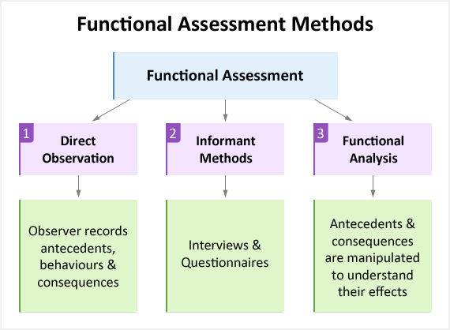
Positive Behavioral Supports
1) Observation and Correlation (e.g., ABC analysis) and then 2) Hypothesis Testing (i.e., Identifying what precipitates and maintains the negative behavior)

Slide 89
Positive Behavioral Supports
Environmental and Behavioral Components in Functional Assessment
Setting Events and Vulnerabilities
Situations in the environment combined with individual’s deficits
Consider broader setting events (i.e., unpredictability, medical conditions {e.g., unstable blood sugar, undiagnosed seizures, untreated sleep problems, medication side effects)
Consider that there can be negative, and positive, setting events…
Antecedents and Triggers: Physical, emotional, cognitive, and behavioral
What occurred immediately before the behavior?
Fast versus slow precipitants? Old versus New Anger?
External (e.g., a conflict earlier in the day) versus Internal antecedents (e.g., feeling isolated and lonely)
Lifestyle issues (e.g., repeated disappointments, interpersonal stresses, problems accessing preferred activities)
The “universal trigger” is often “enforcing rules,” rather than giving flexible guidance
Second Order Conditioning (triggered in the absence of the specific past stimuli)
Unmet Expectations: Self (physical performance, intellectual tasks, success and failure),
Others (etiquette, affirmation, fairness, intrusion, annoyance), or the World (Devices,
organization, activities unfold, or environment)

Slide 90
Environmental and Behavioral Components in Functional Assessment
*Anger to aggressionality needs cognitive belief involving intentionality or purpose…
Adopt a “problem-solving” approach
Precursors
What noticeable actions in body language came before the behavior of concern? (e.g., pacing, pressured speech, rolling their eyes, clinching their fists)
Maintaining Consequences
What occurred immediately after the behavior of concern?
How did the caregivers respond? Is there inadvertent reinforcement?

Slide 91
Behavior serves a particular function for the individual, which we determine through a Functional Assessment of Behavior.
Examples of Broad Categories:
Positive or Negative Reinforcement
Intrapersonal Reinforcement (e.g., emotional reinforcement) or Interpersonal Reinforcement (e.g., help-seeking behavior)

Slide 92
Functional Assessment of Behavior Better Understanding why individuals engage in Maladaptive Behaviors Especially those seen with Intellectual Disability and Psychiatric Disorders
Functions
of
Maladaptive
Behavior
Communication
Modulates
Internal
Distress
Modulates
Physical
Distress
Socio-
Environmental
Control

Slide 93
Key Points in Functional
Assessment of Behavior
“Medical before Behavioral:” A thorough and recent
physical examination including lab work is essential.
Focus on identifying ways to teach adaptive behaviors, as
part of the FBA, as they render maladaptive behaviors
unnecessary and irrelevant.
Realize there is an over-application of attention-seeking, manipulation, and escape as functions of behavior.
*If attention-seeking is the function, when would the behavior be displayed? With staff present or absent?

Slide 94
Understanding Challenging Behaviors:
Physiological, Psychological, Social, and Environmental Terms
Is the challenging behavior a symptom of a medical disorder?
In their opinion, is the quality of the person’s life acceptable in terms of personal relationships, personal choices, or living situation?
Is the challenging behavior a side effect of medication?
Is the challenging behavior part of a cluster or chain of behaviors?
Is the challenging behavior the result of skills deficits?
What purpose does the behavior serve for the person?
The following are some examples of how situations could have been avoided before assuming that the challenging behavior was due to mental illness or developmental disability…

Slide 95
EXAMPLE 1:
Mr. Jones has severe cognitive deficits. He is non-verbal. He has no history of being aggressive or destructive. One evening, he began ragefully throwing the furniture in his group home. He was taken to the local emergency room and seen by a psychiatric crisis specialist. Mr. Jones was admitted to a psychiatric hospital with a diagnosis of psychosis.
Later the hospital determined that he was suffering from dehydration. His fluid and diet intake were adjusted. His outbursts never reappeared.
EXAMPLE 2:
Ms. Smith is a woman in her thirties diagnosed with autism. She does not communicate much with words, but has strong opinions about her likes and dislikes. For many years, Ms. Smith attended a local regional center. She always refused to participate in group activities and community outings, during which she would scream, throw things, and occasionally disrobe. The center’s staff was incredibly frustrated by Ms. Smith’s behavior. There were numerous meetings about ways to address her unacceptable behavior, but nothing worked.
Ms. Smith was discharged to a new personal support provider who allowed her to choose activities and be accompanied by the female companion she preferred. Because of the individualized supports, Ms. Smith was able to experience the community on her terms. Her behavioral issues became very isolated events, which were easier to address on a one-to-one basis.

Slide 96
Positive Behavioral Supports
Underdeveloped Support Plans
Lacks background information, such as learning disabilities, medical conditions, trauma history, and psychiatric issues.
Inadequate functional assessment to “anchor” the
interventions.
Interventions are mismatched with the individual’s level
of functioning and their readiness to change.
Caregivers feel they do not understand the plan or are
poorly prepared to implement it.
Consult templates of what constitutes a well-written plan.

Slide 97
Positive Behavioral Supports
Serving all Aspects of an Individual
Person-centered :
Respects dignity (e.g., person-first language, individual strengths, informed consent)
Not a “cookbook” approach
Focus on Positive Changes in the Environment:
Identify ways to consistently support new skills across settings
Eliminate negative consequences, coercion, and restrictions
Collaborative:
Caregiver training for competency is key to effectiveness
Keep everyone involved as part of the interdisciplinary team (e.g., individual-served, family members, psychiatrist, occupational therapist, psychotherapist, job coach)
Feedback loops between direct care staff, caregivers, and team

Slide 98
Positive Behavioral Supports
Individual Challenges
Difficulty learning new behaviors due to cognitive deficits.
Problem behavior is rooted in negative emotions
often associated with trauma.
Ameliorating psychiatric symptoms is needed to reduce
challenging behaviors.
Unwilling or unmotivated to engage in positive behavior due to
personality style.
Problem behaviors continue to habitually work meeting their needs.
“If I scream, then I always get the snacks I want.”

Slide 99
Positive Behavioral Supports
Caregiver Considerations
Poor empathy and insensitivity
Negative attitude and resistance toward PBS
Consequence and reward mentality
Authoritarian style as the default
Preoccupied by personal stresses
Difficulty performing in a crisis due to fear of disruptive behaviors especially if previously injured

Slide 100
Positive Behavioral Supports
Staff Core Qualities
100% of the Time
Supportive and Caring
Respectful
Strength-based
Collaborative not controlling
Empowering
Give choice
Build self-esteem
*Key factor in resilience for traumatized children
people who believe in them

Slide 101
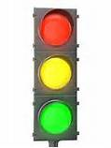
Positive Behavioral Supports
Maladaptive Behaviors:
Interfere with Development
Adaptive and Prosocial Behaviors:
Enhance Growth

Slide 102
Positive Behavioral Supports
Targeted Positive Behaviors:
To instill, increase, and maintain.
Increase emotional regulation through coping strategies, self-soothing, healthy diversions, and opportunities to learn self-control.
Become more adaptive and self-reliant by building autonomy, mastery, confidence, and self-direction.
Increase prosocial skills and participation in community activities

Slide 103
Positive Behavioral Supports
Behaviors of Concern:
Those to decrease or eliminate.
These include verbal outbursts, physical aggression, and refusals.

Slide 104
Criteria foR a Behavior of Concern
Interferes with his or her growth, development, or progress.
Interferes with his or her ability to make decisions and achieve goals.
Results in a psychotropic medication being prescribed to modify the behavior.
Poses a risk to the health and safety of the individual and others.

Slide 105
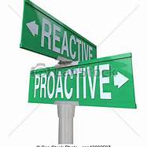
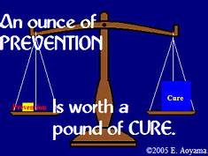

Reactive vs. Proactive Interventions

Slide 106
Positive Behavioral Supports
Reactive Interventions
Caregivers actions after behaviors of concern occur. How to handle challenging behaviors appropriately.
For limited use about 5% of the time.
These should be used to help situations from escalating.
For example, prompting alternative behaviors, using distractions, redirecting away from triggers, or establishing control when harm to self and others.
Affected by state-dependent learning. We may lose up to 25 IQ points when upset.
May include crisis response, respite care, and hospitalization.

Slide 107

Positive Behavioral Supports
Proactive or Preventative Interventions
Caregivers actions designed to help the person to avoid engaging in challenging behaviors.
These should be used 95% of the time.
Multiple Modes: Verbally-mediated, Visual-spatial, Hands-on, and Contextually-driven

Slide 108
PROactive Interventions Toolbox
Be Familiar with the Behavior Plan!
Avoid Triggers and Eliminate Provocations
Positive Setting Events: Prompting and Cueing
Set Expectations Proactively
Well-Understood and Predictable Daily Routine
Adherence with the Schedule
Active Listening
Affirmative Communication

Slide 109

PROactive Interventions Toolbox
Concrete Directions to Compensate for Impairments
Be Person-Centered and Context-Sensitive
Sensory Modalities
Multimodal Approach: Visual Aids and Hands-on Modeling
Building a Positive Sense of Self
Team Approach
Meaningful and Non-Contingent Activities
Natural Supports with Family, Friends, and Volunteers

Slide 110
Proactive Interventions Setting and Reviewing Expectations
Directions given and reviewed at regular intervals. They should be very specific and easily convey the expected behavior.
Tell the person what you want them to do, rather than what you do not.
“Use an ‘inside’ voice,” instead of “Stop talking so loudly”
“Keep your hands down,” rather than “Don’t hit”
“Let’s relax with some slow breathing,” not “Stop being so nervous”
Learning problems and memory deficits may interfere understanding and remembering what constitutes “appropriate” behavior.
Learning occurs in small steps, so have realistic expectations.
Be consistent with language across settings.

Slide 111
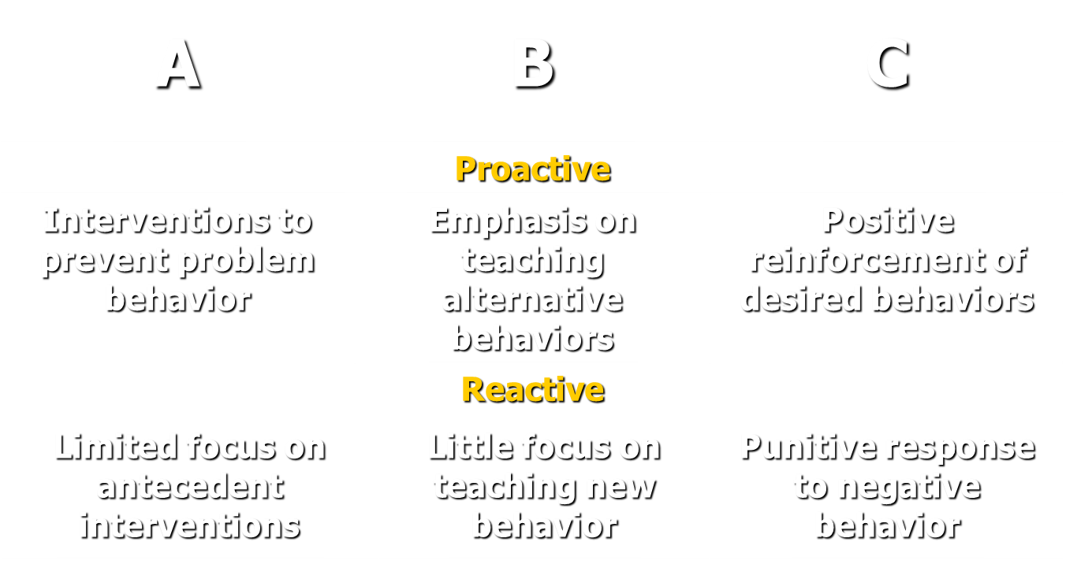
Positive Behavioral Supports

Slide 112
Positive Behavioral Supports Overarching Goal
The aim is the presence of targeted adaptive and prosocial behaviors through teaching, not just the absence of challenging behavior.

Slide 113

Problems with Consequence-Based Interventions
Ethical concerns
Do not teach new replacement behaviors
Points and levels are contra-indicated
“Cycle of Coercion” (George Sugai):We all respond to each other. When a behavior doesn’t work-we escalate! We need to learn to understand our own roles…
Negative side effects, such as lowered self-esteem, frustration, and rejection, even from minor coercion

Slide 114
Positive Behavioral Supports Coercion
Attempting to control behavior through adverse consequences. It is different than natural and logical consequences.
It may include the following:
Ignoring (spontaneous and planned)
Taking away rights and privileges
Response cost
Forcing apologies
Threatening restraint or seclusion
When minor coercion that was once effective ceases to work, staff inclined to use it tend to increase the level of coercion, rather than decrease it.

Slide 115
Positive Behavioral Supports
Examples of Positive Ways to Help Change Behavior
Teach-Prompt –Acknowledge-Repeat
Operant Conditioning
Role Modeling
Teaching social skills goes beyond academics
Developing self-direction through Positive Identity from a centering construct and self-attributions.
Build bridges between actions to help achieve internal self-regulation.

Slide 116
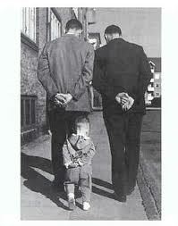

Slide 117
Positive Behavioral Supports
Helpful PBS Strategies
Reinforcement
Usually verbal praise that is delivered immediately (within 30-60 seconds) and explicitly, rather than delayed.
Compassionate Inquiry to build positive self-image and self-esteem
Verbal Mapping:
Connecting words and actions to facilitate expression.
Shaping
Reward "successive approximations” to the desired goal.

Slide 118
Positive Behavioral Supports
Helpful PBS Strategies
Behavior Momentum:
Making a series of requests from easy to hard. It builds willingness to try more challenging things as the preceding tasks get completed.
Daily Routine with Critical Scheduling
Less preferred activities followed by more preferred activities to increase motivation. For example, “When/After/First you take a shower, then we can go to lunch.”
Scaffolding
Fade assistance as the individual's competency and confidence develop toward mastery with the task.

Slide 119
Positive Behavioral Supports
Guidelines for Replacement Behaviors
1. Serve the Same Purpose:
Putting feelings into polite words to communicate.
2. Get Reinforcement as Soon or Sooner:
Self-soothing with ice pack, rather than self-injurious behavior.
3. Receive as Much or More Reinforcement:
Caregivers quickly attend when he says “again please”, as much as if he had expressed his demands with an outburst.
4. Just as Easy or Easier to Do:
Following directions in one-to-two steps is easier than refusing an appointment or missing an outing.

Slide 120
Positive Behavioral Supports Proactive Versus Reaction Intervention Points

Slide 121
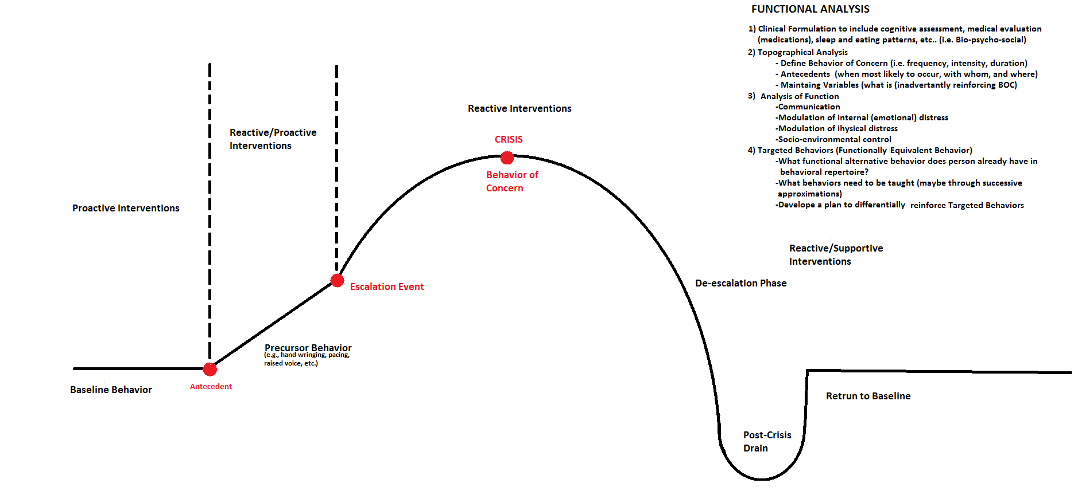
Proactive Versus Reaction Intervention Points
Return to Baseline

Slide 122
Positive Behavioral Supports Primary Reactive Interventions Neutral and Empathic Validation
Acknowledge Perspectives:
Active listening by being attuned
Accurate reflection to defuse negative emotions
Validation means acknowledgement, not necessarily agreement
Try to understand multiple perspectives to the situation
Repeat information back to confirm your understanding
In the Crisis Cycle, sufficiently validate before corrective feedback with
redirecting, limit setting, or finding solutions.
Remember the Context:
Know the situation (e.g., “It sounds like your tired because you didn’t sleep well”)
Understand the individual’s “story” (e.g., “I know this time of year is hard because it’s the anniversary of your dad’s passing away.”)

Slide 123
Positive Behavioral Supports
Obstacles to Implementation
Lack of Communication and Consistency
Caregiver-to-Caregiver
Shift-to-Shift
Provider-to-Family
Residential Program-to-Vocational Program
Inadvertent Reinforcement
Strategic versus Wholesale Capitulation…When is it acceptable?
Notes:
Capitulation “sets up” both patients and other caregivers

Slide 124
Team Process Coordination and Communication
For optimal performance in plan implementation
Determines who is responsible in carrying out each component of the plan
Reduces “splitting,” answer shopping,” and absorbing anger directly through a “unified front”
Identifies stakeholders
Top-Down versus Bottom-Up approaches
Progress monitoring for accountability

Slide 125

Why Collect and Graph Data?

Slide 126

Data Collection to Measure Effectiveness
Generate a “data probe” to determine the most salient problem behaviors to address
Clarify the frequency, rate, intensity, and duration of challenging behaviors
Identify precipitants
Compare intervention data to baseline data
Track changes over time with “annotation” such as the response to behavioral interventions, medication changes, and caregiver fidelity with the plan

Slide 128
Positive Behavioral Supports
Documentation
Interval Spoilage Sheets
Shift | Activity Refusal | Physical Aggress | Self- Injury | Agitation | Property Destruct | Running Away | Sleep Problem | Verbal Threats
1 |  | III
2
3

Slide 129
Positive Behavioral Supports
Antecedent-Behavior-Consequence
Date/Time | Duration of Episode | General Mood | Antecedent and Precursor Behavior | Behavior of Concern | Maintaining Consequences | Comments | Initials
12/18/11 1 PM | 5 min. | Upset, fixated on dinner | Eating dinner with roommate | Taking Food without asking | Moved JC to opposite end of table | He followed directions when they were given slowly | JM

Slide 130
Positive Behavioral Supports
Targeted Behavior Tracking Form
1. Kept hands down | 2. Stayed calm | 3. Waited patiently | 4. Helpful | 5. Followed directions | 6. Finished chores
Caregiver’s Initials and Comments | Time Period | Were expectations set and reviewed? | Category of Targeted Positive Behavior | Circumstances in which behavior occurred
J.T. | 8:00AM | Yes | 3 | Waited with a good attitude when nurse was running late with medications

Slide 131
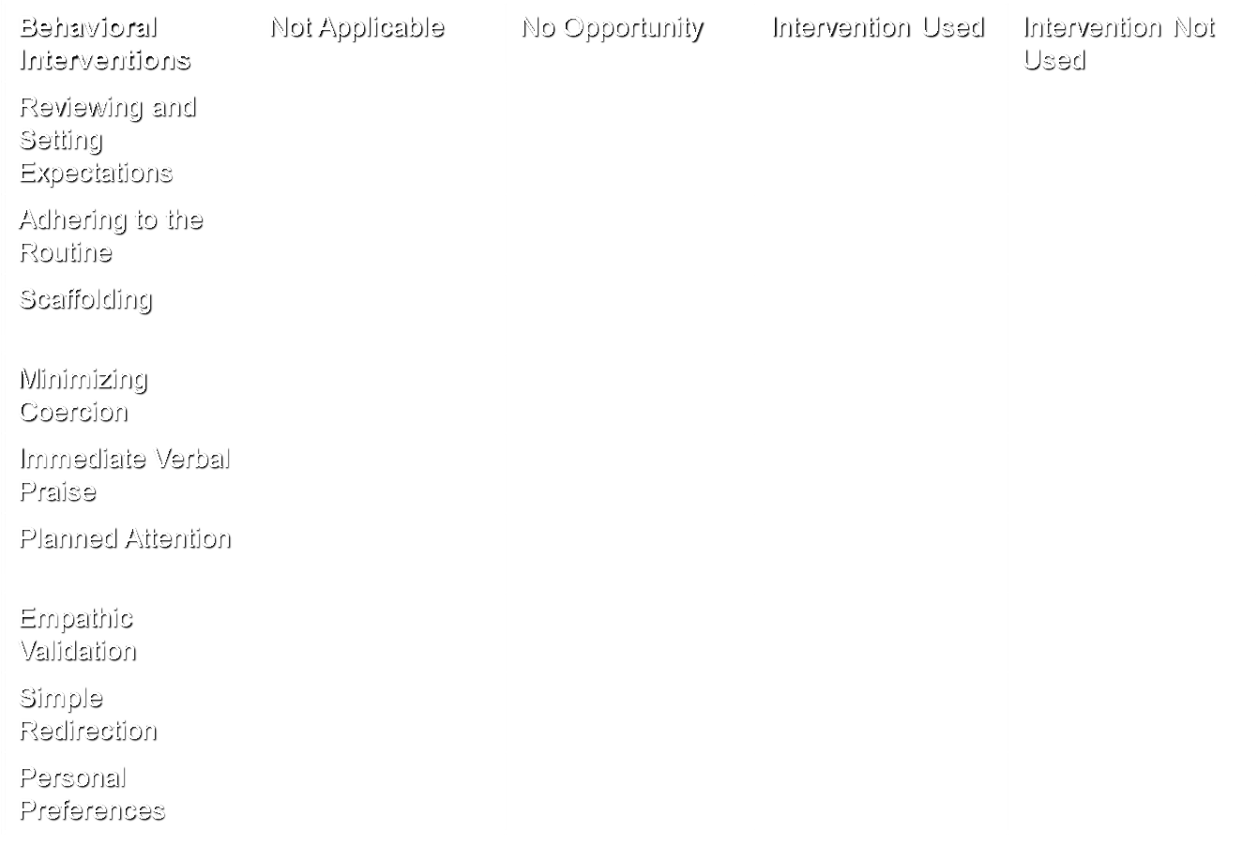
Fidelity Tracking Form

Slide 132
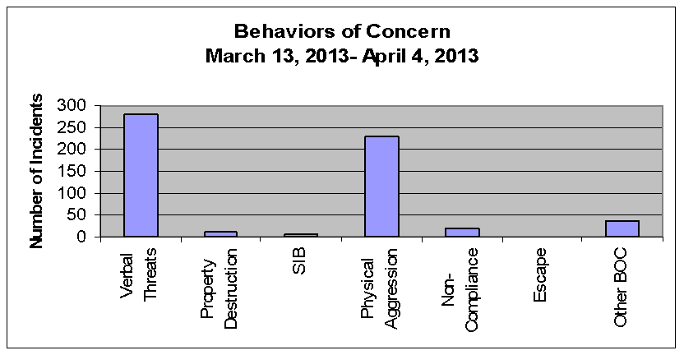
Graphing
Bar Graph Sample: Comparing and Summarizing Data

Slide 133
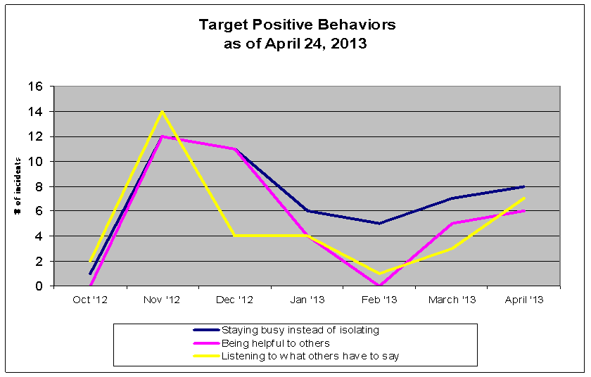
Graphing
Line Graph Sample: Longitudinal Trends

Slide 134
Sample of a Comprehensive PBS Plan
Personal Background:
Information about the following areas from the records reviewed and the collateral sources may be included to better understand the biopsychosocial history of the person-served:
Demographics
Achievements and delays in developmental milestones
Family relationships and dynamics
Trauma, abuse, and neglect history
Physical and medical conditions
Neurological impairments (e.g., seizure disorder)
Intellectual functioning (i.e., cognitive abilities related to knowledge, memory, reasoning, judgment, learning, and planning; severity of intellectual disability)
Adaptive functioning (i.e., skills and deficits in meeting age-related and sociocultural standards for personal independence and social responsibility in the conceptual, practical, and social domains)
Educational and vocational history
Review of the Relevant History:
Include pertinent information from the diagnostic profile (e.g., DSM-V) and clinical formulations
Describe any salient risk factors (e.g., suicidality, substance abuse, maladaptive personality traits, psychosexual issues, legal involvement)
Discuss any recent changes in mental status, such as the signs and symptoms of psychiatric illness and the response to psychotropic medications
Note current psychosocial stresses
Identify the goals and readiness to change of the person-served
Emphasize their personal strengths (i.e., interests, preferences, skills, protective factors, and supports)

Slide 135
Sample of a Comprehensive PBS Plan
Referral Questions:
Identify the reasons that prompted the development of the positive behavioral support plan. For example, describe the ways in which the behaviors of concern (e.g., aggression, refusals) interfere with performance, participation, and/or progress.
Rationale for the Interventions:
Describe the predisposing, precipitating, and perpetuating factors that may influence the behavioral presentation for the person-served. For example, low frustration tolerance and difficulties delaying gratification associated with severe intellectual disability often lead to impulsive behaviors.
Obtain a history of the successes/failures of previous interventions (e.g., attempts at behavioral modification and management)
What is the level of assistance that the person-served needs to learn and retain new information about their behavior (e.g., prompting, demonstrations, visual cues, verbal reminders, line of sight supervision)?

Slide 136
Sample of a Comprehensive PBS Plan
Functional Behavior Assessment
Topography: A clear description of how each behavior of concern is performed that includes information about the frequency/rate, intensity, severity, and duration. The behaviors should be described in measurable and observable terms that everyone understands.
Setting Events and Vulnerabilities: Situations in the environment combined with the deficits of the person-served where the behavior of concern is most and least likely to occur.
Antecedents: The internal and/or external factors that occur before the behavior that might have triggered it. Consideration should be given to fast (immediate) versus slow (delayed) triggers. Categories of triggers include the following:
Physiological (physical issues)
Psychological (emotions, feelings or thought processes)
Social (situations involving other people)
Environmental (the surroundings)
Precursors: Noticeable changes in the body language of the person-served that came before the behavior of concern (e.g., pacing, pressured speech, rolling their eyes, and clenching their fists).
Maintaining Consequences: Events that occur after the behavior. How did the person-served caregiver’s respond immediately after the behavior of concern occurred? Is there inadvertent reinforcement of the challenging behaviors?

Slide 137
Sample of a Comprehensive PBS Plan
Helpful FBA Questions…
Does the person-served understand the behavioral expectations for the situation?
Does the person-served realize that he or she is engaging in unacceptable behavior?
Is the problem behavior associated with certain environmental conditions? For example, who is present and what interactions take place prior to and immediately after the behavior?
What has worked in the past to help stabilize behavior versus what has not?
What was the person-served thinking and feeling before the behavior of concern?
Is it within the person-served’s ability to control the behavior?
Can the person-served identify acceptable behaviors to replace the maladaptive behavior?
Does the person-served have the skills necessary to perform the new behavior?
What modifications to the environment that have been tried to reduce problem behaviors and support more adaptive behaviors?

Slide 138
Sample of a Comprehensive PBS Plan
Identify the Behaviors of Concern to decrease or eliminate in the following hierarchy:
Behaviors that threaten the health and safety of the person-served and others, such as physical aggression, self-injury, property destruction, and refusals with medical care.
Behaviors that pose a barrier to participation in services, such as verbal outbursts and refusals.
Inappropriate behaviors that hinder adaptive and social functioning, such as poor compliance with hygiene and isolative behaviors.
Identify the Target Positive Behavior(s) to increase through teaching, shaping, and reinforcement:
Describe the adaptive and prosocial behaviors that will serve as replacements for behaviors of concern. For example, putting feelings into soft speech and polite words, rather than shouting to express frustration and disappointment. They should always have a direct “correspondence” to the behaviors of concern they are replacing.
Always be mindful that the overarching goal of positive behavioral supports is the presence of targeted adaptive behaviors, especially an emphasis on the development of prosocial behaviors, rather than merely the absence of challenging behavior.

Slide 139
Sample of a Comprehensive PBS Plan
Proactive Interventions:
These are the caregiver’s actions designed to help the person-served engage in their targeted behaviors and to avoid challenging behaviors.
Proactive strategies deal with the conditions that precede the behavior and seek to reduce the future probability of the behavior. In addition, they help the person-served learn effective behaviors that will assist them in reaching their personal goals and lead to responsible choices.
Proactive strategies include the following examples:
Defining and teaching behavioral expectations for each activity
Setting expectations in affirmative language (“do” rather than “don’t” form)
Acknowledging and reinforcing the use of targeted positive behaviors
Minimizing and eliminating triggers
Prompting and cueing
Establishing and adhering to a clear and consistent daily schedule
Engaging in meaningful activities to improve the quality of life and a sense of well-being
Critical scheduling (Premack Principle) of less preferred activities being followed by more activities to increase motivation
Using a team approach
Eliminating the use of coercion and punitive measures

Slide 140
Sample of a Comprehensive PBS Plan
Reactive Interventions:
The caregivers’ actions to maintain calmness and safety.
By definition, reactive strategies typically prescribe exactly when and how to intervene when a behavior of concern occurs.
They should be used only an as necessary basis, as their goal is to either cut short the behavior of concern to minimize its effect or to extinguish it entirely.
Reactive approaches include the following examples:
Active Listening
Empathic validation (acknowledgement, not necessarily agreement)
Sensory modalities for soothing and relaxation (e.g., weighted blanket, soft music, warm beverage)
Gentle redirection
Limit setting
Strategic giving-in
One-to-one supervision in the household and/or community

Slide 141
Sample of a Comprehensive PBS Plan
Lifestyle Enhancements:
These are based on the individual plan of the person-served, such as participation in pleasurable activities, opportunities for choice and control, meaningful relationships, and inclusion in community activities.
Data Collection:
Graphing is a hallmark of positive behavioral supports. Graphs can be viewed as tools to clearly organize and record behavioral data.
More specifically, graphs allow us to continuously evaluate treatment effects, as behavioral change is a dynamic process. For example, we can follow the person-served’s response to interventions and the caregiver’s fidelity with the positive behavioral support plan.
Before implementing interventions, baseline data (e.g., interval spoilage sheets, ABC forms, Target behavior tracking sheets, progress notes, running logs, etc.) should be collected for a period of time (e.g., 2 to 4 weeks) to ensure a representative sampling. This allows us to compare the intervention data to the baseline data to determine whether the treatment is effective.
Most often, the horizontal axis of a graph tracks the passage of time. The vertical axis usually displays dependent variables, such as the frequency of the behaviors of concern and the targeted prosocial behaviors.
Line graphs are usually preferable to bar graphs because they easily show trends across time. Repeated measures (i.e., more data points) lead to greater confidence in estimating behavioral patterns.
In addition to data points, significant changes in the course of treatment that may affect behavior can be reflected in the graphing. These interaction effects may include medication changes, emergent health issues, revisions in the behavioral strategies, and increased engagement in community services.

Slide 142
Sample of a Comprehensive PBS Plan
Documentation and Training Requirements:
Family caregivers and agency providers may use a variety of methods to ensure fidelity to the behavioral support plan. These can include in-service trainings, periodic data reviews in team meetings, weekly clinical supervision, and ongoing consultations.
Criteria for Success: The considerations in determining effectiveness of the behavioral support strategies for the person-served may include the following:
Meaningful improvements in quality of life for the person-served, such as making better choices and demonstrating increased self-regulation over their emotions.
Strengthened use of their desired adaptive behaviors and better engagement in alternative coping skills.
Decreases in the frequency, intensity, and duration of challenging behavior.
Reduction in the reliance on crisis interventions by caregivers.

Slide 143
Strategies and Practices
A process of “defusing” and “deflating” as we try to coach calmness in a situation without physical intervention.
Strive for three practical goals: Safety, Connection, and Empowerment
General Techniques:
Show concern and ask questions with kindness
Conceal your anger and fear
Reassure availability of the team
Give hope about generating solutions
Ground in current reality especially with trauma history
Do not focus only on negative actions
Congratulate steps toward regaining control
Refocus on the individual’s purpose and mission in life
Special Topic: Crisis Intervention

Slide 144
Special Topic: Sample Crisis Plan
Think Crisis Prevention first, rather than Crisis Intervention!
I. Identify Behaviors that lead to Hospitalization.
Hitting and property destruction triggered by invading her personal space or interrupting rituals. running away from staff in the community when overstimulated by noise.
II. Describe past successful interventions. Proceed from least to most restrictive.
Aggression:
Proactive Interventions: Avoid confrontations and direct commands. Use a gentle approach.
Reactive interventions: Give space. Provide distractions (country music, non-caffeinated beverages). Call 9-11 to secure support if she makes repeated physical contact.
Elopement:
Proactive interventions: Assess his willingness. Avoid loud crowds. Be sensitive to room filling with people.
Reactive interventions: Give him space to burn off anxiety. Validate his decision to leave. Call 9-11 immediately if he runs away because he lacks awareness of safety issues and is difficult to track.
III. List Environmental Modifications:
Ample space to walk, low calorie snacks, calendar to track visits, and easy access to soothing objects like soft pillows and weighted blanket.
IV. Approvals: [ ] Individual-Served [ ] Family [ ] Team

Slide 145
Special Topic: Sample Safety Plan
When I am thinking of hurting myself, I will take the following steps:
Use what I learned in therapy to figure out what is upsetting me. I will realize that thinking (thought patterns) I don’t belong bothers me.
I will talk about and write down some positive ways (non-suicidal responses) to deal with what is bothering me.
I will do things (distractions) that, in the past, have helped me feel better (e.g., listening to music, watching DVD movies, playing sports).
If the suicidal thoughts continue or if I find myself preparing to hurt myself, I will call the people (social supports) who can help me to stay safe.
If I feel that I cannot control my behavior, I’ll ask staff to go to the nearest emergency room or call 9-11 (professional help).

Slide 146
Special Topics: Cognitive Remediation
Cognitive remediation is a behavioral treatment that uses drill and practice, compensatory and adaptive strategies to facilitate improvement in targeted cognitive areas like memory, attention and problem solving.
Cognitive remediation aims to improve cognitive impairments that are making it difficult for a person to achieve their functional goals.
Cognitive remediation is intended to help people who have experienced a decline in their cognitive skills, or who were not able to fully develop their skills because of illness. Many psychiatric illnesses cause cognitive problems. For example, schizophrenia and other psychotic disorders cause a decline in attention, memory and problem solving skills.
Cognitive Remediation helps improve the underlying neuropsychological functions that help you think: attention, memory, planning, organization, abstract thinking.
Cognitive remediation often uses the computer to provide exercises to improve neuropsychological skills.

Slide 147


Special Topic: Cognitive Remediation
Specific computer programs (Parrot Software, Lumocity, Bungalow) are designed to remediate cognitive weaknesses and can be done under the supervision of speech/neuropsychologist
Apps on devices can be used to assist in memory, organization, and attention (e.g. alarms, calendar, check lists)

