Slide 1



An Overview of
Working with Developmental Disabilities
using Positive Behavior Supports
Peter Tolisano, Psy.D.
Director of Psychological Services
Connecticut Department of Developmental Services
Tracey M. Sondik, Psy.D.
Director of Behavioral Intervention Services
Connecticut Valley Hospital
Department of Mental Health and Addictions Services
Peter Tolisano, Psy.D., ABPP
Board Certified in Clinical Psychology
Director of Psychological Services
Connecticut Department of Developmental Services
Tracey M. Sondik, Psy.D.
Director of the Behavioral Intervention Service
Connecticut Valley Hospital
Department of Mental Health and Addiction Services
Jennifer Krom, MA, LPC
Director of Autism Services
Beacon Health Options

Slide 2
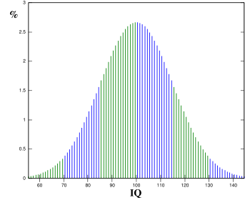
General Intellectual Functioning
1 Percentile Rank 100 Intellectual Disability falls in the 2nd Percentile
Average IQ is 100 with a standard deviation of 15 points

Slide 3
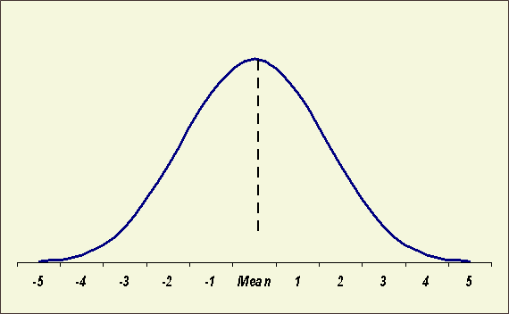
Understanding Intellectual Disability
Less intelligent
than average
More intelligent
than average
25
40
55
70
Degrees of Severity
Mild 85%
Moderate 10%
Severe 3%
Profound 2%
DSM-5: Intellectual Developmental Disorder (formerly mental retardation): Intellectual and adaptive deficits (FSIQ= 70 with a standard error of measurement of 5 points) with onset during the developmental period that occurs between birth to 18 years old.
I/DD is noted to have over 250 syndromal (25%) and non-syndromal causes (75%).

Slide 4
DDS Eligibility Determination Process
Connecticut General Statute Section §17a-210b; Subsection 1-1g is the law that DDS is required to use to determine eligibility for an Intellectual Disability along three criteria.
1)A significant limitation in intellectual functioning (a valid FSIQ of 69 or below) and 2) deficits in adaptive behavior (existing concurrently) that 3) originated during the developmental period before eighteen years of age.

Slide 5
DDS Resources
Individual and Family Support Division
Overarching goal is to meet the needs of the individual and family, particularly ensuring family preservation.
Interim services through IFS may be used when existing caregivers are incapable, permanent supports are being coordinated, or extenuating circumstances require additional resources.
Examples of services available through IFS may include respite, teaching social skills and ADLs, help to attend community-based activities and medical appointments, modeling behavioral techniques, and offering assistance to complete forms for resources.
Criteria for IFS services include:
Currently eligible for DDS through the application and eligibility process
Live in own home or family home
No immediate danger
Needs can be met by family support workers
Services are needed on a short-term basis

Slide 6
DDS Resources Within the IFS Division
Enhanced Family Support Teams
Situations that may require EFS
Challenging behaviors
Loss of primary caregiver/caregiver disability
Changes in physical or mental health status
Homelessness or housing instability
Abuse or neglect investigations/Immediate Protective Services
Stressors affecting family dynamics/insufficient supports
Urgent need for hourly respite
Preventative measures to avoid hospitalization
Assistance to identify and access community resources
Criminal charges or release back to community for forensic cases
EFS teams may recommend follow-up supports, such as nursing, speech consultation, and behaviorist services. These may include direct services from DDS specialists (e.g., BSP behaviorists) or referrals to provider agencies (e.g., home health aides, community-based clinicians, etc.).

Slide 7
DDS Resources Enhanced Family Support Teams for 2-11, DMHAS, and DCF Mobile Crisis Staff…
You may access the family support team network during regular business hours by contacting the individual’s DDS Case Manager. If no case manager is assigned, then call the DDS Regional Helpline Monday to Friday 8:00am to 4:30pm.
DDS North Region Helpline: 1-877-437-4577 (DDS.NR.IFShelpline@ct.gov)
DDS West Region Helpline: 1-877-491-2720 (DDS.WR.IFShelpline@ct.gov)
DDS South Region Helpline: 1-877-437-4567 (DDS.SR.IFShelpline@ct.gov)
Enhanced Family Support Teams are also available on evenings and weekends until 8:30pm. Please call 860-418-8709.

Slide 8
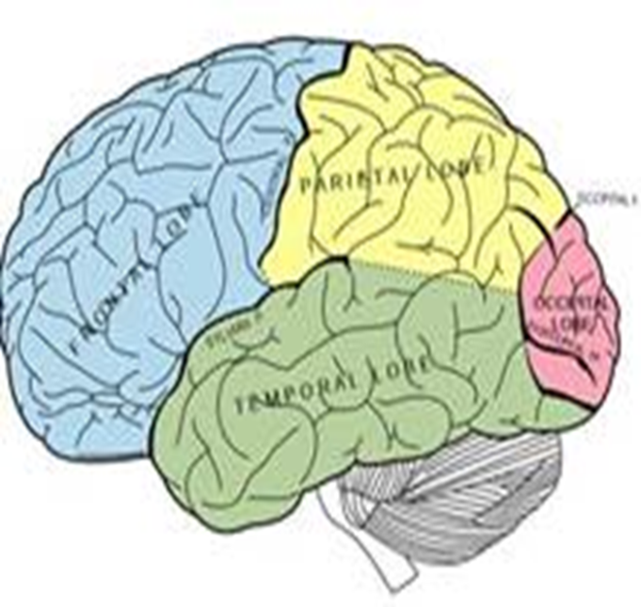
Brain Regions
The brain has three main areas:
Frontal lobes/Cortex for higher-order thinking and executive functions: These include a sense of time and context, planning, inhibiting and initiating action, thinking flexibly, self-monitoring, decision-making, and empathic understanding. The “high road.”
Limbic system that governs emotions. Key areas are the amygdala and the hippocampus. The “low road.”
Brainstem that controls vital physical functions and survival responses.

Slide 9
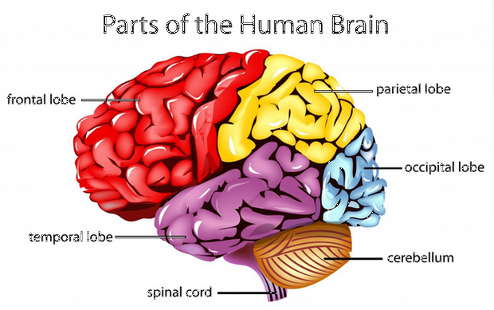
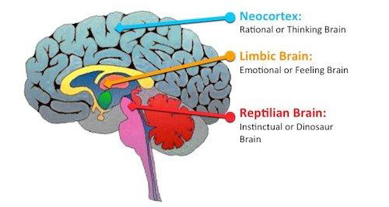
Limbic System
Amygdala that detects threat (fight, flight, and freeze reactions)
Hippocampus for memory storage
Hypothalamus relays sensory information and activates the autonomic nervous and endocrine systems
9T

Slide 10
Intellectual Functioning Full-Scale Score versus Index Scores
Full Scale IQ is the total score that summarizes performance across multiple cognitive abilities.
When unusual variability is observed in the subtests, it is most useful to examine the index scores.

Slide 11
Intellectual Functioning Indexes
Verbal Comprehension:
General knowledge and reasoning skills. Related to formal and informal education.
Language is central our ability to label, organize and manage our internal experiences and the external environment.
Difficulty putting feelings and needs into words makes individuals prone to frustration, aggression, and depression.
Perceptual Organization:
Visual-spatial skills.
Ability to create solutions, especially in novel situations.

Slide 12
Intellectual Functioning Indexes
Working Memory:
In-the-moment reasoning tied to attention, concentration, and short-term memory.
Important to learning, flexibility, planning, and self-monitoring.
Sensitive to anxiety and depression.
Related to trauma responses and anger management
Processing Speed:
Ability to work quickly and efficiently.
Sensitive to motivation and persistence.
PS may negatively effect overall cognitive functioning.

Slide 13
Intellectual Functioning Indexes
Intellectual impairment is often related to behavioral problems with delaying gratification, controlling impulses, and tolerating frustration.
The best approach is building on cognitive strengths and minimizing weaknesses. For example, providing information using pictures, rather than words, to someone with visual-spatial strengths and verbal limitations.

Slide 14
Adaptive Functioning
Based on performance of daily activities at a given age, rather than ability. That is, understanding an individual’s functioning through a “developmental lens” with age-equivalents.
Refers to how effectively people cope with common life demands across multiple environments.
Domains of Practical, Conceptual, and Social skills.
Measures include the Vineland Scales and the BASC.
Specific areas may include the following:
Self-care (e.g., hygiene and grooming)
Expressive and Receptive Communication
Social and Community Activities
Independent living skills (e.g. housekeeping)
Health and safety
Vocational abilities
Self-direction

Slide 15
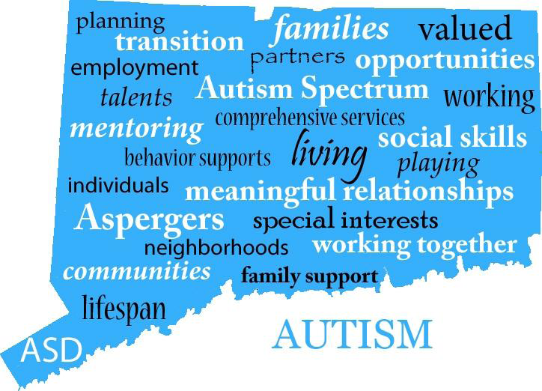
Autism Spectrum Disorder

Slide 16
Department of Social Services: Eligibility Determination Process for Autism
A primary diagnosis of autism spectrum disorder using standardized tests, such as the Gilliam Autism Rating Scale (GARS) or the Autism Diagnostic Observation Schedule (ADOS).
Impairment prior to age 22 years, which is expected to continue indefinitely. (PDD-NOS or Asperger’s syndrome diagnosis given before 2006.)
Deficits in adaptive functioning in at least 3 of 6 areas, as
measured by an appropriate instrument (e.g., Vineland or BASC).
Intellectual functioning above the ID level, which is an IQ of 70 or
above.

Slide 17
Data and Statistics
Steady Increase in Autism Prevalence (existing cases):
2000 birth year of 1992- rate 1 in 150
2004 birth year of 1996-rate of 1 in 125
2008 birth year of 2000-rate of 1 in 88
2010 birth year of 2002-rate of 1 in 68
In 2014, the Centers for Disease Control and Prevention indicated that the prevalence (existing cases) of autism spectrum disorder in the United States is about 4.5 times more common among boys (1 in 42) than among girls (1 in 189).
Notes:
A little over a year ago the CDC released new data about the prevalence of ASD

Slide 18
Reasons Why the Numbers are Increasing?
Probably genuine rates
Diagnostic changes: Broadening of Categories
Better tools and identification process
Awareness (e.g., mental health providers, pediatricians, schools, media, parents)
Previous underestimates
Methodology for obtaining epidemiological data
Access to services (Medicaid, waivers, school-based, etc.)
Increased treatments (ABA, speech therapy)

Slide 19
Core Symptom Domains with Associated Medical Conditions
Epilepsy-
EEG abnormalities
Gastro-intestinal Dysfunction
Aggression
AUTISM
SPECTRUM
DISORDER
Social Anxiety
ADHD
Impaired Social Communication/
Interactions
Restricted & Repetitive Behavior
Sleep Disturbance
Immune Dysfunction
Language Disorders
Intellectual Disabilities
OCD
Motor problems: Apraxia

Slide 20
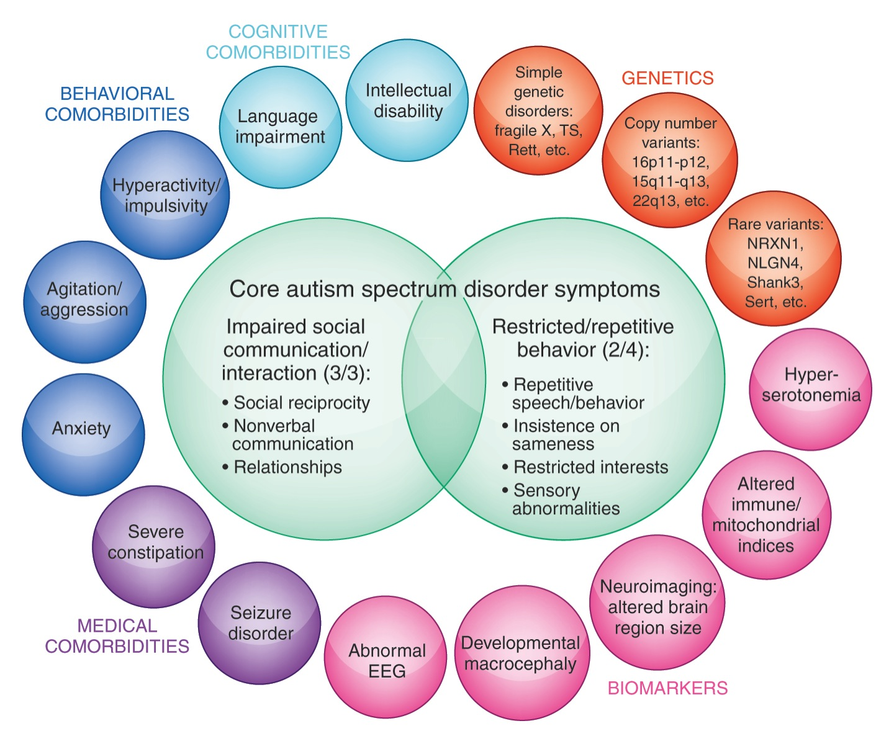

Slide 21
DSM-5
Distinctions can be difficult both within the spectrum and across other disorders
Autistic Disorder
Asperger’s
PDD-NOS
Autism Spectrum Disorder
Notes:
Common Approaches to Functional Framework – ZW with WS comments – 20 min
21

Slide 22
ASD: Themes and Variations
‘Severely Affected’
Non-verbal
Intellectual Disability
Severe behaviors (e.g. self-injury)
Little to no social skills (‘in their own world’)
‘Less Noticeably Affected’
Average to above average IQ
Verbal
Lack of social understanding
Inability to see another’s perspective (ToM)
Insistent on sameness

Slide 23
Autism Spectrum Disorder
Theory of the Mind:
Those with an autism spectrum diagnosis often have significant difficulty understanding and appreciating that others may have thoughts, feelings, opinions, intentions, and plans that are different from their own.
Difficulties with intuition, can result in the following:
Misreading body language. It is used to regulate social interactions (e.g., tone of voice, facial expressions, postures, and vocal volume).
Misinterpreting subtle social cues. “Distancing” in the form of indirect eye contact allows those with autism time and space to make meaning out of sensory information.
Problems with “give and take." Poor reciprocation in social relationships.
Difficulty understanding expectations. Problems predicting what they and others will say or do in social situations.
Painful awareness of social differences and challenges with "fitting in" socially may give rise to episodes of anxiety and depression.

Slide 24
Autism Spectrum Disorder
Cognitive Functioning:
Often rigidly cling to beliefs, convictions, or rules.
Autism is frequently misassociated with intellectual disability.
On the contrary, strong language skills can easily be misinterpreted as advanced communication/social skills, which can lead others to mislabel their actions as purposeful and manipulative.
Early interventions (e.g., ABA) are crucial!
Symptoms may not manifest until social demands exceed capacities or may be masked by learned “compensatory” strategies in adolescence and adulthood.
Awareness of differences might trigger anxiety and depression.

Slide 25
Autism Spectrum Diagnostics:
Goal is symptom identification (phenotypes) and an understanding of severity (specific abnormalities not general impressions).
ADOS creates a “Social World” with interactive questions.
Cautiously look for atypicalness (normal kids will perseverate or overtly gesture to communicate).
ASD can be reliably diagnosed at 2 years. If regressed type check medical first. For example, “prancing” might be other physical condition or smelling of hands could reflect a tic disorder.
Its found across all cultures and socioeconomic groups. About 5:1 male to female.
Often symptoms present in early developmental period but diagnosis comes later (becomes noticeable where social and communication skills are needed across different environments.
Delays are an absence of skill sets. Can be diagnostic overlap (e.g., expressive language affects socialization).

Slide 26
Areas for Diagnostic Consideration:
Language and communication skills
Social relationships and responses to social situations
Responses to noises, touch, sights, and other senses
Behaviors while alone versus in groups
Ability to do a range of intellectual activities

Slide 27
ASD Treatment Considerations:
A lifelong condition. No biological tests exist. Multigenetic make-up with 10 to15% genetic markers identified.
Younger age makes it more difficult to differentiate ID from ASD. Before 70-80% were ID; now 30-80%. About of those with ASD 75% acquire language.
Diagnostics and treatment are challenging because there are both positive (abnormal) and negative (absence of normal) behaviors.
Heterogeneity and variability in behaviors in same child versus different children (e.g., ID, language deficits, ADHD, anxiety disorder).
Overarching treatment goals are modulation of behavior and building life skills especially socially.

Slide 28
Stage of Change Model, slide 1 of 2
*Apply to Individuals, Families, or Systems
Precontemplation:
Characterized by denial, poor awareness, or rebellion.
Goal is to raise consciousness without confronting or create a discrepancy.
Contemplation:
Ambivalent feelings. Reflect both sides by weighing pros and cons.
Explore function (purpose) of the behavior. Avoid dwelling on consequences.
Preparation:
Taking proactive steps about imminent change.
Verbal commitment to a concrete plan within 30 days.

Slide 29
Stage of Change Model, slide 2 of 2
Action:
Demonstrate a commitment to a plan in real life.
Maintenance:
Staying changed at least for 6 months.
Focus on relapse prevention skills.
General Considerations:
Change into and out of behaviors.
Vacillate between stages and phases of each.
Transition from Contemplation-to-Action tends to be most difficult.

Slide 30
Positive Behavior Support
Is it possible for an individual to change their behavior?
Anyone who has broken a New Year’s Resolution appreciates the difficulty of behavioral change. There is no single solution that works for everyone.
We often expect individuals we work with to immediately change a behavior that they have used over a lifetime of repetition and reinforcement.
We need to remember that we are striving for progress toward new behaviors, rather than perfection in getting rid of the old ones.

Slide 31
Positive Behavioral Supports

Slide 32
PBS term adopted by Rob Horner in 1990 George Sugai PBIS in schools in 1997
Positive Behavior Support
Support for Positive Behavior
Support = Encouraging, increasing, and strengthening
Positive Behavior = desirable, adaptive, and prosocial
Versus
Non-Positive Behavior Support
Use of aversive, humiliating, or stigmatizing interventions

Slide 33
PBS Definition “Practical Terms”
Functional Assessment
Information gathering process
Comprehensive Interventions
Preventative techniques, intensive strategies, crisis plans
Lifestyle Enhancement
Person-centered planning
Team Approach
Collaboration to support the process

Slide 34
Positive Behavior Support
Traditions of “Applied Behavioral Analysis”: Analyzes the interaction between purposeful behavior and a changeable environment.
Positive Behavior Support:
Sources are ABA plus…
Normalization and Inclusion Movement
Person- and Family-Centered Values
Contributions from scientific disciplines: Medicine, Biology, Developmental Psychology, Systems Theory, and Empirical Research

Slide 35
Positive Behavior Support
Hallmarks and Strategies:
Proactive teaching of expectations and acceptable behaviors
Building on existing appropriate behaviors
Monitoring problem behaviors
Data-driven decisions and evaluation of effectiveness
Intense efforts for support
Improving quality of life
Integrity with implementation and responsiveness

Slide 36
A Comprehensive Approach
Biological, Historical, Psychological, and Emotional Factors
Clinical Formulation,
Behavioral Interventions, and
Treatment Recommendations
Functional Assessment
Environmental Factors

Slide 37
Positive Behavior Support Flowchart: Case Conceptualization
Operational Description of Challenging Behavior
Person-Centered Planning
Goals
Strengths
Barriers
Resources
Identify the Function
of Problem Behaviors
Physical, Medical, Psychological, and Social Issues
Interventions
Setting Events and Predictors
Problem Situations
Antecedents
Expectations
Task Demands
Foundational and Lifestyle Strategies
Communication
Preferences
Activities
Routines
Relationships
Proactive Strategies
Teaching replacement behaviors
Strengthening adaptive skills
Team Process
Modeling
Reactive Strategies
Reinforcements
Maintaining Desired Behaviors
Crisis Plans

Slide 38
Positive Behavior Support
Components of Functional Assessment
Setting Events and Vulnerabilities
Situations in the environment combined with individual’s deficits
Broader setting events (e.g., unstable blood sugar, undiagnosed seizure activity, untreated sleep problems, medication side effects)
Antecedents and Triggers
What occurred immediately before the behavior? Fast versus slow precipitants?
External (e.g., a conflict earlier in the day) versus Internal antecedents (e.g., feeling isolated and lonely influences behavioral choices)
Lifestyle issues (e.g., remote stresses, interpersonal relationships, problems accessing preferred activities)
The “universal trigger” is often “enforcing rules” rather than giving flexible guidance

Slide 39
Positive Behavior Support
Components of Functional Assessment
Precursors
What noticeable actions in body language came before the behavior of concern? (e.g., pacing, pressured speech, rolling their eyes, clinching their fists)
Maintaining Consequences
What occurred immediately after the behavior of concern?
How did the caregivers respond? Is there inadvertent reinforcement?

Slide 40
Behavior serves a particular function for the individual, which we determine through a Functional Assessment of Behavior.
Examples of Broad Categories:
Functional Assessment of Behavior
Positive or Negative Reinforcement
Intrapersonal Reinforcement (e.g., emotional reinforcement) or Interpersonal Reinforcement (e.g., help-seeking behavior)

Slide 41
Better Understanding Why Individuals Engage in Maladaptive Behaviors Especially Those Seen with Intellectual Disability and Psychiatric Disorders (Robert Souvner, 1991)
Functional Assessment of Behavior
Functions
of
Maladaptive
Behavior
Communication
Modulates
Internal
Distress
Modulates
Physical
Distress
Socio-
Environmental
Control

Slide 42
Key Points in Functional Assessment of Behavior
“Medical before Behavioral”: A thorough and recent
physical examination including lab work is essential.
Focus on identifying ways to teach adaptive behaviors, as
part of the FBA, as they render maladaptive behaviors
unnecessary and irrelevant.
Realize there is often an over-application of attention-seeking, manipulation, and escape as functions of behavior.

Slide 43
Better Understanding Challenging Behaviors:
Asking the right questions!
Physiological, Psychological, Social, and Environmental Terms
Is the challenging behavior a symptom of a medical disorder?
Is it a side effect of medication?
Is it part of a cluster or chain of behaviors (cascading effect)?
Is it the result of skills deficits?
Is the quality of the person’s life acceptable in terms of personal relationships, personal choices, or living situation?

Slide 44
Case Study One
Mr. Jones has severe cognitive deficits. He is non-verbal. He has no history of being aggressive or destructive. One evening, he began ragefully throwing the furniture in his group home. He was taken to the local emergency room and seen by a psychiatric crisis specialist. Mr. Jones was admitted to a psychiatric hospital with a diagnosis of psychosis.

Slide 45
Case Study Two
Ms. Smith is a woman in her thirties diagnosed with autism. She does not communicate much with words, but has strong opinions about her likes and dislikes. For many years, Ms. Smith attended a local regional center. She always refused to participate in group activities and community outings, during which she would scream, throw things, and occasionally disrobe. The center’s staff was incredibly frustrated by Ms. Smith’s behavior. There were numerous meetings about ways to address her unacceptable behavior, but nothing worked.

Slide 46
Positive Behavior Support
Concerns about Behavior Plans
Underdeveloped Support Plans
Lacks background information, such as learning disabilities, medical conditions, trauma history, and psychiatric issues.
Inadequate functional assessment to “anchor” the
interventions.
Interventions are mismatched with the individual’s level
of functioning and their readiness to change.
Caregivers feel they do not understand the plan or are
poorly prepared to implement it.

Slide 47
Positive Behavior Support
Concerns about Individuals
Difficulty learning new behaviors due to cognitive deficits.
Problem behavior is rooted in negative emotions
often associated with trauma (e.g., current cues to old anger)
Ameliorating psychiatric symptoms to reduce
challenging behaviors.
Unwilling or unmotivated to engage in positive behavior due to
personality style.
Problem behaviors continue to work meeting their needs.
“If I scream, then I always get the snacks I want.”

Slide 48
Positive Behavior Support
Concerns about Caregivers
ations
Poor empathy and insensitivity
Negative attitude toward PBS
Consequence and reward mentality
Authoritarian style as the default
Preoccupied by personal stresses
Difficulty performing in a crisis situations

Slide 49
Positive Behavior Support
Systems Obstacles to Implementation
Inadvertent Reinforcement
Inconsistencies in fidelity to the plan!
Strategic versus Wholesale Capitulation
Notes:
Capitulation “sets up” both patients and other caregivers

Slide 50
Positive Behavior Support
Caregiver Qualities
Supportive
Respectful
Strength-based
Collaborative not controlling
Empowering
Give choice
Build self-esteem
*Key factor in resilience for traumatized children:
A person who believes in them

Slide 51
Positive Behavior Support
Good Approaches
Person-centered:
Respects dignity (e.g., person-first language, individual strengths, informed consent)
Not a “cookbook” approach
Focus on Positive Changes in the Environment:
Identify ways to consistently support new skills across settings
Eliminate negative consequences, coercion, and restrictions
Collaborative:
Caregiver training for competency is key to effectiveness
Keep everyone involved as part of the interdisciplinary team (e.g., individual-served, family members, psychiatrist, occupational therapist, psychotherapist, job coach)
Feedback loops between direct care staff, caregivers, and team

Slide 52
Positive Behavior Support
Language
Calm, Clear, Consistent, and Concrete
Directives
Present less preferred tasks and demands in small components (e.g., only do half of math homework to start)
Choices
Offer two to three choices when possible to provide the person with a sense of control that lead to a similar outcomes(e.g., completing a chore, de-escalation, etc.). Be mindful that Negotiation and Bargaining may lead to agitation, confusion, and disorganization.
Reinforcement
Give verbal praise immediately (within 30-60 seconds) and explicitly, rather than delayed.
Compassionate Inquiry to build a positive sense of self
Daily Routine with Critical Scheduling
Less preferred activities followed by more preferred activities to increase motivation. For example, “When/After/First you take a shower, then we can go to lunch.”

Slide 53
Positive Behavior Support
Targeted Positive Behaviors:
To achieve, instill, increase, and maintain
Increase emotional regulation through coping strategies, self-soothing, healthy diversions, and opportunities to learn self-control.
Become more adaptive by building autonomy, mastery, confidence, and self-direction.
Increase prosocial skills and participation in community activities

Slide 54
Positive Behavior Support
Behaviors of Concern:
Those to decrease or eliminate.
These include verbal outbursts, physical aggression, property destruction, perseveration, poor boundaries, and refusals.

Slide 55
Criteria for a Behavior of Concern
Interferes with his or her growth, development, or progress.
Interferes with his or her ability to make decisions and to achieve goals.
Results in a psychotropic medication being prescribed to modify the behavior.
Poses a risk to the health and safety of the individual and others.

Slide 56
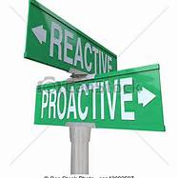
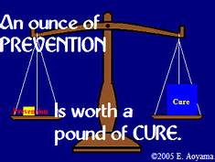

Reactive vs. Proactive Interventions

Slide 57
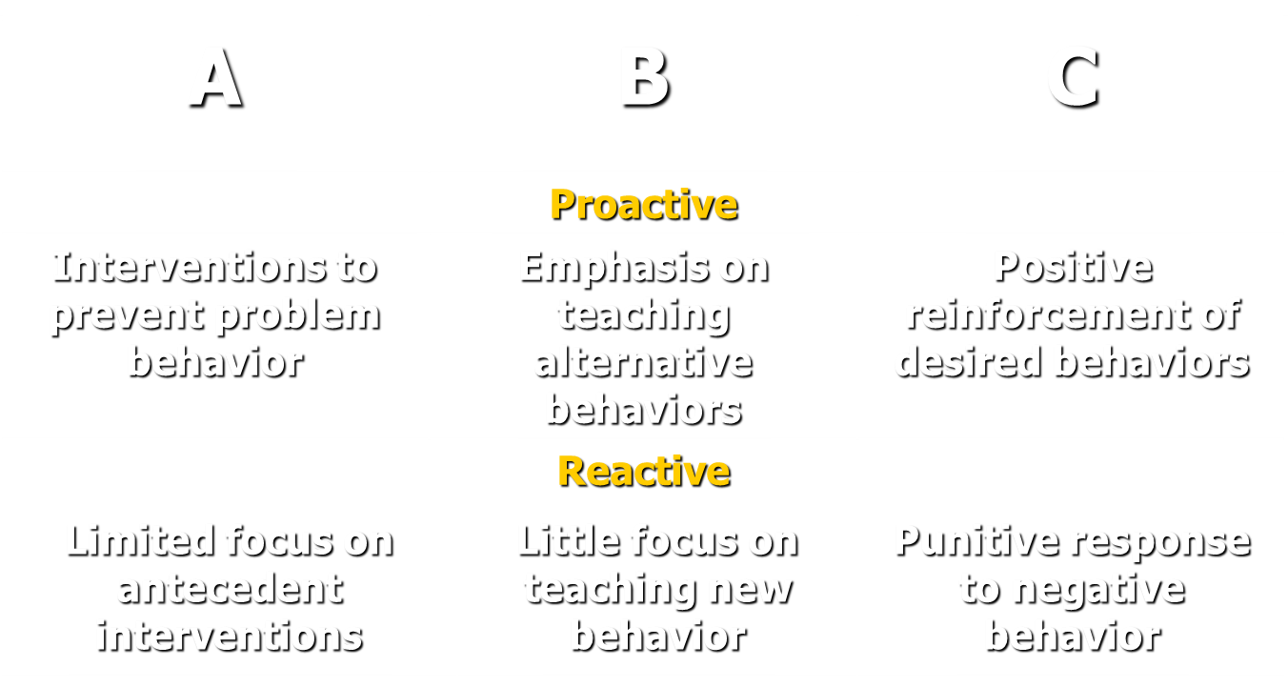
Benefits of Proactive versus Reactive
Notes:
How to help parents understand this concept and teach how to shift

Slide 58
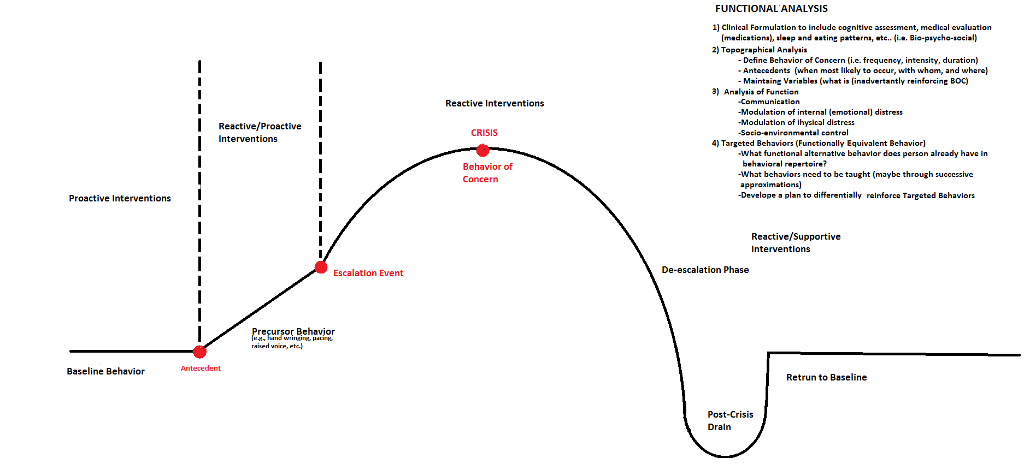
Proactive Versus Reaction Intervention Points
Return to Baseline

Slide 59
Proactive Interventions Setting and Reviewing Expectations
Directions given and reviewed at regular intervals. They should be very specific and easily convey the expected behavior.
Tell the person what you want them to do, rather than what you do not.
“Use an ‘inside’ voice,” instead of “Stop talking so loudly”
“Keep your hands down,” rather than “Don’t hit”
“Let’s relax with some slow breathing,” not “Stop being so nervous”
Learning problems and memory deficits may interfere with understanding and remembering what constitutes “appropriate” behavior.
Learning occurs in small steps, so have realistic expectations.
Be consistent with language across settings.

Slide 60
PROactive Interventions: Toolbox
Be Familiar with the Behavior Plan!
Avoid Triggers and Eliminate Provocations
Positive Setting Events: Prompting and Cueing
Set Expectations Proactively
Well-Understood and Predictable Daily Routine
Adherence with a Written or Picture Schedule

Slide 61

PROactive Interventions: Toolbox
Concrete Directions to Compensate for Impairments
Be Person-Centered and Context-Sensitive
Use Sensory Modalities
Multimodal Approach: Visual Aids and Hands-on Modeling
Build a Team Approach

Slide 62

PROactive Interventions: Toolbox
Active Listening to wants and needs
Affirmative Communication
Meaningful and Non-Contingent Activities for Quality of Life!
Natural Supports with Family, Friends, and Volunteers
Access to “Quiet” Space with Preferred Items (e.g., headphones)
Planned attention and breaks at regular intervals
Rotating through a variety of “fresh” activities

Slide 63

Positive Behavior Support
Reactive Interventions
Caregivers’ actions after a behavior of concern occurs.
For limited use about 5 to 10% of the time. Reactive strategies should never be the only focus of a behavior support plan!
These should be used to help situations from escalating. For example, prompting alternative behaviors, using distractions, redirecting away from triggers, or establishing control when there is harm to self or others.
May include crisis response, respite care, and hospitalization.
Reactive interventions are affected by state-dependent learning. We may lose up to 25 IQ points when upset.
Use Multiple Modes: Verbally-mediated, Visual-spatial, Hands-on, and Contextually-driven

Slide 64
Reactive Interventions
Acknowledge Perspectives:
Active listening by being attuned
Accurate reflection to defuse negative emotions
Validation means acknowledgement, not necessarily agreement
Repeat information back to confirm your understanding
In the Crisis Cycle, sufficiently validate before corrective
feedback with redirecting, limit setting, or finding solutions.
Remember the Context:
Know the situation (e.g., “It sounds like your tired because you didn’t sleep well”)
Understand the individual’s “story” (e.g., “I know this time of year is hard because it’s the anniversary of your dad’s passing away.”)

Slide 65
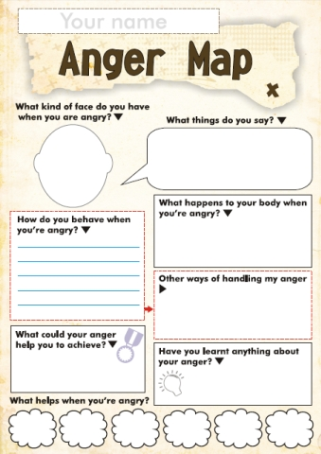
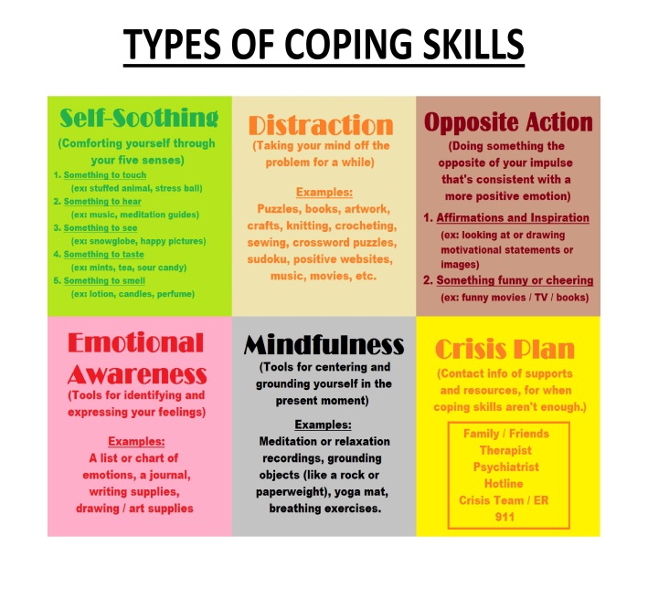
Proactive and Reactive Coping Strategies: Be Specific not Generic!
Be mindful that asking someone with poor impulse control to explore or verbalize their anger as it might lead them to act on their emotions!

Slide 66
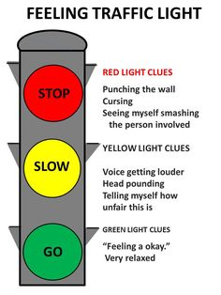
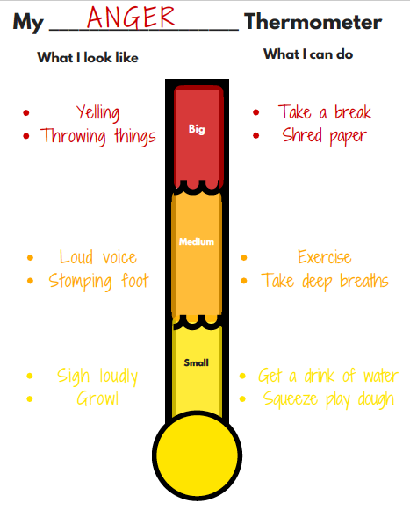
Proactive and Reactive Coping Strategies: Targeting Cognitive Strengths: Visual-Spatial versus Verbal

Slide 67
Positive Behavior Support
Overarching Goal
Our aim is the presence of targeted adaptive and prosocial behaviors through teaching, not just the absence of challenging behavior.

Slide 68
Positive Behavior Support
Guidelines for Replacement Behaviors
1. Serve the Same Purpose:
Putting feelings into polite words to communicate.
2. Get Reinforcement as Soon or Sooner:
Self-soothing with ice pack, rather than self-injurious behavior.
3. Receive as Much or More Reinforcement:
Caregivers quickly attend when he says “again please”, as much as if he had expressed his demands with an outburst.
4. Just as Easy or Easier to Do:
Following directions in one-to-two steps is easier than refusing an appointment or missing an outing.

Slide 69
Positive Behavior Support
Problems with Adverse Consequences
Attempting to control behavior through adverse consequences. It is different than natural and logical consequences.
It may include the following:
Ignoring (spontaneous and planned)
Taking away rights and privileges
Response cost
Forcing apologies
Threatening restraint or seclusion
When minor coercion that was once effective ceases to work, those inclined to use it tend to increase their level of coercion, rather than decrease it.

Slide 70

Measuring Effectiveness:
Why Collect Data?
Generate a “data probe” to determine the most salient problem behaviors to address
Clarify the frequency, rate, intensity, and duration of challenging behaviors
Identify precipitants
Compare intervention data to baseline data
Track changes over time with “annotation” such as the response to behavioral interventions, medication changes, and caregiver fidelity with the plan

Slide 71
General Crisis Intervention Tips to Share with Families
Crisis intervention centers on “what to do” to problem solve regarding the center of the distress.
A process of “defusing” and “deflating” as we try to coach calmness in a situation without physical intervention.
Strive for three practical goals: Safety, Connection, and Empowerment
General Techniques:
Show concern and ask questions with kindness
Conceal your anger and fear
Reassure availability of the team
Give hope about generating solutions
Ground in current reality especially with trauma history
Do not focus only on negative actions
Congratulate steps toward regaining control
Refocus on the individual’s purpose and mission in life

Slide 72
Sample Crisis Plan for Families
Example: Hitting triggered by invading her personal space.
Aggression:
Proactive Interventions: Avoid confrontations and use a gentle approach.
Reactive interventions: Give space. Provide distractions (country music, cold beverages).
Example: Running away from staff in the community when overstimulated by noise.
Elopement:
Proactive interventions: Avoid loud crowds. Be sensitive to room filling with people.
Reactive interventions: Give him space to burn off anxiety. Validate his decision to leave.

Slide 73
A Sample Multimodal Safety Plan for Families
using an Intervention Gradient
Who to contact for support?
When I am thinking of hurting myself, I will take the following steps:
Use what I learned in therapy to figure out what is upsetting me. I will realize that thinking (thought patterns) “I don’t belong” bothers me.
I will talk about and write down some positive ways (non-suicidal responses) to deal with what is bothering me.
I will do things (distractions) that, in the past, have helped me feel better (e.g., listening to music, watching DVD movies, playing sports).
If the suicidal thoughts continue or if I find myself preparing to hurt myself, I will call the people (social supports) who can help me to stay safe.
If I feel that I cannot control my behavior, I’ll ask my staff or family to go to the nearest emergency room, call 2-11, or contact 9-11 (professional help).

