Slide 1
Better Understanding Borderline Personality Disorder and Adapting Dialectical Behavior Therapy
Peter Tolisano, Psy.D. ABPP Board Certified in Clinical Psychology Director of Psychological Services Connecticut Department of Developmental Services

Slide 2
Goals of the Presentation
Understand General Personality Functioning and Personality Dysfunction
Appreciate the Trauma-Based Etiology of Borderline Personality
Learn the Diagnostic Criteria for Borderline Personality and What Constitutes a Borderline Level of Personality Organization
Recognize the Theory and Principles Associated with Dialectical Behavior Therapy (DBT)
Become Familiar with Applying DBT Strategies to Support those Diagnosed with BPD and ID

Slide 3
General Personality Functioning
An enduring pattern of inner experience and behavior that is (1) pervasive across people and situations, and (2) relates to the expectations of an individual’s culture
Organizing and Protective Functions (“Psychological Immune System”)
DSM components:
Cognition
Affect
Interpersonal Functioning
Impulse control
Psychodynamically Rooted in Four Elements:
Temperament
Character
Cognitive Functioning
Morals and Values

Slide 4
Distinguishing Personality Dysfunction
Categorical vs. Dimensional Approach
Is qualitative best? What has the most clinical utility?
Ego Syntonic vs. Ego Dystonic
Internalizing vs. Externalizing

Slide 5
General Characteristics of Personality Disorder
Causes distress and impairment
Misperceptions
Reactivity
Relational Issues
Impulsivity
*Diagnostic Criteria Overlap (e.g., controlling to gain nurturance versus to have power)

Slide 6
Personality Disorders
DSM Phenomenology
Cluster A: Odd-Eccentric
Paranoid: Irrational mistrust and suspicion
Schizoid: Detached from social relationships and restricted emotions
Schizotypal: Odd beliefs and discomfort interacting socially
Cluster B: Dramatic-Emotional/Erratic
Histrionic: Attention-seeking behavior and excessive emotions
Narcissistic: Grandiose and Unempathic
Antisocial: Exploitative, disregard for rights of others
Borderline: Instability in affect, self-image, and relationships.
Cluster C: Anxious-Fearful
Dependent: Excessive need for caring and reassurance
Avoidant: Socially inhibited and sensitive to negative evaluation
Obsessive-Compulsive: Rigid, controlling, and perfectionistic
Differentiation between Borderline Personality and Bipolar Disorder

Slide 7
Individuals Diagnosed with Intellectual Disability are more likely to experience the following:
Receive less scaffolding as children
Experience more psychosocial distress in their families
Be abused, neglected, or witness violence
Feel social stigma (e.g., teasing, ridicule) that affects identity and autonomy
More daily challenges
Out-of-home placement
Medical illnesses and physical anomalies
Statistics for Individuals with ID
25-40% have a co-morbid mental illness
An estimated 7-31% of those in the community with ID suffer from PD
One-third of those with ID have difficulty with emotion regulation and challenging behaviors

Slide 8
The Role of Trauma in Personality Formation
A 2013 report indicated that over 70% of people diagnosed with disabilities identified themselves as being victims of abuse.
The definition of what constitutes trauma can be broadened, as the range of potentially traumatizing events is far greater for persons with lower adaptive functioning (e.g., abuse and neglect, bullying, separation from family, institutionalization, exclusion, being surpassed by siblings, or recognizing oneself as having disabilities). What is Sanctuary Harm?
This vulnerable population is most susceptible to relational trauma because of their limited comprehension, communication, and self-protective skills.

Slide 9
Trauma-Sensitivity
Trauma at critical points in development can literally alter brain structure (hardwiring) to make us vulnerable to intensely negative emotions.
Developmental Trauma: The attachment figures in our formative years impact our brain development and shape personality functioning across our entire life span.
For example, chronically inconsistent (e.g., mixed messages), unpredictable, or chaotic parenting during childhood creates insecurities that lead to fears of abandonment and rejection in adulthood.
Trauma of Invalidation: The Double Bind
We need a deeper appreciation about the cumulative effects that complex trauma can have on cognitive, emotional, and psychosocial development.

Slide 10
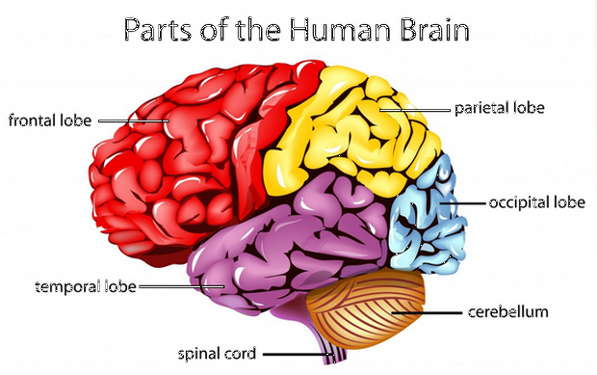
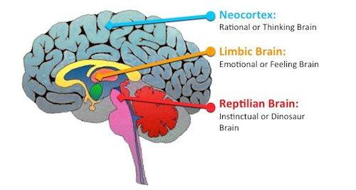
Parts of the Brain Implicated in Borderline Personality
Limbic System
Amygdala that detects threat (fight, flight, and freeze reactions)
Hippocampus for memory storage
Hypothalamus relays sensory information and activates the autonomic nervous and endocrine systems
Frontal Cortex
Responsible for planning, emotional control, thinking flexibly, self-monitoring, and decision-making. Deficits in executive functioning can predispose an individual to personality pathology.

Slide 11
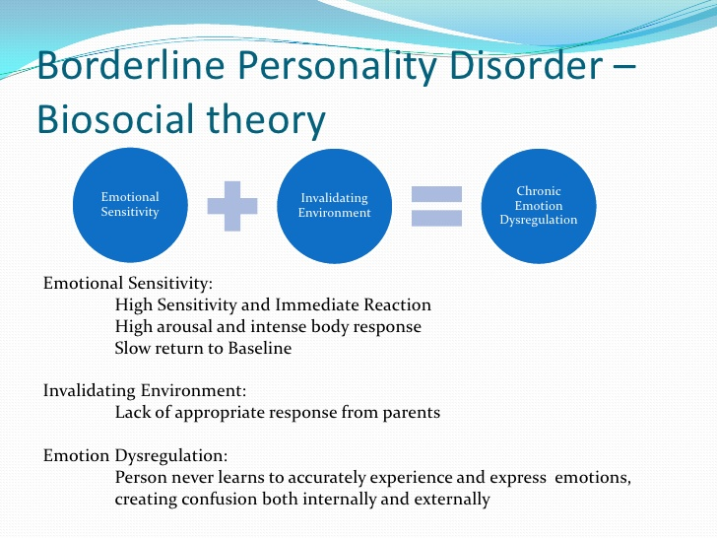

Slide 12
An invalidating environment may be…
intolerant of or punitive about emotional expression
reject communications
intermittently reinforce emotional escalation
hold unreasonable expectations
judgmental language
oversimplify problem solving
Dismissive or demeaning attitude
Pathologize normative responses (e.g., social life, independence)
“You don’t really hate your housemate because she’s
getting her own apartment.”
Research shows that parents of self-harming adolescents are more likely to invalidate, respond aversively, or match/escalate conflict.

Slide 13
Transaction between Biological Vulnerability
and an Invalidating Environment
Forms of Susceptibility
High sensitivity to stimuli (i.e., perceived triggers)
Low threshold for emotional reactions
High reactivity to people and events
Slow return to baseline (i.e., long-lasting reactions)

Slide 14
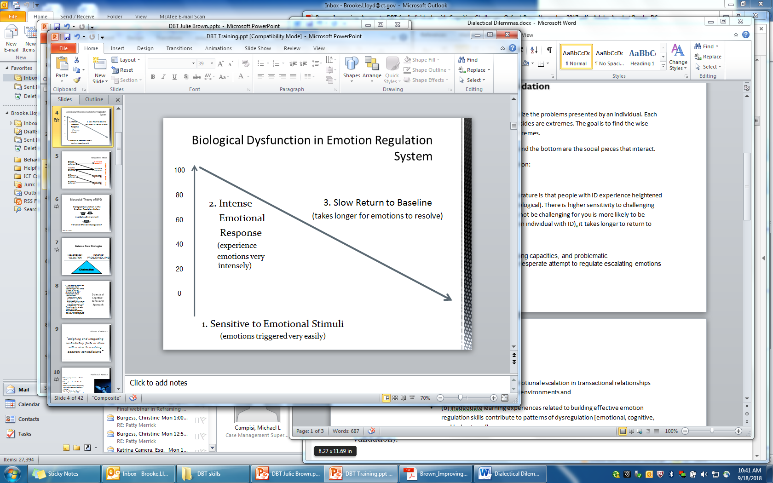

Slide 15
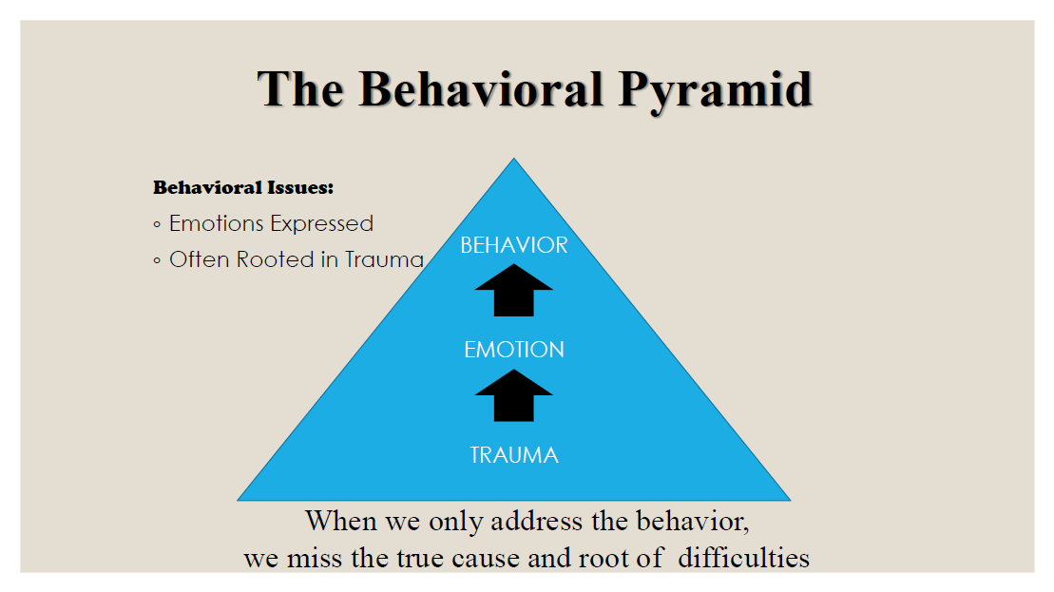
PROBLEM BEHAVIORS THAT WERE ADAPTIVE SOLUTIONS BECOME MALADAPTIVE
BEHAVIORS OF CONCERN CAN BE MALADAPTIVE ATTEMPTS TO MANAGE EMOTIONS
“Where did you learn that you have to “turn up the volume’ in order for people to listen to you?”
“Cutting was an ingenuous way to cope with the intense feelings, but what makes better sense now?”

Slide 16
DSM-5 Diagnostic Criteria for Borderline Personality Disorder
A pervasive pattern of instability of interpersonal relationships, self-image,
affective instability, and marked impulsivity, beginning by early adulthood
and present in a variety of contexts.
About 2-4% of the general population, 10% outpatient, and 20% inpatient
Diagnosed predominantly (75%) in females
Five times higher risk among first-degree relatives
High likelihood of comorbid psychiatric disorders
Lifelong, generally stabilizes by midlife
Two Core Areas: Identity Disturbance and Emotional Dysregulation

Slide 17
DSM-5 Diagnostic Criteria for Borderline Personality Disorder
Five of Nine…Same Diagnosis, Different Presentation
1. Frantic efforts to avoid real or imagined abandonment. What affects our perception of attachment?
2. A pattern of unstable and intense interpersonal relationships characterized by alternating between extremes of idealization and devaluation. Vertical versus Horizontal Splitting.
3. Identity disturbance: markedly and persistently unstable self-image or sense of self. Problems worsen with a lack of structure.

Slide 18
DSM-5 Diagnostic Criteria for Borderline Personality Disorder
4. Impulsivity that is potentially self-damaging (e.g., promiscuous sex, binge eating, substance abuse, reckless driving).
Borderline Personality is the only disorder to contain substance use within its criteria.
Think Control/Mastery Function of Behavior!
5. Recurrent suicidal behavior, gestures, threats, or self-injurious behavior such as cutting. Think Self-Soothing Function!
6. Affective instability (e.g., anxiety and irritability usually lasting a few hours up to a reactive mood).

Slide 19
DSM-5 Diagnostic Criteria for Borderline Personality Disorder
7. Chronic feelings of emptiness.
8. Inappropriate anger or difficulty controlling anger (e.g., frequent displays of temper, recurrent physical fights).
9. Transient psychosis, stress-related paranoid ideation, delusional beliefs, or dissociative symptoms.

Slide 20
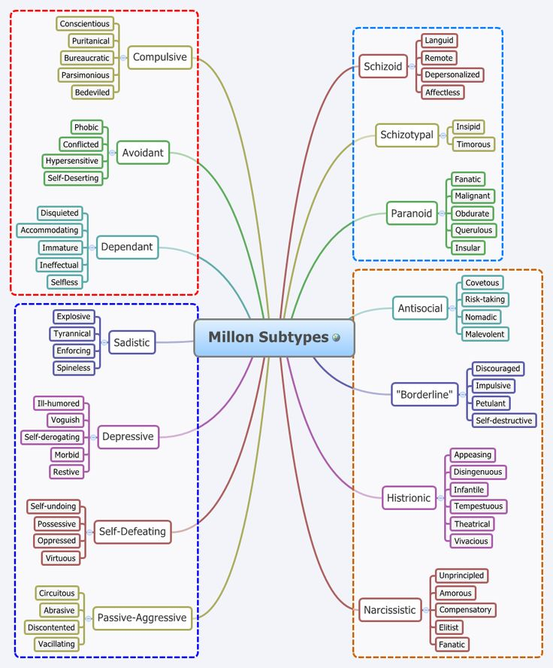
Millon’s Subtypes of Borderline
Personality Disorder
Quiet (dichotomous thinking)
Petulant (negative, rationalizing, resistive)
Impulsive (histrionic or antisocial features)
Self-Destructive (masochistic)
Discouraged (dependency, neediness)

Slide 21
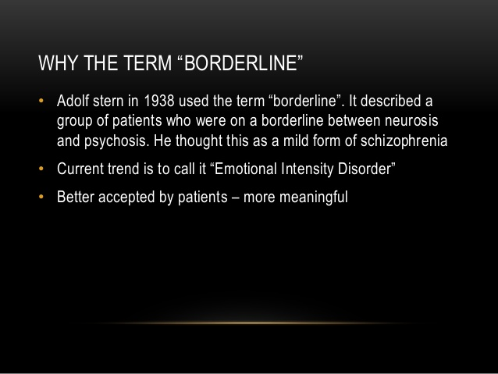
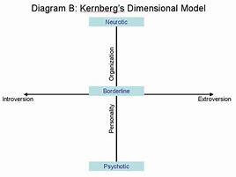
Origination of the Term

Slide 22
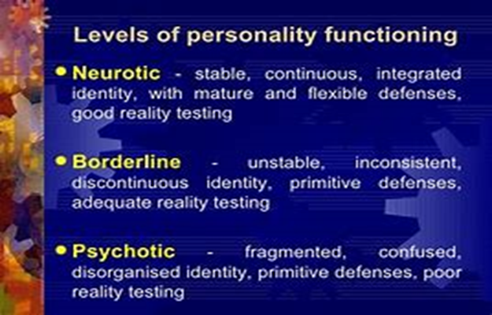
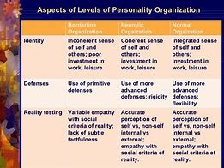
Kernberg’s and McWilliams’ Contributions
What’s the Inner Story? What is the Theme?
Hallmarks
Black/White or All-or-Nothing thinking oftentimes to manage emotional complexity or self-image
Engagement in “primitive” defenses, such as regression, projection, and projective identification

Slide 23
Dialectical Behavior Therapy (DBT)
A modified form of cognitive-behavioral psychotherapy with Eastern mindfulness developed by Marsha Linehan (1993) for parasuicidal behavior and self-injury
Supporting individuals with emotional dysregulation can require an inordinate amount of time, energy, supervision, and patience.
Evidence-Based, “First-Line” Treatment for BPD
DBT-Proper versus DBT-Informed
Largely implemented in community mental health settings
Expanded to multiple problems: substance misuse, eating disorder, depression…
DBT is useful to DDS to help (1) individuals with genuine BPD-related issues; and (2) individuals with multiple diagnoses that might be difficult to engage in treatment.

Slide 24
Dialectical Behavior Therapy
Core presumption is that emotional intensity is caused by the dialectical conflict between the self and the environment.
Dialectical treatment (i.e., two simultaneous goals) means giving the person validation for their experiences AND asking them to change their behavior.
Coping = Acceptance + Change!
Dialectical thinking takes the form of both/and instead of either/or. The antidote to dichotomous thinking!
For example, “I dislike staff telling me what to do and I like it when staff pays attention to me.”

Slide 25
DBT Paradigm
Establish safety
Treat therapy-interfering behaviors (e.g., low motivation) by individuals and staff. Preserves caregiver morale!
Build therapeutic alliance
Process validation and change

Slide 26
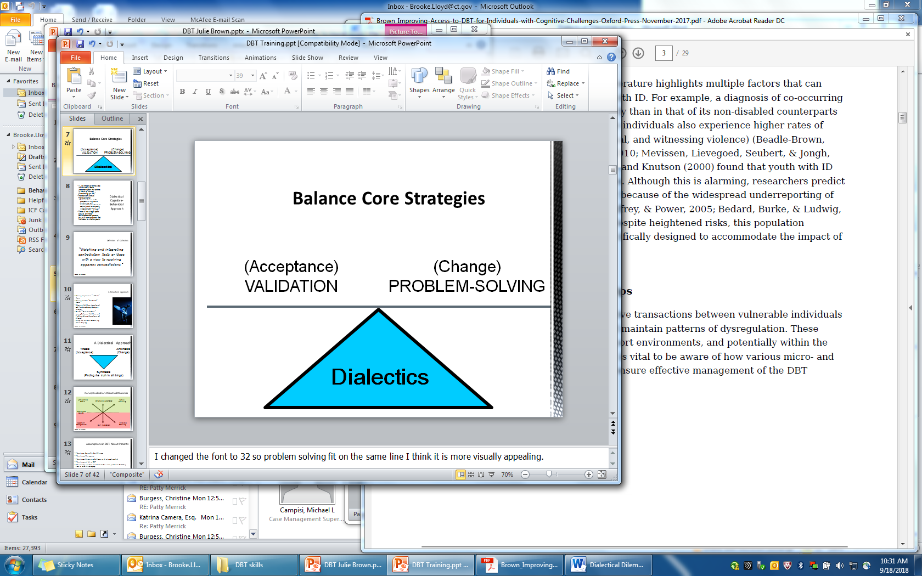
Example of Dialectics in Practicality:
As a therapeutic agent being firm and supportive
“Individual is doing the best they can and let’s stay motivated”
Central Dialectic with ID…”Consultation to the individual (i.e., teach autonomy) and structuring the environment”

Slide 27
Sequelae of Trauma
If an individual never fully learns how to effectively get their emotional needs met, their only choice becomes dysregulation.
Emotion dysregulation leads to cognitive dysregulation and that in turn causes behavioral dysregulation.

Slide 28
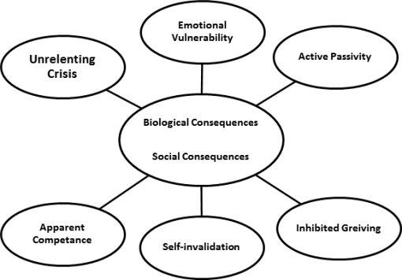
Classic Dialectical Dilemmas

Slide 29
BPD Behaviors to Decrease via DBT
Interpersonal chaos
Labile emotions
Impulsivity
Confusion about self
BPD Behaviors to Increase via DBT
Mindfulness
Emotional Regulation
Interpersonal Effectiveness
Distress Tolerance

Slide 30
DBT-Informed Treatment
“Building a Life Worth Living”
Four Core Life Skills Modules:
Mindfulness
Helps to stay in the present and focus less on painful experiences from the past or frightening possibilities in the future.
Learn to make more accurate decisions and decrease impulsive actions.
Examples: Simple breathing and counting, just stating the facts, using wise mind, monitoring negative judgments, and meditation.
Emotion Regulation
Helps people identify “what gets in the way” of being able to act adaptively.
Learn to recognize and modulate emotions, and practice changing negative mindsets.
Examples: Self-care, emotion log with colors, exercise, opposite to emotion, writing the story, and exposure.

Slide 31
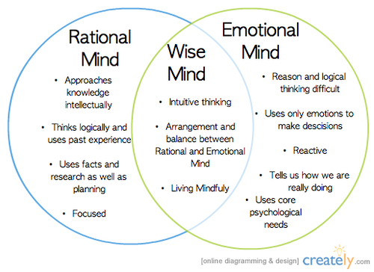

Slide 32
Four Core Life Skills Modules:
Interpersonal Effectiveness
Helps people learn effective ways to build and maintain positive relationships and develop tools to deal with conflict.
Examples: Old versus new habits, red versus green flag behaviors, weighing pros and cons, role playing, assertiveness scripts, polite refusals, reciprocal validation, and “I” statements to express wants and needs.
Distress Tolerance
Helps people to cope better with emotionally painful events, accept reality, and build resiliency.
Examples: Radical acceptance, distraction with pleasurable activities, grounding and self-soothing, relaxation, self-affirmation with targeted positive behaviors, jeopardy game to identify skills.

Slide 33
Ways of Applying and Adapting DBT for ID
Use teaching (psychoeducation and habilitation) to stay skills-based
Be non-judgmental and avoid re-traumatization
Ensure that the environment is supportive
Non-pejorative language. Don’t blame the victim!
Modified diary card for self-monitoring
Generalize skills across settings (e.g., step-down unit to family living situation)
Practice patience and consistency
Always be an ally rather than an adversary!

Slide 34
Neutral and Empathic Validation
Active listening by being attuned
Accurate reflection to defuse negative emotions
Validation means acknowledgement, not necessarily
acceptance or agreement
Try to understand multiple perspectives to the situation
Repeat information back to confirm your understanding
Sufficiently validate before redirecting or offering solutions

Slide 35
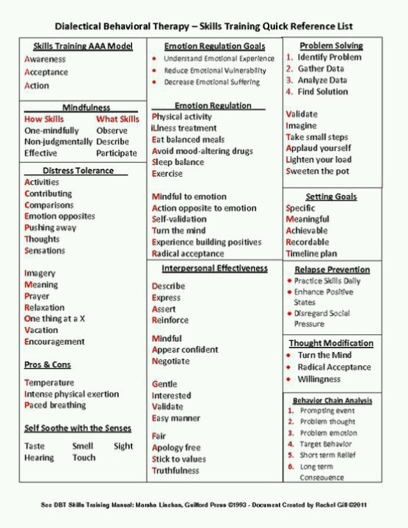

Slide 36
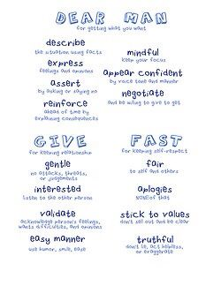
DBT Quick Reference Sheet Suited for Individuals with ID

Slide 37
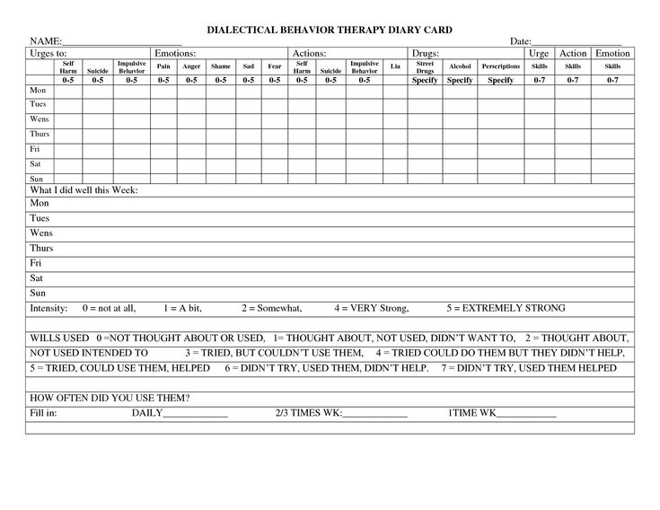
Classic Diary Card

Slide 38
Adapted Diary Card
Day and Date | My Goals | Behavior | Emotion at the time | Skills I used to feel better
Thursday | Making money | Skipped work | Angry | Mindful breathing
Saturday | Control blood sugar | Overate carbs | Sad | Opposite to emotion

Slide 39
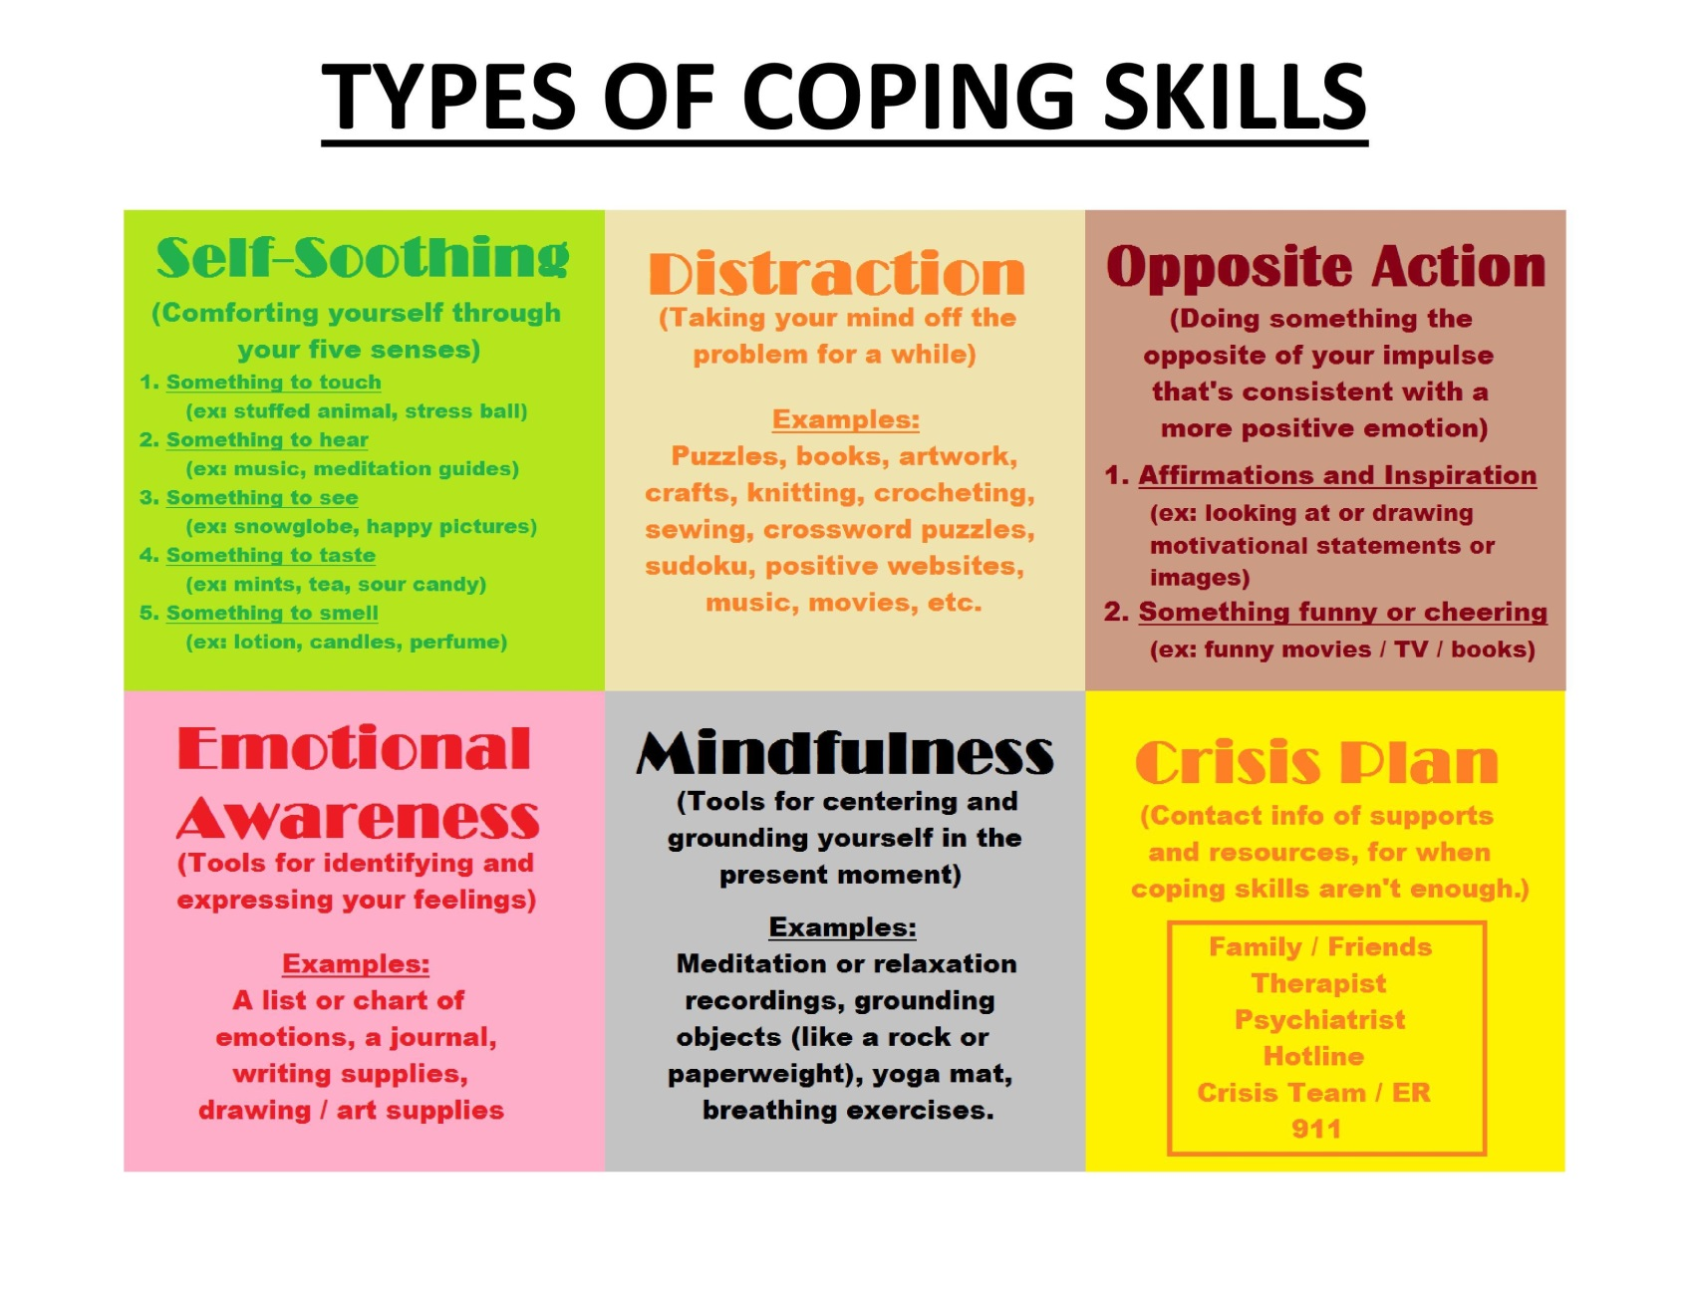

Slide 40
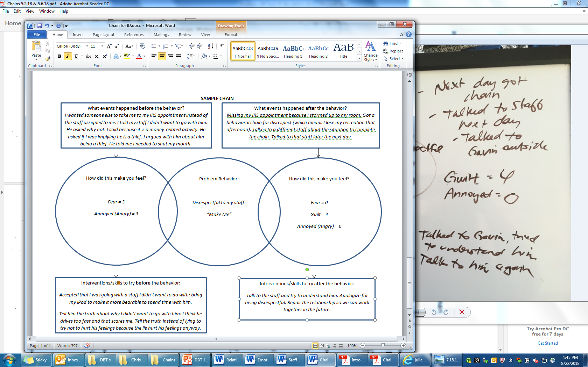
Classic Chain Analysis

Slide 41
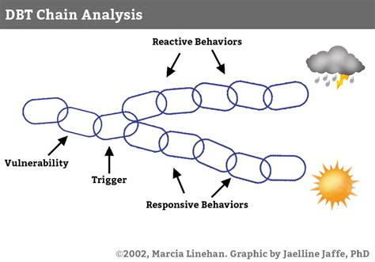
Modified Chain Analysis
What came before…

Slide 42
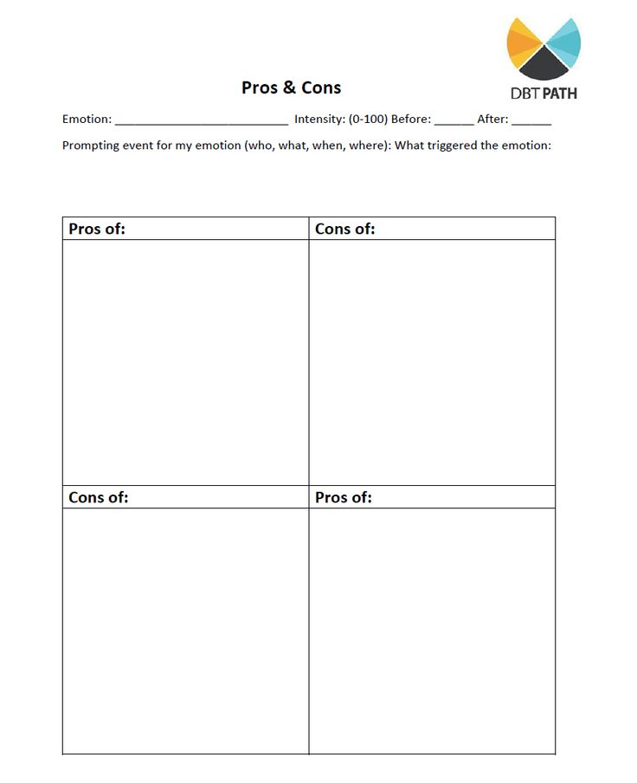
Payoff Matrix

Slide 43
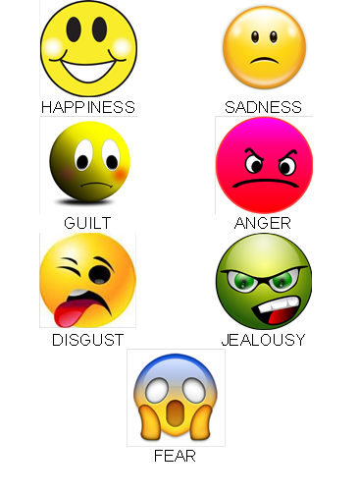
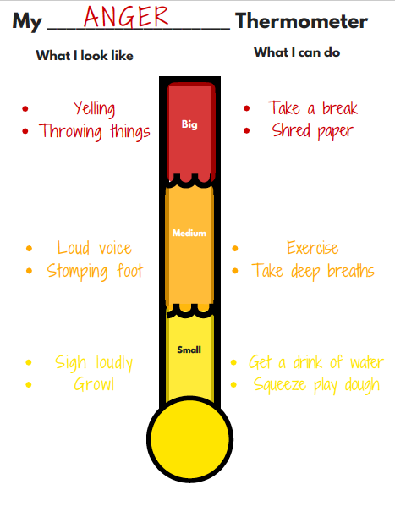
DBT Techniques:
Emotion Identification and Rating Scale
*Always consider Level of Impulse Control before Exploring Emotions

Slide 44
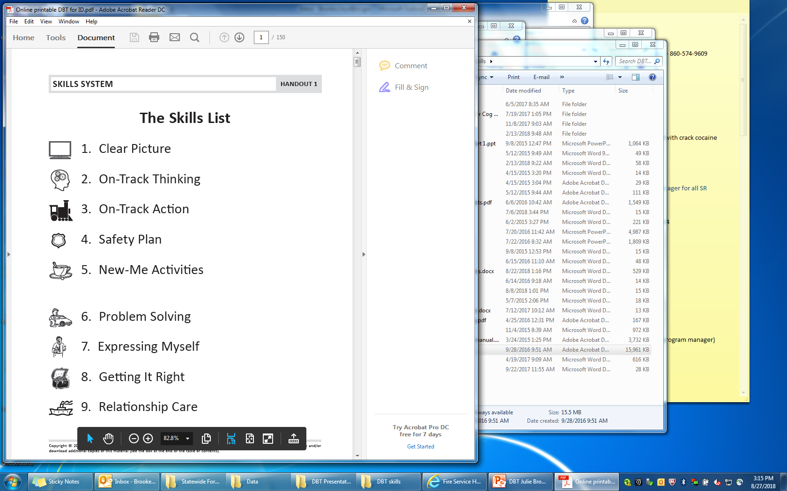
Julie Brown’s
All the Time Skills
Clear Picture
On-Track Thinking
On Track Action
Safety Plan
New Me Activity

Slide 45
Julie Brown’s
Calm Only Skills
Problem Solving
Expressing Myself
Getting It Right
Relationship Care

Slide 46
Benefits of DBT for ID
Compatibility…
Skills-based model that is consistent with habilitation (teach new behaviors, rather than delivering consequences for negative ones)
Learn interpersonal skills
It’s fundamentally positive (suspends judgments)
Increases community involvement
Reduces provider burn-out

Slide 47
Individuals diagnosed with developmental disabilities are no less deserving of care. It is incumbent on us as providers to figure out how to deliver treatment from which they can benefit…

