Slide 1





DDS STEP (Supporting Transformation to Empower People)
Provider Training Session 3: Residential Services
Connecticut Department of Developmental Services
June 2023

Slide 2


Zoom Tips
Click Show Captions to turn captions on
Click Start Video to turn on your camera
Click Unmute to speak
Click Chat to write to the group or to see what people write

Slide 3

Agenda
  Welcome
  Review and approval process
  Financial incentives
  Transition plan and budget examples
  Q&A and closing

Slide 4
Session Objectives
1
Know how to navigate the STEP transition plan creation, submission, and approval process.
2
Be comfortable with the STEP Transitions Plan Templates and Budget sheet.
3
Understand how to build your plan based on sample templates and budgets.

Slide 5
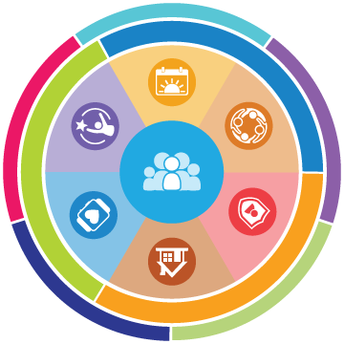
STEP is an incredible opportunity to empower the people we support through strategic investments in the DDS system.
Building on Charting the Life Course priorities, STEP emphasizes a different way of thinking that encourages high expectations, emphasizes life experiences that align with individuals’ goals, and the integration of multiple support types to build independence.
Individuals and their Families
Providers
DDS
Work to develop a vision for their life and build skills and natural supports for lifelong independence according to their goals, interests, and strengths.
Create more support options for individuals that give them opportunities to connect their residential and working lives to their goals and needs.
Develop an organizational approach that prioritizes person-centered processes and supports individuals to be independent and self-determined.

Slide 6
Provider Role
Providers are the on the ground driving force of STEP! Provider transition plans directly create the opportunities for individuals to transition.
1. Consider STEP incentives as part of agency planning. How can you leverage this financial opportunity to best support individuals?
Resources to help you submit plans and answer questions!
Provider Gateway: STEP Resources
Visit the Technical Assistance Request Link for technical support or to learn more about STEP
Attend STEP Office Hours on Fridays from 10 – 11 a.m. via this link
2. Support information sharing and discussions with individuals and their families about transitions.
3. Develop creative approaches and strategies so individual can transition to supports that are right for them and emphasize independence and choice.
4. Create transition plans and coordinate with your region, updating as necessary or requested by your region.
5. Coordinate with individuals and their families and case managers throughout the transition process to ensure that it is person-centered.

Slide 7
Review & Approval Process

Slide 8






Transition Plan Process
Provider submits STEP Transition Plan to regional Resource Administrator
Provider develops a STEP Transition Plan
Regional review of the submitted plan
Regional approval of the plan
Provider begins transformation planning and engages Regional Staff for input and support
Review team collaborates with provider for revisions to the plan as needed
Provider begins implementation activities

Slide 9

What Are Reviewers Looking For?
Transition Plan Templates each include review criteria for consistency in review across regions. Examples include:
Person-centered planning processes that engage individuals and their teams
Provider has the staffing capabilities to facilitate the transition and provide supports
Individuals are receiving transition-specific supports
Plan demonstrates an awareness and approach for addressing emotional challenges
Appropriate transition timelines and milestones
Transformative efforts that demonstrate long-term strategic planning

Slide 10



How Does DDS Make Approval Decisions?
Transition Plan Templates each include review criteria for consistency in review across regions. In addition, DDS is prioritizing approval of plans that are truly transformative and innovative. A transformative plan is characterized by the type of transition and meeting at least one of the four criteria listed below:
TYPE OF TRANSITION
Plan for transitioning individuals from a congregate to a non-congregate, community-based setting
Innovative Criteria for STEP Plans
APPENDIX K OBJECTIVES
SCALE OF IMPACT
NEW APPROACH
NEW PROGRAMS
Completes an Appendix K Objective related to restructuring a residential setting to support individuals with specialized or complex medical, behavioral, or clinical needs
The number of people or settings impacted is significant for the agency and represents real transformation
Tests a new approach for the agency with the potential for growth and capacity to serve more individuals
Creates or expands an agency’s capacity to provide individualized supports through new programs or offerings

Slide 11
Financial Incentives

Slide 12
STEP Incentive
STEP Incentive is a one-time incentive of $33,500 for individuals transitioning to an alternative community-based setting for at least 60 days.
Scenario: Individual transitions from a CLA to IHS
Incentive Calculation: Provider receives a one-time payment of $33,500 for each qualifying transition
Incentive Limits: only applies to transitions in an approved Transition Plan. Must be completed before March 31, 2025.

Slide 13
Provider Transition Incentive
Provider Transition Incentive payments for vacancies left by an individual transitioning to maintain fiscal stability during the transition.
Scenario: Individual transitions from a CLA to IHS in their own apartment
Incentive Calculation: (Current Annual Funding (CLA) / 12 months) x Number of Months Needed = PTI
Incentive Limits: Maximum of 6 months, or until the last individual transitions out of the CLA

Slide 14
New Residential Placement Incentive
New Residential Placement Incentive for individuals that transition from congregate living settings to independent living settings
Scenario: Individual transitions from a CLA to IHS in their own apartment
Incentive Calculation: (Target Annual Funding (IHS) / 52) x Number of weeks needed = NRPI
Incentive Limits: Maximum of 20 weeks

Slide 15



Transforming Settings
Through STEP, people can move to supports that are the best fit for them. This includes people who struggle to find supports because of behavioral or medical support needs, or that are on the DDS waitlist.
CLA or CRS
IHS or CCH Supports
Using incentives to restructure settings to serve individuals with complex needs:
Hire and train additional staff
Invest in assistive technology and remote supports
Transform physical spaces to improve accessibility
Individuals on the DDS residential waitlist and/or individuals with significant behavioral or medical support needs
Backfilling CLA/CRS settings
If a provider backfills a CLA/CRS setting following a transition, that individual must be from the DDS waitlist or approved by DDS as having significant behavioral or medical support needs for the transition to be eligible for STEP incentives.

Slide 16
Transition Plans

Slide 17

STEP Residential Transition Template
1
2
3
Transitioning from a CLA or CRS to a more integrated community-based setting (own home, family home or CCH)
Transition Plan Instructions
Budget Sheet
Template A: Residential
Optional:
Template A2:
Additional Settings
We will now screenshare to walk through the template in detail!
Example Transition Plans are on the Provider Gateway

Slide 18
Q&A

Slide 19
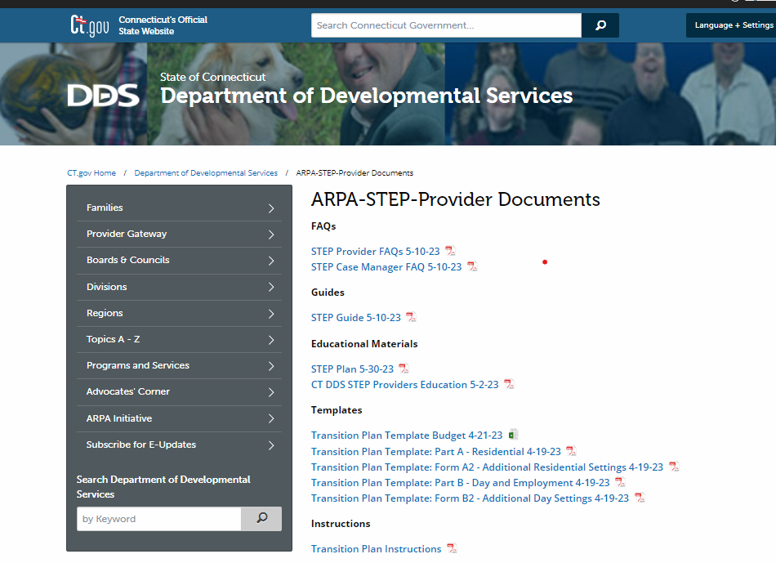
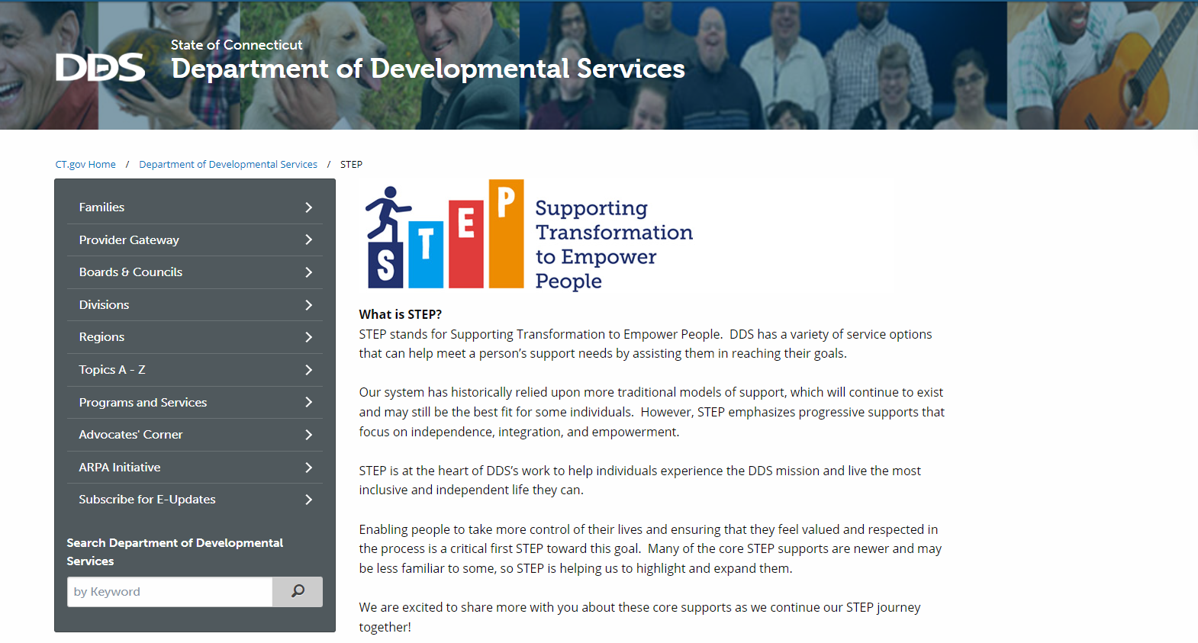
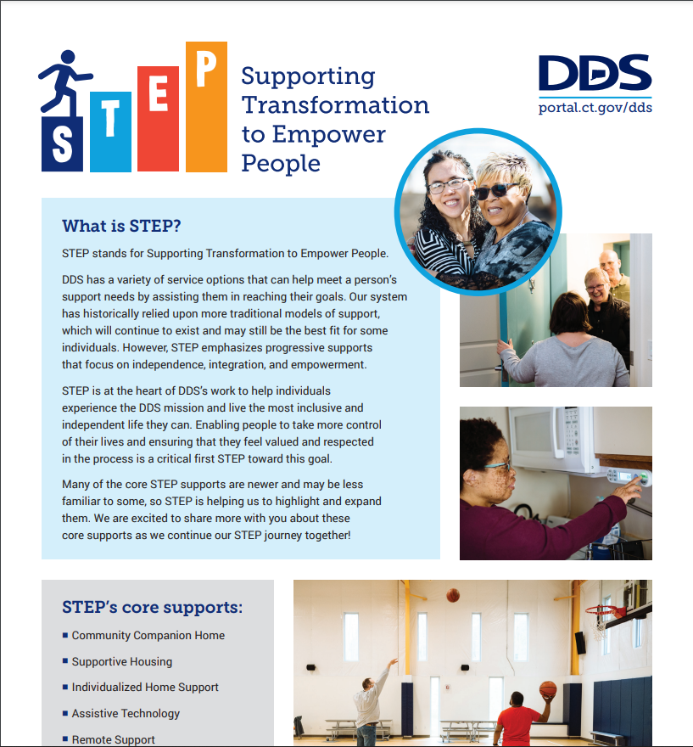
Resources
Looking for more information about STEP? Check out the STEP Resources page on the DDS Provider Gateway
Looking for information about STEP to share with individuals and their families? Check out the new public STEP Page
on DDS Provider Gateway
on www.ct.gov/step

Slide 20
Closing and Thank You

