Slide 1





DDS STEP (Supporting Transformation to Empower People)
DDS Staff – Reviewer Training
Connecticut Department of Developmental Services
June 2023

Slide 2

Agenda
Opening remarks
Plan development process
Review & approval process
Live template review
Q&A and closing

Slide 3
Session Objectives
1
Understand the STEP Transition Plan development and review process, and your role.
2
Share best practices for reviewing plans and assessing submissions.
3
Provide tools to streamline the review process and provider collaboration.

Slide 4
Plan Development Process

Slide 5
Developing a STEP Transition Plan
STEP Guide and Instructions
Providers use these documents to understand the purpose of STEP, the types of incentivized transitions, and how to complete the Transition Plan Templates. If you are working closely with a provider, direct them to these resources prior to starting their plan.
Template Forms
A and B
Providers will complete a narrative description of the transformation. This is a collaborative process that involves close coordination with individuals and their teams/natural supports. Staying in touch throughout the process will result in fewer changes down the line.
STEP Budget Sheet
Providers will complete a STEP Budget that indicates the current and target funding rates for settings, among other key data points. This tool summarizes potential incentive payouts and allows providers to request one-time payments and additional funding for transition program costs.

Slide 6


Plan Element Overview
Transitioning from a CLA or CRS to a more integrated community-based setting (own home, family home or CCH)
Transition Plan Instructions
Budget Sheet
Template A: Residential
Transitioning from non-vocational congregate day settings to transitional and vocational supports
Transition Plan Instructions
Budget Sheet
Template B:
Day & Employment
Transitioning from GSE to ISE or Customized Employment

Slide 7
Review & Approval Process

Slide 8






Transition Plan Process
Provider submits STEP Transition Plan to regional Resource Administrator
Provider develops a STEP Transition Plan
Regional review of the submitted plan
Regional approval of the plan
Provider begins transformation planning and engages Regional Staff for input and support
Review team collaborates with provider for revisions to the plan as needed
Provider begins implementation activities

Slide 9
Regional Review and Approval Process
Providers submit plans to the Regional Resource Administrator, and regional staff review plans.
A plan must have all “Meets requirements” for approval. For plans with “Revision necessary” sections, the region will set up a meeting between the region and the provider to provide guidance.
Following the review meeting, the provider and the review team align on a timeline to revise the necessary responses and resubmit for the region to review.
Once all issues and concerns are resolved, the region will decide whether to approve or ask for edits to the plan. The Assistant Regional Director or Designee will then communicate the plan status to the provider.
When approved, the region will email an approval letter to the provider and designate a staff member to act as the liaison. This liaison will monitor and support implementation.

Slide 10
Who is the Regional Review Team?
Resource Administrator
Leadership representatives
Resource management representatives
Case management representatives
Someone from each group will review the narrative
If reviewers do not agree, it defaults to “Needs Revision”
The Resource Administrator will select who reviews the Budget. It will be reviewed for accuracy and appropriateness given the narrative
As needed, teams will meet internally to discuss submitted plans
Reviewers may ask case managers and resource managers who work with the provider for input as needed

Slide 11



How Does DDS Make Approval Decisions?
Transition Plan Templates each include review criteria for consistency in review across regions. In addition, DDS is prioritizing approval of plans that are truly transformative and innovative. A transformative plan is characterized by the type of transition and meeting at least one of the four criteria listed below:
TYPE OF TRANSITION
Plan for transitioning individuals from a congregate to a non-congregate, community-based setting
Innovative Criteria for STEP Plans
APPENDIX K OBJECTIVES
SCALE OF IMPACT
NEW APPROACH
NEW PROGRAMS
Completes one of the pending Appendix K Objectives related to restructuring settings or ending subminimum wage arrangements
The number of people or settings impacted is significant for the agency and represents real transformation
Tests a new approach for the agency with the potential for growth and capacity to serve more individuals
Creates or expands an agency’s capacity to provide individualized supports through new programs or offerings

Slide 12
Live Template Review

Slide 13
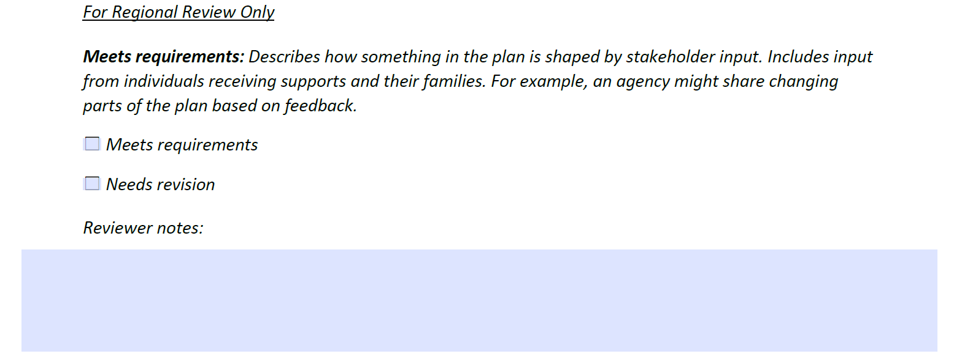
Transition Plan Review: Best Practices for Reviewers
Consistency
Rating checkpoints throughout the template
What to know if review team has different ratings
Reviewer notes field is intended to describe necessary edits and does not need to be completed for sections that “Meet requirements”:

Slide 14
Transition Safeguards and Person-Centered Planning
Individuals and their teams are involved from the beginning of planning to align their goals and interests to the transition
Individuals have flexibility to try a new setting and transition back according to the below guidelines:
Before 60 Days | Between 60 and 120 Days | Between 120 and 365 Days | After 365 Days
Transition back to their original setting | Transition back to the same support type between 60 and 120 days | Transition to another setting with funding up to the annual authorized amount from the date of the individual’s transition. | Utilize the existing PRAT process to request setting changes
STEP puts the individuals and their needs first. No one will be obligated to transition to a new setting or remain in a support that doesn’t fit their goals and needs.

Slide 15
Q&A

Slide 16
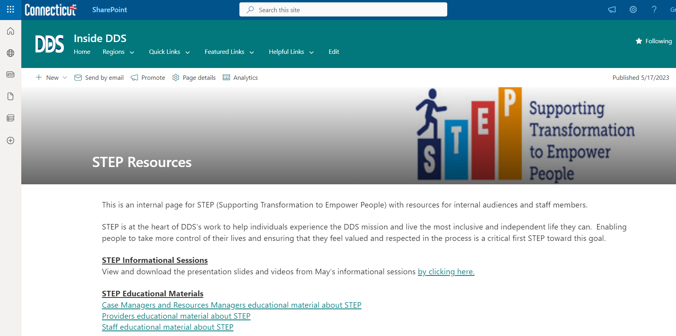
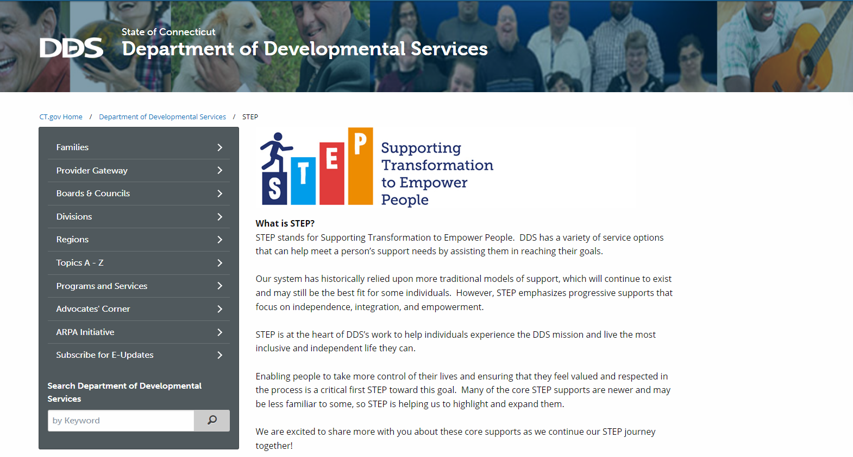
Resources
Looking for more information about STEP? Check out the new STEP Resources page
Looking for information about STEP to share with individuals and their families? Check out the new public STEP Page
on Inside DDS (DDS Intranet)
on www.ct.gov/step

Slide 17
Closing and Thank You

