Slide 1
Department of Developmental Services Individual & Family Supports
Helplines

Slide 2
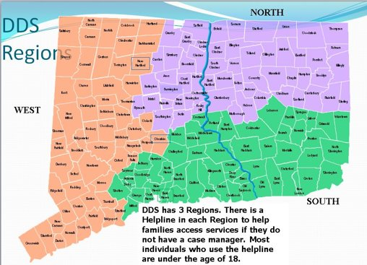

Slide 3


What are the Helplines?
DDS is divided into three Regions across the State – North, South and West.
In 2009, the State of CT DDS established a Helpline in each of its three Regions. The Helplines are for people who are already eligible for services through DDS who are in the Individual & Family Support Division. Individuals are assigned to the Helplines if they are not enrolled in Husky C, which is an adult Medicaid program for the disabled. Typically, individuals are eligible to apply for Husky C when they turn 18 years of age. After enrolled in Husky C, if individuals are not able to be enrolled in a DDS Waiver as they are not receiving a DDS funded service, they may remain on the Helpline depending upon the availability of an assigned Case Manager.
.
DDS NORTH REGION
Location: East Hartford Office
1-877-437-4577
Email: DDS.NR.ifshelpline@ct.gov
DDS SOUTH REGION
Location: New Haven Office
1-877-437-4567
Email: DDS.SR.ifshelpline@ct.gov
DDS WEST REGION
Location: Cheshire Office
1-877-491-2720
Email: DDS.WR.ifshelpline@ct.gov

Slide 4
Eligibility Transfer to Region
After an individual is made eligible the file is sent to the appropriate regional office.
Upon receipt of the file, the regional Helpline mails a welcoming packet that provides additional information on services and supports available with DDS.
Families are welcome to call the Helplines with questions and/or to apply for services and supports

Slide 5
Helpline Team
Currently, the Helpline consist of a Director three Helpline Case Managers
Helplines provide case manager services to individuals and families when the individual does not have HUSKY C.
Helpline Case Managers complete initial guardianship assessments with families and assist families with applying for services offered by DDS. These services include family, camp grants and SDE grants, Respite Center stays Family Support Worker supports, transition advising for individuals and consultative services with members of the Resource Team.
The Resource Team may include, occupational and speech consultation, nursing, psychological/clinical, and behavioral supports.

Slide 6
Helpline Team
Referrals – Within DDS and recommendations to other providers.
Respond, triage and follow through with emergency situations.
Work collaboratively with public and private providers.
Re-determination – What happens when an individual is made eligible prior to the age of eight?
Seventeen-Year-Olds –Next steps when an individual is approaching 18 years-old
Initial guardianship assessments – What is the process?
Assist individuals with applying for HUSKY C
Three - year guardianship assessments – What is the process?
Duration with the Helpline – When is an individual transferred to a traditional Case Manager?

Slide 7
Questions?

