Slide 1

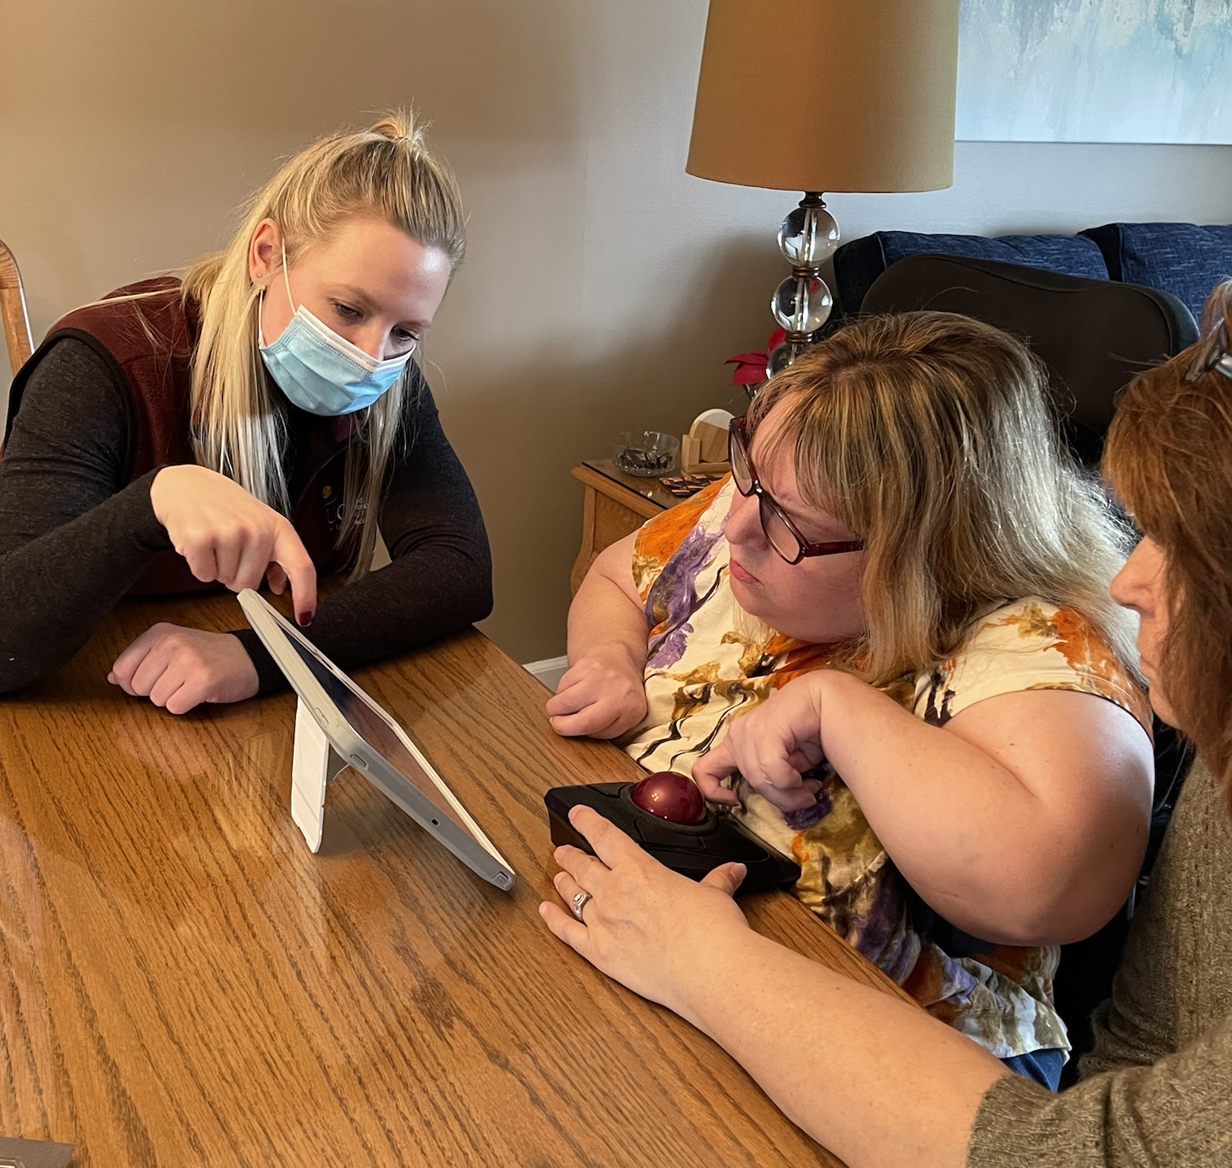
UCP of Eastern CT
Assistive Technology Lending & Accessibility Services Center

Slide 2

Introductions
Shannon Taber
DIRECTOR, INCLUSION & ACCESSIBILITY @ UCP of Eastern CT
Oversee the Atlas Center and the Inclusion & ACCESSIBILITY Program.
Assistive Technology Specialist (ATS)
Certified Living IN Place Professional (CLIPP)
Parent of an adult with disabilities
Fan of All things smart home

Slide 3
Introductions
Miriam Johnson
Manager, INCLUSION & ACCESSIBILITY @ UCP of Eastern CT
Assistive Technology Specialist (ATS)
Specializes in Independent Living
Oversees the bridging the digital divide Program with state unit on aging and CT Tech Act project. This project assists consumers with disabilities over the age of 18 and our aging population learn to use technology.

Slide 4

Connecticut Tech Act Project
The Connecticut Tech Act Project’s mission is to increase independence and improve the lives of individuals with disabilities through increased access to Assistive Technology for work, school and community living.
Primary goal is to increase access to and acquisition of Assistive Technology for individuals with disabilities, family members, educators, employers, and professionals.
Oversees 7 partner agencies throughout Connecticut to ensure all residents can access tools and technology to increase their independence.
www.cttechact.com
Notes:
The Connecticut Tech Act Project (CTTAP) operates out of the State of Connecticut, Department of Aging and Disability Services (ADS). Our goal is to help individuals with disabilities of all ages and all disabilities, as well as family members, employers, educators and other professionals have access to Assistive Technology devices and services.

Slide 5
UCP of
Eastern CT
UCP’s mission is to advance the independence and full citizenship of individuals across a spectrum of disabilities, including Cerebral Palsy.
We are part of a nationwide network of affiliates who strive to ensure the inclusion of people with disabilities in every facet of society.
We provide services and supports for all ages and all stages. Our expertise lies in meeting the needs of people who have medical challenges, physical and intellectual disabilities.
Assistive Technology Lending & Accessibility Services Center offers demonstrations, equipment lending, financial assistance, technology assessments, individual and group training.
Our services are statewide with two physical locations in Waterford and Stratford.

Slide 6
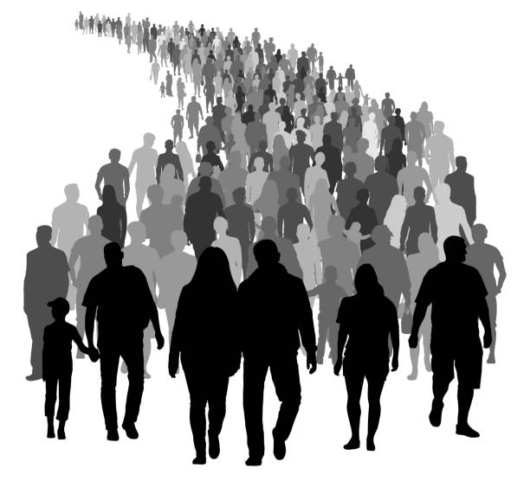
We Are more than our name.
  All Ages
  All Disabilities
  All Stages Of Life.
6

Slide 7
Assistive Technology
Q: What is Assistive Technology (AT)
A: Assistive Technology is any item, piece of equipment, or product system, whether acquired commercially off the shelf, modified, or customized, that is used to increase, maintain, or improve functional capabilities of individuals with disabilities.
Defined by Assistive Technology Act of 2004

Slide 8
Assistive technology
Services
EVALUATIONS
DEMONSTRATIONS
TRAINING
TRIALS
MAINTENANCE
INSTALLATION
PURCHASE POINT
LOANS/LENDING
GROUP TRAINING/ONE ON ONE TRAINING

Slide 9
Assistive technology categories
Computer Access
Smart Home
Vision & Hearing
Speech/Language
Independent living
Environmental Control
Education/Learning/Cognitive & Development
Recreation, Sports & Leisure
These can sometimes be called other header names but traditionally all AT Centers and partners will offer technology in these categories.

Slide 10
Who? What? When? Where? why?
Why would you request an at evaluation?
  When you have an individual who needs assistance in gaining independence. This can be in the home, workplace, community or just about anywhere else.
What would you get from an AT Evaluation?
  The team and individual will receive a thorough report of any tools and technology that the individual might use to increase their capability, overcome a disability and remove a barrier to independence.
When can you have an AT Evaluation done?
  While we see changes in technology regularly within our field, we generally recommend when there is a change in level of need, living arrangements/place, or change in vocation setting. You can also seek an AT Evaluation when you hear of new technology that might be beneficial to you.
Where can you have an AT Evaluation done?
  In your home, in your workplace, in your community, and in your programs.
Who would benefit from an AT Evaluation?
  Pretty much EVERYONE can gain something from an AT Evaluation.

Slide 11
How to request an
Assistive Technology
Evaluation
There are three steps to getting an AT evaluation.
PRAT Approval. Case Managers apply for this for their individuals.
One Time Approval. Providers will need a CSA/VSA to provide the service.
Find an Assistive Technology Specialist.
We will do the rest. It's as easy as 1 – 2 – 3....

Slide 12
Using
Assistive technology can and should be an ongoing process.
As technology improves or adapts, we find new ways for consumers to increase their functional capabilities.
Sometimes an accommodation we suggest might not be the one that works perfectly.
Adjustments can be made or new technology can be put in place to remove the barrier that an individual is facing.

Slide 13
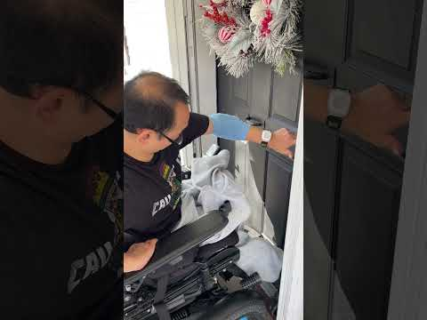
INSPIRING SUCCESS STORIES
Sung Bin lives with his wife, Kelly, in their one level home.
Both are consumers of DDS in the North Region.
Both are wheelchair users.
Bin says he and Kelly are pretty tech savvy.
Bin received an AT assessment in December 2021.
With the first round of NOO ARPA funds, Bin was approved for all the technology recommended following the AT assessment.
Total award $11, 341.90
Technology installed included Smart Microwave, Smart Thermostats (5), Ring Doorbell, Ring Solar Lights (2), Apple iPad, Amazon Alexa Device, Voice Activated Smart Lights, Smart Door Locks and more.
Watch this short video of Bin opening his front door independently.
13

Slide 14
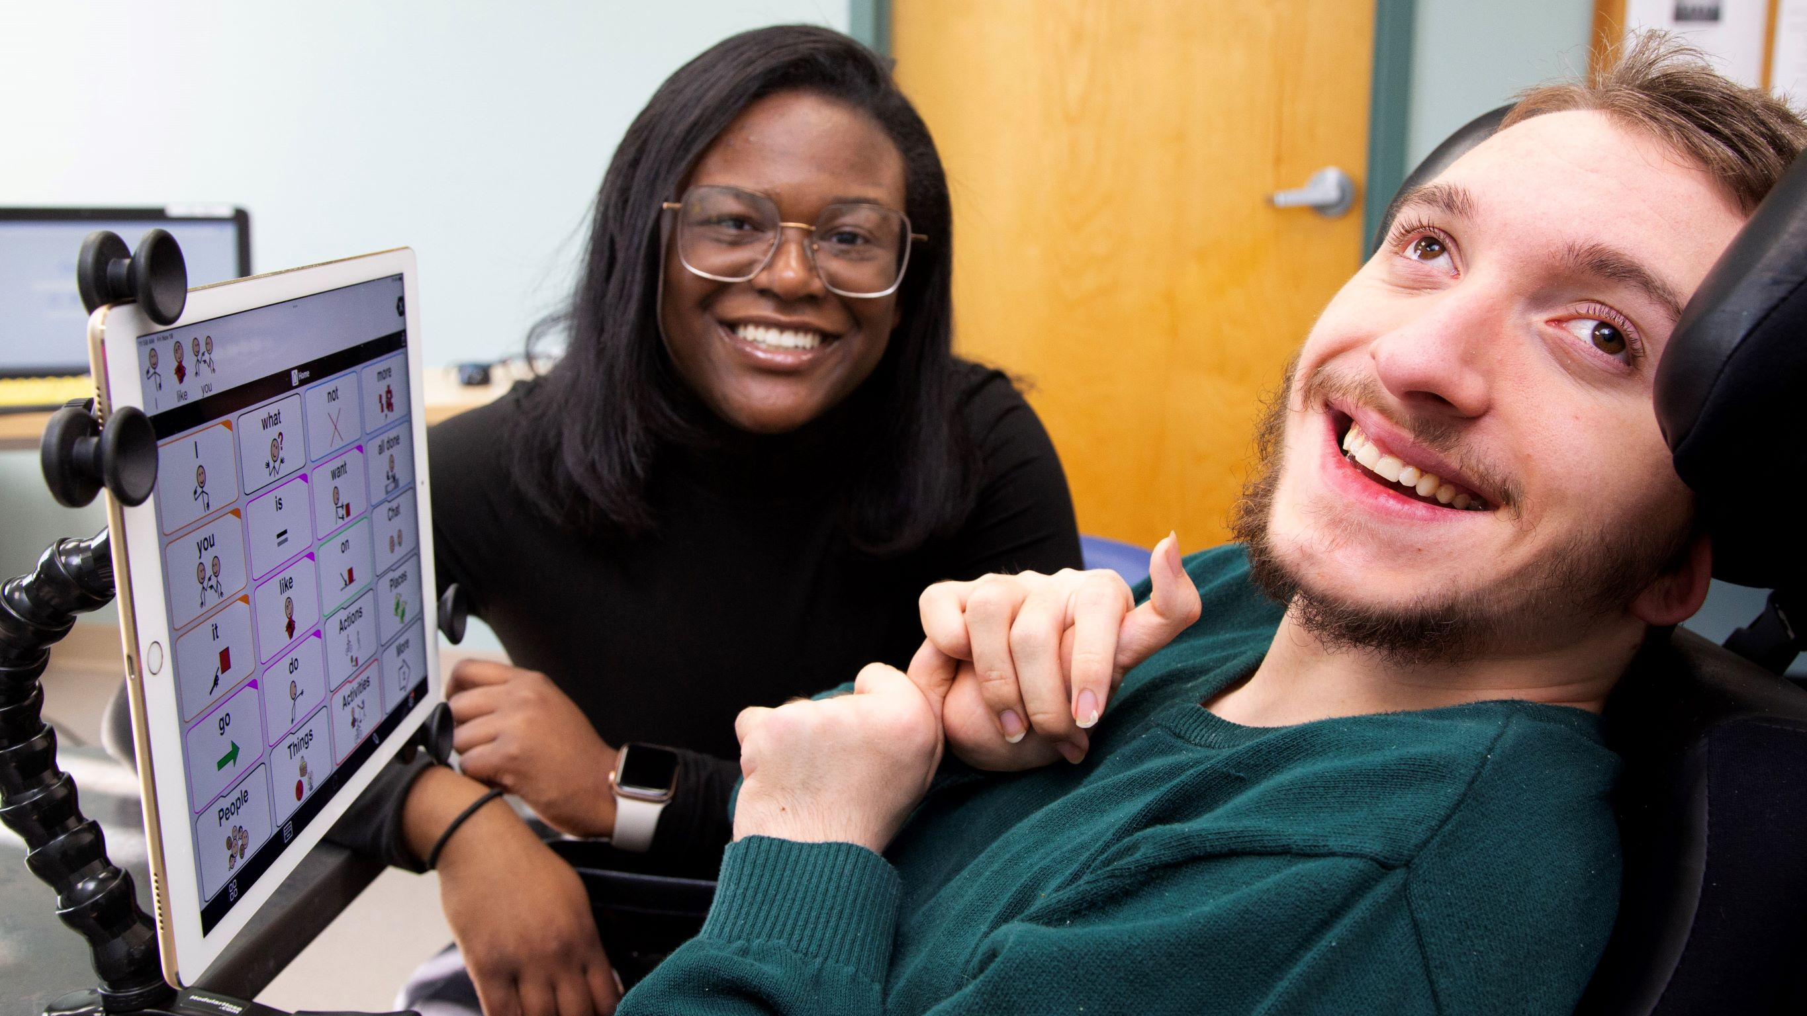
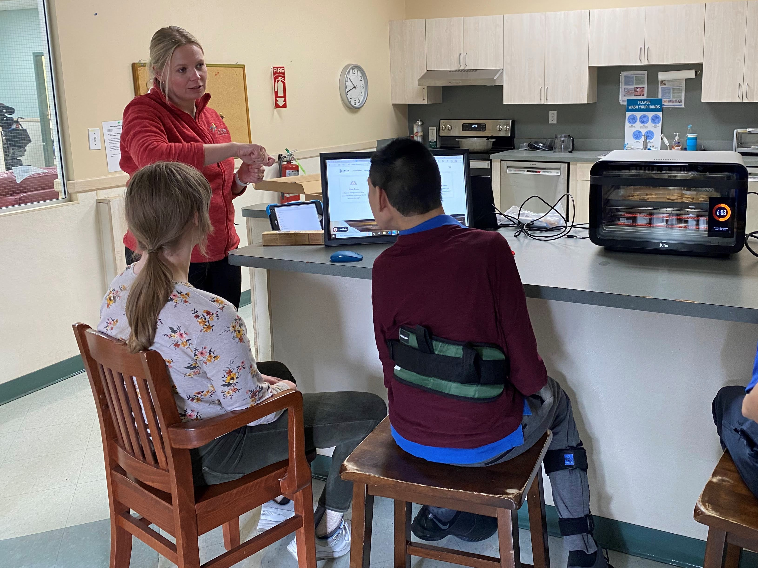
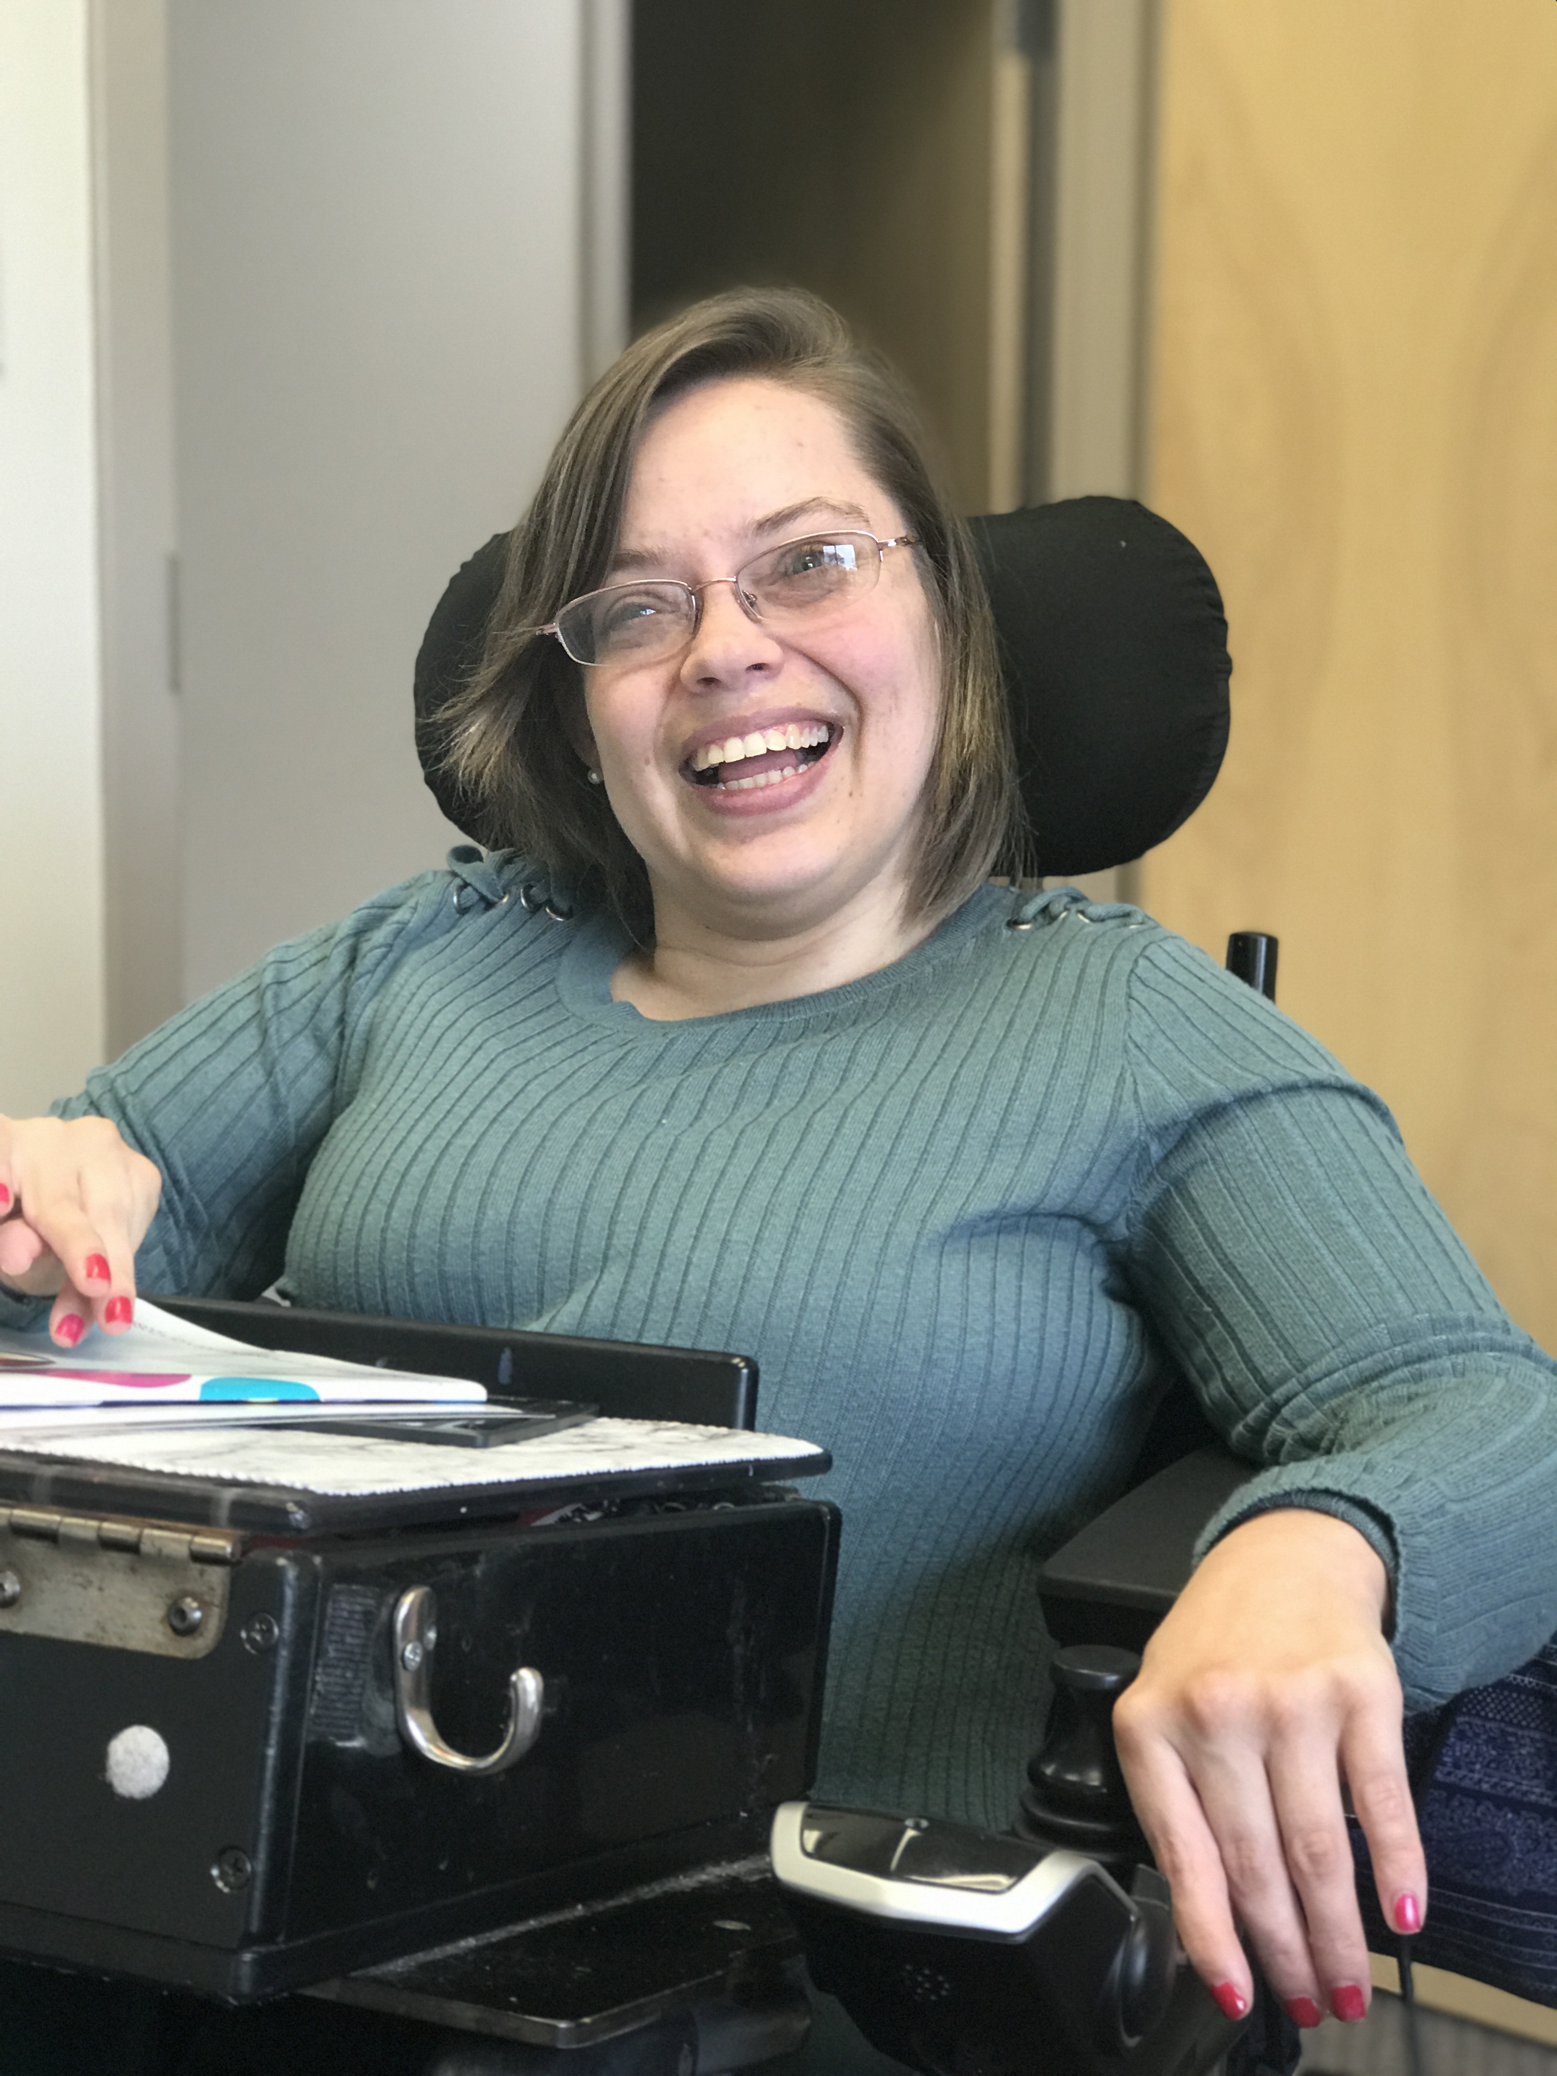
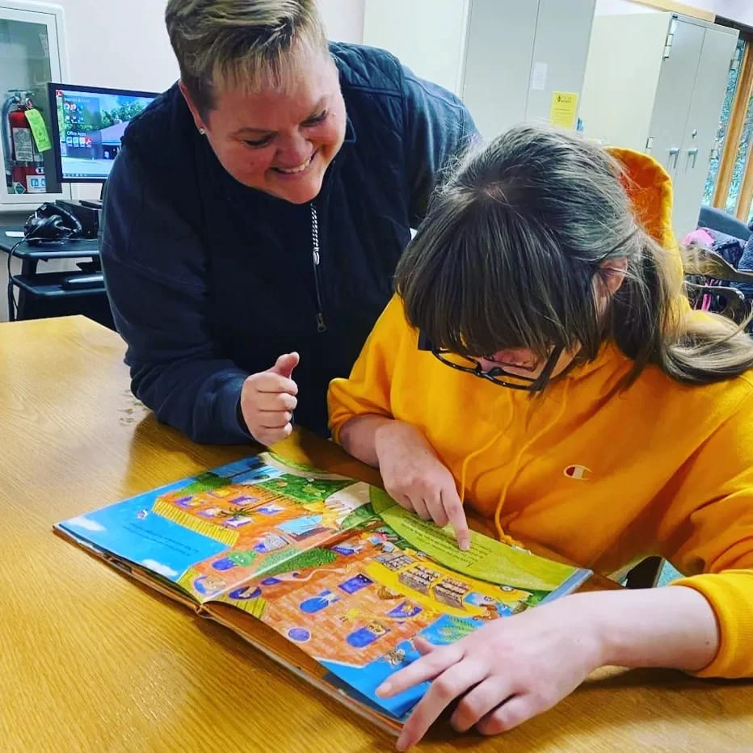
Offering the best service and the most appropriate tools is our passion.

Slide 15
Do you have more questions?
Are you interested in taking a tour of our
AT Center?
Great! Call us! We could talk about AT for hours. No, seriously, you should thank whoever limited our time today. We could have kept going, and going, and going. We hope to hear from you soon!
Shannon Taber, ATS, CLIPP
UCP of Eastern CT
860-288-9519
Staber@ucpect.org

Slide 16
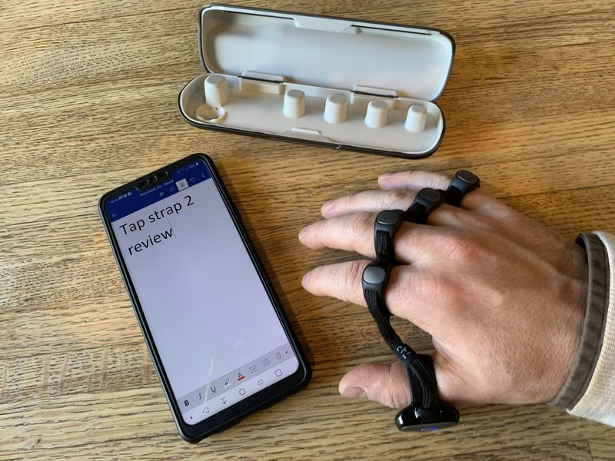
Amazing technology that is trending right now
Notes:
All in one super controller. Wearable keyboard. Simply tap your fingers on any surface or wave your fingers in mid air. This plug and play keyboard, mouse and air gesture controller.

Slide 17
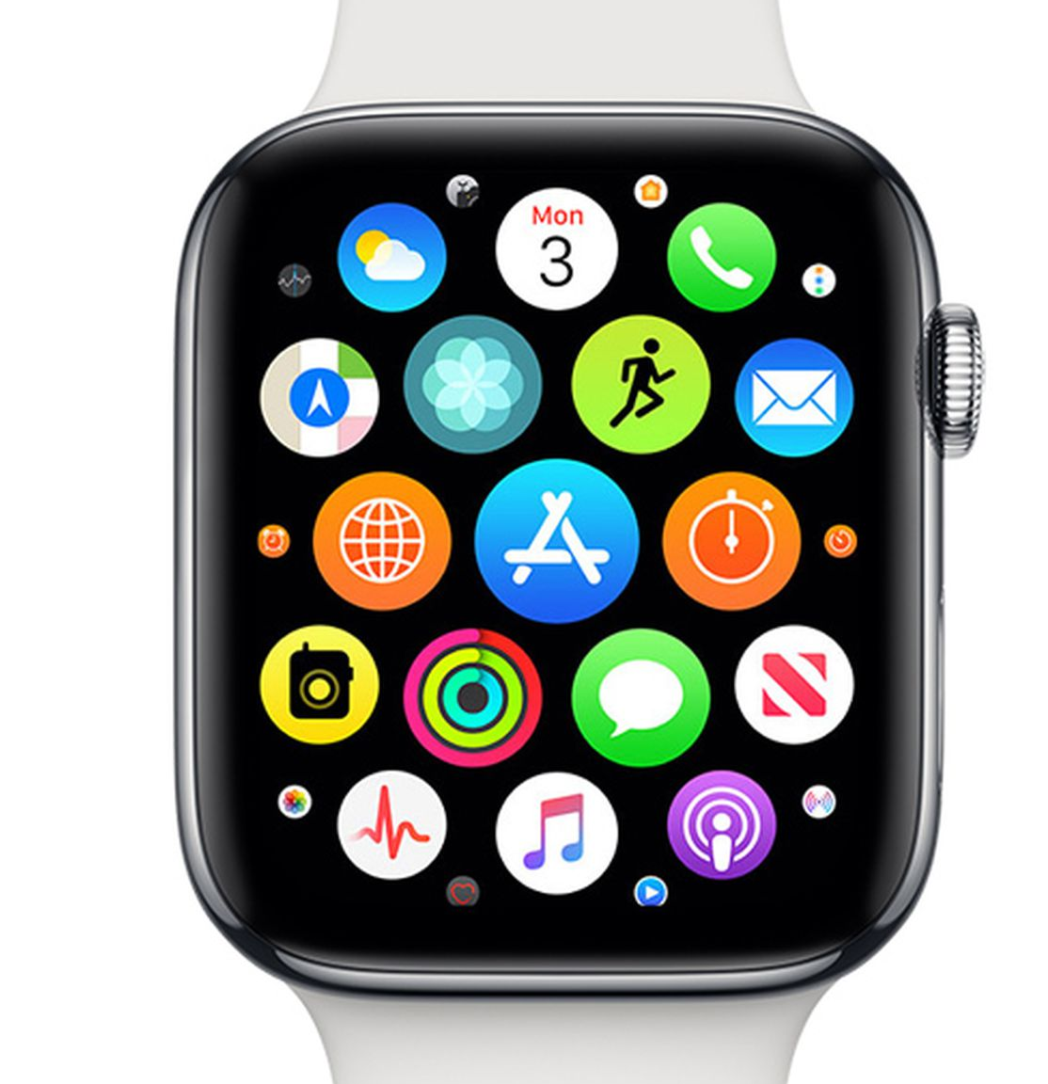
Wearable Technology
It can be used for
Time management
Schedules and reminders
Anxiety and stress relief
Walkie Talkies (apple)
Alerts and notifications
Directions
Weather
Water reminders
Location (GPS)
Steps
And
So much more.
Notes:
Wearable technology is a category of tech gadgets like smart watches, rings, smart clothing, head-mounted displays, and medical tech that makes your life easier by plugging in fitness, convenience, and your lifestyle to the world. It is a widely used accommodation for work environments.

Slide 18

ORCAM READER
For people with mild low vision, reading fatigue, reading difficulties including dyslexia, and for anyone who consumes large amounts of text.
OrCam Read is a first-of-its-kind handheld device with a smart camera that seamlessly reads text from any printed surface or digital screen.
Enjoy the morning paper, read any book, and even read all that appears on your computer or smartphone screen.
Notes:
Price tag?
Reader is $1800

Slide 19
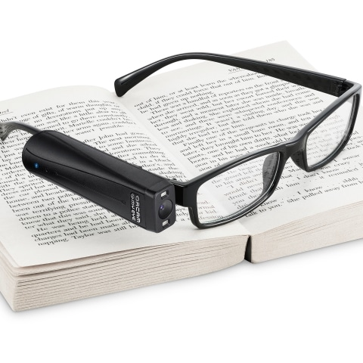
OrCam MyEye
A revolutionary voice activated device that attaches to virtually any glasses. It can instantly read to you text from a book, smartphone screen or any other surface, recognize faces, help you shop on your own, work more efficiently, and live a more independent life!
OrCam MyEye conveys visual information audibly, in real-time and offline..

Slide 20
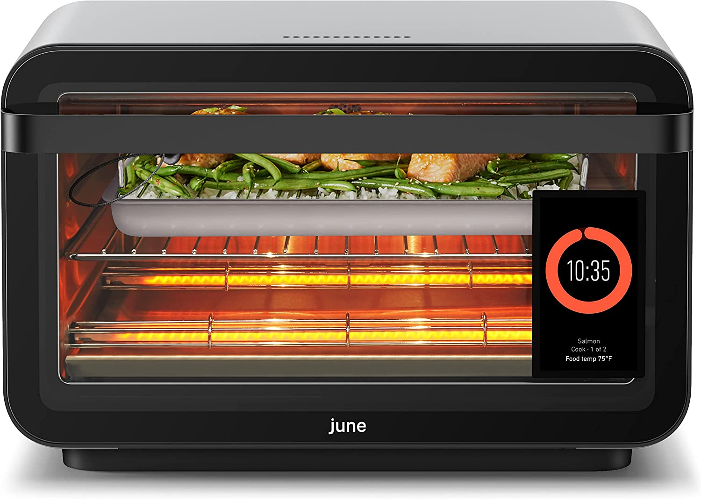
June Oven
It can be used for
Toasting, grilling, roasting, rotisserie, pizza, broiling, air fryer-ing, dehydrating and slow cooking...
But wait, there's more
It has food identification to help you know just how long to cook your food for and at what temp.
It will alert you when your food is almost done.
You can see what you cooked yesterday and the day before and the day before that too.
The outside of the oven doesn’t get hot so it's not a hazard.
There's seriously so much more.
Notes:
Wearable technology is a category of tech gadgets like smart watches, rings, smart clothing, head-mounted displays, and medical tech that makes your life easier by plugging in fitness, convenience, and your lifestyle to the world. It is a widely used accommodation for work environments.

Slide 21
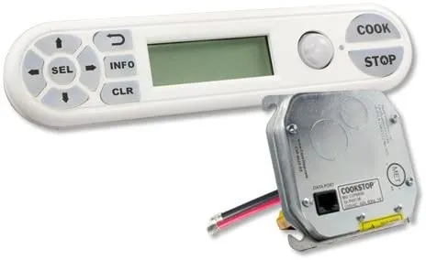
CookStop
​
This fantastic device will automatically turn off the stove if it is left unattended for a specific period of time.
It's especially helpful for our individuals who might get distracted or who are forgetful.
Smoke alarms and sprinklers are super important but they don’t really help until the fire has already started. With this device, you can prevent fires from happening in the first place.
Notes:
Wearable technology is a category of tech gadgets like smart watches, rings, smart clothing, head-mounted displays, and medical tech that makes your life easier by plugging in fitness, convenience, and your lifestyle to the world. It is a widely used accommodation for work environments.

Slide 22
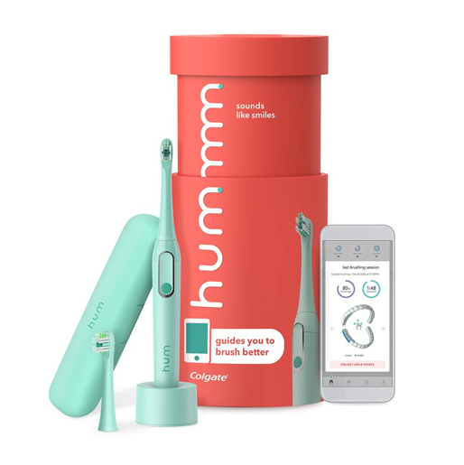
Hummm by Colgate
Dental health is no joke and its often the last thought of medical need.
This toothbrush uses a timer and alerts you when you have brushed one area long enough.
It connects to an app on a smart device to show you where you brushed, where you missed and where you might need to brush longer.
It also reminds you when it's time to change the toothbrush head.
Notes:
Wearable technology is a category of tech gadgets like smart watches, rings, smart clothing, head-mounted displays, and medical tech that makes your life easier by plugging in fitness, convenience, and your lifestyle to the world. It is a widely used accommodation for work environments.

