Slide 1
The Road to Integrated Supports
Regional Road Trips December2014 through March 2015

Slide 2
Agenda
Welcome and Logistics 9:00-9:10
Where we have come from 9:10-9:20
Where we are going 9:20-9:30
Community of Practice 9:30-10:30
BREAK 10:30-10:45
Mentor Project 10:45-11:30
Creating Blue Space 11:30-12:30
Reimagining Quality 12:30-1:00
LUNCH 1:00-2:00
Walk About 2:00-2:30
Making it work with the Waiver 2:30-3:30
Questions 3:30-4:00

Slide 3

Notes:
Before we can understand where we are going we need to understand where we came from.

Slide 4
CT Service System-Where we come from
Institutional Care
  Mansfield Training School opened in1917and was closed in 1993.
  Southbury Training School
    Messier Agreement
Managed Care
  Private Group Home Movement in the 80’s
Person Centered Supports
  Systems Change Grant from Robert Wood Johnson Foundation awarded on 2/1/1997.
  Birth of Self Determination

Slide 5




Evolution of Supports & Services
Family
Supports and
Self Directed Services
Community Providers
Community
Providers
1st
Generation of services
DDS the primary provider of supports
2cd
Generation of Services
DDS and Private Agencies Providing Services
3rd
Generation of SUPPORTS
DDS
Private Agencies
Family Supports
Notes:
It is important to note that the values and principles of self determination and accompanying self direction service models are a reflection of society’s changing beliefs about how people with disabilities should be supported and are not just an isolated viewpoint of DDS. Elder services, children's services, educational services, mental health services, etc. all now strive to base their services on the principles of self determination and attempt to incorporate some type of self direction design features into service delivery options.
DDS has been developing new ways to help our consumers to have more control over the funds they receive since the early 1980’s. We thank all of the pioneers who have helped teach us how to do this well.
The initiatives we are involved in now are just an extension of the path that we as a state have been on for decades.

Slide 6


Evolution of Supports & Services
Self Determination
Families
Direct Hires
Community
Providers
Individual
Natural Supports
DDS
Notes:
Under DDS – the Waiver is one way for Supports – Supports in the community, natural supports, family, direct hires.

Slide 7
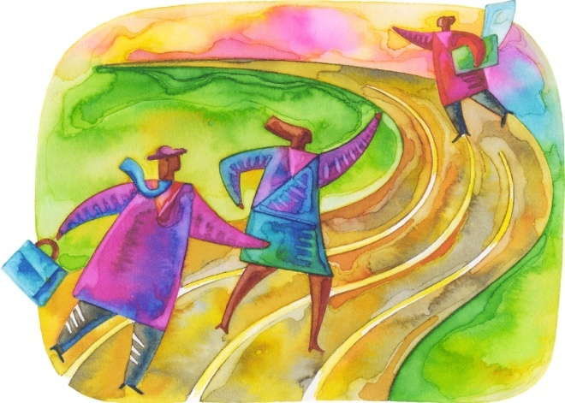
"It isn't where you came from, it's where you're going that counts."
Fitzgerald, Ella Singer (1918-1996)

Slide 8
We have Charted new Courses Before
DDS CT has a long history of being a pioneer in Human Services.
Nationally recognized as a leader on the cutting edge of improvements in our field.
We are just continuing the journey that we have been on for the past 30 years.

Slide 9


Where We are Going
Next Generation of Services.
Citizen Centered Integrative Community Supports.
It is not enough to be physically “in” the community. Everyone deserves to be a contributing member of their community.

Slide 10
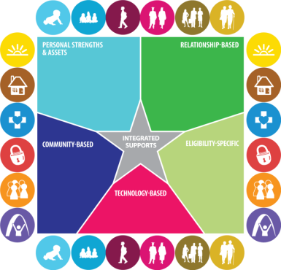
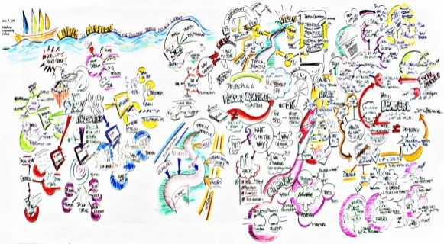
DDS Initiatives to Support Individuals live a ridiculously good life.
Community of Practice: Vision & Infrastructure
Mentor Project: Leadership
Reimagining and Reinventing Quality in Connecticut: Accountability
WHAT we want to accomplish
WHO will lead the charge
HOW we will measure our success
WHY- Because it’s the right thing to do!
WHEN- Now!

Slide 11

3rd Generation Vision of Supports
A New Way to help people have a GOOD LIFE!

Slide 12

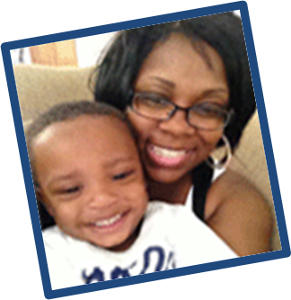
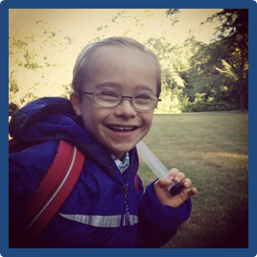

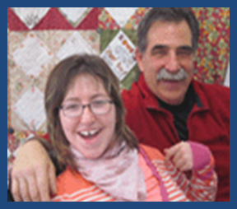
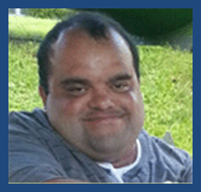
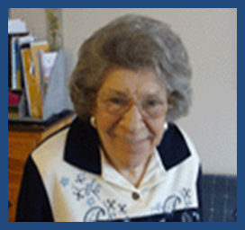
Building a National Agenda for Supporting Families
with a Member with Intellectual and Developmental Disabilities

Slide 13
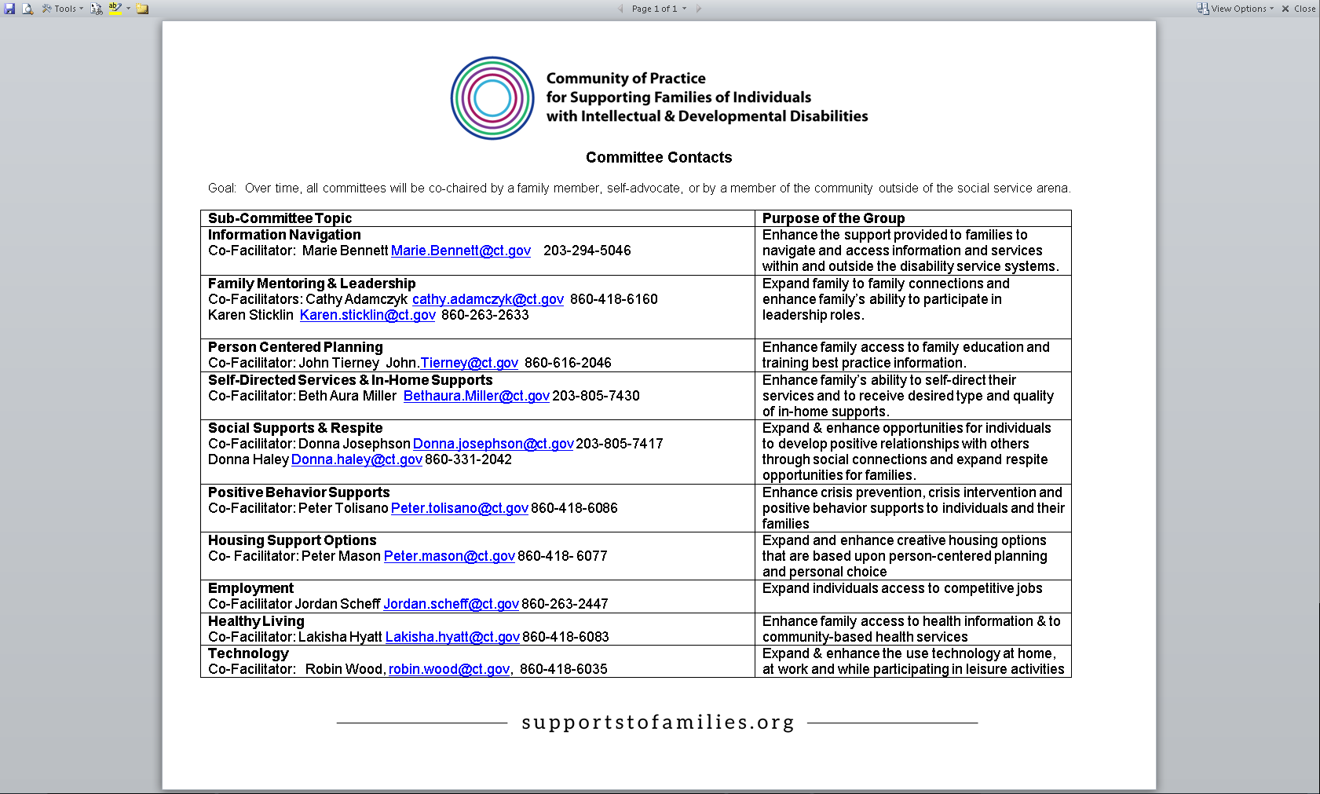

Slide 14







What We’ve Learned Through the
Supporting Families Community of Practice
LEARNING | BARRIERS | What we hope will change…
Life Course Principles Helping families build upon life stages is more effective then waiting for people to arrive at the door of adult services | IDD services are not as effective or efficient as they can be when provided in a silo, or when services are separated from previous developmental stages | Staffing: Partnering with practitioners from each life stage reduces duplication of services & helps lead to better outcomes for people with IDD. Appropriate support is available at each life stage.
A LIFESPAN APPROACH

Slide 15
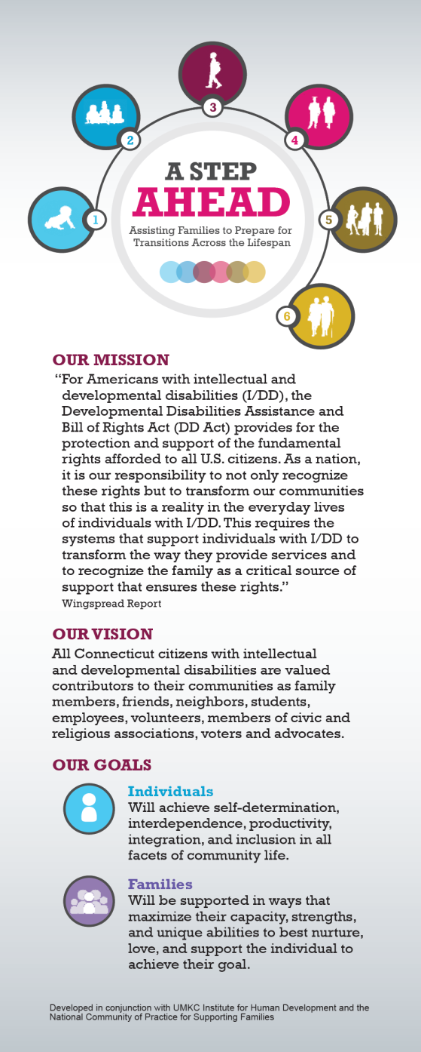
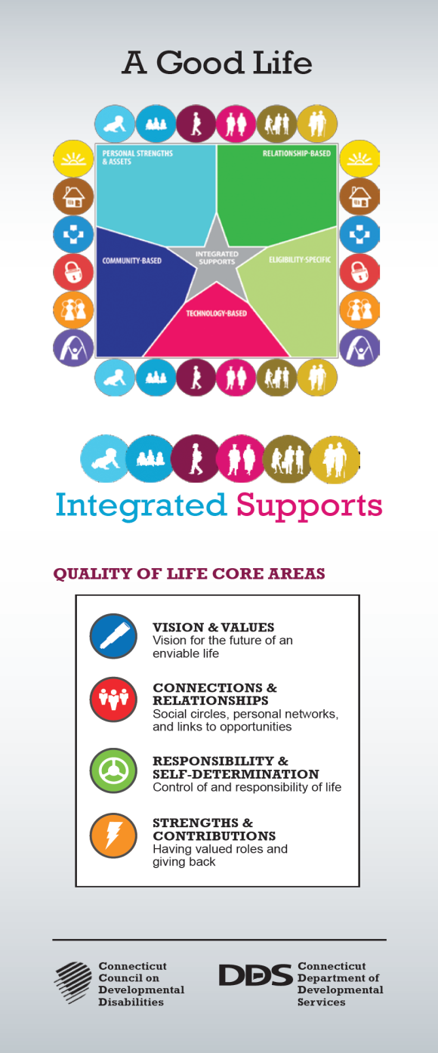

Slide 16


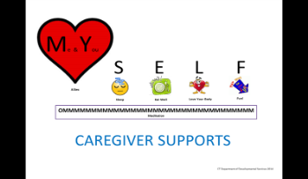
What We’ve Learned Through the
Supporting Families Community of Practice
LEARNING | BARRIERS | What we hope will change…
Individuals and Families We have to plan with BOTH individuals and families | Focusing JUST on the individual limits can be isolating | Person-centered planning is used to support families and build circles of support across the lifespan
Family Engagement Families benefit from collaborations with other families | Isolated families result in increased needs over-time | Funding for family networking, mentoring, training and care-giving supports are available to assist families to be resilient and to support new ideas
Caring For and Caring About “Caring about” people with IDD is the responsibility of all. It is not just a family concern. | Separating “caring about” and “caring for” increases the probability of abuse & neglect | The Community of Practice concepts are infused in all aspects of the agency’s operations. This will require shifting of resources and flexible funding practices.
FAMILIES MATTER!

Slide 17
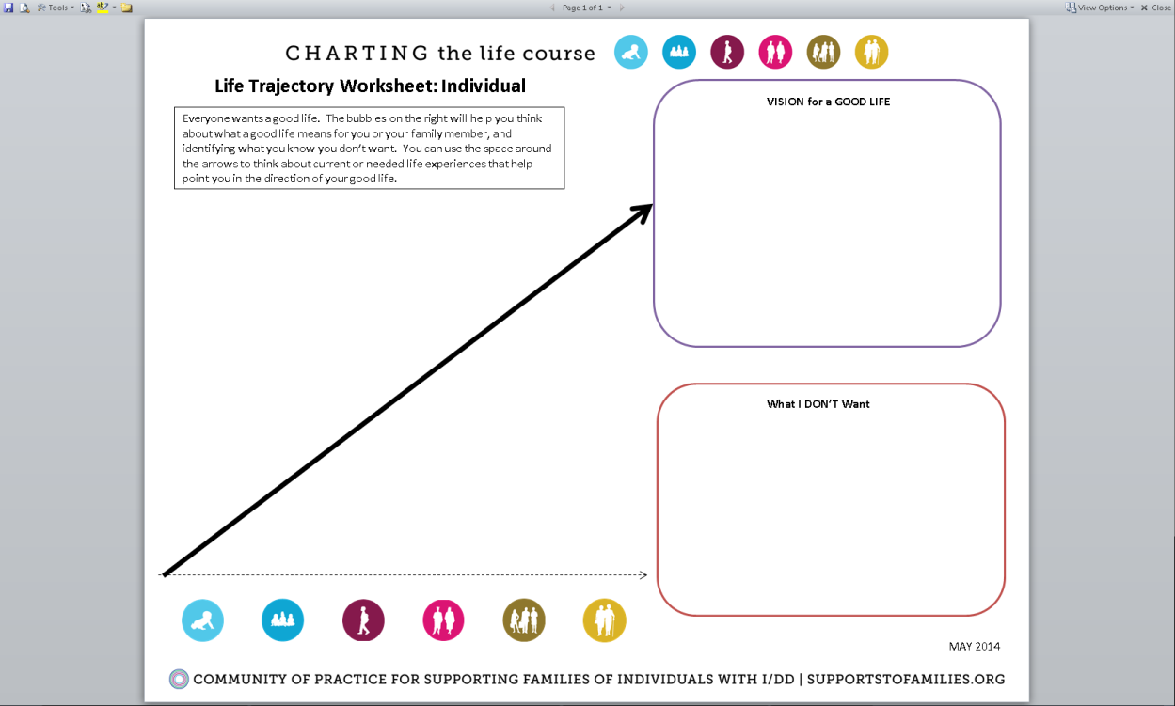

Person-Centered Vision of the Future
Family-Centered Vision of the Future

Slide 18
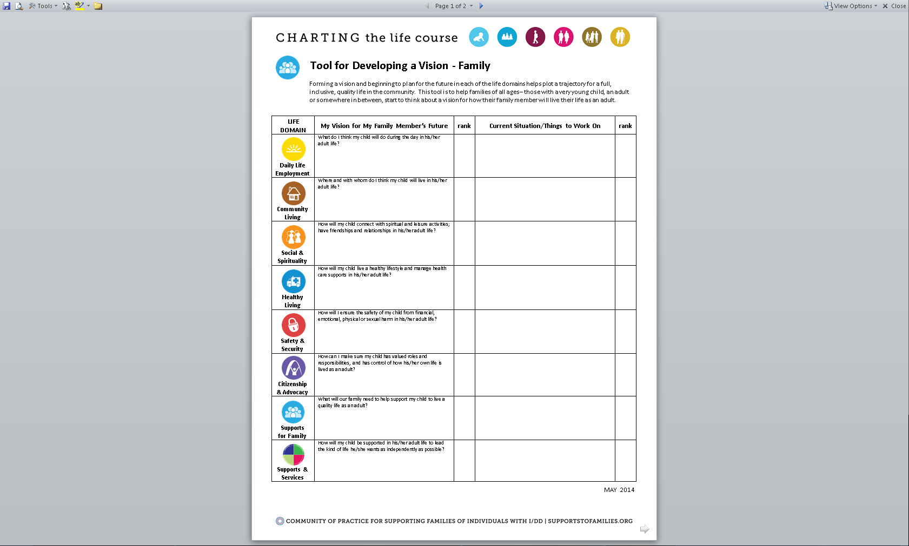

Slide 19
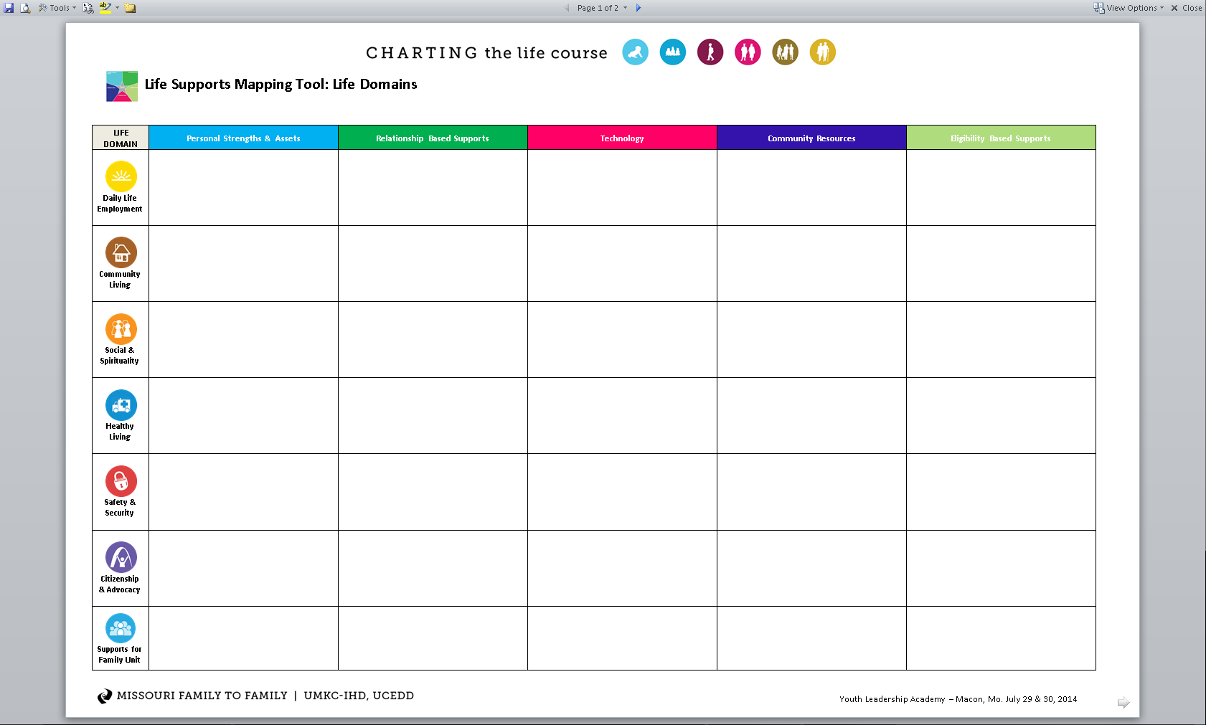

Slide 20

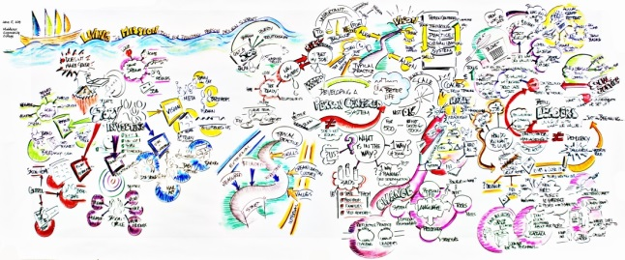
What We’ve Learned Through the
Supporting Families Community of Practice
LEARNING | BARRIERS | What we hope will change…
Organizational Design New infrastructure is needed to support the Integrated Services Model of Supports | It’s hard to let go of “What is” | More “Blue Space” innovation opportunities (pilots/prototypes) will evolve to help management re-think what systems need to change
Waiver Assurances Waivers can help and can hinder depending on how they are perceived. | There are many “myths” about what the waivers allow and don’t allow | Waiver amendments may need to be amended to allow for new models of services to be implemented.
Quality Assurance Quality practices need to keep paces with societal changes. | Current quality measures and designs are based on second generational services. | Quality assurance best practices need to be created for the third generation network model of supports.
LEADERSHIP IS CRITICAL

Slide 21



What We’ve Learned Through the
Supporting Families Community of Practice
LEARNING | BARRIERS | What we hope will change…
System Change Learning takes time | We are moving into a new generation of services. It is hard to let go of the familiar. | Partnerships: Stakeholders move from fear-based responses to hope-based action planning
Communication! | Moving from a provider system of support to a integrated system of support is a whole new way of thinking and doing business. | Networking Tools: Legal, IT, and other decision-makers become less risk averse and social media tools and other networking resources are made more available and accessible
Community Engagement & Reciprocal Contribution | DDS stakeholders often ask for help from the community without showing how reciprocal contributions will occur. | Training: Stakeholders learn the art & science of “crossing thresholds” and develop community partnerships based upon equality & mutual reward
COMMUNITY IS KEY

Slide 22
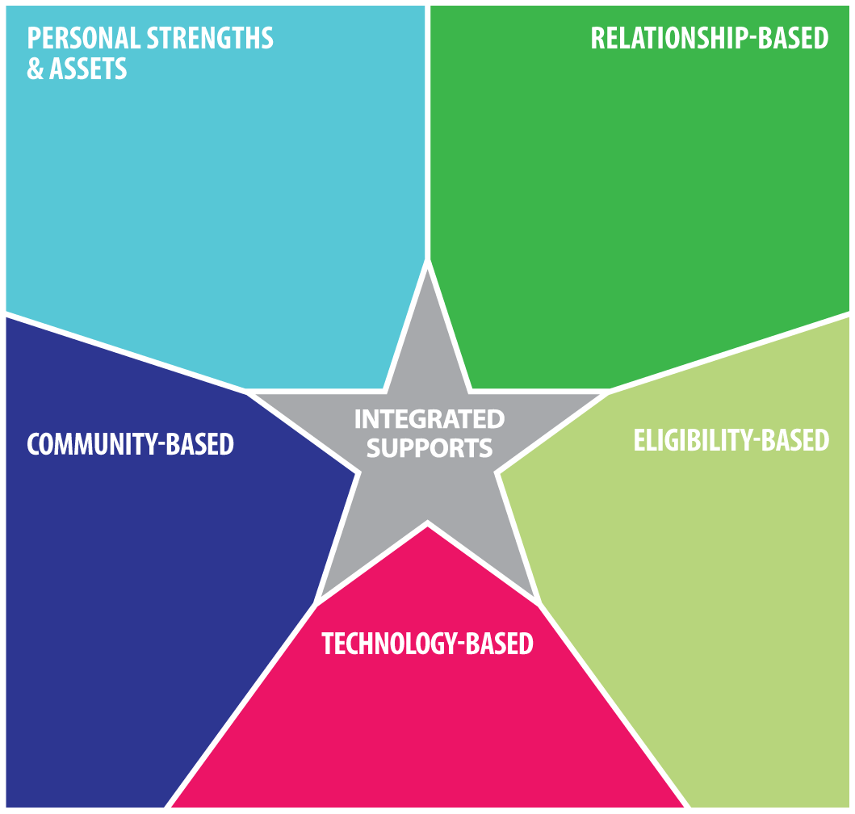
Ways You can support
Learn about Community of Practice committees.
Participate on a committee.
Help teams think through the aspects of building integrative services that lead to a good life for individuals.

Slide 23
BREAK

Slide 24
Mentor Project
Was an outgrowth of a Community of Practice Brainstorming Day.
  Realized that in order to achieve the vision and goals of a new generation of services we needed to provide a supported way for Providers and DDS to shift their agency culture to align with it more fully.
  January 2013 conversations began with DDS Leadership.
  Enlisted the support of three nationally recognized system change mentors who have done this work with providers in other states.
Notes:
Pat present this section

Slide 25
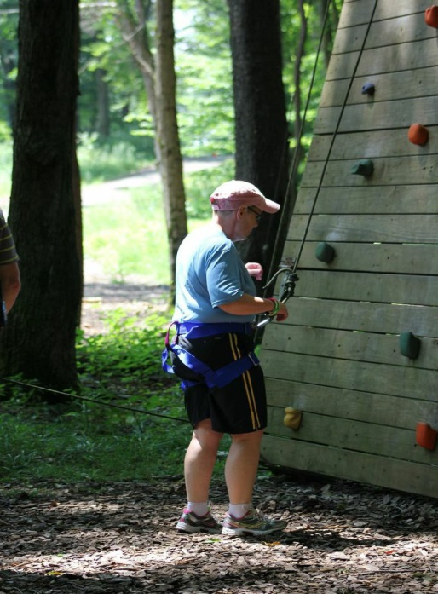
Every Journey starts with a Decision
Beginnings
Are Exciting
  Opportunity to accomplish something new
Are Scary
  Old Baggage
  Fears of unknown
  Mental Limits
Have a path, but they are not always clear and linear
Are supported
Start with a decision to take the first step and keep going

Slide 26
Mentor Project beginning
June 17, 2013
  All Providers and DDS Leadership invited to attend a Kick Off training Day.
  Discussed the importance of investing in each person’s STORY.
  Need to develop a PERSON CENTERED SYSTEM.
  The Internal and External Pressures we will face.
  The importance of LEADERSHIP to navigate the path ahead.
Notes:
Not a One and Done
Really wanted to make transformational change
Commitment from all levels of DDS and Providers
Enlisted Providers as are partners to get there.

Slide 27

Notes:
Invested in Story of the Agency-Assessment Retreats
Invested in Person Centered Strategies-2 Day Trainings with participation of CM and RM
Invested in Leadership-leadership Institute

Slide 28
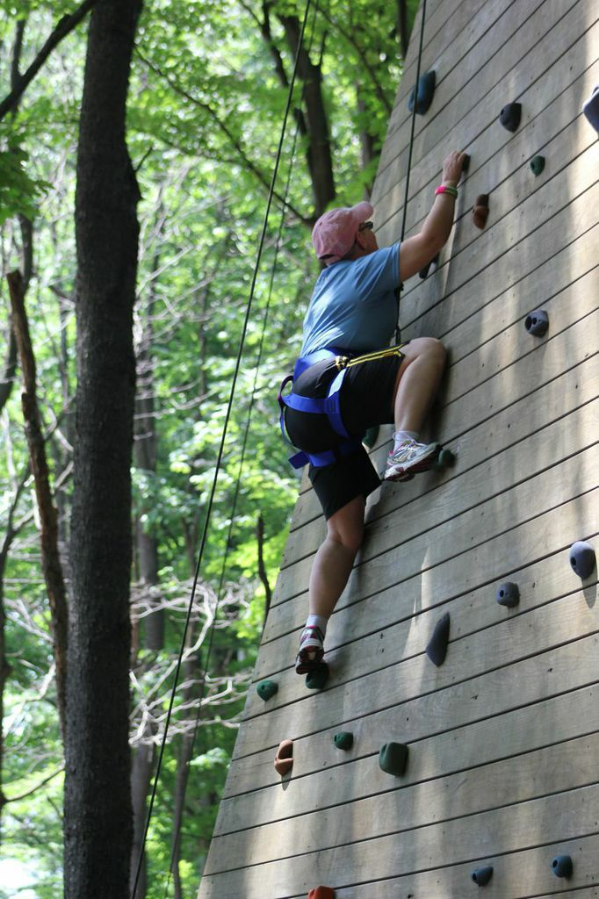
NEXT STEPS
A group of provider Representatives and DDS staff gathered to lay out the goals and expectations and develop an APPLICATION PROCESS for Providers to participate in this project.
All agreed that there needed to be commitment from all areas of the agency from the individuals they support to the Board that governs them.

Slide 29
The Commitments
On-going participation at all levels of the agency in mentor activities (For a year with an option for longer if deemed appropriate).
Participate in on-going discussion groups quarterly, or more frequently if mutually agreed upon.
Participate in Video Conferencing or Webinars if mutually agreed upon.
Participate in Community Learning activities and present at Leadership Forums to share knowledge and learning.
• Assign staff to coordinate and lead agency involvement
• Mentor other providers as a result of the experience.
• Demonstrate how agency will look different 1, 3, 5, and 10
years from now because of participation in this process.

Slide 30
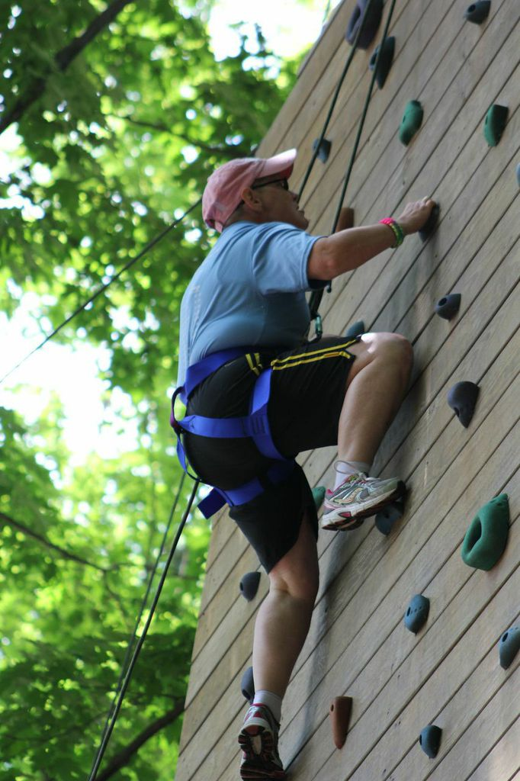
Keep Moving
Application and Commitment Letter developed by the committee was sent to all qualified providers for consideration and submission.
Submission deadline was October 1, 2013.
All applicants were reviewed by a separate panel and eight agencies were selected to participate.

Slide 31
The Mentor Project Participants
ARC of MERIDEN WALLINGFORD
ARC of NEW LONDON
CONNECTICUT INSTITUTE FOR THE BLIND (OAKHILL)
EDUCATION CONNECTION
JOURNEY FOUND
HORIZONS PROGRAMS
MARRAKECH
VINFEN
Notes:
Representative of our Provider Community in Connecticut
Large providers, Small Providers, Union Providers, Non-union providers, long standing providers and Brand new Providers.

Slide 32
First Year Activities
Agency Assessments
  Each agency is starting at a different place and will need mentor support in different areas to shift their culture to support integrative supports.
Person Centered Thinking Trainings
  With participation of DDS Case Management and Resource Management.
Agency Specific plans for follow-up developed
Lead mentors assigned to each agency
Leadership Institute
Notes:
Needed to know where starting-every agency different
Needed to invest time into learning their story.
Needed to invest in skill building around person centered planning strategies.
Investment of resources to develop leaders.

Slide 33
Mentor Agency Experience
Heather Latorra, MARRAKECH
Tracey Walker, JOURNEY FOUND
JodiLynn Binkley, EDUCATION CONNECTION
Notes:
STAY on this SLIDE while all three give overview of how they came to the project

Slide 34
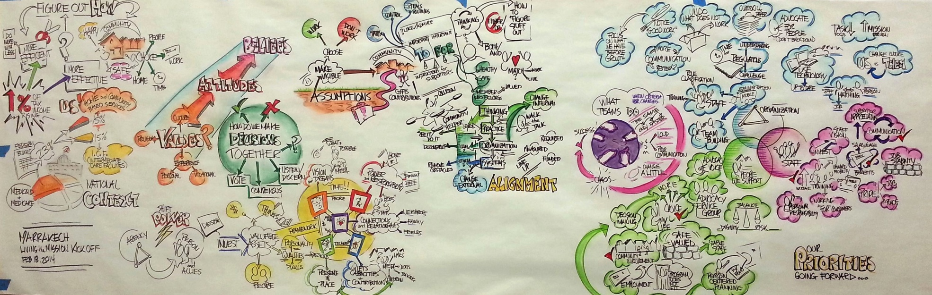
Living the Mission – Providing Person Driven Supports
Marrakech Mentor Program Highlights
Living the Mission Kickoff – February 2014
Staff, Managers, Families, Board Members, Individuals Served Developed “Our Priorities” Map
Ah Ha Moments: Shifting power from agency to individual, Civil Rights, Pockets of Greatness exist when community and technology are used, Training, “Having a Life”, personal responsibility
Agency Priorities: Community Education and Involvement – connections and relationships, Advocacy, Management Training and Empowerment – not just rules and regulations but choice, risk, values and civil rights, importance of technology and community

Slide 35
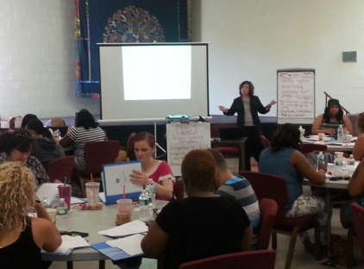
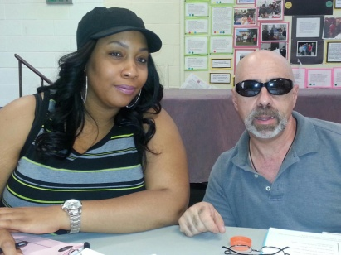

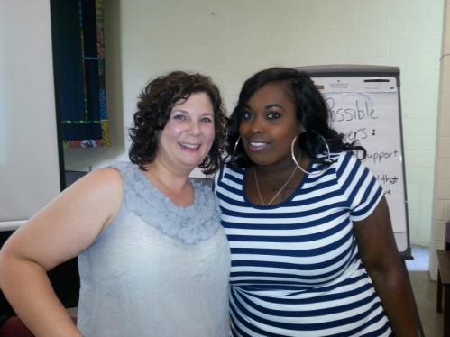
Living the Mission – Providing Person Driven Supports
Marrakech Mentor Program Highlights
May 29th Creating Blue Space Meeting with 8 Mentor Agencies, Self Advocates and DDS Leadership
Discovery: In General we agree on what the world looks like now and what our collective goals should be.
Created Agency Poster
Traditional and legacy
services combined with
innovative person centered
Support models- why and
how this evolved and how
to change direction.
June 26th and 27th Marrakech Staff, DDS Staff and Individuals Supported attended Person Centered Training.

Slide 36
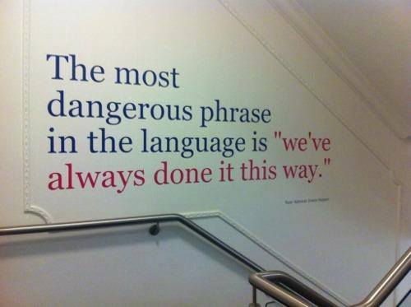
Living the Mission – Providing Person Driven Supports
Marrakech Mentor Program Highlights
July 13- July 18th
The National Leadership Consortium on Developmental Disabilities
https://www.youtube.com/watch?v=oRBchZLkQR0
Progress Made (examples):
Collaborated with region to restructure an RFP awarded CLA to smaller CRS with choices
Individual teams working on Person Centered Plans
Working with State partners to creatively develop supports, work through “lessons learned” and successes
Change Titles i.e. “Admissions”, “Person Centered Connections” –
starts conversations, what does that mean? Values discussions
no more mentality of “Admit” to Program, instead create person centered support plan
Community connections focused instead of facility focused

Slide 37
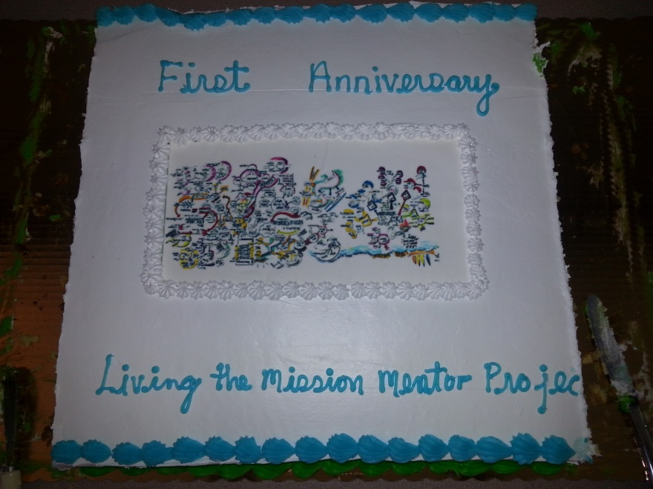

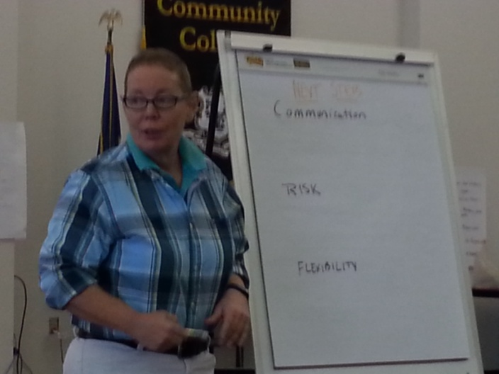
Living the Mission – Providing Person Driven Supports
Marrakech Mentor Program Highlights
Progress (Continued):
Management Meetings – changed the layout – now learning and discussion (previously focused on regulations, rules, and policies)
Problem solve, discuss individualized program models that work and don’t work
Values discussions, challenge our values and related to rights and risk
Community Connection successes and collaboration
Examine various Statewide support models (BRS, DMHAS, DDS, MFP) and share knowledge
Person Centered Planning Culture: i.e. Important To vs. Important For
MFP for ICF/ID – Started with LON rates – choice
Changed Children’s to Family Support Services so continuity in supports from 21 on at home for IHS
Work through stumbling blocks with State Partners
Living the Mission: One Year Anniversary – August 18, 2104
TO DO STILL:
List is large and ambitious however work with Pat to stay focused
Person Centered Planning Training Statewide

Slide 38

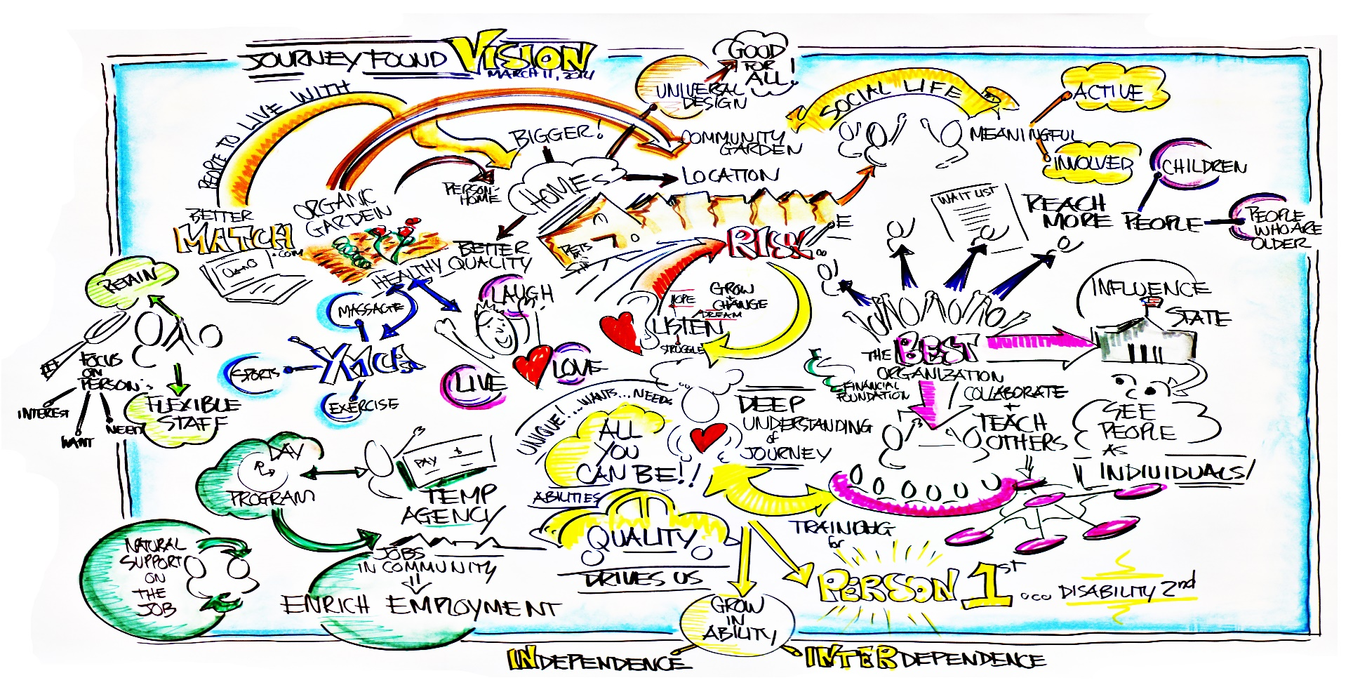
Living the Mission Assessment Retreat
March 2014
65 Attendees: Board, Managers, HR, Finance, Admin, Direct Care, People supported

Slide 39
DISCOVERIES
There was no longer a broad based understanding of our work as part of a social justice movement.
The creation of Journey Found from a larger, more hierarchical entity was the first step toward more person centered practice but the organizational healing from that shift needs to continue as an active practice.
The majority felt that most of the people we work for could be served in more person centered ways with more choice.
We didn’t understand choice as well as we thought we did when viewed from a truly human rights perspective.
The Board declared their full support of our efforts in this direction.
The language we use is important as it shapes the reality of what we do.
The system has driven the decisions for people instead of the people themselves. We listen more to each other and other professionals than the person.
We inherited a very risk aversive culture from the prior parent company in addition to having to deal with this in the general ID/DD service system.
There is wide spread dedication to the people we work for and to the organization. We have a stronger bond due to having the shared experience of becoming Journey Found.

Slide 40
What We’ve Done
Two day Person Centered Thinking Training with Michael Smull for all Managers, Assistant Managers, Directors and HR with DDS resource management and Case Management.
Created a monthly Leadership Round table that meets once a month for supervisors to share experiences and focus on leadership rather than management a cultural change needs leaders not just managers.
CEO attended the week long National Leadership Consortium on Developmental Disabilities in July 2014.
Conducted a road trip by operations team (program, director level, chief level and clinical) to New Jersey to see person centered supports in action.
Submitted our annual CQI plan to DDS with all goals written based on the assessment retreat and the person centered thinking training.
CEO submitted vision to the Board based on assessment retreat. Board accepted.
Changed approach to working with guardians, placing the person first and guardian second resulting in nurturing of a dating relationship, a trip to Disney and a change in day program.
Developed plan to change internal forms to person centered formats, change the content of IP narratives, revise all new hire training to reflect person centered concepts and add education on civil rights/social justice.
Took over a program in three hours as it was the right thing to do for the women living there.

Slide 41

EDUCATION CONNECTION
Living the Mission- Providing Person Driven Supports

Slide 42
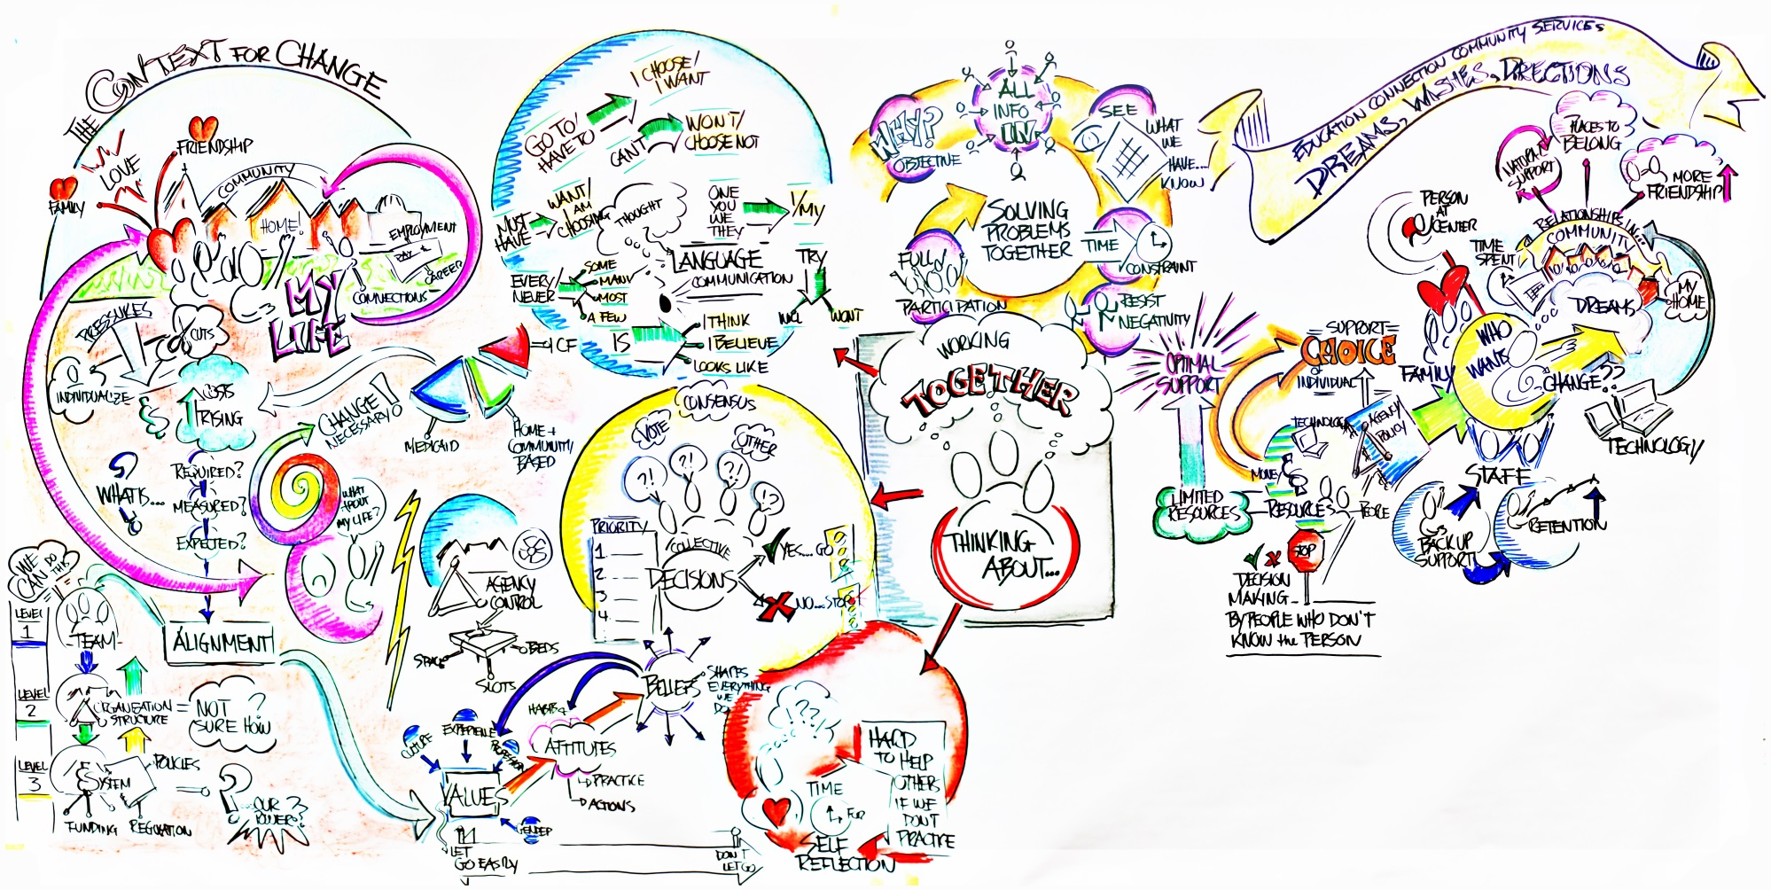
Living the Mission Kickoff
February 2014
Notes:
In attendance were Direct Support Staff, Managers, Executive Director, Director of Operations and Finance, Director of Human Resources
We put our heads together to discuss what our strengths are and where we need to make changes.

Slide 43

Ah-Ha Moments
No individual that we support sits on our Board of Directors
Lack of real choice of the individuals that we support
Language – how we use language determines what we do and how we are perceived
Notes:
Agency developed by state statute as a school district and does not allow for any one other than school superintendents on the Board.
Lack of staffing for individuals to choose from and a hiring process that does not include individuals that staff would be working with
Client, consumer, our individuals, we let them go to the store…

Slide 44
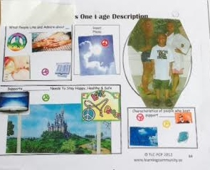
Person Centered Training
June 24-25, 2014
EDUCATION CONNECTION staff and DDS Case Managers and Case Manager Supervisors attending training.
Staff began implementing what they learned.
Began changing the hiring process.

Slide 45
Progress Made
July 13-18 Director of Community Services attended week long National Leadership Consortium on Developmental Disabilities.
Created an Advisory Council which includes manager, direct support staff, self-advocates, and other individuals we support.
Changed monthly managers’ meeting to always include time to share successes in implementing changes.
Person being supported is always included in the hiring process to the extent they choose to be.
Individuals being supported have a more fulfilling life. They have attended baseball games at Yankee Stadium, gone on dates, gone to Mystic, secured better jobs.

Slide 46
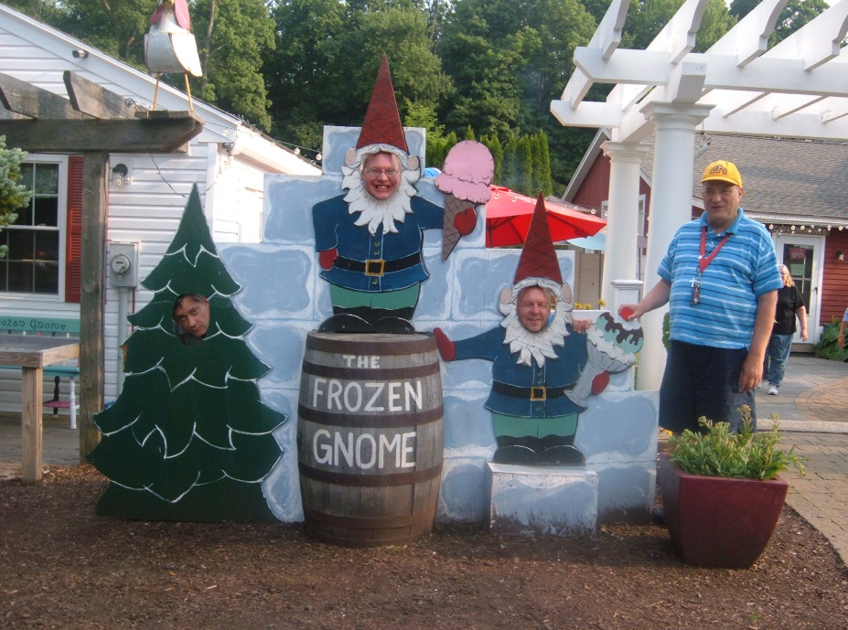
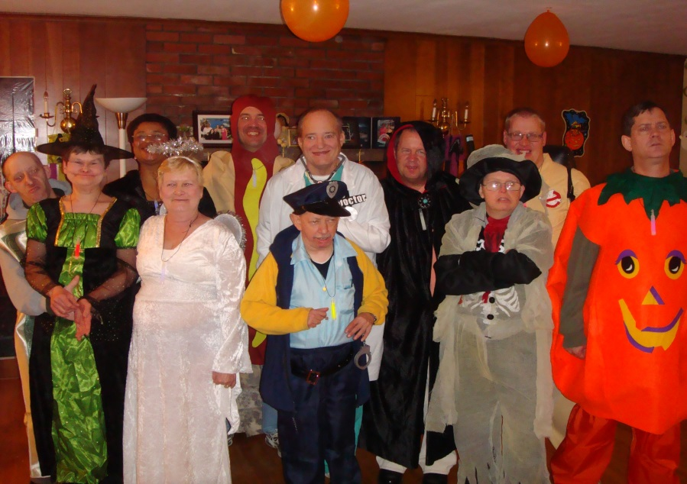
Enjoying Life

Slide 47
Creating Blue Space Days
Realized we needed to make space for conversation to foster innovation
DDS Leadership read Creating Blue Space, a book written to share One Agencies journey to transform itself to support individualized integrative supports
West Region began “Book Club” as part of Executive Team meetings to discuss what they were reading and talk about the challenges and opportunities to apply in their work.
Hanns Meisser, the author of “Creating Blue Space and Beth Mount facilitated a two day training to help DDS managers and Mentor Project providers learn new strategies to effectively support developing and expanding Individualized Support services.

Slide 48
Creating Blue Space Day
To understand the change imperative from the perspective of DDS manager and the mentor agency perspective.
To locate the emerging innovative edge of supports for persons with developmental disabilities in mentor agencies.
To gain a deeper understanding of the personal, team, organizational, and system dynamics that create competing commitments that can stall the movement towards individualized supports.
To identify experiments or small next steps designed to unlock us from our competing commitments and move us towards supporting individuals in real lives.

Slide 49
Themes from Creating Blue Space Day
Providers and DDS Leadership realized that struggles and aspirations were similar.
Appreciated the conversation and experienced new levels of partnership in the effort.
Investment at all levels
No THEM-ONLY US
Stop labeling people, not looking to FIX
ASKING WHY?
Willing to work with creative ideas
More interest than they originally thought
Community is not where you go, but WHO you know
Everyone willing to sacrifice-shift resources to benefit whole
Waiver being used as a crutch - Need to debunk waiver myths
Not size of setting-not necessarily person centered because just a few individuals.
Provider and DDS committed–Common goals and concerns
Sharing stories is important

Slide 50
Ways You can support
When an agency comes to you with an idea for innovation direct them to submit proposal to FIAT(Fast track Innovation Approval Team).
Ensure Person is the CENTER of their planning and their voice directs all activities.
Support and partner with mentor agencies in the use of person centered planning tools.
Celebrate, Document and Share success

Slide 51
Reimaging Quality
Val Bradley
  Oct 16 and 17
  Training with entire Quality Division and Provider representatives
Follow-up Small Group Discussions
  Commissioner continuing conversation with small groups of QM staff
Themes
Notes:
NEED HELP FLESHING OUT THIS SECTION

Slide 52
Performance Measures should Mirror our Values
Person-centered, individually tailored services
Self-direction and self-determination
Freedom from harm and abuse
Independence and productivity
Inclusion and community participation
Rights and respect
Transparency

Slide 53
National Core Indicators
One tool used to measure progress
Connecticut is one of 41 participating states
Data is used to partner with CMS
Data is used to drive legislation
Data is used by states to see where they are doing well and where they need to focus improvements.
Data is used to measure how states rank against national norms.

Slide 54
Where CT Meets or exceeds national norm-Taken from NCI Data
People feel safe in their homes and communities
People receive adequate preventive medical checkups
Slightly more people exercising self direction option
People get slightly more exercise
Exactly at the norm for psychotropic medications
Rights are respected (with the exception of mail opened
People get out into their communities
People report having friends
People have slightly better BMIs

Slide 55
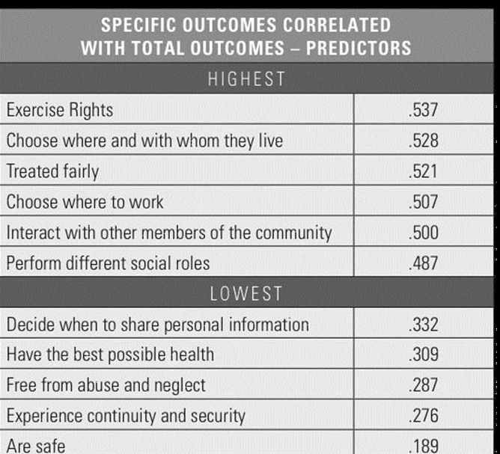
Sentinel Outcomes

Slide 56
Themes
Lowest predictors are what we emphasize must
  Look at what we measure – what questions are we asking
  Balance health and safety and personal goals - Normal life
STRUGGLE with compliance and how to juggle everything Heavy Focus on Compliance.
Build partnerships and positive peer culture

Slide 57
Ways You can support
Ask what outcomes the person wishes to achieve.
Ask what Quality means to the person.
Ensure those are incorporated into the plan.
Encourage individuals to participate in National Core Indicators interviews when invited.
Celebrate, Document and Share success.

Slide 60
As you look at the information posted consider:
GOALS: What are the goals expressed? Can you -contribute to the implementation of these goals and activities?
LEARNING MOMENTS: What are the learning moments expressed? Did any of the learning moments provide ideas on how you can live your life/or do you work differently?

Slide 61
Learning Moments
As you walked about what did you learn from the materials that you didn’t know before?
Did you have any AHA moments?
What ideas did the materials spark of how you can do your job differently?

Slide 62
BREAK

Slide 63
Busting the Waiver Myths
Before January 2014
Medicaid eligibility a must
Majority of DDS services provided under a Waiver
Maximize waiver enrollment
Current 5 waivers
Defined Supports and Services
Person centered expectation
Defined Waiver Assurances

Slide 64
Since January 2014
All the above
HCB Settings requirement
Development of the Statewide Waiver Transition Plan
Opportunity to streamline Waiver Assurances
Adding new waiver services
Waiver Amendments

Slide 65
HCB Settings Requirements and
Development of the Statewide Waiver Transition Plan
What does this mean?
Rules have not changed but how we _________
What do I have to do?
How is this connected to Community of Practice and Mentor Project?

Slide 66
Planning
Planning is the most critical aspect of the HCBS waiver.
As a case manager you play a key role in assuring that participants actively engage in the planning process, have the information they need to make decisions and understand the choices available to them.
This includes assessment, monitoring and follow-up and provide choice.

Slide 67
Qualified Providers
Agencies and workers providing services under the HCBS waiver must be qualified to provide those services.
Must have an authorization to provide those services

Slide 68
Quality Services
How we ensure compliance
Waiver assurances
Focus on the person
Focus on validating services
Weaving in the HCB setting rule

Slide 69
Ways You can support
Openness to new ideas
Suspend “Negative Voices” , ask “What resources do we need to make this happen?”
Partner with Mentor agencies and others exploring new innovative ways to provide supports.
Ensure the person being supported is the center of their planning process.
Be a partner and resource to Providers
Become active in committee work
Talk about at staff meetings

Slide 70
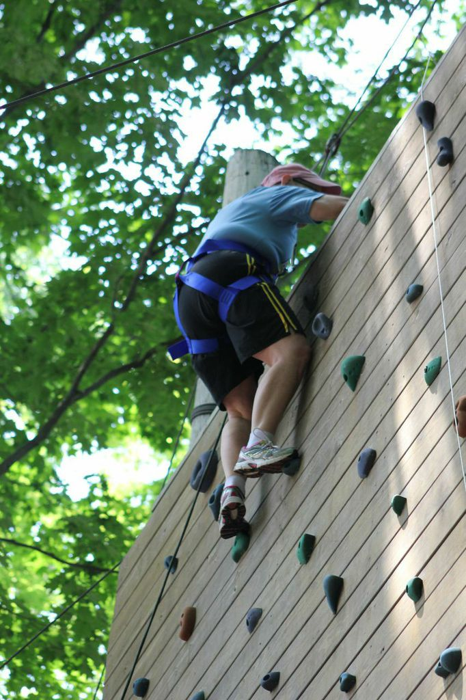
What is Success?
I decided to ignore the negative voices that said “I Can’t” and give it a try.
Asked my support team if they were ready to help me reach my goal.
Took a deep breath found the first good holds to grab and took the first step.
Continued looking for the next right step.
When I couldn’t see the next right step listened to those below who had a better more complete view of the wall.

Slide 71
Success for My Wall Climb
When I panicked and wanted to stop, I rested where I was until the courage to continue came back.
Saw the top and heard the encouragement and knew I could do it.
Experience at the TOP was an exhilaration I had never experienced before.
Exhilaration because it WAS HARD, but I KEPT GOING, DIDN’T GIVE UP and accomplished THE GOAL.

Slide 72
How will we measure progress?
Have the individuals set the goals?
Are individuals feeling supported to achieve what is important to them?
Do we know what Quality means to the person?
What supports to we need to put in place?
Are we flexible to learn from our steps and make corrections along the way?
Is the person living the life they desire, integrated into their community and have access to the same resources we all do.

Slide 73
Next Generation of Services
What we are undertaking to shift our cultures to support Individualized services so everyone can live a RIDICULOUSLY GOOD LIFE is going to take ALL of US.
The next right step will not always be visible.
We will need to be nimble to shift and adjust as we go.
We will need to encourage and support each other to celebrate the small victories and keep moving toward the big picture.
TOGETHER WE CAN DESIGN A PERSON DRIVEN SYSTEM.

