Slide 1
Defining Supports to Families
DISCOVERY AND NAVIGATION Knowledge & Skills | CONNECTING & NETWEORKING Mental Health & Self-Efficacy | GOODS & SERVICES Day-to-Day & Caregiving/Supports

Slide 2
Identifying Key Drivers and Indicators for Systems Transformation and Implementation
*Adapted from SELN Framework

Slide 3
Activities Organized in 3 Buckets
Discover & Navigation
Goods &
Services
Connecting & Networking

Slide 4
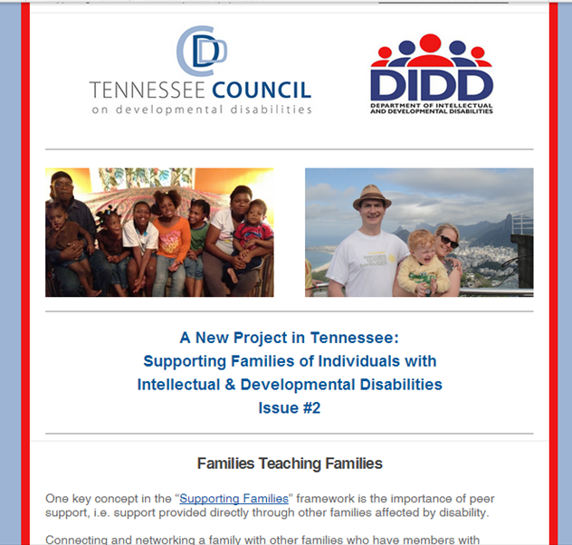
Tennessee
Communication Tools for Reframing
(e-newsletter, magazine, folder, website, social media)

Slide 5
Washington
Infused the lifecourse framework into existing “Informing Families, Building Trust” messaging efforts
Building virtual planning tool based on LifeCourse booklet

Slide 6
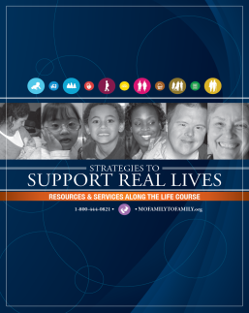
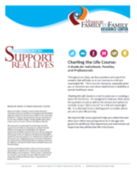
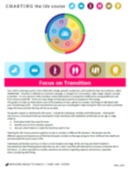
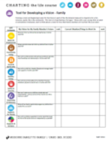
Missouri
Consistent Message Across the LifeSpan
Family to Family at Missouri UCEDD
Early Childhood, Part C
School Districts, Special Education
PNS Show Me Career Grant Pilot Sites
State Division of Developmental Disability
Special Health Care Needs

Slide 7
Peer Support Practices
Tennessee: Created sub-committee enhancing, connecting and sustaining
District of Columbia: State has contracted with P2P USA to assist in starting chapter
Washington: Adult Sibling Focus group
Connecticut: Participated in Parents with Disabilities conference
Missouri: State agency contracted with F2F HIC for seamless front door

Slide 8
Leadership Development Practices
Missouri: Partners in Policymaking and Alumna Weekend
Oklahoma: Statewide Joining Forces Family Leadership Conference and Rural Leadership Institutes
District of Columbia: Family Stipends, Advocacy Training with Georgetown
Connecticut: Facilitating bringing together Family Networks to work together on advocacy and information dissemination

Slide 9
Practices Focused on Those Served by the State Service System

Slide 10
Connecticut
Full time staff in Central office to focus on systems change to support families
Cross department life span team
Community Teams
Information Dissemination
Family Mentoring and Leadership
Training and Education
Self-Directed Services and In-Home Supports
Social Supports and Respite
Positive Behavior Supports
Person Centered Housing
Employment
Healthy Living
Technology

Slide 11
Connecticut

Slide 12
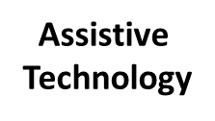
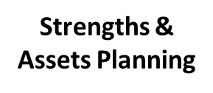
Connecticut
Eligibility
Services
DDS Services
Person Centered Planning

Slide 13
Washington
Strong leadership and partnership of state DD Council with State DD system
Recommendations made for integrating “supporting families” framework and specific services into the new states K Plan
Exploring “a family component” into already strong use of NCI data to drive systems change

Slide 14
What does K Plan: Community First Choice change
about our current system?
Current:
Future:
Entitlements (State Plan)
Other Medicaid
Entitlements (State Plan)
Other Medicaid
Institutional
Home and Community-Based
Home and Community-Based
Institutional
Home and Community-Based
Home and Community-Based
Nursing Facilities or
ICF/ID
Nursing Facilities or
ICF/ID
Medicaid Personal Care:
Personal Care
Waivers:
Personal Care
PERS
Equipment
Assistive Technology
Home Modifications
Respite
Therapies
Habilitation
Employment Support
Other
New - Community First Choice:
Personal Care
Required CFCO Services
Optional CFCO Services?
More Flexibility?
Improved outcomes
Waivers:
Will look different in some cases
May become more of a wrap-around service to CFCO?
New: A client is potentially eligible for both
Current: client is eligible for one or the other

Slide 15
District of Columbia
Currently Legacy System
Adults with Intellectual Disabilities only
Commitment to community based supports
Stalled at reforming the law
Developing new Legislation for DD Services
Budget Line Item for Supports to Families
Initiated Supporting Families Advisory Council
Connecting System Reform Initiatives Together (Employment First, Person Centered Thinking: Trained Family Facilitators, Supporting Families CoP)

Slide 16
Oklahoma
State DD System
Existing initiatives focused on person centered planning
Enhance role of case managers and intake workers to focus on support to families
Governors Blue Ribbon Task Force using LifeCourse framework to guide conversations and plan development

Slide 17
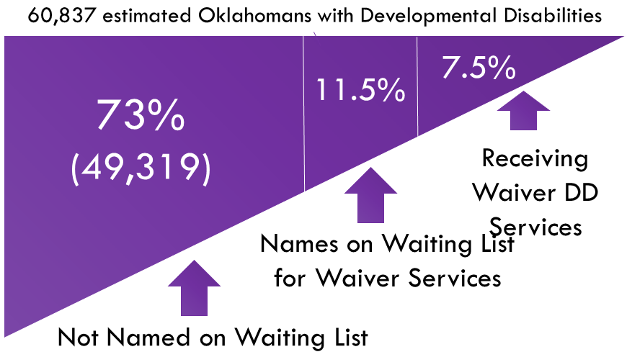
Reframing Wait List Discussion
Information about Oklahomans with DD on Waiting List
0-5 | 6-18 | 19-64 | 65+ | Total | Details
624 | 2579 | 3714 | 59 | 6,976 | Names on Waiting List
114 | 620 | 850 | 11 | 1,695 | On list, No known public benefits
510 | 1959 | 2864 | 48 | 5281 | On list, Getting Some Public benefits

Slide 18
What are we learning? Overall Themes
Balancing Focus on Person with Disability as we try to increase supports to families
Concept of “all” has made a major impact
Family support vs. supporting families
Aging families or “traditional mindset” families comfortable with the current system

Slide 19
What are we learning? Overall Themes
Thinking about integrated supports: Technology is really exciting people and Increased focused on what are “natural or informal supports”
People are “ready” and excited for the message and concrete, practical tools
The skill of “partnering” with other entities and with self-advocates and families is hard

Slide 20
Integrated and Comprehensive Systems: Connecting the Dots
Employment First
Alternatives to Guardianship/Supported Decision Making
No Wrong Door Initiatives
Aging and Disability Resource Center
CMS Balanced Incentive Program
CMS Community Settings and Person Centered Rule
Family Information Systems Project
NIDRR newly funded RRTC on Family support
IDEA Performance Outcomes
HRSA Home Visiting

Slide 21
Future Supporting Families Practice Areas
Providers Partnering with Families
Self-Directed Supports and Families
Goods and Services Specific to Family or Caregiver
Building Capacity of Community to Support Families

Slide 22
Difficulties in Capturing Learning
Constant priorities and changes in state systems (policy, CMS, leadership, staffing, funding)
No operational definition of family support
Lack of defined evidence based practices
Data on “family” and “family support services” difficult to capture
Different Starting Points for Systems Change
Supporting Families is a cultural change, it is bigger than one system

Slide 23
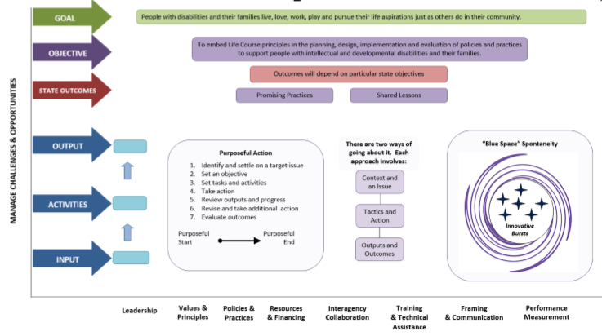
Capturing Our Learning

