Slide 1
Chapter 1

Slide 8
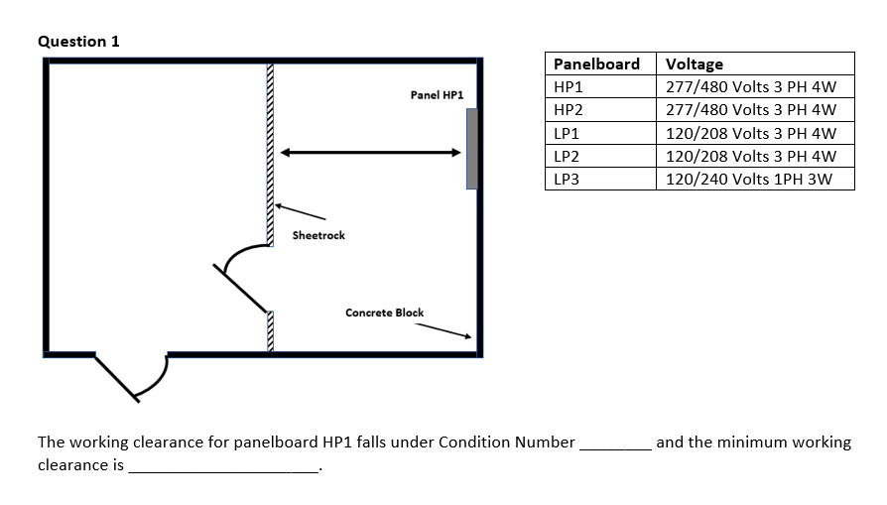

Slide 9
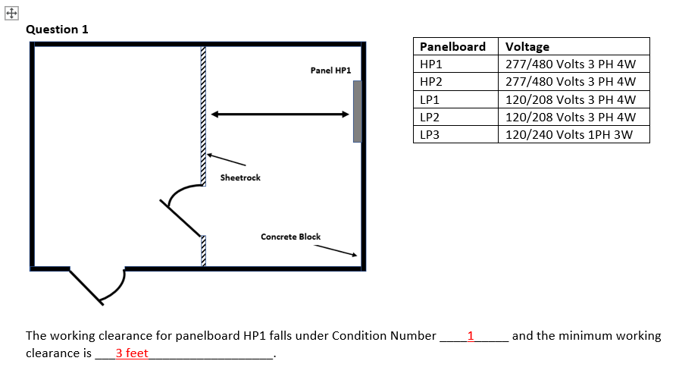

Slide 10
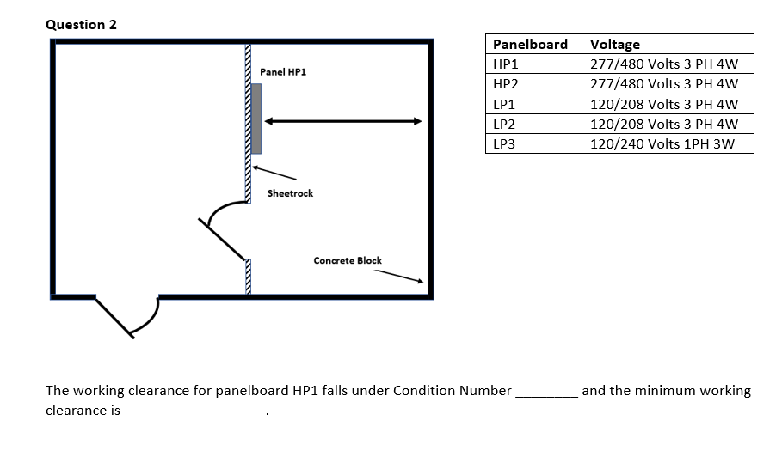

Slide 11
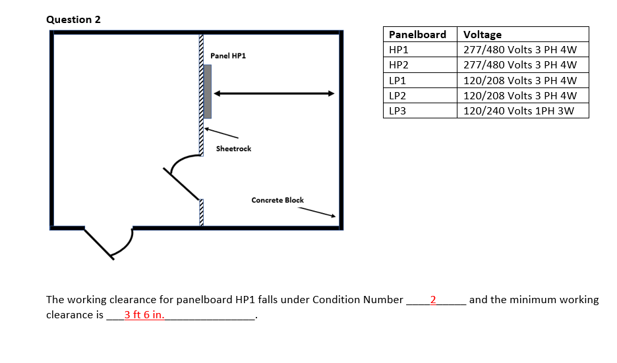

Slide 12
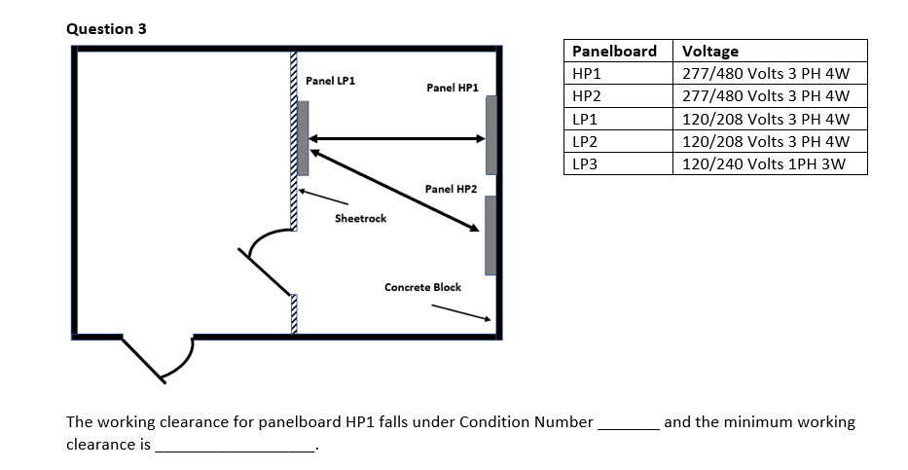

Slide 13
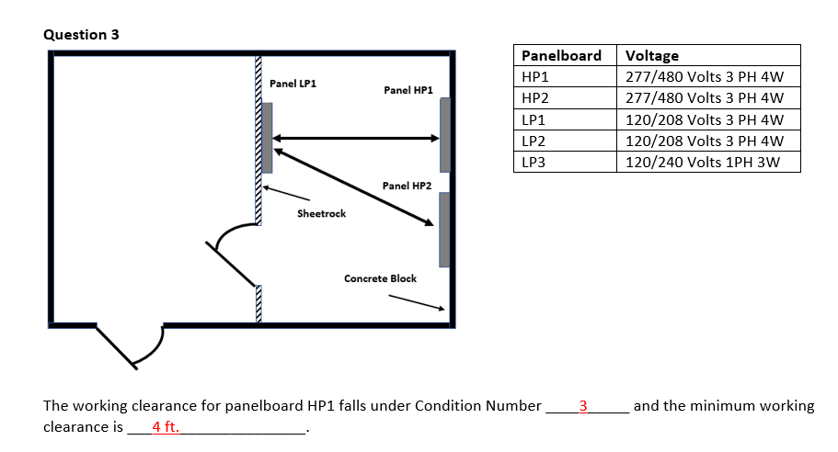

Slide 14
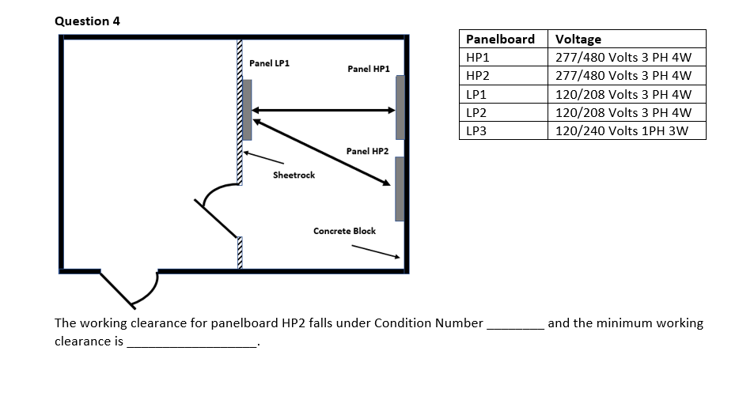

Slide 15
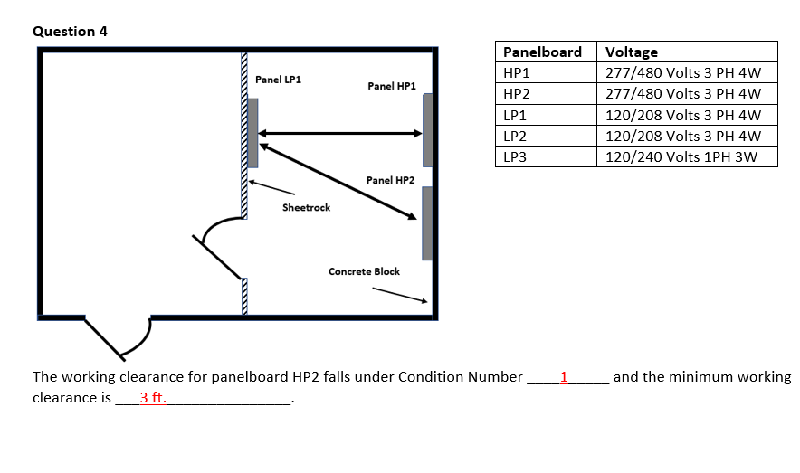

Slide 16
Chapter 2

Slide 17
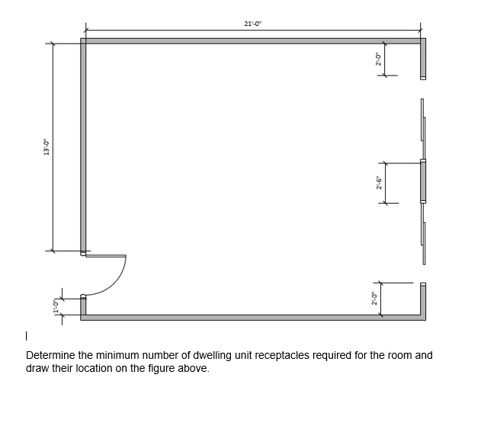

Slide 18
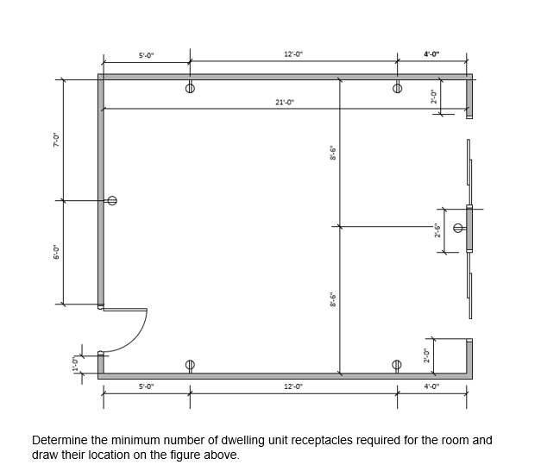
6 Receptacles
210.52 (A)(1) & (A)(2)

Slide 19
When a household wall-mounted oven is tapped from a 50-ampere branch circuit, the ampacity of the tap conductors shall not be less than __ .

Slide 20
When a household wall-mounted oven is tapped from a 50-ampere branch circuit, the ampacity of the tap conductors shall not be less than __ .
20 A **
25 A
30 A
35 A
210.19(A)(3) Exception No. 1

Slide 21
What is the minimum ungrounded conductor(s) feeder demand for two 3 kW household electric ovens in a dwelling unit?

Slide 22
What is the minimum ungrounded conductor(s) feeder demand for two 3 kW household electric ovens in a dwelling unit?
Solution: Table 220.55, Note 3 permits two options.
Calculate both options and select the smaller.
Option 1
Table 220.55, Column A
Two units less than 31/2 kW
2 units = 75%
Line = 2 units × 3 kW × 0.75
= 4.5 kW
Option 2
Table 220.55, Column C
2 units = 11 kW
Selection: Option 1 gives smaller load
Answer: 4.5 kW

Slide 23
A fixed appliance in a dwelling unit has a nameplate marking of 50 amperes. What is the rating of the individual branch circuit required to supply this appliance? The load is noncontinuous.

Slide 24
A fixed appliance in a dwelling unit has a nameplate marking of 50 amperes. What is the rating of the individual branch circuit required to supply this appliance? The load is noncontinuous.
a. 40 A
b. 50 A *
c. 60 A
d. 62.5 A
Note: Individual branch circuits are permitted to supply any load for which they are rated. See 210.23. If, in addition to the appliance, other loads are served from the same branch circuit, see 422.10(B).

Slide 25
What is the lighting load for a 625 square foot structural addition to an existing one-family dwelling?

Slide 26
What is the lighting load for a 625 square foot structural addition to an existing one-family dwelling?
Solution: 220.16(A)(1)
Over 500 sq ft use value in Table 220.12
Unit load for dwelling units = 3 VA per sq ft
Lighting load = Area x unit load
= 625 x 3
= 1,875 VA

Slide 27
Determine the general lighting load for a one-story office building that measures 125 feet by 150 feet.

Slide 28
Determine the general lighting load for a one-story office building that measures 125 feet by 150 feet.
Solution: 220.12 and Table 220.12
Unit load for offices = 3-1/2 VA per sq ft
Lighting load = Area x unit load
= (125 x 150) x 3.5
= 18,750 x 3.5
= 65,625 VA

Slide 29
Only the shell for an office building is to be built. It is 225 feet long, 90 feet wide, and 10 stories high. Calculate the lighting and receptacle feeder demand in volt-amperes for the building with the number of receptacles unknown.

Slide 30
Only the shell for an office building is to be built. It is 225 feet long, 90 feet wide, and 10 stories high. Calculate the lighting and receptacle feeder demand in volt-amperes for the building with the number of receptacles unknown.
Solution: Area = L x W
= 225 x 90
= 20,250 sq ft
220.12 and 220.14(K)
VA per sq ft = 3.5 + 1
= 4.5 VA
Demand = Area x VA per sq ft x No. floors
= 20,250 x 4.5 x 10
= 911,250 VA

Slide 31
A warehouse is 300 feet by 300 feet with a 120/208-volt, 3-phase, 4-wire service. Calculate the lighting feeder demand in volt-amperes. (The line and neutral lighting feeder demand are the same value.)

Slide 32
A warehouse is 300 feet by 300 feet with a 120/208-volt, 3-phase, 4-wire service. Calculate the lighting feeder demand in volt-amperes. (The line and neutral lighting feeder demand are the same value.)
Table 220.12
Unit load for a warehouse = 1/4 VA per sq ft
Area = L x W
= 300 x 300
= 90,000 sq ft
Calc. load = Area x unit load
= 90,000 x 0.25
= 22,500 VA
Table 220.42, Demand factor
Calculated load 22,500 VA
First 12,500 at 100% –12,500 = 12,500 VA
Balance at 50% x 10,000 = + 5,000 VA

Slide 33
What is the minimum size grounding electrode conductor required for 3/O service conductors where the grounding electrode conductor will jump between building steel and two ground rods driven six feet apart in the earth?
a. 1/0
b. #4
c. #3
d. #6

Slide 34
What is the minimum size grounding electrode conductor required for 3/0 service conductors where the grounding electrode conductor will jump between building steel and two ground rods driven six feet apart in the earth?
a. 1/0
b. #4 **
c. #3
d. #6
250.66 specifies the minim urn required GEC.
Always copper unless otherwise indicated in the question.
250.66 (A) the #6 maximum is not applicable here as the grounding electrode conductor extends to building steel which requires a larger size grounding electrode conductor so you can not take advantage of the maximum #6 permitted in 250.66A.

Slide 35
For grounding raceways and equipment, what is the minimum size equipment grounding conductor required for a 60 amp overcurrent protection device?
a. #6
b. #12
c. #8
d. #10

Slide 36
For grounding raceways and equipment, what is the minimum size equipment grounding conductor required for a 60 amp overcurrent protection device?
a. #6
b. #12
c. #8
d. #10 **
Table 250.122

Slide 37
Exposed interior structural steel that is not intentionally grounded and likely to become energized on a 480/277 volt system with three 500 kcmil copper ungrounded conductors per phase requires what size bonding jumper connection to the electrical service?
a. 1/0
b. 2/0
c. 3/0
d. 4/0

Slide 38
Exposed interior structural steel that is not intentionally grounded and likely to become energized on a 480/277 volt system with three 500 kcmil copper ungrounded conductors per phase requires what size bonding jumper connection to the electrical service?
a. 1/0
b. 2/0
c. 3/0 **
d. 4/0
250. 104 (C) says to use Table 250.102 (C) (1)
Remember always use copper unless otherwise stated in the question
However, it also says it is not required to be larger than a 3/0 or 250 kcmil aluminum.
You do not have to do the 12.5% calculation in the note one below the table which would have been 187,500 kcmil round up to a 4/0. So the answer is capped at 3/0 copper.

Slide 39
What size main bonding jumper is required for a 1200 amp electrical service fed from a parallel installation consisting of three 600 kcmil THWN conductors in parallel per phase?
a. 250 kcmil
b. 4/0
c. 2/0
d. 3/0

Slide 40
What size main bonding jumper is required for a 1200 amp electrical service fed from a parallel installation consisting of three 600 kcmil THWN conductors in parallel per phase?
a. 250 kcmil **
b. 4/0
c. 2/0
d. 3/0
250.24 (B) sends to 250.28 (D) (1) which sends you to table 250.102 (C) (1)
250.102 (C) (2) Allows use of the table for parallel installations.
Note 1 below table 250.102 (C) (1) says to add up the Kcmils for the equivalent area in parallel installations.
Over 1100 kcmil its 12.5% of the phase conductors
1800 x .125 = 225 kCmil
225 Kcmil x 1000 = 225000 cmil
Chapter 9 Table 8 = 250 kcmil next size larger is 250,000 cmil

Slide 41
What is the size of the copper common grounding electrode conductor used for two or more separately derived alternating current systems?
a. #1
b. 1/0
c. 2/0
3/0

Slide 42
What is the size of the copper common grounding electrode conductor used for two or more separately derived alternating current systems?
a. #1
b. 1/0
c. 2/0
3/0 **
250.30 A (6) (a) (1)

Slide 43
What is the minimum size grounding electrode conductor required for a 500 kcmil service conductor?
a. 1/0
b. #2
c. #3
d. 2/0

Slide 44
What is the minimum size grounding electrode conductor required for a 500 kcmil service conductor?
a. 1/0 **
b. #2
c. #3
d. 2/0
Table 250.66 specifies the minimum required size GEC
Always use copper unless otherwise indicated in the question.

Slide 45
What is the maximum number of 20-amp 120-volt duplex receptacles permitted on a 20-amp circuit in a commercial occupancy?
a. No maximum
b. 11
c. 10
d. 13

Slide 46
What is the maximum number of 20-amp 120-volt duplex receptacles permitted on a 20-amp circuit in a commercial occupancy?
a. No maximum
b. 11
c. 10
d. 13 **
220.14 (I) 180 va per receptacle
Power = Voltage x current
A 20 amp circuit at 120v = 2,400 va available
2,400 va divided by by 180 va per receptacle = 13.3
The 80% rule has no on making this determine

Slide 47
Chapter 3

Slide 48
What is the minimum burial depth of a direct buried cable or conductor to the top of the cable or conductor?
a. 18”
b. 24”
c. 6”
d. 12”

Slide 49
What is the minimum burial depth of a direct buried cable or conductor to the top of the cable or conductor?
a. 18”
b. 24” **
c. 6”
d. 12”
300.5 Column 1 all locations not specified and Note 1 below the table which states measuring is to the top of the cable or conductor.

Slide 50
When a size 3 AWG copper conductor, with THW insulation, is installed in an area where the ambient temperature is 114 deg F, the wire has an allowable ampacity of _________.
A. 100 amperes
B. 75 amperes
C. 82 amperes
D. 58 amperes

Slide 51
When a size 3 AWG copper conductor, with THW insulation, is installed in an area where the ambient temperature is 114 deg F, the wire has an allowable ampacity of _________.
A. 100 amperes
B. 75 amperes **
C. 82 amperes
D. 58 amperes
ANSWER – (B) 75 amperes
100 amperes x .75 = 75 amperes

Slide 52
When a size 1/0 AWG THWN aluminum conductor is installed in an ambient temperature of 45 deg c, the conductor has an allowable ampacity of __________.
A. 100 amperes
B. 90 amperes
C. 98 amperes
D. 104 amperes

Slide 53
When a size 1/0 AWG THWN aluminum conductor is installed in an ambient temperature of 45 deg c, the conductor has an allowable ampacity of __________.
A. 100 amperes
B. 90 amperes
C. 98 amperes **
D. 104 amperes
ANSWER – (C) 98 amperes
1/0 THW aluminum ampacity before derating = 120 amperes, 120 amps x .82 (correction factor) = 98 amperes.

Slide 54
Where a 100-ampere load is to be supplied with THWN copper conductors in an area where the ambient temperature Will reach 110 deg, F, size__________ THWN conductors are required to serve the load.
A. 1 AWG
B. 2 AWG
C. 3 AWG
D. 1/0 AWG

Slide 55
Where a 100-ampere load is to be supplied with THWN copper conductors in an area where the ambient temperature Will reach 110 deg, F, size__________ THWN conductors are required to serve the load.
A. 1 AWG **
B. 2 AWG
C. 3 AWG
D. 1/0 AWG
ANSWER - (A) 1 AWG
Required ampacity = 100 amps / .82 = 122 amperes

Slide 56
What size aluminum conductor is required for a 400-amp electrical service installed at a dwelling rated 120/240 volt?
a. 350 kcmil
b. 400 kcmil
c. 500 kcmil
d. 600 kcmil

Slide 57
What size aluminum conductor is required for a 400-amp electrical service installed at a dwelling rated 120/240 volt?
a. 350 kcmil
b. 400 kcmil
c. 500 kcmil
d. 600 kcmil **
310.15 (B) (7)
There is an example in informational annex example D7 for reference.
The short answer is to use Table 310.15 (B) (16) = 600 kcmil.
Take the 400 amps and multiply it by 83% per 310.15 (B) (7) (1). This equals 332amps. Go to 310.15 (B) (16) on the aluminum side of the chart Use the 75 degree C column because you are over 100 amps per 110.14 (C) (1) (b) 600 kcmil is the required size

Slide 58
The load on a size 6 AWG THHN copper conductor is limited to________ where connected to a circuit breaker with a termination rated at 60° C.
A. 75 amperes
B. 65 amperes
C. 60 amperes
D. 55 amperes

Slide 59
The load on a size 6 AWG THHN copper conductor is limited to________ where connected to a circuit breaker with a termination rated at 60° C.
A. 75 amperes
B. 65 amperes
C. 60 amperes
D. 55 amperes **
ANSWER· (D) 55 amperes
Table 310,15(8)(16) lists the ampacity of size 6 AWG, copper, 60° C rated conductors to be 55 amperes.

Slide 60
Two 12 AWG conductors pass unbroken through a lighting outlet box. Two 14 AWG conductors enter the box and splice to two 14 AWG conductors leaving the box and two 16 AWG fixture wires that supply a luminaire. Determine the minimum box volume required for this installation. Calculate the box volume to one decimal place.
a. 12.5 in.3
b. 14.0 in.3
c. 16.0 in.3
d. 18.0 in.3
e. 20.5 in.3

Slide 61
Two 12 AWG conductors pass unbroken through a lighting outlet box. Two 14 AWG conductors enter the box and splice to two 14 AWG conductors leaving the box and two 16 AWG fixture wires that supply a luminaire. Determine the minimum box volume required for this installation. Calculate the box volume to one decimal place.
a. 12.5 in.3
b. 14.0 in.3
c. 16.0 in.3 **
d. 18.0 in.3
e. 20.5 in.3
Solution:
Using Table 314.16(B)
Two 12 AWG = 2 × 2.25 in.3 = 4.50 in.3
Four 14 AWG = 4 × 2.00 in.3 = 8.00 in.3
Two 16 AWG = 2 × 1.75 in.3 = 3.50 in.3
Minimum volume required = 4.50 + 8.00 + 3.50 = 16.0 in.3

Slide 62
Two 12 AWG conductors pass through a switch box unbroken. Two 12 AWG conductors terminate on the switch (hot and switch leg) in the switch box. A bare 12 AWG equipment grounding conductor connects to the grounding screw in the box and continues through the box. Determine the minimum size metal device box suitable for this installation.
a. 3 x 2 x 2 in. device box
b. 3 x 2 x 2 1/4 in. device box
c. 3 x 2 x 2 1/2 in. device box
d. 3 x 2 x 2 3/4 in. device box
e. 3 x 2 x 3 1/2 in. device box

Slide 63
Two 12 AWG conductors pass through a switch box unbroken. Two 12 AWG conductors terminate on the switch (hot and switch leg) in the switch box. A bare 12 AWG equipment grounding conductor connects to the grounding screw in the box and continues through the box. Determine the minimum size metal device box suitable for this installation.
a. 3 x 2 x 2 in. device box
b. 3 x 2 x 2 1/4 in. device box
c. 3 x 2 x 2 1/2 in. device box **
d. 3 x 2 x 2 3/4 in. device box
e. 3 x 2 x 3 1/2 in. device box
Solution: a. Calculate the number of conductors in the box for the purposes of determining box fill.
Switch 2
Two 12 AWG passing through 2
Two 12 AWG on switch 2
Equipment grounding conductor 1
Total Count 7
Volume allowance = Seven 12 AWG
Answer: Seven 12 AWG conductors
Determine the minimum size metal device box for this installation.
Table 314.16(B) Seven 12 AWG
7 x 2.25 in.3 = 15.75 in.3 Minimum volume required = 15.75 in.3
Table 314.16(A), device box 3 x 2 x 3-1/2 in. = 18.0 in.3
Answer: 3 x 2 x 3-1/2 in. device box

Slide 65
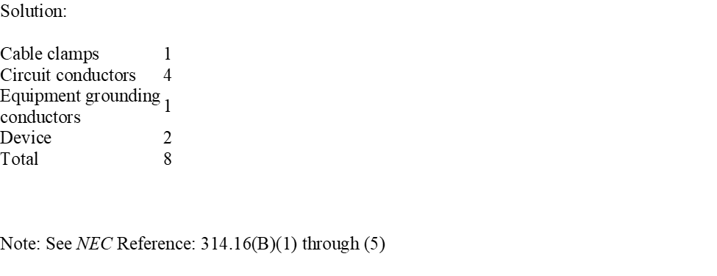

Slide 66
What size copper type NM or NMS cable is required for a 60 amp circuit?
a. #8
b. #6
c. #4
d. #3

Slide 67
What size copper type NM or NMS cable is required for a 60 amp circuit?
a. #8
b. #6
c. #4 **
d. #3
334.80 After any ampacity adjustment, in the end NM or NMS (RX) cable must be sized under the 60 degree ‘’C” column of 310.16. This is largely due to the effects of heating caused by various insulation in the walls. A larger wire will help dissipate heat.

Slide 68
What is the minimum size wireway would you need for 6-#4 THHN, 4-350 kcmil THW, and one #6 bare cu conductor?
A) 2” x 2”
B) 3” x 3”
C) 4” x 4”
D) 6” x 6”

Slide 69
What is the minimum size wireway would you need for 6-#4 THHN, 4-350 kcmil THW, and one #6 bare cu conductor?
A) 2” x 2”
B) 3” x 3”
C) 4” x 4” **
D) 6” x 6”
Solution:
Chapter 9, Tables, Art. 376.22(A)
Table 5, Table 8
#4 -.0824 (6) = .4944
350’S- .5958(4) = 2.3832
#6 - .027
A=.4944 + 2.3832 + .027 =
A= 2.9 x 5
A=14.523 min in.² A 4” x 4” trough would work, which is 16 in.²

Slide 70
A 6” x 6” nonmetallic wireway has 12-#4 RHW copper conductors inside, how many 1/0 THW copper conductors can be added to the trough?
A) 21
B) 17
C) 19
D) 25

Slide 71
A 6” x 6” nonmetallic wireway has 12-#4 RHW copper conductors inside, how many 1/0 THW copper conductors can be added to the trough?
A) 21
B) 17
C) 19
D) 25 **
Solution:
Chapter 9, Tables, Art. 378.22
Table 5, Table 8
#4 -.1333 (12) = 1.596
6 x 6 = 36”sq x 20% fill = 7.2 in.²
7.2 - 1.596 = 5.604 [remaining area]
1/0- .2223
A= 5.604/.2223 =
A= 25.21 or 25 - 1/0 conductors can be added

Slide 72
A 4” x 4” metallic wireway has 24-#10 THWN copper conductors, 12-#12 THWN, and 3-#3 THWN inside, how many #10 THWN copper conductors can be added to the trough?
A) 110
B) 117
C) 119
D) 112

Slide 73
A 4” x 4” metallic wireway has 24-#10 THWN copper conductors, 12-#12 THWN, and 3-#3 THWN inside, how many #10 THWN copper conductors can be added to the trough?
A) 110
B) 117 **
C) 119
D) 112
Solution:
Chapter 9, Tables, Art. 376.22(A)
Table 5, Table 8
#10 -.0211 (24) = .5064
#12-.0133(12) = .1596
#3-.0973(3) = .0466
4 x 4 = 16”sq x 20% fill = 3.2 in.²
3.2-(.5064+.1596+.0466) = 2.4874 [remaining area]
2.4874/.0211 = 117.89
A= 117-#10 THWN CU conductors can be added

Slide 74
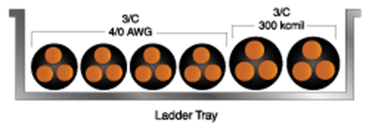
Using the illustration, calculate the minimum standard-size ladder cable tray needed for the installation, as shown, for the following multiple conductor cables: four 3-conductor 4/0 AWG and two 3-condcutor 300 kcmil. (OD 4/0 AWG = 1.92 inches; OD 300 kcmil = 2.12 inches.)
(Note: The abbreviation OD refers to the outside diameter of a cable measured in inches.)

Slide 75
Using the illustration, calculate the minimum standard-size ladder cable tray needed for the installation, as shown, for the following multiple conductor cables: four 3-conductor 4/0 AWG and two 3-condcutor 300 kcmil. (OD 4/0 AWG = 1.92 inches; OD 300 kcmil = 2.12 inches.)
(Note: The abbreviation OD refers to the outside diameter of a cable measured in inches.)
Solution:
392.22(A)(1)(a), single layer
Sum of OD (Sd) not to exceed width of tray
4/0 AWG width = 1.92 × 4 = 7.68 in.
300 kcmil width = 2.12 × 2 = 4.24 in.
Min. width = 7.68 + 4.24 = 11.92 in.
Table 392.22(A)
Next larger std. size = 12 in. wide ladder cable tray

Slide 76
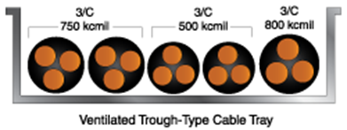
Calculate the minimum standard-size ventilated trough cable tray needed for the installation of the following multiple conductor cables: two 3-conductor 750 kcmil; two 3-conductor 500 kcmil; and one 3-conductor 800 kcmil. (OD 750 kcmil = 3.05 inches, OD 500 kcmil = 2.68 inches, and OD 800 kcmil = 3.24 inches.)

Slide 77
Calculate the minimum standard-size ventilated trough cable tray needed for the installation of the following multiple conductor cables: two 3-conductor 750 kcmil; two 3-conductor 500 kcmil; and one 3-conductor 800 kcmil. (OD 750 kcmil = 3.05 inches, OD 500 kcmil = 2.68 inches, and OD 800 kcmil = 3.24 inches.)
Solution:
392.22(A)(1)(a), single layer
Sd not to exceed width of tray
750 kcmil width = 3.05 × 2 = 6.10 in.
500 kcmil width = 2.68 × 2 = 5.36 in.
800 kcmil width = 3.24 × 1 = 3.24in.
Min. width = 6.10 + 5.36 + 3.24 = 14.70 in.
Table 392.22(A)
Next larger std. size = 16 in. wide ventilated trough tray

Slide 78
Chapter 4

Slide 79
Determine the MINIMUM size THHN copper conductors required to supply a 3 hp, 240-volt, single-phase continuous-duty motor when all terminations have a rating of 75°C.
A. 14 AWG
B. 12 AWG
C. 10 AWG
D. 8 AWG

Slide 80
Determine the MINIMUM size THHN copper conductors required to supply a 3 hp, 240-volt, single-phase continuous-duty motor when all terminations have a rating of 75°C.
A. 14 AWG
B. 12 AWG **
C. 10 AWG
D. 8 AWG
ANSWER – (B) 12 AWG
Motor FLC = 17 amperes Table 430.248.
17 amperes x 125% (Table 430.22) = 21.25 amperes
Size 12 AWG THHN is rated at 25 amperes at 75°C (Table 310.15(B)(16))

Slide 81
Conductors supplying a 40 hp, 480-volt, three-phase, 5-minute rated elevator motor with an ampere rating of 50 amperes marked on the nameplate, shall have an ampacity of at least______.
A. 42.5 amperes
B. 45.9 amperes
C. 62.5 amperes
D. 67.5 amperes

Slide 82
Conductors supplying a 40 hp, 480-volt, three-phase, 5-minute rated elevator motor with an ampere rating of 50 amperes marked on the nameplate, shall have an ampacity of at least______.
A. 42.5 amperes **
B. 45.9 amperes
C. 62.5 amperes
D. 67.5 amperes
ANSWER - (A) 42.5 amperes
Motor FLA = 50 amperes x 85% Table 430.22 (E) = 42.5 amps

Slide 83
Determine the MAXIMUM initial rating of non-time delay fuses to be used for branch-circuit, short-circuit and ground-fault protection for a 5 hp, 230-volt, three-phase, squirrel cage, continuous-duty motor.
A. 40 amperes
B. 45 amperes
C. 50 amperes
D. 60 amperes

Slide 84
Determine the MAXIMUM initial rating of non-time delay fuses to be used for branch-circuit, short-circuit and ground-fault protection for a 5 hp, 230-volt, three-phase, squirrel cage, continuous-duty motor.
A. 40 amperes
B. 45 amperes
C. 50 amperes **
D. 60 amperes
ANSWER = (C) 50 amperes
5 HP FLC = 15.2 amperes (Table 430.250) 15.2 amperes x 300% = 45.6 amperes (Table 430.52)
Since 45.6 amperes is not a standard rating for non-time delay fuses, as per 430.52 (C) (1) Ex 1, You are permitted to go up to the next standard size fuse (240.6 (A)) which is rated at 50 amperes.

Slide 85
Determine the absolute MAXIMUM standard size time-delay fuses permitted for short-circuit, branch-circuit and ground-fault protection for a 40 hp, 480-volt, three-phase, induction type, continuous-duty motor.
A. 100 amperes
B. 110 amperes
C. 115 amperes
D. 125 amperes

Slide 86
Determine the absolute MAXIMUM standard size time-delay fuses permitted for short-circuit, branch-circuit and ground-fault protection for a 40 hp, 480-volt, three-phase, induction type, continuous-duty motor.
A. 100 amperes
B. 110 amperes **
C. 115 amperes
D. 125 amperes
ANSWER – (B) 110 amperes
40 HP FLC = 52 amperes (Table 430.250)
52 amperes x 225% = 117 amperes (430.52 (C) (1) Ex.2 (b))
Since you are NOT permitted to exceed 225% of the FLC of the motor, you must go down to the next smaller standard size fuse as listed in 240.6 (A).

Slide 87
What standard size time-delay fuses are required for the feeder overcurrent protection of a feeder supplying four (4), 15 hp, 480-volt, three-phase, continuous-duty induction-type motors, each protected with 40 ampere rated time-delay fuses?
A. 100 amperes
B. 110 amperes
C. 125 amperes
D. 150 amperes

Slide 88
What standard size time-delay fuses are required for the feeder overcurrent protection of a feeder supplying four (4), 15 hp, 480-volt, three-phase, continuous-duty induction-type motors, each protected with 40 ampere rated time-delay fuses?
A. 100 amperes **
B. 110 amperes
C. 125 amperes
D. 150 amperes
ANSWER – (A) 100 amperes
15 HP FLC = 21 amperes (Table 430.250)
40 Amp (largest OCP in group) + 21 Amp+ 21 Amp + 21 Amp = 103 amps
You are required to go down to 100 ampere rated fuses. (240.6(A))
See 430.62 (A)

Slide 89
A single 30-horsepower, 460-volt, 3-phase, continuous-duty, induction type Design B motor is supplied by a motor branch circuit. Calculate the minimum ampacity for the motor branch-circuit conductors.
a) 50 A
b) 60 A
c) 70 A
d) 80 A

Slide 90
A single 30-horsepower, 460-volt, 3-phase, continuous-duty, induction type Design B motor is supplied by a motor branch circuit. Calculate the minimum ampacity for the motor branch-circuit conductors.
a) 50 A **
b) 60 A
c) 70 A
d) 80 A
Solution: Minimum ampacity branch-circuit conductors
Table 430.250, 3-phase, 30 hp 460 V = 40 A FLC
430.22(A), branch circuit ampacity = FLC × 125%
40 × 1.25 = 50 A

Slide 91
A single 3-horsepower, 240-volt, single-phase, continuous-duty, induction type Design B motor is supplied by a motor branch circuit. Calculate the minimum ampacity for the motor branch-circuit conductors.
a) 17 A
b) 21.25 A
c) 27 A
d) 38.25 A

Slide 92
A single 3-horsepower, 240-volt, single-phase, continuous-duty, induction type Design B motor is supplied by a motor branch circuit. Calculate the minimum ampacity for the motor branch-circuit conductors.
a) 17 A
b) 21.25 A **
c) 27 A
d) 38.25 A
Solution: Minimum ampacity BC conductors
Table 430.248, single-phase, 3 hp, 240 V = 17 A FLC
430.22(A) branch circuit ampacity = FLC × 125%
17 × 1.25 = 21.25 A

Slide 93
One 3-horsepower, 240-volt, single-phase, continuous-duty, induction-type Design B motor; one 71/2-horsepower, 240-volt, single-phase, continuous-duty, induction-type Design B motor; and one 10-horsepower, 240-volt, single-phase, continuous-duty, induction-type Design B motor are supplied by a single motor branch circuit. Calculate the minimum ampacity for the single motor branch-circuit conductors supplying all three motors.
a) 119.5 A
b) 130.2 A
c) 125 A
d) 137.5 A

Slide 94
One 3-horsepower, 240-volt, single-phase, continuous-duty, induction-type Design B motor; one 71/2-horsepower, 240-volt, single-phase, continuous-duty, induction-type Design B motor; and one 10-horsepower, 240-volt, single-phase, continuous-duty, induction-type Design B motor are supplied by a single motor branch circuit. Calculate the minimum ampacity for the single motor branch-circuit conductors supplying all three motors.
a) 119.5 A **
b) 130.2 A
c) 125 A
d) 137.5 A
Solution:
Table 430.248, single-phase
3 hp, 240 V = 17 A FLC
7 1/2 hp, 240 V = 40 A FLC
10 hp, 240 V = 50 A FLC
430.24, branch circuit ampacity = (largest FLC × 125%) + other motor(s)
(50 × 1.25) + 40 + 17
62.5 + 40 + 17 = 119.5 A

Slide 95
Determine the maximum overload protection, using overload relays, for a 25-horsepower, 240-volt, 3-phase continuous-duty motor with a motor nameplate full-load current rating of 65 amperes, a temperature rise of 40°C, and a service factor of 1.15.
a) 65 A
b) 66.25
c) 70 A
d) 81.25 A

Slide 96
Determine the maximum overload protection, using overload relays, for a 25-horsepower, 240-volt, 3-phase continuous-duty motor with a motor nameplate full-load current rating of 65 amperes, a temperature rise of 40°C, and a service factor of 1.15.
a) 65 A
b) 66.25
c) 70 A
d) 81.25 A **
430.32(A)(1), Separate Overload Device
40°C rise, 1.15 service factor
Max. overload rating = 125%
Max. overload = motor nameplate FLC rating × 125%
65 × 1.25 = 81.25 A

Slide 97
What is the minimum current rating of the motor disconnecting means for a 40-horsepower, 208-volt, 3-phase squirrel-cage motor?
a) 114 A
b) 116.15 A
c) 131.1 A
d) 150 A

Slide 98
What is the minimum current rating of the motor disconnecting means for a 40-horsepower, 208-volt, 3-phase squirrel-cage motor?
a) 114 A
b) 116.15 A
c) 131.1 A **
d) 150 A
Solution:
430.6(A) use Table 430.250 value
40 hp, 208 V = 114 A FLC
430.110(A)
Min. current rating = FLC × 115%
114 × 1.15 = 131.1 A

Slide 99
A single 75-horsepower, 208-volt, 3-phase, continuous-duty, induction type Design B motor is supplied by a motor branch circuit. Calculate the minimum ampacity for the motor branch-circuit conductors.
a) 263.75 A
b) 251 A
c) 211 A
d) 225 A

Slide 100
A single 75-horsepower, 208-volt, 3-phase, continuous-duty, induction type Design B motor is supplied by a motor branch circuit. Calculate the minimum ampacity for the motor branch-circuit conductors.
a) 263.75 A **
b) 251 A
c) 211 A
d) 225 A
Solution:
Table 430.250, 3-phase, 75 hp, 208 V = 211 A FLC
430.22(A), branch circuit ampacity = FLC × 125%
211 × 1.25 = 263.75 A

Slide 101
One branch circuit supplies a piece of fixed electric space heating equipment (motor-operated) with one 5-horsepower, 230-volt, single-phase motor and one unit of electric heat rated at 12,500 watts at 230 volts. Calculate the minimum branch-circuit ampacity to supply the combined load.
Hint: Fixed electric heat is required to be sized at 125% according to Section 424.3(B).
a) 100 A
b) 102.94 A
c) 103 A
d) 150 A

Slide 102
One branch circuit supplies a piece of fixed electric space heating equipment (motor-operated) with one 5-horsepower, 230-volt, single-phase motor and one unit of electric heat rated at 12,500 watts at 230 volts. Calculate the minimum branch-circuit ampacity to supply the combined load.
Hint: Fixed electric heat is required to be sized at 125% according to Section 424.3(B).
a) 100 A
b) 102.94 A **
c) 103 A
d) 150 A
Solution:
Table 430.248, single-phase 5 hp 230 V = 28 A FLC
I = W ÷ E = 12,500 ÷ 230 = 54.35 A
430.24, Exception 2 and 424.3(B)
Branch circuit ampacity = (motor FLC + heat FLC) × 125%
(28 + 54.35) × 1.25 = 82.35 × 1.25 = 102.94 A
Note: Section 430.24, Exception No. 2 refers to 424.3(B) for fixed electric space heating. It requires that the conductors and the overcurrent protective device supplying fixed electric space-heating equipment be sized at 125%. Section 424.1 defines the scope of fixed electric space-heating equipment.

Slide 103
Determine the maximum overload protection, using overload relays, when starting current is a problem, for a 50-horsepower, 208-volt, continuous-duty motor with a motor nameplate full-load current rating of 148 amperes and a service factor of 1.15.
a) 207.2 A
b) 210.5 A
c) 120.2 A
d) 180.7 A

Slide 104
Determine the maximum overload protection, using overload relays, when starting current is a problem, for a 50-horsepower, 208-volt, continuous-duty motor with a motor nameplate full-load current rating of 148 amperes and a service factor of 1.15.
a) 207.2 A **
b) 210.5 A
c) 120.2 A
d) 180.7 A
Solution:
430.32(C), Starting current is a problem
Service factor = 1.15
Max. overload rating = 140%
Max. overload = motor nameplate FLC rating × 140%
148 × 1.40 = 207.20 A

Slide 105
For an installation with a primary current of 1.75 amperes, determine the maximum standard size fuse permitted using Table 450.3(B), for primary-only protection, where the primary currents are less than two amperes.
a) 2 A fuse
b) 3 A fuse
c) 4 A fuse
d) 5 A fuse

Slide 106
For an installation with a primary current of 1.75 amperes, determine the maximum standard size fuse permitted using Table 450.3(B), for primary-only protection, where the primary currents are less than two amperes.
a) 2 A fuse
b) 3 A fuse *
c) 4 A fuse
d) 5 A fuse
Solution: Table 450.3(B), primary protection
Currents less than 2 A
OCPDpri = Ipri × 300% max.
= 1.75 × 3.00
= 5.25 A
Note 1 is not applicable
Next smaller size
240.6(A) standard sizes
5.25 A → 3 A

Slide 107
For an installation with a 45-kVA, 3-phase transformer, a 460-volt primary, a 220-volt secondary, and secondary protection where the transformer secondary overcurrent protection does not exceed 125% of the secondary current, determine the maximum standard rating of the primary feeder OCPD, where primary and secondary overcurrent protection are provided for the transformer.
a) 100 A OCPD
b) 150 A OCPD
c) 125 A OCPD
d) 200 A OCPD

Slide 108
For an installation with a 45-kVA, 3-phase transformer, a 460-volt primary, a 220-volt secondary, and secondary protection where the transformer secondary overcurrent protection does not exceed 125% of the secondary current, determine the maximum standard rating of the primary feeder OCPD, where primary and secondary overcurrent protection are provided for the transformer.
a) 100 A OCPD
b) 150 A OCPD
c) 125 A OCPD *
d) 200 A OCPD
Table 450.3(B), Primary and Secondary Protection
Currents of 9 A or more
Max. rating of OCPD = 250%
OCPDpri = Ipri × 250%
= 56.54687107 × 2.5
= 141.37 A
Next smaller OCPD → 125 A OCPD

Slide 109
Chapter 6

Slide 110
What size conductor is required for the source circuit conductors from a photovoltaic module with a short circuit current rating sum of 22 amps when the lowest ambient temperature is expected to be 15 degrees Fahrenheit?
a. #12
b. #10
c. #6
d. #8

Slide 111
What size conductor is required for the source circuit conductors from a photovoltaic module with a short circuit current rating sum of 22 amps when the lowest ambient temperature is expected to be 15 degrees Fahrenheit?
a. #12
b. #10
c. #6
d. #8 **
690.8 (B) (2) & Table 310.16
Take the sum of the short circuit current rating times 125%. Then multiply by the temperature correction factor of 1.14 for 15 degrees Fahrenheit.
22 x 1.25 x 1.14 = 31.35 amps Since terminal temperature is not stated, per 110.14 (C), under 100 amps is sized at 60 degrees Celsius in 310.15 (B) (16).

Slide 112
Chapter 8

Slide 113
A 3-pair shielded 485 communication cable has an overall diameter of .360”, how many can we pull through a 2” IMC conduit?
A) 12
B) 13
C) 14
D) 16

Slide 114
A 3-pair shielded 485 communication cable has an overall diameter of .360”, how many can we pull through a 2” IMC conduit? (Use 3.14 for π)
A) 12
B) 13
C) 14 **
D) 16
Solution:
Chapter 9, Tables, Notes 5 and 9
Table 4, 2” IMC at 40% (over 2) = 1.452 in.²
Diameter of communication cable= .360 inches
A=3.14(r²)
A=3.14(.18)(.18)
A=.101736
Number of cables = 1.452/.101736 =14.27 or 14-commuication cables.

Slide 115
How many Cat 6 cables can you pull through a ¾” EMT Conduit?
A) 2
B) 3
C) 4
D) 6

Slide 116
How many Cat 6 cables can you pull through a ¾” EMT Conduit?
A) 2
B) 3
C) 4
D) 6 **
Solution:
Chapter 9, Tables, Notes 5 and 9
Table 4, 3/4” EMT at 40% (over 2) = .213 in.²
Diameter of Cat 6 cable= .3 inches
A=3.14(r²)
A=3.14(.15)(.15)
A=.0765
Number of cables = .213/.0765 =3.015 or 3-cat 6 cables.

Slide 117
A 6 fiber single mode optical fiber cable has an overall diameter of .1890”, how many can be pulled through a 4” EMT conduit?
A) 120
B) 170
C) 210
D) 195

Slide 118
A 6 fiber single mode optical fiber cable has an overall diameter of .1890”, how many can be pulled through a 4” EMT conduit?
A) 120
B) 170
C) 210 **
D) 195
Solution:
Chapter 9, Tables, Notes 5 and 9
Table 4, 2” EMT at 40% (over 2) = 5.901 in.²
Diameter of communication cable= .1890 inches
A=3.14(r²)
A=3.14(.0945)(.0945)
A=.028
Number of cables = 5.901/.028 = 210.44 or 210 fiber optic cables

Slide 119
Chapter 9

Slide 120
Determine the maximum number of 6 AWG THW copper conductors permitted in a 1-1/4- inch RMC conduit nipple, 20 inches long, connecting a cabinet and an auxiliary gutter.

Slide 121
Determine the maximum number of 6 AWG THW copper conductors permitted in a 1-1/4- inch RMC conduit nipple, 20 inches long, connecting a cabinet and an auxiliary gutter.

Slide 122
Determine the minimum size rigid metal conduit needed for an installation consisting of two 3-phase, 480-volt motor circuits installed in the same conduit. One motor circuit consists of 1 AWG THW copper conductors and the other is fed with 4 AWG THW copper conductors.

Slide 123
Determine the minimum size rigid metal conduit needed for an installation consisting of two 3-phase, 480-volt motor circuits installed in the same conduit. One motor circuit consists of 1 AWG THW copper conductors and the other is fed with 4 AWG THW copper conductors.
Solution: Chapter 9, Table 5
1 AWG THW = 0.1901 in.2
4 AWG THW = 0.0973 in.2
0.1901 × 3 = 0.5703 in.2
0.0973 × 3 = 0.2919 in.2
Total = 0.8622 in.2
Chapter 9, Table 4 (RMC)
40% fill column
0.8622 in.2 = 2 in. RMC
Note: See NEC Reference: Chapter 9, Tables 4 and 5

Slide 124
What is the minimum size rigid PVC conduit, Schedule 80, permitted for the installation of four 4/0 AWG THW copper conductors and one 1 AWG bare copper equipment grounding conductor?
a. 1-1/2 in. PVC, Schedule 80
b. 2 in. PVC, Schedule 80
c. 2-1/2 in. PVC, Schedule 80
d. 3 in. PVC, Schedule 80

Slide 125
What is the minimum size rigid PVC conduit, Schedule 80, permitted for the installation of four 4/0 AWG THW copper conductors and one 1 AWG bare copper equipment grounding conductor?
a. 1-1/2 in. PVC, Schedule 80
b. 2 in. PVC, Schedule 80
c. 2-1/2 in. PVC, Schedule 80
d. 3 in. PVC, Schedule 80
Solution: Chapter 9, Table 5
4/0 AWG THW = 0.3718 in.2
Chapter 9, Table 1, Note 8
Chapter 9, Table 8
1 AWG bare = 0.087 in.2
4 × 0.3718 in.2 = 1.4872 in.2
1 × 0.087 in.2 = 0.087 in.2
Total = 1.5742 in.2
Chapter 9, Table 4
40% fill column
1.5742 in.2 = 2-1/2 in. PVC, Schedule 80
Note: See NEC Reference: Chapter 9, Tables 4, 5, and 8, and Note 8 of Table 1

Slide 126
Additional Calculations

Slide 127
Determine the current, in amperes, for a 120-volt, single-phase branch circuit that has only six (6) 100-watt incandescent luminaries (lighting fixtures) connected.
A. 5 amperes
B. 15 amperes
C. 20 amperes
D. 2 amperes

Slide 128
Determine the current, in amperes, for a 120-volt, single-phase branch circuit that has only six (6) 100-watt incandescent luminaries (lighting fixtures) connected.
A. 5 amperes
B. 15 amperes
C. 20 amperes
D. 2 amperes
ANSWER – (A) 5 amperes
I = watts I = 600 watts = 5 amperes
volts 120 volts

Slide 129
A 36,026 VA load connected to a 208Y/120-volt, three-phase circuit will draw ______ of current per phase.
A. 110 amperes
B. 173 amperes
C. 250 amperes
D. 100 amperes

Slide 130
A 36,026 VA load connected to a 208Y/120-volt, three-phase circuit will draw ______ of current per phase.
A. 110 amperes
B. 173 amperes
C. 250 amperes
D. 100 amperes
ANSWER – (D) 100 amperes
I = VA I = 36,026 VA I = 36,026 = 100 amperes
E X 1.732 208 volts X 1.732 360

Slide 131
The power factor of 5-kW load drawing 30 amperes of current when connected to a 208-volt, single-phase source is____________.
A. 92 percent
B. 46 percent
C. 80 percent
D. 83 percent

Slide 132
The power factor of 5-kW load drawing 30 amperes of current when connected to a 208-volt, single-phase source is____________.
A. 92 percent
B. 46 percent
C. 80 percent
D. 83 percent
ANSWER – (C) 80 percent
PF = kW X 1000 PF = 5-kW X 1000 PF = 5,000 Watts = .80 or 80%
Volts x amperes 208-volt x 30-amperes 6,240 VA

Slide 133
What is the voltage drop on a single-phase branch circuit supplying a 42-ampere load a distance of 125 feet with 6 AWG TW uncoated copper conductors? Calculate your answer to two decimal places.
a) 4.91 V
b) 5.25 V
c) 3.35 V
d) 2.86 V

Slide 134
What is the voltage drop on a single-phase branch circuit supplying a 42-ampere load a distance of 125 feet with 6 AWG TW uncoated copper conductors? Calculate your answer to two decimal places.
a) 4.91 V **
b) 5.25 V
c) 3.35 V
d) 2.86 V
Solution:
Note: Chapter 9, Table 8, DC resistance Table 310.104(A)
TW = 60°C
Temp. correction necessary
Divide by 1.05
6 AWG uncoated copper = 0.491 ohms/kFT
Vd = (DC Res. × I × 2L) ÷ (1,000 × 1.05)
= (0.491 × 42 × 2 × 125) ÷ (1,000 × 1.05)
5,155.5 ÷ 1,050 = 4.91 volts

Slide 135
What size copper conductors are needed to supply a 3-phase, 208-volt, 200-ampere load at a distance of 250 feet and not exceed a 3% voltage drop? (Use 12.9 for k)
a. 2/0 AWG
b. 3/0 AWG
c. 4/0 AWG
d. 250 kcmil

Slide 136
What size copper conductors are needed to supply a 3-phase, 208-volt, 200-ampere load at a distance of 250 feet and not exceed a 3% voltage drop? (Use 12.9 for k)
a. 2/0 AWG
b. 3/0 AWG
c. 4/0 AWG **
d. 250 kcmil
Solution:
Vdmax = supply voltage × 3%
208 × 0.03 = 6.24 V
cmils = (k × L × I × 1.73) ÷ Vd
= (12.9 × 200 × 250 × 1.73) ÷ 6.24
= 1,115,850 ÷ 6.24
= 178,822 cmils
Chapter 9, Table 8, Area, cmils
Read (more than) 178,822 = 211,600 cmils
211,600 cmils = 4/0 AWG copper

Slide 137
What is the voltage drop of a 240 volt 24 amp single phase load located 160 feet from the panelboard using #10 THHN conductors?
a. 4.25 volts
9.5 volts
3.2 volts
5.9 volts

Slide 138
What is the voltage drop of a 240 volt 24 amp single phase load located 160 feet from the panelboard using #10 THHN conductors?
a. 4.25 volts
9.5 volts **
3.2 volts
5.9 volts
K = 12.9 for Copper or 21.2 for aluminum
VD single phase = (2 x K x I x D) / Cmil
VD = (2 x 12.9 x 24 x 160’) / 10,380
VD = 9.5 volts

Slide 139
How much power is required to operate a series circuit with 80 ohms of resistance and 3 amps of current?
a. 240 watts
b. 720 watts
c. 580 watts
d. 820 watts

Slide 140
How much power is required to operate a series circuit with 80 ohms of resistance and 3 amps of current?
a. 240 watts
b. 720 watts **
c. 580 watts
d. 820 watts
This is called your I squared R losses
Current squared times the resistance formula is used (3 amps x 3 amps) x 80
9 amps x 80 = 720 watts

