Slide 1

Owning our stories in the Immigrant Movement

Slide 2
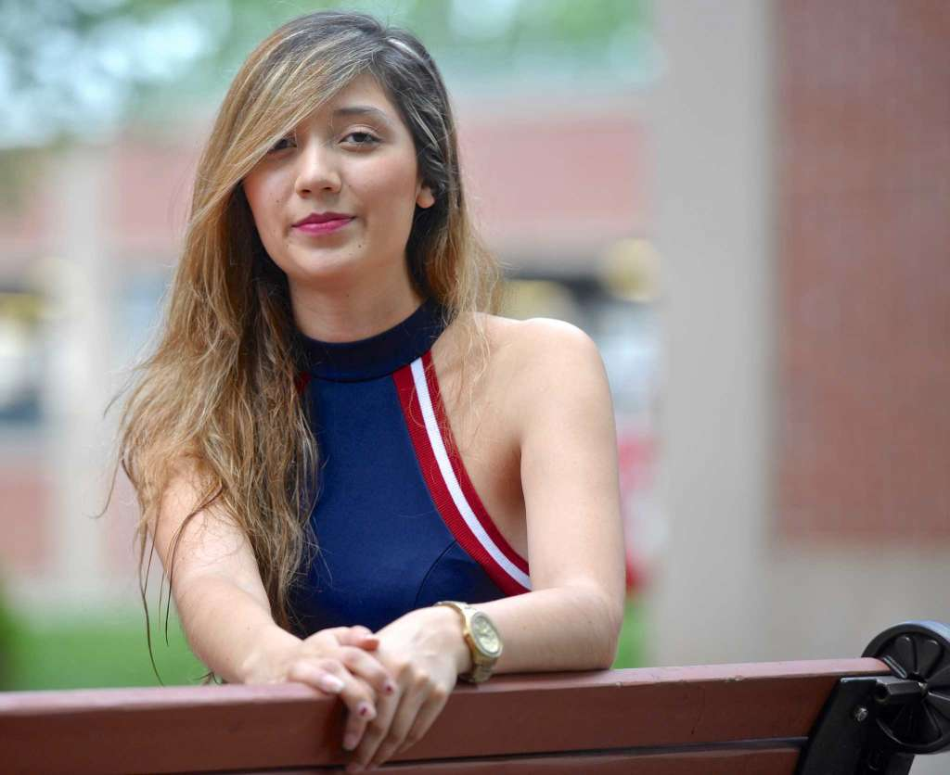
Angelica Idrovo
Youth Organizer
CT Students for a Dream
Notes:
BUILdind

Slide 3
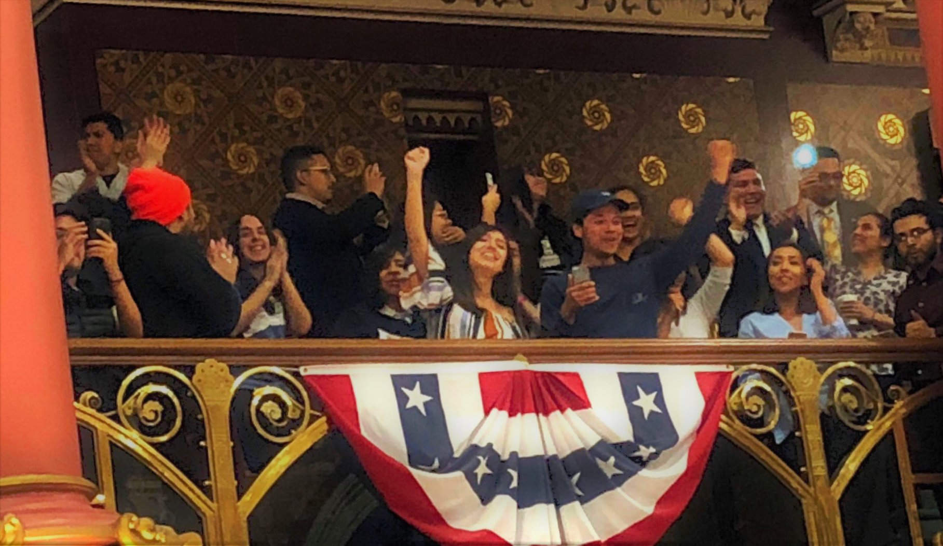
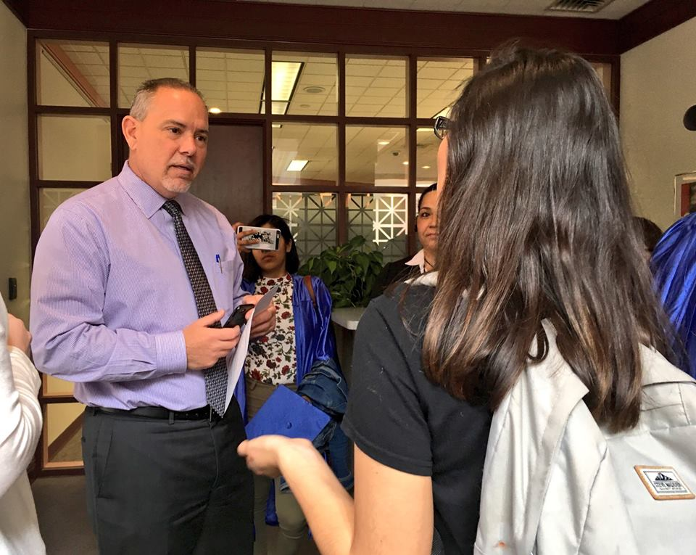
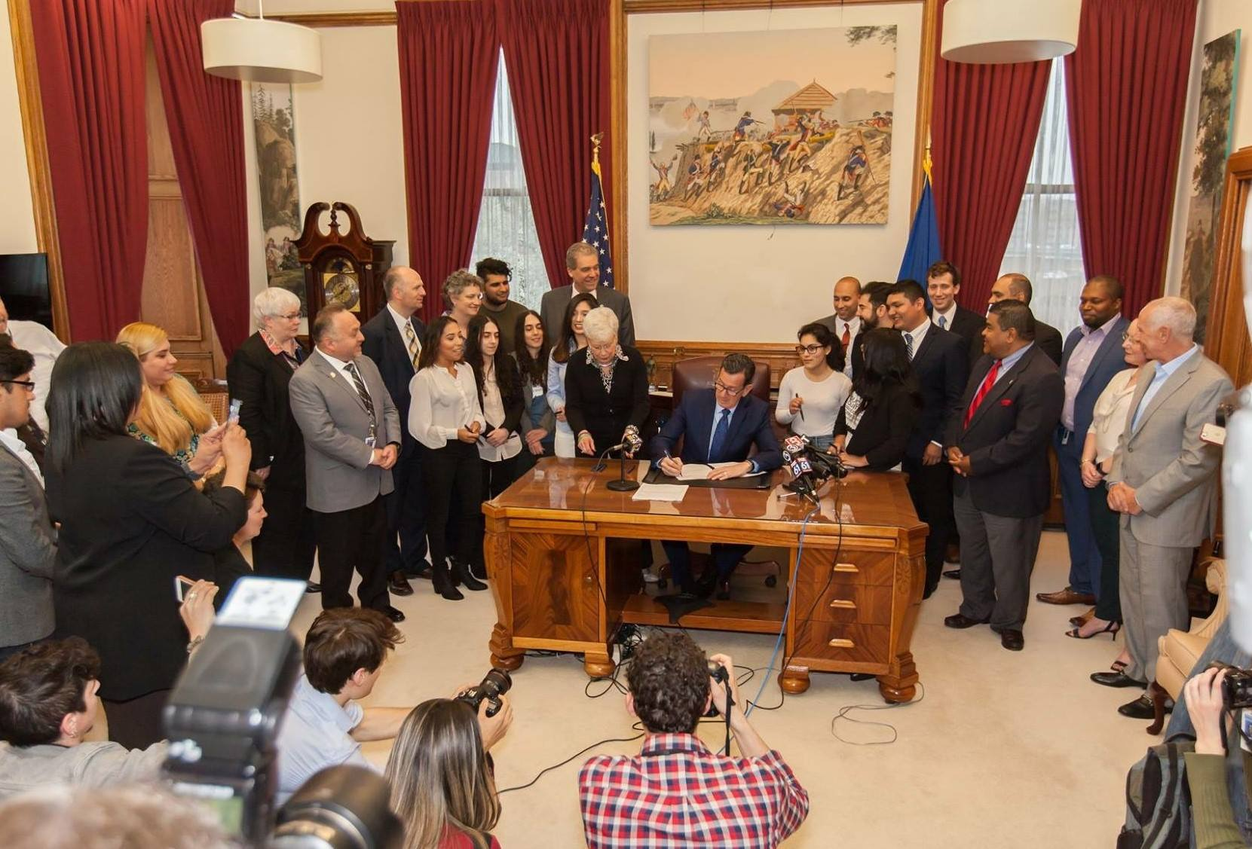
Legislation
Notes:
republicans compromise on less students could qualify push back compromising our values
What are stories for? -ownernishop power over their voices

Slide 4
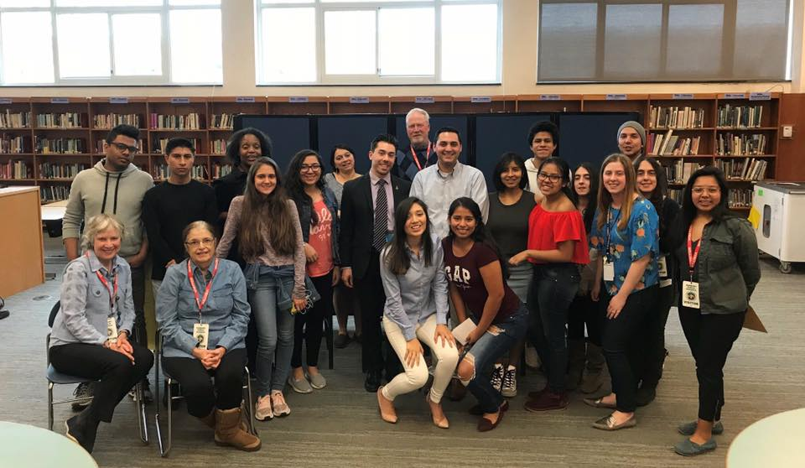
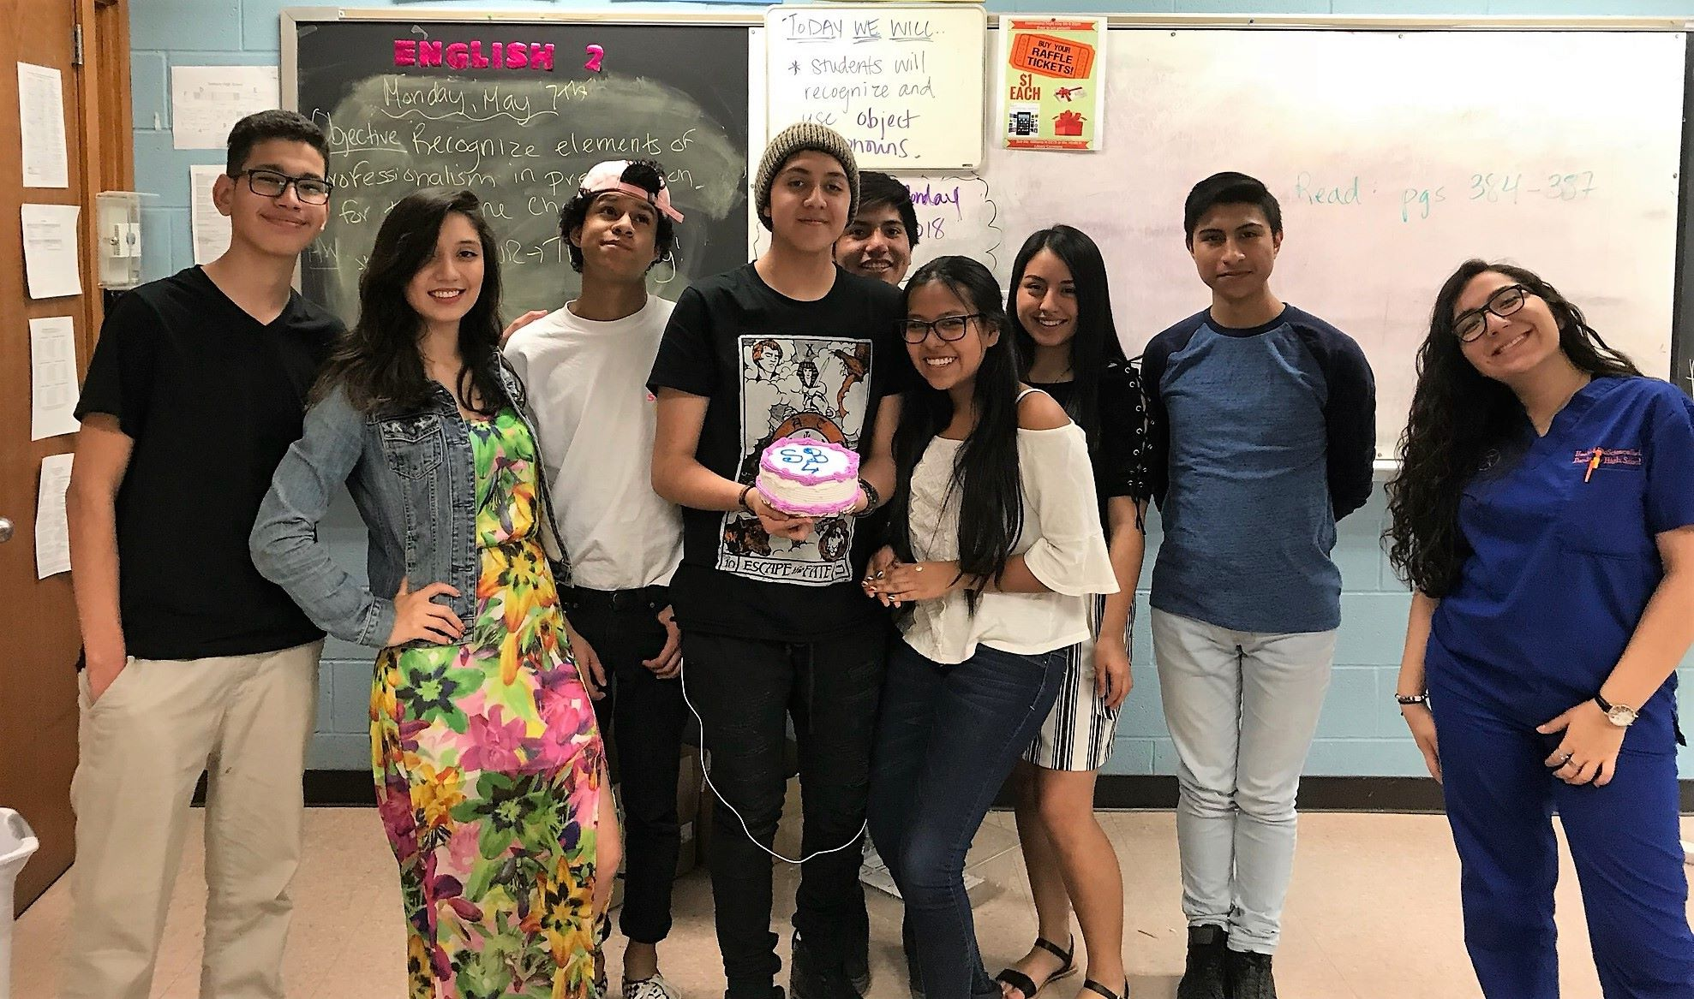
After School Programs
Notes:
What are stories for? -ownernishop power over their voices
non-profit and profit they use ppls stories to benefit themselves.
roundtable - students share student with legislators

Slide 5
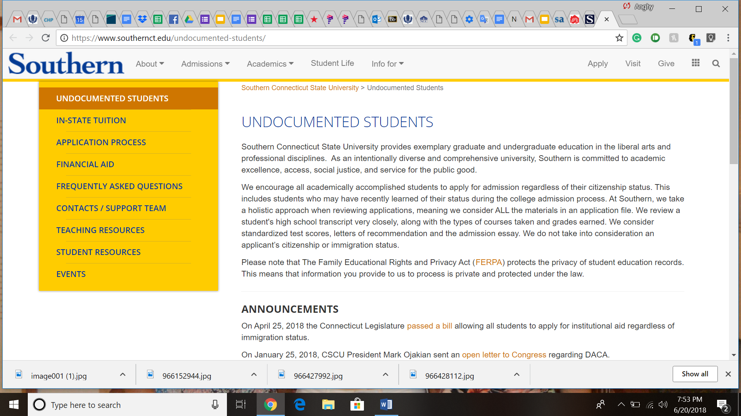
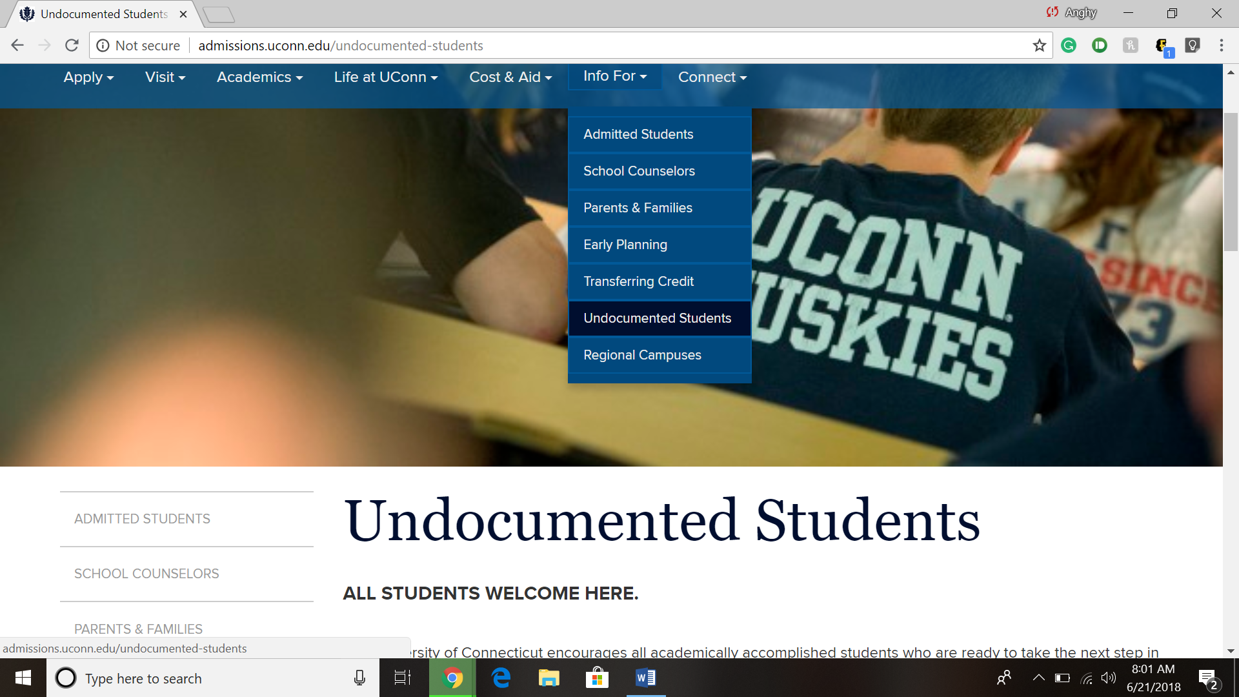
SCSU/ UCONN/WSCU
Notes:
South support team a team of edu,admin, student if the campus is meeting the needs of the students
came about talk to their professor/ admin how they didnt feel welcome on the compus. meet monthly
Share their stories
The admin came up with guidelines for students who are in deportantion.

Slide 6

URGENCY
Inertia
ANGER
Apathy
STAGNATION
MOTIVATION
Fear
HOPE
Isolation
SOLIDARITY
Self Doubt
YCMD
Notes:
WE created a lot of change and it was our stories that make change
but how did our stories created change bc our stories move ppl
How you bring peolple to

Slide 7





URGENCY
Inertia
ANGER
Apathy
STAGNATION
MOTIVATION
Fear
HOPE
Isolation
SOLIDARITY
Self Doubt
YCMD

