Slide 1
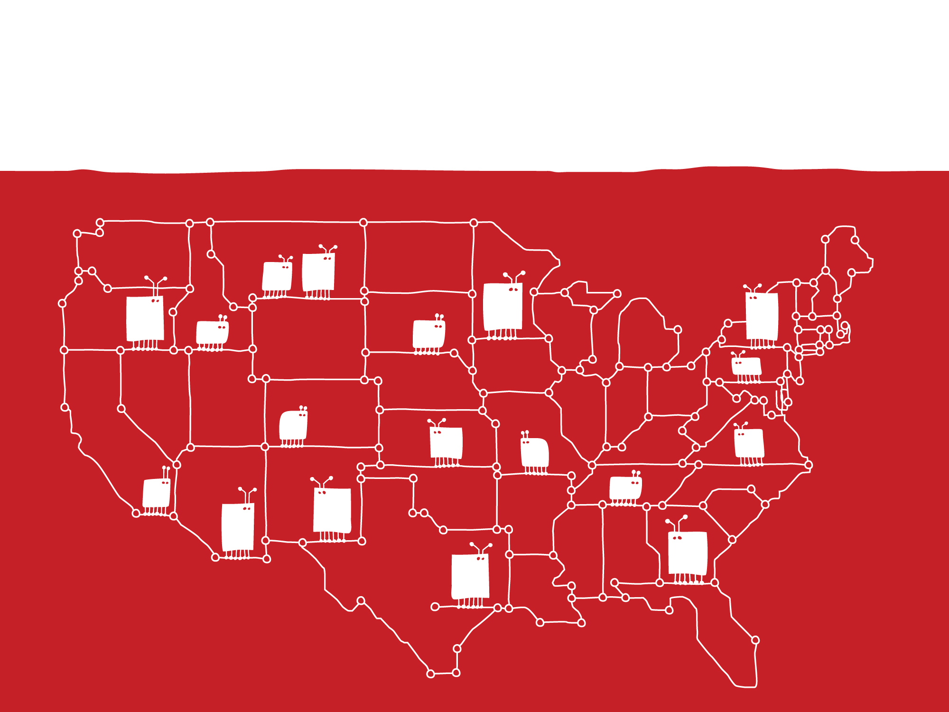
Digital Equity:
Reaching the Under-served and Under-connected
Vikki Katz Associate Professor
School of Communication & Information, Rutgers University

Slide 2

Notes:
Internet connectivity increasingly becoming synonymous with access to opportunity and resources, for both adults and children…
Digital equity increasingly recognized as tied to broader social inequalities that low-income families and children experience in the U.S.
To date, efforts to address digital inequality in learning opportunities have focused almost entirely on students in schools. And with considerable effect; ConnectED reports that 99% of nation’s classrooms are now broadband connected.
Attention turned increasingly to children’s connectivity outside of the classroom, programs began proliferating to encourage low-income families with school-age kids to get connected. Connect2Compete.
At the time I began this study in 2013, C2C was the only national-level effort to connect low income families with school-age kids to broadband at home, by offering access for $9.95 per month to families whose children qualify for free or reduced cost lunch.
My goal was to understand how families respond to digital equity programs being offered at national, state, and district levels—in their own words, and on their own terms. What is the bottom-up response from families to top-down digital equity policies?
How do they make decisions about adopting and integrating tech into family life, and how does that vary, and why across diverse families and localities?

Slide 3

Study Design
Qualitative Phase
(July 2013 to Feb 2015)
Three predominantly Mexican-heritage, high-poverty school districts in AZ, CA & CO
336 in-depth, open-ended interviews with parents and children ages 6-13 on the school lunch program
Member checks with administrators and families
Quantitative Phase
(Jan to July 2015)
Nationally-representative telephone survey (N=1,191)
Parents with children ages 6-13
All below national median household income ($65,000)
Race/ethnicity: 47% White, 30% Hispanic, 16% Black
Among Hispanics: 62% immigrants; 53% primarily Spanish-speaking
Notes:
Between July 2013 and February 2015, I led a talented team of student researchers to conduct open-ended interviews with parents and children in three demographically similar school districts in Arizona, California and Colorado.
All three districts were majority Hispanic with more than three quarters of students in the schools where we did interviews were on free/reduced lunch.
We focused on districts that were specifically Mexican-heritage because this is group of U.S. children most likely to be growing up in poverty, to have parents with less than a high school diploma.
All three districts were prioritizing tech initiatives of different kinds, and that included rolling out C2C.
We adopted a rapid approach to qualitative data collection, spending 2-3 weeks in each site and interviewing 50 to 60 families in that time.
Interviews took roughly an hour each. Children and parents were interviewed simultaneously but separately, in their language of preference, at home or at school, according to their comfort.
We asked how they make decisions about adopting technology, and how connectivity affects family relationships, learning activities, and connections to local services and resources. Part of each questionnaire was tailored to each site, asking parents and children to reflect on technology initiatives (e.g., one-to-one computing, computerized testing), specific to their district.
In total, we interviewed 170 families, a total of 336 interviews.
Once we had analyzed the interview data, we returned to schools with analyzed data to discuss findings with parents, children, and administrators.
Our findings informed the survey questionnaire we developed for the second stage in the study, which was a nationally representative survey of 1,200 parents raising children below the U.S. median household income—the first representative survey of this demographic. The survey was conducted in Spring 2015 and results were released in February of this year.
READ
I’m going to overview three themes from the findings today to frame our discussion

Slide 4

Family connectivity
Notes:
The first is that most families are connected, but most are not as connected as they want to be

Slide 5
Internet Access
94%
Have access*
*of 1,191 surveyed parents
Notes:
91% below FPL, 90% immigrant Hispanics
81% of families owned either a desktop or laptop computer, 79% at least one smartphone and 67% a tablet—so NOT the “have nots”
“Home access” means have a home computer with Internet service (laptop or desktop)—either broadband or dial-up
“Mobile-only access” means have a smartphone or tablet, but no home computer

Slide 6
Access is not enough:
Many families are under-connected
Parents with home access reporting on the past 12 months:
Parents with mobile-only access reporting on the past 12 months:
Notes:
33% of all experienced at least one; 51% of parents below FPL, 64% of Hispanic immigrants
How survey allowed us to assess who needs help most: 20% immigrant Hs don’t go online at all (2-4% of others) 41% mobile-only (vs. 16-25% of others, 44% don’t use computers at all (others 17-19%)

Slide 7
Those with mobile-only access less likely to use it

Slide 8
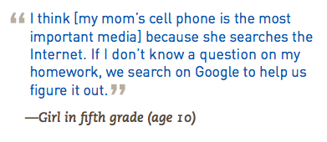
Managing the challenges of being under-connected
“
A veces es difícil, pero prefiero no pagar otras
cosas que [no pagar] por el Internet por las
tareas. Antes, lo cortaban, y durábamos tres
meses para volverlo a pagar. Ahora no, porque
si no lo tengo, ¿cómo le voy a ayudar para las
tareas? [Mejor] no pago el cable y voy juntando
[hasta que] me completo los $30 para el
Internet. Me decían del programa que hay
de Cox pero en esta área no entra Cox.
Sometimes it’s hard, but I prefer not to pay for
other things than to not pay for the Internet,
because of the homework. Before, they would
disconnect our service, and it would take up to
three months for us to pay it again. It’s not the
same now, because if I don’t have Internet
service, how will I help her with homework?
Instead I don’t pay for cable and save money
until I gather the $30 for the Internet. I heard
of the program through Cox, but Cox doesn’t
reach this area.
—Mother of a first-grade girl (age 7)
Creative strategies and parental sacrifices to provide tech and broadband connections for their children
Realities of parents’ tough choices
“
Notes:
Creative strategies—In interviews, parts talked about the sacrifices they made to purchase tech and provide Internet for their children--EG.
Similarly in the survey, it was clear that these families are not “have nots”—81% of surveyed families owned either a desktop or laptop computer, 79% owned at least one smartphone and two thirds (67%) owned a tablet.
making do; using mobile if that’s what they have
CLICK—hard choices.
Cost is the main factor driving lack of access; 42% of parents without access at home say it costs too much. Next category is 13% who say they don’t need it

Slide 9
Assessing available digital equity programs
Notes:
But very few families are benefiting from programs for low-income families like C2C

Slide 10
Very few have been reached by low-cost initiatives
Parents with household incomes >185% below FPL who have ever used low-cost Internet plans with income eligibility requirements:
Have ever used: 6%

Slide 11
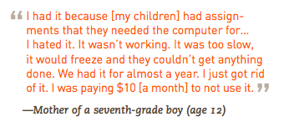
Digital equity initiatives: Perceptions and realities
Programs like C2C broadly under-utilized
Mismatch between family needs and service providers’ perceptions of adequate connectivity
Notes:
Consistent with the survey findings, interviews revealed that C2C was broadly underutilized by families who qualified for it—as all 170 families we interviewed did.
Only 37 families signed up for C2C’s broadband offer across the three sites
8 of 170 families going online for the first time
Why was program a mismatch for their needs?
They had more experience and more devices than the program’s designers had anticipated
An internet offer for a connection via one Ethernet cord did not match families’ media environments or needs, and this representative quote describes the speeds as too slow for the activities families routinely did online.
Therefore, families did not see this as a way to get internet that met their needs—so they paid more money for it.

Slide 12

Technology as a Catalyst for Family Learning
Notes:
The final finding I want to highlight is that although many families were less connected than they wanted to be, they made the most of the connections they have, together.
Important because it emphasizes considerable existing strengths in these families when it comes to engaging each other as learning partners around tech—families that are too often only considered in terms of their deficits (in income, ed, etc.)

Slide 13

Parents and Children
as Digital Learning Teams
We’re a team, and we achieve things together.
When I don’t know something, my wife helps, or we ask our other son. We solve the problem together.
In that aspect, technology has helped us, because it has made us closer.
Father of a 5th grader (age 10)
Notes:
Drawing the term from one of our interviewed parents, we found that parents and kids work as digital learning teams. We like the term “teams” because it emphasizes that all players matter, and that the results of efforts are shared.
We found that parents and kids scaffold each other’s learning, bringing different skills to the table and exchanging expert and learner roles dynamically.

Slide 14

Qualitative Phase:
Veronica and Teresa
When I can’t find a
website, they take the computer from me and do it themselves….I have to ask them to teach me [how to find it myself], and that’s when they help me.
- Teresa
Sometimes when
I have homework on the computer, I ask my mom and she helps me—and she learns a little bit more.
- Veronica (age 12)
Notes:
One of the families we profile in our case study report is Teresa and her daughter Veronica, in our Arizona study site. You can read about their family in more detail in that report, available on our website, but what I want to point out here is that parents and kids we interviewed routinely recognized the value of what they learned from each other when it came to technology…

Slide 15
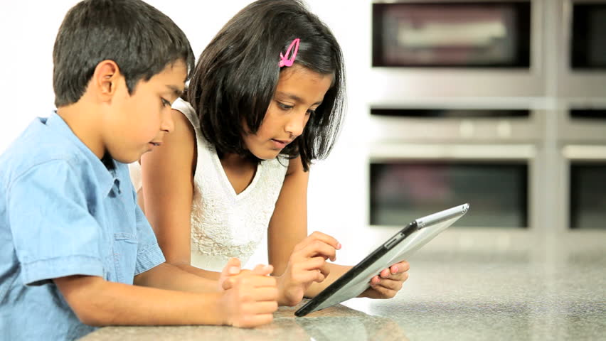
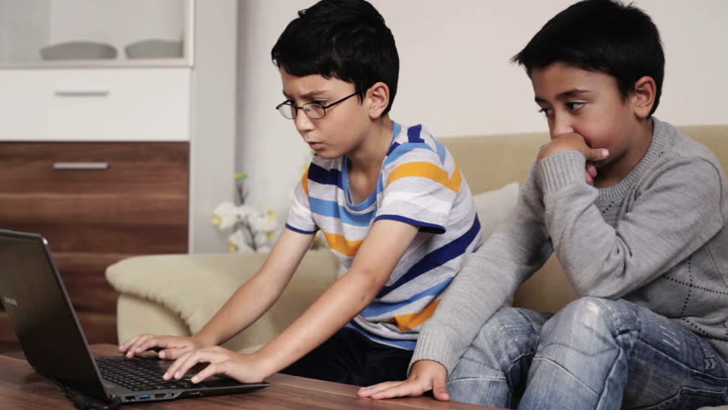
In parent-driven households, school-age siblings are significantly more likely to:
Read with or to each other**
Do homework together*
Do art and science projects together**
In child-driven households, school-age siblings are significantly more likely to:
Learn how to use computers or mobile devices together*
Watch TV shows or videos to learn something new**
N = 536; *p < .05 **p < .01

Slide 16
Differentials between parent tech guidance and child tech brokering (%)
 | Fixing things that go wrong with devices | Finding (and translating) online info | Learning how devices work | Downloading apps, software, music and movies
College grad or more | 26 | 41 | 19 | 23
Non-Hispanic Whites | 19 | 30 | 15 | 11
HS grad or some college | 11 | 12 | 5 | <1
English-dominant Hispanics | 5 | 7 | 4 | 4
African Americans | 9 | 1 | 2 | 3
Some HS or less | 9 | 7 | 15 | 12
Spanish-dominant Hispanics | 12 | 17 (14) | 23 | 21
Tech assistance flows from parents to children
Tech assistance flows from children to parents
Notes:
77% of parents have guided kids’ tech use; 53% of kids have brokered parents’ connections, and 81% of siblings have done so for each other.
With regard to these more specific activities,
Across the full sample, no fewer than one-third—and up to two-thirds—of parents and children help each other learn how new devices work.
This finding alone reveals that the process of adopting “personal” devices is, in fact, strongly predicated on collective engagement with those technologies. Likewise, parents and children are frequently guiding each other in troubleshooting things that go wrong with devices, finding (and translating, in Spanish-dominant families) online information, and downloading apps, software, music, and movies.
Sig variation by race/ethnic origin, parent education, but not income.
What about siblings?
Intensive parent-tech guidance = help each other more with homework, art/science projects, reading together
Intensive child tech brokering = more help with going online together to learn, videos and TV together

Slide 17
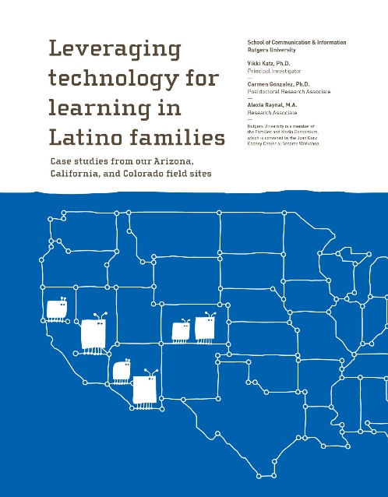
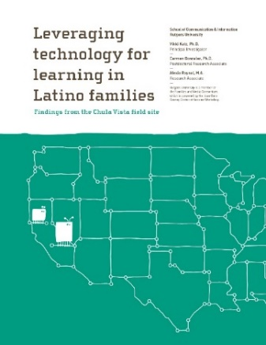
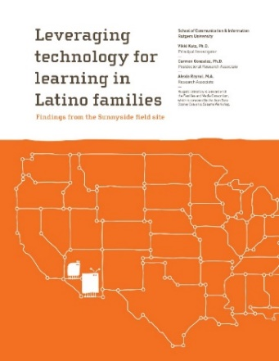
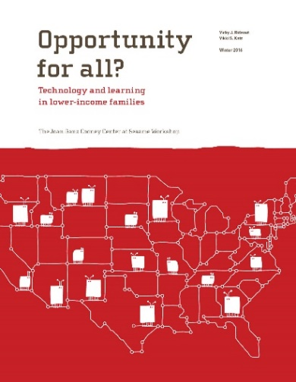
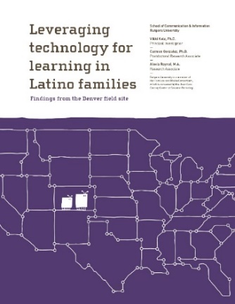
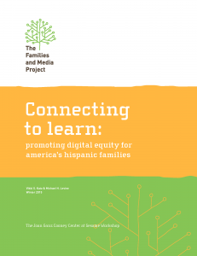
digitalequityforlearning.org

Slide 18


Vikki Katz
Rutgers School of Communication & Information
vkatz@rutgers.edu
vikkikatz.com digitalequityforlearning.org
With gratitude:
To My Research Team:
Rocio Almanza-Guillen n Adam Bradbury n Regina Calvario n Yasmin Campos n
Jesus Jaime Diaz n Daisy Garcia n Camila Gavin-Bravo n Beni Gonzalez n Carmen Gonzalez n Michelle Hawks-Cuellar n Gerardo Hernandez n Leslie Hill n Scarlett Jimenez n
Hillary Kosnac n Yarazel Mejorado n Andres Nuncio-Zuñiga n Alexia Raynal n
Andrea Rodriguez n Boanerges Rodriguez n Silvia Rodriguez-Vega n Hugo Salgado n
Dinorah Sanchez n Dennise Vega n Mariana Zamboni
To My Funding Partners:
Notes:
How digital and social inequalities are made manifest in the everyday lives of low-income and immigrant children and their families—and in how families respond to the challenges that result from these disparities.
I am fundamentally concerned with how children learn by contributing to family efforts to address everyday challenges, and whether the skills they develop through these activities are recognized and validated in school settings.

