Slide 1

Digital Equity: Reaching the Under Served and Under Connected
ELIN SWANSON KATZ
CONNECTICUT CONSUMER COUNSEL
Cross-Cultural Communications: Telling Your Story
Sponsored by Connecticut Department of Consumer Protection
JUNE 21, 2018
Notes:
Until I was appointed to this job in 2011, I never really thought about utility poles; in fact, I never really even saw them. However, I now know that utility poles are one of the most important structures when it comes to both electric and telecom utility services. They bring us two of our most essential services: electricity and communication. So utility poles are sexy.
I’m please because I think in part because of the work of my office, but also because of the folks in this room and others like you, Connecticut has made some major advances, even in the last week, and is now treating utility poles with the respect they deserve.

Slide 3

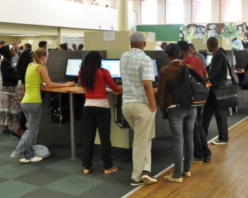
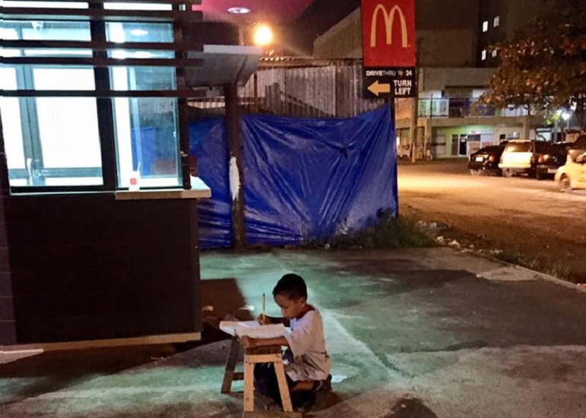

How are unserved and underserved children doing their schoolwork?

Slide 4
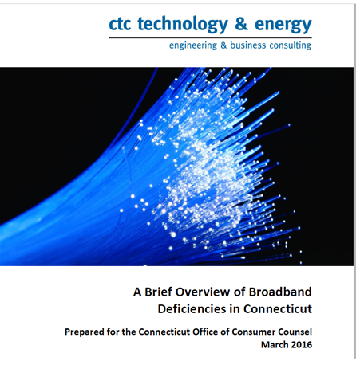

Slide 5
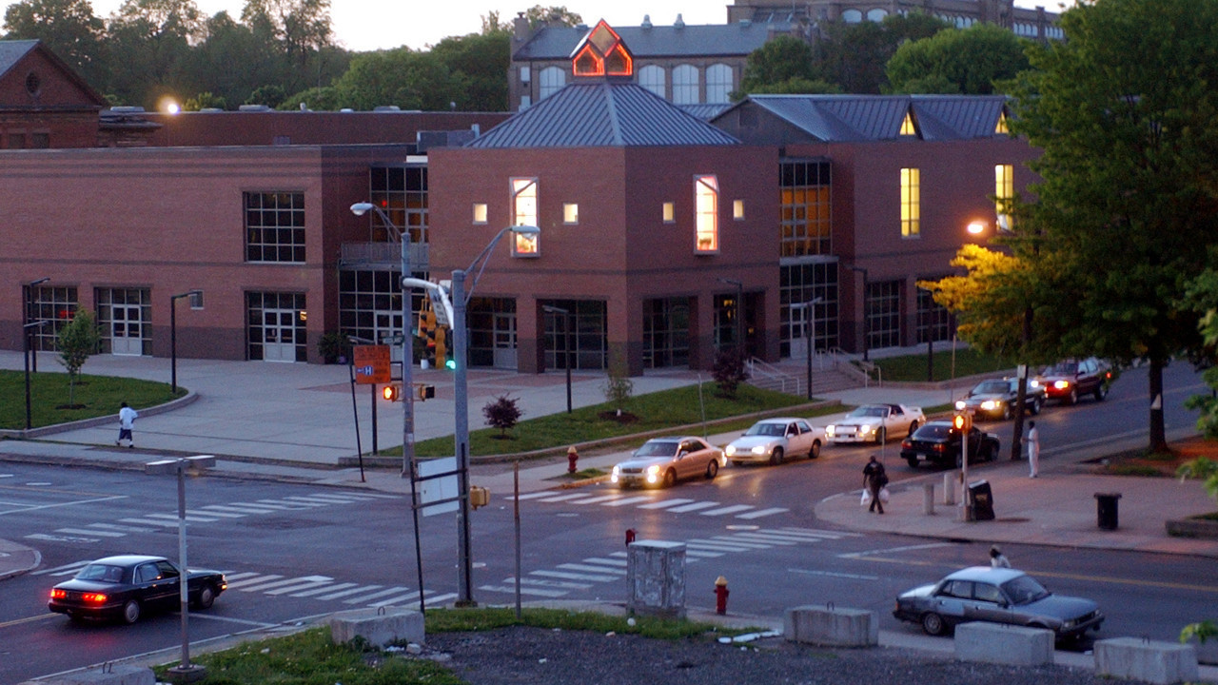
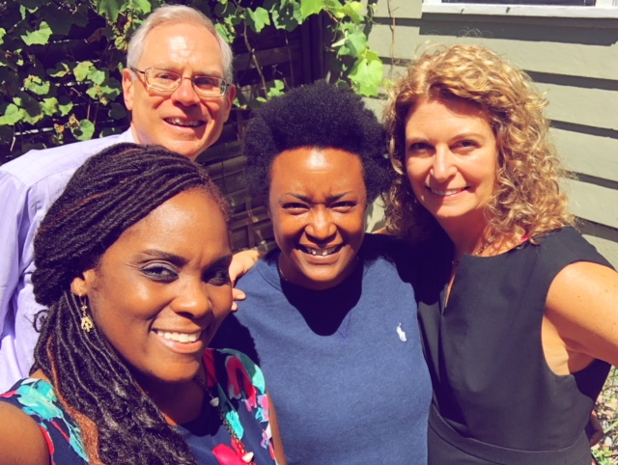
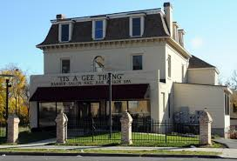
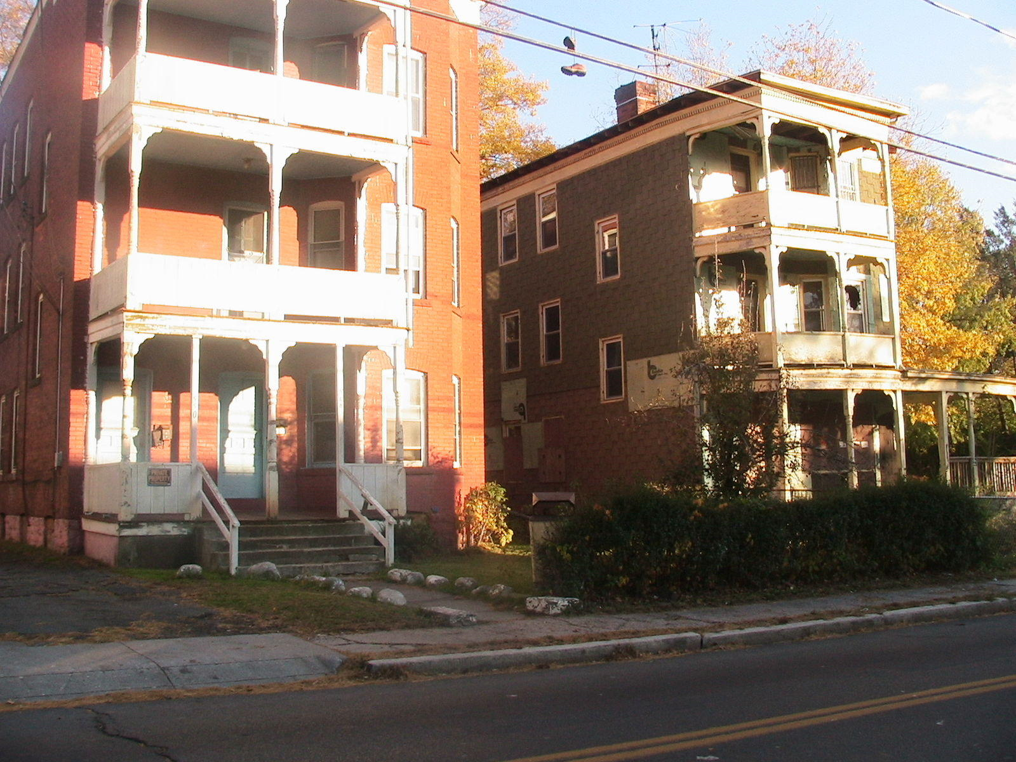

Slide 6
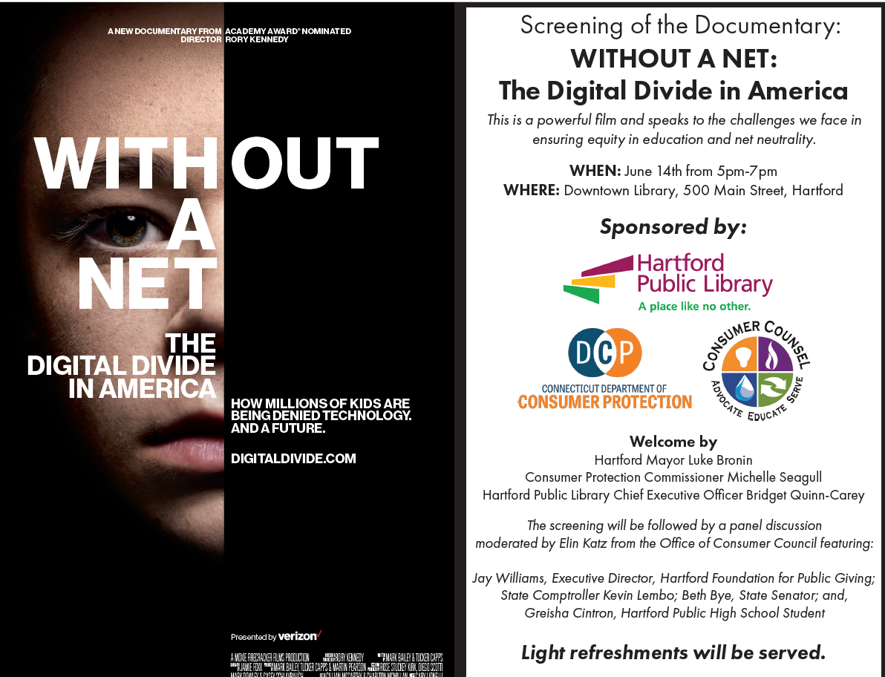

Slide 7

How do we change the narrative?
Notes:
Legal action

Slide 8

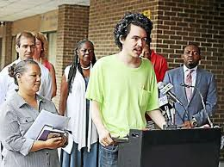
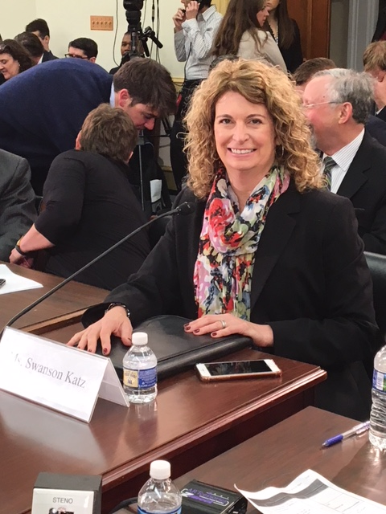

Advocate. Speak Up. Tell Your Story.
Notes:
No one believes us!

