Slide 1
How to Cultivate Authentic Board Diversity
DCP Cross Cultural Communication Symposium
June 21, 2018

Slide 2
Copyright Notice
Copyright © 2018 by Minority Inclusion Project Incorporated
All rights reserved. No part of this publication may be reproduced, distributed, or transmitted in any form or by any means, including photocopying, recording, or other electronic or mechanical methods, without the prior written permission of Minority Inclusion Project Inc., except in the case of brief quotations embodied in critical reviews and certain other noncommercial uses permitted by copyright law.
Minority Inclusion Project Incorporated
901 Main Street
Manchester, CT 06040
www.ctmip.org

Slide 3
Questions We Will Answer Today
What is Minority Inclusion Project?
Why Does Diversity Matter on Nonprofit Boards?
What are the ways to cultivate board diversity?
What is the Board Diversity Initiative?

Slide 4

What is Minority Inclusion Project?

Slide 5
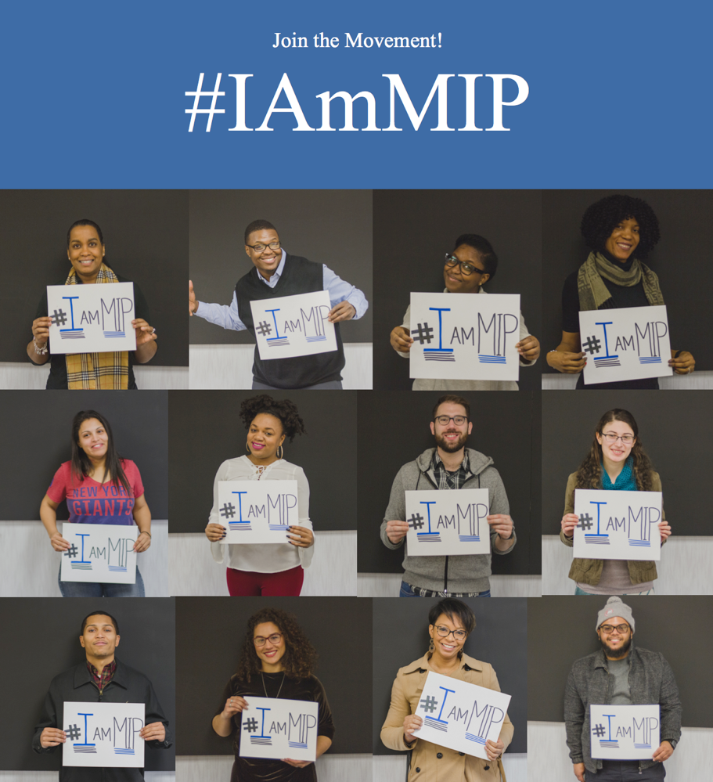
Who We Are
Minority Inclusion Project (MIP) works within a peer-learning network of nonprofit, private, and public partners to close the nonprofit racial leadership gap by creating pathways to leadership for people of color
Our growing network includes more than 50 organizations and 700 individuals across sectors including faith-based and arts organizations, private foundations, nonprofit agencies, community coalitions, private sector businesses, colleges, and more
Notes:
Reference Information one-pager in folder***

Slide 6



















2018 Partnerships

Slide 7
MIP Strategic Goals & Objectives
GOALS
To close the nonprofit racial leadership gap by leading efforts to overcome individual, institutional, and systemic barriers
To help nonprofits stay effective and relevant in a changing world by aligning their values based on equity and inclusion with their practices
To break the cycle of racialized practices, organizational structures, and policies that lead to majority white boards, and staff in nonprofits
To increase the number of nonprofit leaders of color needed to address the practices and biases of nonprofits in Connecticut
OBJECTIVES
Connect nonprofits with a pipeline of racially and ethnically diverse talent, emerging leaders, and seasoned professionals for executive and board leadership
Provide transformational technical assistance, training, and consulting services for nonprofit organizations in strategic visioning, goal setting, and planning of diversity, equity, and inclusion plans
Engage in, facilitate and lead cross-cultural bridge building between professionals of color and nonprofits
Leadership & career development services for professionals of color including board training, job coaching, networking & referrals.

Slide 8
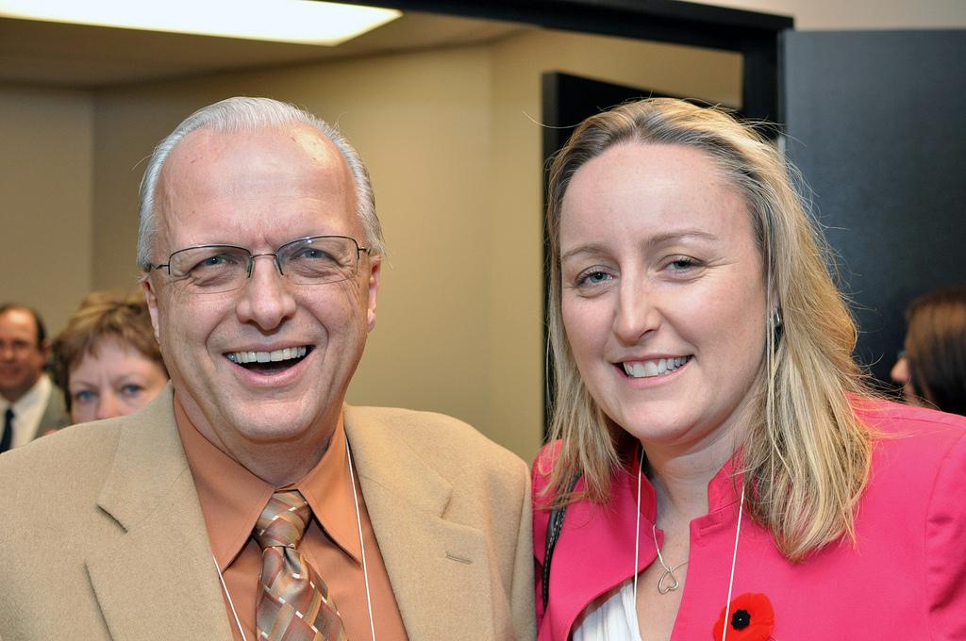

Programs & Services
Nonprofit & Public Agencies
  Board Diversity Initiative w/ recruitment assistance
  Equity, & Inclusion Training, Coaching & Consulting
  Nonprofit Equity Summit
  Courage in Conversations
  Peer Learning Network
Students & Professionals of Color
  Board Leadership Training & Coaching
  **Pathways to Service Initiative
  **Emerging Consultant Network
  Coffee Connections
  Board, Job, and Internship Opportunities

Slide 9
Why Diversity Matters

Slide 10
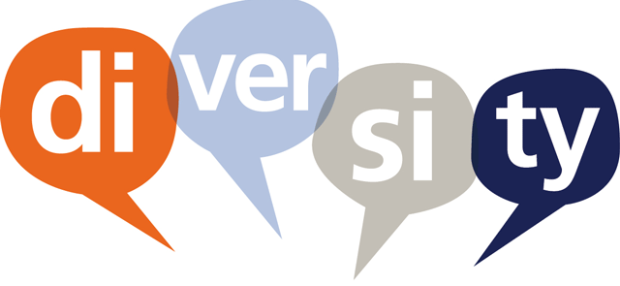
Nonprofits & Diversity
One of the reasons that DEI conversations tend to be frustrating and unproductive is that they lack a clear framework, a starting point that emphasizes consensus around definitions of terms and concepts, and most importantly, a clear set of goals.” – D5 Coalition
“Nonprofits don’t really care about diversity” – Rosetta Thurman, Stanford Social Innovation Review
“While increasingly, the nonprofit sector is embracing “asset” based approaches to its work, people of color remain too much on the outside of program design, development, delivery, and evaluation” – Tiziana Dearing (former Executive Director of Harvard’s Hauser Center for Nonprofit Organizations)
“Discussions about diversity are difficult to engage in. The topics of race, ethnicity, gender, and sexual orientation evoke deeply felt, complex emotions, and participants in the discussion frequently have quite different points of view.” Jan Masaoka, Blue Avocado
“The nonprofit sector has a Ferguson problem” – Derwin DuBose, Nonprofit Quarterly
Notes:
DEI conversations tend to be frustrating and unproductive
Lack a clear framework, a starting point that emphasizes consensus around definitions of terms and concepts, and most importantly, a clear set of goals.
DEI conversations begins with color consciousness or critical awareness of race and racism.
Colorblindness is an aspirational strategy to reduce racial prejudice that is not effective in a world of racial inequalities.
Colorblind racial ideology has been defined in a landmark American Psychologist article by Helen A. Neville and colleagues (2013) as consisting of two interrelated domains:
Color-evasion - denial of racial differences by emphasizing sameness
Power-evasion - denial of racism by emphasizing equal opportunities
Arguments and policies based on colorblind theories and ideas tend to have certain common characteristics. They tend to deny:
race
blatant forms of racism
institutional racism
Privilege
Awareness of and valuing diversity are not sufficient to achieve it
Assuming that diverse persons will be attracted to an institution simply because of its excellence or because it values diversity is a passive approach that is unlikely to diversify an institution.
Proactive and ongoing efforts toward inclusion and equity are necessary to create and sustain diversity.
Diversity, equity, and inclusion are inter-related but distinct concepts. As such, efforts toward their realization can create synergy, but each requires specific attention.

Slide 11
WHY IS BOARD DIVERSITY SO HARD TO ACHIEVE?
OPTICS
Race, Gender, Age
UNDERLYING REASON
SYSTEMS
CULTURES
BELIEFS, VALUES, BEHAVIORS

Slide 12
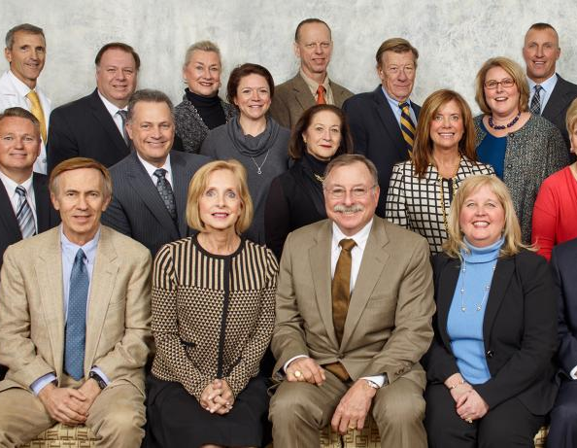
The Problem
PEOPLE OF COLOR ARE GROSSLY UNDERREPRESENTED IN CEO AND BOARD ROLES IN THE NONPROFIT SECTOR
  The U.S. is 60% Non-Hispanic White and 40% of People of Color; By 2044, the majority of the U.S. population will be People of Color
  80% of nonprofit board members are white; 25% of nonprofit boards are entirely comprised of white people
  90% of board chairs and 89% of nonprofit ED/CEOs are white
Notes:
Source: Leading With Intent, BoardSource (2017)

Slide 13

WHY DEI?
REPRESENTATION MATTERS!
IT’S GOOD FOR BUSINESS.
IT’S GOOD FOR IMPACT.
IT’S THE RIGHT THING TO DO!
Notes:
Source: Leading With Intent, BoardSource (2017)

Slide 14
Ways to Cultivate Authentic Board Diversity

Slide 15

TOKENISM
The practice of making only a symbolic effort to recruit a small number of people from underrepresented groups in order to give the appearance of sexual or racial equality, or the appearance that all people are treated fairly
Happens when organizations cannot articulate the CASE for diversity
Devalues POCs and other marginalized groups

Slide 16
The Cycle of Change
Phase 1
Phase 3
Phase 2

Slide 17
Board Self Assessment
Assemble DEI Cmte
Phase 1
Gather Information
Define DEI for your board

Slide 18
Establish Case Statements
Develop a vision for change
Phase 2
Establish Measurable Goals/Outcomes for your DEI Initiative
Create a DEI evaluation plan

Slide 19
Create a DEI Action Plan
Secure Resources to Support Implementation
Phase 3
Implement the DEI action
Sustain, Manage, and Evaluate the DEI Action

Slide 20
What is the Board Diversity Initiative

Slide 21
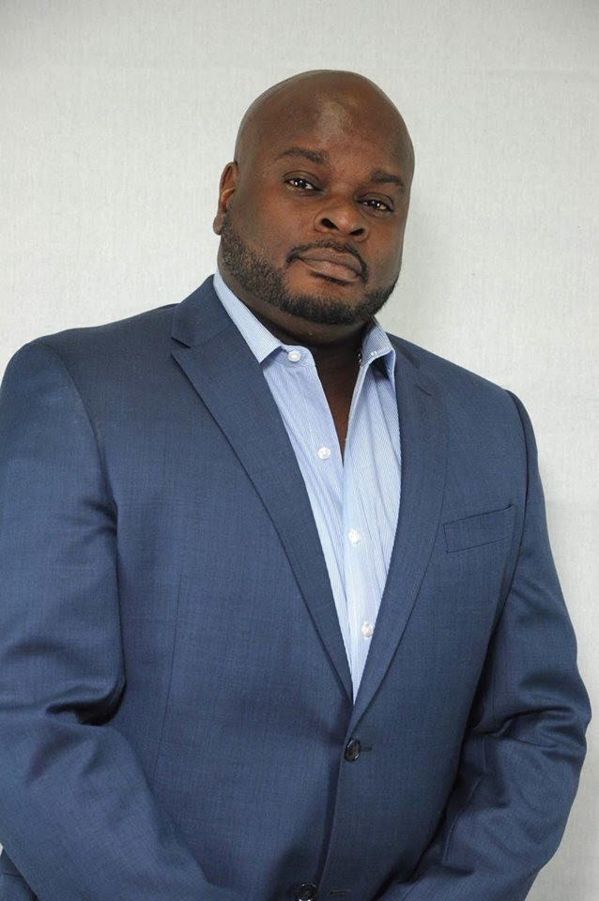
Lv. 1 – Board Diversity Starter
2 hour DEI conversation starter facilitated by MIP:
    1 hr. information session about nonprofit board diversity / overview of REIDS
    1 hr. moderated Q&A with board & org leaders
    On Site convenient location for your board (physical location, online, etc)
Advanced enrollment is based on scheduling and availability of MIP staff and organization’s board

Slide 22
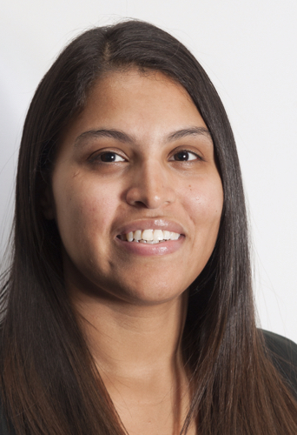
Lv. 2 – Customized Board Diversity Retreat
1-2 Day REIDS Workshop for teams of up to 4 (Executive Leaders and Board Members)
    REIDS Training
    Team Activities
Includes
    Pre-Course Materials
    Program Course Materials
    Post-Course Resources
Advanced enrollment is based on scheduling and availability of MIP staff and organization’s board

Slide 23

Lv. 3 – Board Diversity Cohort
6 months – REIDS training & Inclusion Coaching
Networking & Cultivation Event
REIDS Certification - Community Presentation Event
6 months - post-program Board Recruitment Assistance

Slide 24
Program Timeline (PHASE I)
Contracting; Enrollment; Board Assessment; Board Recruitment Profile Sheet
Planning
Sept. – Oct. 2018
July – August 2018
Nov. – Dec. 2018
Recruitment
Information Sessions

Slide 25
Program Timeline (PHASE II)
STAGE I
  Intro to BDI
  Terms, Definitions, etc.
  Research
  Case Statements
STAGE 2
  REIDS Strategies & Activities
  REIDS Evaluation
Board Diversity Networking & Cultivation Event
Recruitment Assistance
Feb. 2019
Apr. 2019
June 2019
Jan. 2019
Mar. 2019
May 2019
July–Dec. 2019
Inclusion Coaching
Inclusion Coaching
STAGE 3
  REIDS Action Plan Due
  Final Presentation

Slide 26
INTERESTED?
Contact:
Esther Jean-Marie, Director of Operations
Esther@ctmip.org
Karen Adamson, BDI Program Coordinator
Karen@ctmip.org

Slide 27


