Slide 1
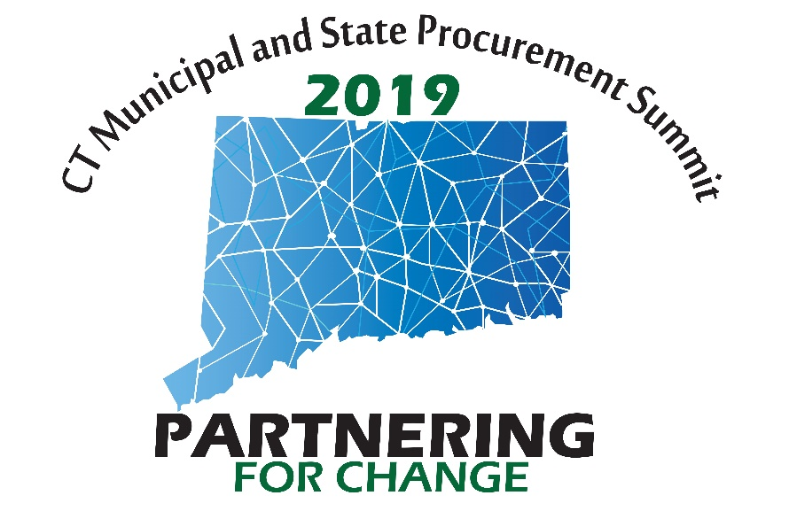
Reaching New Limits!
General Letter #71 & Amazon Business Services

Slide 2
What is General Letter 71 (handout)?
Delegated purchase authority granted by DAS/Procurement to executive branch agencies for purchases that are not on a current/active state contract

Slide 3
What has changed in General Letter #71?

Slide 4
How do I use it?
Determine if there’s a state contract in place for what you need to purchase (see State Contracting Portal)
If yes, agency must use the state contract for the purchase.
If no, follow the application of General Letter #71 (see handouts)
Be sure to review and follow the terms/application of each section of the Letter as they cover different thresholds and/or purchase scenarios.
DAS reviews/audits purchases under General Letter #71 periodically and searches for opportunities for new contracts as well as addresses/educates misuse of delegation.

Slide 6
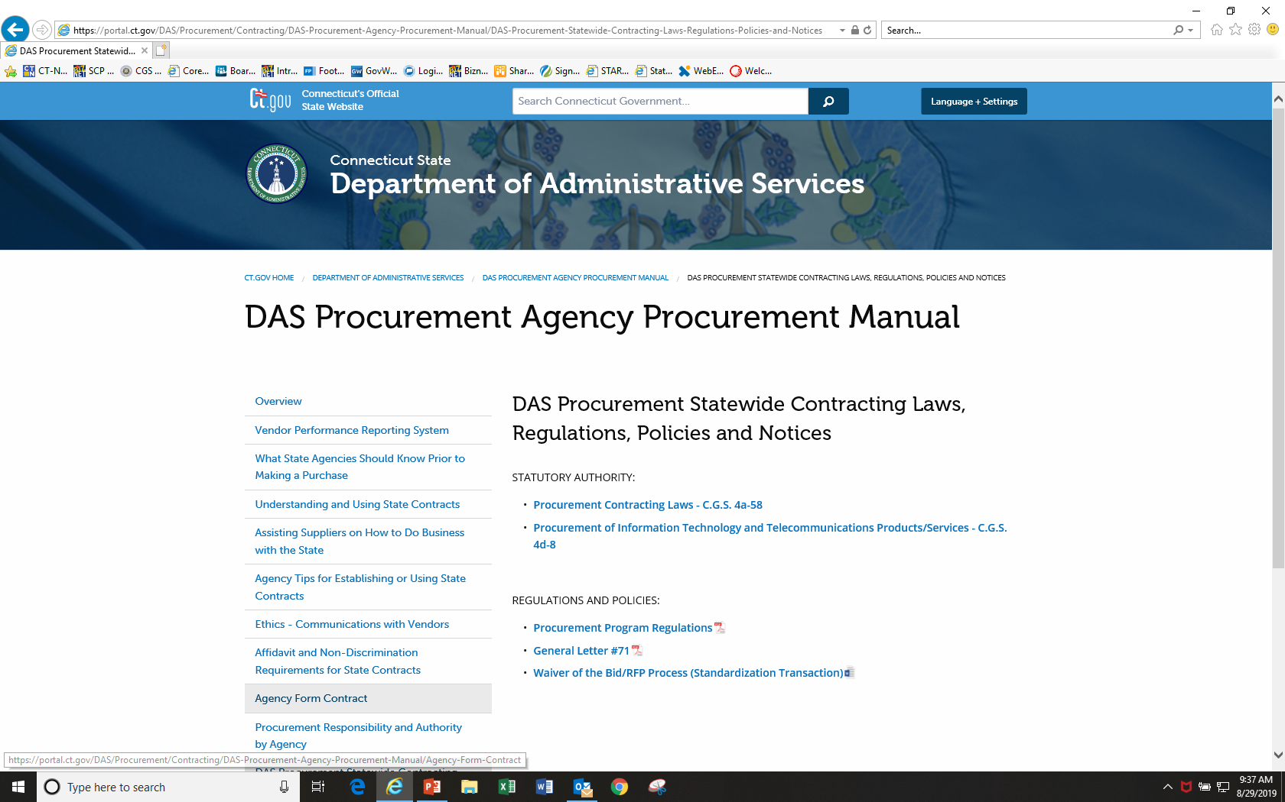
Where can I find more information about GL71?

Slide 7
Amazon Business Services!
How do I use Amazon for GL-71 purchases?
Link to Amazon Business Information on DAS Web Portal

Slide 8
Everything you love about Amazon. For Public Sector.
Amazon Business is bringing the Amazon marketplace to government to help achieve cost-savings goals, meet compliance requirements, reduce procurement complexity and access unmatched selection breadth.

Slide 9
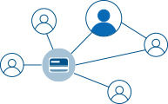
Introducing Amazon Business for Public Sector
Flexible features that align with your organization’s procurement processes & policies
Improve Risk Management
Keep personal & work purchases separate
Tax-exempt shopping
Detailed transaction reporting
Spending approvals & controls
PunchOut from eProcurement systems
Save Your Org Time & Money
Fast reliable shipping
discounts on millions of items
Consolidated shipments, Quote to order
Dedicated implementation specialists

Slide 10
Amazon Business Benefits
Business Pricing & Quantity Discounts
Business pricing and quantity discounts are only available to registered business account customers on Amazon. Click to learn more.
Business Prime Shipping
Once Business Prime Shipping has been purchased, it provides Free Two-Day Shipping on eligible items for all users in the business account. There are multiple pricing tiers to meet the needs of businesses of all sizes. Click to learn more.
Buying Policies
Customize Amazon Business to your organization’s buying standards and procedures. Features include approval workflows, negotiated pricing, preferred suppliers and preferred products.
Business-Only Selection
Business-only selection refers to items and offers that are only available for purchase by Amazon Business customers.
Amazon Business Analytics
Use Amazon Business Analytics to view data about your orders, create and filter reports based on your business needs, and view both charts and tables. Click to learn more.

Slide 11
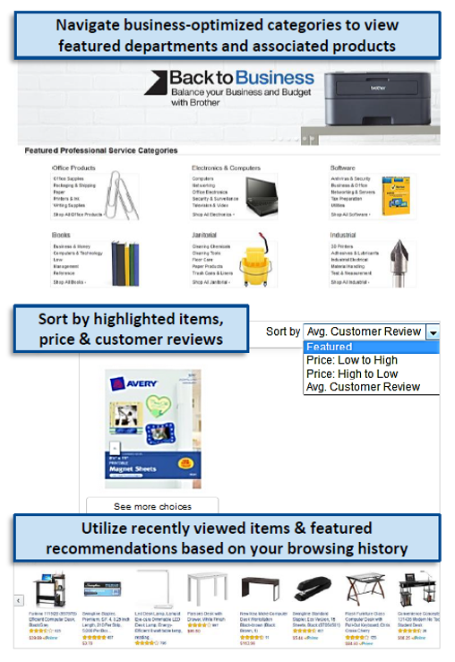
Search & Browse Optimization
Amazon is the “everything store.” With such a large selection, we do our best to make it easy for you and your end users to find what you’re looking for.
Recommended filters:
Business Sellers
Prime Eligible
Brand
Average Customer Review/Rating
Diversity Credentials

Slide 12
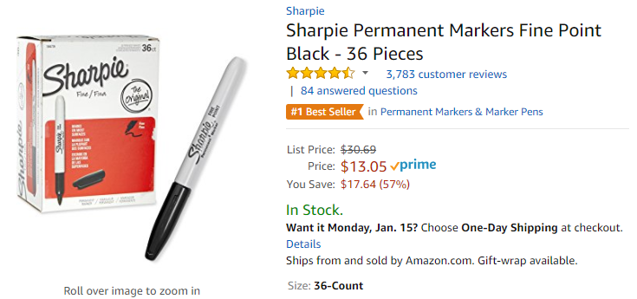
Take Advantage of Amazon Prime Shipping Benefits
An easy way to ensure that your products arrive on time and as expected, is to order products fulfilled directly from Amazon. All products clearly mark who the seller is on the product detail page.
Prime Eligibility – Fulfilled by Amazon
Prime eligible items are fulfilled by Amazon. We recommend searching for prime eligible items.
What’s not Included?
Business Prime Shipping does not include additional Prime benefits such as Amazon Fresh, Pantry, Video, or Music.

Slide 13
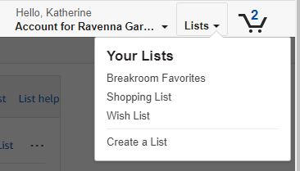
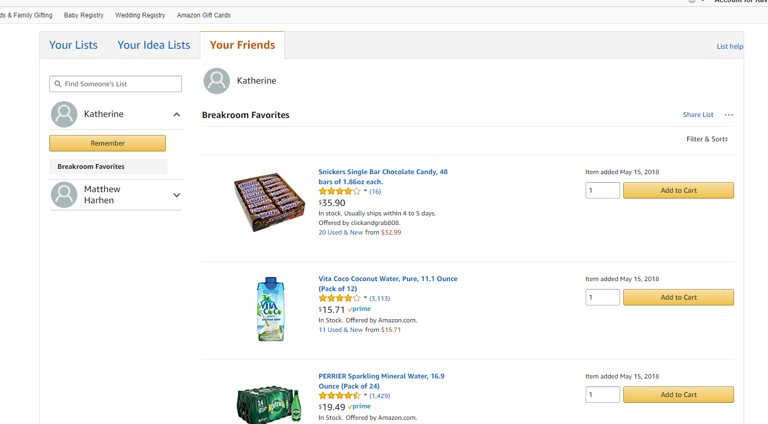
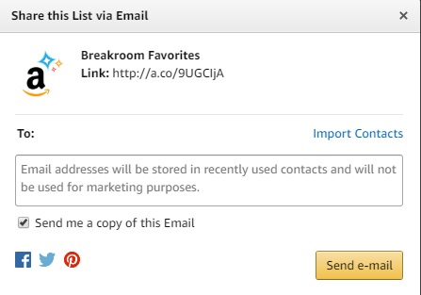
Reorder & Shopping Lists
How do lists work on Amazon Business?
Lists make it easy to keep track of the things you need and are easy to share with others. Any User on Amazon Business can create a shopping list
Choose between multiple list types depending on if you want the items to remain on a list after they are ordered
To share your list, create a public list and use the URL to email it directly to your desired audience
When a list is shared with you, you can save it to your own account or make a copy to edit yourself

Slide 14
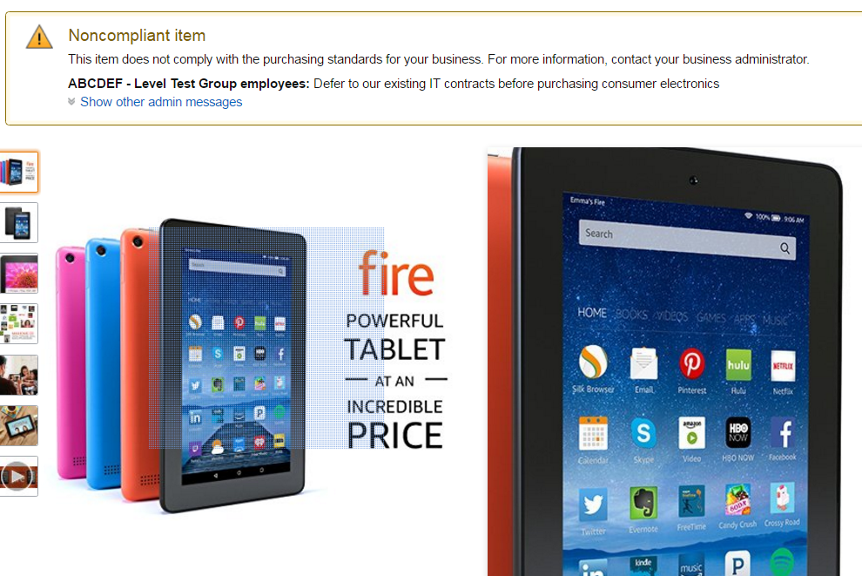
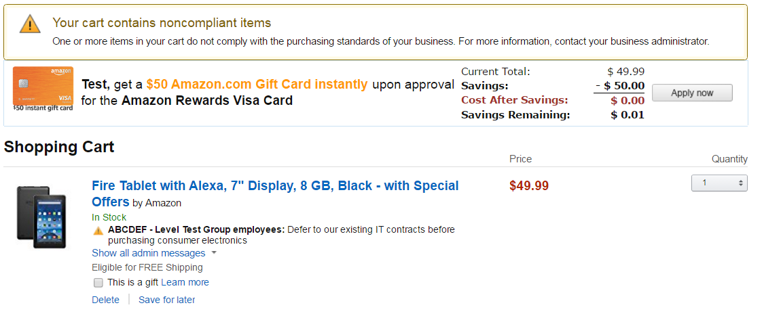
Restricted Policies
Look for customize messaging! This will let buyers know IF and WHEN they can purchase certain categories on Amazon Business
Restriction Best Practice:
Because restrictions are created at the category level, some permitted items may get unintentionally restricted.

Slide 15
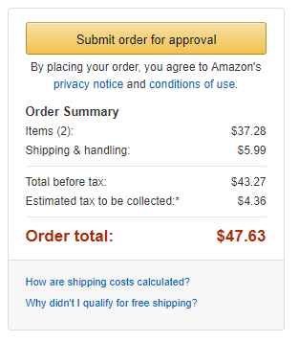
Approval Workflows
Some orders or all orders placed on the account may be subject to approval before being fulfilled
How do I order with Approvals configured?
Depending on your role, some or all of your orders may require approval.
There are no additional steps to take to submit your order for approval. Check out as you normally would and you will see the option at checkout.
Your order will not be processed until it is approved by the appropriate approver. Keep this in mind for shipping timelines.
You will be notified over email once your order is submitted and then again once your order has been approved and processed. Just as with a normal order on Amazon, you will also receive relevant shipping updates.
If your order is not approved within 7 days, the order will automatically be canceled; however, the items in your order will not be deleted. If your order is canceled, you will need to submit the order again for approval.

Slide 16
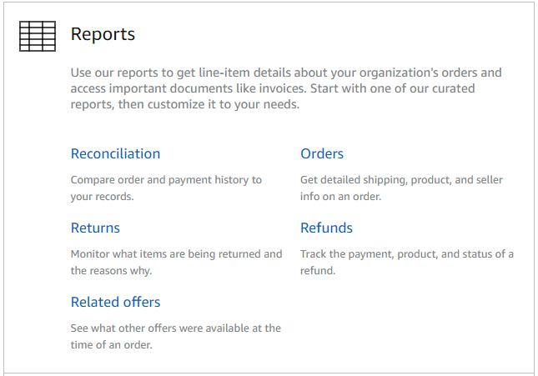
Amazon Business Analytics
Amazon Business Analytics provides the ability to:
Aggregate purchases to compare and track spend over time
Monitor and track 60+ data fields including customer info, shipment info, payment info, and seller info
Customize and save report templates to meet business needs
Download CSV files to analyze your data in excel

Slide 17
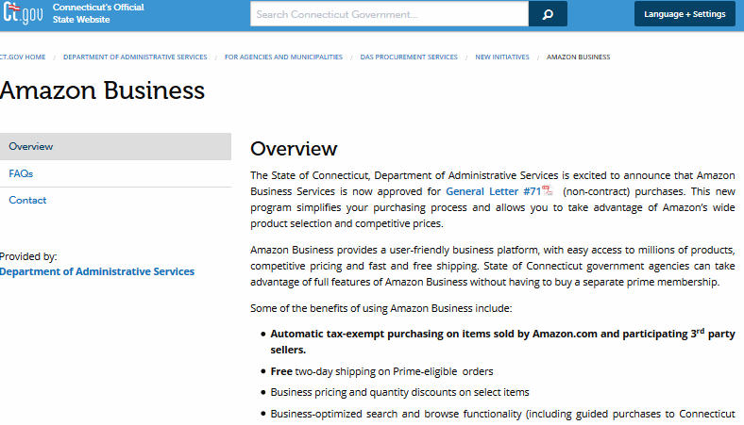
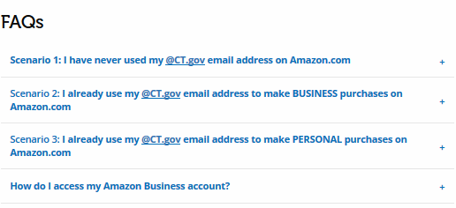
Check the DAS portal for more information
Look on the portal:
https://portal.ct.gov/DAS/Procurement/Contracting/Amazon-Business

Slide 18
THANK YOU!

