Slide 1
Long-Term Recovery Planning June 2020

Slide 2
Agenda
Our Shared Challenge
Statewide Long-Term Recovery Approach
Engagement with Local Communities
Example: The Process in Action
Next Steps and Resources

Slide 3
Our Shared Challenge

Slide 4
Forging a Path to Connecticut’s Recovery
Responding to a disaster is shared responsibility; it calls for the involvement of everyone — state government, local government, and a wide range of community partners.
By working together, we can help our residents and our communities meet their urgent needs and bounce back from the COVID-19 crisis.
— Governor Ned Lamont

Slide 5
FEMA’s Factors of a Successful Community Recovery
Experience shows that the presence of certain factors in a community can help ensure a successful recovery:
Effective Decision making and Coordination
Integration of Community Recovery Planning Processes
Well-managed Recovery
Proactive Community Engagement, Diverse Representation, and Public Awareness
Well-administered Financial Acquisition
Organizational Flexibility
Resilient Rebuilding

Slide 6
We have a chance to employ important lessons from Hurricanes Sandy and Maria
Recovery starts locally: it is essential to maximize local resources to help our residents. This disaster will likely have impacts that last several months. We will need all available resources from local, state and federal levels working together to restore our communities.
Local Long-Term Recovery Committees should maximize participation of partners including social service and faith-based organizations, local governmental agencies, private sector and philanthropic partners, and organizations that serve diverse populations to ensure interests of all community members are represented.
Communities should establish a system for identifying unmet recovery needs of residents to properly advocate for resources and funding.
Statewide emergency response is most effective when our state-level recovery team works together with coordinated efforts in our local communities.

Slide 7
Our Shared Goals for This Recovery:
All Connecticut residents receive the assistance that they need.
Our communities are confident the process is fair, and that cities, suburbs and small towns are treated equitably in terms of need. Our local, state, and federal resources work closely together.
Our residents, our communities, and our state recover as quickly and as fully as possible!

Slide 8
Statewide Long-Term Recovery Approach

Slide 9
FEMA Coordination Map: Large-Scale Events

Slide 10
Strategically Uniting Local, State, and Federal Efforts
Our goal is to unite efforts at the statewide level with efforts of multiple stakeholders at the local level
Some of the parts of recovery are already working – many communities are already doing great work to support residents
State and federal programs provide critical assistance in many areas
Nonprofit partners and VOAD (Voluntary Organizations Active in Disaster) agencies are providing emergency assistance to those most in need
Our towns and cities are answering the call, staying on the job and protecting their citizens

Slide 11
Connecticut State Disaster Recovery Framework
The Connecticut Long Term Recovery Committee (LTR) is one of 14 Support Functions (ESFs) that comprise the State Response Framework.
Since early 2012, the LTR Committee has been building a framework for the state to support long-term recovery of our communities through:
Coordination of federal, state, local government resources
Involvement of business and nonprofit sectors
Education & outreach
Mitigation and risk reduction programs & policies
Involvement of Connecticut VOAD & NGOs

Slide 12
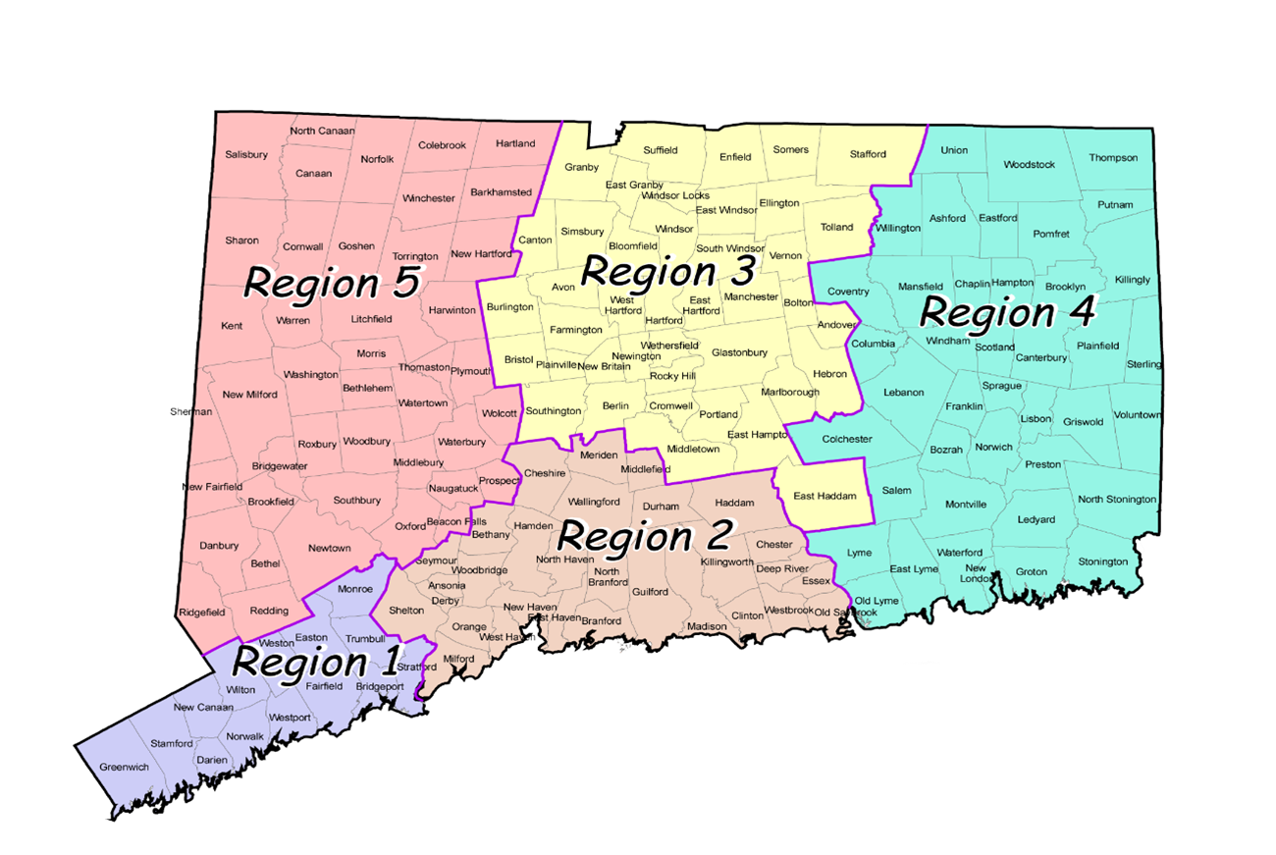
DEMHS Regions DEMHS Regional Coordinators connect local communities to the state emergency Operations Center (SEOC)
The Regional Emergency Planning Team in each DEMHS region has appointed a Long-Term Recovery Coordinator

Slide 13
Regional Recovery Committees
Together with a statewide Recovery Steering Committee under ESF14, DEMHS Regional Coordinators and community partners have formed Regional Recovery Committees.
Regional Recovery Committees include:
Locally elected officials
Councils of Government
Nonprofit leaders
Businesses, Chambers of Commerce and other business support organizations
Representatives of underserved communities
These committees will:
Help lead and manage recovery at a regional level
Provide input and feedback for statewide recovery planning and implementation
Support local recovery committees

Slide 14
Engagement with Local Communities

Slide 15
Connecticut State Disaster Recovery Framework
Statewide emergency response is most effective when our state-level recovery team works together with coordinated recovery efforts in our local communities.
Each community needs to identify a town long-term recovery coordinator (this should be someone who is not a first responder)

Slide 16
Recovery Support: Local Leadership Responsibilities
Lead the creation and coordinate the activities of local recovery-dedicated organizations and initiatives
Work with state officials to develop a unified and accessible communication strategy
Participate in damage and impact assessments with other recovery partners
Organize recovery planning process for the community
Ensure inclusiveness in the community recovery process
Communicate recovery priorities to the State and Federal partners
Incorporate mitigation, resilience, sustainability and accessibility-building measures into recovery efforts
Lead the development of COMMUNITY RECOVERY PLANS THAT ARE actionable and feasible, BUILD public support

Slide 17
Local Long-Term Recovery Committees
Local Long-Term Recovery Committees (LTRCs) are an important way communities can make sure local resources are pulling together most effectively to meet the needs of residents – so that every ounce of energy and every dollar spent each community has maximal impact.
At the same time, local recovery committees are an important way that local communities can identify gaps and develop a comprehensive understanding of which members of your community might need more support in the recovery process.
Finally, the Local Long-term Recovery Committee is an important and effective channel to communicate to the state emergency management team major gaps/needs that may require a state-level response.

Slide 18
Inclusivity
The agenda for recovery needs to be inclusive.
Need to ensure the following groups are included in recovery planning and recognized for assistance:
Low-income and marginalized communities• People who are negatively affected by health issues • People with access and functional needs • Workers who do not have the option of staying home • People experiencing homelessness or who lack access to affordable, safe, and healthy housing • People who have limited food security • Those without access to transportation or life-sustaining supplies • People who live in rural regions • Immigrants, asylum-seekers, refugees and the undocumented • Culturally diverse communities (including those who may need language services)

Slide 19
Local Long-Term Recovery Committees
LTRCs should bring together:
Local government
Voluntary agencies
Community and faith-based organizations
Philanthropy
Private sector partners
The participating organizations agree to work together cooperatively according to their respective missions and guidelines. Diversity and community representation is crucial.

Slide 20
Local Long-Term Recovery Committee Structure
Recovery Coordinator
Volunteer
Professional Services
Insurance
Construction Coordinator
Social Services
Health Dept.
Spiritual Care
Residents
Economic Development
Education
Chamber of Commerce
Local Businesses
Legal Aid
Financial Services
Meals on Wheels
Housing
Senior Services
Mental Health
COAD; CERT
VOAD
Unmet Needs
DCM
Transportation
Permitting and Land Use
Donations Mgmt
Communications

Slide 21
The Process in Action
Unmet Needs coordination

Slide 22
Unmet Needs: Lessons Learned from Sandy and Maria
The lessons learned post Superstorm Sandy in Connecticut and also in New Jersey: recovery is local and we need to hear the community voice their needs. Then we need to fund those needs with sustainable recovery as a goal.
We learned how to organize for unmet needs and borne out of that experience is the Unmet Needs Table.
Needs emerging in the COVID crisis include: food, health and medical needs, rent and mortgages, utilities and banking assistance, mental health and crisis counseling.

Slide 23
The 4 C’s
Communicate needs
Coordinate programs
Collaborate with partners
Cooperate to maximize available funding

Slide 24
Building Local Unmet Needs Coordination
APPOINT A COORDINATOR – Nominate a recovery coordinator in each city and town who is not an emergency responder – someone plugged into the community – municipal employee or other partner
IDENTIFY NEEDS – Identify the major needs of that community
BUILD A COMMITTEE – Identify local members for an unmet needs recovery group for an individual community/communities and a fiduciary agent
CREATE PROGRAM GUIDELINES – Establish Unmet Needs guidelines
BUILD FUNDS – Identify the funds for necessities

Slide 25
EXAMPLE: Berkshire Taconic Community Foundation’s Action Plan
Step 1
Contact your Long-Term Recovery Coordinator and your DEMHS Regional Coordinator. Ask what needs they are observing and review your plans with them.
Step 2
Discovery outreach to Selectmen/Town Managers/Senior Center/Emergency Mgt. regarding what needs they are noticing in towns.
Step 3
Work with towns and with community foundation to identify one or two people to serve as recovery coordinator for this area.
Step 4
Identify a 501c3 that can serve as fiduciary to the Unmet Needs table.

Slide 26
EXAMPLE: Berkshire Taconic Community Foundation’s Action Plan
Step 5
Identify 3-5 people from these towns to sit on unmet needs – guidelines include faith based, minority, business, bank/mortgage, legal, someone from the funeral business and someone with a psychological/medical background).
Step 6
Draw up guidelines and priorities for assistance at unmet needs table: What needs do you want to fund? Utilities, funereal, rent/mortgage, food, medical, etc.? Will you consider extenuating circumstances (disability, special needs, age)? Will you consider income guidelines? Is the goal recovery to “normal” ? Who will be considered “victims?” This ideally will be identified on a statewide basis. But towns can add their own criteria – rural areas have different needs than cities.
Step 7
Who are the funders? Community Foundation? Other partners might include other charities, non-profits and business partners. If they cannot assist monetarily, they may want to donate services -- i.e, a mortgage broker or attorney can provide guidance or a funeral director can provide reduced services.

Slide 27
EXAMPLE: Berkshire Taconic Community Foundation’s Action Plan
Step 8
Identify who will coordinate the table, the intake, the vetting of clients. This is the difficult part and you may want to hire someone to do this. You need someone to track funding – worksheets and sample tracker are available. What will be the review process? Ideally, there will be case managers involved in reviewing and vetting cases – is there a social services individual available for volunteering or hiring?
Step 9
Utilize standard form (sample available). This can be amended to provide for certain needs or guidelines group may want.
Step 10
Ensure that there is no duplication of benefits – if a client is receiving help from one area, it may negate ability to receive from state, federal or other area.
Step 11
Remember, the unmet needs structure is dependent upon the needs of the local community as well as the nature and resources of the disaster.

Slide 28
Disaster Case Management Approach
Local Long-Term Recovery Committees can and should use the disaster case management process to help survivors identify unmet needs.
Federal and State funds should be maximized.
Through disaster case management* disaster-related unmet needs must be verified to avoid duplication of benefits.
*Please note: Although there is no disaster case management funding from the federal
government for COVID now, towns will need to establish a case management
process to address local unmet needs.

Slide 29
Disaster Case Management: Mission Statement to Unmet Needs Tables
To strengthen area-wide disaster coordination in the State of Connecticut by fostering efficient and streamlined service delivery to people affected by disaster, while eliminating unnecessary duplication of effort, through cooperation in recovery.
Determining Disaster-Caused Unmet Need
The disaster caused a serious unmet need(s) and created a situation the disaster client cannot meet with any other program or resource.
It may be a loss of income, housing, or health. It may be caused by stress.
It is NOT a pre-disaster condition.
It is NOT an ongoing social issue.
It is NOT intended to be an upgrade to the client’s previous living condition
It should be identified by the survivor and verified by the caseworker.

Slide 30
Assistance Guidelines
Decide who is a victim of the COVID-19 disaster. A definition might be someone who has suffered a specific loss, need or hardship due to this disaster.
This will provide transparency to funders and the public regarding the population this LTRC intends to serve
Identified unmet needs should be verified to avoid a duplication of benefits.

Slide 31
Planning for Effective Efforts
Utilize
Utilize CCM (CT Conference of Municipalities), COGs (Councils of Government) and COST( Council of Small Towns) to reach out to local representatives and identify needs, including business
Prioritize
Separate immediate needs from emerging needs – Some examples
Immediate: Food, rent and mortgage, bills, medical
Emerging: child care (parents returning to work), business assistance
Connect
Connect via emergency management structure with statewide Long-Term Recovery Committee including the Recovery/Unmet Needs Subgroup.

Slide 32
Next Steps and Resources

Slide 33
Outreach and Follow-up
Office of the Governor, DEMHS, and VOAD will:
Reach out through a series of webinars to connect with a wide range of stakeholders on local long-term recovery coordination, including:
Elected officials and staffs
Nonprofit leaders
Philanthropy
Social Services leadership
Advocacy groups
Provide additional training, including follow-up training on unmet needs coordination

Slide 34
Key Contacts
Robert Kenny
DEHMS
Region 1 Coordinator
Robert.Kenny@ct.gov
Wk: 203-696-2640
Region 1
Cell: 860-250-2478
Michele DeLuca
LTRC R-1
Long Term Recovery
mdeluca@norwalkct.org
Wk: 203-854-0238
Norwalk
Coordinator Region 1
Cell: 203-722-1928
Jacob Manke
DEHMS
Region 2 Coordinator
Jacob.Manke@ct.gov
Wk: 860-685-8105
Region 2
Cell: 860-250-3453
Richards, Bill
LTRC R-2
Long Term Recovery
wrichards@ci.milford.ct.us
Cell: 203-874-6321
Milford
Coordinator Region 2
Cell: 203-671-6661
William Turley
DEMHS
Region 3 Coordinator
William.turley@ct.gov
Wk: 860-529-6893
Region 3
Cell: 860-250-2548
Laurie Whitten
LTRC R-3
Long Term Recovery
whittenlp61@gmail.com
Wk: 860-698-1387
Enfield
Coordinator Region 3
Cell: 860-614-1988
Mike Caplet
DEHMS
Region 4 Coordinator
Michael.Caplet@ct.gov
Wk: 860-465-5460
Region 4
Cell: 860-250-3449
Michael Licata
LTRC R-4
Long Term Recovery
mlicata@windhamct.com
Wk: 860-465-3044
Colchester
Coordinator Region 4
Cell: 860-208-3787
John Field
DEHMS
Region 5 Coordinator
John.field@ct.gov
Wk: 203-591-3509
Region 5
Cell: 860-250-2535
Martin Connor
LTRC R-5
Long Term Recovery
Martin_Connor@torringtonct.org
Wk: 860-489-2220
Torrington
Coordinator Region 5
Cell: 860-485-3262

Slide 35
Additional Resources
Please visit ctrecovers.ct.gov to find these and other helpful resources:
FEMA National Disaster Recovery Framework
National VOAD Long Term Recovery Guide
CT Rises: Planning for Long-Term Disaster Recovery: A Guide and Toolkit
Disaster Recovery Framework and ESF #14
Connecticut State Response Framework (SRF)

