Slide 1
Power Outage Resources
Created By Yana. R, North Region SAC

Slide 2
***be kind to electric company workers. It’s not their fault you lost power so don’t be rude to them***
** If all of your neighbors have power but you don’t, its important to call your electricity provider and report the outage again***

Slide 5
Staying Cool during a power outage
Be sure to buy a few battery-operated fans to have on hand in case you lose power.
Keep your curtains closed to stop the sun from getting in.
If you have a family member or friend who has power, see if you can go over there to keep cool.
Another option is getting a hotel room. Keep in mind that this can be pricey, and it might be hard to find a hotel room if lots of others are staying there too.

Slide 6
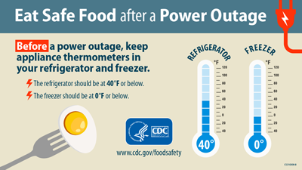

Slide 7
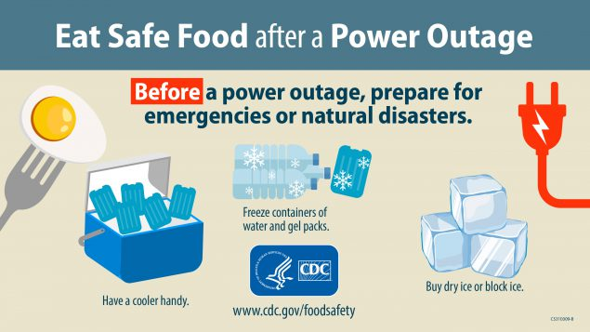

Slide 9
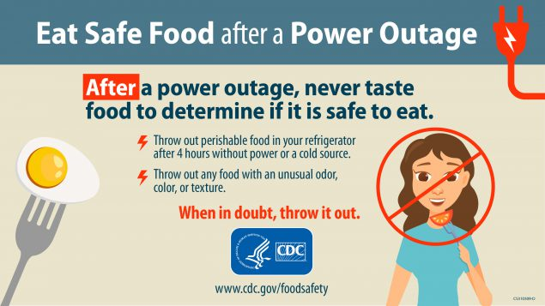

Slide 12
Statewide Resources
Call 211 to get info about cooling centers, shelters and charging station locations in your area.
Reach out to the American Red Cross if you need emergency assistance such as food and shelter. You can reach them at (877) 287-3327
Your town may have some resources as well. Reach out to your town hall via phone or on social media to see local resources.
If your town has a neighbors and friends' group on Facebook, it’s a good idea to join it as you can communicate with people in the community and find resources and help. Or give help if you can.

