Slide 1
Leadership for Learning:
Partners in Achievement
Diane Dugas, EASTCONN Director of Leading and Learning
EES Presentation
June 2, 2022

Slide 2
Essential Questions:
Why is leadership development important?
How does central office support the capacity of leaders to lead transformation advancements?
What does effective leadership learning look like?

Slide 3
Wallace Foundation Findings

Slide 4
Leaders do not create value directly. They deliver results indirectly, by enabling others to achieve more. It is normally impossible to separate the contributions of the leader and the team members. This suggests that, rather than thinking in terms of either/or, we need a balance of investments in developing great principals and great teachers.
How Principals Affect Students and Schools, Wallace Foundation, February 2021

Slide 5
Replacing a principal at the 25th percentile in effectiveness with one at the 75th percentile can increase annual student learning in math and reading by almost three months.
How Principals Affect Students and Schools, Wallace Foundation, February 2021

Slide 6
Principal Facts: Why Leadership Supervision and Evaluation is so Important
Notes:
Decline in principal tenure from 1988 to 2016, declining tenure impacts sustainable change and growth, negatively impacting student growth.

Slide 11
Wallace Foundation Synthesis of Literature
Identifies four interrelated domains of behaviors and practices that integrate instruction, people, and organizational skills to produce school outcomes.
1. Engaging in instructionally focused interactions with teachers,
2. Building a productive climate,
3. Facilitating collaboration and professional learning communities, and
4. Managing personnel and resources strategically

Slide 12
Principal Skills and Behaviors to Improve School Outcomes

Slide 13
Equity

Slide 14

Leadership Teams: Partners in Inquiry, Learning and Continuous Achievement
Other leaders who need supervision and evaluation to ensure results:
Nested Structures and Systems:
Leadership Induction
Modeling Collaboration
Explicit Modeling Leadership Meetings
Shared Leadership of Professional Learning
Strategic Focus/Coherence and Simplicity
Leadership for Learning Frameworks – articulate the organizational structure
Leadership capacity to give effective feedback
Improve Data Analysis/Celebrate results
Assistant Superintendent
Director of Curriculum
Director of Pupil Services
Notes:
Research confirms it takes nearly 50 hours of professional learning to re
alize any substantive change in teacher instructional practice (Darling Hammond, 2009) limit new instructional behaviors and focus high leverage.

Slide 15

What does it look like in practice?

Slide 16

Challenges the status quo
Builds trust through clear communication and expectations
Builds commonly owned plans for success
Focuses team over self
Has a high sense of urgency for achieving sustainable results
Commits to continuous improvement for the organization and self
Builds external networks and partnerships

Slide 17
Driving Inquiry Questions
What do we want leaders/teachers/students to know and be able to do? (Standards, POG)
How will we know when they get it? (Observation/Rounds/ Student Assessment, Multiple measures of data)
What will we do for leaders/teachers/students who aren’t there yet? (Interventions)
What will we do for leaders/teachers/students who are there or get it? (Deep Learning/Application)

Slide 18

Portfolio Approach to Continuous Advancement
I. Problem of Practice Question/Theory of Action
II. Target Outcomes
III. Strategies and Supports: Action Plan and Professional Learning Plan
IV. Evidence and Outcome/Results

Slide 19
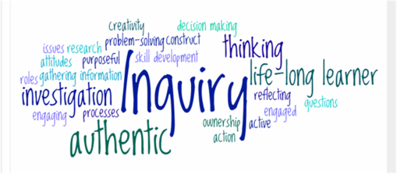
I. Inquiry Question/Theory of Action
What professional experiences have you had that led you to this question?
What data do you from practice that prompted this question?
How does your question align with the district and school strategic goals?
What research supports your question/TOA? What professional learning will help to inform your inquiry?

Slide 20
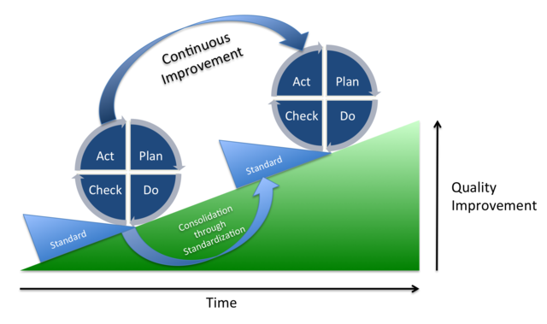
II. Target Outcomes
III. Strategies and Supports
A statement of professional goals, strategies, and supports for improving practice and student learning
  Identify goals for teacher growth and development of learners
  State your professional goals for your own growth and development
  What is the action plan?
  What high leverage, research based strategies, structures, systems will you apply?
  What supports are needed (from central office, others) to implement?

Slide 21
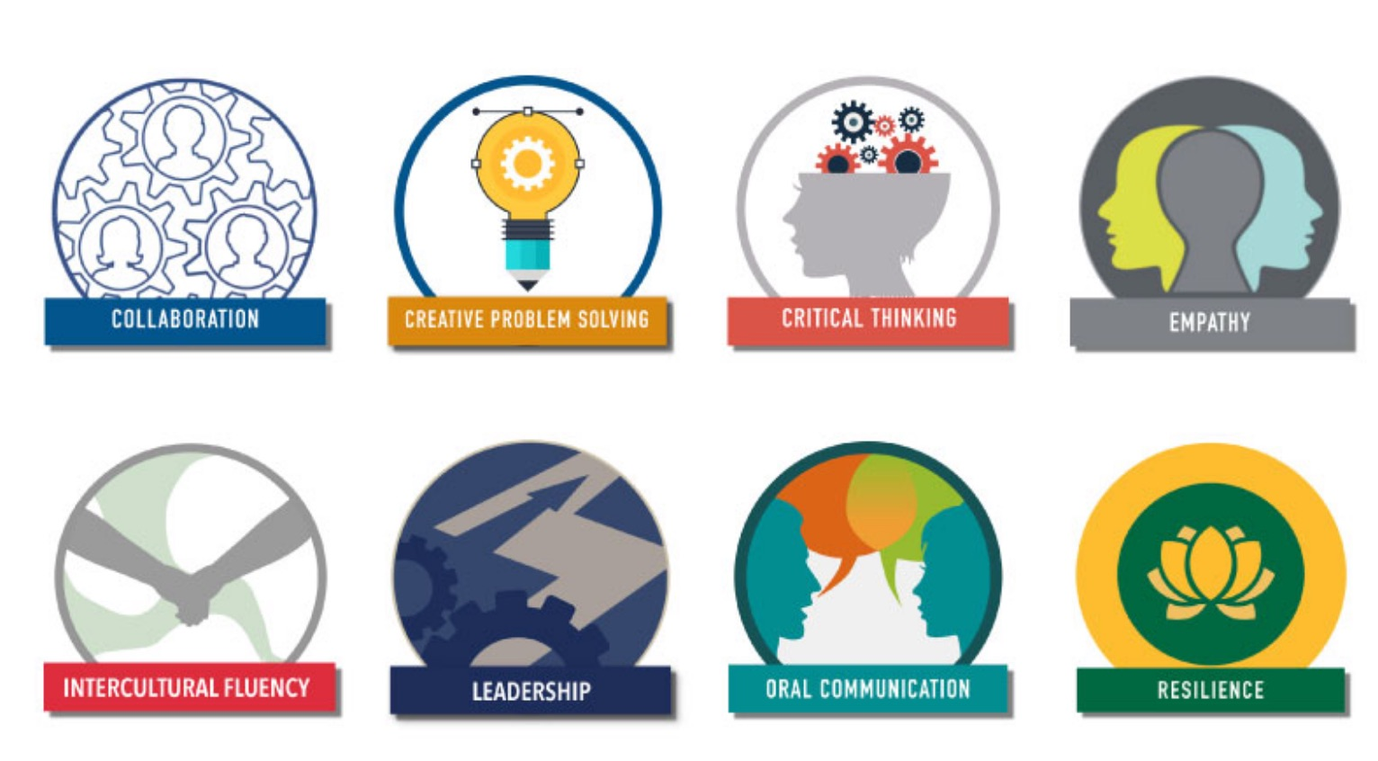
IV. Evidence and Outcomes/Results
How were results measured?
What impact did your learning have on the outcomes/results?
What impact did your intentional leadership have on the outcomes/results?

Slide 22
Principals really matter. Indeed, given not just the magnitude but the scope of principal effects, which are felt across a potentially large student body and faculty in a school, it is difficult to envision an investment with a higher ceiling on its potential return than a successful effort to improve principal leadership.
How Principals Affect Students and Schools, Wallace Foundation, February 2021

Slide 23


Slide 24
Thank you
Diane Dugas
EASTCONN Director of Leading and Learning
EASTCONN Schools Superintendent
ddugas@eastconn.org
860-324-9491

