Slide 1
Redistricting
Continuing Education Series Part 5
Redistricting Nuts and Bolts

Slide 2
Why does the General Assembly redraw Congressional and legislative district lines every 10 years?
The U.S. and Connecticut constitutions require it. In a 1964 case, the U.S. Supreme Court held that the U.S. Constitution’s Equal Protection Clause requires that districts have about equal populations so that everyone’s vote has equal importance (i.e., the “one person, one vote” doctrine) (Reynolds v. Sims, 377 U.S. 533 (1964)).

Slide 3
Why does the General Assembly redraw Congressional and legislative district lines every 10 years?
The state constitution requires that Congressional and legislative district lines be redrawn every 10 years (Conn. Const. Art. III., § 6). The districts must be based on the federal census and consistent with federal constitutional standards (Conn. Const. Art. III., § 5).

Slide 4
Who draws the lines?
The state constitution requires that an eight-member, bipartisan committee (i.e., the Reapportionment Committee) prepare a districting plan and the General Assembly approve it with a two-thirds vote in each chamber. The committee is composed of legislators.

Slide 5
STATE LEGAL AUTHORITY
Connecticut Constitution
▪ Art. III., § 3: Senate
▪ Art. III., § 4: House of Representatives
▪ Art. III., § 5: Districts to be consistent with federal standards
▪ Art. III., § 6: Decennial reapportionment
Connecticut General Statutes
▪ § 9-9: Representatives in Congress
▪ § 9-10a: State senators, senatorial districts
▪ § 9-169g: Town clerks submit voting district maps to secretary of the state; use of maps by General Assembly in redistricting

Slide 6
Process Overview
In general, by February 15 of the year following the decennial census, the top four legislative leaders must each designate two committee members. Historically, each leader has designated two legislators from his or her own party’s caucus in the Senate or House of Representatives.
If the General Assembly does not approve a plan by September 15 of that year, a nine-member commission (i.e., the Reapportionment Commission) is formed. The top four legislative leaders must each designate two commission members, whom the governor appoints. As with the committee, in the past each leader has designated two legislators from his or her own party’s caucus in the Senate or House of Representatives. The eight appointees select a state elector as a ninth member.
(For both the committee and the commission, the constitution establishes a different procedure if there are members of more than two political parties in either chamber.)

Slide 7
When does it have to be done?
As indicated above, the Reapportionment Committee must complete its task by September 15 of the year following the census. If the General Assembly fails to adopt a plan by that deadline, the Reapportionment Commission must prepare a plan by November 30 of that year that is certified by at least five members; the commission’s plan is not subject to General Assembly approval.

Slide 8
What happens if the Reapportionment Commission does not agree on a plan?
If the commission does not agree on a plan, the constitution empowers the state Supreme Court to compel the commission to complete its task. Alternatively, the court can draw the district boundaries itself, which it must do by February 15 of the second year following the decennial census.

Slide 9
What are the 2020 redistricting cycle deadlines under the Connecticut Constitution?
Deadline Requirement
February 15, 2021 - Legislative leaders appoint an eight-member Reapportionment Committee
September 15, 2021 - General Assembly adopts a plan of districting
Forthwith after September 15, 2021 - Governor appoints a Reapportionment Commission based on legislative leaders’ designations (if General Assembly fails to adopt a districting plan by September 15)
Within 30 days after appointment of Reapportionment Commission - Members select a state elector as the ninth member
November 30, 2021 - Reapportionment Commission submits a certified plan of districting to the secretary of the state
Forthwith after November 30, 2021 - Secretary of the state notifies the Chief Justice of the state Supreme Court (if Reapportionment Commission fails to submit a plan by November 30)
February 15, 2022 - State Supreme Court files its plan of districting with the secretary of the state
*The secretary of the state must forthwith publish the plan at which point it has the full force of law.

Slide 10
Information for Registrars and Local Officials
Following the publication of the Plan of Districting, our office transmits copies of the plan to the town clerk and registrars of voters of each town in the state. The plan is to be used by the clerks and the registrars for the development of voting districts in each town. In addition to the plan, our office also transmits maps reflecting the various district boundary lines to each town. Separate maps for the congressional, state senate, and state assembly districts are provided.
Once the plans are transmitted to the local officials, it is their responsibility to create, eliminate or re-align their local voting districts consistent with the Plan of Districting.

Slide 11
Local Impact – In General
The legislative body of any town may divide such municipality into voting districts. (9-169)
The responsibility for assigning polling places to each of those districts in a municipality lies with the local registrars of voters or legislative body. (9-168)
Whenever a Congressional, Senatorial or Assembly district line splits a voting district in a town, by operation of law, each portion of the whole voting district becomes a new separate voting district. (Conn. Gen. Stat. §9-169a). If a town is located entirely within a Congressional, Senatorial or Assembly district separate voting districts are not established.

Slide 12
Local Impact – In General
Registrars of voters are required to print registry lists and enrollment lists according to these new voting districts and, generally, must provide a separate polling place in each of the new voting districts.
In many towns, the separate lists must be prepared before the January 2022 endorsement of town committee members, and in the remaining towns separate lists must be prepared before the March/April 2022 endorsement of delegates.
If the registrars wish to change the boundaries of voting districts (without crossing any Assembly, Senatorial or Congressional district lines), the municipal legislative body must approve the new lines, and the new voting district lines are effective upon adoption by the municipal legislative body. (Conn. Gen. Stat. §9-169b) Whenever a state district line falls on a street, the voters are divided by the center of that street.

Slide 13
Generally, town can be broken into three categories with regard to redistricting:
1. Towns that are located wholly within congressional, senatorial and assembly districts (approximately 70).
2. Towns that are split by congressional, senatorial and assembly district lines only.
3. Towns that are split by multiple congressional, senatorial and assembly districts lines and also have local voting district lines.

Slide 14
Town Committees
Town committees can be selected at large or from political subdivisions. The method for choosing the committees is defined in party rules.

Slide 15
Municipal Office
Towns can elect town officers from political subdivisions or at large. The method for elected town officers is located in state statute or local town charter.

Slide 16
Election Results
Election results must be reported and broken out by voting district and in some cases by congressional, senatorial and assembly district.
Delegates to the national conventions are determined by congressional district and delegates to the state conventions are determined by senatorial district. (May change subject to party rules).

Slide 17
2022 Crossover
Between now and January 4, 2023, we will be operating under to different redistricting plans.
Current Representatives continue to represent their constituents until their term ends (January 4, 2023).
However, the Representatives that run in 2022 are running for a seat in the NEW districts that you are all working on now. They will represent their new constituents when they take office (January 4, 2023) BUT the new districts must be in place for the election in 2022 so that the people who will be represented on January 4, 2023, can vote for their new Representative.

Slide 18
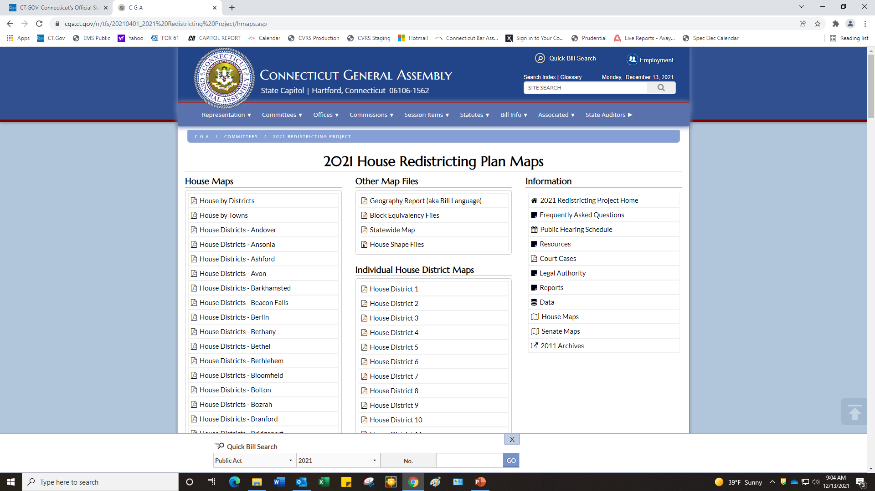
Resources - Data

Slide 19
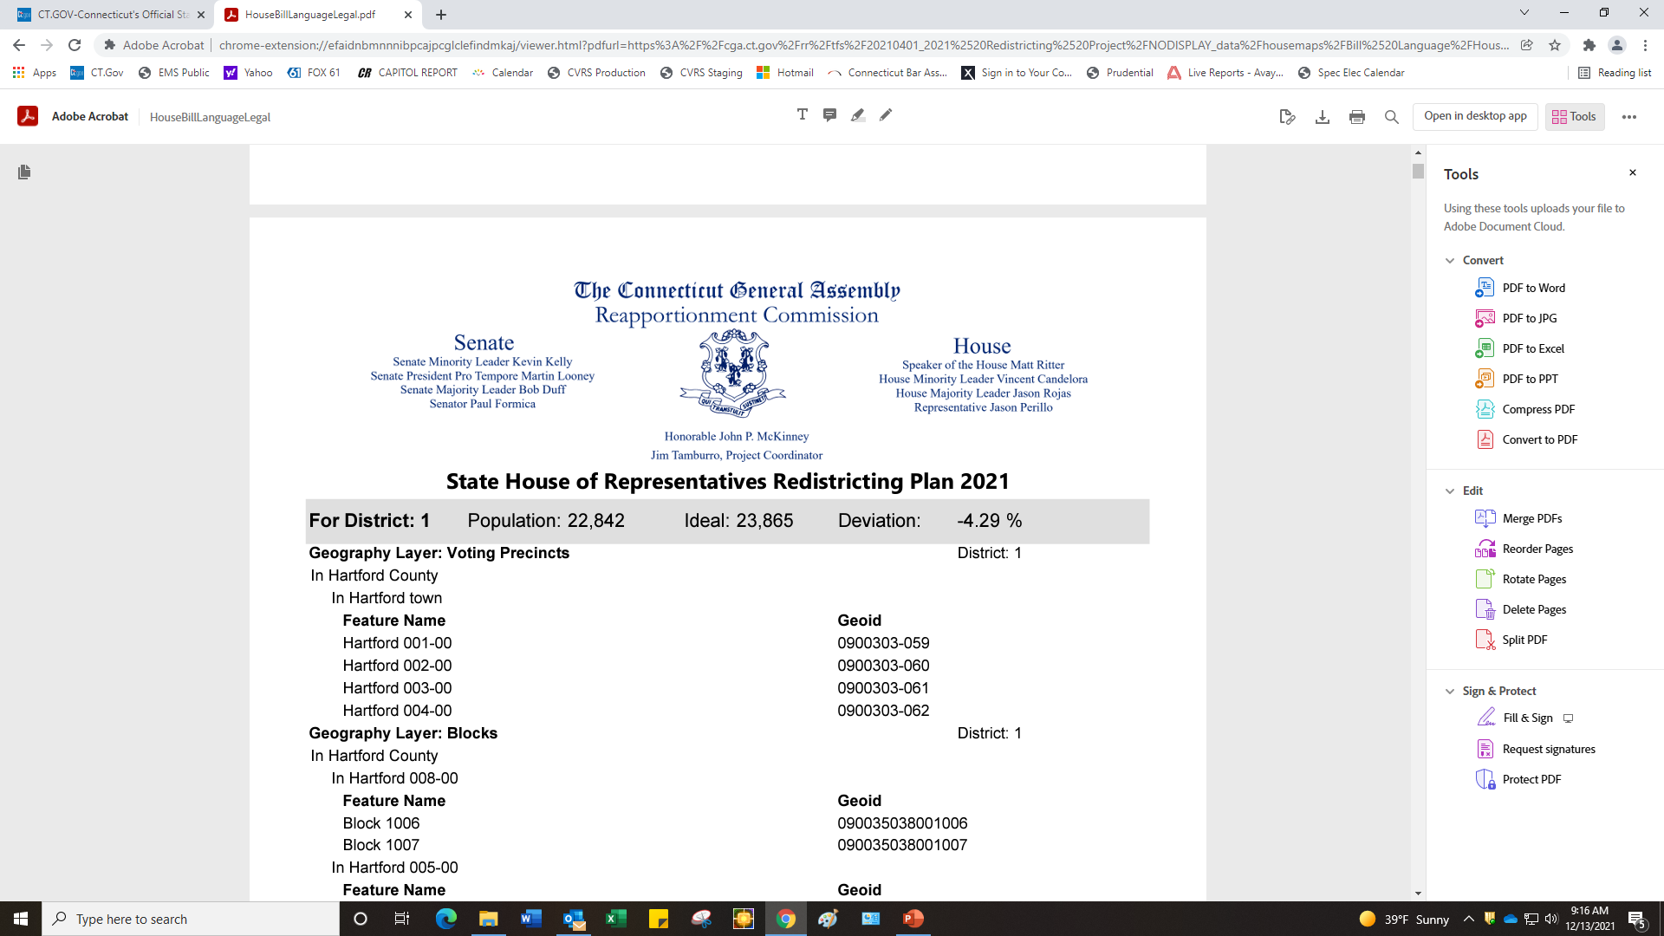
Resources – The Plan

Slide 20
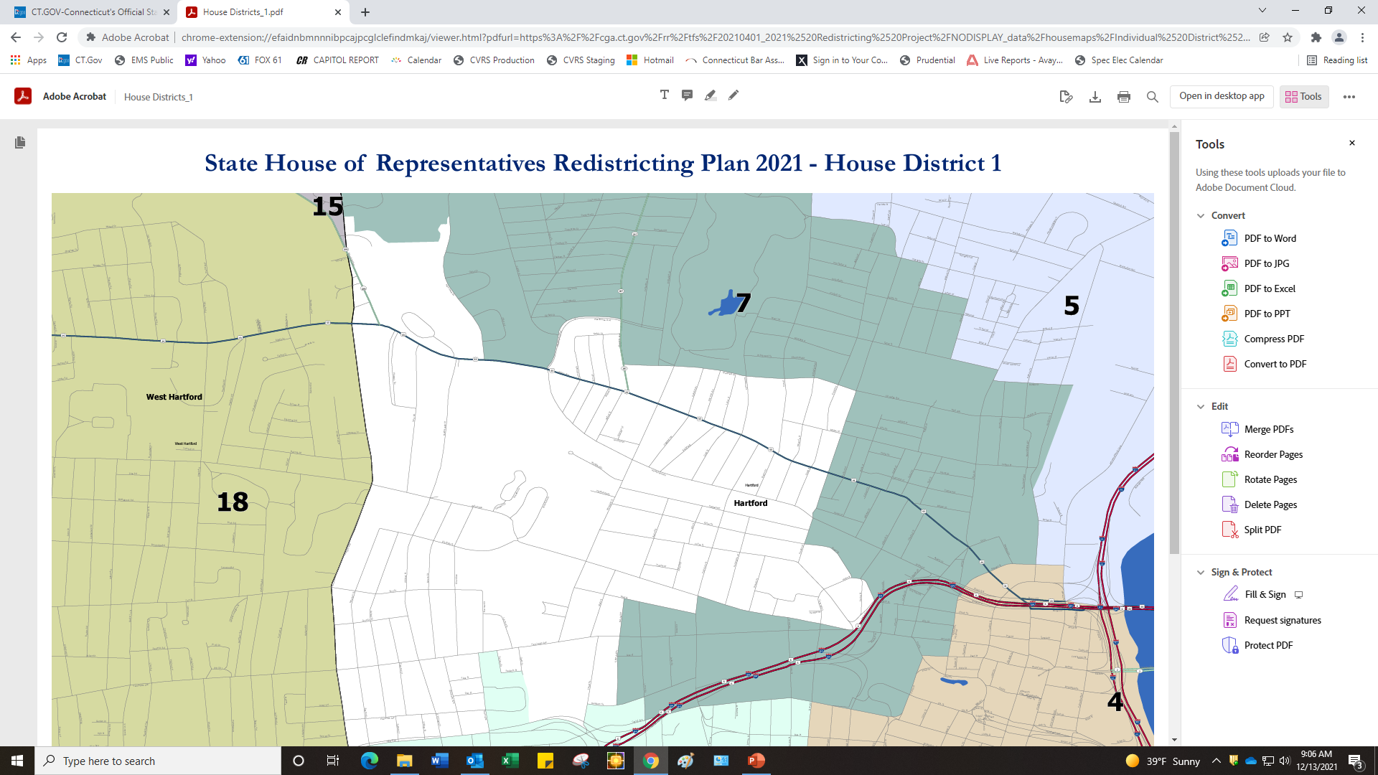
Resources - Maps

Slide 21
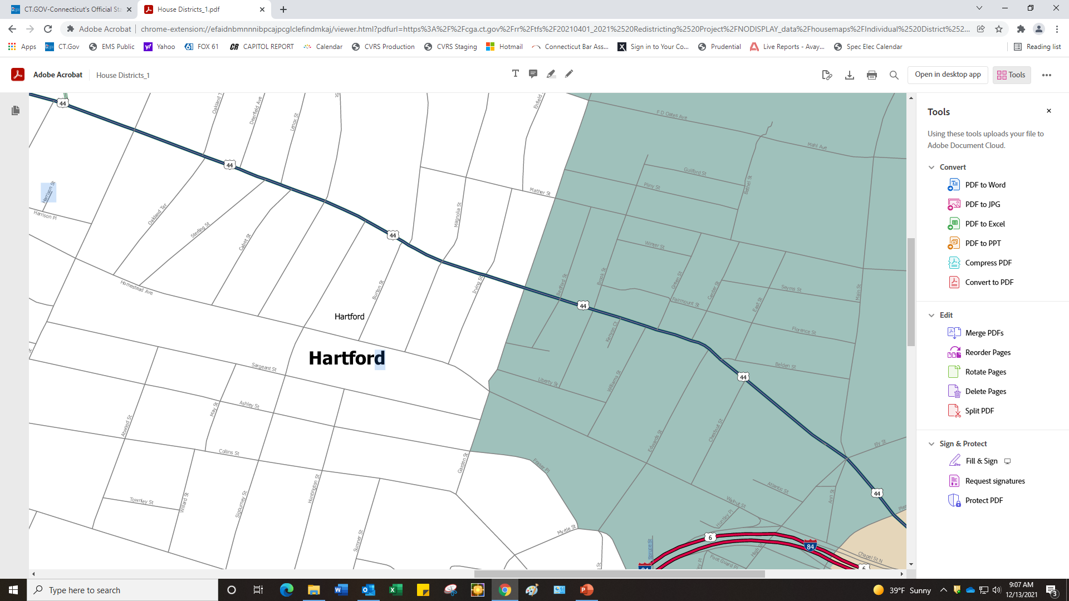
Resources - Maps

Slide 22
Fundamentals - Maps
What is on the Map The maps show towns and the area immediately surrounding them. They contain census geography and, in color, the new legislative districts. The census geography is based on tracts and blocks. Census blocks follow streets, railroad tracks, streams, trails, and other identifiable features. The new legislative district lines follow these blocks and you must, too. The computer colors the blocks in a legislative district and places the district number in the geographic center of the district.
What to do with the Maps First you should locate a good town map and compare it with this one. If a legislative district line follows a feature that is not on your map, you should determine what that feature is and draw it in on your map. In this way, it will be comparable to the legislative map.
When drawing new local voting district lines, do not move any legislative district line. If the line follows a street, it is in the middle of the street. That must be the new voting district line. This means that people on one side of the street will be in a separate legislative district and voting district than those on the other. Voters on different sides of the street in different districts will have to vote in different districts.
The Geographic Report The maps are generated from the data contained in the geographic report. The report lists every piece of geography in the state at the highest level. If a town is wholly in a district, its name is listed. If a town is split but a tract or block group is wholly in a district, the tract or block group is listed in the geographic report, but without a town designation. If a tract is split, the town’s name, tract number, and block number are listed.
Who to Call with Questions If you are unsure about a census line, you may want to contact your town’s officials who participated in the Census Bureau’s local review of maps project. Some census lines that do not follow local maps were added at the towns’ request. They may also have the best town map available.

Slide 23
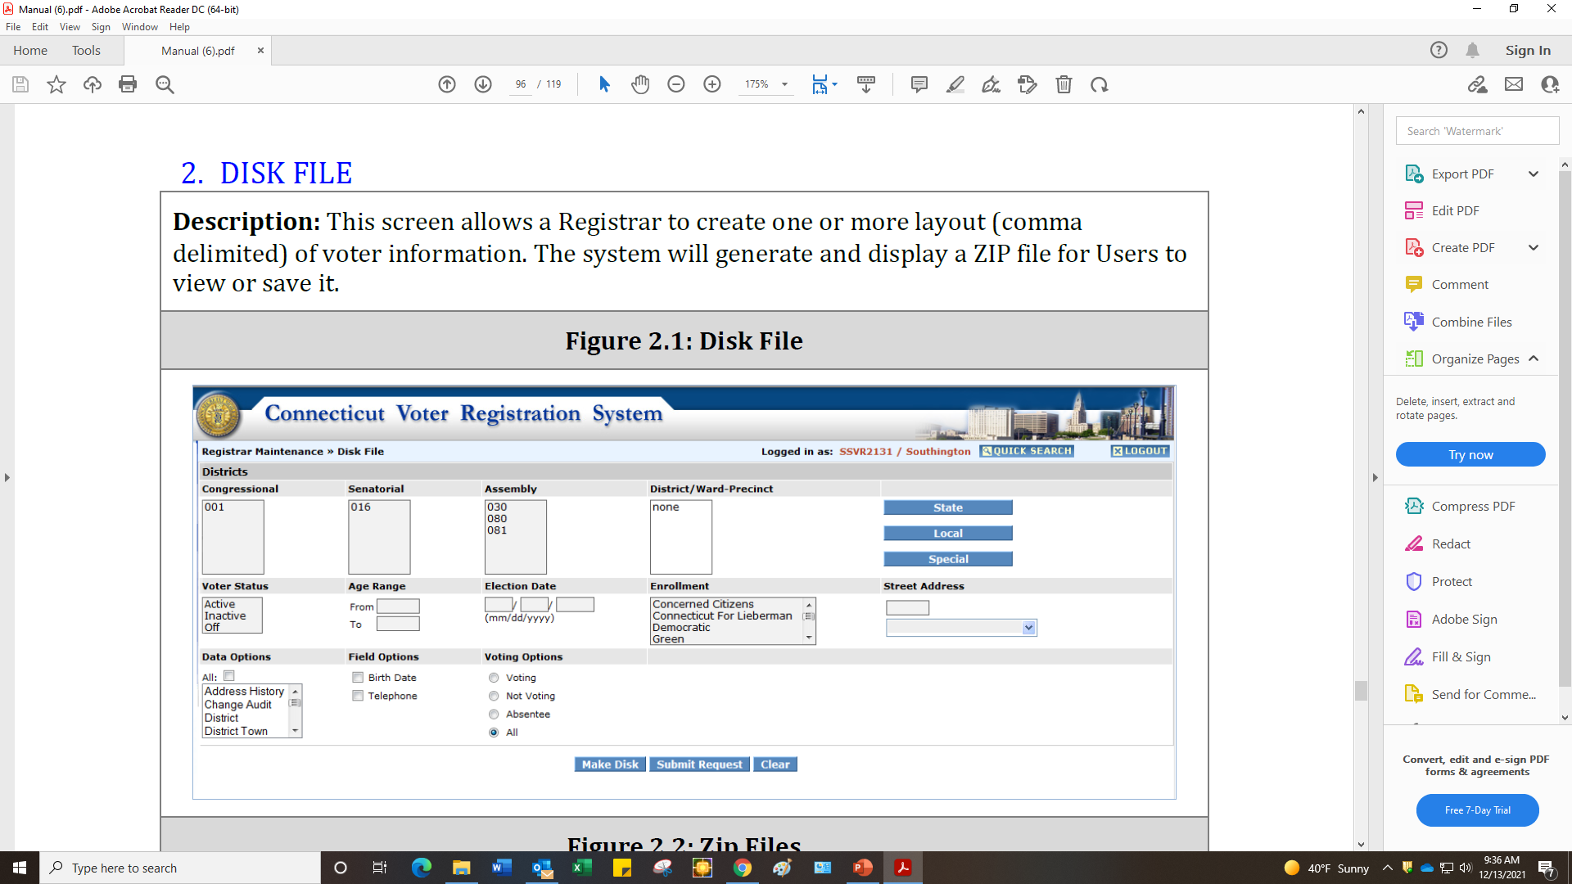
Using CVRS – before you start

Slide 24
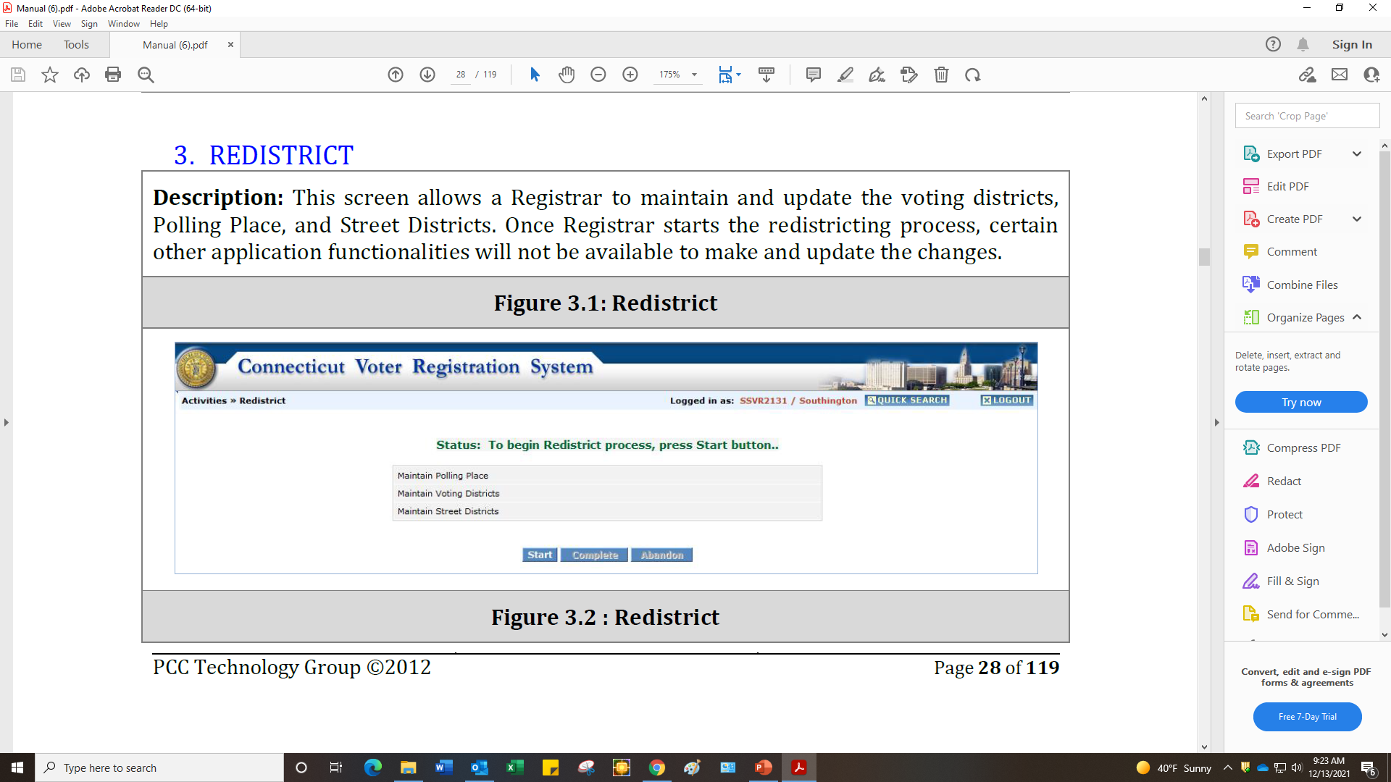
CVRS - Start

Slide 25
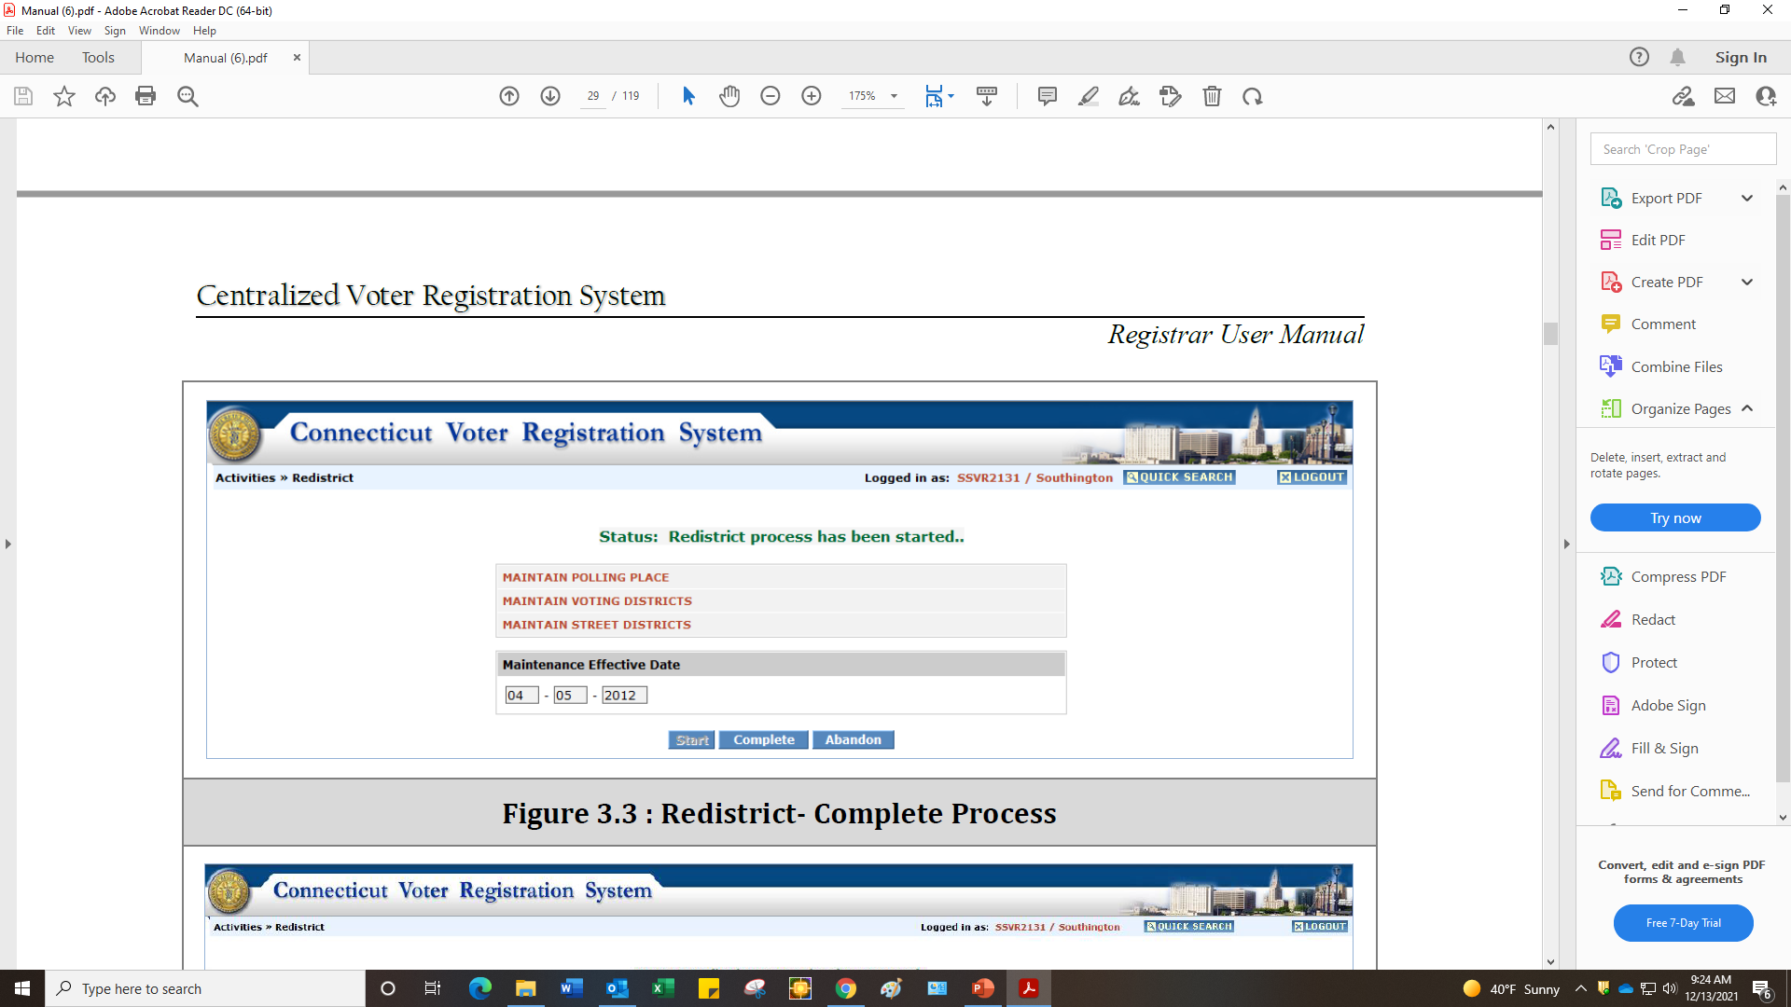
CVRS – Start Date

Slide 26
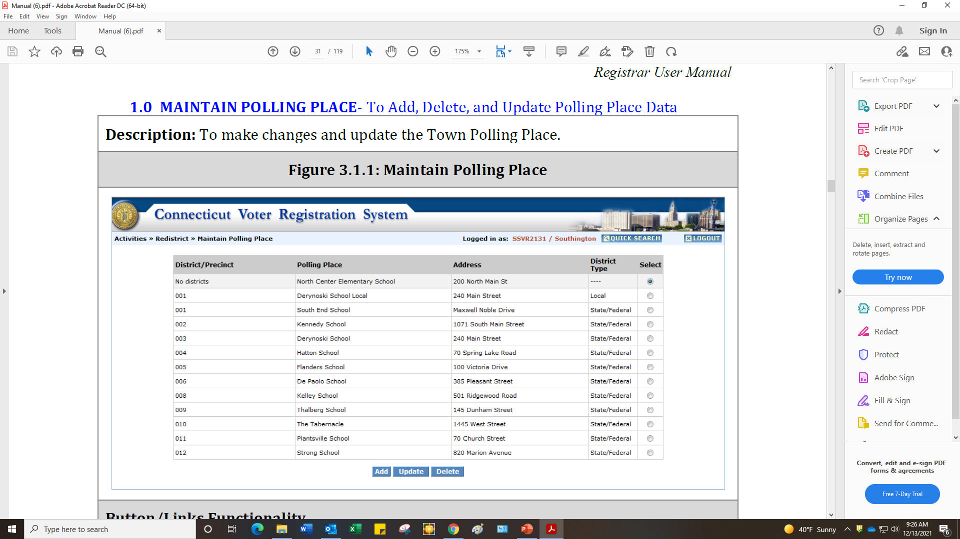
CVRS – Step #1 Establish Polls

Slide 27
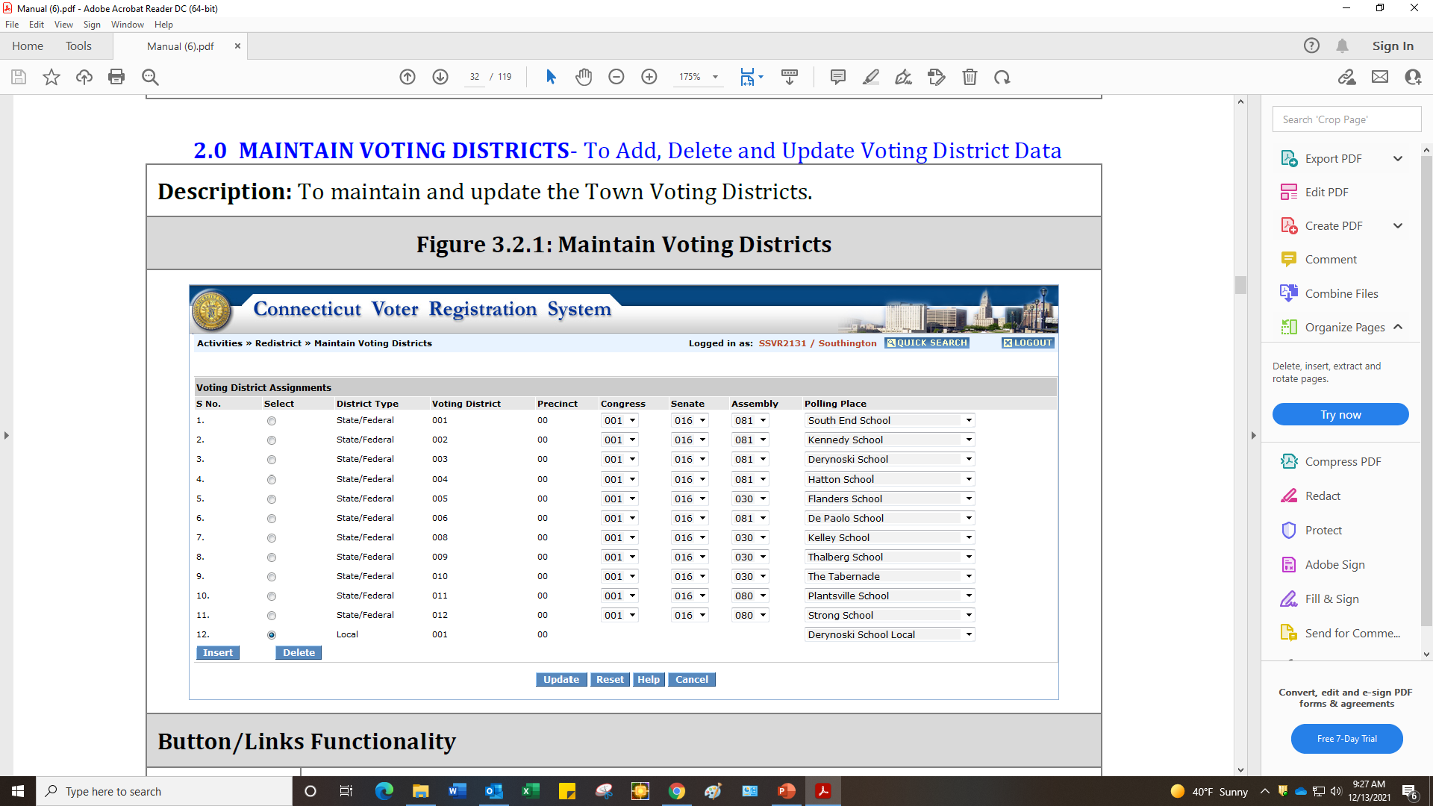
CVRS – Step #2

Slide 28
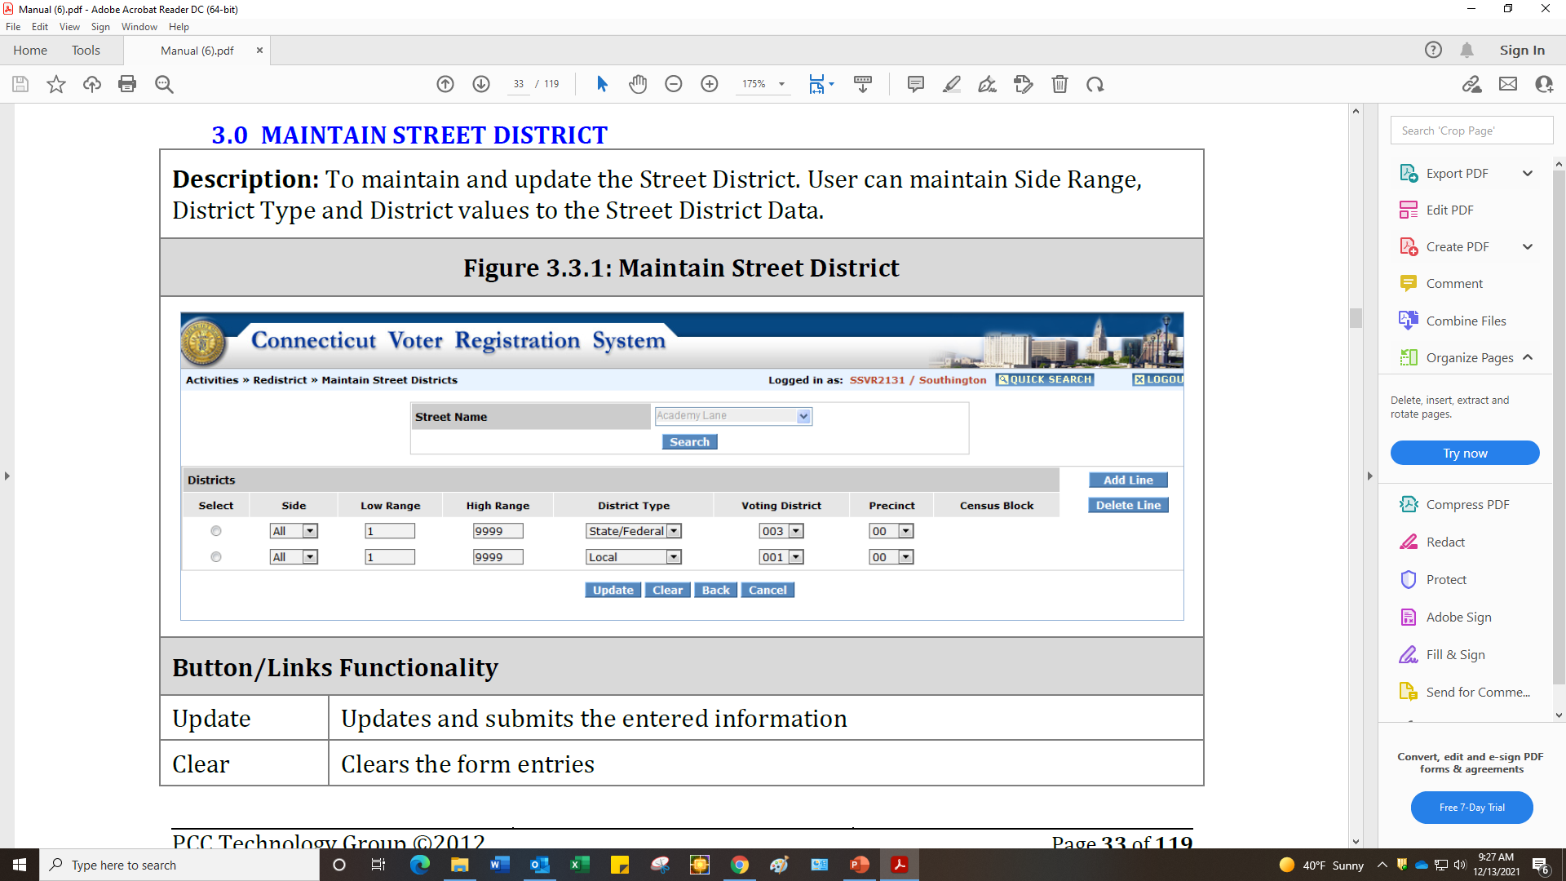
CVRS – Step #3

Slide 29
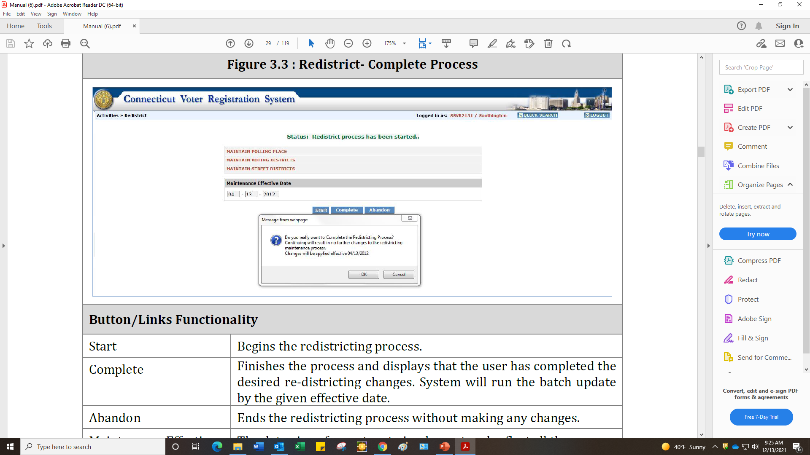
CVRS – Final Step - Complete

