Slide 1
CT-SEDS Expert Training

Slide 2
IEP Process

Slide 3
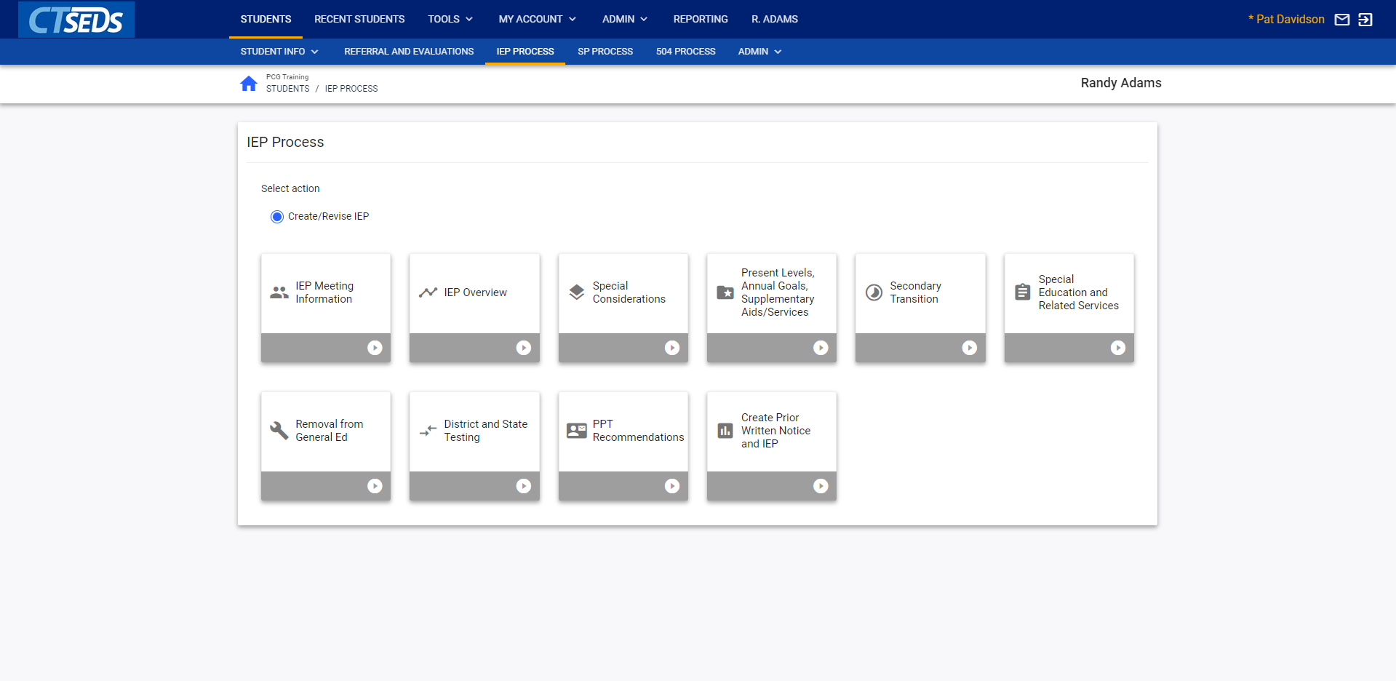
Use this Slide for Screenshots
Notes:
After going into a student’s record (described in the core navigation presentation), the user can navigate to the IEP process. Standard functionality for this module is the same as for Referral and Evaluation and the other modules in CT-SEDS. The process is meant to be completed linearly though users can access tiles out of order if needed. This presentation will walk through some of these tiles highlighting certain sections of creating an IEP, but will not cover every step in the process. Full details on the process can be found in the IEP Process and Progress Reporting User Manual.

Slide 4
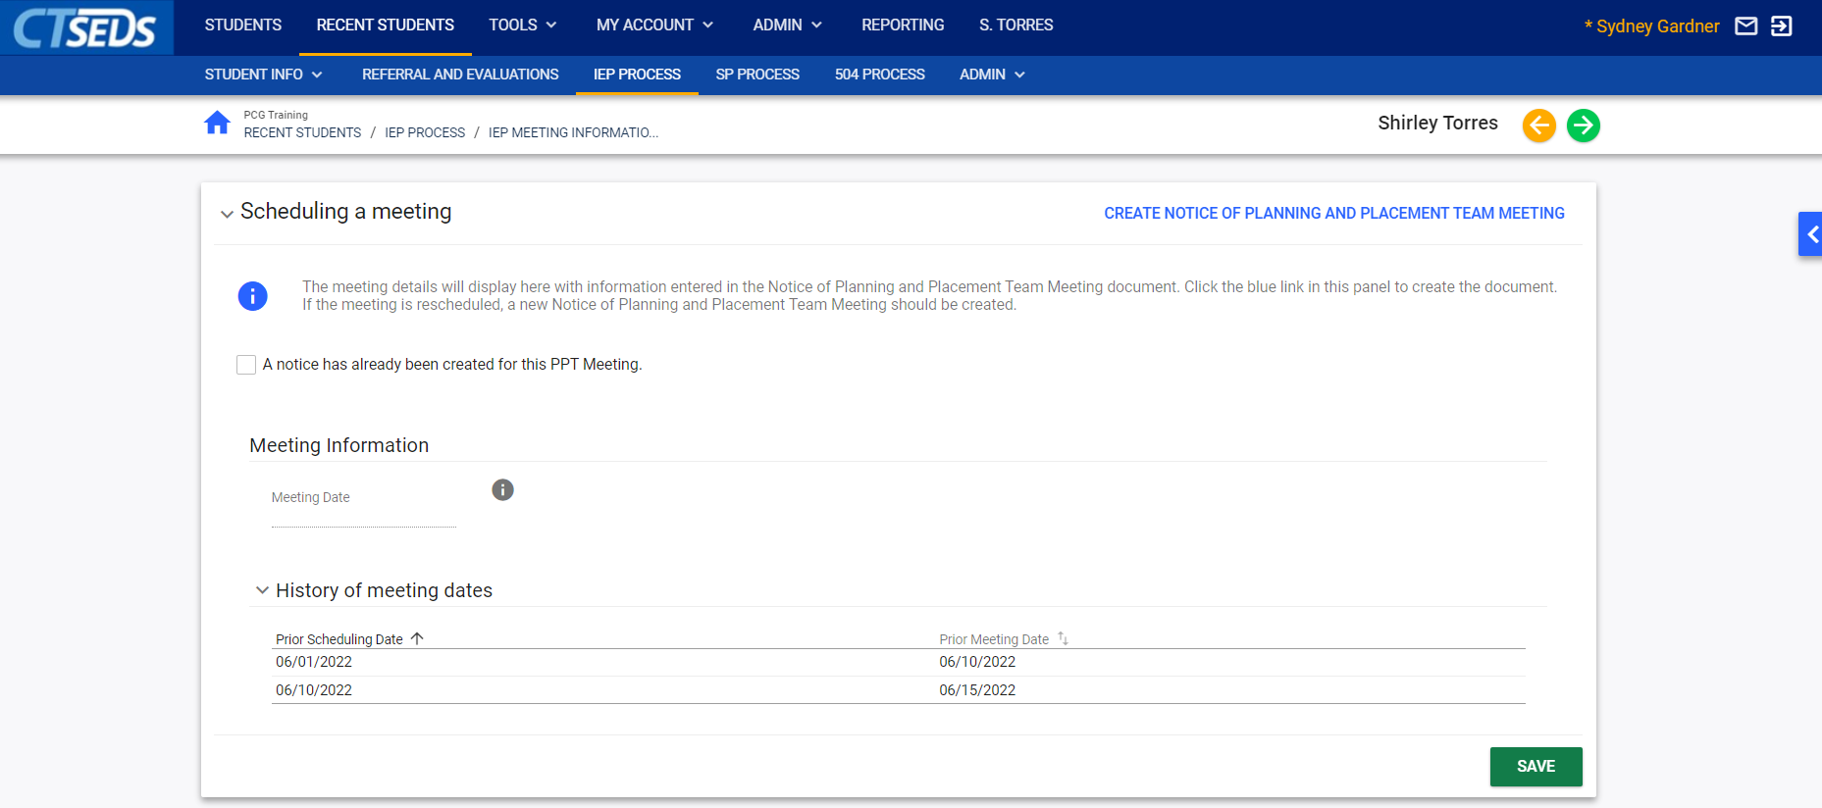
Notes:
We’ll start with the first page, IEP Meeting Information. On this page, the user can create a Notice of Planning and Placement Team Meeting Notice and record meeting attendance. To schedule a PPT Meeting, the user navigates to the Scheduling a Meeting Panel and clicks on the blue link in the upper right corner CREATE NOTICE OF PLANNING AND PLACEMENT MEETING.

Slide 5
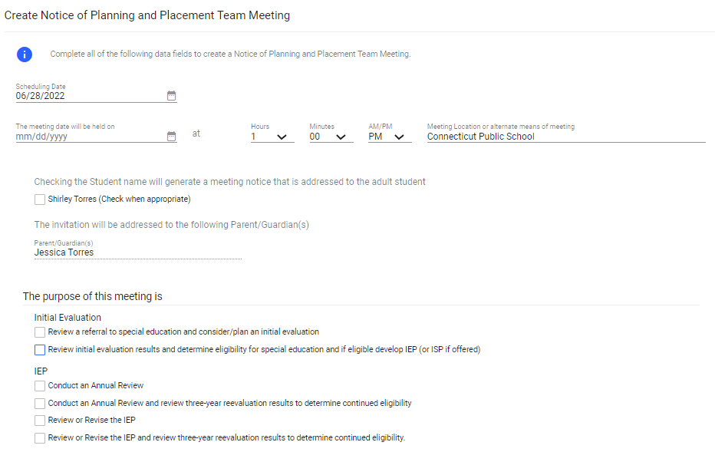
Notes:
This will open a pop-up panel that will allow the user to enter PPT Meeting details. The user will select the purpose of the meeting and indicate individuals invited. If applicable, the user can select checkboxes to address the meeting notice to the adult student or indicate that the team will address transition goals. Once completed, the meeting notice should be saved by clicking on the SAVE button. A draft document can be created by clicking CREATE DRAFT and a final document can be created by clicking CREATE FINAL or the pop-up panel can be closed to return to the IEP Meeting page by clicking the CLOSE button.

Slide 6
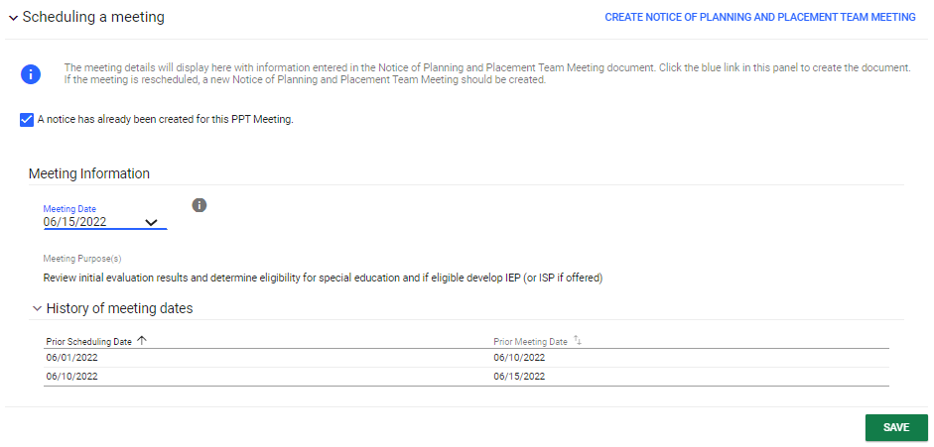
Notes:
If the user has previously created the Notice of Planning and Placement Team Meeting, check the checkbox labeled “A notice has already been created for this PPT Meeting” on the Scheduling a meeting Panel. Under Meeting Information, a drop-down will allow the user to choose the meeting notice by selecting the appropriate date already created in the Referral/Evaluation Process. Please note that the scheduled meetings will appear in the History of Meeting Dates in consecutive order.

Slide 7
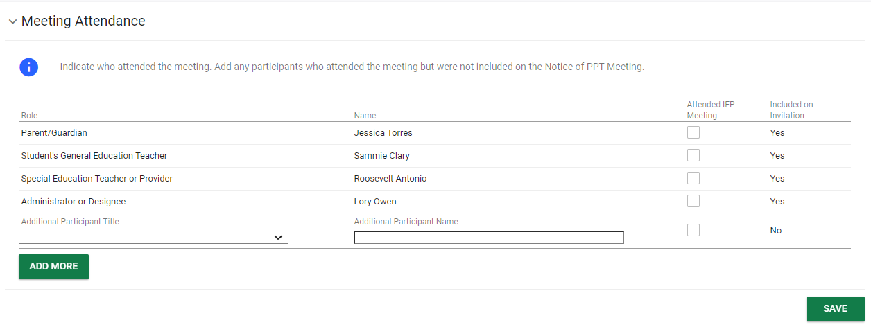
Notes:
The Meeting Attendance Panel allows the user to select who attended the meeting and add any additional participants who were not initially listed on the Notice of Planning and Placement Team meeting document if unexpected participants, like a parent advocate, attended.

Slide 8
Notes:
If an attendee did not attend as planned, navigate to the Meeting Attendance Excusal panel and check the checkbox labeled “At least one of the required participants was not in attendance at the PPT Meeting.” Once checked, it will require the user to create a PPT Attendance Excusal Document by clicking on the blue link in the upper right corner CREATE PPT ATTENDANCE EXCUSAL DOCUMENT.

Slide 9
Notes:
In the Documents panel, the user can see all documents created in this part of the process. After completing the page, the user should click the green Save and Continue arrow at the top of the screen. This will save what was entered on the page and run an error check. If any errors or missing information is found, the user will see a red error message telling them what needed to be edited before moving forward. If the page has been successfully completed, click the Save and Continue arrow will save what was entered on the page and move the user to the next page in the process.

Slide 10
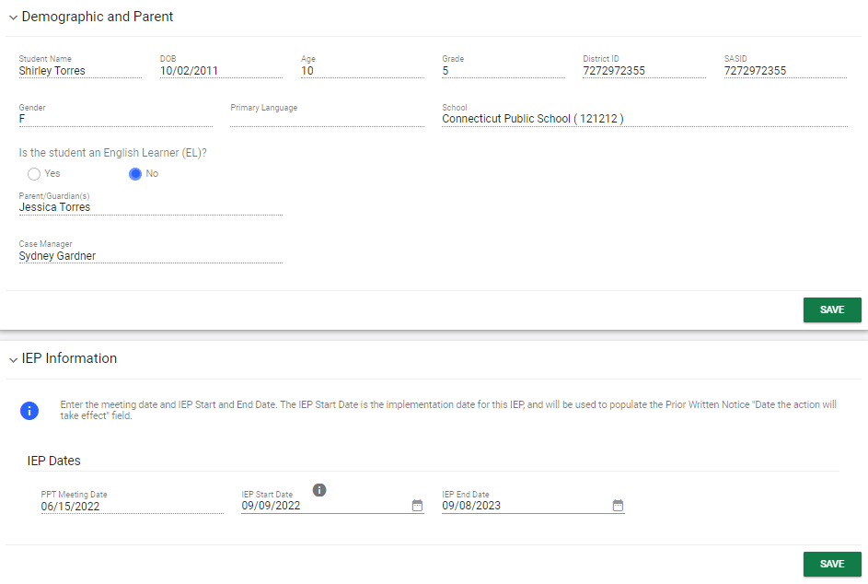
Notes:
The first section in the IEP Overview page is the Demographic and Parent page which displays information on the Parent/Guardian(s) who will participate in the IEP team meeting. Note: The Parent/Guardian(s) and Case Manager information is view only on this page. To edit this information, navigate to the “Team” page on the student menu bar. The IEP information panel pulls in the PPT Meeting Date from what the user entered on the previous page and allows the user to review and edit the IEP Start and IEP End Dates. Establishing these dates will drive compliance throughout the process by confirming all service and goal dates fall within these parameters.

Slide 11
Notes:
The Revert Workspace function is an optional step for the IEP but required for an IEP Amendment. It allows the user to revert all the pages in the IEP Process back to what was entered when the most recent IEP was finalized . This is done by clicking the blue click on the blue link in the upper right corner REVERT IEP WORKSPACE TO CURRENT IEP.

Slide 12
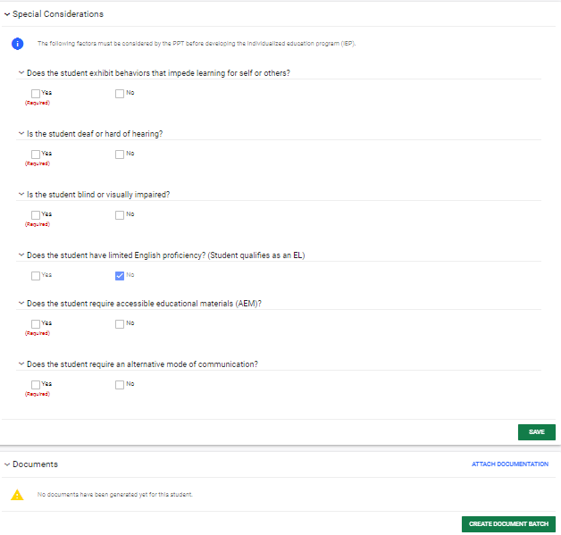
Notes:
The Special Considerations page captures the factors that are considered when developing the IEP. The user can select the checkboxes that indicate factors that affect the development of the IEP. The Limited English Proficiency checkbox will automatically populate if the student is an English Learner from information on the Demographic page. If the student is an English Learner, the additional fields will appear. If the student is deaf or hard of hearing and the box is checked on the Special Considerations panel, the Language and Communication Plan panel will appear. In many places in the process, new panels will appear depending on what information was selected.

Slide 13
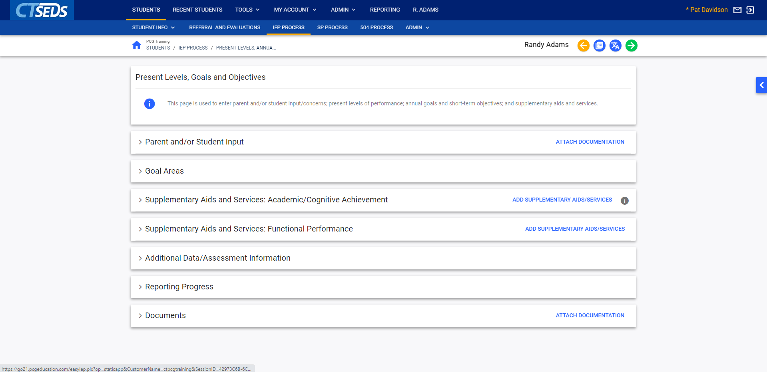
Notes:
The Present Levels, Goals and Objectives page is used to enter parent and/or student input/concerns; present levels of performance; annual goals and short-term objectives; and supplementary aids and services. It is a substantial step in the IEP process. Users can collapse the panels to look at the big picture by clicking on the arrow next to the title of the panel. This can be done on any page. Users can expand each panel by clicking again on the arrow.

Slide 14
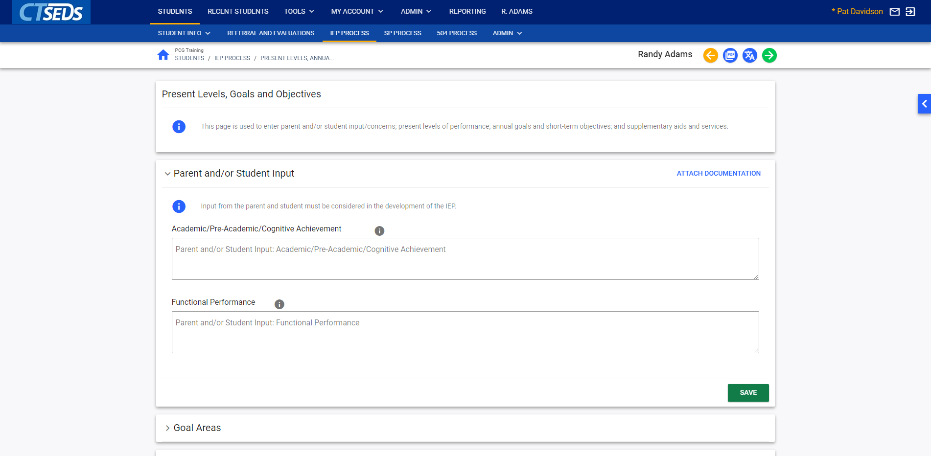
Notes:
The Parent and/or Student Input Panel allows the user to record any information given by the Parent and Student relating to the Academic/Pre-Academic/Cognitive Achievement and Functional Performance of the student for whom the IEP is being developed.
If the user clicks on the blue link in the upper right corner ATTACH DOCUMENTATION, this opens a pop-up panel Attach External Documents Using CT-SEDS Paperclip that allows the user to upload any additional documentation by using the arrow to upload the file and clicking the UPLOAD FILES button.

Slide 15
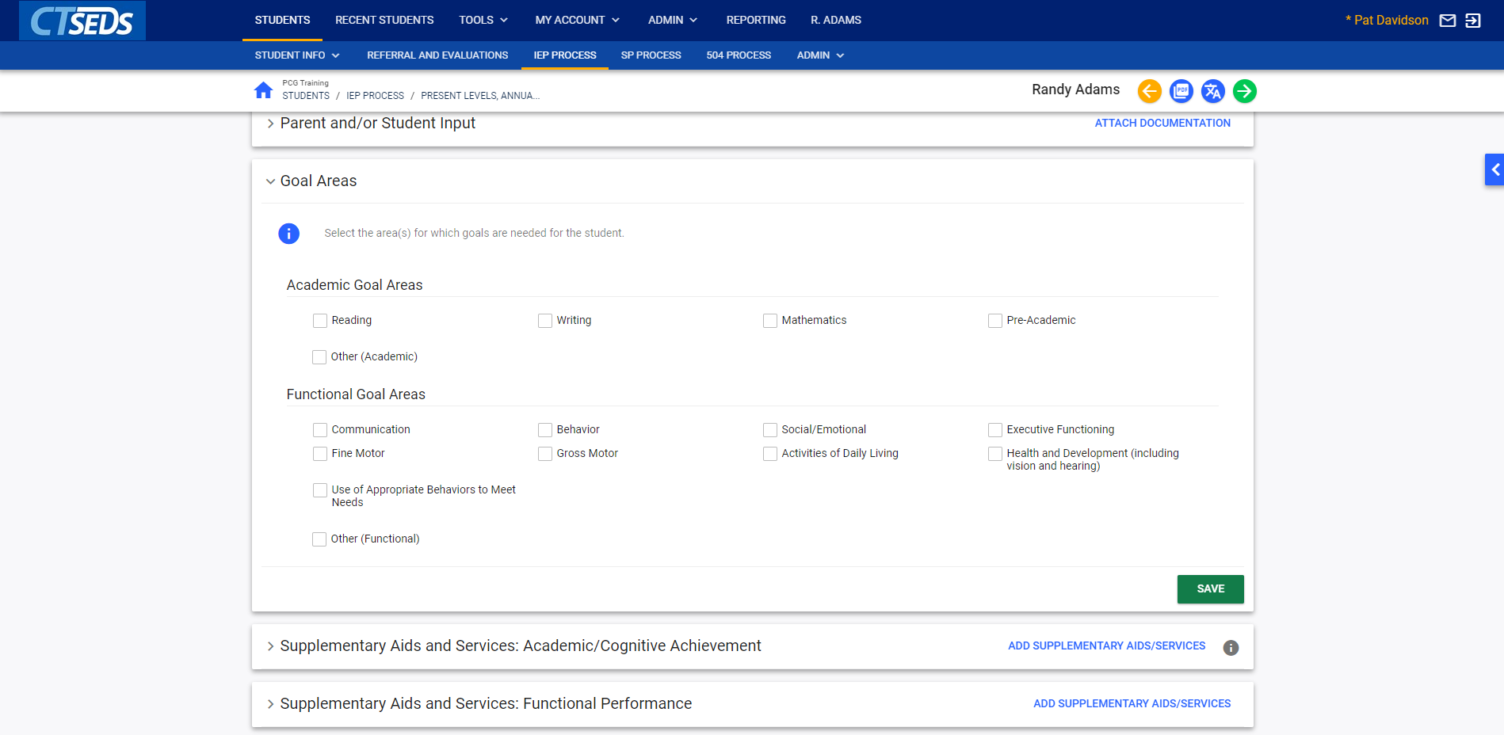
Notes:
In the Goal Areas panel, two different goal areas are displayed, Academic and Functional. For each checkbox checked, a corresponding panel will appear that allows the user to fill in data on the current level of performance in the goal area and the annual goals and short-term objectives for that specific goal area.

Slide 16
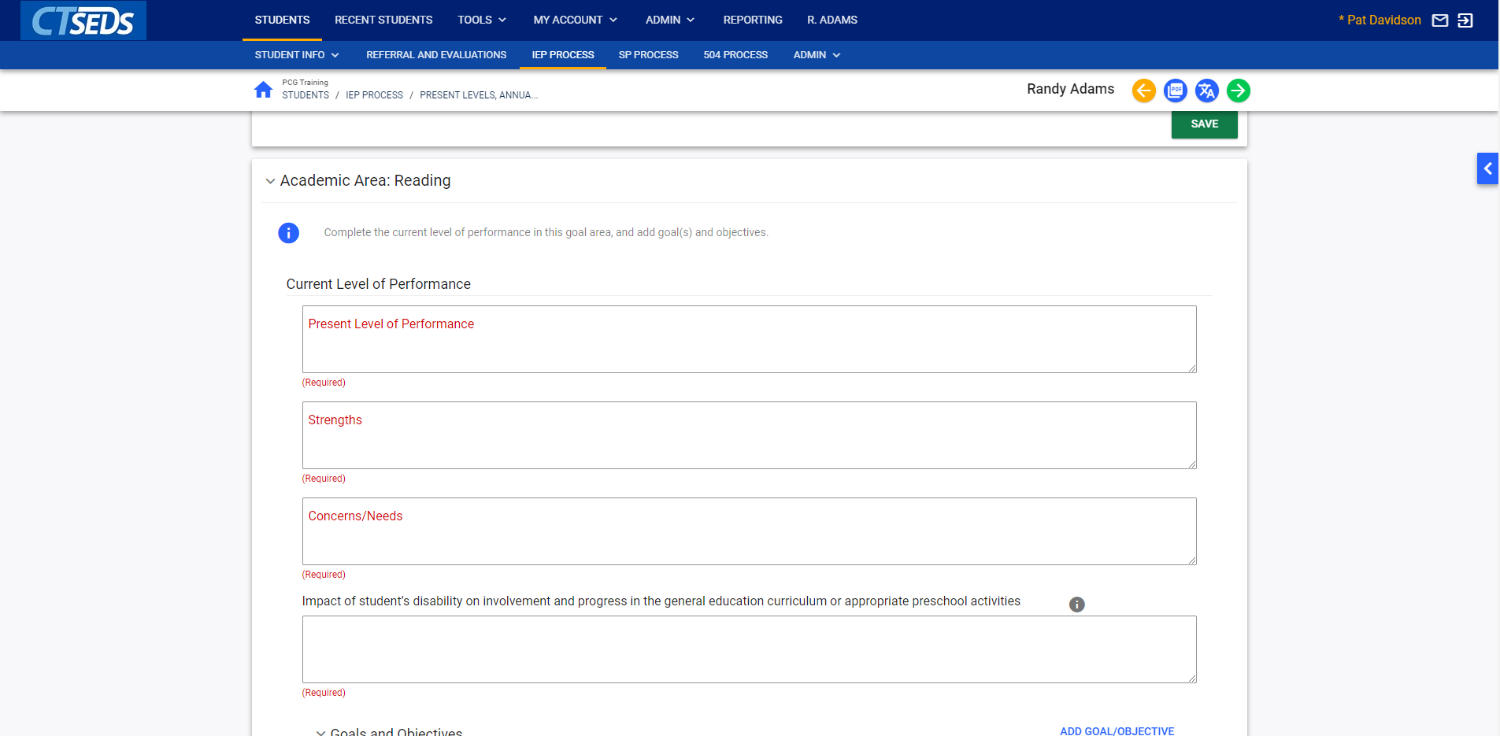
Notes:
Here we have clicked the Academic Area: Reading in the Goal Areas panel to begin working on this goal area. Now the user can see that the Present Level of Performance, Strength and Concerns/Needs fields are required. Also required is an explanation of the Impact of student’s disability on involvement and progress in the general education curriculum or appropriate preschool activities. Complete these sections adding text and the text boxes will expand as necessary to capture the details.

Slide 17
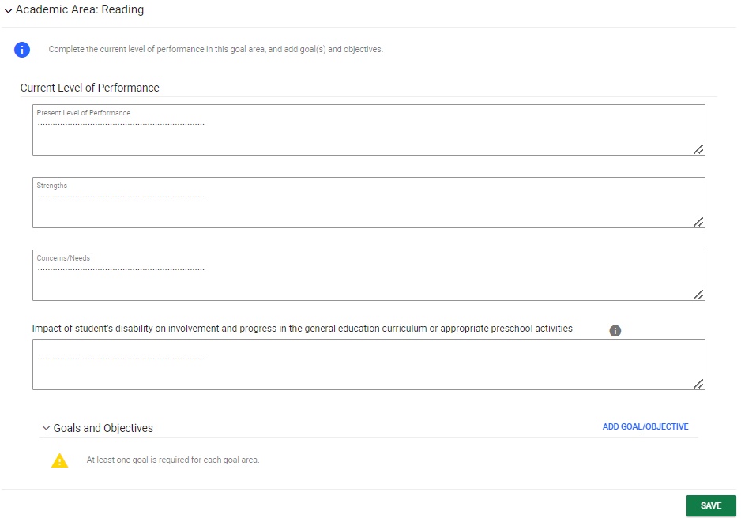
Notes:
After completing the Current Level of Performance, the next step would be to add Goals and Objectives for the specific Academic or Functional area. Here, it is Reading. To add the Goals/Objectives, click on the blue link ADD GOAL/OBJECTIVE on the far-right hand side. This will open a new set of pop-up panels where the Goal/Objective can be added.

Slide 18
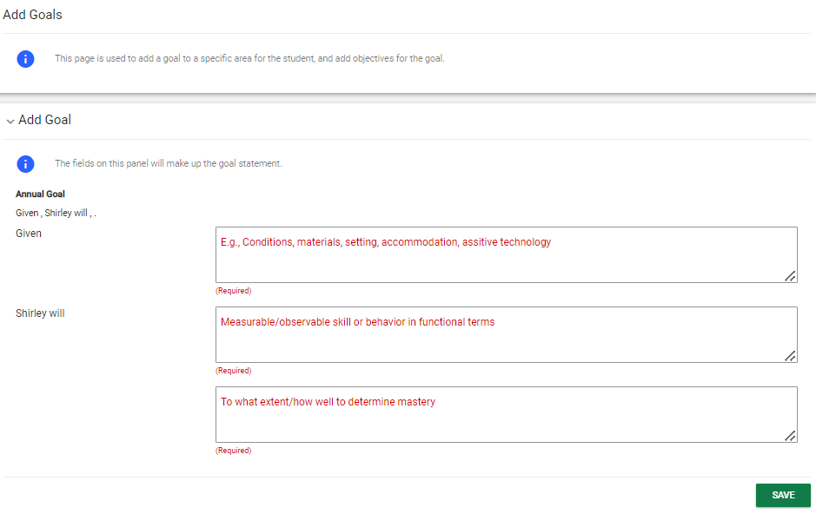
Notes:
The user starts by writing the Goal Statement on the Add Goal panel. Click SAVE when complete to open up the next panel.

Slide 19
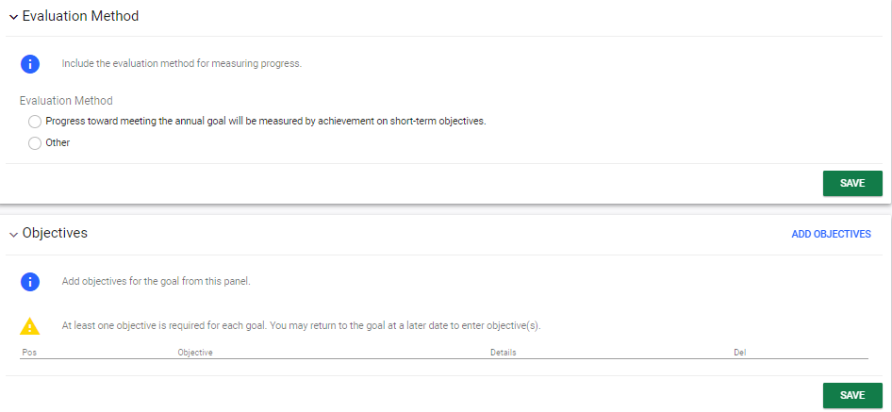
Notes:
The user will then need to select an Evaluation Method. Please note that if the Other field is selected, text will need to be entered explaining the other form of evaluation method. In the Objectives Panel, at least one objective must be entered. Click on the blue link ADD OBJECTIVES in the right corner of the panel. This opens a pop-up panel that allows objectives to be drafted using the template provided.

Slide 20
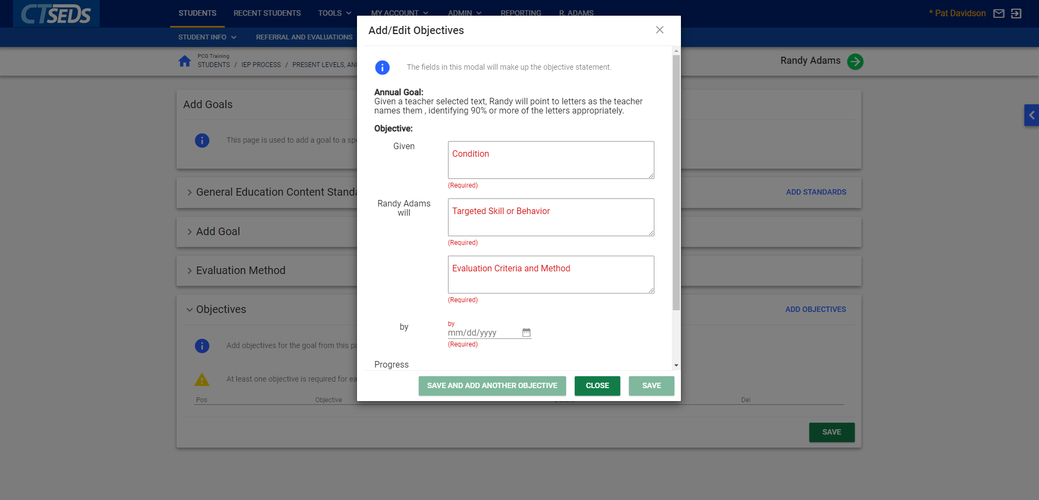
Notes:
On the Add/Edit Objectives pop-up panel, the Annual Goal already entered in the Add Goals/Objectives panel will be listed at the top. At this point, a Condition, Targeted Skill or Behavior and Evaluation Criteria and Method are required for that Objective. A target date is also required for the objective. For the Progress Monitoring Schedule, a drop-down is available that gives various options (bi-weekly, daily, etc.) Once all corresponding fields are completed, the SAVE button and the SAVE AND ADD ANOTHER OBJECTIVE button will change from grey to green indicating that these actions are available. If the user clicks SAVE AND ADD ANOTHER OBJECTIVE, the first objective will be automatically saved in the Objectives Panel and user will be to add another.

Slide 21
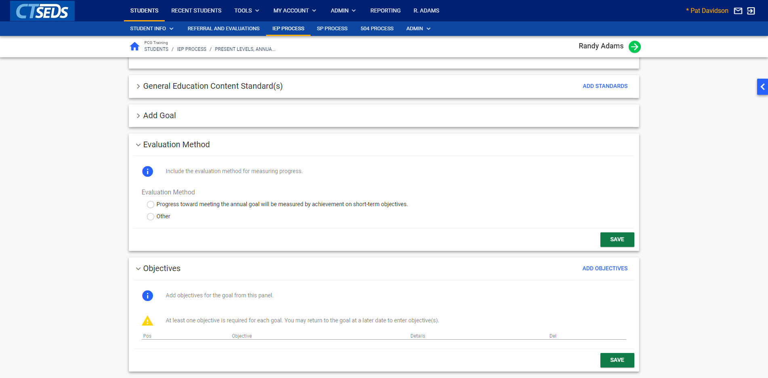
Notes:
Now the user can navigate back to the Present Levels, Annual Goals, Supplementary Aids/Services page by clicking the green Save and Continue arrow in the top right corner of the page.

Slide 22
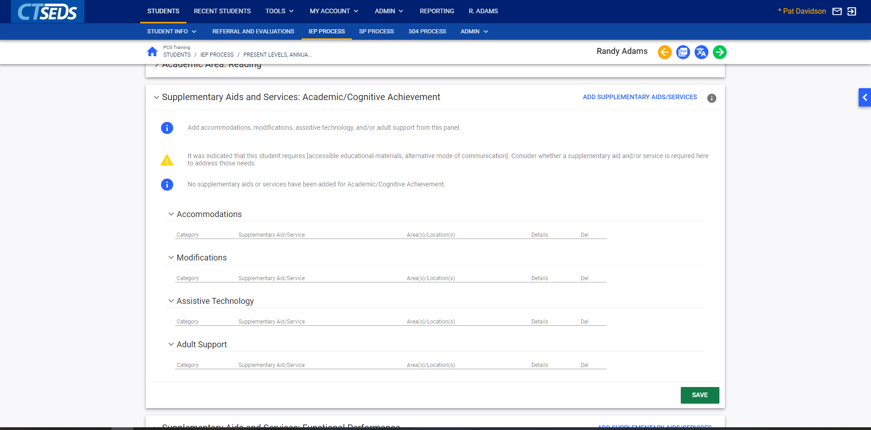
Notes:
The Supplementary Aids and Services panel, which is available in the Academic, Functional, and Transition goal area pages, allows accommodations, modifications, assistive technology, and/or adult support to be added by the user. A warning message will appear if it was indicated earlier in the process that the student requires accessible educational materials or alternative mode of communication. If so, it suggests adding a supplementary aid and/or service. The supplementary aid/service can be added by clicking on the blue link in the upper right corner ADD SUPPLEMENTARY AIDS/SERVICES in the Supplementary Aids and Services panel corresponding to the specific goal area.

Slide 23
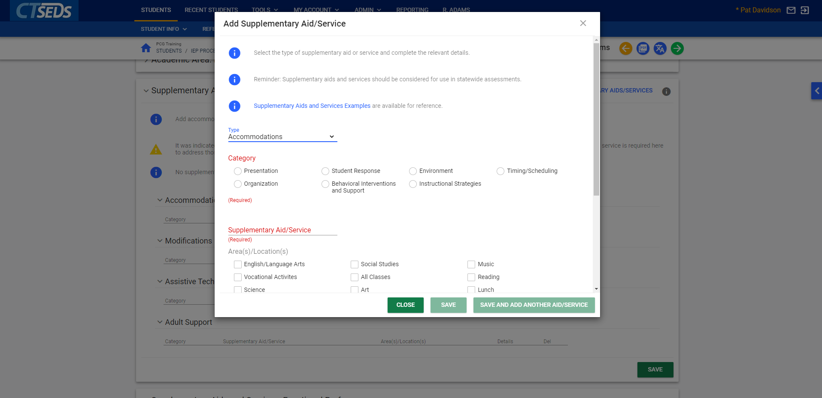
Notes:
The Add Supplementary Aid/Service pop-up panel that appears when the blue link is clicked will require the type of aid/service and the area/location to be selected. Once the type is selected, a corresponding Category section will appear, and one category must be selected.

Slide 24
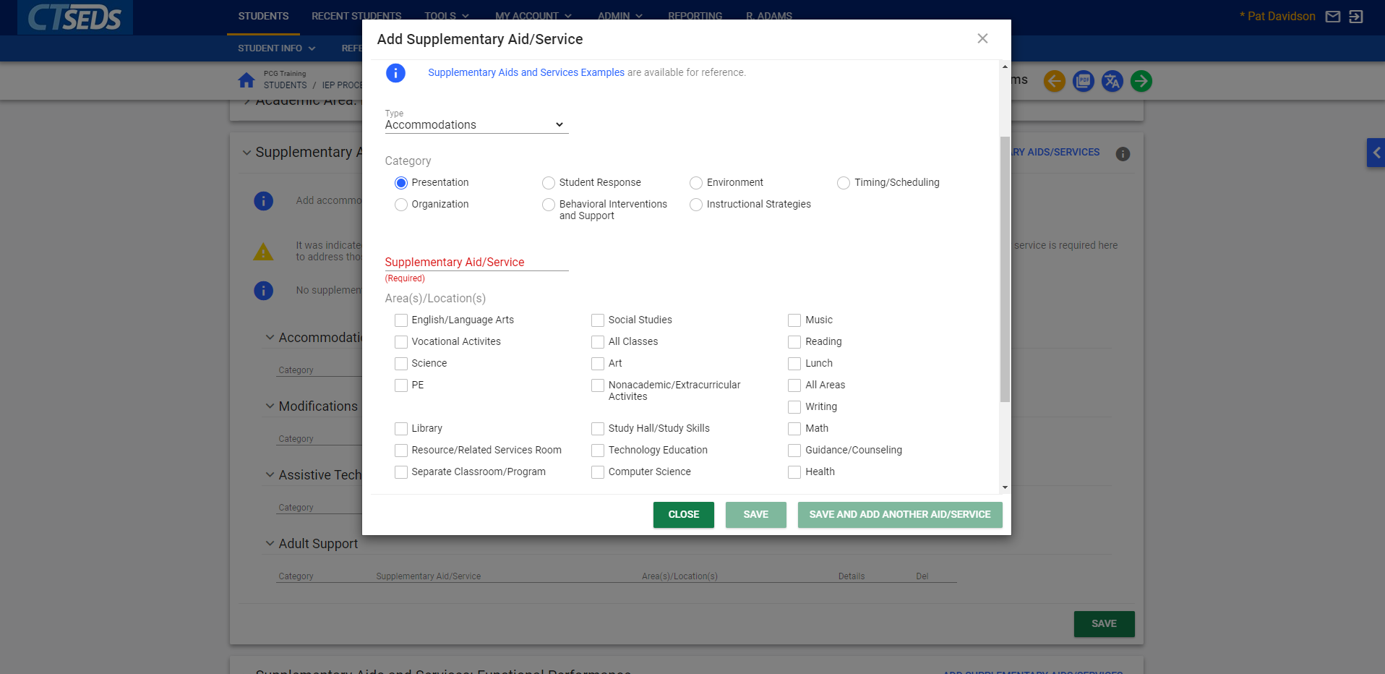
Notes:
After selecting the category, the user will need to type in the Supplementary Aid/Service and select the checkboxes for the area(s)/location(s) where the aid/service will apply. Once all corresponding fields are completed, the SAVE button and the SAVE AND ADD ANOTHER AID/SERVICE button will change from grey to green indicating that these actions are available. If the user clicks SAVE AND ADD ANOTHER AID/SERVICE the first aid/service will be automatically saved in the both the Supplementary Aids and Services panel and the pop-up panel that is open.

Slide 25
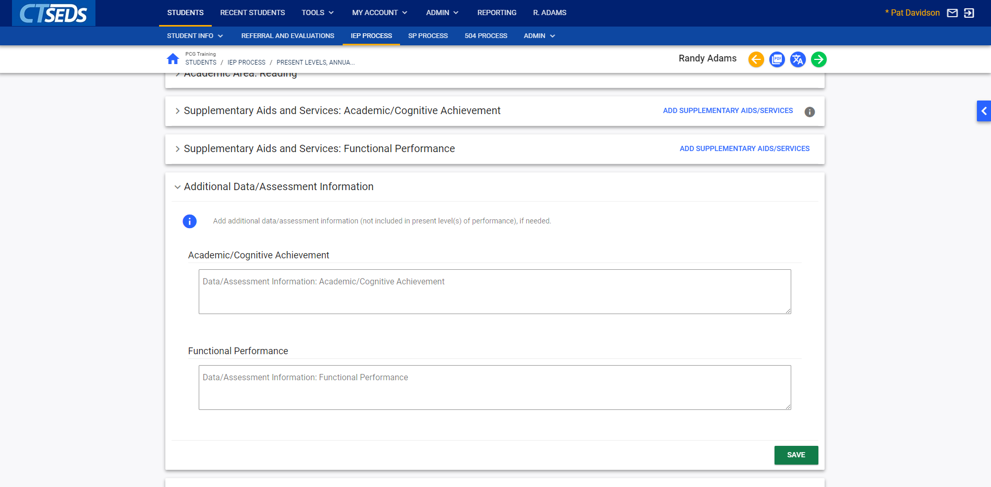
Notes:
Once Supplementary Aids/Services are added for each goal area, the next panel is Additional Data/Assessment Information. Please note that these fields are not required.
This panel provides the user the opportunity to enter any additional data or assessments, that is not “present levels” data such as relevant info from norm-referenced testing or data. This is not in lieu of uploading the evaluation reports but is data that will be printed in the IEP. This is similar to the “other” row on page 4 of the old IEP where educational psychological data may have been provided. This data will remain in visible for 3 years until the next re-evaluation, unlike present levels data which will be cleared out annually at point of annual review.

Slide 26
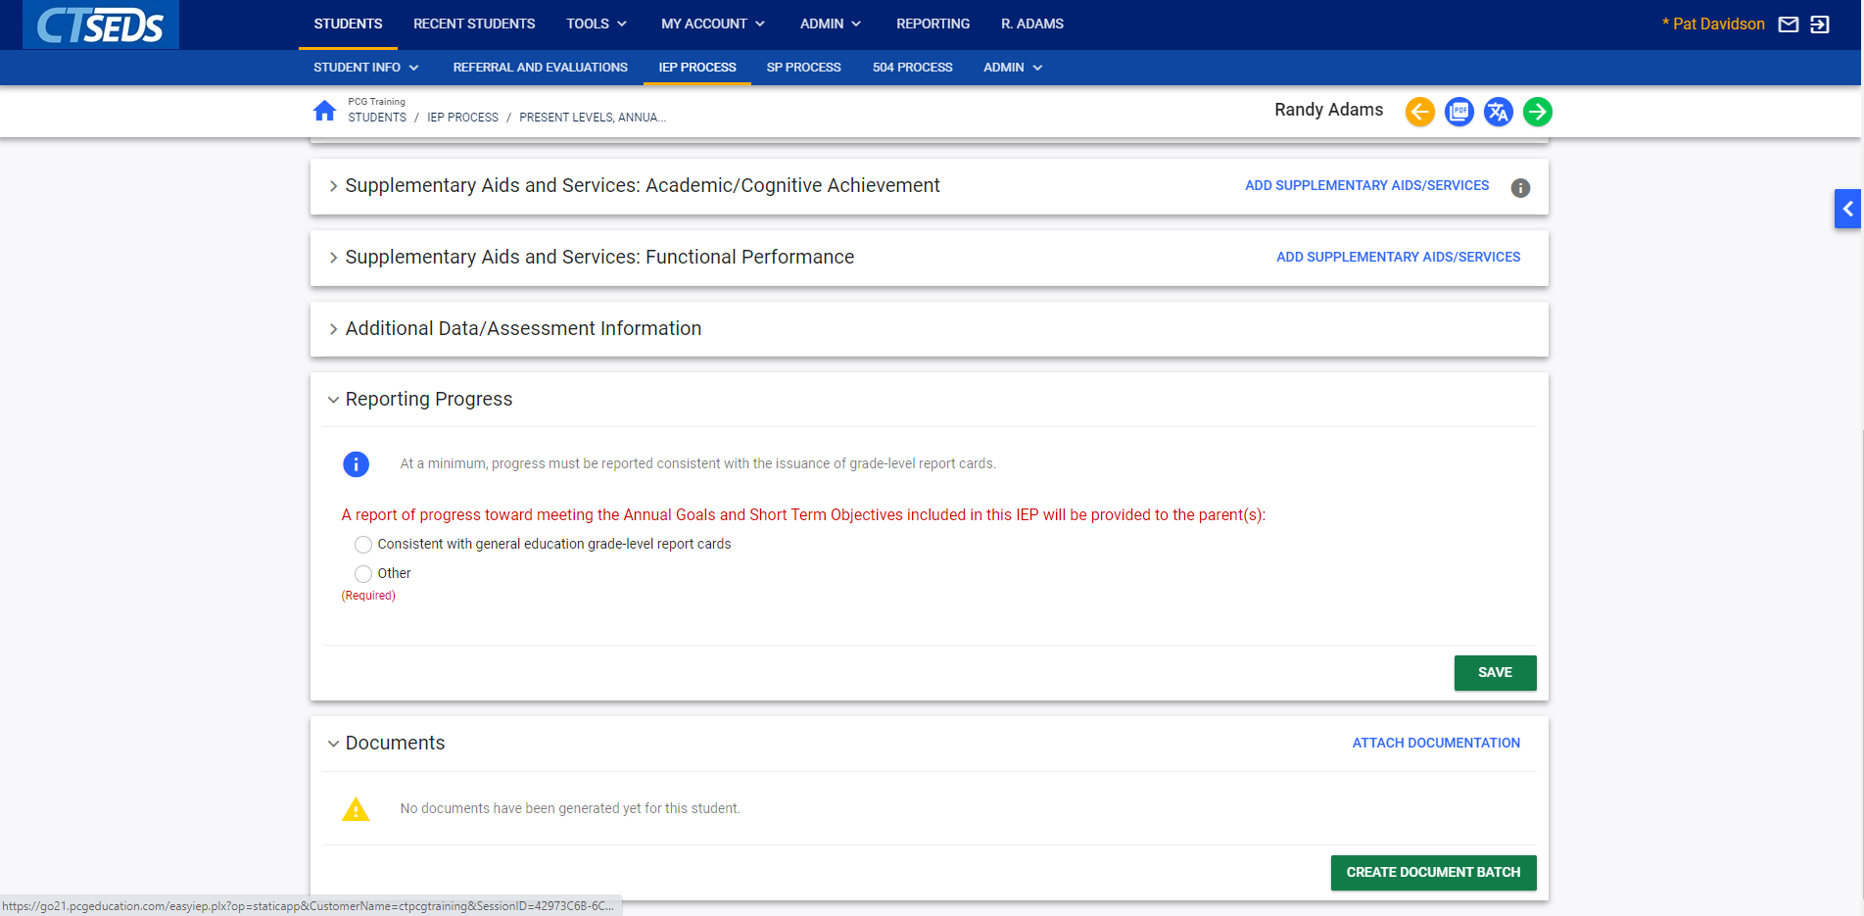
Notes:
For the Reporting Progress panel, the user must select how often IEP progress will be provided to the parent. This information will be included in the IEP provided to the parents. Please note that if “Other” is selected, the corresponding text field will have to be completed.
The Final panel on this page is the documents panel that allows the user to attach any supporting documentation. If the user clicks on the blue link in the upper right corner ATTACH DOCUMENTATION this opens a pop-up panel “Attach External Documents Using CT-SEDS Paperclip” that allows the user to upload any additional documentation by using the arrow to upload the file and clicking the UPLOAD FILES button.

Slide 27
Notes:
Please note, in addition to the orange back arrow and green Save and Continue arrow at the top of the screen, there are two additional options available on some pages in the process. The pdf icon will allow the user to view the section of the IEP they just created to see how it will look on the final IEP document. The other blue icon is the translation icon, which will allow the user to view a translated version of the document into the document language set on the student’s Personal Page. When complete, as on other pages, click the green Save and Continue arrow to run the error check and continue to the next page.

Slide 28
Notes:
The next page in the process is Secondary Transition. The panel shown here will display if the student is under the required age for transition services. If the student is of the required age for transition services or if the checkbox is selected indicating that transition planning is appropriate, additional panels will appear allowing the user to enter information on Transition Assessments, Goals and Objectives, the Course of Study, Supplementary Aids and Services, and transfer of rights. In this demonstration, we will not go into these details, but more information can be found in the IEP and Progress Reporting User Manual.

Slide 29
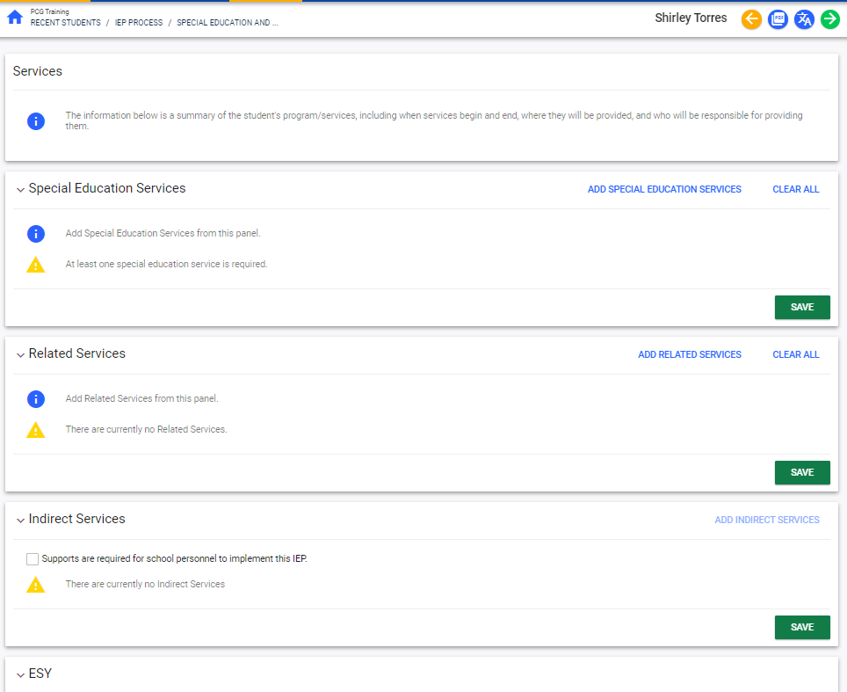
Notes:
The Special Education and Services page allows the user to create a grid of the student's program/services, including when services begin and end, where they will be provided, and who will be responsible for providing them. Then user can add Special Education services, Related Services, Indirect Services, Extended School Year Services, and Transportation Services.

Slide 30
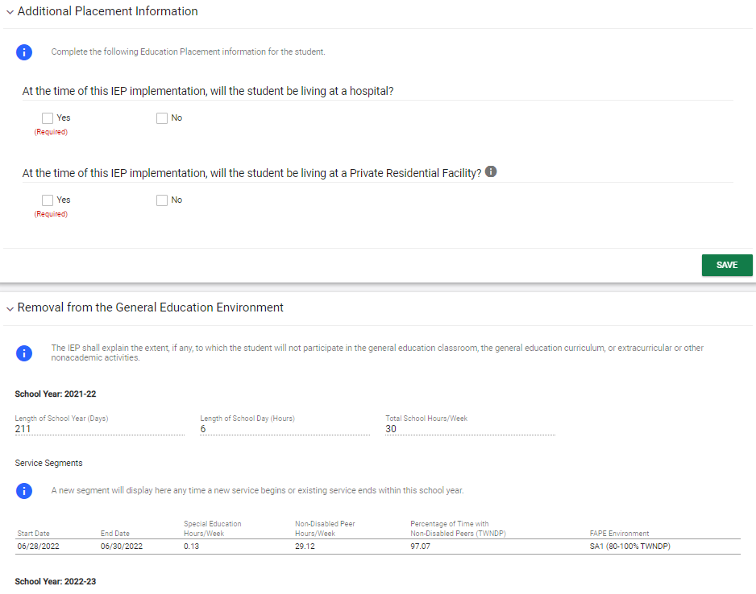
Notes:
The Removal from General Ed page allows the user to complete the details of the removal of the student from the General Education Classroom. An Early Childhood Placement panel will appear on the Removal from General Education page if the student is between 3-5 years old. On the Additional Placement Information panel, the user can select if the student will be living in a hospital or a Private Residential Facility.
The Removal from the General Education Environment panel will explain the extent, if any, to which the student will not participate in the general education classroom, the general education curriculum, or extracurricular or other nonacademic activities. Most fields will auto-populate based on the information already entered in the IEP Process. The two fields that are required are the “Explain the extent to which the student will not participate in general education classes and non-academic activities with non-disabled peers” and “Justification for the removal from the general education environment.” If the LRE Checklist is needed, the LRE Checklist Panel will populate.

Slide 31
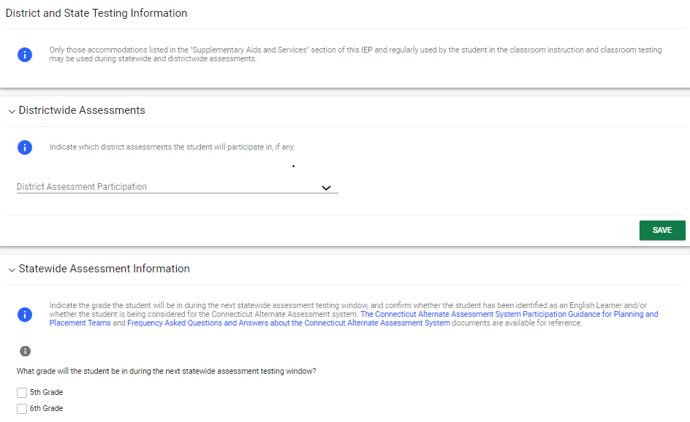
Notes:
The State and District Testing page allows the user to record District and State Testing accommodations or designated supports.
Note: Data from this section will be pulled automatically for TIDE reporting of statewide accommodations. However, accommodations on the SAT must still be provided directly to the College Board.

Slide 32
Notes:
The PPT Recommendations page allows the user to document an itemized list of the PPT Recommendations that were made by the student's PPT. Once recommendations are added, the user can proceed to the final step in the IEP process.

Slide 33
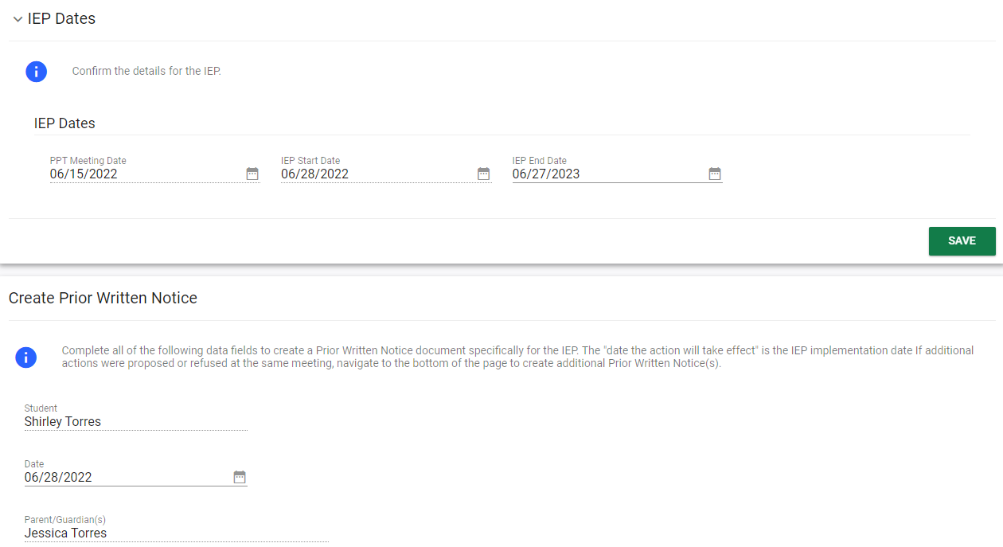
Notes:
The Create Prior Written Notice and IEP page displays the previously entered IEP dates and allows a Prior Written Notice and IEP to be finalized. The Create Prior Written Notice panel requires the user to Complete all the data fields to create a Prior Written Notice document specifically for the IEP. If additional actions were proposed or refused at the same meeting, navigate to the bottom of the page to create additional Prior Written Notice(s).
Please note, a Reason for Delay panel will only display for Initial IEPs and only if the student is out of compliance with evaluation timeline as of the IEP Begin Date.

Slide 34
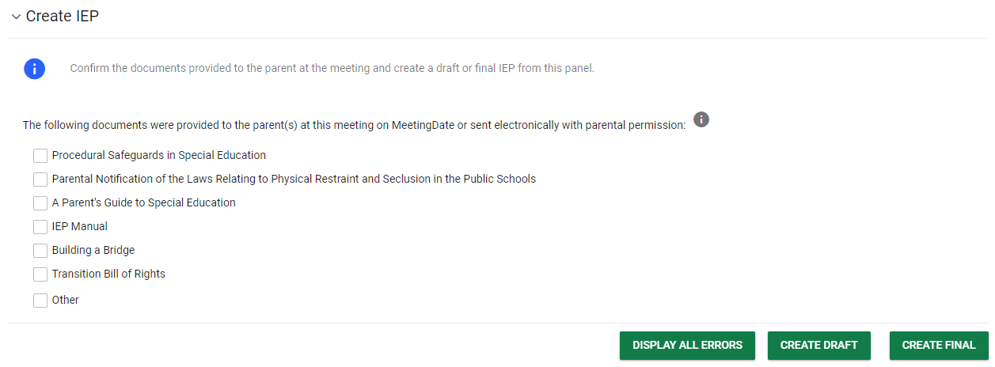
Notes:
In the Create IEP panel, the user must confirm the documents provided to the parent at the meeting and create a draft and/or final IEP. There are checkboxes that the user can check to indicate which documents were provided to the parent(s) at this meeting on the Meeting Date or sent electronically with parental permission. The grey information tooltip will explain the types of documents that can be selected and when they are required to be shared with the Parent.
When complete, the user will conduct the final steps to create the IEP. The green DISPLAY ALL ERRORS button should be clicked to check to see if the user has missed anything in the process. If there are no errors, the user will be able to move forward to finalize the IEP. If there are errors, it will display all errors from the entire IEP Process in a red box for the user to make corrections. The system requires the user correct any errors before finalizing the IEP so errors will also appear when clicking the green create final button if there are errors in the process. The green CREATE DRAFT and CREATE FINAL buttons will create either a draft IEP or a Finalized IEP. Please note, not all user types have the permission to create a final IEP. Once a Finalized IEP is created, the IEP process for the student is completed.

