Slide 1
Implementation of NCQA Person-Centered Outcome Measures in CHCP, PCA, and ABI waivers
Martha Porter
Center on Aging
April 5, 2024

Slide 2
ARPA initiative
Improvement in person-centered goal attainment is part of the provider value-based payments
ARPA funding to create and implement process, evaluate findings, create benchmarks.
Incorporate goals into Connie – All providers can work together and support the individual with achieving their goals

Slide 3
NCQA Person-Centered Outcome Measures
NCQA PCO measures
Goal Identification: Identify person-centered goal, complete goal attainment scale, develop action plan
Goal Follow-up: Follow-up within 180 days
Goal Achievement: Document progress toward or achievement of goal using goal attainment scale

Slide 4
Current process
CHCPE, PCA, ABI
Universal Assessment
SMART goals
Access Agency care managers incorporate individual’s goals into care plans, create action steps, and follow-up with next contacts

Slide 5
Goal Attainment Scale
Kiresuk & Sherman, 1968

Slide 6
Goal follow-up and achievement
Care manager follow-up within 180 days
Goal discussion
Individual and care manager each independently rate the individual’s current goal attainment score
Review or revise action steps
Revise or create new goal

Slide 7
Current status
All Access Agency care managers completed training
Access Agencies modified their IT systems to incorporate scale and other analytic data
Implemented person-centered outcome goals with all new clients and UA reassessments in January 2024

Slide 8
First data submission in February 2024
MEASURE ONE
Agencies sent goals, goal attainment scale, other program information to UConn for 10 random individuals
UConn supplemented with UA data
NCQA reviewed

Slide 9
Future data submissions
MEASURES ONE & TWO
Second data submission April 2024
Possible some follow-up to goals sent in January
MEASURES ONE, TWO & THREE
Quarterly until March 2025

Slide 10
Analyses
NCQA with UConn to test all three measures
Benchmark the two process measures –
– Goal Identification
– Goal Follow-up
Benchmark Measure 3
– Goal attainment

Slide 11
Future use
Share with other providers via Connie
Coordinate and support the individual in reaching their goals
Part of Value-based Payment

Slide 12
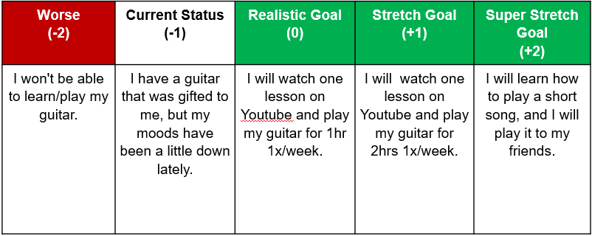
“I want to view some You tube lessons and learn how to play guitar in the next 3 months.”

Slide 13
Per son due to client's cognitive decline: “I would like my mom to start walking to be a little more independent in mobility.”

Slide 14
UConn Center on Aging Team:
Julie Robison, PhD
jrobison@uchc.edu
Ellis Dillon, PhD
edillon@uchc.edu
Martha Porter
porter@uchc.edu

