Slide 1
Review of the Connecticut Child Support Guidelines
Presentation to Commission for Child Support Guidelines
(Sept. 7, 2023)
Jane Venohr, Ph.D. Economist/Research Associate
jvenohr@centerforpolicyresearch.org
303-837-1555

Slide 2
Outline
Recap of February meeting
Federal requirements
Update of economic schedule
Updated to July 2023 price levels
Findings from the analyses of case file data and labor market data
Income imputation at f-t, minimum wage
Low-income adjustment
Next steps

Slide 3
Recap

Slide 4
Recap of Feb. Meeting
Federal requirements of state child support guidelines
2016-added requirements of state guidelines
Requirements of the review process
Economic data on the cost of children and child support schedule
Existing schedule is based on economic data from 2012

Slide 5
CT’s Compliance with Federal Requirements of Guidelines (red font: added in 2016) This slide appeared in the Feb. Materials
Requirements | CT Complies
Provide one guideline, used statewide | ☑
Consider all earnings and income | ☑
Be specific and numeric | ☑
Provide deviation criteria & finding on record | ☑
Consider specific circumstances when imputing income (e.g., literacy, age, criminal record) | ☑ tweak
Consider other evidence of ability to pay (e.g., verbal testimony, dept. of labor data) | ☑ tweak?
Consider parent’s basic subsistence need | ☑ update?
Do not treat incarceration as voluntary unemployment | ☑ tweak?
Provide for child’s healthcare needs | ☑ Opportunity to review?

Slide 6
Fulfilling Federal Requirements of Reviews This slide appeared in the Feb. Materials
Continued Requirement
Consider economic data on the cost of raising children | CPR prepared in Feb and updated to July 2023 price levels
Consider case file data on application of and deviation from the guidelines | CPR: This presentation
Review, and revise, if appropriate, the child support guidelines | Commission and Legislative Regulation Review Committee
New Requirement
Consider labor market data | CPR
Impact of guidelines policies on parents with low income | CPR in progress
Factors that influence employment rates and compliance | CPR from case file data
Rates of default, imputation, and application of low-income adjustment
Comparison of payments by case characteristics including default, imputation, and application of the low-income adjustment
Provide meaningful opportunity for public input, including input from low-income parties | Representation on Commission and Regulation Process
Obtain the views and advice of the IV-D agency | Representatives on Commission
Publish report on internet, membership of reviewing body, and effective date of the guidelines and next review | Updated Child Support and Arrearage Guidelines if Changes

Slide 7
Child Support Schedule: Part Economic Data and Part Policy This slide appeared in the Feb. Materials
Example with no income deductions or adjustments
1 Child
Parent A: $1,000
Parent B: $ 500
Combined = $1,500
Basic obligation from schedule = $278
Parent A Income/Combined Income = 67%
Order = $278 X 67% = $186 per week

Slide 8
Assumptions and Data Underlying Existing Schedule & What Could Be Updated (updated from Feb presentation)
 | Basis of Existing Schedule | Update Alternatives
1. Guidelines model | Income Shares (used by 41 states) | Other models
2. Price levels | March 2012 price levels | Dec. 2022 (29.4% increase) July 2023 (33.3% increase)
3. Measurement of child-rearing expenditures | 4th Betson-Rothbarth study (BR4) from expenditure data collected in 2004-09 | BR5 (2013-2019 expenditure data), USDA, and other studies
4. Adjustments for CT higher income/cost of living | Income realignment (CT 3rd highest state in 2010) | Income realignment (CT is 6th highest state in 2021) Price parity (102.6) CT ranks 13th in 2021 median gross rent
5. Adjusted so no decrease | Higher of existing (2005 schedule) and BR4 income aligned: 2005 schedule applies to net weekly incomes below $1,250 for 1child; $920 for 2 children; and about $600 for 3 or more children | Policy decision
6. Lowest and highest income to be considered | Combined net incomes of $50 - $4,000 per week | Depends on economic basis and adjustment for CT incomes (e.g., BR study allows for up to about $5,000 per week)
7. Spending more/less of after-tax income | Use actual ratios with cap | District of Columbia approach (after-tax income = expenditures, which would increase schedule amounts)
8. Highly variable child-rearing expenses excluded from schedule | Childcare & healthcare expenses excluded from schedule | Various options
9. Low-income adjustment & minimum order | 2012 federal poverty guidelines for 1 person = $215 per week and 10-12% minimum order at net income of $50 per month | 2023 FPG: $280 per week
U.S. Bureau of Economic Analysis. (2022). 2021 Regional Price Parities by State (US = 100). Retrieved from https://www.bea.gov/data/prices-inflation/regional-price-parities-state-and-metro-area

Slide 9
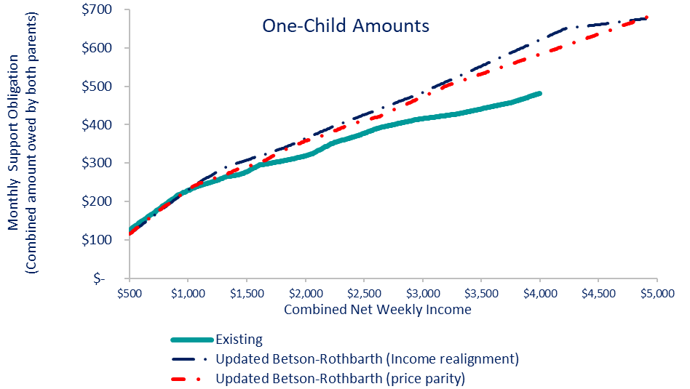
Comparisons: 1 Child (updated to July 2022 price levels)
Comparisons start at combined net incomes of $500 per week (lower incomes may be eligible for low-income adjustment).
Updated BR (price parity and income realignment) generally track closely except at higher incomes
Updated BR (income realignment) slightly more than BR (price parity)
Updated BR (income realignments bows from lowest and highest of incomes.
Gap between existing and BR widens with more income

Slide 10
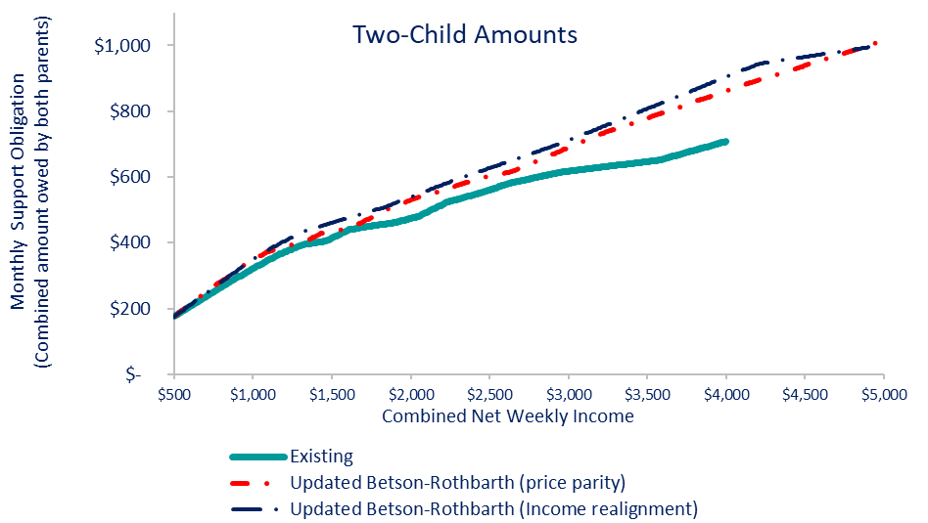
Comparisons: 2 Children (updated to July 2022 price levels)

Slide 11
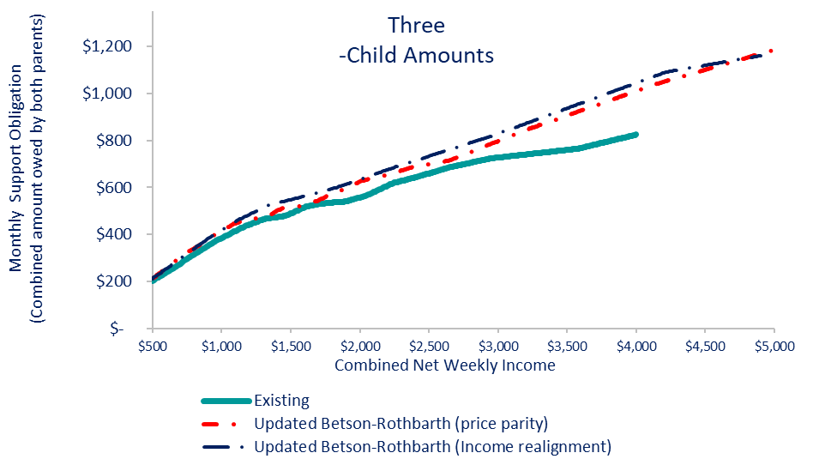
Comparisons: 3 Children (updated to July 2022 price levels)

Slide 12
Findings about BR5 Updates (updated to July 2023 price levels from Dec. 2022 price levels in Feb. presentation)
Mostly Increases for combined net incomes of $500 - $4,000 per week
 | 1 Child |  | 2 Children |  | 3 Children
 | Realign. | Price Parity | Realign. | Price Parity | Realign. | Price Parity
Average Increase | $59 (15%) $62 (16%) | $43 (11%) $45 (12%) | $74 (13%) $78 (14%) | $54 (9%) $58 (10%) | $84 (13%) $89 (14%) | $60 (9%) $65 (10%)
Median Increase | $44 (12%) $48 (13%) | $31 (9%) $35 (10%) | $59 (11%) $64 (12%) | $37 (7%) $43 (8%) | $65(10%) $73 (12%) | $39 (8%) $45 (8%)
Maximum | $137 (28%) $139 (29%) | $96 (21%) $101 (22%) | $192 (27%) $196 (28%) | $147 (21%) $153 (22%) | $215 (26%) $220 (27%) | $180 (22%) $185 (22%)
Weekly Combined Incomes with Increases More than 15% | $2,930 $2,900 | $3,050 $3,060 | $3,000 $3,000 | $3,170 $3,160 | $3,070 $3,060 | $3,270 $3,260
SOME DECREASES for BOTH BR UPDATES
1 child: decrease of $1 to $10 per week for combined net incomes up to $980 950 per week)
Decreases are closest to $10 at lower incomes (i.e., about $500 per week) and become smaller with more income
All decreases less than 8%
No decreases for 2+ children

Slide 13
Findings from the Analysis of Case File Data and Labor Market Data

Slide 14
Federal Requirements for Analysis of Case File Data
Federal Requirements for Analysis of Case File Data
Application of the guidelines and deviations from the guidelines
Rates of:
Income imputation
Application of the low-income adjustment
Defaults
Analysis of payments
1,859 Orders Extracted for Analysis
Case file data from the automated system supporting Connecticut Department of Social Services (DSS) Office of Child Support Services (OCSS)
Does not include non-OCSS cases
Cases with current support orders established during Federal Fiscal Year 2021-2022 (Oct. 1, 2021 – Sept. 30, 2022)
Payment data from the following 5 months (Oct. 2022 – Feb. 2023)

Slide 15
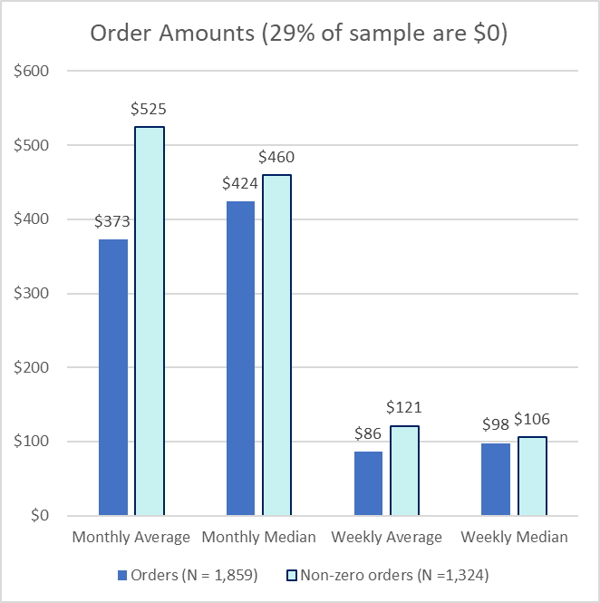
Overview of Case File Data
Each of these DSS offices had at least 10% of orders
Bridgeport (12%)
Danbury 10%)
Hartford (22%)
Middletown (14%)
Subtotal: 58%
The combined percentage for the remaining offices was 42%

Slide 16
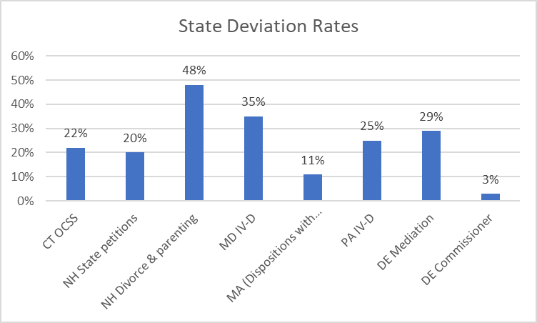
CT Deviation Rate = 22.4%
Based on data from other states, deviation rates tend to vary by data source and IV-D status. Generally, IV-D deviation rates are lower; and non-IV-D deviation rates are higher (e.g., NH divorce & parenting cases).

Slide 17
CT Deviation Reasons
Deviation reason (n = 416)
Excerpt from CT guidelines worksheet: Top 3 circled

Slide 18
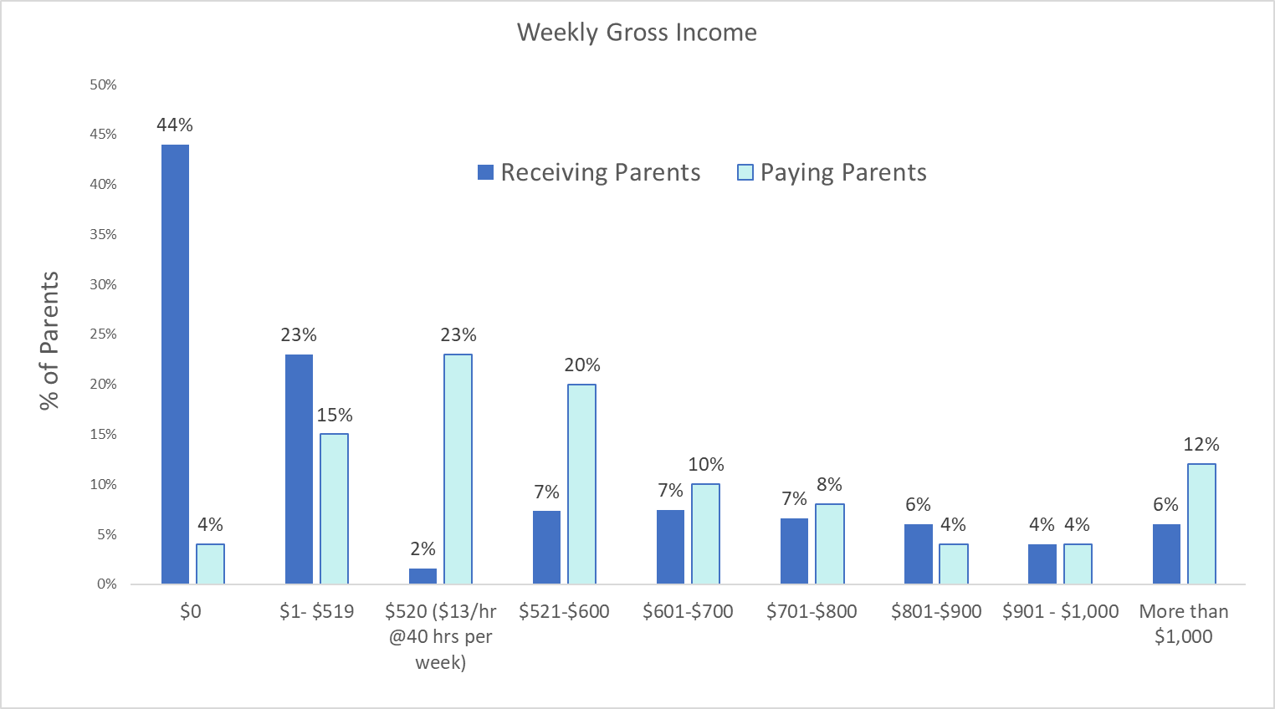
Income Distribution
23% of paying parents with $520 per week is reflection of income imputation at state min. wage Jan – June 2021.

Slide 19
Imputed Income to Paying Parent and Defaults
Connecticut
27% Income imputation rate
28% Default rate (income known or imputed)
Default & income known: 10%
Default & income imputed: 18%
39% Appeared & income known
Percentage of Support Paid
Other States
DE: 33% income imputation
MA: 11% combined default & income imputation
MD: 23% income imputation rate
PA: 11% income imputation rate
NH state petitions: 49% default rate
NH divorces and parenting: 8% default rate
NH state petitions: 38% income imputation rate
NH divorces and parenting: 3% income imputation rate

Slide 20
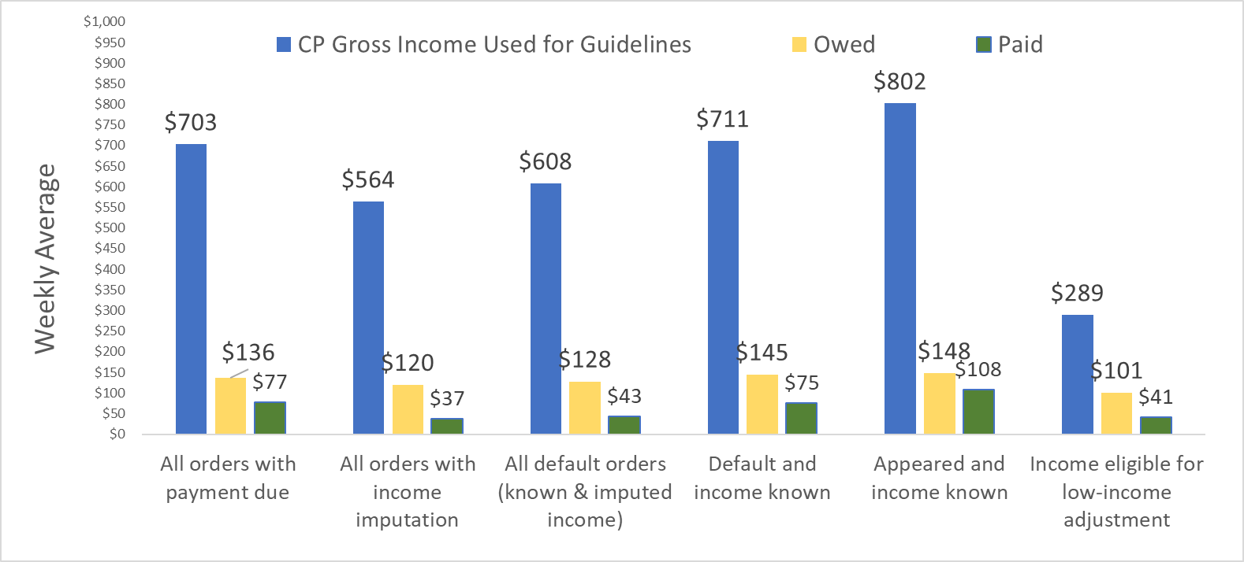
Weekly Averages: Income, Order Amount, & Dollar Paid (n = 1,389)

Slide 21
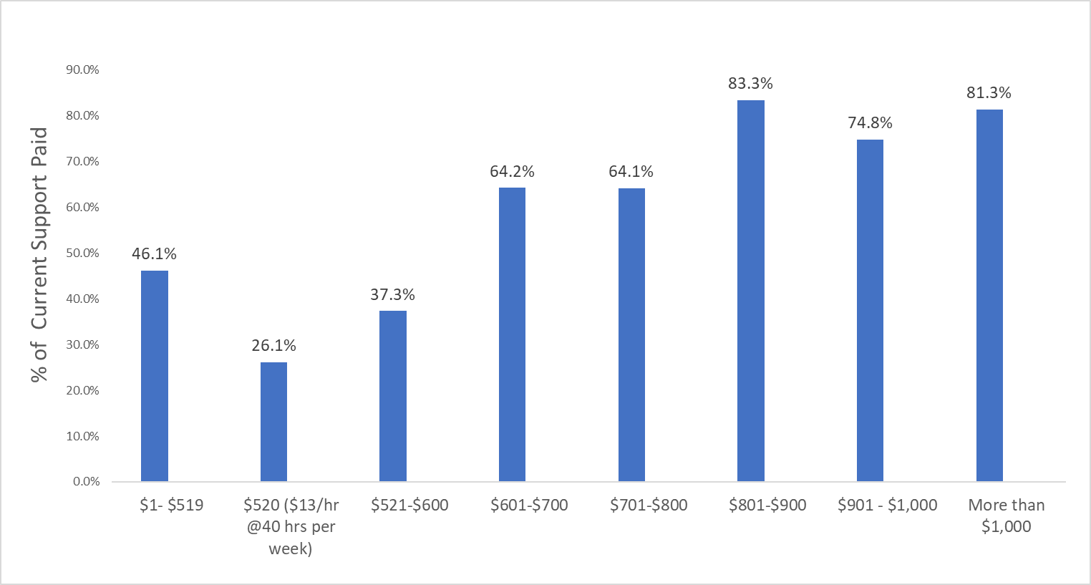
Percentage of Current Support Paid by Noncustodial Parent’s Gross Weekly Income
The lowest percentage paid occurs at common imputed income amounts: $520 is 2021 min. wage; $560 is 2022 min. wage; and $600 is 2023 min wage.

Slide 22
Labor Market Analysis
2023 State minimum wage = $15/hr
40-hour workweek = $600 gross per week,
About $480 net per week
Findings from CT Labor Market Analysis (July 2023)
Unemployment rate 3.6% (U.S. 3.5%)
Ranges from 2.2% in North Canaan and Deep River to 6.4% in Hartford
Labor force participation rate: 64.1%
Average hours for CT private industry Jul. 2023): 33.4 hours per week
Average hours for CT leisure and hospitality: (25.3 hrs)
Small decreases in construction and manufacturing from Jan. 1, tourism up
National data:
55% of all workers work at hourly wage
35% of nonresidential parents had incomes below 200% poverty
Less likely to work f-t, year round
Lower levels of highest educational attainment
Few low-wage earners have paid sick and vacation time
Low-paying jobs often don’t offer 40-hour workweeks

Slide 23
Employment Projections: Top 10 Occupations Requiring less than 1 Month of Training & Earnings
Cashiers: $15.31/hr
Fast food and counter workers: $15.47/hr
Waiters and waitresses: $20.30/hr
Retail salesperson: $18.77/hr
Laborers and freight, stock, and material movers: $19.06/hr
Janitors and cleaners: $19.04/hr
Stockers and order filers: $18.56/hr
Customer service representatives: $23.15/hr
Office clerks: $21.73/hr
Secretaries and administrative assistants: $26.36/hr

Slide 24
Examples from Other States: Limiting Income Imputation
Adopt federal language and apply
45 C.F.R 302.56(c)(1)(iii) If imputation of income is authorized, takes into consideration the specific circumstances of the noncustodial parent (and at the State’s discretion, the custodial parent) to the extent known, including such factors as the noncustodial parent’s assets, residence, employment and earnings history, job skills, educational attainment, literacy, age, health, criminal record and other employment barriers, and record of seeking work, as well as the local job market, the availability of employers willing to hire the noncustodial parent, prevailing earnings level in the local community, and other relevant background factors in the case.
Encourage verbal testimony & review of all sources of income (see DC in attachment)
Treat income imputation like deviation (e.g., DC requires a finding that parent can earn more/shirking responsibility and documentation)
As last resort impute income at something less than 40 hours/52 weeks per year (e.g., See CO, which uses 32 hrs/50 weeks, in attachment)
Apply low-income adjustment at common income imputation amounts
Training of agency staff and courts
Encourage appearance and communication with child support agency
E.g., simplified forms and notices in plainspeak and text and refrigerator magnet reminders
See findings and resources from federal Office of Child Support Services Behavioral Economics Demonstration projects https://www.acf.hhs.gov/css/grants/current-grants/bics
Other?

Slide 25
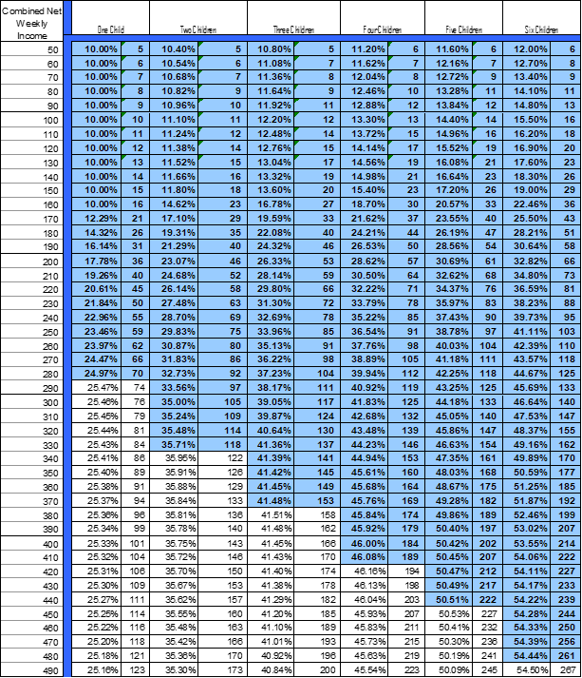
Low-Income Adjustment
Low-income adjustment is shown by shaded area (based on 2012 Federal Poverty Guidelines for 1 person) = $215 per week
2023 FPG = $280 per week
Findings from Case file Data
13.5% of paying parents had incomes eligible for the low-income adjustment
Median order = $190 per week
Median gross income = $234 per week
Median order amount as % of gross income = 14.3%
Median percentage of current support paid =23.7%, average = 36.4%
Best practices:
Use state minimum wage (e.g., AZ uses 80% of FT earnings at state min wage) or more than 100% FPG (e.g., NJ uses 150% of FPG)
Index and put in worksheet so can be updated annually and administratively without technical assistance

Slide 26
Simplified Example of Low-Income Adjustment in Worksheet
Major Strength: Can be updated annually for changes in poverty or state minimum wage
Major Weakness: Big change
 | Parent A | Parent B
Line 14. Net Weekly Income | $400 | $600
II. CURRENT SUPPORT
Line 15 Combined net weekly income | $1,000
Line 16. Basic child support obligation (from Schedule of Basic Child Support Obligation) for 6 children | $514
Line 17. Each parent’s percentage share of Line 15 | 40% | 60%
Line. 18 Each parent’s share of the basic child support obligation | $205 | $308
Line 20/Line 30 Preliminary presumptive current support amount for noncustodial parent |  | $308
NEW SECTION: ABILITY TO PAY/SELF-SUPPORT RESERVE
Line X: Self-Support Reserve (130% of poverty = 130% x $280 = $364 per week) |  | $364
Line Y: Income available for current support (Line 18 minus Line X) |  | $236
Line Z: Current support amount after consideration of ability to pay/self-support reserve (Lower of Line 20/Line 30 and Line Y) |  | $236
Amount of SSR is a policy decision, worksheet can be designed to have minimum order and other attributes

Slide 27
Other Findings from Case File Data
 | All Orders (N = 1,859) |  | Orders Established by Appearance and Known Income ( n = 706)
 | Receiving Parent | Paying Parent | Receiving Parent | Paying Parent
Income deduction for medical/hospital/dental insurance (Line 6 on worksheet) | 19% Average = $22/wk | 36% Average = $21/wk | 24% Average = $27/wk | 45% Average = $30/wk
Income deduction for non-arrearage payments on court ordered alimony and child support (Line 11 on worksheet) | <0.5% | 16% | None | 16%
Income deduction to support qualified children (Line 12 on worksheet) | 14% | 7% | 25% | 10%
Social security dependency benefits adjustment (Line 19 on worksheet) | None | <0.5% | None | <0.5%

Slide 28
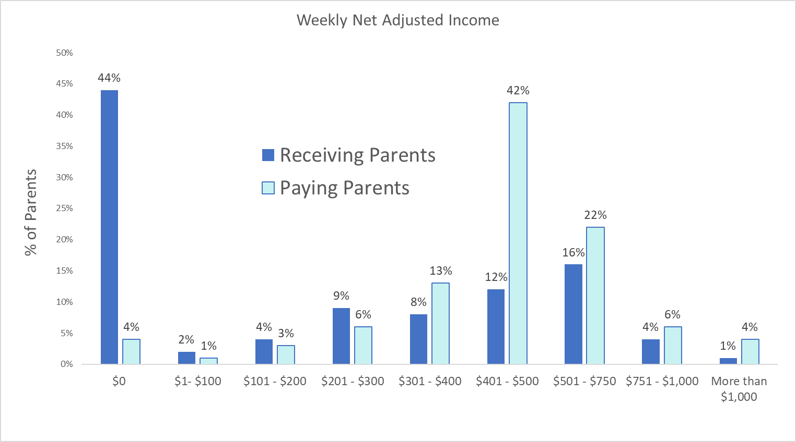
Distribution of Net Incomes
On average, the paying parent’s income is 55% of combined income

Slide 29
Summary, Suggested Considerations and Next Steps

Slide 30
Summary and Suggested Considerations
Summary
There are new federal requirements of state guidelines and guidelines reviews
Economic: There is new economic data on the cost of raising children; the existing schedule is based on 2012 data
Income imputation at 40 hr per week at minimum wage is common
Many low-paying jobs offer less than 40-hour per week and often less than 52 weeks per year are paid
Economic Considerations:
Should the schedule be updated using updated BR? If so, should it account for Connecticut’s income using income realignment or price parity?
Be extended from maximum combined income of $4,000 per week to $5,000 per week?
Should the amount of the low-income adjustment be increased and expanded to higher incomes?
Should the low-income adjustment approach be modified (e.g., put in worksheet)?
Non-economic Considerations
Tweak income imputation considerations to lessen income imputation at f-t, state minimum wage
Other tweaks (see slide 5 from Feb. presentation)

Slide 31
Next Steps
Examples from Other States: Income Imputation
CPR
What additional information is needed for decision making?
Updating low-income adjustment in schedule requires decision to use price parity or income realignment
Commission
Timelines

Slide 32
Attachments

Slide 33
Examples from Other States: Income Imputation
MA | D. Imputation of income When the Court finds that a parent has, in whole or in part, undocumented or unreported income, the Court may reasonably impute income to the parent based on all the evidence submitted, including, but not limited to, evidence of the parent’s ownership and maintenance of assets, and the parent’s lifestyle, expenses and spending patterns. Expense reimbursements, in-kind payments or benefits received by a parent, personal use of business property, and payment of personal expenses by a business in the course of employment, self-employment, or operation of a business may be included as income if such payments are significant and reduce personal living expenses. In circumstances where the Court finds that a parent has unreported income, the Court may adjust the amount of income upward by a reasonable percentage to take into account the absence of income taxes that normally would be due and payable on the unreported income. E. Attribution of income Income may be attributed where a finding has been made that either parent is capable of working and is unemployed or underemployed. If the Court makes a determination that either parent is earning less than he or she could earn through reasonable effort, the Court should consider potential earning capacity rather than actual earnings in making its child support order. The Court shall consider the age, number, needs and care of the children covered by the child support order. The Court shall also consider the specific circumstances of the parent, to the extent known and presented to the Court, including, but not limited to, the assets, residence, education, training, job skills, literacy, criminal record and other employment barriers, age, health, past employment and earnings history, as well as the parent’s record of seeking work, and the availability of employment at the attributed income level, the availability of employers willing to hire the parent, and the relevant prevailing earnings level in the local community.
PA | A) Earning Capacity Limitation. The trier-of-fact: (I) shall not impute to the party an earning capacity that exceeds the amount the party could earn from one full-time position; and (II) shall determine a reasonable work regimen based upon the party’s relevant circumstances, including the jobs available within a particular occupation, working hours and conditions, and whether a party has exerted substantial good faith efforts to find employment. (B) The trier-of-fact shall base the party’s earning capacity on the subdivision (d)(4)(ii) factors. (C) After assessing a party’s earning capacity, the trier-of-fact shall state the reasons for the assessment in writing or on the record. (D) When the trier-of-fact imputes an earning capacity to a party who would incur childcare expenses if the party were employed, the trier-of-fact shall consider reasonable childcare responsibilities and expenses. (ii) Factors. In determining a party’s earning capacity, the trier-of-fact shall consider the party’s: (A) child care responsibilities and expenses; (B) assets; (C) residence; (D) employment and earnings history; (E) job skills; (F) educational attainment; (G) literacy; (H) age; (I) health; (J) criminal record and other employment barriers; (K) record of seeking work; (L) local job market, including the availability of employers who are willing to hire the party; (M) local community prevailing earnings level; and (N) other relevant factors.

Slide 34
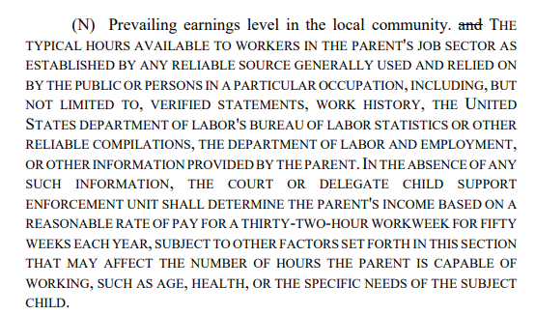
Examples from Other States: Income Imputation
CO | (background factors I
DC | §303.4 Establishment of support obligations. (b) Use appropriate State statutes, procedures, and legal processes in establishing and modifying support obligations in accordance with §302.56 of this chapter, which must include, at a minimum: (1) Taking reasonable steps to develop a sufficient factual basis for the support obligation, through such means as investigations, case conferencing, interviews with both parties, appear and disclose procedures, parent questionnaires, testimony, and electronic data sources; (2) Gathering information regarding the earnings and income of the noncustodial parent and, when earnings and income information is unavailable or insufficient in a case gathering available information about the specific circumstances of the noncustodial parent, including such factors as those listed under §302.56(c)(1)(iii) of this chapter; (3) Basing the support obligation or recommended support obligation amount on the earnings and income of the noncustodial parent whenever available. If evidence of earnings and income is unavailable or insufficient to use as the measure of the noncustodial parent’s ability to pay, then the support obligation or recommended support obligation amount should be based on available information about the specific circumstances of the noncustodial parent, including such factors as those listed in §302.56(c)(1)(iii) of this chapter. (4) Documenting the factual basis for the support obligation or the recommended support obligation in the case record

