Slide 1
Review of the Connecticut
Child Support Guidelines
Presentation to Commission for Child Support Guidelines
(Feb 2, 2023)
Jane Venohr, Ph.D. Economist/Research Associate
jvenohr@centerforpolicyresearch.org
303-837-1555

Slide 2
Historical Overview
Federal requirements of state child support guidelines
  1987: States required to have advisory guidelines
  1989 (Family Support Act of 1988):
    States required to have rebuttable presumptive guidelines
    Review at least every four years
      Consider economic data on the cost of raising children
      Analyze guidelines deviations to keep deviations to a minimum
  2016: Major expansion of federal requirements
      Added requirements of state guidelines to better address low-income families
      Added requirements of state guidelines reviews
      Deadline tied to state’s review cycle– as late as 2025 for some states
Connecticut’s last review with technical assistance: 2012 assistance → 2015 changes

Slide 3
Outline
Federal requirements
  Documented in state IV-D plan and approved by federal Office of Child Support Enforcement
  CPR’s role– show how other state’s meet them
Economic data
  Summarize basis of existing schedule and what could be updated (Slide 24)
  Review economic data on the cost of raising children (federal requirement)
  Update core schedule: a couple options for adjusting national data for CT incomes/costs
    Slide 35 summarizes dollar/percentages changes
    Layer low-income adjustment on top of schedule later
Discussion of Next Steps
  Other issues (e.g., subtraction for insurance premium, childcare expenses)
  Findings from case file data
  Analysis of labor market data
  Update of low-income adjustment

Slide 4


Federal Requirements of State Guidelines

Slide 5
CT’s Compliance with Federal Requirements of Guidelines (red font: added in 2016)
Requirements | CT Complies
Provide one guideline, used statewide | ☑
Consider all earnings and income | ☑
Be specific and numeric | ☑
Provide deviation criteria & finding on record | ☑
Consider specific circumstances when imputing income (e.g., literacy, age, criminal record) | ☑ tweak
Consider other evidence of ability to pay (e.g., verbal testimony, dept. of labor data) | ☑ tweak?
Consider parent’s basic subsistence need | ☑ update?
Do not treat incarceration as voluntary unemployment | ☑ tweak?
Provide for child’s healthcare needs | ☑ Opportunity to review?

Slide 6
Connecticut Child Support Guidelines
C.G.S.A. § 46b-215a-e
Sec. 46b-215. (Formerly Sec. 17-320). Relatives obliged to furnish support. Attorney General and attorney for town as parties. Orders.
Sec. 46b-215a. Commission for Child Support Guidelines. Duties. Members. Validity of actions taken during vacancy.
Sec. 46b-215b. Guidelines to be used in determination of amount of support and payment on arrearages and past-due support.
Sec. 46b-215c. Guidelines to be approved by legislative regulation review committee.
Sec. 46b-215d. Certain earnings not considered income for purposes of guidelines.
Sec. 46b-215e. Initial or modified support order when child support obligor is institutionalized or incarcerated. Procedure in IV-D support cases when child support obligor is incarcerated for more than ninety days.
State of Connecticut Commission for Child Support Guidelines. (eff. July 1. 2015.) Child Support and Arrearage Guidelines. Retrieved from https://www.jud.ct.gov/publications/childsupport/csguidelines.pdf

Slide 7
Federal Requirement: Consider All Income and Evidence of Ability to Pay
Federal Requirement | CT Provisions
45 CFR §302.56(c) The child support guidelines established under paragraph (a) of this section must at a minimum: (1) Provide that the child support order is based on the noncustodial parent’s earnings, income, and other evidence of ability to pay that: Takes into consideration all earnings and income of the noncustodial parent (and at the State’s discretion, the custodial parent); OCSE’s explanation of the rule change cites PIQ–00–03. Retrieved from: https://www.acf.hhs.gov/css/resource/state-iv-d-program-flexibility-low-income-obligors States may want to take steps to limit the imputation of income, for example, to cases in which the non-custodial parent has apparent assets and/or ability to pay, but is uncooperative. And, most importantly, States should make the maximum use of improved methods of determining income and resources of non-custodial parents, including the State and National Directories of New Hires as well as the Financial Institution Data Match (FIDM) and Multistate Financial Institution Data Match (MSFIDM). | §46b-302 Definitions (9) “Income” includes earnings or other periodic entitlements to money from any source and any other property subject to withholding for support under the law of this state. §46b-215 (7)(B) In the determination of support due based on neglect or refusal to furnish support prior to the action, the support due for periods of time prior to the action shall be based upon the obligor's ability to pay during such prior periods, as determined in accordance with the child support guidelines established pursuant to section 46b- 215a. The state shall disclose to the court any information in its possession concerning current and past ability to pay. If no information is available to the court concerning past ability to pay, the court may determine the support due for periods of time prior to the action as if past ability to pay is equal to current ability to pay, if current ability is known. If current ability to pay is not known, the court shall determine the past ability to pay based on the obligor's work history, if known, or if not known, on the state minimum wage that was in effect during such periods, provided only actual earnings shall be used to determine ability to pay for past periods during which the obligor was a full-time high school student or was incarcerated, institutionalized or incapacitated.

Slide 8
Examples from Other States: All, Actual Income & Other Evidence of Ability to Pay
DC | §303.4 Establishment of support obligations. (b) Use appropriate State statutes, procedures, and legal processes in establishing and modifying support obligations in accordance with §302.56 of this chapter, which must include, at a minimum: (1) Taking reasonable steps to develop a sufficient factual basis for the support obligation, through such means as investigations, case conferencing, interviews with both parties, appear and disclose procedures, parent questionnaires, testimony, and electronic data sources; (2) Gathering information regarding the earnings and income of the noncustodial parent and, when earnings and income information is unavailable or insufficient in a case gathering available information about the specific circumstances of the noncustodial parent, including such factors as those listed under §302.56(c)(1)(iii) of this chapter; (3) Basing the support obligation or recommended support obligation amount on the earnings and income of the noncustodial parent whenever available. If evidence of earnings and income is unavailable or insufficient to use as the measure of the noncustodial parent’s ability to pay, then the support obligation or recommended support obligation amount should be based on available information about the specific circumstances of the noncustodial parent, including such factors as those listed in §302.56(c)(1)(iii) of this chapter. (4) Documenting the factual basis for the support obligation or the recommended support obligation in the case record
ME | MAINE Title 19-A, Chapter 63: §2004. Income information and child support worksheets 1. Court actions. A. In a court action to determine or modify support of a minor child, the plaintiff and defendant shall exchange, prior to mediation, affidavits regarding income and assets. These affidavits must conform with the forms provided by the court and must be accompanied by supporting documentation of current income, such as pay stubs, tax returns, employer statements or, if the plaintiff or defendant is self-employed, receipts and expenses. D. If a party fails to comply with this subsection, the court may, in its discretion: (2) Presume for the purpose of determining a current support obligation that the party has an earning capacity equal to the average weekly wage of a worker in this State as determined by the most recent Department of Labor statistics. A different annual income may be used if there is sufficient reliable evidence to conclude reasonably that the noncomplying party earns a greater or lesser actual income. E. The court may admit Department of Labor statistics into evidence for purposes of computing a parental support obligation.
MA | Source of Income For purposes of these guidelines, income is defined as gross income from whatever source, regardless of whether that income is recognized by the Internal Revenue Code or reported to the Internal Revenue Service or state Department of Revenue or other taxing authority. However, income derived from a public assistance program or benefit that is based on the person’s financial circumstances (for example: TAFDC, SNAP, certain veterans’ benefits and supplemental security income (SSI) benefits) shall not be counted as income for either parent. D. Imputation of income When the Court finds that a parent has, in whole or in part, undocumented or unreported income, the Court may reasonably impute income to the parent based on all the evidence submitted, including, but not limited to, evidence of the parent’s ownership and maintenance of assets, and the parent’s lifestyle, expenses and spending patterns.
UT | (b) Each parent shall provide verification of current income. Each parent shall provide year-to-date pay stubs or employer statements and complete copies of tax returns from at least the most recent year unless the court finds the verification is not reasonably available. Verification of income from records maintained by the Department of Workforce Services may be substituted for pay stubs, employer statements, and income tax returns.

Slide 9
Federal Requirement: Income Imputation
Federal Requirement | CT
45 C.F.R. §302.56(c)(1)(iii) If imputation of income is authorized, takes into consideration the specific circumstances of the noncustodial parent (and at the State’s discretion, the custodial parent) to the extent known, including such factors as the noncustodial parent’s assets, residence, employment and earnings history, job skills, educational attainment, literacy, age, health, criminal record and other employment barriers, and record of seeking work, as well as the local job market, the availability of employers willing to hire the noncustodial parent, prevailing earnings level in the local community, and other relevant background factors in the case. | §46b-215 (7)(B) If current ability to pay is not known, the court shall determine the past ability to pay based on the obligor's work history, if known, or if not known, on the state minimum wage that was in effect during such periods, provided only actual earnings shall be used to determine ability to pay for past periods during which the obligor was a full-time high school student or was incarcerated, institutionalized or incapacitated. §46b-215(e) In IV-D support cases, as defined in section 46b-23 l, when the child support obligor is institutionalized or incarcerated for more than ninety days, any existing support order, as defined in section 46b-23 l, shall be modified to zero dollars effective upon the date that a support enforcement officer files an affidavit in the Family Support Magistrate Division. The affidavit shall include: (1) The beginning and expected end dates of such obligor's institutionalization or incarceration; and (2) a statement by such officer that (A) a diligent search failed to identify any income or assets that could be used to satisfy the child support order while the obligor is incarcerated or institutionalized, (B) the offense for which the obligor is institutionalized or incarcerated was not an offense against the custodial party or the child subject to such support order, and (C) a notice in accordance with subsection (c) of this section was provided to the custodial party and an objection form was not received from such party.

Slide 10
Examples from Other States: Income Imputation
MA | D. Imputation of income When the Court finds that a parent has, in whole or in part, undocumented or unreported income, the Court may reasonably impute income to the parent based on all the evidence submitted, including, but not limited to, evidence of the parent’s ownership and maintenance of assets, and the parent’s lifestyle, expenses and spending patterns. Expense reimbursements, in-kind payments or benefits received by a parent, personal use of business property, and payment of personal expenses by a business in the course of employment, self-employment, or operation of a business may be included as income if such payments are significant and reduce personal living expenses. In circumstances where the Court finds that a parent has unreported income, the Court may adjust the amount of income upward by a reasonable percentage to take into account the absence of income taxes that normally would be due and payable on the unreported income. E. Attribution of income Income may be attributed where a finding has been made that either parent is capable of working and is unemployed or underemployed. If the Court makes a determination that either parent is earning less than he or she could earn through reasonable effort, the Court should consider potential earning capacity rather than actual earnings in making its child support order. The Court shall consider the age, number, needs and care of the children covered by the child support order. The Court shall also consider the specific circumstances of the parent, to the extent known and presented to the Court, including, but not limited to, the assets, residence, education, training, job skills, literacy, criminal record and other employment barriers, age, health, past employment and earnings history, as well as the parent’s record of seeking work, and the availability of employment at the attributed income level, the availability of employers willing to hire the parent, and the relevant prevailing earnings level in the local community.
PA | A) Earning Capacity Limitation. The trier-of-fact: (I) shall not impute to the party an earning capacity that exceeds the amount the party could earn from one full-time position; and (II) shall determine a reasonable work regimen based upon the party’s relevant circumstances, including the jobs available within a particular occupation, working hours and conditions, and whether a party has exerted substantial good faith efforts to find employment. (B) The trier-of-fact shall base the party’s earning capacity on the subdivision (d)(4)(ii) factors. (C) After assessing a party’s earning capacity, the trier-of-fact shall state the reasons for the assessment in writing or on the record. (D) When the trier-of-fact imputes an earning capacity to a party who would incur childcare expenses if the party were employed, the trier-of-fact shall consider reasonable childcare responsibilities and expenses. (ii) Factors. In determining a party’s earning capacity, the trier-of-fact shall consider the party’s: (A) child care responsibilities and expenses; (B) assets; (C) residence; (D) employment and earnings history; (E) job skills; (F) educational attainment; (G) literacy; (H) age; (I) health; (J) criminal record and other employment barriers; (K) record of seeking work; (L) local job market, including the availability of employers who are willing to hire the party; (M) local community prevailing earnings level; and (N) other relevant factors.

Slide 11
Federal Requirement: Address Subsistence Needs
Federal Requirement | CT Provisions from Booklet
45 CFR §302.56(c)(1)(ii) Takes into consideration the basic subsistence needs of the noncustodial parent (and at the State’s discretion, the custodial parent and children) who has a limited ability to pay by incorporating a low-income adjustment, such as a self- support reserve or some other method determined by the State | ^{(4) Low-income adjustments} ^{(A)An historical perspective} One of the continuing themes that surfaced throughout the commission's review process was the challenge of striking an appropriate balance between the interests of parents and children in the setting of a child support award when one or both parents are of extremely limited means. On the one hand is the child's interest in sharing equitably in the parents' income, consistent with the income shares model. On the other hand is the low-income parent's need to retain sufficient income to provide for his or her own subsistence, in order to permit such parent to play a positive role in the child's life. The present commission determined that continuing the imposition of a minimal order of support even at poverty levels, as established in the 1999 guidelines and maintained in the 2005 guidelines, was consistent with the underlying public policy making parents primarily responsible for the support of their children. The imposition of an order of a specific amount of child support, no matter how minimal, in almost every case is intended to convey the important message to both parents that an obligation to support exists even where the ability to pay is limited. (See the preamble to the 2005 guidelines for a fuller historical perspective). (B) Low-income adjustments in the new schedule The present commission recognizes that in low-income families where the parents reside in two separate households, there will inevitably be immense financial pressures on both parents to maintain themselves and their children adequately. Nonetheless, the commission returned repeatedly in its deliberations to a concern for the best interests of the child. It therefore continues to prescribe minimal support payments for even very low-income noncustodial parents, but has tempered this determination with several further adjustments in the low-income area of the schedule, in an effort to build upon and refine the commendable work of previous commissions. (i) No obligation for parents with less than $50 net income The present commission retains the elimination of a child support obligation for noncustodial parents earning less than $50 per week net income instituted by the 2005 commission. Parents with such extremely low income are in truly desperate circumstances, and their first concern, even before the payment of a child support obligation, understandably is their own economic survival. (ii) Increased range of low-income area The 2005 guidelines phased out the low-income, darker shaded area of the schedule at the point where the obligor retained about $250 per week net income. The present commission has extended the reach of the protections associated with this area of the schedule by increasing to approximately $290 per week the level of net income at which the low-income designation ceases to apply. The effect of this change is not only to deflate the required support contribution for borderline low-income obligors, but also to extend to such obligors the additional protections accorded such obligors under other provisions of the guidelines, which are addressed elsewhere in this preamble. (iii) Lower percentages in the darker shaded area The commission also slightly reduced some of the percentages in the low-income area of the schedule in light of the commission extending the darker shaded area of the schedule. In the commission's view, these reductions will ultimately work to the benefit of children, while serving the immediate self-support needs oflow-income obligors, since they will assist such obligors in establishing a pattern of payment based on realistic expectations of their ability to pay.

Slide 12
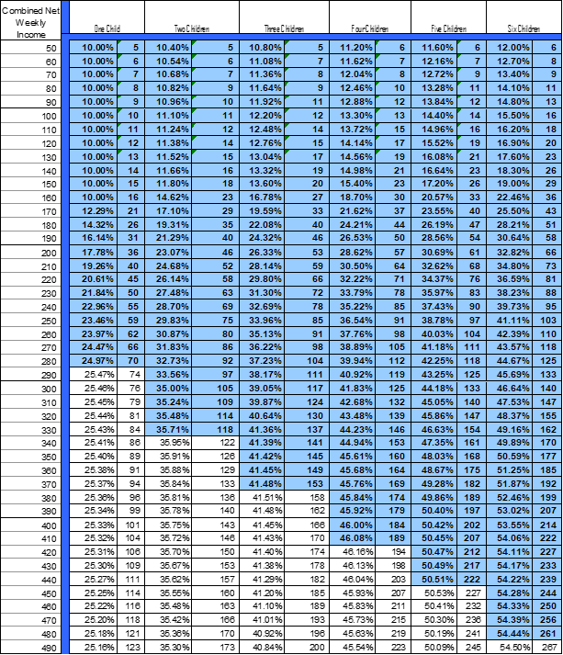
Area of Child Support Schedule Adjusted for Low Income
The blue-shaded area of the existing schedule to shows where the schedule amounts have been lowered from the measurements of child-rearing expenditures to include a low-income adjustment
CT eliminated “shaded-area” adjustment last review
Low-income no longer applied for incomes of $490 net per week
2023 Federal Poverty Guidelines (FPG) for One Person = $280 per week
2023 State minimum wage = $14/hr
  40-hour workweek = $560 gross per week,
    About $450 net per week
  Average hours for CT private industry (Dec. 2022): 35.2 hours per week
  Average hours for CT leisure and hospitality: (22.5 hrs)

Slide 13
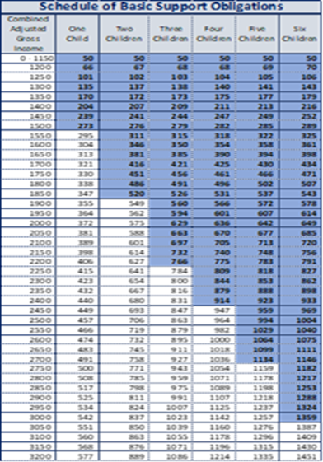
North Carolina’s Shaded Area and Explicit Statement of SSR
Self-Support Reserve: Supporting Parents with Low Incomes
The guidelines include a self-support reserve that ensures that obligated parents have sufficient income to maintain a minimum standard of living based on the 2014 federal poverty level for one person ($973 per month) for obligated parents with an adjustment gross income of less than $1,097 the Guidelines require, absent a deviation, the establishment of a minimum support order ($50). For obligated parents with adjusted gross incomes above $1,097, the Schedule of Basic Support Obligations incorporates a further adjustment to maintain the self-support reserve for the obligated parent.
If the obligated parent’s adjusted gross income falls within the shaded area of the Schedule and Worksheet A is used, the basic child support obligation and the obligated parent’s total child support obligation are computed using only the obligated parent’s income. In these cases, childcare and health insurance premiums should not be used to calculate the child support obligation. However, payment of these costs or other extraordinary expenses by either parent may be a basis for deviation. This approach prevents disproportionate increases in the child support obligation with moderate increases in income and protects the integrity of the self-support reserve. In all other cases, the basic child support obligation is computed using the combined adjusted gross incomes of both parents.

Slide 14
Arizona’s Self-Support Reserve (SSR) in the Worksheet
AZ sets SSR at 80% of F-T minimum wage earnings

Slide 15
KY’s Explicit Statement of Self-Support Reserve
(d) "Self-support reserve" means a low-income adjustment amount to the obligated parent of nine hundred fifteen dollars ($915) per month that considers the subsistence needs of the parent with a limited ability to pay in accordance with 45 C.F.R. sec. 302.56(c)(1)(ii), and as applied under subsection (3) of this section
KY write’s out the SSR-income thresholds instead of shades them
(3)
Except as provided in paragraph (b) of this subsection, the child support obligation set forth in the child support guidelines table shall be divided between the parents in proportion to their combined monthly adjusted parental gross income.
If the monthly adjusted gross income of the obligated parent and the number of children for whom support is being determined fall within the following defined areas, which represent the self-support reserve, the basic child support obligation shall be calculated by using the monthly adjusted gross income of the obligated parent only to provide the obligated parent with the self-support reserve:
1. Equal to or less than one thousand one hundred dollars ($1,100) with one (1) or more children;
2. Equal to or less than one thousand three hundred dollars ($1,300) with two (2) or more children;
3. Equal to or less than one thousand four hundred dollars ($1,400) with three (3) or more children;
4. Equal to or less than one thousand five hundred dollars ($1,500) with four (4) or more children; or
5. Equal to or less than one thousand six hundred dollars ($1,600) with six (6) or more children

Slide 16
Federal Requirement: Incarcerated Parents
Federal Requirement | CT Provisions
45 CFR §302.56(c) (3) Provide that incarceration may not be treated as voluntary unemployment in establishing or modifying support orders; | Sec. 46b-215e. Initial or modified support order when child support obligor is institutionalized or incarcerated. Procedure in IV-D support cases when child support obligor is incarcerated for more than ninety days. (a) Notwithstanding any provision of the general statutes, whenever a child support obligor is institutionalized or incarcerated, the Superior Court or a family support magistrate shall establish an initial order for current support, or modify an existing order for current support, upon proper motion, based upon the obligor's present income and substantial assets, if any, in accordance with the child support guidelines established pursuant to section 46b-215a. Downward modification of an existing support order based solely on a loss of income due to incarceration or institutionalization shall not be granted in the case of a child support obligor who is incarcerated or institutionalized for an offense against the custodial party or the child subject to such support order. (b) In IV-D support cases, as defined in section 46b-23 l, when the child support obligor is institutionalized or incarcerated for more than ninety days, any existing support order, as defined in section 46b-23 l, shall be modified to zero dollars effective upon the date that a support enforcement officer files an affidavit in the Family Support Magistrate Division. The affidavit shall include: (1) The beginning and expected end dates of such obligor's institutionalization or incarceration; and (2) a statement by such officer that (A) a diligent search failed to identify any income or assets that could be used to satisfy the child support order while the obligor is incarcerated or institutionalized, (B) the offense for which the obligor is institutionalized or incarcerated was not an offense against the custodial party or the child subject to such support order, and (C) a notice in accordance with subsection (c) of this section was provided to the custodial party and an objection form was not received from such party.

Slide 17
Federal Requirement: Incarcerated Parents
Provision complements 45 C.F.R. §303.8 Review and adjustment of child support orders
(2) The State may elect in its State plan to initiate review of an order, after learning that a noncustodial parent will be incarcerated for more than 180 calendar days, without the need for a specific request and, upon notice to both parents, review, and if appropriate, adjust the order, in accordance with paragraph (b)(1)(i) of this section. * * * * *
Federal View on Exceptions
There was a proposed federal rule change that would give states the option to make exceptions based on crimes involving domestic abuse and nonpayment of child support. That proposed rule change was rescinded Nov. 2021.
  https://www.federalregister.gov/documents/2021/11/10/2021-24606/optional-exceptions-to-the-prohibition-against-treating-incarceration-as-voluntary-unemployment
In a letter to Mississippi, OCSE essentially states such exceptions do not meet the requirement to base guidelines amounts on “ability to pay.”
Recent Excerpt from Delaware Guidelines Review about Exception
https://courts.delaware.gov/forms/download.aspx?id=172308
Incarcerated Parents After 180 days of continuous confinement, obligations established after February 1, 2019, are reduced to one-half of a minimum order, currently $60 for one child and $90 for two or more. However, persons incarcerated for a crime against the support recipient, or the children of the order cannot benefit from the reduction.
At the urging of the Federal Office of Child Support Enforcement (OCSE), that exception has been eliminated.

Slide 18
Federal Medical Support Change
45 C.F.R. 302.56 (c) (2)Address how the parents will provide for the child’s health care needs through private or public health care coverage and/or through cash medical support;
45 C.F.R. §303.31 Securing and enforcing medical support obligations.
(a) * * * (2) Health insurance care coverage includes fee for service, health maintenance organization, preferred provider organization, and other types of private health insurance and public health care coverage which is available to either parent, under which medical services could be provided to the dependent child(ren).
(3) Cash medical support or the cost of health insurance is considered reasonable in cost if the cost to the parent responsible for providing medical support does not exceed five percent of his or her gross income or, at State option, a reasonable alternative income-based numeric standard defined in State law, regulations, or court rule having the force of law or State child support guidelines adopted in accordance with § 302.56(c) of this chapter.
CONNECTICUT
Sec. 46b-215.(2) Any such support order in a IV-D support case shall include a provision for the health care coverage of the child. Such provision may include an order for either parent or both parents to provide such coverage under any or all of subparagraphs (A), (B) or (C) of this subdivision.
(A) The provision for health care coverage may include an order for either parent to name any child as a beneficiary of any medical or dental insurance or benefit plan carried by such parent or available to such parent at a reasonable cost, as defined in subparagraph (D) of this subdivision. If such order requires the parent to maintain insurance available through an employer, the order shall be enforced using a National Medical Support Notice as provided in section 46b-88.
(B) The provision for health care coverage may include an order for either parent to: (i) Apply for and maintain coverage on behalf of the child under the HUSKY Plan, Part B; or (ii) provide cash medical support, as described in subparagraphs (E) and (F) of this subdivision. An order under this subparagraph shall be made only if the cost to the parent obligated to maintain coverage under the HUSKY Plan, Part B, or provide cash medical support is reasonable, as defined in subparagraph (D) of this subdivision. An order under clause (i) of this subparagraph shall be made only if insurance coverage as described in subparagraph (A) of this subdivision is unavailable at reasonable cost to either parent, or inaccessible to the child.
(C) An order for payment of the child's medical and dental expenses, other than those described in clause (ii) of subparagraph (E) of this subdivision, that are not covered by insurance or reimbursed in any other manner shall be entered in accordance with the child support guidelines established pursuant to section 46b-2 l 5a.
(D) Health care coverage shall be deemed reasonable in cost if: (i) The parent obligated to maintain such coverage would qualify as a low-income obligor under the child support guidelines established pursuant to section 46b-2 l 5a, based solely on such parent's income, and the cost does not exceed five per cent of such parent's net income; or (ii) the parent obligated to maintain such coverage would not qualify as a low-income obligor under such guidelines and the cost does not exceed seven and one-half per cent of such parent's net income. In either case, net income shall be determined in accordance with the child support guidelines established pursuant to section 46b-2 l 5a. If a parent obligated to maintain insurance must obtain coverage for himself or herself to comply with the order to provide coverage for the child, reasonable cost shall be determined based on the combined cost of coverage for such parent and such child.
(E)Cash medical support means (i) an amount ordered to be paid toward the cost of premiums for health insurance coverage provided by a public entity, including the HUSKY Plan, Part A or Part B, except as provided in subparagraph (F) of this subdivision, or by another parent through employment or otherwise, or (ii) an amount ordered to be paid, either directly to a medical provider or to the person obligated to pay such provider, toward any ongoing extraordinary medical and dental expenses of the child that are not covered by insurance or reimbursed in any other manner, provided such expenses are documented and identified specifically on the record. Cash medical support, as described in clauses (i) and (ii) of this subparagraph, may be ordered in lieu of an order under subparagraph (A) of this subdivision

Slide 19



Federal Requirements of State Guidelines Reviews

Slide 20
45 C.F.R 302.56 (e) and (h)
(e) The State must review, and revise, if appropriate, the child support guidelines established under paragraph (a) of this section at least once every four years to ensure that their application results in the determination of appropiate child support order amounts. The State shall publish on the internet and make accessible to the public all reports of the guidelines reviewing body, the membership of the reviewing body, the effective date of the guidelines, and the date of the next quadrennial review.
(h)As part of the review of a State’s child support guidelines required under paragraph (e) of this section, a State must:
(1) Consider economic data on the cost of raising children, labor market data (such as unemployment rates, employment rates, hours worked, and earnings) by occupation and skill-level for the State and local job markets, the impact of guidelines policies and amounts on custodial and noncustodial parents who have family incomes below 200 percent of the Federal poverty level, and factors that influence employment rates among noncustodial parents and compliance with child support orders;
(2) Analyze case data, gathered through sampling or other methods, on the application of and deviations from the child support guidelines, as well as the rates of default and imputed child support orders and orders determined using the low-income adjustment required under paragraph (c)(1)(ii) of this section. The analysis must also include a compaCTson of payments on child support orders by case characteCTstics, including whether the order was entered by default, based on imputed income, or determined using the low-income adjustment required under paragraph (c)(1)(ii). The analysis of the data must be used in the State’s review of the child support guidelines to ensure that deviations from the guidelines are limited and guideline amounts are appropCTate based on cCTteCTa established by the State under paragraph (g); and
(3)Provide a meaningful opportunity for public input, including input from low-income custodial and noncustodial parents and their representatives. The State must also obtain the views and advice of the State child support agency funded under title IV–D of the Act.

Slide 21
Plan to Fulfill Federal Requirements of Reviews
Continued Requirement
Consider economic data on the cost of raising children | CPR preparing & on agenda today
Consider case file data on application of and deviation from the guidelines | CPR is working with child support agency
Review, and revise, if appropriate, the child support guidelines | Commission and Legislative Regulation Review Committee
New Requirement
Consider labor market data | CPR
Impact of guidelines policies on parents with low income | CPR case file scenarios
Factors that influence employment rates and compliance | CPR from case file data
Rates of default, imputation, and application of low-income adjustment
Comparison of payments by case characteristics including default, imputation, and application of the low-income adjustment
Provide meaningful opportunity for public input, including input from low-income parties | Representation on Commission and Regulation Process
Obtain the views and advice of the IV-D agency | Representatives on Commission
Publish report on internet, membership of reviewing body, and effective date of the guidelines and next review | Updated Child Support and Arrearage Guidelines if Changes

Slide 22


Analysis of Economic Data on the Cost of Raising Children

Slide 23
Child Support Schedule: Part Economic Data and Part Policy
Example with no income deductions or adjustments
1 Child
Parent A: $1,000
Parent B: $ 500
Combined = $1,500
Basic obligation from schedule = $278
Parent A Income/Combined Income = 67%
Order = $278 X 67% = $186 per week

Slide 24
Assumptions and Data Underlying Existing Schedule & What Could Be Updated
 | Basis of Existing Schedule | Update Alternatives
1. Guidelines model | Income Shares (used by 41 states) | Other models
2. Price levels | March 2012 price levels | Dec. 2022 (29.4% increase)
3. Measurement of child-rearing expenditures | 4th Betson-Rothbarth study (BR4) from expenditure data collected in 2004-09 | BR5 (2013-2019 expenditure data), USDA, and other studies
4. Adjustments for CT higher income/cost of living | Income realignment (CT 3rd highest state in 2010) | Income realignment (CT is 6th highest state in 2021) Price parity (102.6) CT ranks 13th in 2021 median gross rent
5. Adjusted so no decrease | Higher of existing (2005 schedule) and BR4 income aligned: 2005 schedule applies to net weekly incomes below $1,250 for 1child; $920 for 2 children; and about $600 for 3 or more children | Policy decision
6. Lowest and highest income to be considered | Combined net incomes of $50 - $4,000 per week | Depends on economic basis and adjustment for CT incomes (e.g., BR study allows for up to about $5,000 per week)
7. Spending more/less of after-tax income | Use actual ratios with cap | District of Columbia approach (after-tax income = expenditures, which would increase schedule amounts)
8. Highly variable child-rearing expenses excluded from schedule | Childcare & healthcare expenses excluded from schedule | Various options
9. Low-income adjustment & minimum order | 2012 federal poverty guidelines for 1 person = $215 per week and 10-12% minimum order at net income of $50 per month | 2023 FPG: $280 per week
U.S. Bureau of Economic Analysis. (2022). 2021 Regional Price Parities by State (US = 100). Retrieved from https://www.bea.gov/data/prices-inflation/regional-price-parities-state-and-metro-area

Slide 25
Studies of Child-Rearing Expenditures: 10 Different Studies underlying State Guidelines
Study Name and CES Years | Study Year | Full Reference
Van der Gaag | 1981 | Jacques van der Gaag, On Measuring the Cost of Children, Discussion Paper No. 663-81 (Univ. of Wisconsin Inst. for Research on Poverty, 1981)
Espenshade | 1984 | Thomas J. Espenshade, Investing in Children: New Estimates of Parental Expenditures (Urban Inst. Press, 1984).
Lewin Report (compared methods) | 1990 | Lewin/ICF. (1990). Estimates of Expenditures on Children and Child Support Guidelines. Report to U.S. Department of Health and Human Services, Office of the Assist. Secretary for Planning and Evaluation. Virginia
Betson-Rothbarth 1 (BR1) CE: 1980-86 | 1990 | David M. Betson (1990). Alternative Estimates of the Cost of Children from the 1980-86 Consumer Expenditure Survey, Report to U.S. Department of Health and Human Services, Office of the Assistant Secretary for Planning and Evaluation, University of Wisconsin Institute for Research on Poverty, Madison, WI.
BR2 and BR3 (1994-98 and 1998-2004) | 1996 2006 | See Betson (2021) for summaries
Betson-Rothbarth 4 (BR4) CE: 2004-09 | 2010 | Betson, David M. (2010). “Appendix A: Parental Expenditures on Children.” in Judicial Council of California, Review of Statewide Uniform Child Support Guideline. San Fran-cisco, California. Retreved from: http://www.courts.ca.gov/partners/documents/2011SRL6aGuidelineReview.pdf
Rodgers-Rothbarth/NJ CE: 2000-11 | 2012 | New Jersey Child Support Institute (March 2013). Quadrennial Review: Final Report, Institute for Families, Rutgers, the State University of New Jersey, New Brunswick, NJ. Retrieved from: http://www.judiciary.state.nj.us/reports2013/F0_NJ+QuadrennialReview-Final_3.22.13_complete.pdf
Comanor (CE: 2004-09) | 2015 | Comanor, William, Sarro, Mark, and Rogers, Mark. (2015). “The Monetary Cost of Raising Children.” In (ed.) Economic and Legal Issues in Competition, Intellectual Property, Bankruptcy, and the Cost of Raising Children (Research in Law and Economics), Vol. 27). Emerald Group Publishing Limited, pp. 209–51
USDA (CE: 2011-2015) | 2017 | Lino, Mark (2017). Expenditures on Children by Families: 2015 Annual Report. U.S. Department of Agriculture, Center for Nutrion and Policy Promotion. Miscellaneous Publication No. 1528-2015, Washington, D.C. http://www.cnpp.usda.gov/publications/crc/crc2017.pdf
Florida State/Rothbarth and Engel (CE: 2013-19) | 2021 | Norribin, Stefan C., et al. (Nov. 2021). Review and Update of Florida’s Child Support Guidelines. Retrieved from http://edr.state.fl.us/Content/special-research-projects/child-support/ChildSupportGuidelinesFinalReport2021.pdf.
Betson-Rothbarth (BR5) CE: 2013-19 | 2020 | Betson, David M. (Mar 2021). “Appendix A Parental Expenditures on Children.” in Venohr, J. and Matyasic, S., Review of Arizona Child Support Guidelines: Findings from the Analysis of Case File Data and Updating the Child Support Schedule. Report to the Arizona Supreme Court Administrative Office of the Courts https://www.azcourts.gov/Portals/74/FCIC-CSGR/SupplementalPacket-030121-FCIC-CSGRS.pdf?ver=2021-02-26-161844-187
Bold font indicates study in use. Besides the 8 studies in bold above, there is an old KS study and Betson-Engel study

Slide 26
Consumer Expenditure Survey
https://www.bls.gov/cex/
Conducted by the U.S. Bureau of Labor Statistics
PCTmary purpose: shape market basket used to track inflation
Ongoing survey
About 6,000 households each quarter
Hundreds of items
Each household stays in for 4 quarters (earlier years: 5 quarters)
Designed to be nationally representative
  Also 4 regions: NE, South, Midwest and West
  Recently added state-specific for largest states

Slide 27
Comparison of Average Child-Rearing Expenditures as Percentage of Total Expenditures
Economists generally don’t agree which methodology best measures actual child-rearing expenditures.
However, most economists and policymakers agree that a guidelines amount between the lowest and highest of credible measurements is within an appropriate range
STATE USAGE
31 states use a BR study (CO, CT, RI, OR, NH, VT, PA)
No state uses Comanor (2015)
MN and MD high incomes use USDA
Several states based on older studies (CA, NY)
NJ uses own Rothbarth study
MA not based on study

Slide 28
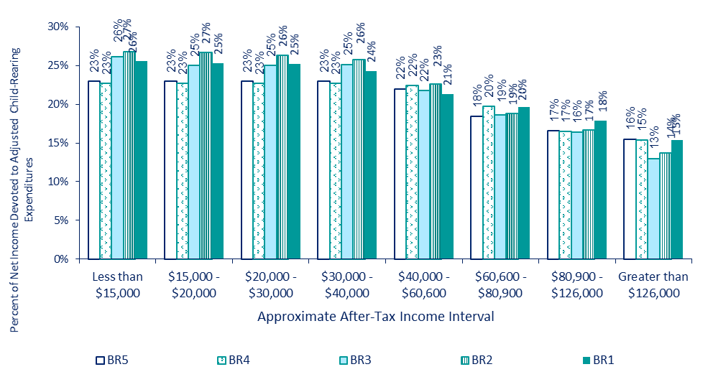
BR Studies over Time by Income Range

Slide 29
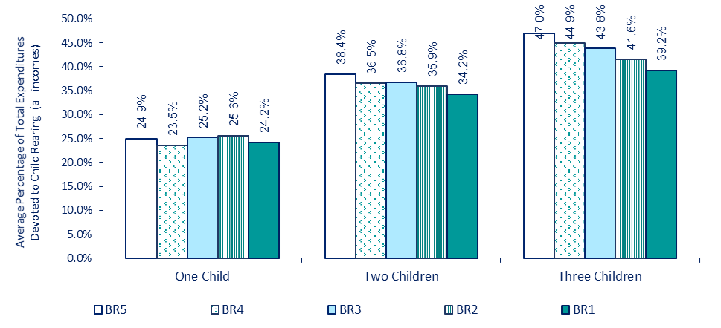
Factor 5 (slide 24) BR Average Estimates over Time

Slide 30
Alternative Updates
 | Basis of Existing Schedule | Updated USDA | Updated BR (income realignment) | Updated BR (price parity) | Updated Comanor, Sarro and Rogers (CSR)
Guidelines model | Income Shares | Income Shares
Price levels | March 2012 | Dec 2022
Measurement of child-rearing expenditures | BR4 | USDA | BR5 |  | CSR
Adjustments for CT higher income | Income realignment | None | Income realignment | Price parity | None
Highest net weekly income | $4,000 | $3,400 | $4,900 | $5,750 | $3,000
Spending more/less of after-tax income | Use actual ratios with cap | No Cap | Use actual | Use actual | N.A.
Highly variable child-rearing expenses excluded from schedule | Excluded | Excluded

Slide 31
Factor #7 from Slide 24: Convert BR measurements from Expenditures to Net Income
Use average expenditures to net income ratios from same CE sample, Cap expenditures so it doesn’t exceed after-tax income for low incomes
Alternative: Assume all net income is spent. DC uses this approach. Raises schedule amounts
Upper-Middle to Upper Income Families
Gross Income
Taxes
Savings
Expenditures on Children
Total Expenditures
After-Tax Income
Lower to Middle Income Families
After-Tax Income
Expenditures on Children
Total Expenditures
Notes:
Families with $50K or less, spend all or more of their after tax income on average

Slide 32
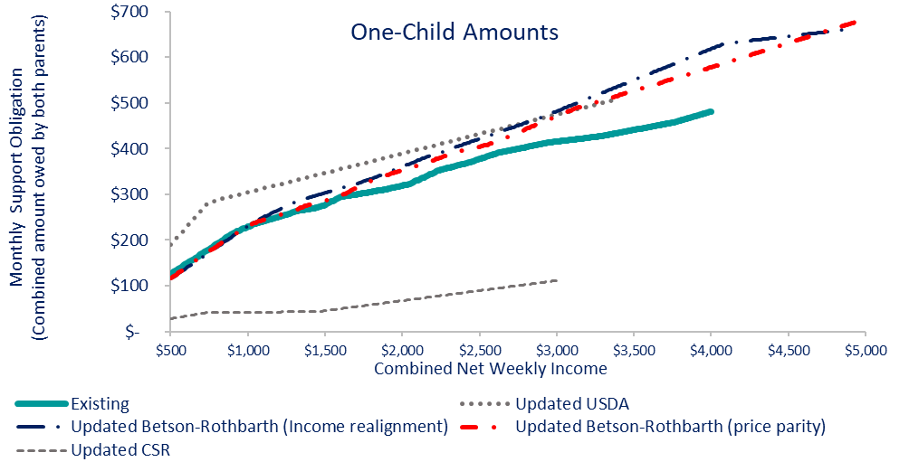
Comparisons: 1 Child
Comparisons start at combined net incomes of $500 per week to save discussion about updating low-income adjustment later.
USDA is generally highest
CSR is lowest
BR (price parity and income realignment) generally track closely except at higher incomes
Gap between existing and BR widens with more income

Slide 33
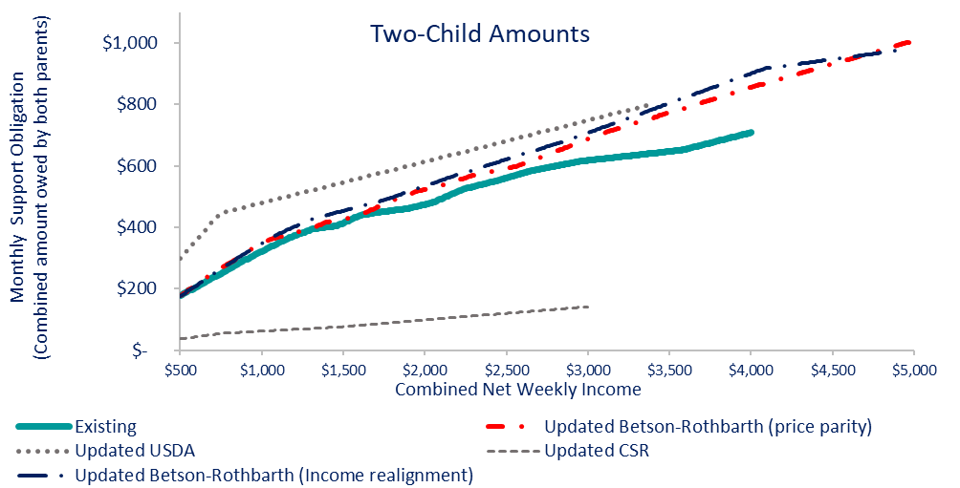
Comparisons: 2 Children
Comparisons start at combined net incomes of $500 per week to save discussion about updating low-income adjustment later.
USDA is generally highest
CSR is lowest
BR (price parity and income realignment) generally track closely except at higher incomes
Gap between existing and BR widens with more income

Slide 34
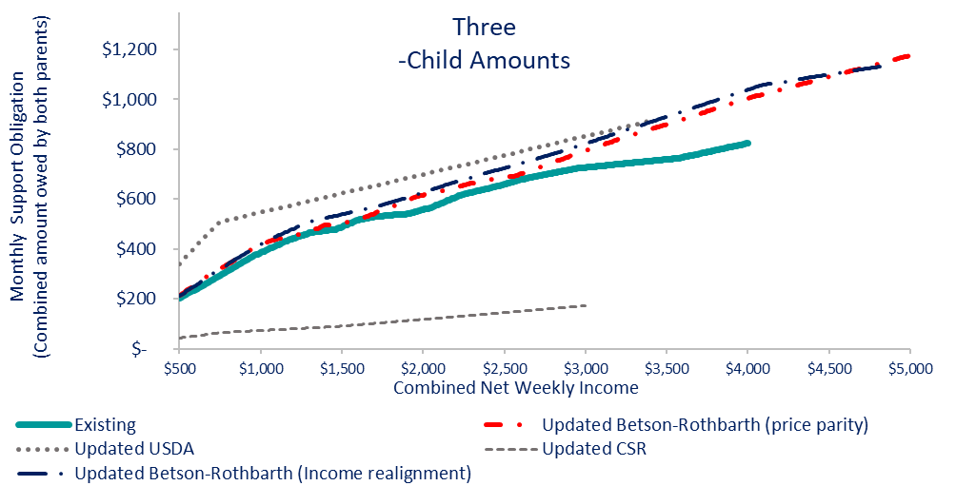
Comparisons: 3 Children
Comparisons start at combined net incomes of $500 per week to save discussion about updating low-income adjustment later.
USDA is generally highest
CSR is lowest
BR (price parity and income realignment) generally track closely except at higher incomes
Gap between existing and BR widens with more income

Slide 35
Findings about BR5 Updates from Comparisons
Mostly Increases
 | 1 Child |  | 2 Children |  | 3 Children
 | Realign. | Price Parity | Realign. | Price Parity | Realign. | Price Parity
Average Increase | $59 (15%) | $43 (11%) | $74 (13%) | $54 (9%) | $84 (13%) | $60 (9%)
Median Increase | $44 (12%) | $31 (9%) | $59 (11%) | $37 (7%) | $65(10%) | $39 (8%)
Maximum | $137 (28%) | $96 (21%) | $192 (27%) | $147 (21%) | $215 (26%) | $180 (22%)
Weekly Combined Incomes with Increases More than 15% | > $2,930 | > $3,050 | > $3,000 | > $3,170 | > $3,070 | > $3,270
SOME DECREASES for BOTH BR UPDATES
1 child: decrease of $1 to $10 per week for combined net incomes up to $980 per week)
  Decreases are closest to $10 at lower incomes (i.e., about $500 per week)
  All decreases less than 15%
No decreases for 2+ children

Slide 36
CT 2021 Median Earnings for Workers Age 25 and Older
 | Gross Weekly Income
Highest Educational Attainment | Males | Females
1. Minimum wage earners ($14.00/hr) | $ 560 | $ 560
2. Less than High School Degree | $ 605 | $ 529
3. High School Degree or GED | $ 868 | $ 607
4. Some College or Associate’s Degree | $ 1,052 | $ 715
5. Bachelor’s Degree | $ 1,589 | $ 1,115
6. Graduate or Professional Degree | $ 2,003 | $ 1,496
Case scenarios: Male is parent owing support, female is parent receiving support, no other adjustment, incomes are approximate after-tax incomes
Tax rates are approximated.
Low-income adjustment doesn’t apply to Case 1 or Case 2. This could change after low-income adjustment is updated.
36

Slide 37
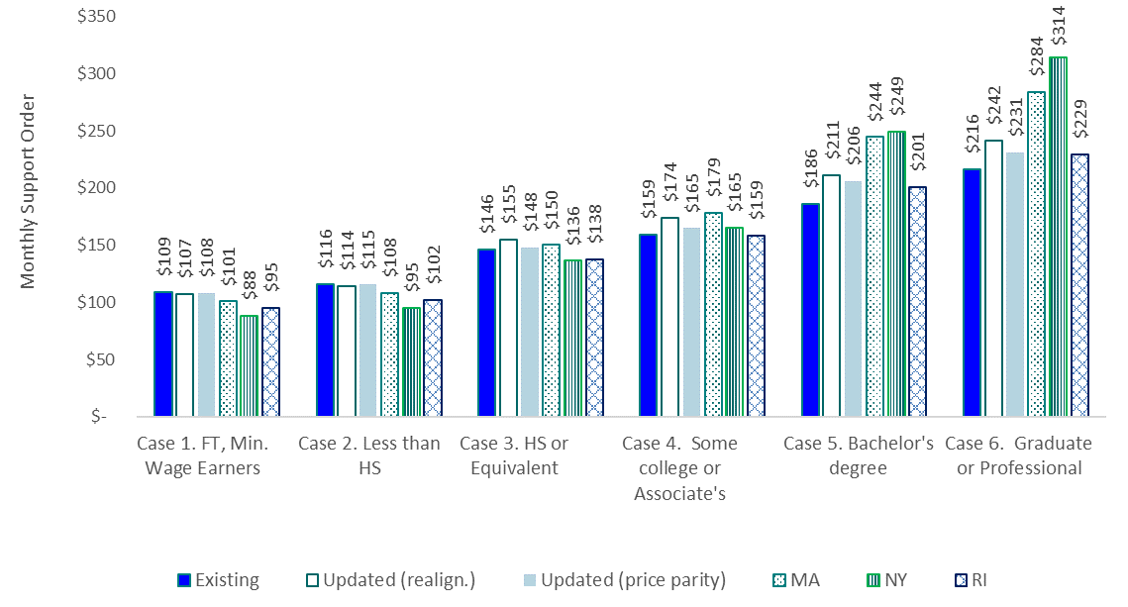
Case Scenarios: One Child
Findings
Nominal decrease for Cases 1 and 2
Small increases that become larger with more income for Cases 3-6
CT slightly larger than other states for Case 1 and 2 (but this is before update of low-income adjustment)
NY and MA are larger than others at high income
37

Slide 38
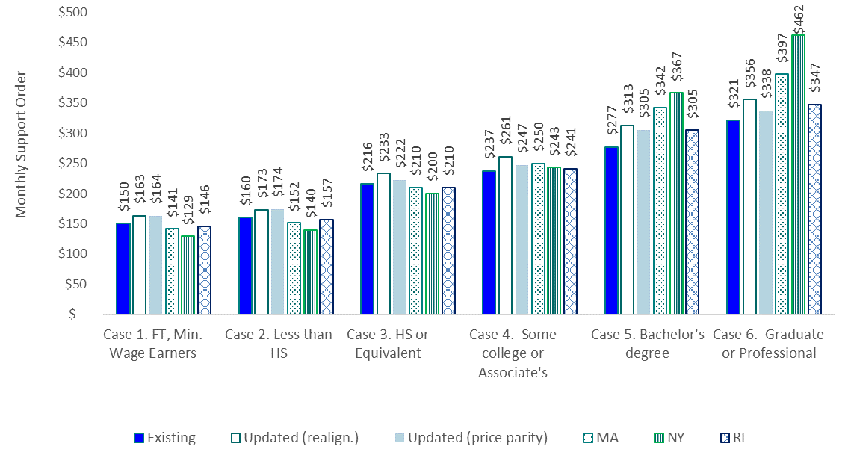
Case Scenarios: Two Children
Findings
Small increases that become larger with more income
CT larger than other states for Case 1-3 (but this is before update of low-income adjustment)
NY and MA are larger than others at high income
38

Slide 39

Case Scenarios: Three Children
Findings
Small increases that become larger with more income
CT larger than other states for Case 1-3 (but this is before update of low-income adjustment)
NY and MA are larger than others at high income
39

Slide 40



Next Steps

Slide 41
Questions and Next Steps
Commission
  Questions?
  Reactions to updated schedule and options for adjusting for CT incomes/costs
  Thoughts about low-income adjustment
  Questions/comments concerning non-schedule issues
Next Steps for CPR
  Analysis of case file data and labor market data
  Update low-income adjustment
  Other issues (e.g., income deduction for insurance premium)
Timelines

Slide 42



Attachments

Slide 43
45 C.F.R. 302.56 (1 of 2)
Guidelines for setting child support orders
(a) Within 1 year after completion of the State’s next quadrennial review of its child support guidelines, that commences more than 1 year after publication of the final rule, in accordance with § 302.56(e), as a condition of approval of its State plan, the State must establish one set of child support guidelines by law or by judicial or administrative action for setting and modifying child support order amounts within the State that meet the requirements in this section.
(b) The State must have procedures for making the guidelines available to all persons in the State.
(c) The child support guidelines established under paragraph (a) of this section must at a minimum:
(1) Provide that the child support order is based on the noncustodial parent’s earnings, income, and other evidence of ability to pay that:
(i) Takes into consideration all earnings and income of the noncustodial parent (and at the State’s discretion, the custodial parent);
(ii) Takes into consideration the basic subsistence needs of the noncustodial parent (and at the State’s discretion, the custodial parent and children) who has a limited ability to pay by incorporating a low-income adjustment, such as a self- support reserve or some other method determined by the State; and
(iii) If imputation of income is authorized, takes into consideration the specific circumstances of the noncustodial parent (and at the State’s discretion, the custodial parent) to the extent known, including such factors as the noncustodial parent’s assets, residence, employment and earnings history, job skills, educational attainment, literacy, age, health, criminal record and other employment barriers, and record of seeking work, as well as the local job market, the availability of employers willing to hire the noncustodial parent, prevailing earnings level in the local community, and other relevant background factors in the case.
(2) Address how the parents will provide for the child’s health care needs through private or public health care coverage and/or through cash medical support;
(3) Provide that incarceration may not be treated as voluntary unemployment in establishing or modifying support orders; and
(4) Be based on specific descriptive and numeric criteria and result in a computation of the child support obligation.
(d) The State must include a copy of the child support guidelines in its State plan.

Slide 44
45 C.F.R. 302.56 (2 of 2)
Guidelines for setting child support orders
(d) The State must include a copy of the child support guidelines in its State plan.
(e) The State must review, and revise, if appropriate, the child support guidelines established under paragraph (a) of this section at least once every four years to ensure that their application results in the determination of appropriate child support order amounts. The State shall publish on the internet and make accessible to the public all reports of the guidelines reviewing body, the membership of the reviewing body, the effective date of the guidelines, and the date of the next quadrennial review.
(f) The State must provide that there will be a rebuttable presumption, in any judicial or administrative proceeding for the establishment and modification of a child support order, that the amount of the order which would result from the application of the child support guidelines established under paragraph (a) of this section is the correct amount of child support to be ordered.
(g) A written finding or specific finding on the record of a judicial or administrative proceeding for the establishment or modification of a child support order that the application of the child support guidelines established under paragraph (a) of this section would be unjust or inappropriate in a particular case will be sufficient to rebut the presumption in that case, as determined under criteria established by the State. Such criteria must take into consideration the best interests of the child. Findings that rebut the child support guidelines shall state the amount of support that would have been required under the guidelines and include a justification of why the order varies from the guidelines.
(h) As part of the review of a State’s child support guidelines required under paragraph (e) of this section, a State must:
Consider economic data on the cost of raising children, labor market data (such as unemployment rates, employment rates, hours worked, and earnings) by occupation and skill-level for the State and local job markets, the impact of guidelines policies and amounts on custodial and noncustodial parents who have family incomes below 200 percent of the Federal poverty level, and factors that influence employment rates among noncustodial parents and compliance with child support orders;
Analyze case data, gathered through sampling or other methods, on the application of and deviations from the child support guidelines, as well as the rates of default and imputed child support orders and orders determined using the low-income adjustment required under paragraph (c)(1)(ii) of this section. The analysis must also include a comparison of payments on child support orders by case characteristics, including whether the order was entered by default, based on imputed income, or determined using the low-income adjustment required under paragraph (c)(1)(ii). The analysis of the data must be used in the State’s review of the child support guidelines to ensure that deviations from the guidelines are limited and guideline amounts are appropriate based on criteria established by the State under paragraph (g); and
Provide a meaningful opportunity for public input, including input from low-income custodial and noncustodial parents and their representatives. The State must also obtain the views and advice of the State child support agency funded under title IV–D of the Act.

