Slide 1
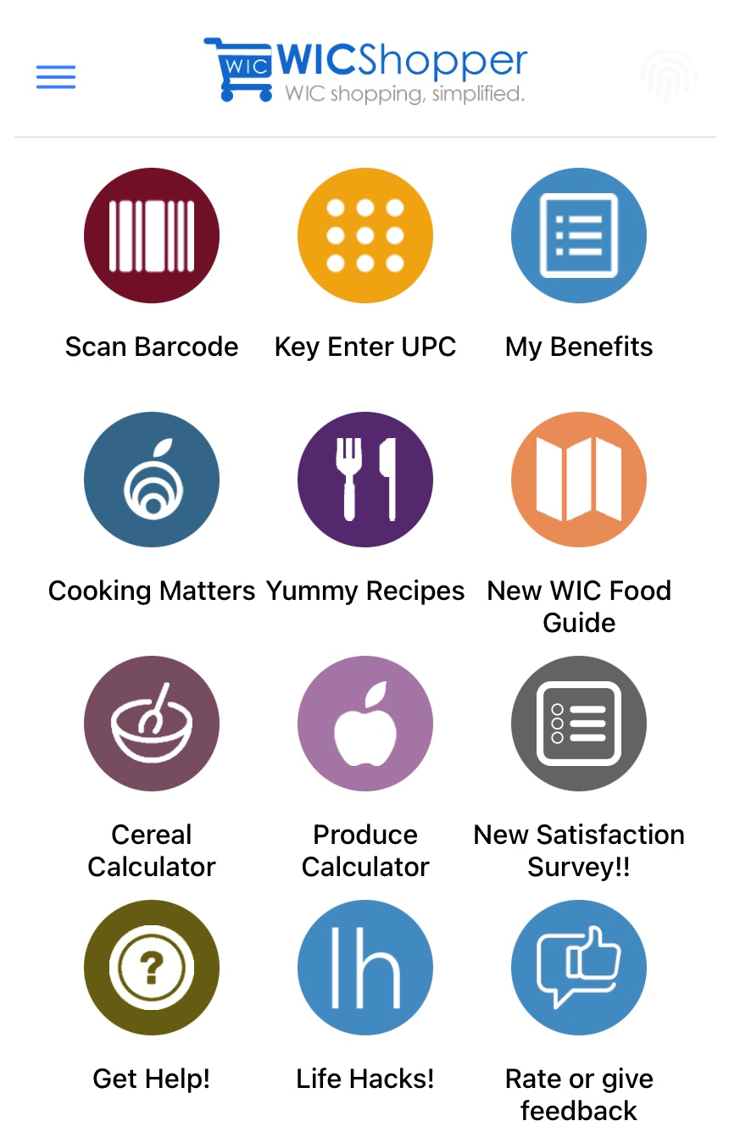
Participant Shopping Experience, Where We Are Now
February 4, 2021
Notes:
Welcome to the Participant Shopping Experience, Where We Are Now webinar. We have a full presentation today and have attempted to allot time for questions in the last 10 minutes of this scheduled time. Here are some housekeeping rules: Marilyn will be monitoring the chat. If you are having technical difficulties, please put it in the chat and she will do her best to assist you. Also, during the presentation, all attendees will be muted. Please do not unmute during this time. During the presentation, if you have questions, please enter them in the chat and we will address them at the end of the presentation. Thank you for joining the webinar. We hope that you are able to take the information back to your work with WIC Participants and help Participants have an positive shopping experience.

Slide 2
Importance of the Participant Shopping Experience
Positive Shopping Experience
Ongoing Active WIC Participation
Increased WIC Food Redemption Rates
Improved Health Outcomes
Economic Boost
Notes:
The WIC Shopping Experience has so many important related factors. When a WIC Participant uses their eWIC card at a WIC approved store with no difficulties at all, they are more likely to attempt to use their eWIC card again. This can contribute to ongoing active WIC participation which can lead to improved health outcomes such as reduced anemia rates or reduced overweight and obesity rates. A positive shopping experience can also lead to increased WIC food redemption rates which also contributes to the economy. Did you know that WIC transactions average around $2.9 million monthly? This means that this amount of money is put back into the economy.

Slide 3
Objectives
Survey Results
eWIC Shopping Orientation
Common Shopping Issues and Tips
Formula/Special Formula Shopping Issues and Tips
Redemption Rates
Notes:
Today, we will share participant survey results and show how you can incorporate changes to how you talk about shopping with WIC benefits to participants from their first certification appointment to following up on shopping at their secondary appointment. We will also review a few common shopping issues including ideas on how to avoid them in the future. Luz Hago will discuss formula and special formula issuances, purchases, common formula purchasing issues and tips to avoid issues in the future. Lastly, Mellessa McPherson-Milling will review Connecticut WIC Program redemption data, what it means and how you can help improve these rates. Everyone plays a hand in the participant shopping experience. Whether you are a Program Assistant returning a phone call to a participant who reports an issue purchasing a box of cereal OR you are a Peer Counselor FaceTiming a mom who doesn't know how to purchase baby foods with her WIC benefits OR you are a Nutritionist who received a phone call from a participant who was treated poorly at a store, we all play an important role in helping participants. You may not have all the answers, but you may be able to guide them in the direction to get help.

Slide 4
eWIC Shopping Experience Survey July-August 2019
Purpose:
Assess Local Agency Instruction on Using Benefits
Assess Shopping Experience
Finding WIC Approved Foods
Trouble Purchasing WIC Approved Foods
Treatment of WIC Participants at Stores
Food Accessibility
Target Audience:
Newly Certified Participants between July-August 2019
507 Total Participants Sent a One Call Now text message with a link to the survey
Notes:
Between July and August 2019, newly certified participants were sent a SurveyMonkey link through a One Call Now text message to complete the eWIC Shopping Experience Survey. This purpose of this survey was to assess local agency instruction on using benefits and assess the shopping experience which included finding WIC Approved foods, identifying trouble purchasing WIC Approved foods, treatment of participants at stores and food accessibility.

Slide 5
eWIC Shopping Experience Survey: Results July-August 2019
Notes:
This question assessed what was introduced or discussed with the participant at their WIC appointment. As you can see, almost 85% of the 58 participants who responded said that the Approved Food Guide and about 69% said the eWIC Card brochure was received. This is the brochure that explains how to use the eWIC card. It includes the Conduent Customer Service phone number and the online client portal url to check their benefits. About 52% of the participants said their Family Benefits List and 53% reported the Authorized Vendor List was received. Remember, this survey was sent to Newly Certified participants. They had received benefits 1-2 months prior to completing the survey. 55% said the Juice and Cereal Guides and 43% said the Milk and/or Peanut Butter Quick Pick Guides were received. And about 52% said they had received information on the WICShopper mobile app. It is important for all this information to be provided to participants, especially at their very first WIC visit. Ask yourself, “Did I review all of these with the last person who I conducted a certification for? If not, why not?”. Also ask yourself at the participant’s second WIC appointment, “What are my follow-up questions for shopping?”. If you don’t have any follow-up questions, ask your co-worker what they ask. What about “How did it go using your WIC card for the first time?”. If they had problems, ask “What happened at the store?”. From there, you can troubleshoot – is it something you can handle like not knowing what type of milk to buy or is it something that you need to pass onto the State office such as being mistreated at the store?

Slide 6
eWIC Shopping Experience Survey: Results July-August 2019
Notes:
This next question is interesting. How often have you had issues finding WIC foods? 56.9% of participants reported Rarely or Never having issues finding WIC foods, but almost 33% of participants reported having issues finding foods Sometimes. Making sure you review all eWIC shopping information at the certification could help a participant not have any issues when shopping, but this also goes back to the follow-up questions at subsequent appointments. Asking follow-up questions at sub-sequent appointments can help solve some of the shopping problems participants are having. You may also get a WIC participant who has been on for years and at every appointment, they tell you that they always have a problem buying cereal and you never address it. As little as the problem may seem, never ignore what the participant is saying. Even if you don’t have the answer, tell them you will find someone who may be able to help and keep them posted.

Slide 7
eWIC Shopping Experience Survey: Results July-August 2019
Notes:
Q7 Do you ever have ounces of juice or cereal remaining that you are not able to purchase? 32.75% of participants said Yes to this. These are 2 items where a participant does not purchase the full benefit amount that is issued to them due to different product sizes.

Slide 8
Q8 If You Answered “Yes” to the Previous Question, Did WIC Staff Explain How to Use All of Your Juice and Cereal Benefits So That You Do Not Have Any Leftover Ounces?
Notes:
Q8 asks, “If you answered Yes to the previous question, did WIC staff explain how to use all of your juice and cereal benefits so that you do not have any leftover ounces? 52.27% of participants said no.

Slide 9
Post-Partum Woman
Issued | 96 oz | 96 oz
Purchased | 64 oz container fluid juice | 2 – 12 oz cans concentrated juice
Remaining | 32 oz | 0 oz
Notes:
This is where it is important discuss how to purchase their full benefit every month. For example, a Post-partum woman receives 96 oz juice per month. If they purchase a 64 oz container of fluid juice, this will leave 32 oz of unredeemable juice. Remember, a juice balance of less than 48 oz cannot be redeemed. However, if the participant purchases 2 cans of concentrated juice, they will have 0 oz remaining for juice. There are other combinations that can make sense such as the child juice benefit is 128 oz. Participants may be encouraged to purchase a gallon of orange juice or 2 – 64 oz containers of fluid juice, based on what their preference is. It is not always going to be a perfect, but the more a participant knows, they are being offered the opportunity to make decisions based on what they will consume.

Slide 10
Q12 How Often Do Your WIC Items Not Go Through?
Notes:
The next 2 questions are related to each other and are not directly related to local agency staff orientating WIC participants on how to purchase WIC foods. Q12 asks “How often do your WIC items not go through?”. Almost 64% of participants said their items always scan. However, roughly 14% said WIC items scan most of the time and 22% of participants said sometimes and most times their WIC items don’t scan or go through. Why don’t WIC items go through? There can be many reasons why. Sometimes, participants are trying to purchase an item that has not been issued to them. For example, a participant may be trying to purchase whole fat milk when they were issued 1% milk. Many times, participants will report, “I tried buying a gallon of the store brand milk and it didn’t go through.” It is important to ask details, what type of milk were you trying to purchase? What brand? Do you happen to have a picture of the UPC#?
Occasionally, the UPC# has not been entered into the Approved Product Listing (otherwise known as the APL). In this case, the State Food Resource and Vendor Management staff can evaluate the product and add it to the APL.

Slide 11
Q13 When the WIC Items Don’t Go Through, What Do You Do?
Notes:
We also asked a question on when the WIC items don’t go through, what does the participant do? Almost 30% of participants said they ask for the store manager while 11% call the customer service number on the back of the card, about 6% take a picture of the food, but more surprisingly, 24% of participants didn’t know what to do. Lastly, in this set of respondents, none of the participants had called the local agency or the state agency. Even when you are giving the participant all the information, they need to make a successful WIC purchase, it can be a lot of information to take in and process. It is always good to tell a participant what their options are when items don’t scan. During COVID, participants may not want to spend a lot of time in the store trying to troubleshoot the issue. Participants can call the local agency to report the issue. All staff should be prepared to take calls related to shopping issues. Ask questions, get details. The participant can always call the State office if there is an issue that the local agency can’t resolve. Taking a picture of the food is always a good idea. Local agency staff should encourage participants when they are teaching participants how to use the card and anytime it discussed at other visits.

Slide 12
Q13 Comments
“I ended up just paying cash for what didn’t scan.”
“Leave them because I’m frustrated and holding the line up.”
“Or sometimes return item to the cashier.”
“Sometimes go to a different store.”
“I leave the item and go without.”
Notes:
When items don’t go through, participants responded in different ways. Some participants pay for the item or return it to the cashier. Others will get frustrated, will go to a different store or go without the item. All these answers affect how participants view using WIC benefits and will decide on what they will attempt to purchase for future purchases, if anything at all. Purchasing WIC foods should not be an act that makes a person feel different than any other customer.

Slide 13
Q14 What Suggestions Would You Give to Make Your Shopping Experience Better?
“The stores need to label their items.”
“I think the supermarkets need to know the wic items better.”
“Have a better way of tracking what’s left on your card each month.”
“Should be able to pick up any brand item.”
“Explain the wic system better. It wasn’t explained clear enough to me.”
“Fix the app.”
“Improve information about the amounts of juices and milk.”
Notes:
Now this question is a favorite of mine. We asked the question – What suggestions would you give to make your shopping experience better? Now, we get to look at the responses to see if we can make changes that will help participants have a better shopping experience. The first 2 responses are related to the stores directly. The Food Resource and Vendor Mgmt team at the State office provides training to the stores as they become authorized vendors. These trainings include details on the WIC Approved Food Guide and how WIC participants are issued a specific food package. Shelf tags are not mandatory for stores to display, but they are printed and offered to stores if they wish to use them. Some respondents said to Fix the app or have a better way of tracking what’s left on the card each month. 3 months after this survey was completed by participants, the WICShopper app for Connecticut WIC was updated to include benefit balances. Due to technical limitations, benefit balances that are displayed are not available in real time but are from purchases as of 3:30 pm the prior day. One participant also commented on being able to pick up any brand item. Unfortunately, there are reasons why many products are not WIC approved. The nutritional content must comply with WIC Federal Regulations.

Slide 14
Q5: WIC has recently expanded the approved food list to help make shopping during COVID-19 easier. How did you hear about these added foods?
Notes:
In the previous slides, the new participant shopping survey from August through September 2019 was discussed. 10 months ago, you began to conduct all WIC appointments by phone due to the COVID-19 pandemic. As we know, shopping in general has changed. It was hard to find certain foods and other household items. In order to get a grasp on how these shopping issues were affecting participants, a specific survey geared towards ‘pandemic’ shopping was sent out to all participants. Due to the pandemic, the State agency requested waivers to add more foods that previously did not meet the size requirements such as an increased bread size from 16 oz to 24 oz. We wanted to get an idea of how participants were hearing about these additions. 55% of participants said that they heard about the added foods from a text message while almost 22% said they heard about the changes from WIC staff. What was surprising is that 41% of participants did not hear about the expanded food list. Luckily, the WIC program has been able to use several different outlets to get this information out to participants and not just relying solely on WIC staff. One Call Now text messages are a great way to get important information out. Banners on the WICShopper app also link to a page that gives a description of the additions and even though the traffic to the state WIC webpage is not as high as getting people to the mobile app, information is always posted there as well. It’s important for WIC staff to inform participants of the changes, but it’s equally important to inform participants to where they can get updated WIC information. Think about how you can incorporate these points in your orientation to WIC participants.

Slide 15
Q15 How has the COVID-19 pandemic changed how you grocery shop for WIC foods? (Check all that apply)
Notes:
WIC Participant Satisfaction Survey 2020-2021 Q15 How has the COVID-19 pandemic changed how you grocery shop for WIC foods? Participants could check all that apply.
This is another question that is not tied directly to how local agency staff discuss shopping with participants, but how their shopping has changed. Responses to this question can help you have conversations with participants on how they are currently using their WIC benefits. Almost equal numbers of participants are reducing their usual number of trips to the store or on the other hand, they are making more trips than usual to the store to be able to find WIC foods. Almost 26% of participants report their shopping has not changed. So, for almost 75% of participants, their shopping has changed. It is important during the WIC appointment, for all staff, to be aware of the different shopping issues participants are facing. This would be the perfect opportunity to verify with participants that they are fully aware of the WIC Approved Food Guide and the types of foods they are being issued. For those that may need it, think about assisting in creating shopping lists for participants. If you know the layout of the store they shop at, assist them in creating a shopping list that makes sense so that they are not going from one end of the store to the other constantly. These are just a couple of ideas. When you speak to participants and hear about the problems they are having, try to think about solutions to those problems and then share it with your coworkers.

Slide 16
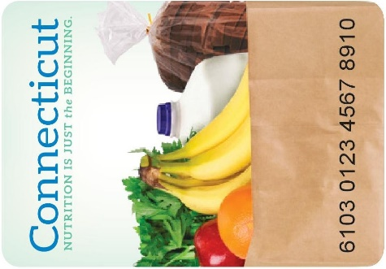
Staff Shopping Experience
Ability to explain eWIC shopping to Participants
To put yourself in the participant’s shoes while shopping
New Staff and Staff who need retraining
Notes:
Next, I am going to talk about the staff shopping experience. A couple of years ago, each local agency Coordinator was provided an eWIC card for the purposes of teaching staff what WIC shopping was like. The reason we wanted to teach local agency staff how to shop with WIC benefits was so you could explain to participants how to shop and to put yourself in the participant’s shoes while shopping. Because we need to limit the amount of foods that are purchased with these types of buys, local agency staff are only permitted to shop when there are new staff on board and it can be available for staff who need retraining.

Slide 17
Staff Shopping Experience: Feedback
"Asked cashier for balance inquiry - was super nice but said they cannot do that and suggested I call the number on the back of the card or use the app.“
"Only a select few items had 'WIC Approved' tags. Misleading as there were many other brands & flavors approved for WIC but had no tag.“
“Cereals are tricky w/the oz. of the box. Some boxes are 23 oz or 14.5 oz and this is why some WIC participants can’t redeem their whole allowance for cereal.”
"We used the WIC APP to scan barcodes, very helpful & easy to navigate."
Notes:
When local agency staff shop with an eWIC card, we require staff to document and submit their feedback to the Food Resource and Vendor Management group at the state office. We received a lot of feedback the first time all local agency staff went shopping including the comments on this slide. Many of the comments that were submitted are comments participants will say to you. Take a look at these comments and ask yourself, “How would you respond to a participant?”. For example, the first comment is “Asked cashier for balance inquiry – was super nice but said they cannot do that and suggested I call the number on the back of the card or use the app.” If a participant said this to you, what would you say? How about asking for a store manager or go to the Customer Service desk to request a balance inquiry? Would you explain other ways for a participant to check their balance such as calling the customer service number on the back of their eWIC card or logging into the online client portal or how to check their balance on the WICShopper app? Most of the time, there is a solution. We know that there are issues that are out of everyone’s control, but the majority of issues can be resolved.

Slide 18
Staff Shopping Experience
Do’s
New Staff Only or Staff Who Need a Refresher
Shop at small and large stores
Run an Authorized Vendor List
Ok to engage with store staff
Don’ts
You are not Vendor Monitors!
Don’t worry about Minimum Inventory
Do not pretend to be “Secret Shoppers”
Notes:
After the first go around with local agency shopping, it was clear we needed to provide a little more guidance. As stated before, local agency staff shopping is for new staff only or for staff who need a refresher. It is recommended to shop at all size stores – small, medium and large. A small store is considered a corner store or a bodega. A medium size store is store like C-Town and an example of a large store is Stop & Shop or Walmart. Always print a new Authorized Vendor list. Whenever there are changes in a Vendor status, that will be reflected on the Vendor lists generated in the Clinic module immediately. And lastly, it is ok to engage with store staff. There is no need to pretend to be a participant. There is no pressure to engage with store staff, but it might be helpful to build relationships with store staff. And now the Don’ts! After the first go around, local agency staff provided quite a bit of feedback reporting issues at the store – very specific feedback. Again the purpose of staff shopping is to put yourself in the participant’s shoes so that you can help them not be the State WIC Vendor Monitors. Some staff also reported back on the minimum inventory requirements too. That is not what we are expecting for local agency staff to do and we have state staff whose jobs are dedicated to monitoring vendors on a daily basis. And lastly, please don’t pretend to be “Secret Shoppers”. You can be open with store staff or you can just go shopping. This experience is not to act as though you are trying to catch the store doing something wrong, but for you to be of assistance to participants.

Slide 19
Staff Shopping Experience: Prepare
Check eWIC balance
Family Benefit List (Initial Issuance)
WICShopper
Conduent Customer Service (1-855-222-0510)
Conduent Client Portal www.connectebt.com
Create Shopping List
WIC Approved Food Guide
WICShopper
Choose Your Store
Client Vendor Listing
WIC Authorized Vendors
WICShopper
Notes:
Here we have some tips on preparing your shopping experience. Check you eWIC balance from the following: the initial Family Benefits List, the WICShopper app, the Conduent Customer Service number found on the back of the eWIC card or the Conduent Client Portal – the url is on the trifold eWIC Shopping brochure or on the tear off sheets.
Next, create a shopping list using the WIC Approved Food Guide or the WICShopper app.
Then, choose your store using the Client Vendor Listing, the WIC Authorized Vendors list or the WICShopper app.

Slide 20
Staff Shopping Experience: Shopping
At the Store
Check eWIC Balance
Customer Service
Cashier
Shop Using Your List
Checkout
“Mixed Bag”
WIC Only Transaction
Notes:
Lastly, when you are at the store, you can check your eWIC balance at the Customer Service desk or at a cashier. Use your list to shop and then, finally checkout. When checking out, you can have a WIC Only transaction or a “mixed bag”. A “mixed bag” transaction is a transaction containing WIC items and non-WIC items.

Slide 21
Staff Shopping Experience
IMPORTANT
Donation Form and Receipts:
Email to Angie no later than 48 hours after shopping
Experience Feedback Form:
Email to Pam no later than 48 hours after shopping
Notes:
And the very last thing you need to do after shopping is complete the Donation form and gather your receipts. You will need to submit these to Angie Santana-Ortiz at the State WIC office by email no later than 48 hours after shopping. This is important because she needs to keep track of what was purchased. Also, provide the Experience Feedback form to me no later than 48 hours after shopping as well.

Slide 22
Self-Checkout
Walmart
Shop Rite
ACME (all 4)
Notes:
A fairly new way for participants to shop is to use the Self-Checkout. Since this is on the newer side of being allowed, there are only 3 stores offering self-checkout at this time: Walmart, Shop Rite and ACME stores.
We have also been notified by 2 local agency Coordinator’s that the Shop Rite stores in their service area have started to offer online ordering for WIC participants. We have had a meeting with one Shop Rite owner in the Manchester and Vernon area to understand how this service works for participants using WIC benefits. We want you to know that we will continue to investigate this option and will provide guidance when we have more details.

Slide 23
Common Shopping Issues
Purchasing items not on the benefit list
When using WICShopper app, participants are scanning items and seeing that they are approved, but not taking into consideration what was issued to them
Waiting to the last day to use benefits. Big rush when there are problems shopping. Lose benefits many times.
Attempting to purchase items not WIC approved – ex. Trying to purchase 96oz OJ rather than 128 or 64oz.
Notes:
This slide talks about some common shopping issues that have been discovered by speaking to participants who have called the state office for assistance. We have found that sometimes participants are attempting to purchase items not on their benefit list. The classic example would be a participant trying to buy whole milk when 1% milk is the only milk issued to them. This commonly occurs when a child turns 2 years old and the issued milk changes from whole to 1% reduced fat. Participants also scan items on the WICShopper app, see that it’s approved, but again not taking into consideration what has been issued to them. A discussion on how the WICShopper app houses ALL WIC approved food items and how the scanning is not tailored to the participant on the app. One of the most common issues can have a big impact on participants. Many participants are waiting until the last day to use their benefits – otherwise known as the Benefit Valid Through Date – the BVT. Many times, participants are rushing to the store shop and when they run into problems, they will lose their benefits. Participants do have One Call Now text message reminders about using their remaining benefits one week prior to the BVT date and another reminder sent by the WICShopper app 5 days prior to the benefits expiring that is, if they have the WICShopper app notifications turned on. It might be helpful to discuss with participants the importance of not waiting until the last day to use their benefits. Last, but not least, some participants try to purchase items that are not WIC approved – most common is attempting to buy a 96 oz container of orange juice rather than a 64 oz or 128 oz container.

Slide 24
WICShopper
Know what is on the app (not just the benefits and appt’s)
Explain it to participants
How often the benefit balance updated in the app
Notes:
The last thing I will be talking about is the WICShopper mobile app. Just like with the Local Agency Staff Shopping experience, local agency staff should be get familiar with the WICShopper mobile app. In order for you to be able to explain all aspects of the WICShopper app to participants, you will need to know about it. We all are aware of the main uses of the app, right? Participant benefit balances are displayed as of 3:30 pm the prior day, their appointments are listed on the app and food items can be scanned as well. But, did you know that there is a vendor list on the app too? Did you know the Get Help! tab will give tips on shopping or that they can use the I Couldn’t Buy This tab to submit information on a product that they had trouble purchasing? Think about how you can build talking about the WICShopper app into your conversations with participants when shopping is the topic.

Slide 25
Formula Purchasing: Specialized Formula Medical Foods Contract Formula
Luz Hago

Slide 26
Objectives
Briefly will review trends in formula redemption for 2018, 2019 and 2020
Discuss preliminary result and analysis of the survey monkey on Specialized Formula and Medical Food administered in January 2021.
What WIC staff can do to improve WIC shopping Experience
Some available tools provided by the State Office
Notes:
The objectives for this section are:
Briefly will review trends in formula redemption for 2018, 2019 and 2020
Discuss preliminary result and analysis of the survey monkey on Specialized Formula and Medical Food administered in January 2021.
What WIC staff can do to improve WIC shopping Experience
Some available tools provided by the State Office

Slide 27
Notes:
This graph is about formula redemption trends during calendar years 2019 and 2020.
Standard Formula category 21 (in dark blue) is on the first place on redemptions (Average of 95.7%)
Follows category 31 ( in green) on the second place Specialized Formula for Infants/Toddlers (Nutramigen, Puramino, Neosure, Similac Alimentum,etc.) (Average of 92.9%)
On the third place on redemptions are Category 41 on yellow color that correspond for Supplements / Medical Food for Children and Women such as PediaSure, Boost, Neocate Junior, Boost Kids Essential, etc. . (Average of 74.2 %)
As you can notice in the graph, the highest pick for the formula 41 in yellow was in February 2020, and the stated to decline down the hill and correspond with the COVID pandemic event.
Also we can see a decrease in the redemption of the Standard Formula and Specialized Infant Formula (In category 21 and 31). Next

Slide 28
Redemption of Infant Formula & Medical Food
Calendar Year | Category 21 Standard Formula | Category 31 Specialized Formula | Category 41 Medical Food
2018 | 95.6 | 92.8 | 74.0
2019 | 95.7 | 92.9 | 74.2
2020 | 93.5 | 91.1 | 72.2
Notes:
We can notice in this slide that the redemptions from calendar year 2018 and 2019 was steady with a slight positive trend average of .1 -.2'
The trend changed in 2020 with a change in redemption trend average of –2% across all categories. (-2.2%, -1.8% , -2%) NEXT

Slide 29
Non – Redemption Data - December 2020
Formula 21 | Formula 31 | Formula 41
Similac Soy Concentrate 27.7% | Elecare Powder 21.95 % | Ensure Original 52.9%
Similac Advance Concentrate 16.7% | PurAmino 22.1% | Ensure Plus 57.4%
Similac Sensitive RTU 15.5 % | Neocate 24.4% | PediaSure 21%
 |  | PediaSure with Fiber 23.9%
 |  | Neocate Jr. 75%
 |  | Boost Kids Essential 88.1%
 |  | Complete Pediatric 100%
 |  | Boost 100%
Notes:
We see that the formulas with higher non- redemptions are in Formula 21 Similac Soy Concentrate, Similac Advance Concentrate, Similac Sensitive RTU.
On Formula 31 the higher non-redemption is on Elecare Powder, Puramino, Neocate . And on The Formula 41 non redemption high scores on Ensure Original, Ensure Plus, PediaSure, PediaSure with Fiber, Neocate Jr. Boost Kids Essential, Complete Pediatric And Boost.
To provide to you a visual amount of the non-redemption of Formula 41 On December 2020 Data
It was Issued 3,875 units , of that, it was Redeemed 2,783 (71.8%), with a balance of 1,092 units not redeemed or 28.2%
We had an idea of the issues people faced preCOVID era, and during COVID era.
Therefore, we administered a survey to ask participant what is going on and to investigate in dept, get feedback and to target effectively a correction action plan. NEXT

Slide 30
SurveyMonkey results January 2021.
Notes:
We just launch a Survey Monkey during end of January 2021. We are still in a process to analyze the data. But today we are discussing some of the data we got in relation to the shopping experience.
First, let discuss the number of possible participant that could complete the survey and how many completed the surveys.
The English surveys sent to 1308 total participants / of those 88 were not delivered / and Delivered 1220 / We got back 89 Completed surveys or 7.3 % of the total English surveys delivered.
The Spanish surveys sent to 175 total participants / of those 6 were not delivered / and Delivered 169 / We got back 25 Completed surveys or 14.7% of the total Spanish surveys delivered.
Altogether 114 completed surveys - 8.2%.

Slide 31
SurveyMonkey Question 1
Notes:
It was great to see that 87% Received help from the nutritionist / However Did not received help 6% reported.

Slide 32
Question 1 comment:
" Can't find a retailer that sell formula that accept WIC.
Said I'd get a call back almost 2 weeks ago and haven't."
Notes:
One of the comments that standout is the following quote from the survey question 1:
" Can't find a retailer that sell formula that accept WIC. Said I'd get a call back almost 2 weeks ago and haven't."

Slide 33
SurveyMonkey Question 2
Notes:
The Question no 2, wanted to find out participants' use of SNAP benefits in place of WIC benefit. 13% answer very likely.
This might indicate that some WIC participants that also get SNAP benefits might not know how to maximize their benefit by for instance,
learning the diference of the Food they can buy with each type of benefit and how to pay in the cashier station.
Also on this slides Not applicable or Not on SNAP is 45.6% .
( Another investigation is needed to determine why a large amount participants are not on SNAP
– perhaps they do not qualify, or they do not know how to apply; they might need a referral). NEXT

Slide 34
SurveyMonkey Question 3
Notes:
Question no. 3 How likely are you to use your Husky/Medicaid instead of WIC benefit to buy formula?
Specially for the children supplement or medical food (on formula 41)
we wanted to investigate whether or not participants uses Husky Health Insurance to get the prescribed formula or medical food,
which might explain lowest redemption on this type of formula.
Husky rather than WIC very likely 30% / Not on Husky 15.7%
A talking point with participants could be when more specialized formula or medical food is needed, the doctor can fill out a prescrition for the Husky Health Insurance coverage for the extra formula needed after a nutrition assessment is done.
Also, in case the participant uses Husky Health insurance, WIC benefits needs to be tailor. NEXT

Slide 35
SurveyMonkey Question 5
Notes:
Question 5 – Ask if Amount of formula or supplement WIC provides is MORE than what you – or your child- need?
15.7% answered receiving more WIC benefit that what is needed / Never 51.7%
In which cases infant formula issuance is more than what is needed? Let see next slide Quote:

Slide 36
Question 5 Comment
"Primarily breast feeding, formula to supplement"
Notes:
Breastfeeding requires to tailor formula to provide the amount that is just right, or a real need. NEXT

Slide 37
Question 5 Comments
"Always have to buy more because it's not enough cans for the month"
"Just make it or I have to buy a can before I get more benefits"
" I need more... It is enough to feed my son 2 weeks out of the month, I buy the rest of his formula with food stamps."
Notes:
For the ones who answer NEVER is MORE than what is needed some quotations are as follow:
WIC is supplemental, but also, the family needs to learn proper dilution of the formula; Nutrition assessment and referrals to social programs SNAP, Husky, food banks, soup kitchens. (During the winter -energy assisstance program,etc.)

Slide 38
Questions about Shopping experience during COVID-19 pandemic
Notes:
Finding formula very difficult 28.9%
Less trip to the Store 67.5%
Store Limiting amount of formula 26.3% (Only few answer providing the name of the vendor that is limiting the formula:Shoprite, Stop and Shop, Walmart)
We have analysis that match the vendor with the local agency.
Worries about ability to pay for additional formula - 42.9%

Slide 39
Questions 7 ,8,10 Comments
"Sometimes it was hard to find. Other times they had just enough. Some stores carried the formula but didn't accept WIC"
"Didn’t like being out & about during these times because I didn’t want to catch something & bring it home"
"Sometimes my snap benefits aren't enough to cover it and it makes things tough. His formula is $29-34 per can depending on the store. He drinks a can about every day and a half to 2 days"
Notes:
7 – finding formula very difficult -
8- Less trip to the store
10 – food insecurity – ability to pay for additional formula

Slide 40
Contract Formula
Show images of the formula in the family benefit.
Provide a WIC authorized vendor list
During COVID- advice the participant to call the Store of choice in advance
To make sure the formula is in stock
To make sure there are no limits on the amount the customer can purchase
Notes:
We needs to explore what else we can do to help WIC families. We are not providing all the alternatives but every agency could set strategies to help families.
We have the analysis of the questions matching the local agency, which your local agency liaison can bring this out during your meetings.
During COVID-19 Pandemic a great % of participants limits trips to the store, therefore, we need to empower them.
Show images of the formula in the family benefit.
Provide a WIC authorized vendor list
During COVID- advice the participant to call the Store of choice in advance
To make sure the formula is in stock
To make sure there are no limits on the amount the customer can purchase

Slide 41
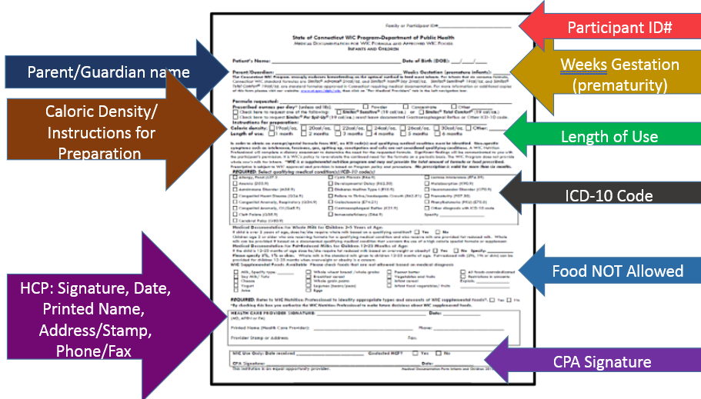
Specialized Formula and Medical Food
Before issuing benefits start to make sure HCP completes the Medical Documentation appropriately.
Perform a Nutrition Assessment – Tailor benefits

Slide 42
WIC 400-12 Retail Purchase of Special (Exempt) Formula & Numbered Memorandum 16-005
The WIC Nutritionist is expected to assist the Authorized Person in identifying and contacting at least one WIC authorized retail and/or grocery store pharmacy.
The nutritionist will inquire if the issued WIC Special formula is in stock.
If it is not in stock, assist the participant in placing the first-time order of the specialized infant formula or medical food.
Notes:
For the most part CPA assist participants in placing the first order for a Specialized Formula or Medical Food. Very seldom we encounter situations in which the CPA did not help the participant to place the first order. (Survey Monkey -6%)

Slide 43
CPA consult CT approved listing
Notes:
When placing the first order to the vendor, the local agency CPA first ask to speak with the Store Manager and provide a distributor code on the right columns of the listing . We are EBT and the store does not require a HCP Prescription.
CPA should visit the State WIC Web Page CT Approved Contract and Specialized Formula and Medical Nutritional Listing for latest listing approved in CT. (We have seen a case in which nutritionist has been using desk hard copy file that contains outdated information).
The latest one at this moment is dated March 2020.
We are planning to post a revised version by March 2021.

Slide 44
To make sure a great shopping experience
CPA find out when the formula will arrive at the store and communicates to participant
CPA provides with the vendors phone number and a contact person, for the participant to call the vendor to ensure the specialized formula or medical nutritional product has arrived before coming to the store
Notes:
To make sure a great shopping experience
CPA find out when the formula will arrive at the store and communicates to participant
CPA provides with the vendors phone number and a contact person, for the participant to call the vendor to ensure the specialized formula or medical nutritional product has arrived before coming to the store

Slide 45
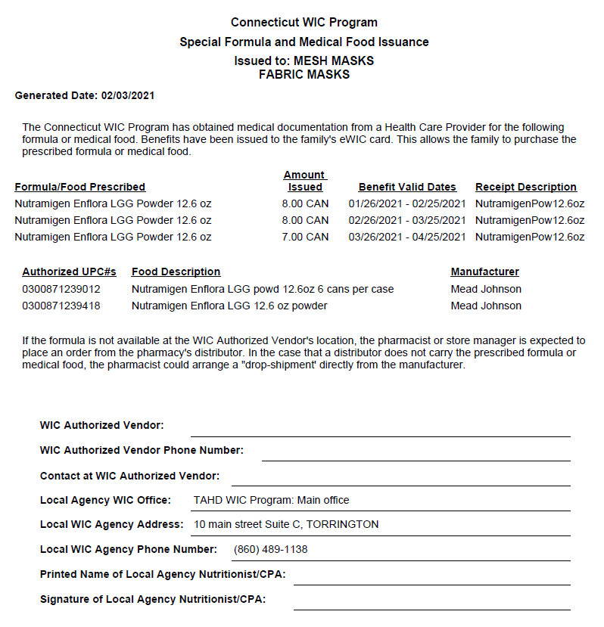
Special Formula and Medical Food Issuance Document
Participant and Authorized Person's Names
Specialized Formula Description Package Size, Amount Issued
Benefit Valid Dates
UPC code Number
Space to write WIC authorized Vendor name Phone number and a Contact Person
Local Agency Office, Address and Phone Number
Nutritionist Name and Signature
Notes:
After the initial order, for next months of benefits, provide the authorized person/caretaker with a Special Formula and Medical Food Issuance.
Participant and Authorized Person's Names
Specialized Formula Description Package Size, Amount Issued
Benefit Valid Dates
UPC code Number
Space to write WIC authorized Vendor name Phone number and a Contact Person
Local Agency Office, Address and Phone Number
Nutritionist Name and Signature
Where is located: Print Documents – In the drop down list – the last choice Special Formula and Medical Food Issuance Document.

Slide 46
Formula Shortages
The Manufacturers usually notifies the State Agency of expected formula shortages.
The State Office notifies the Local Agencies through a Numbered Memorandum.
Common Issues:
Formula is delivered to the store but cannot be sold to the participant.
Formula is ordered on specific days.
Notes:
Formula Shortages
The Manufacturers usually notifies the State Agency of expected formula shortages.
The State Office notifies the Local Agencies through a Numbered Memorandum.
Common Issues:
Formula is delivered to the store but cannot be sold to the participant.
Formula is ordered on specific days.
Sometimes some stores place special formula or medical food orders to the distributors only certain days during the week, and plus the delivery time add ups to the expected time in which the shipping gets to the store. (Sometimes takes about 5 business days finalize a transaction). The Authorized Person should be advice to go to the vendor as soon as the benefit start date and not to wait until a later time close to the Benefit End Date to make sure shipment gets within benefit valid through period.

Slide 47
Encourage to express concerns/ask questions Answer Questions Return Phone Calls Keep promises Talk with the right person at the store
Notes:
Best customer service involves: Encourage participant to express concerns and ask questions, ... During COVID – Do not shake hands, Keep Distance, Wear Mask and a face shield, Use Hand sanitizer, Use a desk shield divisor.

Slide 48
Have conversations on how to Maximize Food Benefits
Notes:
Document created on January 2021, on talking points to Maximize WIC and SNAP Benefits. This informational handout have a description of each Program eligibility criteria to qualify for SNAP and WIC and also describe food benefit for each program; and shopping tips such as use the eWIC card first and then use the SNAP benefit for the remaining of the balance.
Another conversation to have with the participant is referrals to HUSKY if needed. Conversations could be that since WIC is a supplemental, for additional specialized formula or medical food, the doctor can prescribe to HUSKY to provide the difference that is needed.

Slide 49
It is the responsibility of everybody to treat each other with courtesy and respect: WIC participant Store Staff WIC Staff

Slide 50
Contact the State Office if you encounter problems out of your control
Be prepared to provide the following information:
Store Name
Contact Person in the Store
Product Name
UPC code number
Send an image with the UPC code included.

Slide 51
When more than regulatory maximum of formula is needed:
Make referrals to other social services programs
To learn more about other nutrition assistance programs go to http://www.benefits.gov/
Notes:
WIC formula issuance is based on prescribed food packages according to the category and nutritional needs of the participant in quantities that do not exceed the regulatory maximum. If more formula is needed is important to perform referrals to social services programs. Thank you for your attention. Next Mellessa session will start on Redemptions.

Slide 52
Redemptions
Mellessa McPherson-Milling

Slide 53
BENEFIT REDEMPTIONS
75%
25%
60%
15%
80%
When scaling, group all elements to be scaled. Scale as needed. Use the “Increase Font Size,” “Decrease Font Size” buttons or manually change the font size for the editable text.
Notes:
What does this look like for Connecticut?

Slide 54
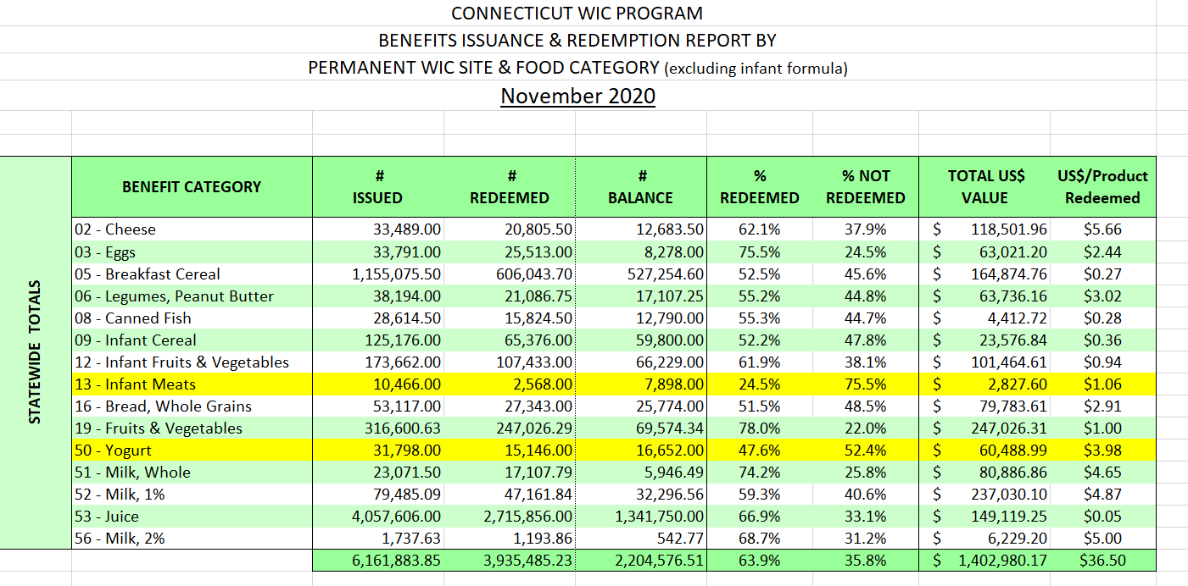
Notes:
The monthly benefit redemption report is a useful tool for assessing your local agency’s redemption rates and to plan messaging around this subject.

Slide 55
Monthly Benefit Redemption Rate Reports
Provided Monthly with a Closeout Schedule of 1 Month
Permanent Site Information is Entailed
All Foods are Listed By Category
Formula & CVV are NOT Included

Slide 56
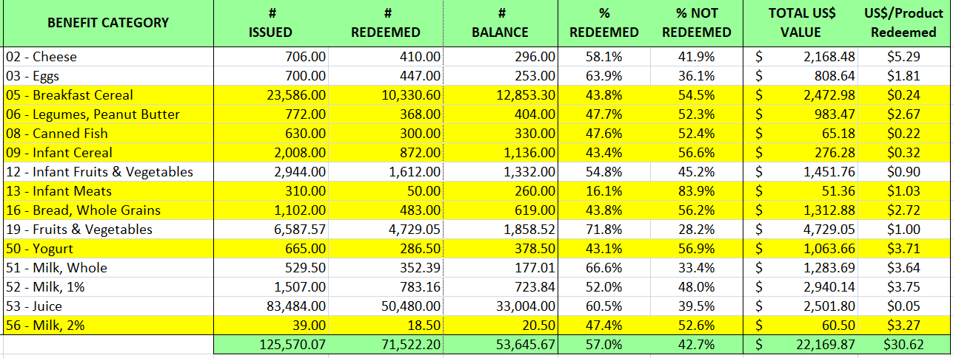
Monthly Benefit Redemption Rate Reports
Notes:
Discuss /explain this slide

Slide 57
What Can You Do To Improve Redemption Rates?
For New and OST participants……
1. Start the conversation.
Example:
“Shopping for WIC items are easier than ever!!! We have the WICSHOPPER app to assist you.”
2. “Sell” the products.
Example:
“Select your favorite brand from our food list.”
3. Encourage to purchase all items provided or to remove what will not be consumed by the participant.

Slide 58
What can you do to impact the Redemption rates?
For returning participants or Follow up visits…..
1. Keep the conversation going.
Example:
“What were some items you purchased last month?” AND/OR
Offer recipe ideas that incorporate WIC approved foods.
2. Tailor the food package once the participant has agreed to it.
3. Provide redemption messaging in every way possible.
Example:
LA website/page, recording played when on hold on the telephone, add a bold reminder to welcome packets (electronic or print), etc.
Notes:
Local agency redemption rates should be a standing topic for monthly staff meetings

Slide 59
Questions

Slide 60
Pamela Beaulieu – pamela.beaulieu@ct.gov Luz Hago – luz.hago@ct.gov Mellessa McPherson-Milling – mellessa.mcpherson-milling@ct.gov
Contacts:

Slide 61
Survey Monkey
Notes:
Received help from CPA 87% / Did not received help 6%
SNAP rather than WIC 13% / Not on SNAP 45.6%
Husky rather than WIC 30% / Not on Husky 15.7%
Receiving more WIC benefit that what is needed 15.7% / Never 51.7%

Slide 62
Survey Monkey results January 2021.
Notes:
English surveys 1308 total participants / 88 undeliverable / Delivered 1220 / Completed surveys 89 – 7.3 % of the total surveys delivered.
Spanish surveys 175 total participants / 6 undeliverable / Delivered 169 / Completed surveys 25 – 14.7% of the total surveys delivered.
Total surveys completed 114 – or 8.2%.
Altogether 114 surveys completed - 8.2%

