Slide 1
Outreach & Retention
Connecticut WIC Program
Local Agency Staff Orientation
October/November 2020

Slide 2
The 5 W’s of Outreach
Why?
What?
Where?
When?
Who?
Notes:
Why? There are many reasons why we should be conducing outreach.
is to maintain our participation. With decreasing participation rates nationwide we must continue to focus on both enrollment and retention.
to ensure community partners and providers are aware of requirements for participation i.e. bloodwork requirements, formula updates etc.
3. so the greater community truly understands the benefit of the WIC program not only to families participating but also the economic benefit to Connecticut.
What? Update to local agency web sites, Pandora, Facebook & Twitter, traditional radio, outreach toolkit
Where? Community partners- DSS offices, Social Service agencies, Health Centers, medical providers, local hospitals, Planned Parenthood, free pregnancy testing sites, Head Start, local food banks, grocery stores, local employers etc.
When? Often. Any time there is a significant change that would require your partners to be aware of what’s new & upcoming in WIC.
Who? Typically management is involved in outreach efforts however all staff should be aware of the benefit of outreach activities. Additionally, all staff should be involved in outreach in order to encourage early and continuous enrollment in WIC as well as education of policies and requirements.

Slide 3
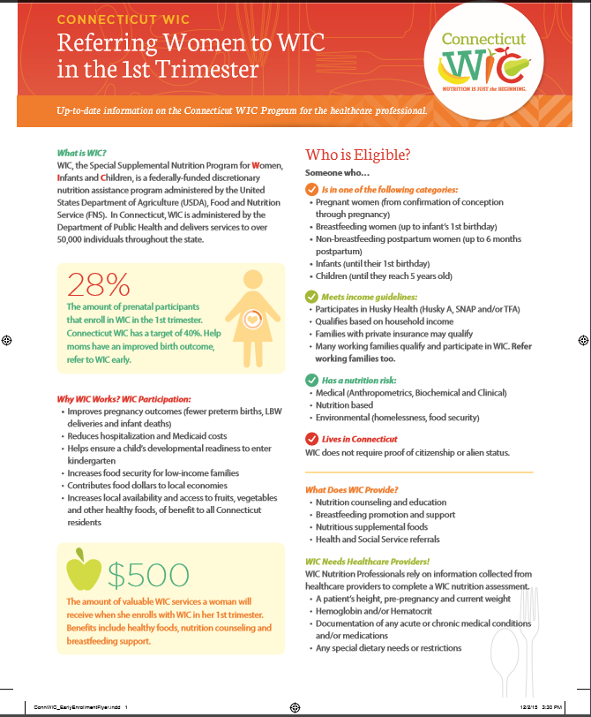
Outreach: Flyers for Medical Providers
1st trimester enrollment Breastfeeding Childhood Obesity Stick with WIC
Notes:
There are 4 flyers that were developed specifically for medical providers. They are:
Referring Women to WIC in the 1st Trimester
Support Breastfeeding because breastfeeding supports health
WIC’s efforts in preventing childhood obesity
Help your patients Stick with WIC until age 5.

Slide 4
Outreach: Flyers for Employers/Employees
Notes:
Another flyer was developed with both the employer and employee in mind. These flyers explain the benefit of the employer encouraging staff to participate in the WIC program. In addition it provides basic information to an employee so they can also see the benefit and determine if they may be eligible. These flyers could be included with paychecks, posted in breakrooms included in hiring packets etc. If employers use direct deposit and electronic file is available as well.

Slide 5
Outreach: Posters Pregnant?
As soon as you know, let WIC know
Goal is to increase 1st trimester enrollment
Notes:
Here is an example of our prenatal outreach materials, a poster that shows the importance of early enrollment. (1st trimester). Since the longer a prenatal participant receives WIC services positively impacts their birth outcomes and breastfeeding experience it is important o ensure that participants and providers know that women can enroll as soon as they learn of their pregnancy.

Slide 6
Posters: Child Retention
There’s much more to WIC than free formula.
Start Healthy Habits, Stick with WIC.
Save Money, Stick with WIC.
WIC is for all kinds of families.
Notes:
We have also developed a series of posters addressing childhood participation. There are many reasons families choose to leave WIC before their child turns 5 years of age. These four posters were developed to target the times they tend to leave.
For some families, we know that they may come to WIC for the formula. So what can we do to stem that tide? Start conversations early and frequently to encourage continued participation beyond the child's 1st birthday. *** Some local agencies have developed their own child retention messaging, like the 1yr birthday card with a reminder message about recertification. ***
For other families although they stay on the program past the child’s 1st birthday they drop off between 18 months and 2 years. Again, frequent reminders of eligibility and the benefit of staying on WIC is helpful. These reminders may include the cost savings of participating as well as the health benefits to the child.

Slide 7
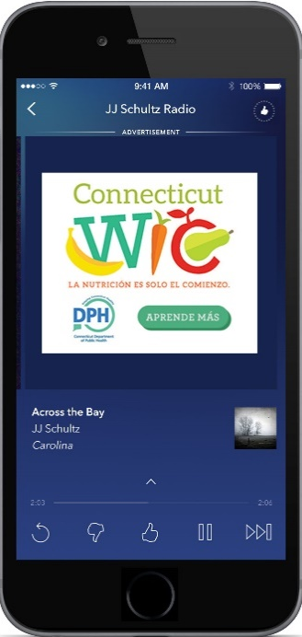
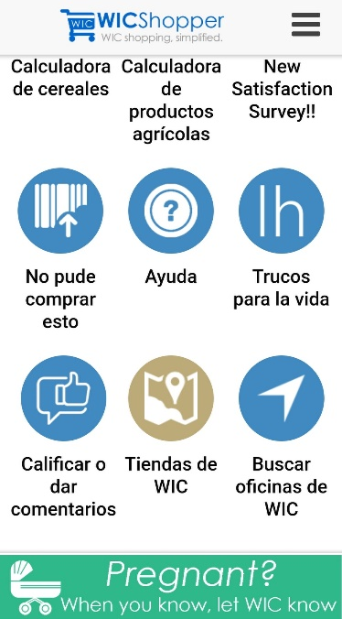
Outreach: Social Media & Radio
Ad campaign: focus on 1st trimester enrollment & child retention
Key messages include:
Breastfeeding
Farmers Market
General WIC info
Head Start eligibility
Stick with WIC
Monthly $ benefit
eWIC card
And much more
Recently Added: WICShopper
1st trimester enrollment
Notes:
Just over 1 yearsago we kicked off a Facebook ad campaign which focused both on 1st trimester enrollment and child retention. This ad ran in both English & Spanish for some time. We did not run any media in 2020 d/t COVID, but plan to resume some campaign in FY 2021 as resources allow.
Our communications office at DPH has been sending out a tweets for some time now. The list provides some of the types of messages that have gone out.
Along with our print materials we have been working with a media group to develop and distribute PSAs through Pandora and traditional radio.
Although we have received positive results from analysis done from either the media group and/or DPH staff we do not know the full impact it has had on CT residents. We need the help of local agency staff to determine if the messages have been seen/heard. We need your help to capture the most important data…. Who has it reached and has there been impact on participation?

Slide 8
Capturing Data
How?
How heard about WIC?
Precertification screen
30% Medical Providers (Maternity clinics, PCP, OB/Gyn)*
29% Family/Friend/Neighbor
12% Previously on WIC
8% OST
Notes:
This information was pulled from the Referred From report in CT-WIC.
When participants FIRST apply for WIC, there is a question How Heard about WIC? on the Precertification Screen.
A 1/3 of participants have said that they learned of WIC from a family/friend/neighbor. But what else…. Did their doctor encourage them to come, did they hear our ad on Pandora, did they see the Facebook ad, did they attend a community event you were at, did their Head Start worker encourage them to come to WIC? With probing questions we can more determine if our current efforts are effective.
For more information & tips on accurately collecting referral data-review Tell Us….. We want to know! referral sign.

Slide 9
Capturing Data
How?
Where have you heard/seen WIC outreach?
Family Information Screen
94% Other
3% Primary Health Care Provider
1% Radio/Media*
Notes:
The other point where local agency staff can capture outreach data after the initial certification is reviewed on the next few slides.

Slide 10
Capturing Data
Why?
Measure effectiveness of outreach efforts
Determine areas to consider for future outreach efforts
Are we accurately capturing referral data?

Slide 11
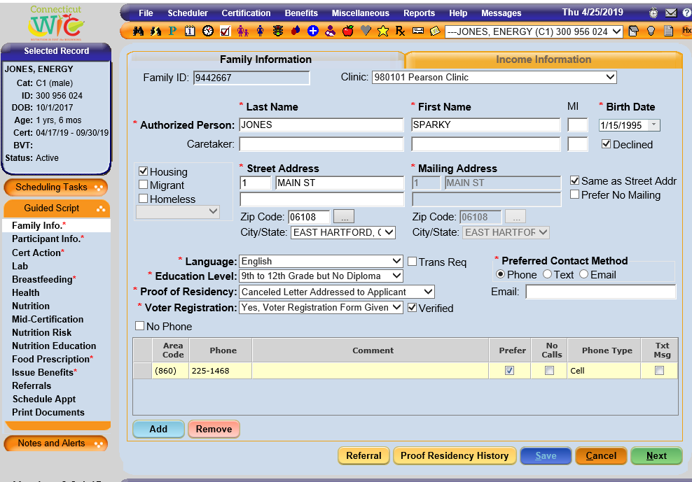
Capturing Data - Where do you document the responses?
Notes:
This slide shows where in CT-WIC PA/NA staff should document outreach responses FAMILY INFORMATION SCREEN for TARGETED REFERRALS.
On the Family Information Screen, there is a “Referral” button on the bottom of the page (left image). When you click that, a popup appears to allow you to document if participants’ have seen or heard any outreach campaigns. Add a row to add the type.

Slide 12
Outreach: WIC Powtoon
Played in all 12 DSS locations throughout Connecticut
Child retention message
Notes:
In 2016 we started to work with staff at DSS on shared outreach.
https://www.powtoon.com/online-presentation/cse4xs0X9Tm/?utm_campaign=email%2Bshare%2Bby%2Bowner&utm_medium=SocialShare&mode=movie&utm_source=player-page-social-share&utm_content=cse4xs0X9Tm
This video or PowToon is the collaborative effort of both groups. We are in the process of collaborating with DSS on a training to provide and overview of WIC services and benefits to home visiting workers in the Office of Early Childhood. We are excited about this partnership, as it is to everyone’s benefit when community members and organizations know how WIC operates and can be leveraged with other food and nutrition programs such as SNAP.

Slide 13
Retention How do we help our retention rates?
One Call Now: Via Push notification, sends reminder calls and/or text messages for upcoming appointments, missed appointments, expiring benefits, farmers market reminders, participant satisfaction surveys and more to come.
Provide key retention messages through outreach.
Shopping Experience: Ensuring participants have a positive shopping experience. WICShopper
Customer service trainings
Office hours policy & Appointment policy guidance
Streamlining services and reducing barriers
Fatherhood Initiative
WIC & Head Start Better Together Collaboration
Notes:
Outreach is for recruiting participants, but once they apply and are eligible, we want to keep them on the program.
This slide lists several ways we have available to keep families participating.
One Call is a platform we use to provide information to participants in a message (call or text) format.
We can provide key retention messages (i.e. 5 posters previously seen) through out outreach efforts.
The Shopping Experience is key to retention and we need to ensure we train participants’, so they are comfortable shopping for their WIC foods. WIC Shopper is an App that provides participants with information on WIC eligible foods on their FBL. (More detail on shopping will be provided in the next few slides.)
Other policy and training related measures that we take to improve retention include: customer service training, having flexible office hours and appointment policies, reducing barriers to WIC participation and 2 projects, the Fatherhood Initiative and WIC & Head Start Better Together.

Slide 14
WIC & Head Start Better Together.
Notes:
Funded by a WIC Special Project Grant from 2014-2017, the Connecticut WIC Program has formed a collaboration with Head Start
This collaboration aimed to increase WIC Program retention by co-enrollment in both WIC and HS programs. Co-enrollment means that families participate in both WIC and HS. Connecticut has similar co-enrollment rates to the national data (only 50% of HS enrollee also participate in WIC). Here in CT, we were able to see increased enrollment in our pilot site (New Britain) which increased from 50% to 70%.
Phased in implementation of this collaboration occurred through 2020. Happily, all local agencies will receive limited NSA funding to build and maintain partnerships with local Head Start (and Early Head Start) programs.

Slide 15
Fatherhood Initiative
Goal for WIC to be more welcoming to dads/family men
Local WIC offices to be more family centered by encouraging dads to participate in all aspects of WIC
Evaluate current attitudes, offices, policies and practices to identify strategies needed for WIC to further welcome and engage with dads.
feedback and technical assistance provided to LA to be more welcoming to dads participating in WIC.
Notes:
Research shows that father involvement improves the health of women during their pregnancy, improves birth outcomes and positively affects the health of infants and children. With 53 percent of all infants born in the United States participating in WIC during their first year, WIC has the opportunity to positively affect the health and future of low-income families. Nationally there is focus on engaging with Dads in the WIC Program. This project is focused on providing in depth training and technical assistance to 3 local agencies to pilot initiatives focused on engaging more with dads and providing a more family focused service to CT WIC families.

Slide 16
Shopping with WIC
Ensuring a positive shopping experience
Notes:
A big piece of customer service and ensuring participant retention is the shopping experience and whether the participant had a positive or negative experience. We sometimes hear of participant complaints and unfortunately no matter how well you’ve treated your participants at the clinic if they’ve had a negative experience in the grocery store they may not return. However there are things we can do to be sure participants have positive experiences while shopping. And for those who continue to have problems shopping there are tips to help ensure future shopping trips are smoother every time.
Some common complaints are: it’s hard to identify what foods are WIC approved, cashiers are rude, not sure what their benefit balance is

Slide 17
What turns a happy shopper into an unhappy one?
Notes:
What are some of the things you have heard?

Slide 18
What do you do to prevent shoppers from being unhappy?
How do you make sure shoppers know what to do at the store?
What follow-up to shopping trips do you provide?
How do you resolve shopping issues you hear about?
Notes:
How do you educate your participants about the shopping experience? What tools do you utilize when educating new participants?
Do you ask about their shopping experiences? If so how often?
If a participant has issues shopping for WIC benefits what have you done to help to ensure they have a better outcome the next time?

Slide 19
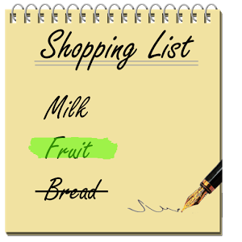
Before they shop
Explain how to shop
Family Benefits List
Approved Food Guide
WICShopper app
Tips on how to make shopping easier
Provide personalized help depending on their situation
Notes:
This is an important part of educating participants. Take the time to review what exactly they are prescribed on their food package as well as a careful review of the WIC Approved Food Guide.
Providing personalized help. For example if someone will be purchasing both can evaporated milk and gallon milk be sure to instruct them on how to get their full benefit. ie 5 cans of evaporated milk=1 gallon of milk.

Slide 20
Four things every WIC shopper needs to know before they shop!
1.
2.
3.
4.
Notes:
Their food benefit balance.
They can check their balance on WICShopper, get a balance inquiry at any register, call the number on the back of their card or visit www.ebt.acs-inc.com
What foods are allowed.
Bring their food guide every time they shop, use the scan barcode function on WICShopper, look for shelf tags
They don’t have to buy an item that isn’t ringing up as a WIC food.
If they believe an item is WIC approved but isn’t scanning ask for a store manager if it won’t scan they do not have to buy it. They can request for a UPC to be added by going to the I couldn’t buy this tab on WICShopper or calling the State office.
How to report issues to WIC.
Some issues require reeducation of the participant, some require an update to a UPC. Staff must understand first what the problem is before deciding how to proceed. Many of the issues can be handled at the local agency however when they cannot be resolved locally they should contact the state agency.

