Slide 1


October 2020
The CT WIC Program New Staff Orientation
Certification
Notes:
The process of Certification is undertaken in order to determine an applicant’s eligibility to receive program benefits in accordance with State and Federal regulations.
Local agencies develop a system to certify applicants using a series of Processing Standards in order to ensure Program Integrity.
The core series of processing standards include: Income verification, Identity verification and Residency Verification that are done at each Certification (recertification) visit. Other standards include: Providing timely appointments and Benefit issuance at the time of certification.

Slide 2
Eligibility Requirements for Certification
Identity proof
Residency (CT) proof
Income documentation
Nutritional Risks
Notes:
These 4 items are absolutely required to be met for an applicant to be eligible to participate in the CT WIC program.
Identity- Proof of identity must be applicable to the applicant/participant category e.g infant /Crib Card, Woman/Driver’s License
Residency- applicants must prove CT residency
Income- The HH income must be within the Federal Poverty guidelines as published annually by the US Department of Agriculture
Nutritional Risks- Applicants must be determined to be “Nutritionally at risk.” This Assessment can done by the Local WIC Nutritionist or a member of the applicant’s HealthCare team.
Once all of the above is satisfied, the applicant is then screened for Categorical eligibility……….

Slide 3





Categorical Eligibility
Pregnant Women
Postpartum Women
Breastfeeding Women
Infants (to their first birthday)
Children (to their fifth birthday)
Notes:
The LA staff person will screen for Categorical Eligibility i.e to determine which one of the 5 eligible categories the applicant belongs.
Categorical Eligibility: An applicant shall be in one of the WIC approved categories: pregnant women, postpartum women up to 6 months after termination of pregnancy (miscarriage, abortion or fetal death), breastfeeding women up to infant’s 1st birthday, infants from birth to their first birthday, and children to their fifth birthday.
In the case of : Categorical Ineligibility: If applicant is determined to not be within any of the above categories. In that case, complete the Notice of Participant Action. Scan the completed form in the participant’s CT-WIC file and give a copy to the applicant.

Slide 4
  Other Certification Requirements
Physical Presence is required, unless the applicant meets an exemption criterion (See Policy 200-02, Physical Presence Requirement)
  OHC-ongoing health care
  MC-medical condition
  ND-natural disaster
  WPC-working parents or caretakers
  Out of State Transfer
  Infant under 8 weeks of age
Certification shall be performed at no cost to the participant.
WIC allows program participation by foreign citizens, including foreign students residing in the U.S.
Citizenship status cannot be a factor in eligibility determinations.
Nondiscrimination statement /Rights & Responsibilities.
Notes:
Physical presence: there are some exceptions that are allowable on an individual basis. The need for an exception must be re-assessed prior to each certification period. Physical presence or the acceptable waiver is required in the Cert Action Screen in CT-WIC.
Medical Condition: may include participants who require medical equipment not easily transportable, confined to a bed, infectious disease, major illness or injury ie cancer, burns, a newly discharged premature infant etc.
* As most of you know, due to the current pandemic, USDA has allowed the Physical presence waiver to used until 2/20/2021. That waiver allows to us proceed with service in cases where there is no updated wt/ht/bloodwork
When the “Infant under 8 weeks of age” option is selected, benefits can only be issued for up to 2mths depending on the infants age at certification. If the infant is not seen for physical presence at 8 weeks old, then benefits will be locked until the requirement is met. The Present for Cert Checkbox is no longer locked throughout the certification period.
Policy 200-02 Physical Presence Requirement
Participants must be read their R & R, which includes the NDS & their right to a Fair Hearing if requested
NOW LET’S TALK ABOUT PROCESSING STANDARDS

Slide 5

Processing Standards
Local agency staff shall develop a system to certify applicants for WIC benefits using the processing standards/timeframes:
  20 calendar days from the date of application
  (includes weekends and holidays)
  10 calendar days from the date of application
  (includes weekends and holidays)
    women who would become priority 1 participants
    Infants
    migrant farm workers and their families
    Homeless applicants
  Processing standards are based on calendar days, not business days.
Notes:
Application: Application for WIC benefits officially begins when an applicant visits or calls the LA to request program benefits or the LA received a completed certification form from a Health Care Provider. When an applicant, calls or visits the local agency to inquire about WIC benefits, you screen for identity, residency and income, as well as for categorical eligibility (Precert)
* Complete the Precertification screen in CT-WIC and instruct the applicant about the application process. When possible an applicant can be certified that day, otherwise schedule an appointment within the processing timeframe. Category I applicants (pregnant women, infants under 1 year, the homeless and migrants shall be scheduled within 10 calendar days of the initial request for benefits so that their eligibility can be determined. All other applicants can be scheduled within 20 calendar days.
Policy 200-01 Certification Process and Applicant Processing Standards

Slide 6
Processing Standards
So……..
1. If a woman calls to apply to WIC for her pregnancy on November 1st when would be the last day to schedule her within the standard processing time frame?
2. Let’s say that a woman comes to her appointment on November 7th and you learn she has a 3 year old. What would be your next step? When should that child be scheduled for a certification appointment?
Notes:
The woman should be scheduled no later than November 11th to be within the processing timeframe however the participant should be seen sooner if time allows.
If the child is present and time allows she should be offered the opportunity to add the child on that day. If the child is not present, staff should complete the required fields on the precertification screen and inform the participant what is needed to certify the child. That child should be made an appointment within 20 calendar days, so no later than November 27th. If the mother chooses to wait until her next scheduled appointment staff must document that the mother chose to wait.

Slide 7
Identity Requirement
Individuals who are being certified must be present and provide documentation of their identity at the time of certification
See Policy 200-03, Identity Requirement
Notes:
The policy is clear.
Before we talk about what is sufficient for Proof of Identity, let’s talk about the No Identity proof protocol

Slide 8
No Identity Proof Protocol
No Proof of Identity Protocol
Does not have proof because is victim of theft, loss or disaster, is homeless, a migrant or a person holding a VOC card.
Applicant can self-declare identity for a maximum of 30 days by completing the self declaration form. If all other WIC eligibility criteria are met, issue one month of benefits and possibly provide the Verification form.
Verification form must be completed by a reliable 3rd party and returned at next appointment to continue receiving WIC benefits.
Has proof, but forgets to bring to appointment.
Reschedule a timely certification appointment.
Do not issue benefits.
Notes:
The Verification Form may be completed by a reliable third party verifying identity for a WIC applicant.
The individual providing the verification should have knowledge of the applicant family’s situation. Such individuals are: a social service agency worker, church, legal aid society or an employer can confirm the individual’s identity.
Advise the applicant/participant the completed verification form must be returned at next appointment to continue WIC benefits.

Slide 9
Acceptable Proofs of
Identity for Women
WIC Cert Form – signed by Health Care provider
ConneCT card issued in the woman's name
TFA, SNAP, Medicaid/Healthy Start notice of eligibility
Health Plan Card in the woman's name
Pay stub with applicant’s name (no > 60 days old)
CT DMV issued: Driver’s License, Learner’s Permit, Non-Driver Photo ID
Employee, School, Patient or Military ID
Connecticut eWIC card (not for initial certification)

Slide 10
Acceptable Proofs of
Identity for Women (cont’d)
Immigration or Refugee Card
Social Security Card
W-2 Form
Unemployment Benefit Notification Letter
Unemployment Check
Tuition Assistance Document
Birth Certificate
Passport
Cancelled letter addressed to applicant

Slide 11
Acceptable Proofs of
Identity for Women (cont’d)
Discharge Papers/Visit Summary
Non –Connecticut Driver’s License/DMV Photo ID (Transfer)
Non-Connecticut Photo ID (not Driver’s License)

Slide 12
Acceptable Proofs of
Identity for Infants and Children
WIC Cert Form – signed by Health Care Provider
ConneCT Card issued in the child’s name
Medicaid notice of eligibility
Health Plan card issued in child’s name
Birth Certificate
Hospital Birth “Crib” Card
Immunization Record
Passport
Immigration or Refugee card
Connecticut eWIC card (Not for initial certification)

Slide 13
Acceptable Proofs of
Identity for Infants and Children (cont’d)
Passport
Social Security Card
Discharge Papers/Visit Summary

Slide 14
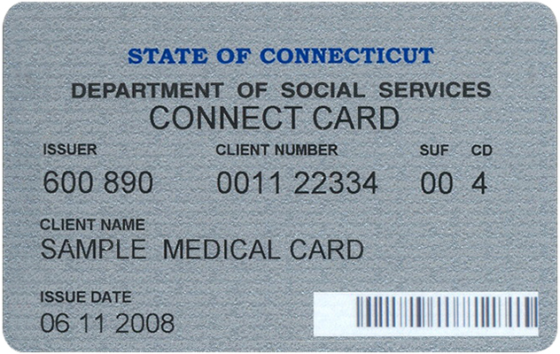


Slide 15
Residency Requirement
Determine if the applicant lives in Connecticut by asking the applicant to provide documentation which lists the applicant’s current street address and/ or verifies that the applicant resides in Connecticut
See Policy 200-04, Residency Requirement
Notes:
Again, let’s talk about the No Proof of Residency protocol 1st.

Slide 16
Proof of Residency
Proof of Residency
Does not have proof because is victim of theft, loss or disaster, is homeless, a migrant or a person holding a
VOC card.
Applicant can self declare residency for a maximum of 30 days. If all other WIC eligibility criteria are met, issue one month of benefits and possibly provide Verification Form.
Verification form must be completed and returned at next appointment to continue receiving WIC benefits.
Has proof, but forgot
to bring to the appointment.
Applicant can self declare residency for maximum of 30 days. Complete Self-declaration form, document reason and if all other eligibility criteria are met, issue one month of benefits. Applicant must bring proof to next appointment or WIC benefits must be discontinued.

Slide 17
Acceptable Proofs of
Residency for Women
WIC Cert Form with address imprint, signed by Health Care provider
ConneCT card issued in the woman's name
TFA, SNAP, Medicaid/Healthy Start notice of eligibility
Pay stub with applicant’s address (not > 60 days old)
CT DMV issued: Driver’s License, Learner’s Permit, Non-Driver photo ID
CT DMV motor vehicle registration
School, Patient or Municipal ID
Cancelled letter addressed to applicant

Slide 18
Acceptable Proofs of
Residency for Women (cont’d)
Utility bill or other current document that includes street address
Rent or Mortgage receipt
Bank Statement with current address
W-2 Form with current address
Unemployment Benefit Notification Letter
Unemployment Check/Deposit statement
Tuition Assistance Document with current address
Voter Registration Card with current address

Slide 19
Acceptable Proofs of
Residency for Infants and Children
WIC Cert Form with address imprint and Health Care Provider signature
ConneCT Card issued in child’s name
Medicaid notice of eligibility
Health Plan card issued in child’s name
Utility bill or other document that includes current street address

Slide 20
Notes:
Clarification of Address Imprint

Slide 21
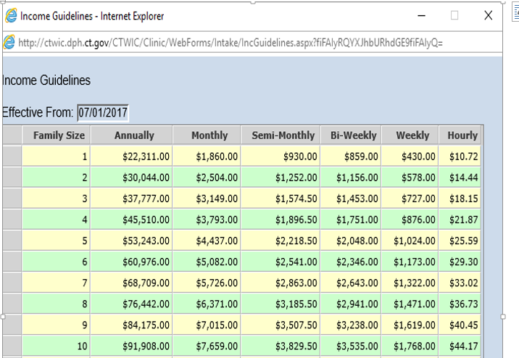
Let’s talk income …
Household income must be assessed at certification and recertification visits, and must meet the Federal Income Eligibility Guidelines. These guidelines are revised and published annually by USDA.
SAMPLE

Slide 22
Income Determination
First determine the household number or family size and if they are considered one or more economic units
Here is an example of a pregnant woman who is living with her sister:
  Scenario 1 - Both sisters have their own source of income but they share the household expenses.
  Scenario 2 - The applicant has no source of income at this time and when asked states that her sister supports her.
  For further guidance on income determination for Special Situations refer to policy 200-07 Income Eligibility Documentation
Notes:
Through appropriate questioning determine if the reported number in the family is one or more economic units.
For example, consider the pregnant women who is living with her sister. In scenario #1…She may be determined to be a separate economic unit from her sister if the staff can reasonably establish that she has a separate source of income and is paying her share of household, living and personal expense.
However, in the 2nd scenario where her sister is supporting her – they can be considered as one economic unit.
Special situations may include foster care, migrant farmworkers, students, emancipated minors, those reporting zero income.

Slide 23
The Family/Household Size
Pregnant Woman – Do NOT count the Unborn Infant, unless if doing so will make the family income eligible
Foster Child – Count as One
Joint Custody – Count Child in Family Size of the Applying Parent
Two Families Living Together – Count All Persons as One Household, if they are all living on Combined Group Income.
Minor- Count in the Family Size of the Economic Unit in which she is Residing, unless she is Employed or “Emancipated”

Slide 24
Income Eligibility
ADJUNCT ELIGIBILTY
Recipients of the following programs are automatically income eligible for WIC benefits:
Supplemental Nutrition Assistance Program (SNAP)
Temporary Family Assistance Program (TFA)
HUSKY A,C,D /Medicaid Program
Or, if the applicant is a member of a family that contains:
A SNAP/TFA Recipient
An infant enrolled in HUSKY A/Medicaid
A pregnant woman enrolled in Medicaid/Healthy Start
Notes:
Because of the income guidelines for SNAP, TFA and HUSKY A/Medicaid, a WIC applicant/participant who proves that they qualify for one or more of the State Assistance programs, automatically qualifies for WIC. This means is that they have already proven income eligibility.
If the participant doesn’t receive benefits from one of these State assistance programs they may still be automatically income eligible if someone in their economic unit has:
TFA or SNAP
If the infant has HUSKY A/Medicaid they can confer eligibility until they change categories to a child; however once the child turns 1 year of age, income will need to be reassessed for all family members
If a pregnant women receives HUSKY A/C/D or Healthy Start for the remainder of her pregnancy

Slide 25

IF THE APPLICANT IS ADJUNCTIVELY INCOME ELIGIBLE, WHY DO I HAVE TO RECORD HOUSEHOLD INCOME?
IT IS REQUIRED BY USDA
Notes:
If an applicant/participant is deemed eligible based on ANY State Assistance, then staff is allowed to collect a verbal report of other HH income. For Example, once HUSKY A/Medicaid is verified then ALL other forms of income may be documented as “Self Reported”. That includes: SNAP and/or TFA benefits received, child support, or income from work.
If, in this case (adjunctively eligible), the participant states they have no income, staff should ask the applicant/participant to describe in detail their living situation and how they obtain basic necessities such as food, shelter, medical care, clothing etc. This is to determine if there is any other income in the HH and to give applicant more options. This is a requirement from USDA. Although in this case the participant is found to be adjunctively eligible household income must be documented.
This income should be documented as Participant Reported in the Income Verification field.

Slide 26
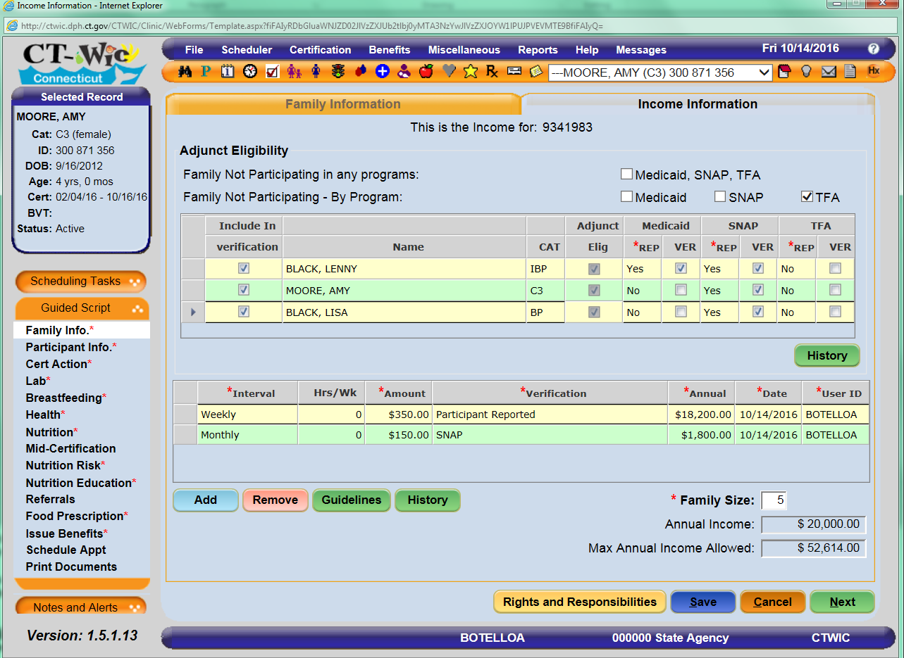
Notes:
So in this case you will see that the infant Lenny receives HUSKY A/Medicaid and that the family receives SNAP benefits. So all family members are adjunctively income eligible. Again all income needs to be reported. You can also see the the income from work is documented as Participant Reported and then the dollar amount received for monthly SNAP benefits is documented.

Slide 27
Income Sources
Gross cash or monetary compensation for services including: wages, salary, commissions, or fees
Net Income from farm and non-farm self-employment
Social Security benefits
Dividends or interest on savings or bonds, income from estates or trusts, or net rental income
Public assistance or welfare payment
Unemployment compensation
Government or civilian employee or military retirement or pensions or veterans’ payments
Notes:
For the migrant farm-worker, a letter from the current employer may be used to determine income.
Applicants from households with adult members who are unemployed shall be eligible based on income during the unemployment period, or if the loss of income causes the current household income to meet the WIC income eligibility guidelines.
Military Income: In determining income eligibility of any applicant whose family contains one or more military members, all gross income should be counted except the value of in-kind housing. You may find additional information on determining military income in the State Plan, Section II, Certification, 200-06 Income Eligibility.

Slide 28
Income Sources (cont’d)
Private pensions or annuities
Alimony or child support payments
Regular contributions from persons not living in the household
Net Royalties
Other cash income, to include but not limited to cash amounts received or withdrawn from any other source including savings, investment trust accounts and other resources which are readily available to the family.
Nutrition Assistance document
ANY INCOME THAT WAS NOT VERIFIED MUST BE DOCUMENTED AS “Participant Reported”

Slide 29
Acceptable Proofs of Income
Pay stubs (30 days worth)
Current W-2 form (wages, tips & other compensation figure)
1040 Tax Return Form (with Schedule C for self-employed) (Gross Income line)
Letter from employer on letterhead stating gross income and frequency
Unemployment benefit notification letter
Unemployment check
Tuition assistance document
Social Security (retirement or disability) benefit letter
Alimony payments - Court Decree or copies of check
Child support payments - Court Decree or copies of checks
VOC card
Military Earnings
Supplemental Insurance award notification (Long & Short term disability)
Notes:
Pay stubs: require 30 days worth of paystubs. If paid weekly that would be 4, biweekly 2.
Tuition Assistance Documents could include loans/grants in which the participant has constant or unlimited access to funds. They may provide documentation of a trust fund, or savings or a monthly personal loan from a family member.

Slide 30
Income Documentation
Proof of Income
Does not have proof because is victim of theft, loss or disaster, is homeless or a migrant.
Applicant can self declare income for a maximum of 30 days. If all other WIC eligibility criteria are met, issue one month of benefits and possibly provide Verification Form.
Verification form must be completed and returned at next appointment to continue receiving WIC benefits.
Applicant can self declare income for maximum of 30 days. Complete Self-Declaration form, document reason and if all other eligibility criteria are met-issue one month of benefits. Applicant must provide proof to next appointment or WIC benefits must be discontinued.
Has proof, but forgets to bring to appointment.
Proof is not available because applicant is a pregnant teen in crisis or an individual for whom the LA coordinator determines the income documentation requirement would present an unreasonable barrier to participation.
These are the ONLY 2 instances where self-declaration is allowed for more than 30 days. Use Self-Declaration form to document the reason proof is not available and instruct applicant to complete income amount, sign and date form. These are the only 2 circumstances where completion of the Verification Form by a third party is NOT required.

Slide 31
If an applicant has
No Proof OF:
- Identity *
Residency
Income
During the first visit…..Use the
Self Declaration Form
Notes:
* Self declaration form can only be used to document identity for the following: victim of theft, loss or disaster, homeless, migrant or VOC holder Otherwise reschedule a timely appointment

Slide 32
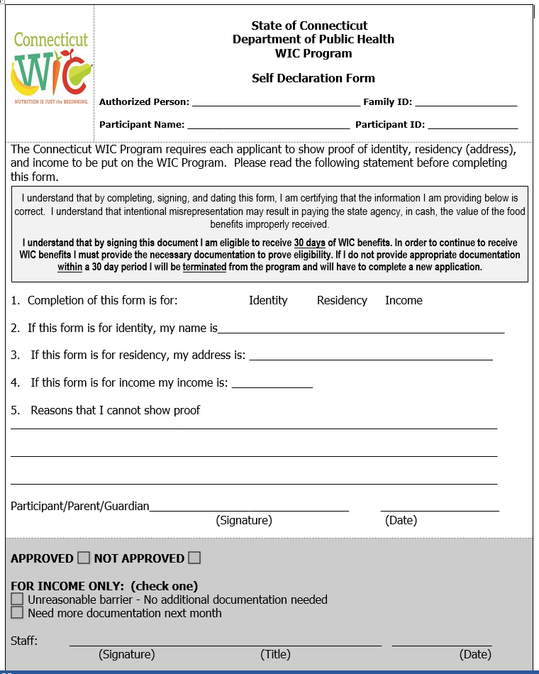

Slide 33
If Applicable
Documentation Is Available, but not Present …..
Fill Out Self-Declaration Form
Ask the applicant to bring required documentation next month
Issue One Month of benefits
Schedule a PROOF appointment within 30 days or 15 days for income/short-cert
Notes:
Use the Self declaration form to document the reason that proof is not available and self-declare their residency/income
The local agency shall not certify or issue food instruments to applicants without proof of identity except for persons who meet the criteria (see next slide)

Slide 34
If Applicable Documentation is Not Available….
and the applicant is a:
Victim of Theft, Loss or Disaster
Homeless
Migrant
VOC Holder
Then….(next slide)
Notes:
Only Exceptions:
If the applicant reports not being able to obtain applicable documentation on her identity/residency/income because she is a:
victim of theft, loss or disaster
homeless
migrant
person holding a Verification of Certification (VOC) card……..
Then ask if a reliable 3rd party can confirm the applicant’s Identity, Residency or Income

Slide 35



A Reliable Third Party Can Confirm
Identity, Residency & Income
Staff of a social service agency, church, legal aid society, relief organization, school counselor, or an employer
If so, Use
Verification Form
Notes:
Complete Verification Form:
Tell applicant to have a third party confirm her identity, residency, income and to bring the completed Verification Form at next visit. But, who can be considered a third party verifier? (Refer to slide)
If all other program requirements are met, issue one month worth of checks and reschedule certification appointment for the following month.
Keep the Verification Form in the participant’s file.
Purpose:
The Verification Form is to be used when proof of identity, residency and/or income is NOT available because of one of the exceptions discussed before and as outlined in Section 2, Certification Section (victim of theft, loss or disaster, a homeless individual, a migrant, or a person holding a VOC card). The form serves to give assist applicants who cannot provide proof of this information the opportunity to have a third party provide a letter to confirm an individual’s identity, residency and/or income.
Verification Form may be found in State Plan, Policy . Our current State Plan is clear on who can be a third party verifier and what is required for verification.
In the event, the Verification Form is not returned completed to the local agency at next appointment, the applicant shall be informed that she is being disqualified to obtain WIC benefits until either she brings the required proof or the completed Verification Form.

Slide 36
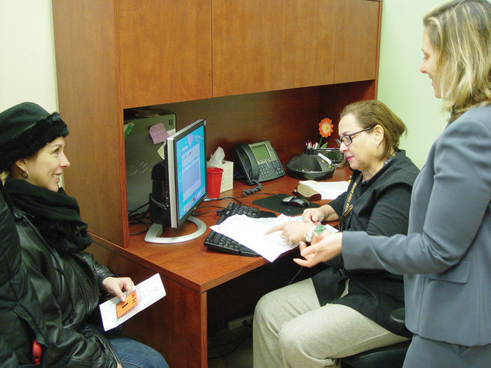
If There is NO Reliable Third Party
Refer Applicant To…
Your Local agency Coordinator or Designee for further assistance
        Program
        Coordinator
Notes:
Refer to the LA COORD/designee for assistance on how to obtain adequate documentation.

Slide 37
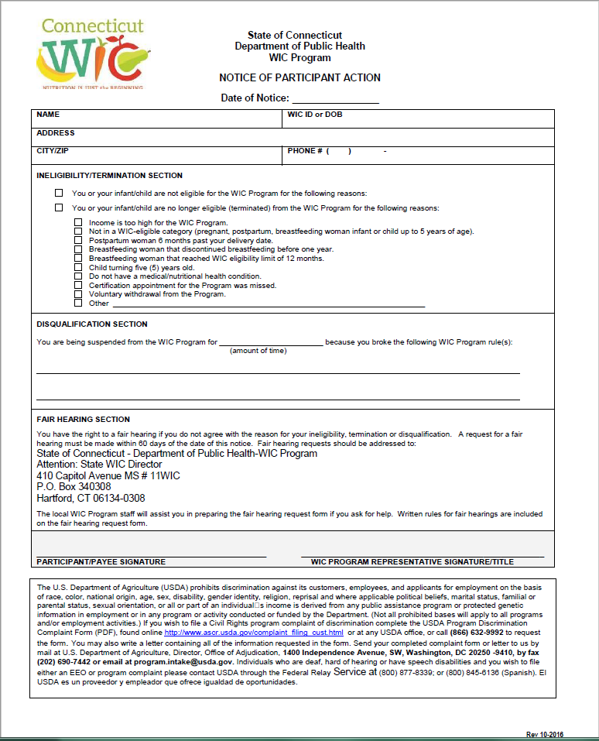
Notice of Participant Action
If ineligibility was determined during an appointment, complete and issue a Notice of Participant Action form (NOPA). *
Give a copy to the participant, review the Fair Hearing Section and keep a copy of the form in the ineligible applicant document file.
Issue a NOPA to participants who will be termed for categorical reasons. Must be provided at least 15 days prior to the termination date.
Notes:
1. For Applicants that are deemed to be “over income” & never received benefits: keep a copy of the income presented, a copy the completed NOPA form & the WIC cert form (if available) in the Over income/ineligible folder.
2. For Participants who are recertifying and are deemed to be over income- document the income in the Participant’s CT-WIC record. Complete and provide a signed copy of the NOPA form to the applicant/AP. Scan a copy pf the completed NOPA form into the participant’s CT-WIC record
When issuing the NOPA form, the applicant/ participant MUST BE INFORMED OF the reason for the notice of termination AND THEIR RIGHT TO A FAIR HEARING

Slide 38
Rights & Responsibilities
A review of the Participant’s Rights & Responsibilities is required at Certification and Recertification.
Not required at mid-certification.
Participants must be aware:
  WIC does not discriminate, however if they do feel discriminated against, Civil Rights complaint information is available
  If they fail to receive benefits for 2 consecutive months they will be terminated from the program and may have to reapply to continue to receive benefits
  WIC policy on fraud and abuse-maintain receipts

Slide 39
Participant Authorization
Must be updated at certification and recertification. Can also be updated as needed e.g if there’s a change Provider information during the certification period
Should be clearly completed and signed by the participant/Authorized person/Authorized Caretaker
Participants should know that the HCP will only be contacted for WIC purposes

Slide 40
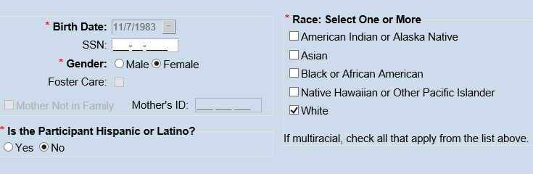
Race / Ethnicity Data Collection
Collection of Ethnic/Racial Data MUST be followed according to OMB Standards.
Data Collection Procedure:
Clients must self-identify verbally (Parent/Guardian must “self identify” for the infant/child)
If unwilling to self identify, WIC staff may visually identify
Document appropriately in CT-WIC
Participant Information screen.
Notes:
This standard was developed to ensure uniformity and comparability in the collection and use of data on race and ethnicity by all Federal agencies and to monitor compliance with Federal civil rights laws.
The purpose of this requirement is to ensure that those who are eligible to receive program benefits, minorities in particular, get what they are entitled to receive.
If participants question the need for reporting their ethnic/racial background, LA staff must explain that the collection of this information is for statistical purposes and has no effect on the determination of their eligibility to participate in the WIC program.
The protocol for Collection/Documentation of Racial/Ethnic data is as follows:
Show the form to the participant during the intake process. Some local agencies have this form taped to their desk and ask participant to self identify from the race/ethnicity categories. Once information is collected, document the information in CT-WIC.
If a participant declines to provide this information, visual identification by staff shall be used. When LA staff performs visual identification, selection of just one race is acceptable.

Slide 41
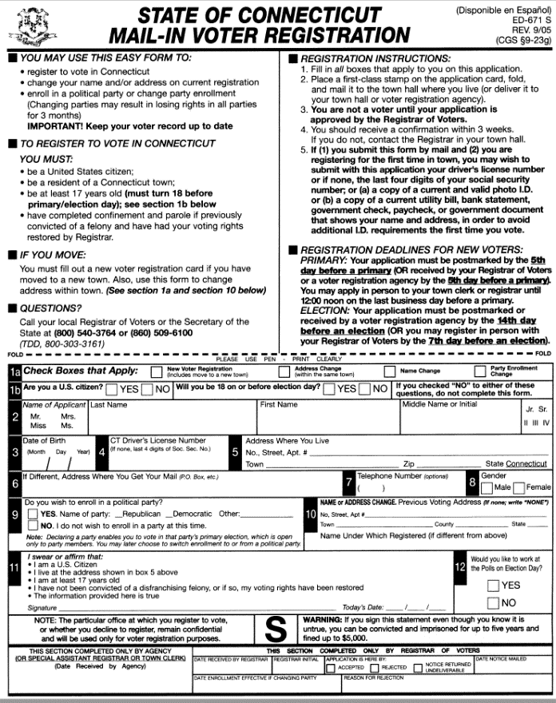
Voter Registration
Offer Voter Registration Option as is required by National Voter Registration Act of 1993
The opportunity to register should be offered at initial certification, recertification (women categories) or time of reported address change
Document on Opportunity to Register to Vote in CT-WIC
  Yes, Voter Registration Form Given
  Yes, Voter Registration Form Completed and mailed
  No, Already Registered at Current Address
  No, Not Interested, Information Sheet Given,
  No, Not Eligible
Notes:
The NVRA of 1993 requires public assistance agencies to offer voter registration services to clients at certification, re-certification and change of address.
Voter Registration Policy – 105-01
Adult applicants/participants (i.e. pregnant, breastfeeding, or postpartum women) shall be provided
with the opportunity to register to vote at:
• The time of certification,
• Each subsequent certification, and
• Any time the applicant/participant reports a change of address.
Adult parents/caretakers applying on behalf of an infant/child shall be provided with the opportunity
to register to vote at:
• The time of certification and
• Any time the parent/caretaker reports a change of address.

Slide 42
Request for Caretaker
An Authorized Person may request in writing, the designation of a Caretaker to attend to WIC appointments
See Policy 200-23

Slide 43
Caretaker Responsibilities
The Caretaker is defined as any person who is authorized by the participant or parent/guardian to:
Participate in recertification, mid-certification and nutrition education sessions
Sign all required forms
Shop for WIC foods
The caretaker must be someone responsible for the primary care and well-being of the participant and must be able to provide information on the eating habits and medical conditions of the client or child (i.e parent -father or grandmother)
Notes:
“Caretaker” Requirements/Responsibilities:
Must be able to provide information on the eating habits and medical conditions of the participant or child
Can pick up WIC benefits
Can shop with WIC benefits
Can represent participant/authorized person at (re)certification, mid-certification and at nutrition education sessions

Slide 44
Documentation of the Caretaker Requests
The selection of an caretaker must be documented on the Request for Caretaker form.
Sign and scan the completed Request for Caretaker form into CT-WIC Images
Complete the appropriate information in the Family Information screen in CT-WIC

Slide 45
Caretaker Request & Authorization form

Slide 46
THANK YOU

Slide 47
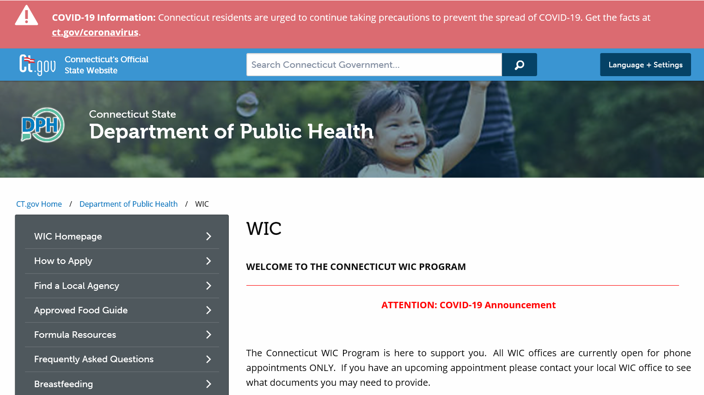
www.ct.gov/dph/wic

