Slide 1
NWS New York NY Coastal Services CT DEMHS/Silver Jackets Flood Awareness Workshop – Region2 United Illuminating
National Weather Service New York, NY
Nelson Vaz – Warning Coordination Meteorologist
Building a Weather-Ready Nation

Slide 2
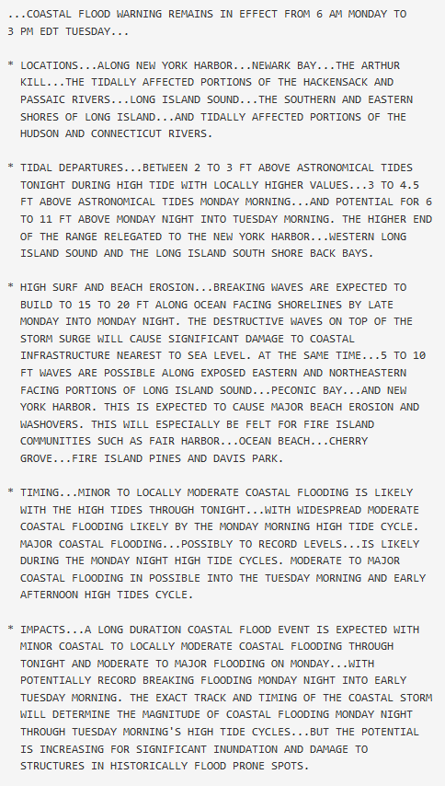
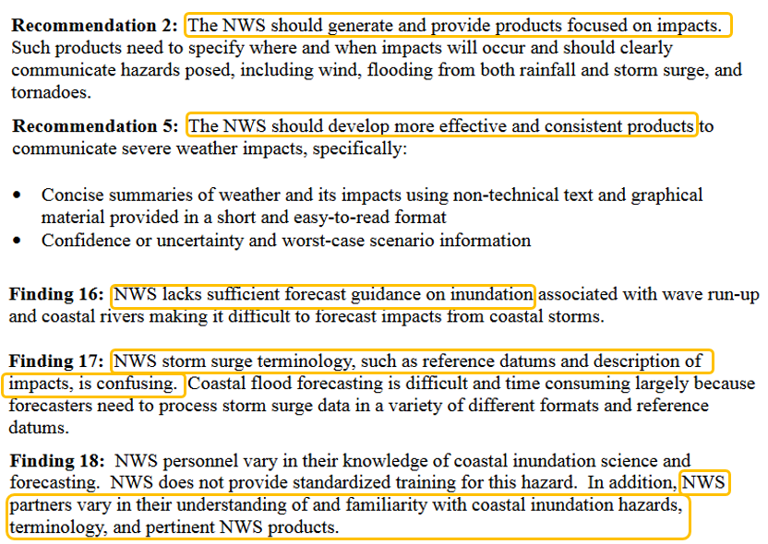
Eastern Region WFO Coastal Flood Webpages
NOAA’s Hurricane Sandy Service Assessment
National Weather Service
WFO New York, NY

Slide 3
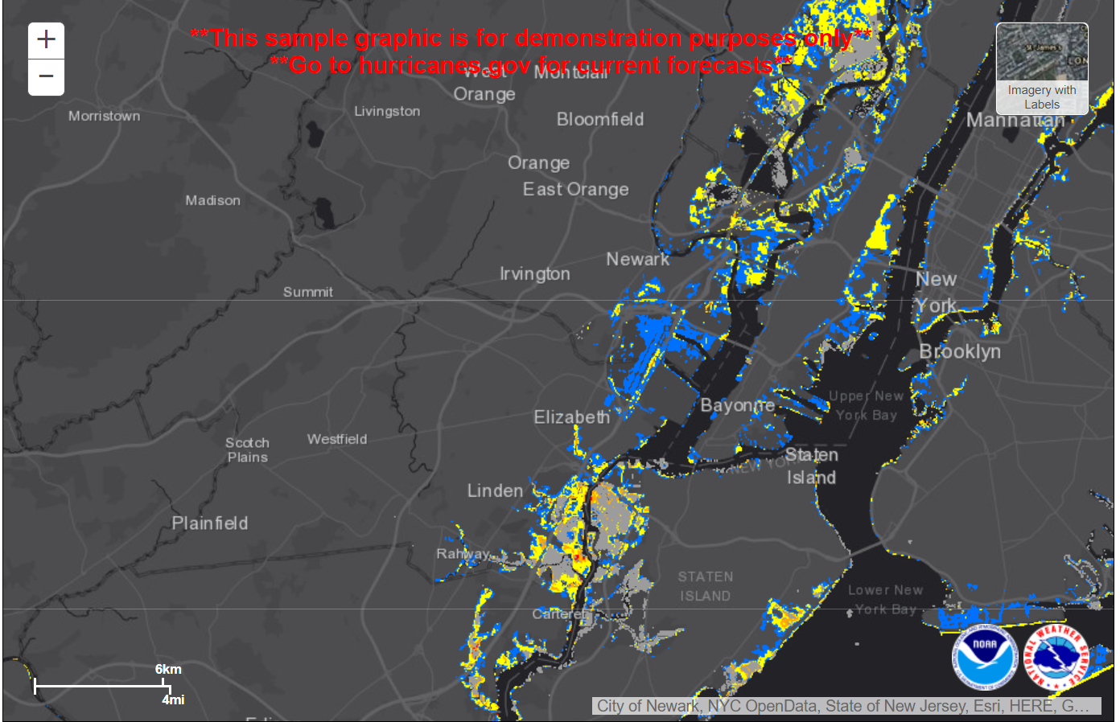
Eastern Region WFO Coastal Flood Webpages
NHC Tropical Inundation Visualizations
Issued when tropical watches are in effect.
Based on 100s of storm surge simulations of the official forecast track and historical track, intensity and size errors.
Subtracting topography from a composite of reasonable worst case water levels at a point
National Weather Service
WFO New York, NY

Slide 4
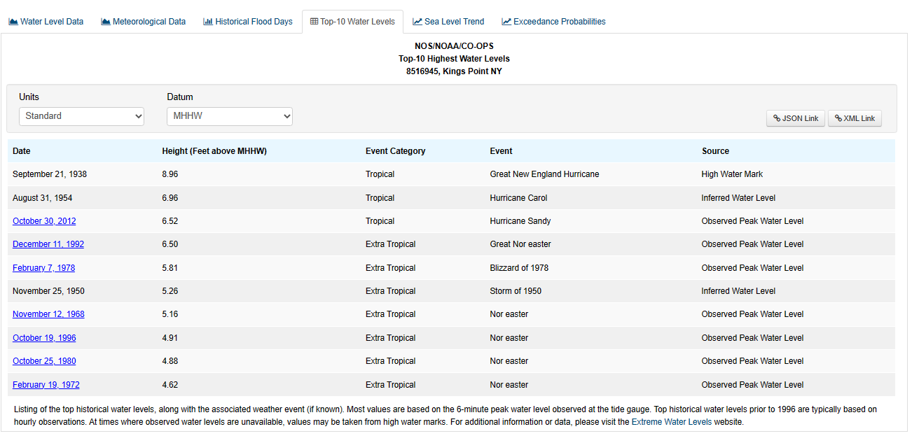
Eastern Region WFO Coastal Flood Webpages
Why do we need flood visualizations for extra-tropical storm surge?
National Weather Service
WFO New York, NY

Slide 5
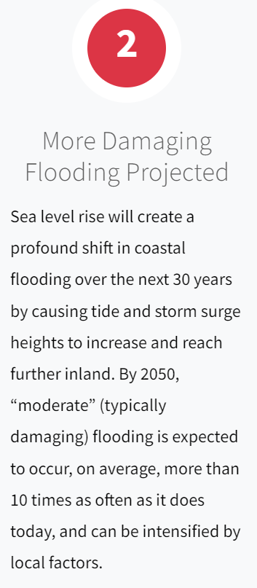
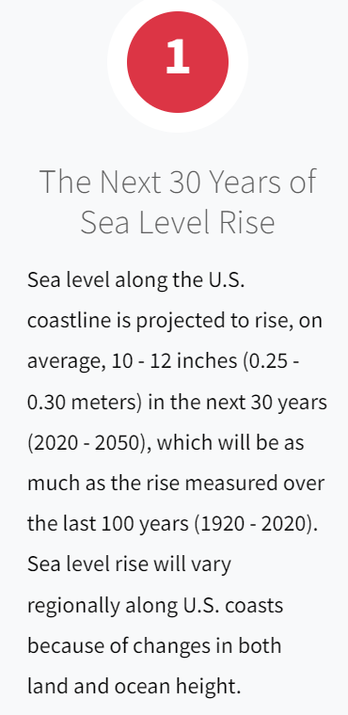
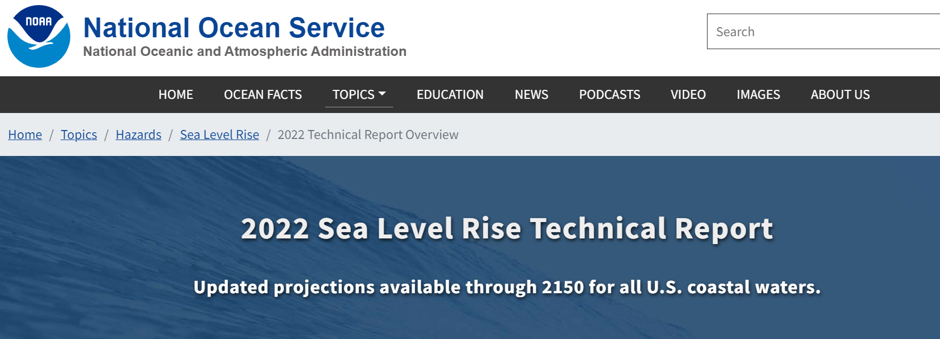
Eastern Region WFO Coastal Flood Webpages
Why do we need flood visualizations for extra-tropical storm surge?
National Weather Service
WFO New York, NY

Slide 6
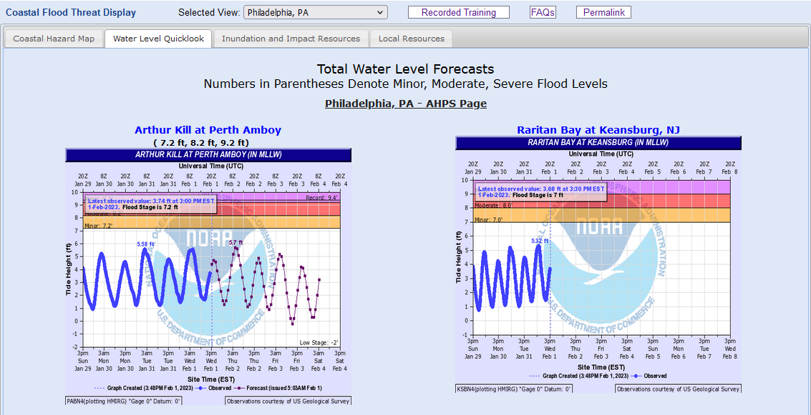
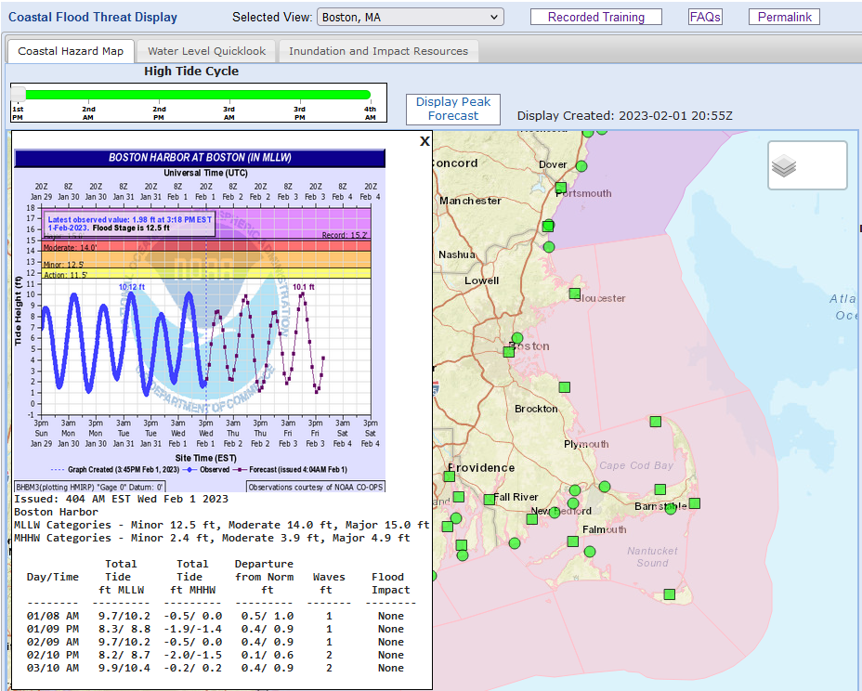
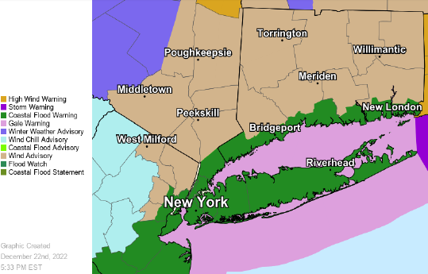
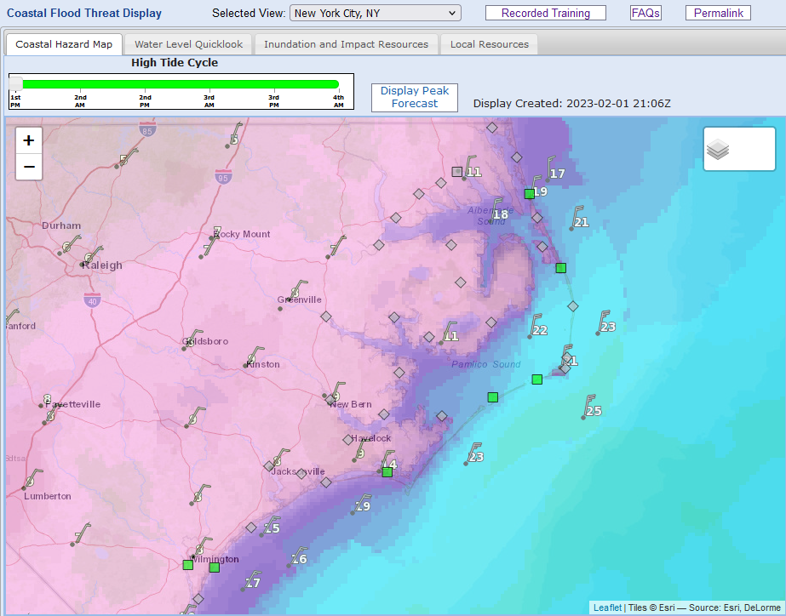
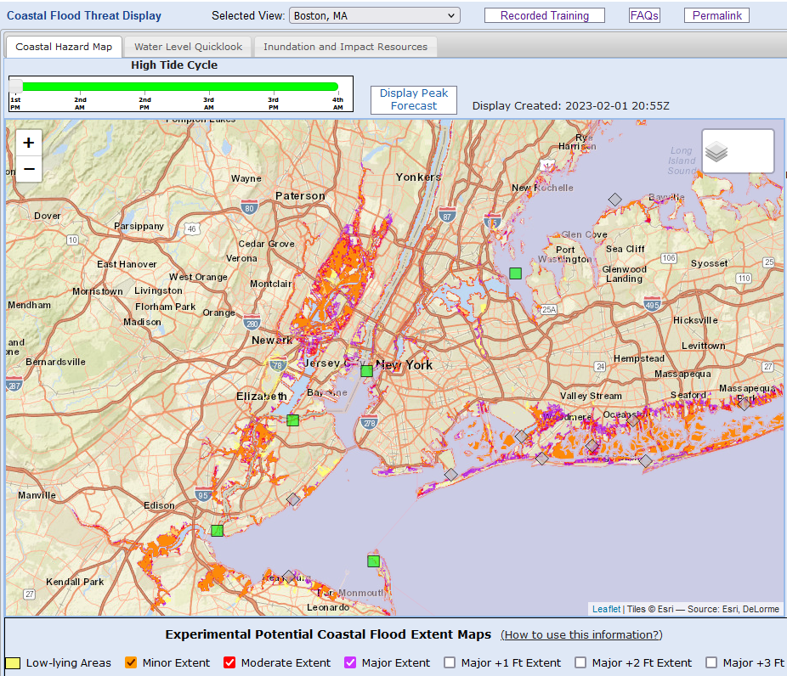
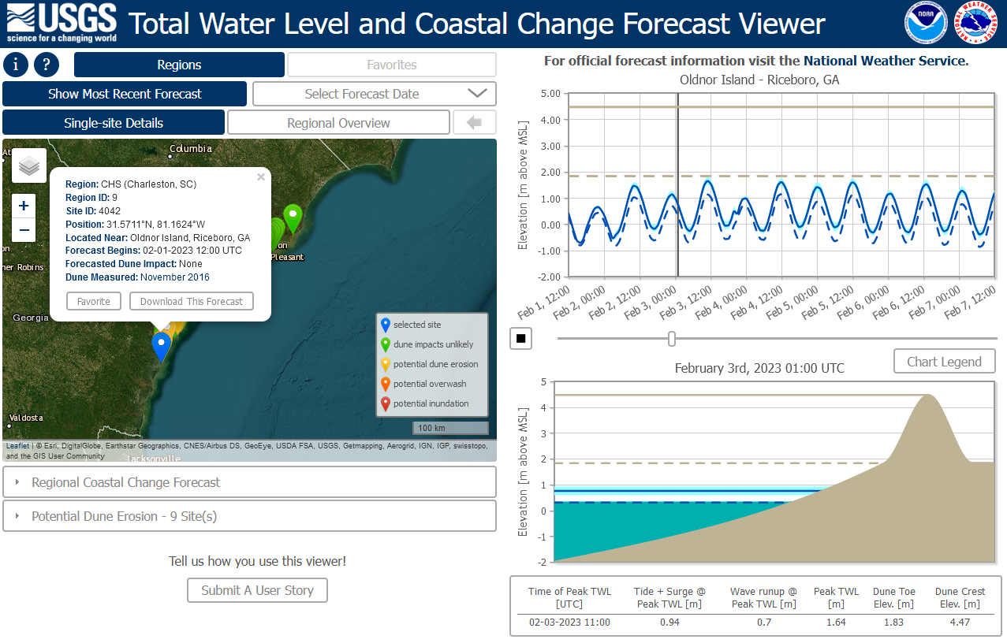
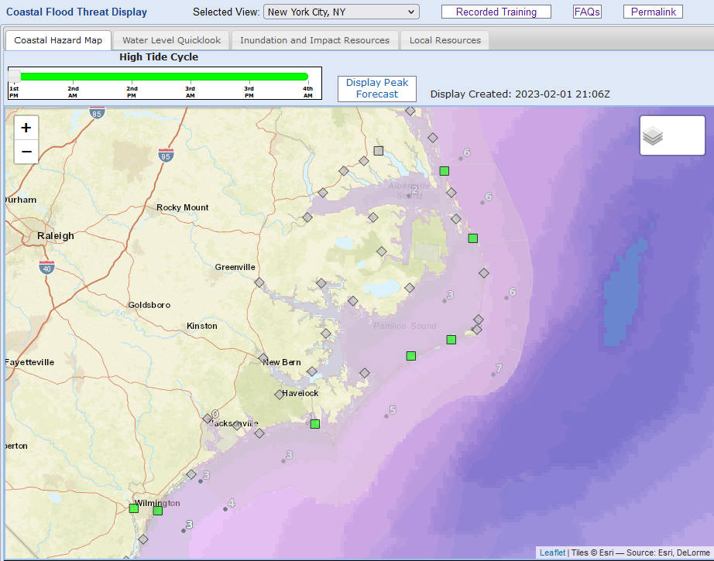
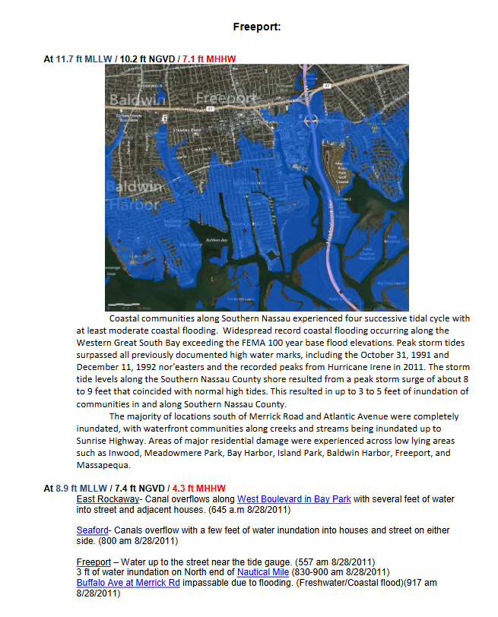
Eastern Region WFO Coastal Flood Webpages
Streamlining access to the most important coastal flood information
Website: https://www.weather.gov/erh/coastalflood
Website Tutorial: https://youtu.be/fiBdBJed8Bw
Website Feedback Survey: https://www.surveymonkey.com/r/ExpPotentialCoastalFloodExtentOverlaysforER_2022
Scan the QR Code
to go the Website
Water Level Observations
Water Level Forecasts
Coastal/Marine Hazards
www.weather.gov/erh/coastalflood
Wind/Wave Forecasts
Coastal Flood Impact Tools
Shoreline Impact Tools
Contacts: nelson.vaz@noaa.gov, laurie.hogan@noaa.gov

Slide 7
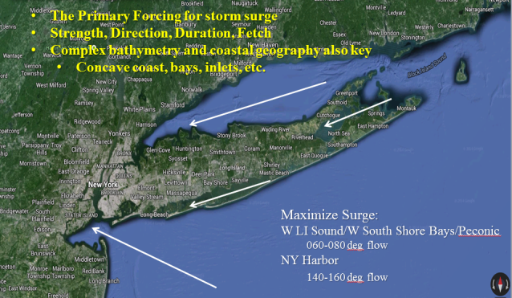
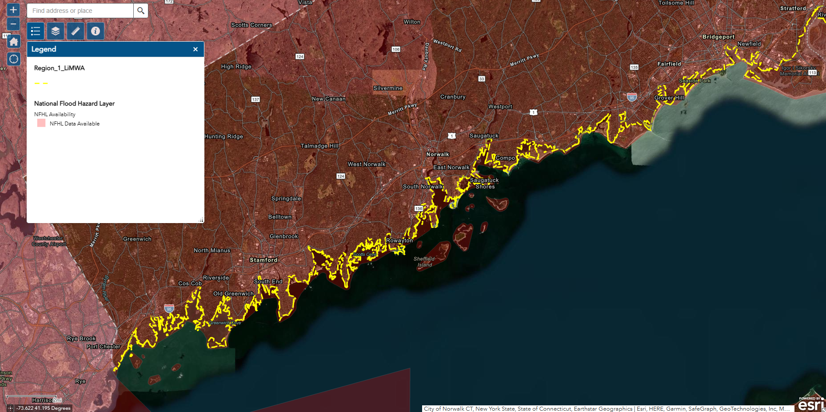
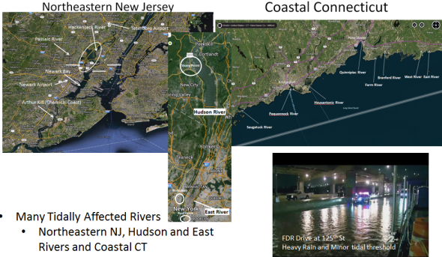
NWS New York Coastal Flood Products and Services
Ingredients for Coastal Flooding
Direct Wind Stress – (Primary)
Strength, Direction, Duration, Fetch (Length)
Eckman Transport
1-2 days to develop
Pressure Perturbations
30mb drop in pressure ~ 1 ft rise in surge
Waves
Raises total water level- Wave Setup
Damage to dunes and structures
Freshwater/Riverine
Tidally affected rivers
Heavy rain and high tides – urban flooding
National Weather Service
WFO New York, NY

Slide 8
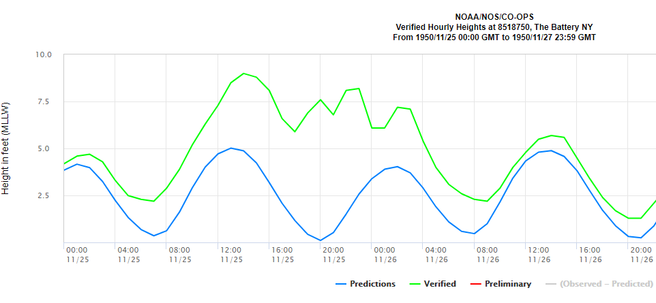
NWS New York Coastal Flood Products and Services
Forecast Uncertainties and Challenges
Wind Speed/Direction/Fetch/Duration
Surge in models is sensitive to these forcings
Timing/Magnitude of Surge with High Tide
4 ft surge at low tide is a much different story than 4 ft at high tide
Surge Models
Resolution
Physics & inputs
Wave Runup/Setup - Not incorporated into surge models
Rainfall/Groundwater - Not incorporated into surge models
We cant skillfully predict this type of surge behavior
We take path of least regret!
7 ft surge
We use a multi-storm surge model and statistical model forecast approach!!
National Weather Service
WFO New York, NY
Notes:
Hazardous Weather Event Briefing Template

Slide 9
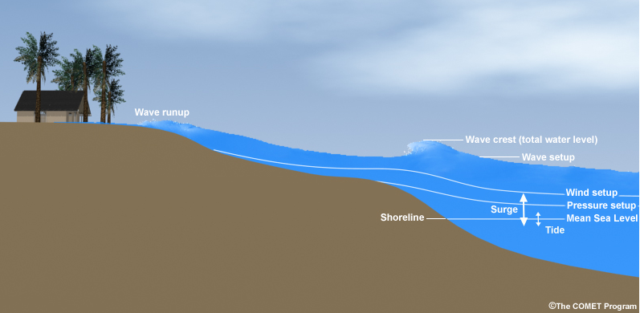
NWS New York Coastal Flood Products and Services
NWS Total Water Level Forecasts
NWS NY TWL Forecast = Storm Surge + Tides
Note: Waves + Freshwater inputs are not included in TWL (stillwater) forecast, but are incorporated into our impact forecast!
National Weather Service
WFO New York, NY
Notes:
Hazardous Weather Event Briefing Template

Slide 10
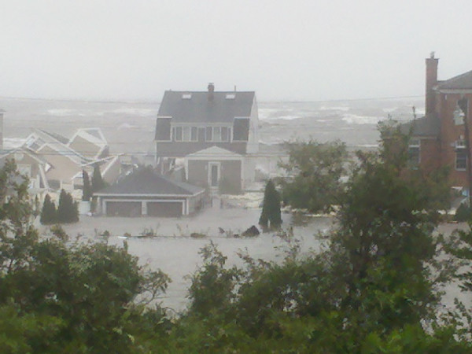
NWS New York Coastal Flood Products and Services
What are you interested in…
Inundation - Water covering normally dry land.
Inundation events are among the most frequent, costly, and deadly coastal hazards that can impact coastal communities in the U.S.
How can we better provide you inundation info and communicate the impacts?
National Weather Service
WFO New York, NY
Notes:
Hazardous Weather Event Briefing Template

Slide 11
NWS New York Coastal Flood Products and Services
Communicating Coastal Impacts – Coastal Flood W/W/A
Coastal Flood Outlook (Hazardous Weather Outlook (HWO)) issued 2 to 7 days in advance...when there is 30% or greater confidence that expected coastal hazards will pose a serious threat to property and potentially life.
A Coastal Flood Watch is issued when tidal flooding or storm induced flooding, posing a serious threat to property and potentially life, along coastal areas is possible within the next 12 to 48 hours. (50 percent or higher confidence).
https://forecast.weather.gov/product.php?site=NWS&issuedby=OKX&product=CFW&format=CI&version=1&glossary=1&highlight=off
National Weather Service
WFO New York, NY

Slide 12
NWS New York Coastal Flood Products and Services
Communicating Coastal Impacts – Coastal Flood W/W/A
A Coastal Flood Warning is issued when tidal flooding or storm induced flooding, posing a serious threat to property and potentially life, is imminent or is expected along the coastal areas within the next 24-36 hours. (80% or higher confidence)
A Coastal Flood Advisory is issued when minor tidal flooding or storm induced flooding is occurring or expected within the next 24-36 hours. The minor flooding is more than just localized or marginal.
Coastal Flood Statement issued in cases where minor coastal flooding is expected to be localized, with tidal benchmarks expected to be reached but not exceeded within the next 12-24 hours.
National Weather Service
WFO New York, NY

Slide 13
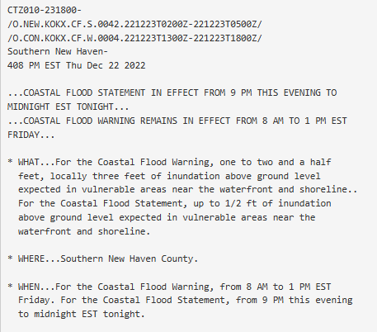
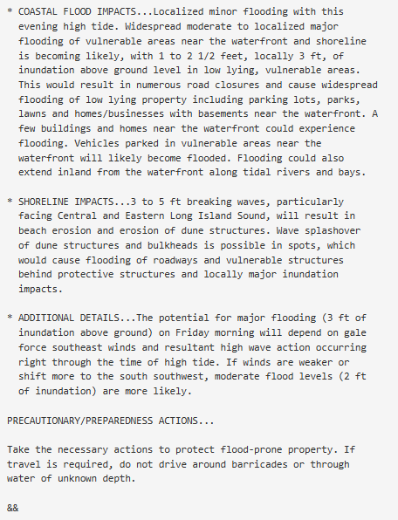
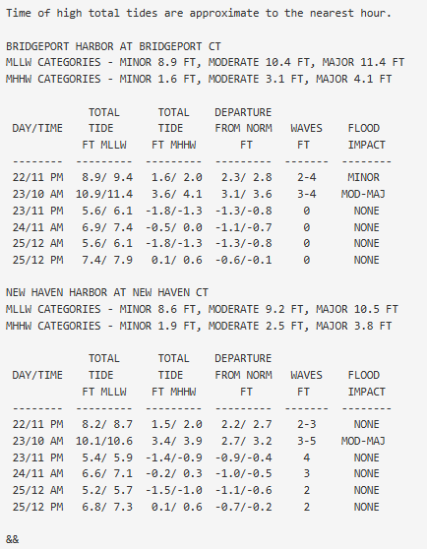
NWS New York Coastal Flood Products and Services
Communicating Coastal Impacts – Coastal Flood W/W/A
https://forecast.weather.gov/product.php?site=NWS&issuedby=OKX&product=CFW&format=CI&version=1&glossary=1&highlight=off
National Weather Service
WFO New York, NY

Slide 14
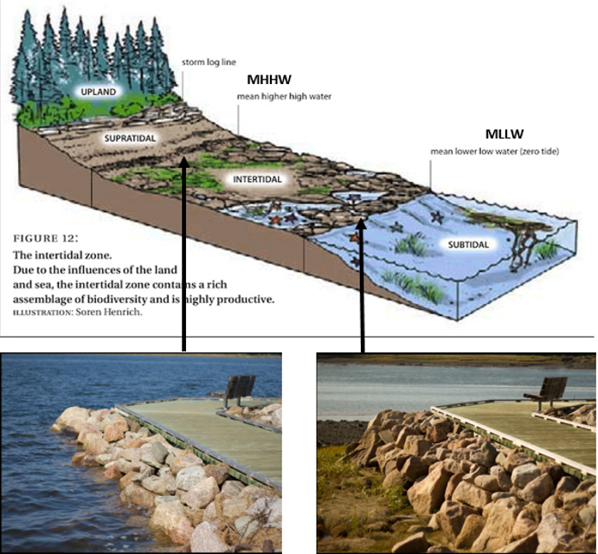
NWS New York Winter Weather Products and Services
Translating the Tidal Table and Benefits of MHHW
Translation: Forecast is for storm tide to reach 3.4 to 3.9 ft above MHHW (high tide line) at 10am on the 23rd. That is due to a 2.7 to 3.2 ft storm surge on top of the astronomical tides. 3 to 5 ft landward directed wave action is expected, which will cause moderate to local major flood impacts.
National Weather Service
WFO New York, NY

Slide 15
Eastern Regional WFO Coastal Flood Web Pages
National Weather Service
WFO New York, NY

Slide 16
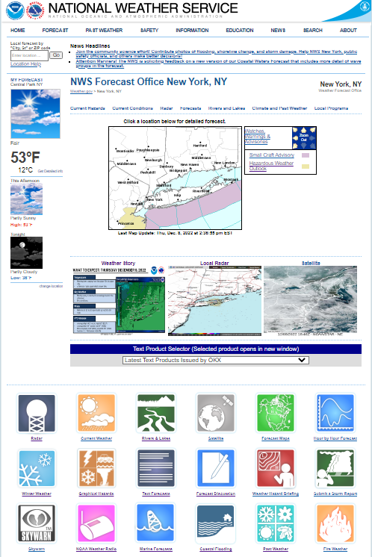
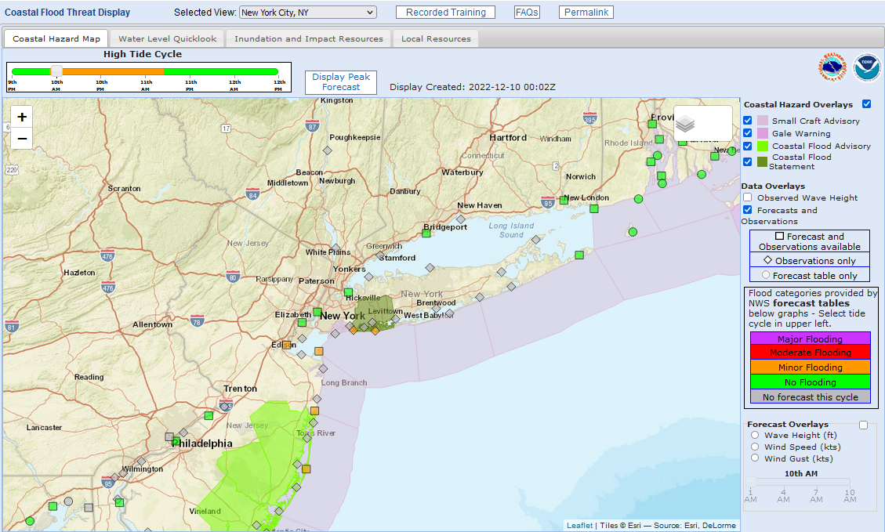
Eastern Region WFO Coastal Flood Webpages
Coastal Flood Threat Display
https://www.weather.gov/erh/coastalflood?wfo=okx
National Weather Service
WFO New York, NY

Slide 17
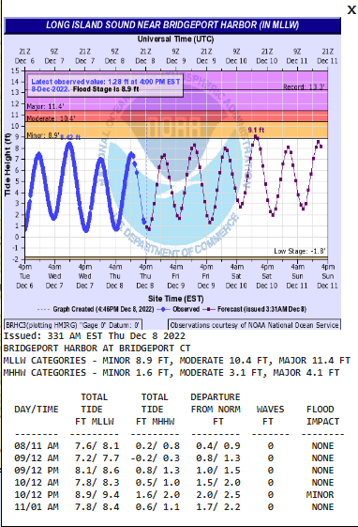
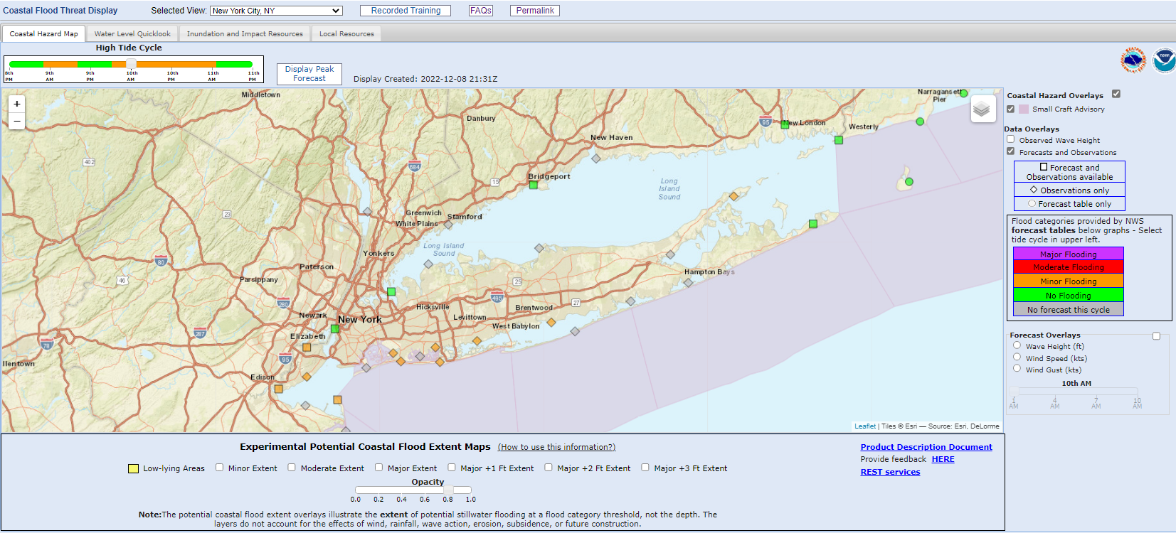
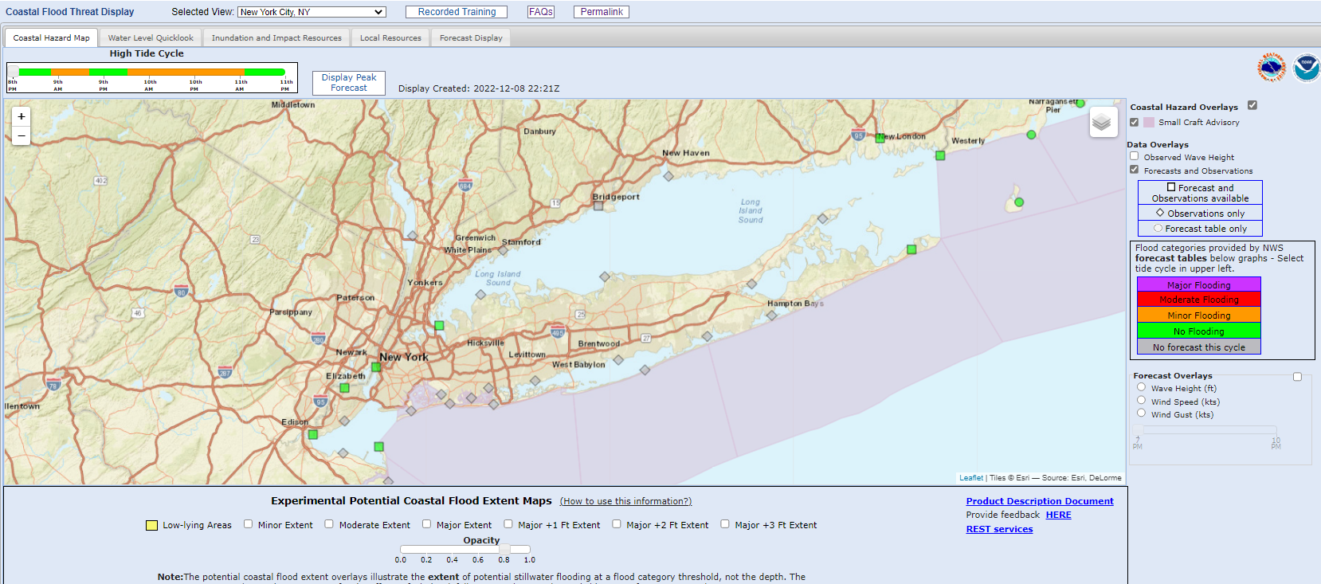
Eastern Region WFO Coastal Flood Webpages
Coastal Flood Forecasts
National Weather Service
WFO New York, NY

Slide 18
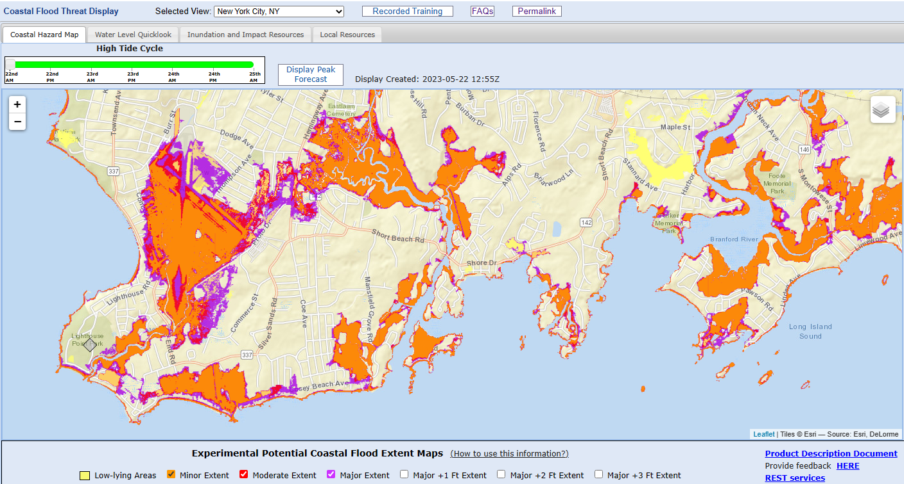
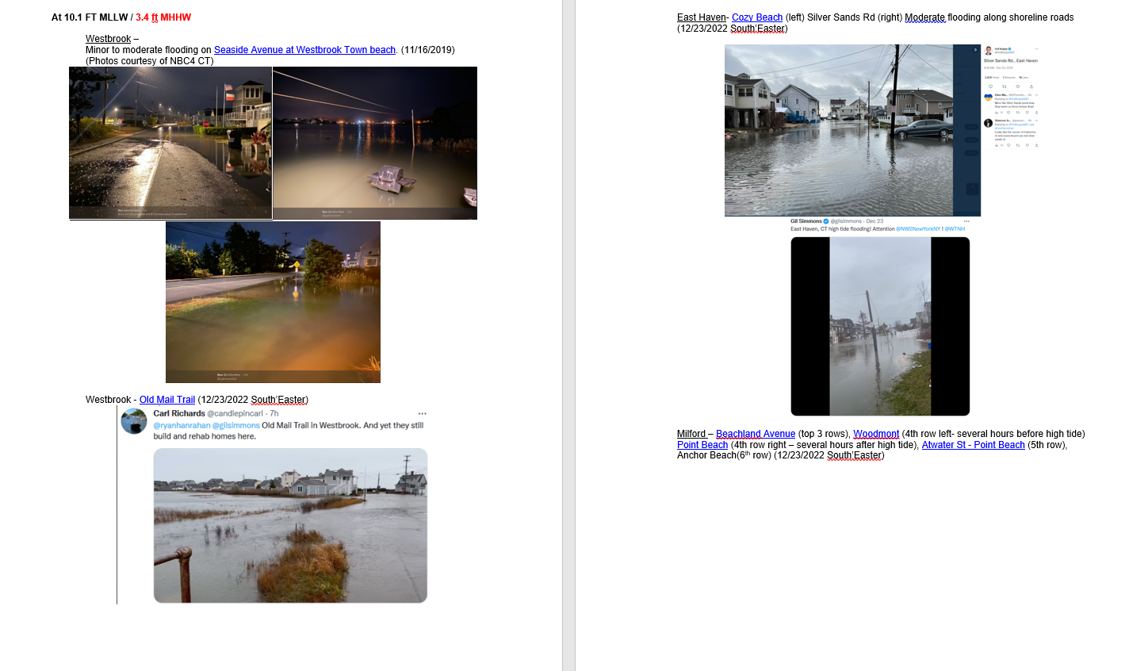
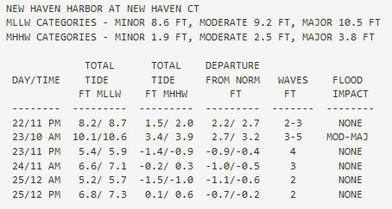
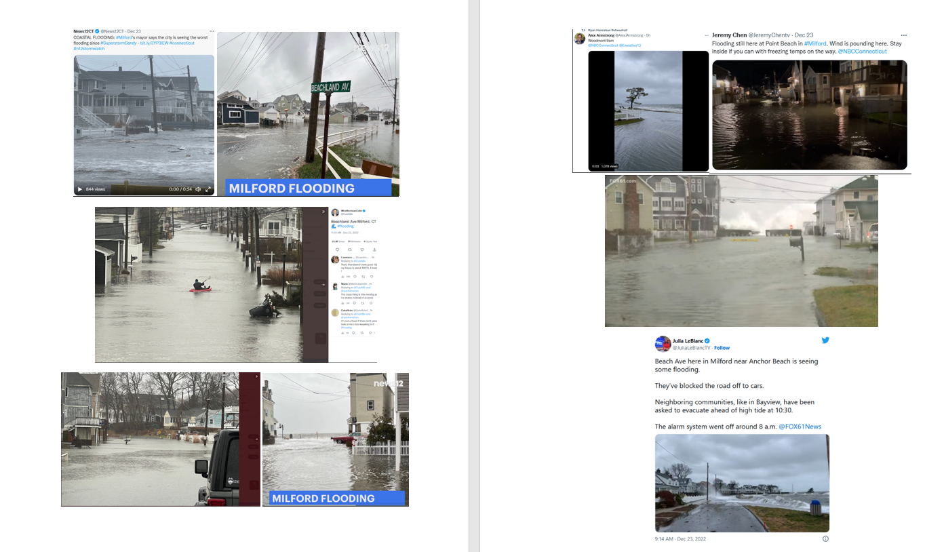
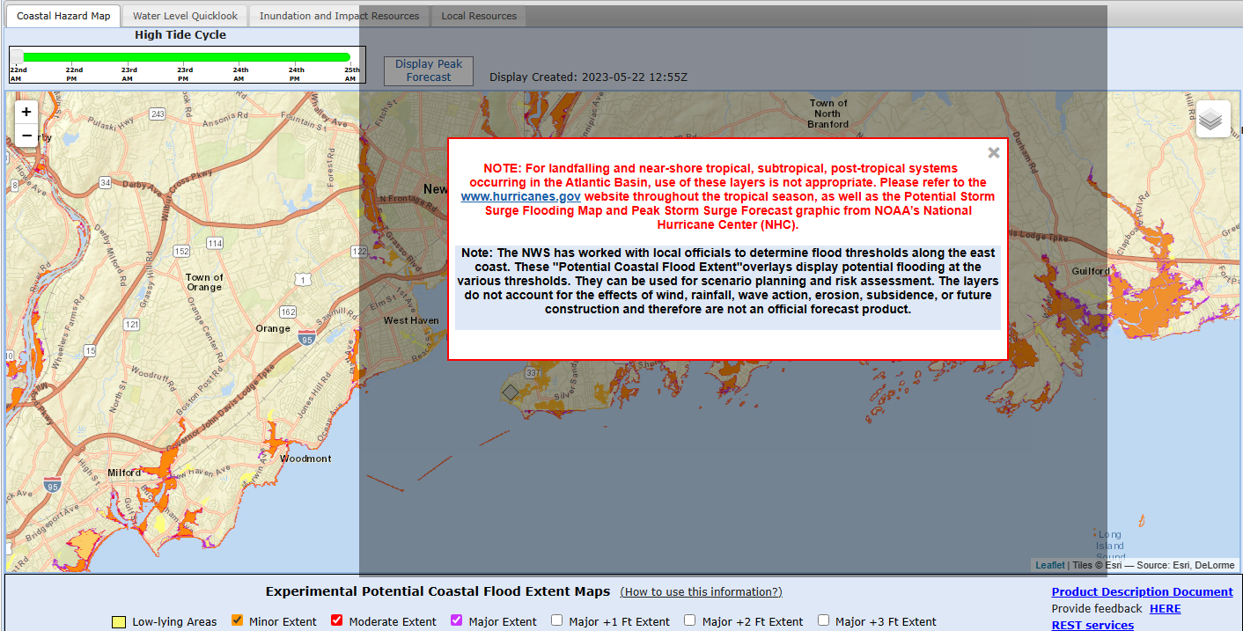
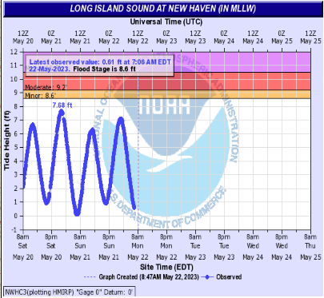
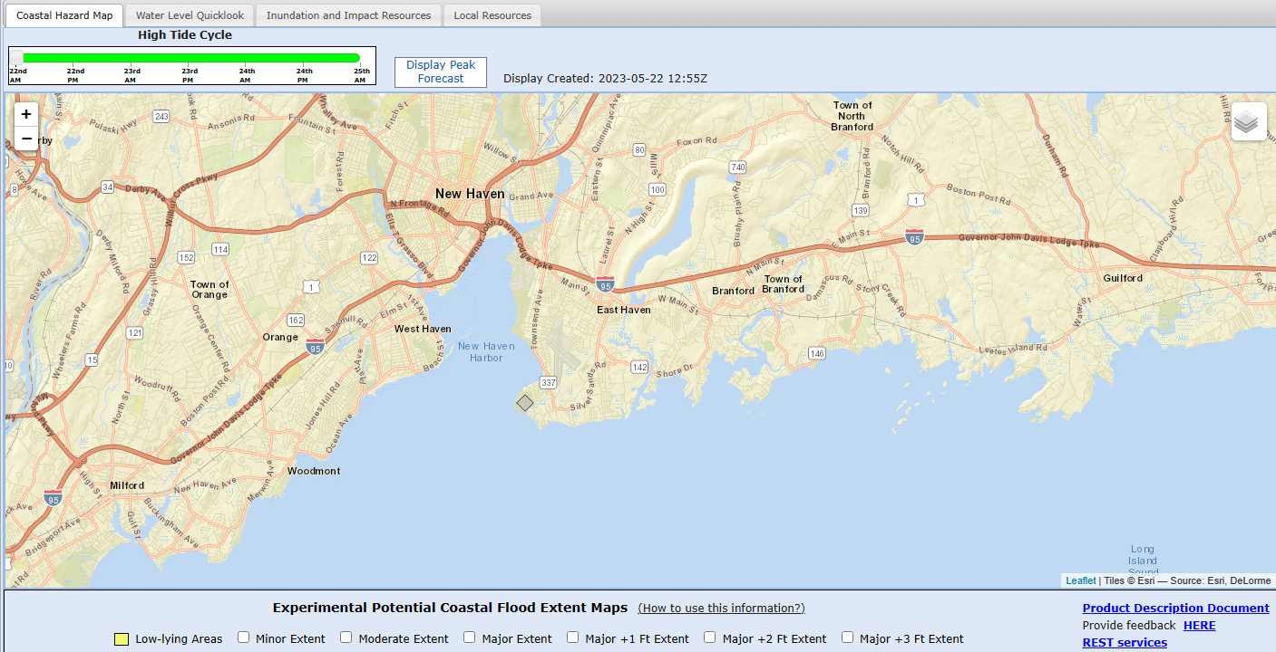
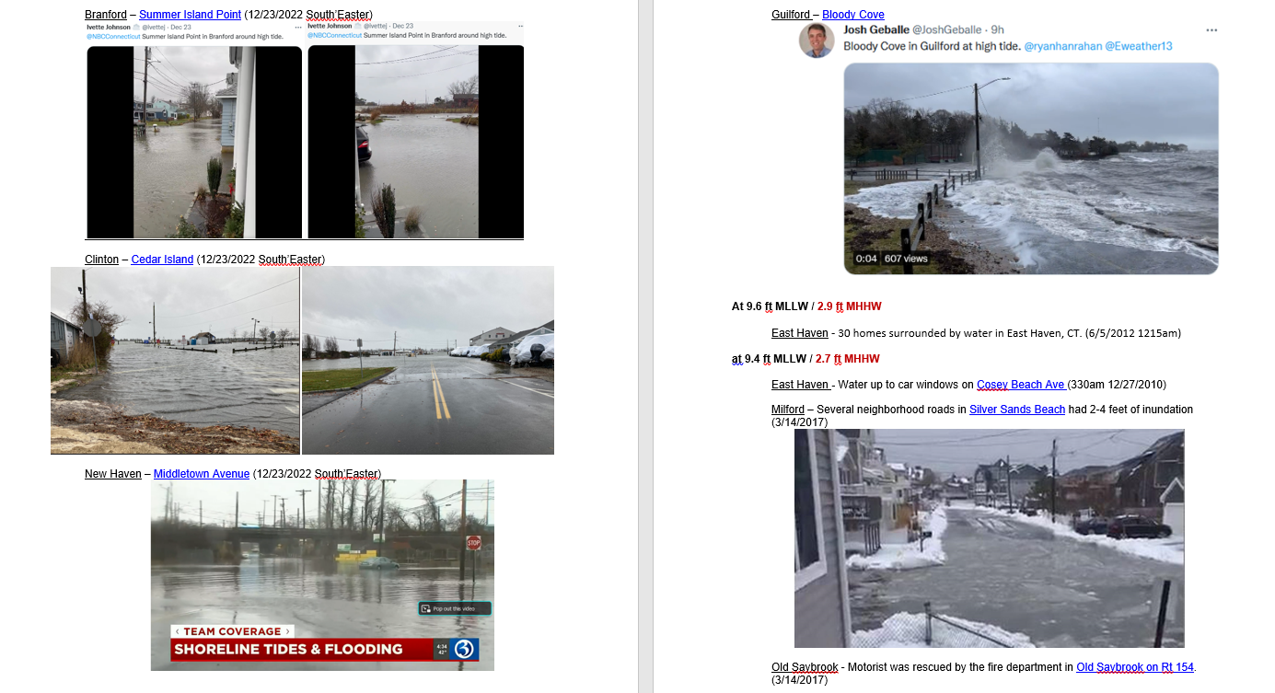
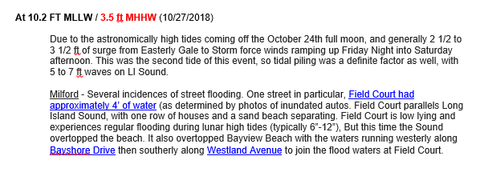
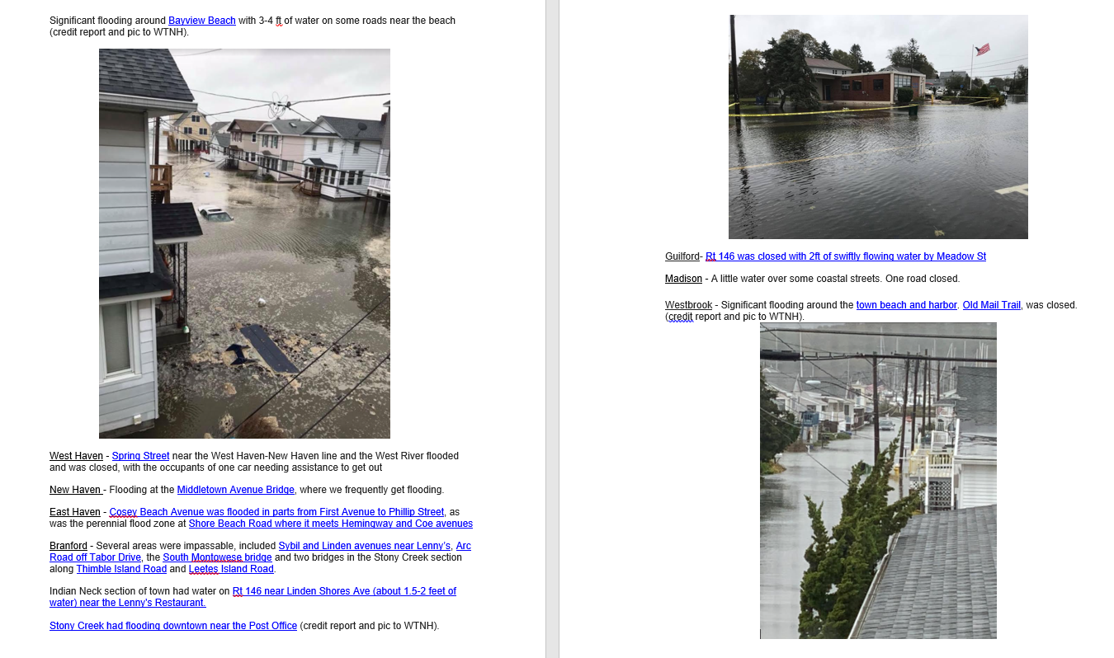
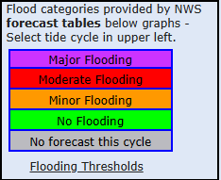
Eastern Region WFO Coastal Flood Webpages
Coastal Flood Forecasts
National Weather Service
WFO New York, NY

Slide 19
Eastern Region WFO Coastal Flood Webpages
Potential Coastal Flood Extent Layers
Maps indicate wet or dry areas at threshold level of flooding.
Yellow areas indicate low lying areas where rain/fresh water can be trapped and salt water can reach through storm drains.
Maps do not provide depth.
National Weather Service
WFO New York, NY
Notes:
Using still water assumption (no waves/wave setup)
The layers do not account for the effects of wind, rainfall, wave action, erosion, subsidence, or future construction

Slide 20
Eastern Region WFO Coastal Flood Webpages
Potential Coastal Flood Extent Layers Purpose
Benefits-
Meets FEMA flood mapping standards
Provide partners/stakeholders with experimental/prototype potential coastal flood extent information from an authoritative source
Based on NOAA’s Digital Coast elevation information and the NWS coastal flood thresholds at coastal gauge locations
What it isn’t-
Does not provide depth and is not a forecast.
Using still water assumption (no waves/wave setup)
The layers do not account for the effects of wind, rainfall, wave action, erosion, subsidence, or future construction
https://www.weather.gov/erh/coastalflood?wfo=okx
National Weather Service
WFO New York, NY

Slide 21
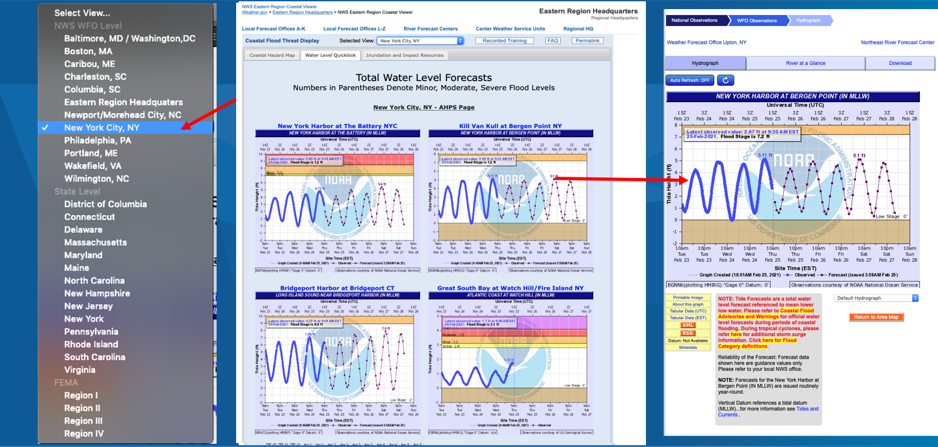
Eastern Region WFO Coastal Flood Webpages
Water Level Quicklook
National Weather Service
WFO New York, NY

Slide 22
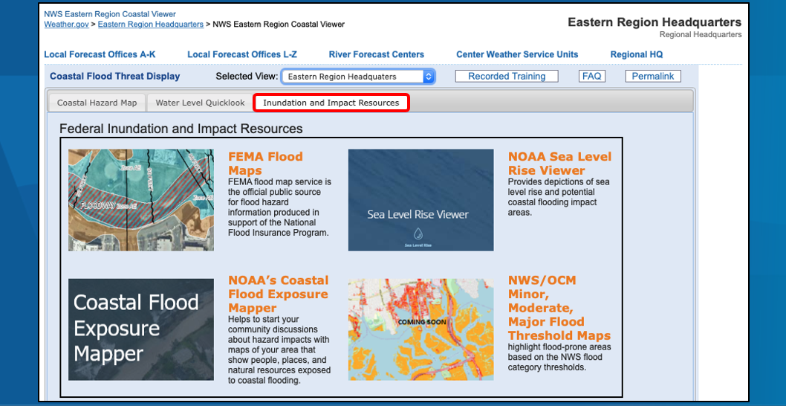
Eastern Region WFO Coastal Flood Webpages
Inundation and Impact Resources
National Weather Service
WFO New York, NY

Slide 23
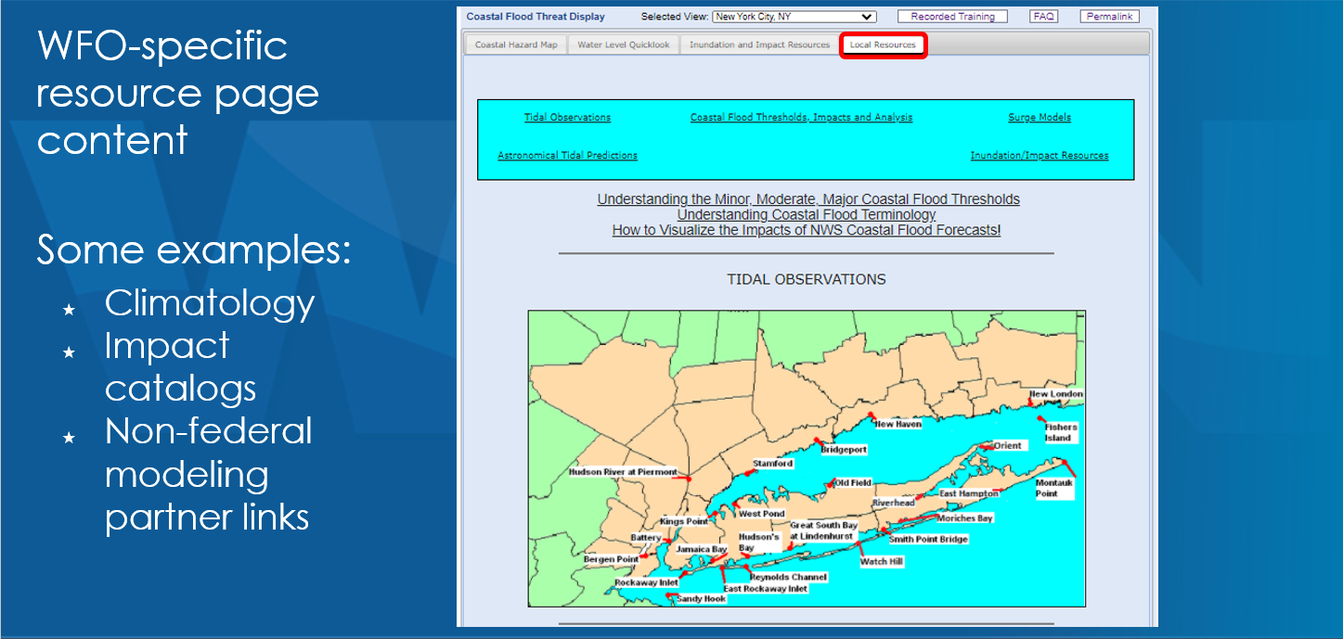
Eastern Region WFO Coastal Flood Webpages
Local Resources
National Weather Service
WFO New York, NY

Slide 24
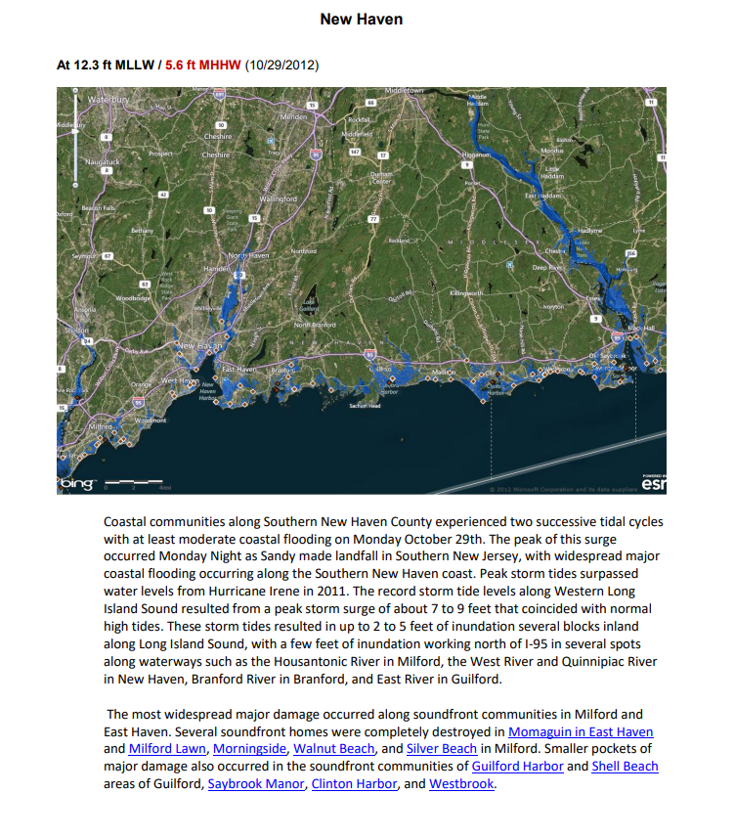
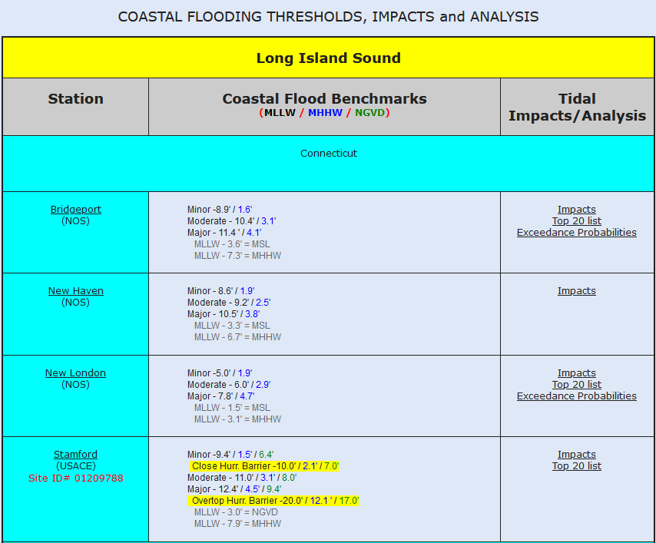
Eastern Region WFO Coastal Flood Webpages
Visualizing Coastal Impacts – Impacts Catalog
National Weather Service
WFO New York, NY

Slide 25
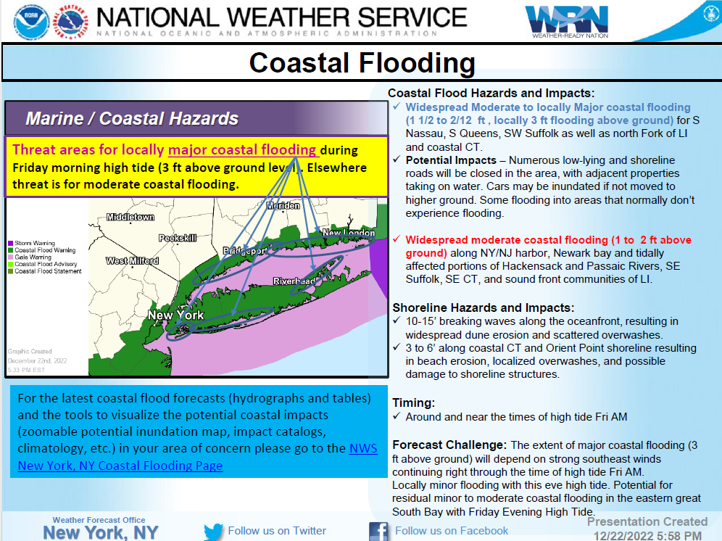
Eastern Regional WFO Coastal Flood Web Pages
Dec 23rd IDSS
National Weather Service
WFO New York, NY

Slide 26
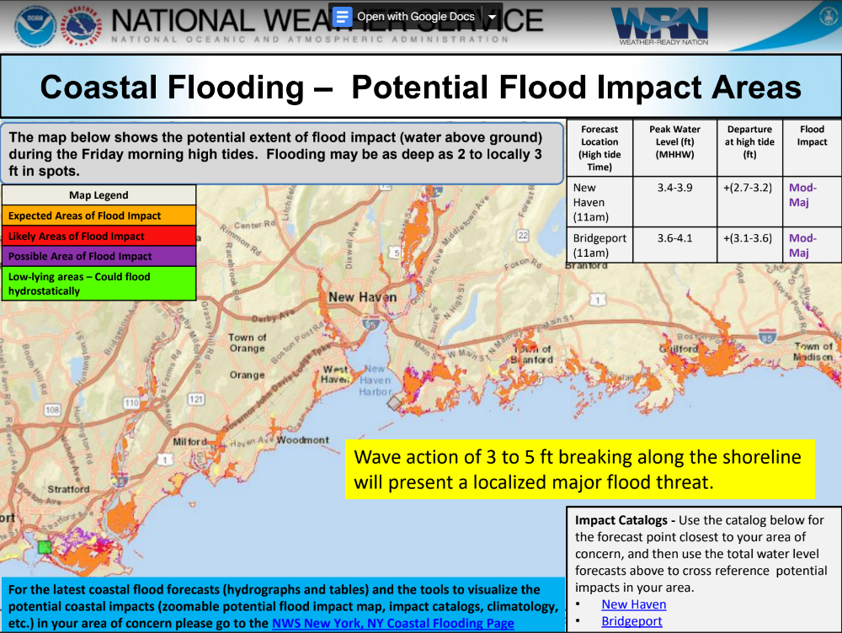
Eastern Regional WFO Coastal Flood Web Pages
Dec 23rd IDSS
National Weather Service
WFO New York, NY

Slide 27
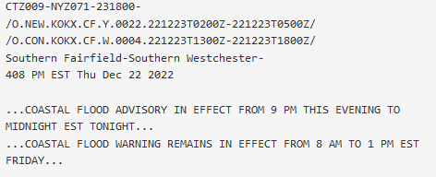
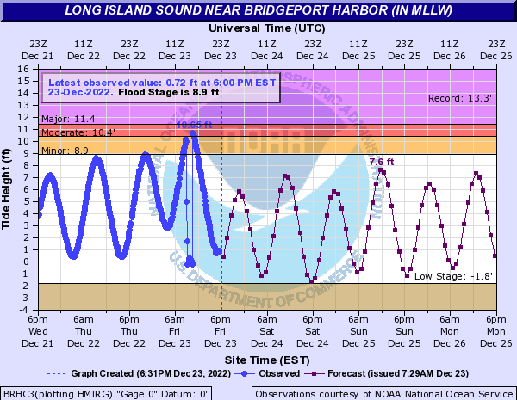
Eastern Region WFO Coastal Flood Webpages
December 23rd 2022 Major Flood Event – Forecast and Observation
Observation
Forecast
National Weather Service
WFO New York, NY

Slide 28
Eastern Region WFO Coastal Flood Webpages
December 23rd 2022 Major Flood Event – Forecast and Observation
Observation
Forecast
National Weather Service
WFO New York, NY

Slide 29
Eastern Region WFO Coastal Flood Webpages
December 23rd 2022 Major Flood Event – Forecast and Observation
Observation
Forecast
National Weather Service
WFO New York, NY

Slide 30
Eastern Region WFO Coastal Flood Webpages
December 23rd 2022 Major Flood Event - Verification
National Weather Service
WFO New York, NY

Slide 31
Eastern Region WFO Coastal Flood Webpages
December 23rd 2022 Moderate Flood Event - Verification
National Weather Service
WFO New York, NY

Slide 32
NWS New York Coastal Flood Products and Services
Reaching Historically Underserved and Socially Vulnerable Communities
English
Spanish
Chinese (Mandarin)
National Weather Service
WFO New York, NY

Slide 33
NWS New York Coastal Flood Products and Services
Coupling Riverine and Storm Surge Impacts – National Water Model
National Weather Service
WFO New York, NY

Slide 34
Eastern Region WFO Coastal Flood Webpages
Contact Info
Nelson Vaz, NWS NY Warning Coordination Meteorologist
nelson.vaz@noaa.gov
William Goodman, Coastal Services Team Leader, Meteorologist
william.goodman@noaa.gov
National Weather Service
WFO New York, NY
Notes:
Hazardous Weather Event Briefing Template

Slide 35
Eastern Regional WFO Coastal Flood Web Pages
Dec 23rd IDSS
National Weather Service
WFO New York, NY

Slide 36
Eastern Regional WFO Coastal Flood Web Pages
Dec 23rd IDSS
National Weather Service
WFO New York, NY

Slide 37
Eastern Region WFO Coastal Flood Webpages
December 23rd 2022 Major Flood Event – Social Media
Hamilton / Howard
Beach community group amplifies our briefings to these highly vulnerable
communities
National Weather Service
WFO New York, NY

Slide 38
Eastern Region WFO Coastal Flood Webpages
December 23rd 2022 Major Flood Event – Forecast and Observation
Observation
Forecast
National Weather Service
WFO New York, NY

Slide 39
Eastern Region WFO Coastal Flood Webpages
December 23rd 2022 Major Flood Event – Forecast and Observation
Observation
Forecast
National Weather Service
WFO New York, NY

Slide 40
Eastern Region WFO Coastal Flood Webpages
December 23rd 2022 Moderate Flood Event - Verification
National Weather Service
WFO New York, NY

Slide 41
Eastern Region WFO Coastal Flood Webpages
December 23rd 2022 Major Flood Event - Verification
National Weather Service
WFO New York, NY

Slide 42
Eastern Region WFO Coastal Flood Webpages
December 23rd 2022 Major Flood Event – Forecast and Observation
Observation
Forecast
National Weather Service
WFO New York, NY

Slide 43
Eastern Region WFO Coastal Flood Webpages
December 23rd 2022 Major Flood Event - Verification
National Weather Service
WFO New York, NY

Slide 44
Eastern Region WFO Coastal Flood Webpages
December 23rd 2022 Moderate Flood Event - Verification
National Weather Service
WFO New York, NY

Slide 45
Eastern Region WFO Coastal Flood Webpages
December 23rd 2022 Major Flood Event – Forecast and Observation
Observation
Forecast
National Weather Service
WFO New York, NY

Slide 46
Eastern Region WFO Coastal Flood Webpages
December 23rd 2022 Moderate Flood Event - Verification
National Weather Service
WFO New York, NY

Slide 47
Eastern Region WFO Coastal Flood Webpages
December 23rd 2022 Moderate Flood Event - Verification
National Weather Service
WFO New York, NY

Slide 48
Eastern Region WFO Coastal Flood Webpages
Potential Coastal Flood Extent Layers
National Weather Service
WFO New York, NY

Slide 49
October 31st 1991
(Perfect Storm)
1 Tidal Cycle of Moderate to Major Coastal Impacts. Multiple tidal cycles of Min-Mod.
84 hours of small craft to gale winds locally between strong high pressure over Southern Canada and strong low pressure retrograding southeast of LI. 2-3 days of Storm to Hurricane force winds over Georges Bank.
Peak Winds: 20 hrs of NNE winds 25-30 g 35-40 kt locally. Hurricane force wind gusts along Cape Cod.
High astronomical tides
Observations
Location Surge (Peak Storm Tide MLLW/MHHW)
Bridgeport 4.6 ft (11.4 ft MLLW / 4.1 ft MHHW) Major
Stamford (12.1 ft MLLW / 4.3 ft MHHW) Mod/Maj
Impacts
4 days
Bridgeport Impact Catalog

Slide 50
February 7th 1978
1 Tidal Cycle of Moderate to Major Coastal Impact. Multiple tidal cycles of Min-Mod.
Low pressure tracked up the coast Feb 5-6th…stalling just south of the region into the 7th…before moving out to seas. 24 hrs of gale to storm force NE winds between strong high over Canada and intense coastal low.
Peak Winds: 24 hrs of NE winds of 30-40 g 40-50kt
30 mb pressure fall in 24 hrs
High astronomical tides
Observations
Location Surge (Peak Storm Tide MLLW/MHHW)
Bridgeport 3.9 ft (11.2 ft MLLW / 3.9 ft MHHW) Mod/Maj
Stamford (12.9 ft MLLW / 5.1 ft MHHW) Major
Impacts
3 days
Stamford Impact Catalog

