Slide 1
Advancing the Children’s Behavioral Health System in Connecticut
A Public Private-Partnership
May 10, 2021

Slide 2
Agenda
Welcome
Connecticut's Children's Behavioral Health System
Where we have been, how we arrived here
Vision and Goals-Success for a Future State
Discussion and Response-Public Private Partnership
Next Steps and Wrap-up
Closing Remarks

Slide 3
THE CONNECTICUT CHILDREN’S BEHAVIORAL HEALTH PLAN:
WHERE WE’VE BEEN AND WHERE WE’RE HEADED
Tri-Chairs:
Elisabeth Cannata, Ph.D.
Wheeler Clinic
Ann R. Smith, JD, MBA
AFCAMP

Slide 4
CONNECTICUT
CHILDREN’S BEHAVIORAL
HEALTH PLAN
OVERARCHING GOALS:
Promote wellbeing of all of Connecticut’s Children through prevention, early detection and access to responsive and effective services
Provide a broad array of services through a coordinated and integrated system that maximizes available resources
Empower and support families to raise healthy and happy children
Reduce racial and ethnic disparities in outcomes for children and families of color

Slide 5
CHILDREN’S BEHAVIORAL HEALTH PLAN IMPLEMENTATION ADVISORY BOARD
STATE AGENCY PARTNERS: OTHER REPRESENTED VOICES:
Department of Children and Families (DCF) Department of Developmental Services (DDS) Department of Social Services (DSS) Department of Public Health (DPH) Department of Mental Health and
Addiction Services (DMHAS)
Connecticut Insurance Department (CID)
Connecticut State Department of Education (CSDE)
Office of Early Childhood (OEC) Office of the Child Advocate (OCA) Office of the Healthcare Advocate (OHA) Judicial Branch Court Support Services Division (JBCSSD) Commission on Women, Children and Seniors (CWCS)
Families
Providers
Advocates
Other System Stakeholders

Slide 6
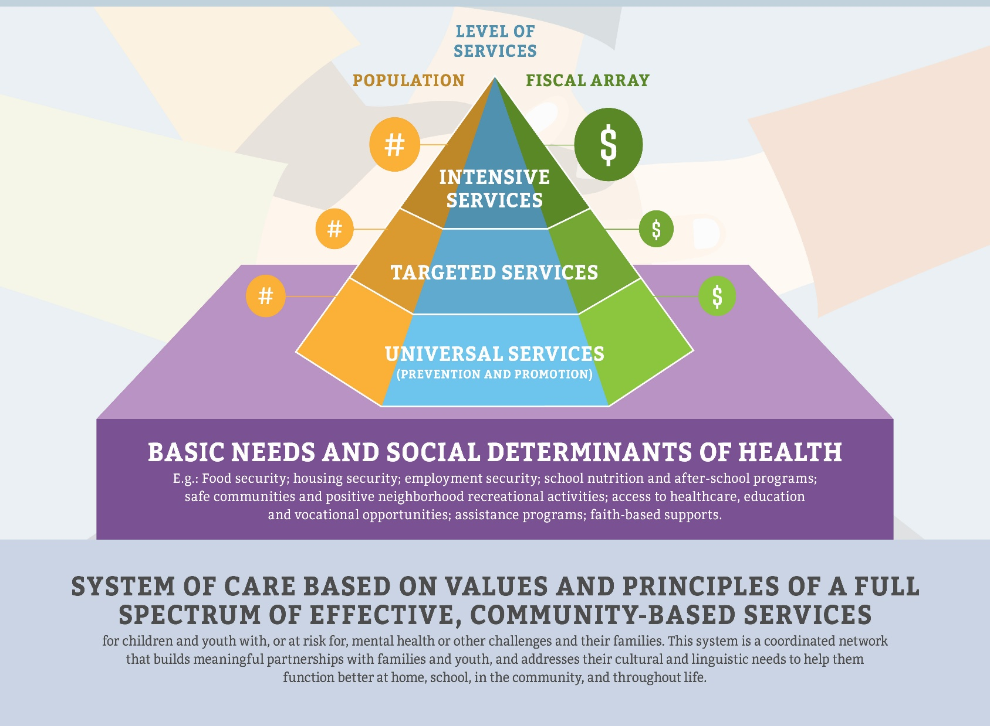
CONNECTICUT
CHILDREN’S BEHAVIORAL HEALTH
SYSTEM

Slide 7
ADVISORY BOARD ANNUAL REPORT
(OCTOBER 2020)
Top Priority areas for 2021:
Ensuring access to targeted behavioral health services (in addition to primary care supports) during and in the aftermath of COVID-19
Addressing disparities in child and family wellbeing that have been exacerbated and laid bare by COVID-19
Reducing silos in planning, financing and service delivery

Slide 8
WHERE WE GO FROM HERE

Slide 9
NEXT LEG OF THE RACE

Slide 10
CHALLENGES AND OPPORTUNITIES

Slide 11
DIFFERENT RUNNERS…SAME RACE

Slide 12
PASSING THE BATON

Slide 13
IT’S A HEAVY LIFT…ALONE

Slide 14
ADVANCING THE VISION… TOGETHER

Slide 15
Connecticut’s Children’s Behavioral Health Plan
Values and Principles
Racial Equity and Justice - All services will be measured and evaluated with a health equity and racial justice perspective with the explicit intent of reducing disparities and racial injustice.
Family-driven and youth guided - The family voice informs all aspects of the service system.
Trauma informed -Trauma is pervasive and all services must be provided in a trauma informed manner, with the recognition that unmitigated exposure to adverse childhood experiences including violence, physical or sexual abuse, and other traumatic events can cause serious and chronic health and behavioral health problems and is associated with increased involvement with the criminal justice and child welfare systems.
Culturally and linguistically appropriate - agencies, programs, and services will reflect the cultural, racial, ethnic, and linguistic differences of the populations they serve to facilitate access to and utilization of appropriate services and supports and to eliminate disparities in care
Community-based - the locus of services as well as system management resting within a supportive, adaptive infrastructure of structures, processes, and relationships at the community level
Workforce development – Providers and staff should promote hiring and sustaining qualified staff that resemble the community served
Vision
A spectrum of effective, community-based services and supports for children and youth with or at-risk for mental health or other challenges and their families, that is organized into a coordinated network, builds meaningful partnerships with families and youth, and addresses their cultural and linguistic needs, in order to help them to function better at home, in school, in the community, and throughout life.

Slide 16
Gaps in the Crisis Service System
-Enhance capacity for Special Populations
-Increased demand for services
-Higher Acuity and Rates of Acuity
-Urgent Care as a place-based alternative to the ED when a child cannot remain at home
-System infrastructure to support improved coordination of behavioral health system components
Lack of Evidence Based Practice at Scale
-Introduce Measurement Based Care as a foundational service component
-Lower provider burden by focusing on actionable clinically meaningful data
-Leverage technology to improve efficiency
-Expand and support existing EBPs to close racial and ethnic treatment disparities
Fragmented Service Delivery System
-Expand CTBHP membership OR create statewide CME to ensure no-wrong-door and system accountability
-Develop a mechanism through which funding and services can be braided/blended for improved efficiency
-Increase capacity for cross-system care management
Lack of Key Accountability Structures
-Implement standardized easily administered Outcome Measures, including measures for EBPs
-Tie a Portion of Payment to Quality of Care Delivered
-Standardized health equity analysis across services

Slide 17
Value Based Reimbursement Strategies
Statewide Data Collection Analytics and Reporting
Public Private Partnership
Behavioral Health Urgent Care Centers
Outcome Measurement via Measurement Based Care (MBC) Platform

Slide 18
Children’s Behavioral Health Short-Term
Expand Access to Acute Care Services
Expand capacity to provide pediatric inpatient psychiatric services
At least 10% greater bed capacity through:
A rate add-on for expanding bed capacity
An acuity-based rate add-on to improve services for highly complex children on inpatient units
Facilitate safe and timely discharges from acute levels of care
Individualized, timely discharge through:
Statewide coverage by 12 care coordinators for discharges from emergency departments, hospital inpatient and Psychiatric Residential Treatment Facility levels of care
Expand access to child-serving Mobile Crisis services
Timely and continuous access to EMPS through:
Increasing child Mobile Crisis to 24/7 basis
Respond to Crises, Reduce ED length of stay, promote safe and timely discharges from acute levels care and ensure safe community re-engagement

Slide 19
Children’s Behavioral Health Medium-Term
Health Promotion, Prevention, and Early Identification
Behavioral Health Urgent Care Centers (6 – 17 years)
This creates a short-term, bidirectional crisis stabilization program to avoid unnecessary emergency department stays and improve throughput for children on inpatient levels of care.
Urban Trauma Intervention/Violence and Racism
Funds will support a proof of concept to elevate the Urban Trauma Intervention model and to provide evidence based documentation, as well as identify threshold training, qualifications and build upon/incorporate existing service array
Enable Comprehensive, Local Integration of Primary Care Medical and Behavioral Health Integration
Expansion of ACCESS Mental Health program
Comprehensive Workforce Development
Develop and implement comprehensive workforce develop training plan to increase skills and competencies for developmental disabilities/DDS and other special populations

Slide 20
Children’s Behavioral Health Infrastructure/Performance
A Public Private Partnership
Systems Governance
12 State agencies to govern through the expansion of CTBHP
Operations to occur through a Performance Improvement Center
Racial Equity and Justice
In collaboration with the other state agencies, the creation of a racial equity and justice lens will be established and sustained within the Continuous Quality Improvement and Performance Management systems of the behavioral health service system. The 4 components, outlined in the DCF report required by P.A. 18-11 are:
Workforce Composition 3. Results and Outcomes
Provider Diversity 4. Community Partnerships and
Stakeholder Feedback

Slide 21
Children’s Behavioral Health Infrastructure/Performance
A Public Private Partnership (con’t)
Common Data Platform/ Master Patient Index
Make getting services easy for CT Residents by streamlining and digitizing access to state human services to help people thrive through My CT Portal. Specifically, this will create a single point of access. The system will be accessible by all participants and data collection will be standardized. Privacy will remain at the forefront, while bringing information under one central location.
Leverage a youth single patient identifier that follows kids through their medical and care coordination experience. Allows all who provide care (i.e., School-based MH clinic, EDT, IICAPs, etc.) to coordinate and ensure quality access to care for all youth. Educate users and clients on disclosures and rights.

Slide 22
Discussion and Response Facilitated by Children’s Behavioral Health Implementation Advisory Board Plan Tri-Chair Carl J. Schiessl, JD

Slide 23
Public Private Partnership Requires All of Us Working Together
Next Steps and How You Can Participate
DCF is currently operationalizing and building infrastructure for participation in Operation Groups:
Value Based Purchasing and Measurement Based Care
Data Integration (Consideration for Integration with DSS and OPM activities)
Behavioral Health Urgent Care Centers
These will not be “vision setting” but rather operationalizing the details towards implementation.

