Slide 1
DAS PROCUREMENT TRAINING EVENT 2017

Slide 2
https://youtu.be/7VmdKLLwt3o

Slide 3
DAS PROCUREMENT
STRATEGIC BUSINESS PLANNING PROCESS
2017

Slide 4
What is Strategic Business Planning?

Slide 5
March 2016 – Received the results from Governing Institute’s 2015 State
Procurement Survey
April 2016 – Debriefed with Governing Institute on our Strengths &
Weaknesses
Our Strengths:
Good at Policy ; Clearly Defined Methods; Staff get Training; Understand the
importance of our Customers and Communications; Facilitate ideas and Concept Sharing; Value innovations; use strategic sourcing techniques; Use LEAN Thinking; Benchmark our performance; Ability to develop technology for solutions;
Our Weaknesses:
Opportunities exist to improve communications; Client agency feedback not included in our performance measures; Many rules-guidance on contract administration not Published; Lack of Strategic Plan with performance measures; Lack of a vision statement; Stakeholders see Procurement practices as regulatory, not as a solution enabler; lack a Quality improvement program; Technology business models are changing rapidly and don’t match current technology needs

Slide 6
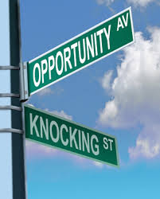
August 2016 – Wake Up Call!
It was time to make improvements and proactively plan for where we want to be!
Contracted with a formal business planning facilitator to conduct a focused workshop in 2017 to guide us in developing our business plan.
Goal: Align us with our customer needs and strengthen our credibility and value to our customers. Establish a Vision, Mission, Values & Goals/Objectives

Slide 7
We needed to create new synergies with our customers to strengthen our credibility and value, and improve our products.

Slide 8
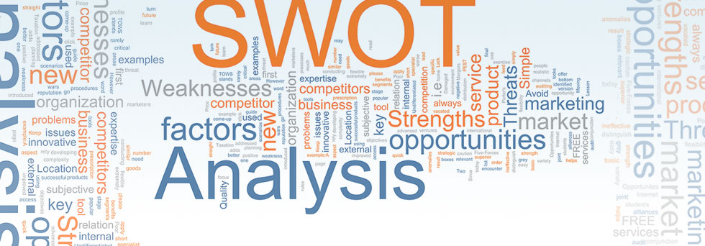
What’s Happened Next? December 2016 – January 2017
Organizational Effectiveness Assessment
Organizational Information, history, products, services
Developed and conducted an organizational survey (our staff and our customers)
Training & Pro-D
Org Structure & Culture
Work Product & Services
Purpose/Core Functions
Communication
Resources/Technology
Conducted a SWOT Analysis (Strengths,
Weaknesses, Opportunities, Threats)
Identified Themes from Assessment Report

Slide 9
February 2017 – Craft the Strategic Plan
Leadership Team – Focused on assessment results & themes, received training on crafting a strategic plan and discussed/developed thoughts on the Vision, Mission Values – Going from Good to Great!
Created a Vision Statement
Developed our Mission
Focused on our Human Factors – Identified our Values
Input from Staff & Customers throughout the process

Slide 10
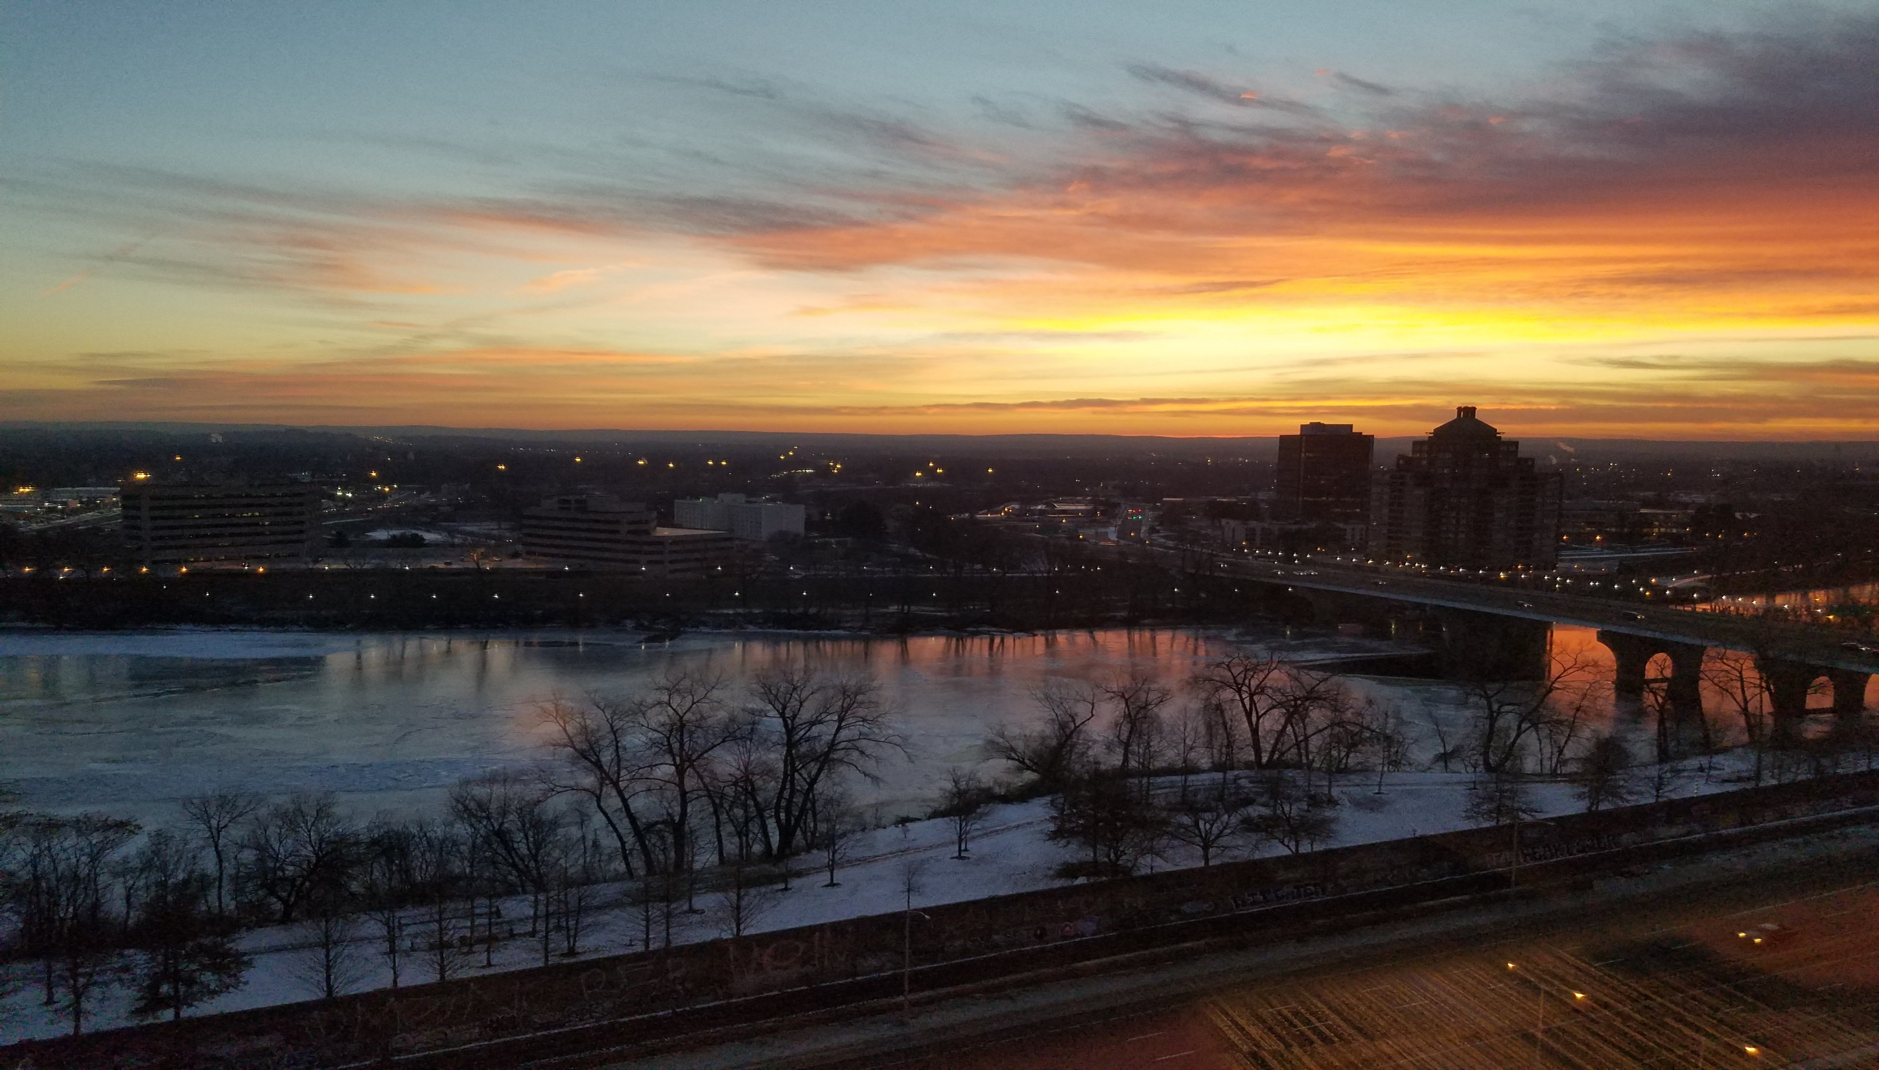
Results

Slide 11
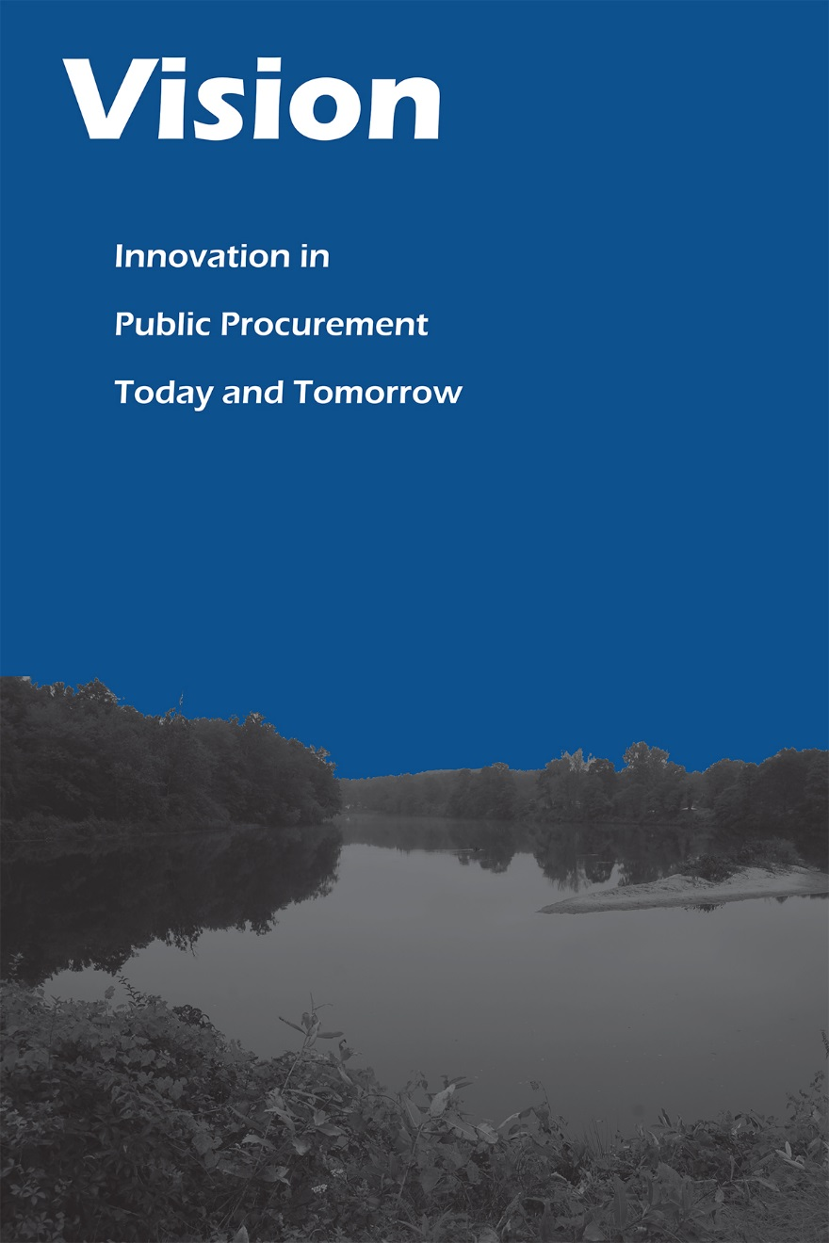

Slide 12
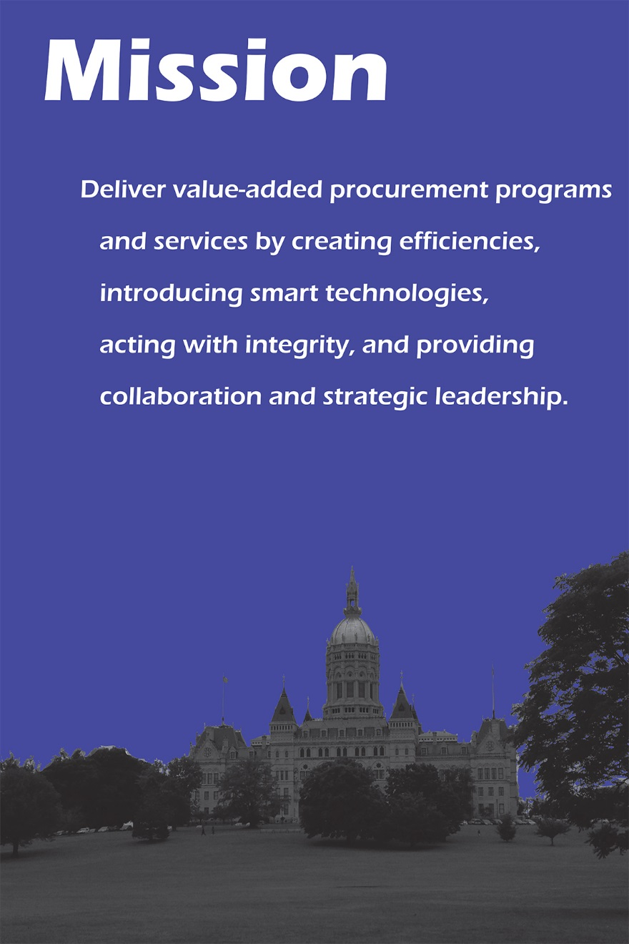

Slide 13
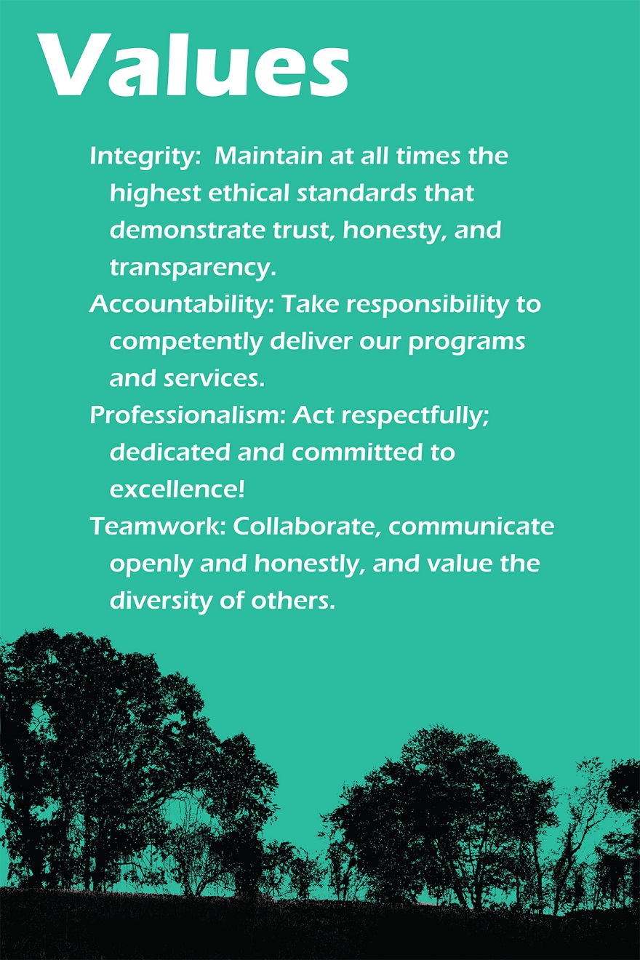

Slide 15
What’s on the Horizon?
Delivery on our Objectives!
Annual Customer Satisfaction Survey
New Customer Advisory Groups
More Customer/Vendor Training Events
More Municipal Participation in our Programs
Process & Technology Improvements
Increased Savings/Revenues

Slide 16
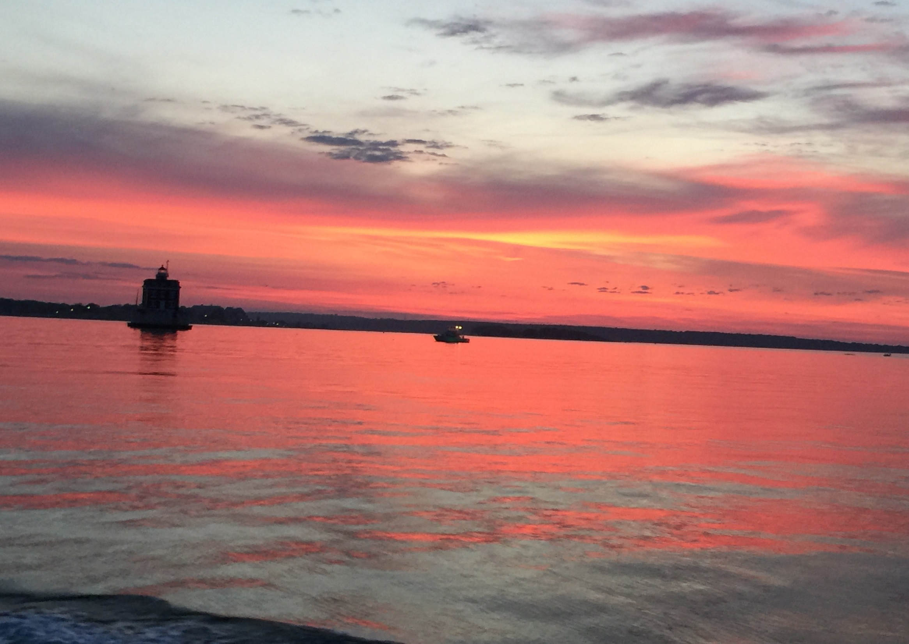
Hear More about what DAS is doing to implement
our Business Plan Vision in Other Sessions Today!

Slide 17
Questions?

