Slide 1
What is it?
How do we
get there?
AGILE
PROCUREMENT

Slide 2
ALERT
“agile”
FLEXIBLE
Agile Procurement
Methodologies to make
Complex Procurements
Simple
RESPONSIVE
SWIFT

Slide 3
SCRUM:
Project Management framework
for incremental product development
Sprint
Product
Owner
Waterfall
Approach
ScrumMaster

Slide 4
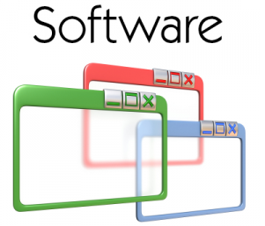
I.T.
PROCUREMENTS

